Slide 1
Korean class
Week 5

Slide 2

index
Postpositional Particles
Future expression
Sixth Principle (when, where, who, what, why, how)
Day of week, Month
Dialogue
Korea’s Culture

Slide 3
Postpositional particles – object making
을[eul] / 를[leul]
Words ending with a consonant + -을
Words ending with a vowel + -를

Slide 4
Example
거울[geo-ul] + 을[eul]
=mirror
나무[na-mu] + 를[leul]
=tree
나[na] + 를[leul]
=me
기차를 봐요 ! [gi-cha-leul bwo-yo] = Look at the train !
=train

Slide 5
Future expression
If you want to make a future expression,
add –ㄹ 거야/거다 to verb’s ending
[geo-ya / geo-da]
= will

Slide 6
Future expression
가다[ga-da]= go
Verb stem
+
=
Future
tense
-ㄹ거다
[geo-da]
가
[ga]
갈 거다
[gal-geo-da]

Slide 7
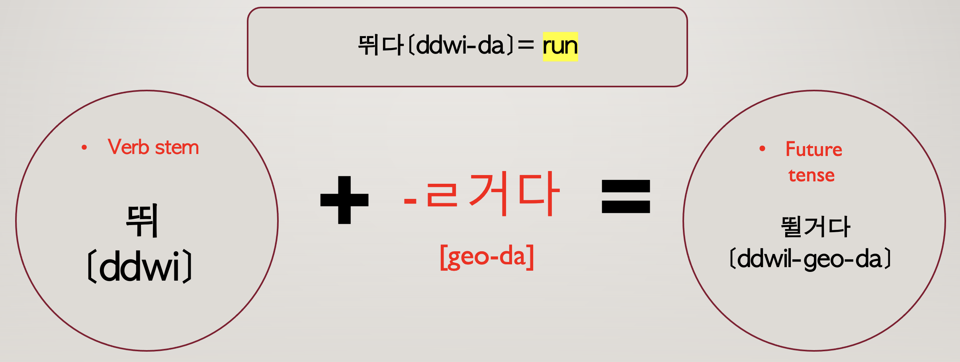

Slide 8
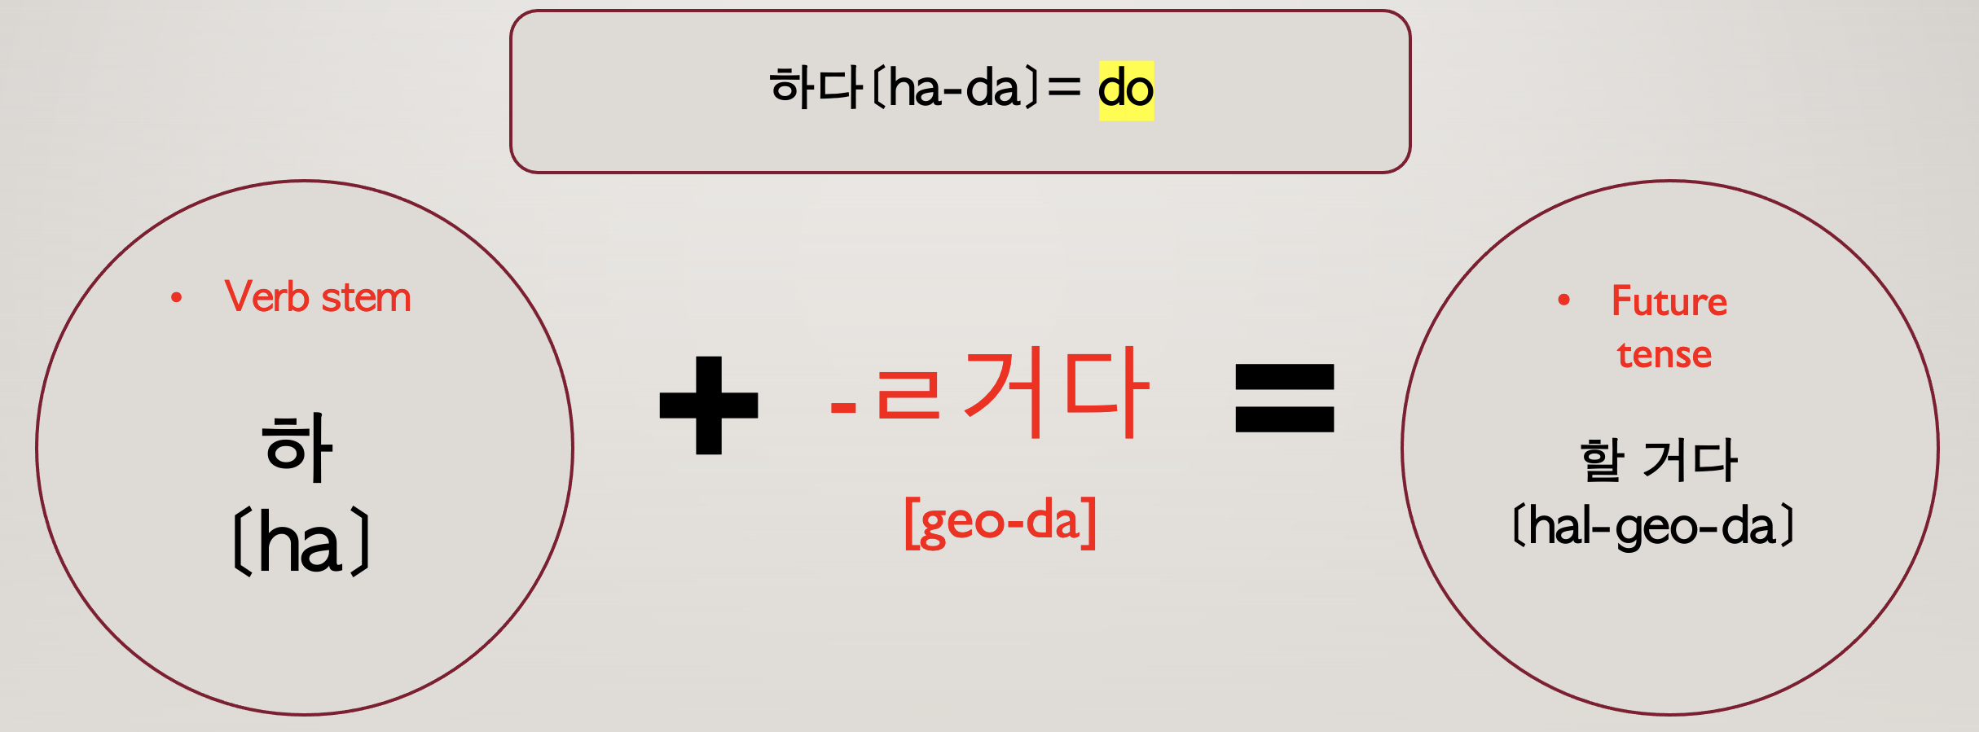

Slide 9
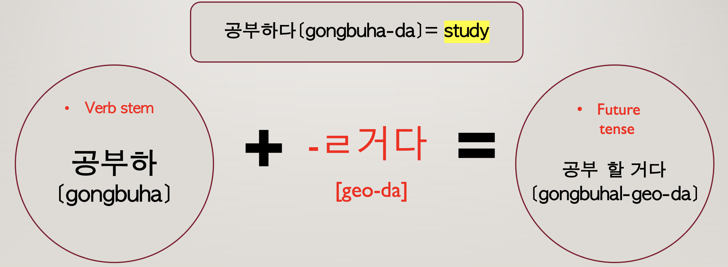

Slide 10
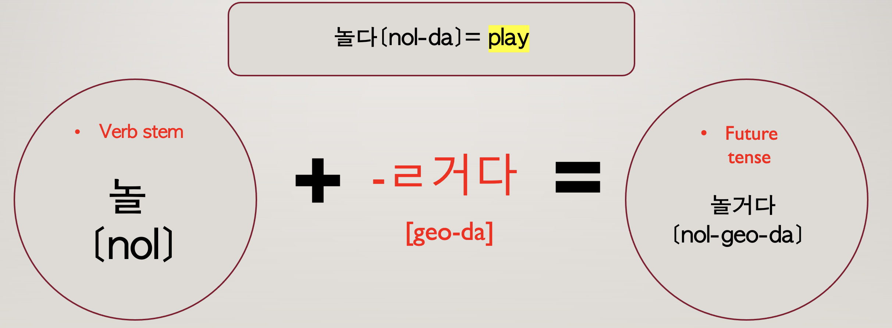

Slide 11
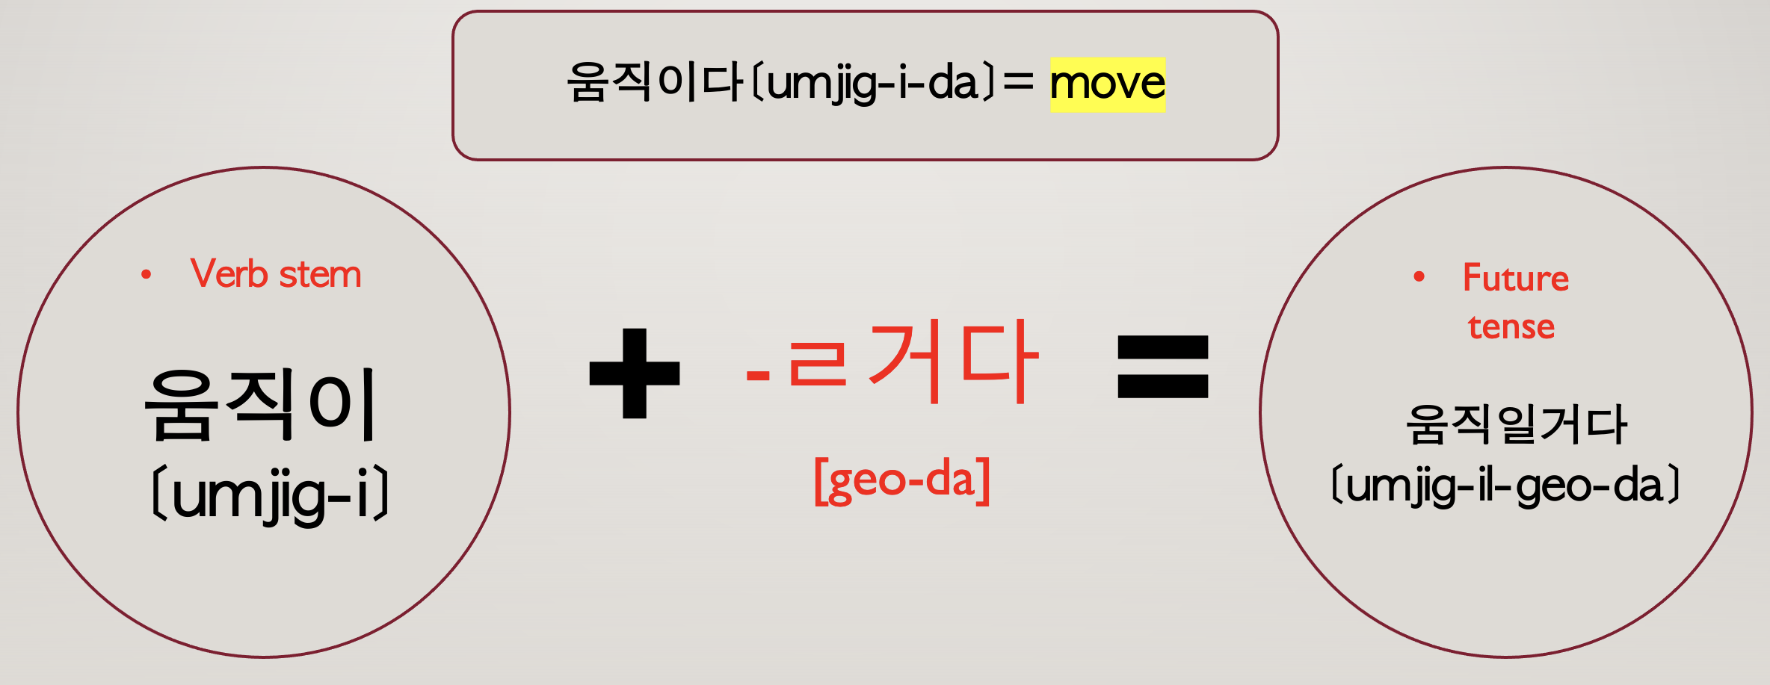

Slide 12
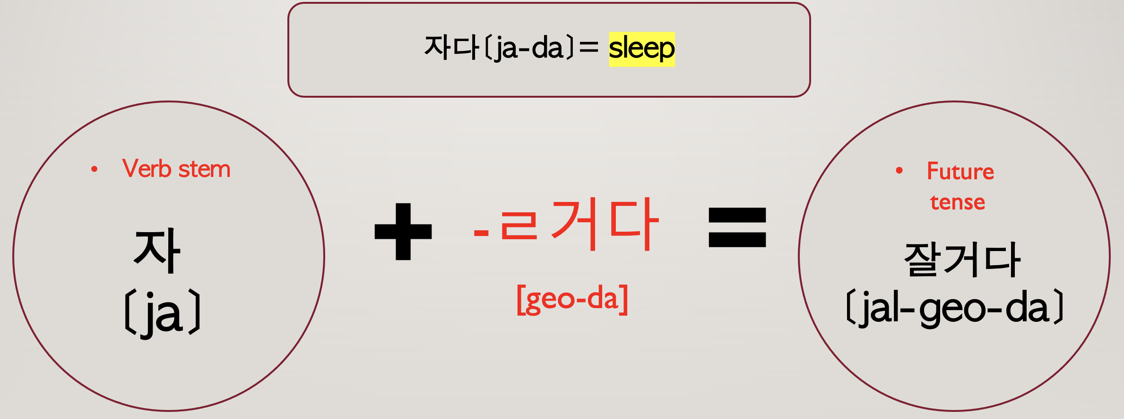

Slide 13
Future expression dialogue
Yoongi : 너 내일 뭐해?
[neo-nae-il mwo-hae?]
=What will you do tomorrow?
Jenny : 나 내일 프라하 갈 거야.
[na nae-il peu-ra-ha gal-geo-ya]
=I will go Prague tomorrow.

Slide 14
Sixth principle
When = 언제
[eon-jae]

Slide 15
Sixth principle
Yoongi : 너 학교 언제가?
[neo-hak-gyo-eon-jae-ga?
=When do you go to school?
Jenny : 나 어제 갔다왔어.
[na eo-jae-gad-da-wot-eo]
=I went yesterday.

Slide 16
Sixth principel
Where = 어디서
[eo-di-seo]

Slide 17
Sixth principle
Yoongi : 이번 BTS 콘서트 어디서 한대?
[i-beon BTS concert eo-di-seo han-dae?]
=Where is the BTS concert going to be held?
Jenny : 서울에서 해!
[seoul e-seo hae!]
=In Seoul!

Slide 18
Sixth principle
Who = 누가
[nu-ga]

Slide 19
Sixth principle
Yoongi : 내 빵 누가 먹었어?
[nae-bbang-nu-ga-meok-eoss-eo?]
=Who ate my bread?
Jenny : 나도 몰라.
[na-do mol-la]
=I don’t know.

Slide 20
Sixth principle
What = 무엇을=뭐를
[mu-eoss-eul = mwo-leul]

Slide 21
Sixth principle
Yoongi : 너 뭐 가지고 싶어?
[neo-mwo ga-ji-jo-sip-eo?
=What do you want to get?
Jenny : 나 새로운 신발 가지고싶어.
[na-sae-ro-wun sin-bal-ga-ji-go-sip-eo]
=I want to get new shoes.

Slide 22
Sixth principle
Why = 왜
[wae]

Slide 23
Sixth principle
Yoongi : 너 왜 늦었어?
[neo-wae-neut-eoss-eo?]
=Why are you late?
Jenny : 지하철을 놓쳤어.
[ji-ha-chul-eul-not-chyeot-eo]
=I missed the subway.

Slide 24
Sixth principle
How = 어떻게
[eo-tteok-e]

Slide 25
Sixth principle
Yoongi : 이거 어떻게 만들어?
[i-geo-eo-tteok-e-man-deul-eo?]
=How do I make this?
Jenny : 내가 너를 도와줄게
[nae-ga neo-leul- do-wa-jul-gae]
=I will help you

Slide 26
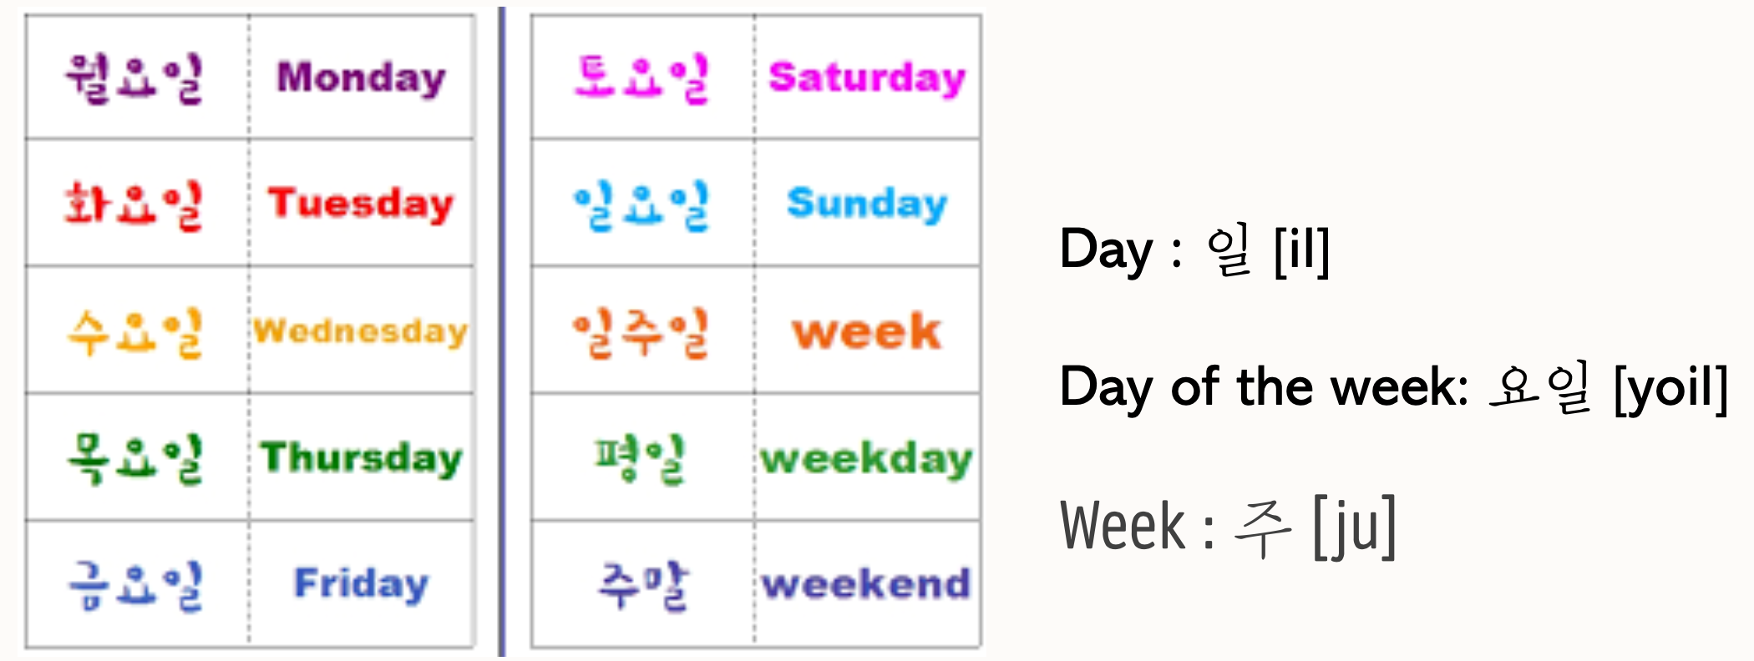
Day of week

Slide 27
Day of week
Monday = 월요일 [Wor-yo-il]
Tuesday = 화요일 [Hwa-yo-il]
Wednesday = 수요일 [Su-yo-il]
Thursday = 목요일 [Mok-yo-il]
Friday = 금요일 [Kum-yo-il]
Saturday = 토요일 [To-yo-il]
Sunday = 일요일 [il-yo-il]

Slide 28
Day of week
Weekday = 평일 [Pyeong-il]
Weekend = 주말 [Ju-mal]
A Week = 일주일 [il-ju-il]

Slide 29
Month
January = 1월 [il-wol]
Febuary = 2월 [i-wol]
March = 3월 [sam-wol]
April = 4월 [sa-wol]
May = 5월 [o-wol]
June = 6월 [yu-wol]

Slide 30
month
July = 7월 [chil-wol]
August = 8월 [pal-wol]
September = 9월 [gu-wol]
October = 10월 [si-wol]
November = 11월 [sib-il-wol]
December = 12월 [sib-i-wol]

Slide 31
dialogue
Yoongi : 이번방학에 어디로 여행 갈거야?
[i-beon banghak-e eo-di-ro yeo-hang gal-geo-ya?]
=Where will you go to travel this vacation?
Jenny : 나는 스위스에 갈거야
[na-neun swiss-e gal-geo-ya]
= I will go Switzerland

Slide 32
dialogue
Yoongi : 왜 스위스로 결정했어?
[wae-swiss-ro-gyeol-jeong-haess-eo?]
=Why did you decide Switzerland?
Jenny : 왜냐하면, 나 아직 한 번도 안가봤거든
[wae-nya-ha-myeon, na-a-jig-han-beon-do an-ga-bwat-geo-deun]
=Because, I haven't been there yet

Slide 33
dialogue
Yoongi : 좋겠다! 거기 어떻게 갈거야?
[jot-get-da! Geo-gi e-ddeot-ge-gal-geo-ya?]
=How will you go there?
Jenny : 기차 타고 갈거야
[gi-cha-ta-go-gal-geo-ya]
=I will go by train

Slide 34
dialogue
Yoongi : 언제 출발 할거야?
[eon-jae-chul-bal-hal-geo-ya?]
=When will you departure?
Jenny : 12월 12일 토요일에!
[sib-i-wol sib-i-il to-yo-il-e!]
=On Saturday 12 December!

Slide 35
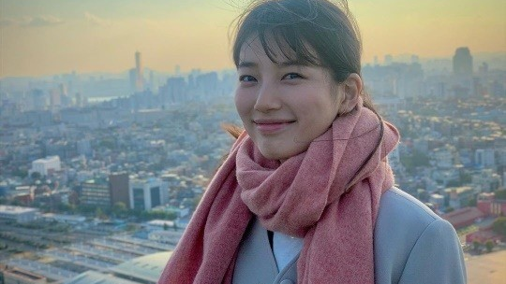
Korea’s culture
Drama & Movie

Slide 36

스카이 캐슬
-sky castle
# DRAMA
-It shows the university entrance examination system in Korea and the daily life of students.
-Exciting family history of the rich people.
-Available on Netflix.

Slide 37

태양의 후예
-Descendants of the sun
-Love story of soldiers and doctors.
-The characters are handsome and pretty.
-The content is interesting as it is a drama loved around the world.
-OSTs are good.

Slide 38

미스터션샤인
-MR.SUnshine
-Created based on Korea’s sad History.
-Korean but an American soldier&The secret of a rich woman is main characters.
-Available on Netflix.

Slide 39

사랑의 불시착
-a crash landing of love
-A love story between a Korean Royal family woman and a North Korean soldier man.
-Start of story is fun.
-The main characters are really pretty and handsome.
-Available on Netflix.

Slide 40

별에서 온 그대
-A man from the star
-The story of an alien who fell to Earth 400 years ago and the best top star actress.
-Intermediate actress's comic acting is interesting.
-Available on Netflix.

Slide 41



# MOVIE
-Haeundae
-Extreme job
-Miracle in Cell No.7

Slide 42

Thank you

