Slide 1
Korean class
WEEK 6

Slide 2
Index
Grammar
Counter
Adverb
Key Sentences
Korea’s Culture

Slide 3
Grammar - palatalization
A phenomenon in which ㄷ, ㅌ meets 'ㅣ‘ [i] vowels and turns into‘ㅈ, ㅊ’.
ㄷ+ㅣ= 지
ㅌ+ㅣ= 치
Example) 같이 /ga-ti/: together – 가치[gachi]
해돋이 /hae-do-di/ : sunrise – 해도지[hae-do-ji]

Slide 4
Grammar - liquidization
'ㄴ' is pronounced as [ㄹ] in front or behind＇ㄹ’
ㄹ + ㄴ + ㄹ =ㄹ
Example ) 논리 /non-li/ : logic – 놀리[nol-li]
온라인 :On-line – 올라인[Ol-line]
난로 /nan-lo/: Stove – 날로[nal-lo]

Slide 5
Grammar - nasalization
A phenomenon in which consonants other than the original nasal sounds are changed to nasal sounds (ㄴ, ㅁ, ㅇ) under the influence of neighboring nasal sounds.
Example)
국물 : soup – 궁물[goong-mool]
대통령 : president – 대통녕[dae-tong-nyung]
국립 : national – 국닙 – 궁닙[goong-nip]
'ㅂ, ㄷ, ㄱ’ + ‘ㄴ, ㅁ’ → ［ㅁ, ㄴ, ㅇ］
'ㅁ, ㅇ’ + ‘ㄹ’ → ［ㅁ, ㅇ］ + ［ㄴ］
‘ㅂ, ㄷ, ㄱ’ + ‘ㄹ’ → ‘ㅂ, ㄷ, ㄱ’ + ［ㄴ］ → ［ㅁ, ㄴ, ㅇ］ + ［ㄴ］

Slide 6
Important !!
When you write, you must use original word !
These grammatical rules are only used when you speak.
같이 ( ㅇ )
가치 ( x )
대통령 ( ㅇ )
대통녕 ( x )

Slide 7
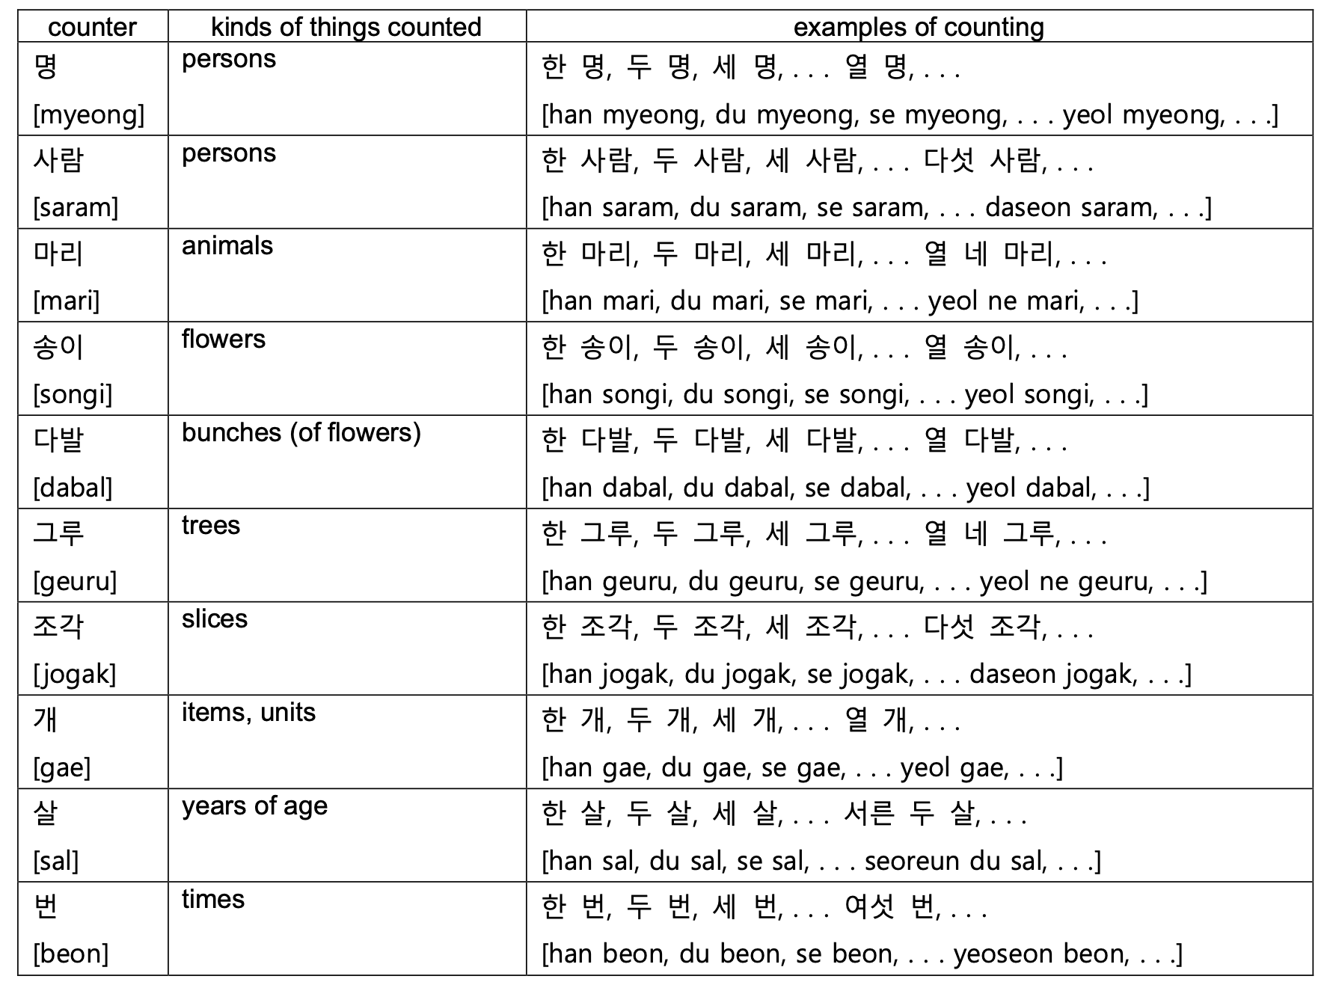
counter

Slide 8
Question word

Slide 9
Adverb

Slide 10
Adverb – note: first word in the table is [bballi] not [deougi]

Slide 11
Key sentences - in café & restaurant
물 한 잔 주시겠어요?
“Could I have a glass of water?”
[mul han jan ju si ge sseo yo?] :→(what) (how many)잔 (action/verb)시겠어요?
냅킨은 어디 있나요?
“Where is the napkin?”
[naeb kin eun eo di it na yo?]
:→(what)은/는 어디 (action/verb)나요?
오늘 카페에서 숙제를 했어요.
“I did my homework at the café today”
[o neul ka pe e seo sug je leul hae sseo yo] :→(when), (where)에서 (what)을/를 (action/verb)어요.

Slide 12
Key sentences - in café & restaurant
아메리카노 두 잔 이랑 초콜렛 마카롱 하나 주세요.
“(Give me) two glasses of Americano and one chocolate macaron”
[amelikanodujanIlangchokolletmakalong ha na ju se yo]
:→ (what) (how many)잔 이랑 (what)(how many) (action/verb)세요.
화장실이 어디 있는지 알 수 있을까요?
“Can I know where the toilet is?”
[hwa jang sil i eo di it neun ji al su i sseul kka yo?]
:→(where)이/가 어디 (action/verb)는지 (action/verb) 수 있을까요?
너는 뭐 주문 할래?
“What do you want to order?”
[neo neun mwo ju mun hal lae?] :→(who)은/는 뭐 (action/verb)할래?

Slide 13
Key sentences - in café & restaurant
남은 음식 포장해주세요.
“Please pack the leftovers.”
[nam eun eum sig po jang hae ju se yo] :→(what) (action/verb)세요
어떤 메뉴가 제일 인기 많나요?
“Which menu is the most popular?”
[eo tteon me nyu ga je il in gi manh na yo?] :→ 어떤 (what)이/가 제일 인기 (action/verb)나요?
피클이랑 김치 더 주시겠어요?
“Would you please give more pickle and kimchi?”
[pi keul I lang gim chi deo ju si ge sseo yo?] :→(what)(이)랑 (what) 더 (action/verb) 시겠어요?

Slide 14
Key sentences - private question
가족은 몇 분이나 됩니까?
How many people are there in your family?
[gajogeun myeot bunina doemnikka]
→(noun)은 몇 (counter)이나 됩니까?
남편은 무슨 일을 하세요?
What does your husband do for a living?
[nampyeoneun museun ireul haseyo]
→(noun)은 무슨 (noun)을 하세요?
아들은 둘이고 딸은 없습니다.
I have two sons, but no girls.
[adeureun durigo ttareun eopseumnida]
→(noun)은 (number)고 (noun)은 (number)입니다.
기혼입니다. / 미혼입니다.
I’m married. / I’m single. → (noun)입니다.
[gihonimnida. / mihonimnida]

Slide 15
Key sentences - private question
나이를 여쭤봐도 될까요?
May I ask your age?
[naireul yeojjwobwado doelkkayo]
→(noun)을 여쭤봐도 될까요?
당신의 종교는 뭡니까?
What’s your religion?
[dangsinui jonggyoneun mwomnikka]
→당신의 (noun)은 뭡니까?
저는 기독교 신자입니다.
I’m a Christian.
[jeoneun gidokgyo sinjaimnida] →저는 (religion) 신자입니다.

Slide 16
Key sentences - private question
전주에서 태어나 서울에서 자랐습니다.
I was born in Jeonju and raised in Seoul.
[Jeonjueseo taeeona seoureseo jaratseumnida]
→(place)에서 (verb) (place)에서 (verb).
어느 학교 나오셨나요?
Which school did you graduate from?
[eoneu hakgyo naosyeonnayo]
→ 어느 (noun) (verb)?
교육학을 전공하고 있습니다.
I’m majoring in education.
[gyoyukageul jeongonghago itseumnida]

Slide 17
Key sentences - private question
몇 시에 만날까요?
What time shall we meet?
[myeot sie mannalkkayo]
→몇 시에 (verb)?
6시 45분이에요.
It’s quarter to seven.
[6si 45bunieyo]
→(number)시 (number)분이에요.
오늘이 무슨 요일이죠?
What day is it today?
[oneuri museun yoirijyo]
→(noun)이 무슨 요일이죠?

Slide 18
Key sentences - time & date
생일이 언제십니까?
When is your birthday?
[saengiri eonjesimnikka]
→(noun)이 언제입(십)니까?
다음 모임은 7월 15일 화요일입니다.
The next meeting will be on Tuesday, July 15th.
[daeum moimeun 7wol 15il hwayoirimnida.]
→(noun)은 (number)월 (number)일 (day)입니다.
우리 휴가가 언제 시작이지?
What date does our vacation start?
[uri hyugaga eonje sijagiji]
→(noun)이 언제 (verb)?

Slide 19
Key sentences - time & date
언제 서울에 도착했습니까?
When did you arrive in Seoul?
[eonje seoure dochakaetseumnikka]
→언제 (noun)에 (verb)?
가장 편한 시간은 언제세요
When is the most convenient time for you?
[gajang pyeonhan siganeun eonjeseyo]
→(adj) 시간은 언제세요?
벌써 6시가 넘었어요.
It’s already after six.
[beolsseo 6siga neomeosseoyo] →벌써 (time)이/가 넘었어요.

Slide 20
Key sentences - in school
전공 수업 건물을 찾아가려면 어디로 가야하나요? “Where should I go to find the major class building?”
[jeongong sueop geonmureul chajagaryeomyeon eodiro gayahanayo]
:→(where) 을 찾아가려면 어디로 가야하나요?
학생 식당에 가서 점심먹자. “Let’s have a lunch in student cafeteria”
[haksaeng sikdange gaseo jeomsimmeokja.]
:→(where)에 가서 점심먹자.
이번학기에몇학점들어? “How many credits do you take this semester?”
[ibeon hakgie myeot hakjeom deureo]
:→(when)에 몇 학점 들어?

Slide 21
Key sentences - in school
과제 제출일이 언제까지야? “When is the dead-line of assignment?”
[gwaje jechuriri eonjekkajiya]
:→(what)이 언제까지야?
장학금을 받으려면 어떤 기준을 충족해야하나요? “Which criteria should be met to get a scholarship?”
[janghakgeumeul badeuryeomyeon eotteon gijuneul chungjokaeyahanayo]
:→(what)을 받으려면 어떤 기준을 충족해야하나요?
오늘 팀플하러 가야해. “I have to go to the team meeting today.”
[oneul timpeulhareo gayahae]
:→(when) (what)하러 가야해

Slide 22
Key sentences - in school
오늘 같이 과제 할래? “Do you want to work together today?”
[oneul gachi gwaje hallae] :→(when) 같이 (what)할래?
수업 끝나고 아르바이트 가야해. “I have to go for part time job after class.”
[sueop kkeunnago areubaiteu gayahae]
:→(what) 끝나고 (where)가야해.
시험 끝나고 술마시러 가자.
“Let’s go drink after the exam.”
[siheom kkeunnago sulmasireo gaja]
:→(what) 끝나고 술마시러 가자.

Slide 23
Korea’s culture - holiday

Slide 24
추석 [chusuk]
Chuseok is Korean Thanksgiving Day (August 15th in the lunar calendar)
Eat 송편[songpyeon] - Rice cake made of rice flour mixed with boiling water and stuffed with sesame, beans, and red beans in a half-moon shape.
강강술래[GangGangSulRae]
씨름[SsiRuem]

Slide 25
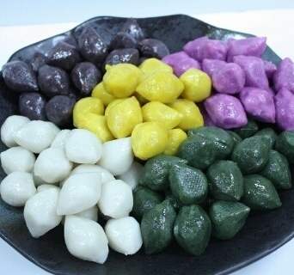
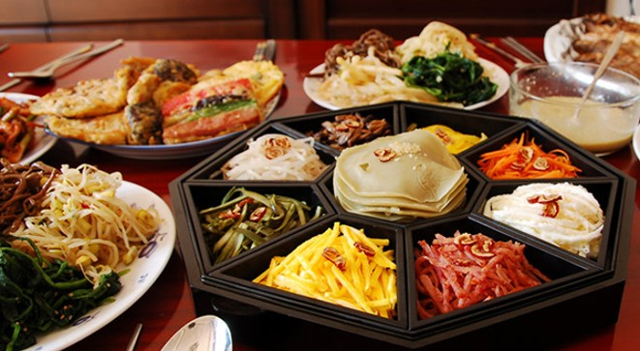

Slide 26
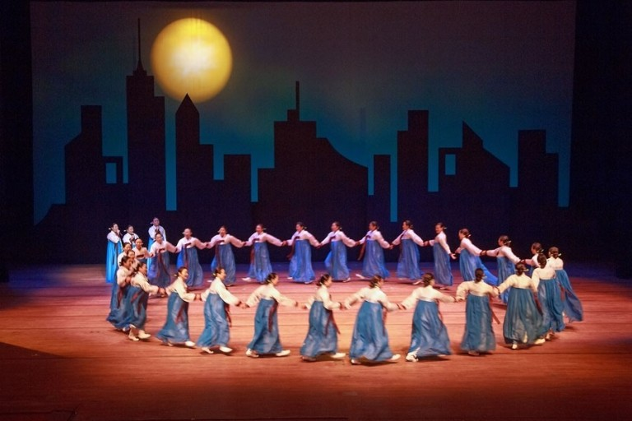
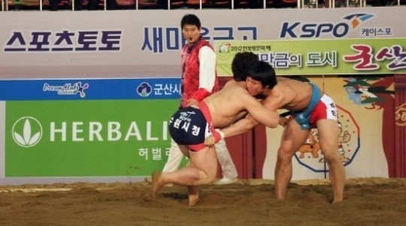

Slide 27
Watch video
강강술래 [ganggangsulrae]
https://youtu.be/FtXMvWOzwI4

Slide 28
설 [sul]
It is the first day of the New Year, and there is a custom of greeting and saying words of blessing as the first holiday of the year.(January 1st, in the lunar calendar)
윷놀이[Yutnoli]
떡국[ddeokguk]

Slide 29
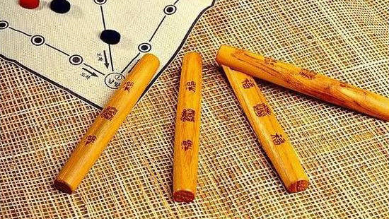

Slide 30
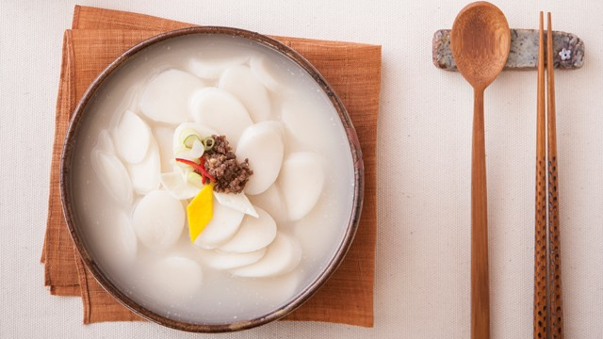

Slide 31
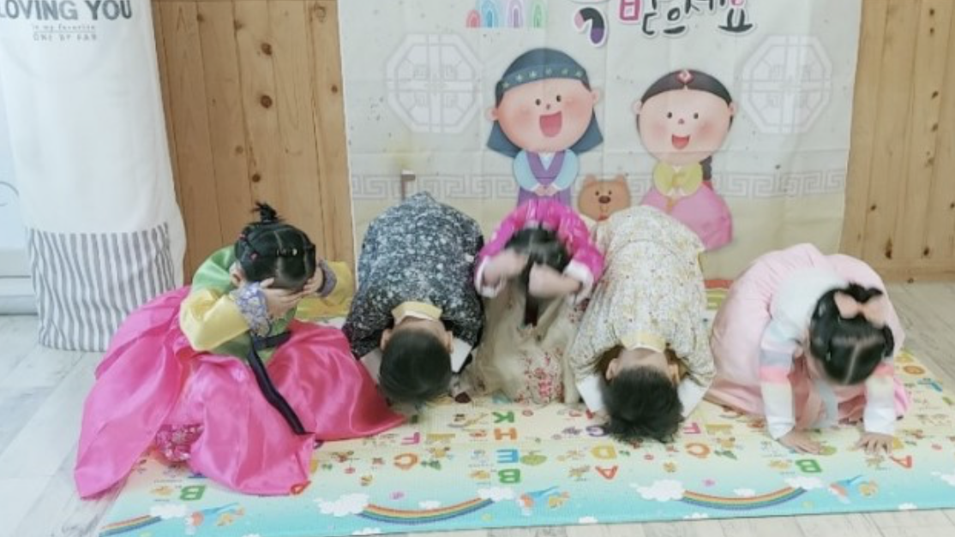

Slide 32
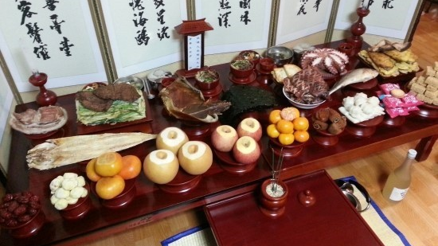

Slide 33
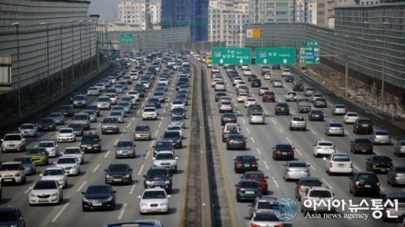

Slide 34
Useful websites
King Sejong Institute
http://www.sejonghakdang.org/sjcu/home/main.do
Talk to me in Korean
https://talktomeinkorean.com/

Slide 35
Thank you

