Slide 1
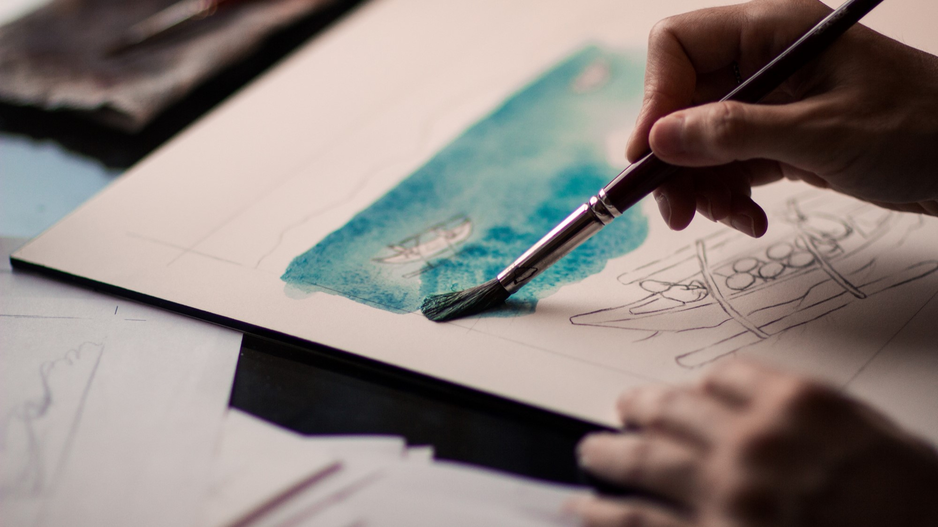
KPOP CLASS
2019.11.19 + 2020.12.30
Copyrightⓒ. Saebyeol Yu. All Rights Reserved.

Slide 2
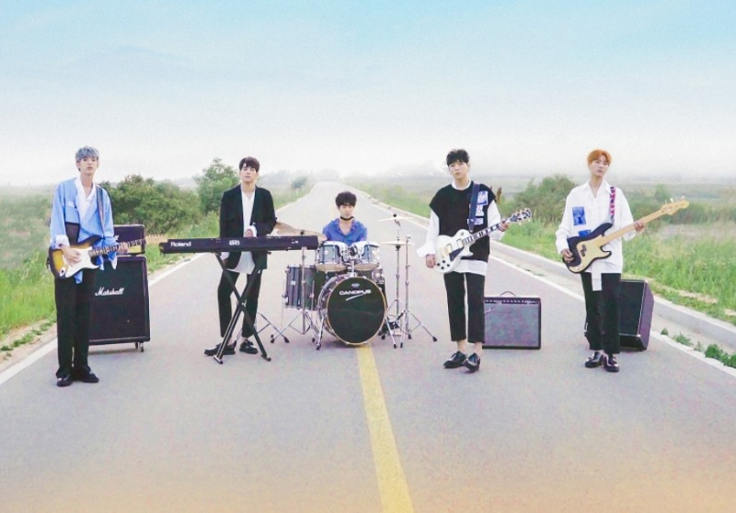

DAY6

Slide 3
Debut: 07-09-2015
Debut Song : Congratulations
Meaning of the Team name:
6 days + 1day = 1week
Fandom: My day

Slide 4
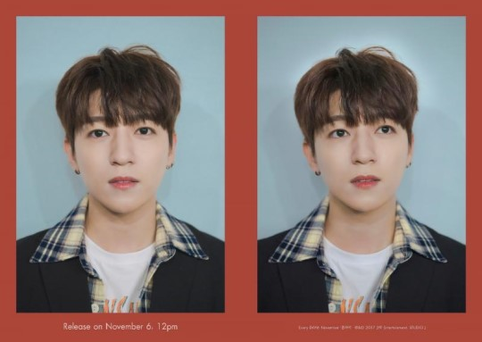
Name: SungJin
Position: Leader, Vocal, Guitar
Birth: 16-01-1993
Physical: 177cm, 70kg
https://www.youtube.com/watch?v=kSMNmyjsuxs

Slide 5
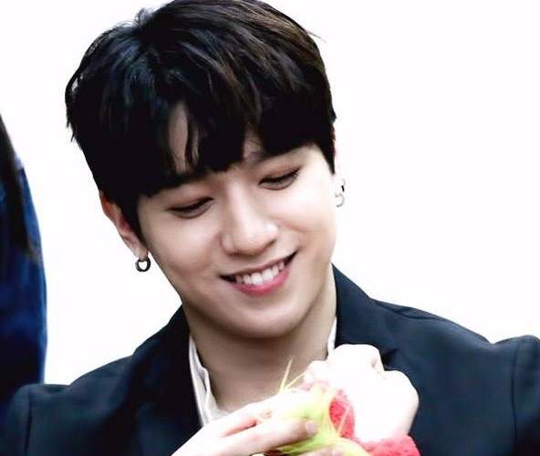
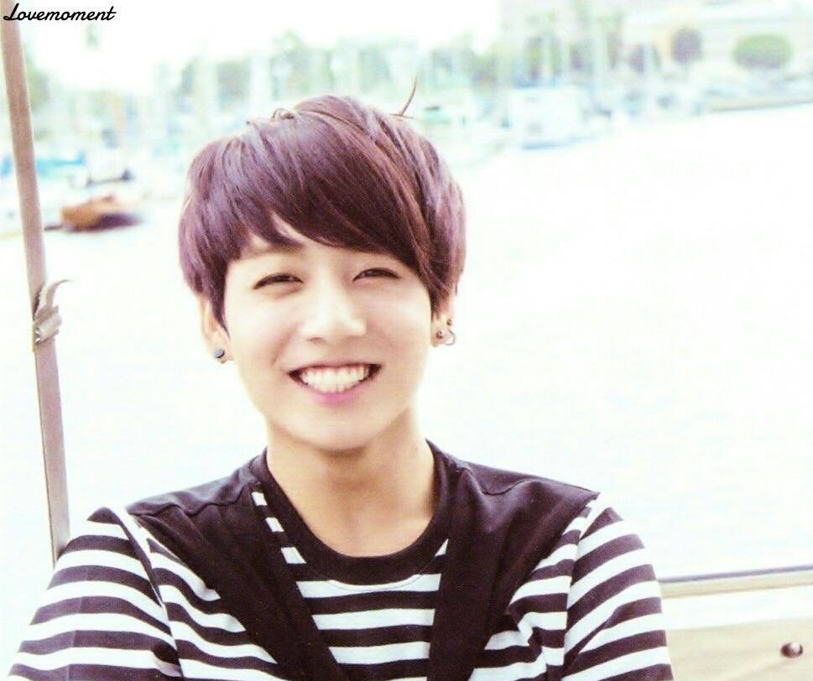
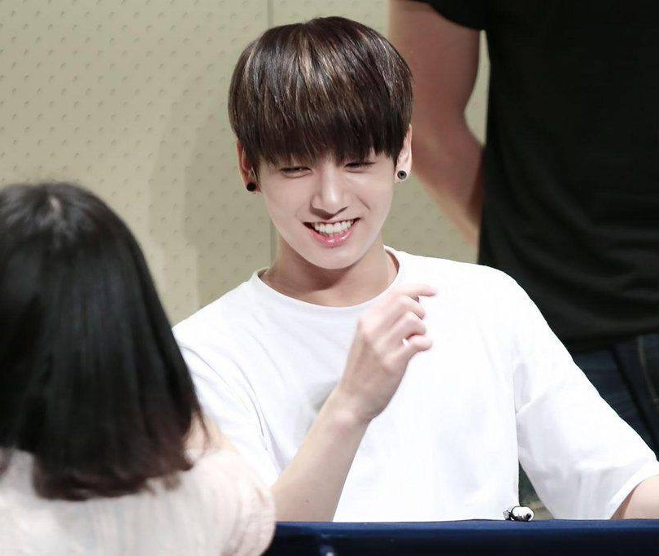

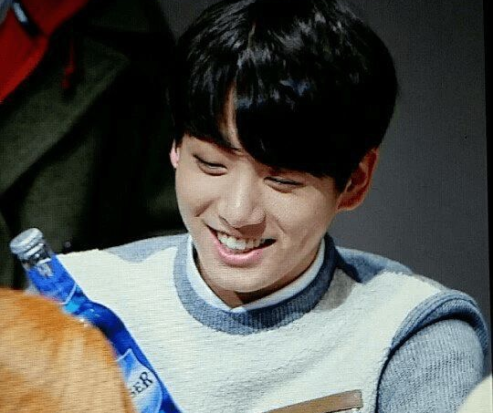
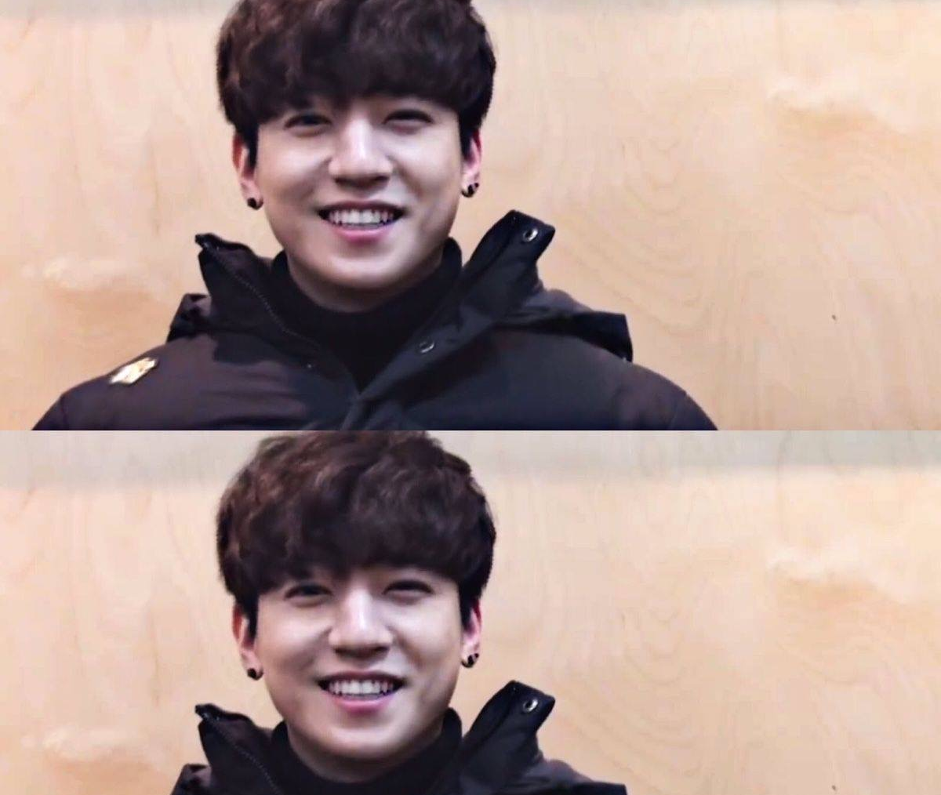

Slide 6

Name: Jae
Position: Vocal, Rap, Guitar
Birth: 15-09-1992
Physical: 182cm, 65kg
https://www.youtube.com/watch?v=8CUlKW4MWN8

Slide 7
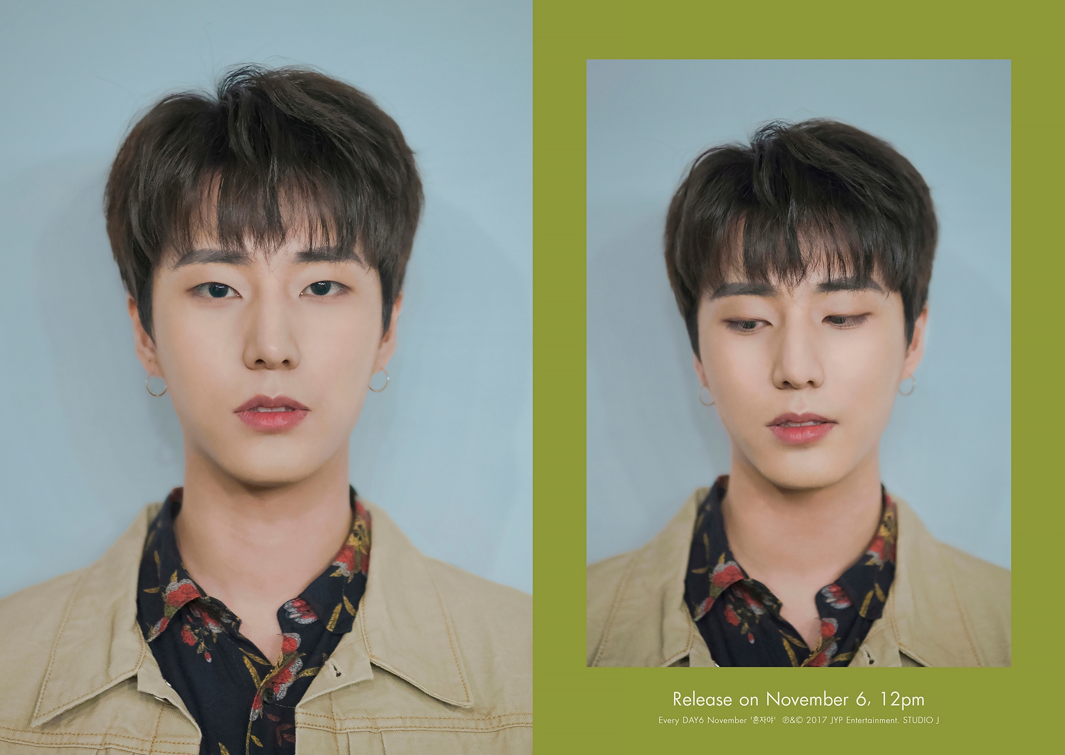
Name: Young K
Position: Vocal, Rap, Base Guitar
Birth: 19-12-1993
Physical: 180.2cm, 68kg
https://www.youtube.com/watch?v=J1ZpmxpHApQ

Slide 8
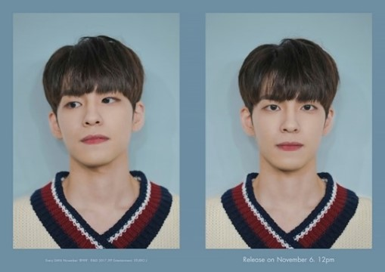
Name: Wonpil
Position: Vocal, Keyboard, synthesizer
Birth: 28-04-1994
Physical: 176cm, 60kg
https://www.youtube.com/watch?v=g74D8h-_quA

Slide 9
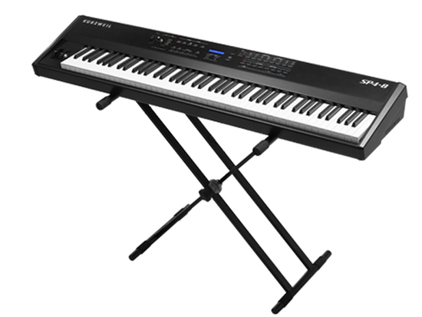
https://www.youtube.com/watch?v=whs7gl4Yeks

Slide 10
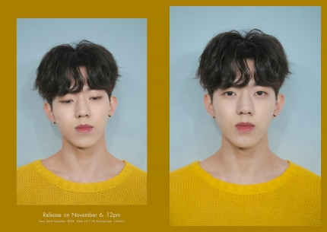
Name: Dowoon
Position: Vocal, Drum
Birth: 25-08-1995
Physical: 177cm, 60kg
https://www.youtube.com/watch?v=zXEU9W2GLyQ

Slide 11
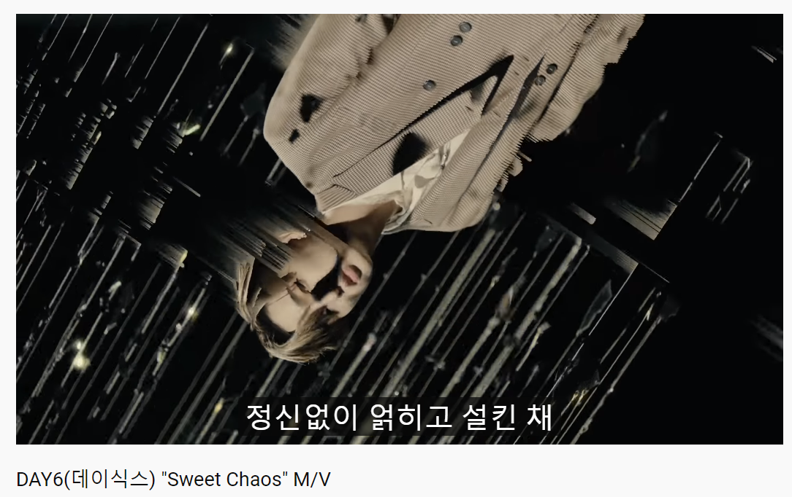
https://www.youtube.com/watch?v=CWUGikRxGQs

Slide 12
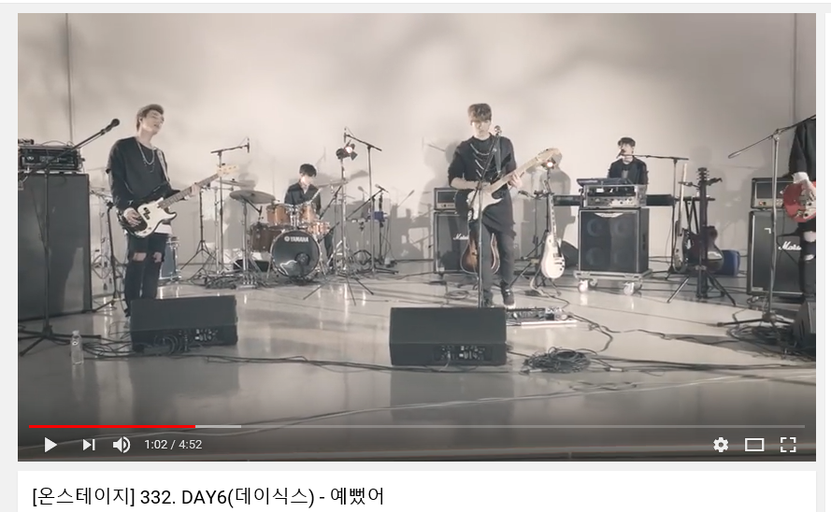
https://www.youtube.com/watch?v=sGBlO8Qd9-Q

Slide 13
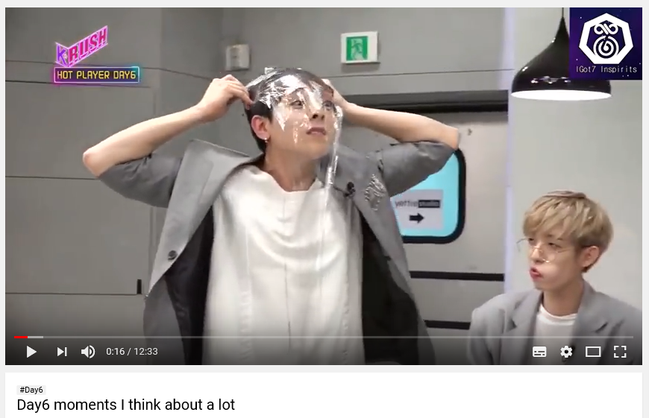
https://www.youtube.com/watch?v=clj74ZNdJu0

Slide 14
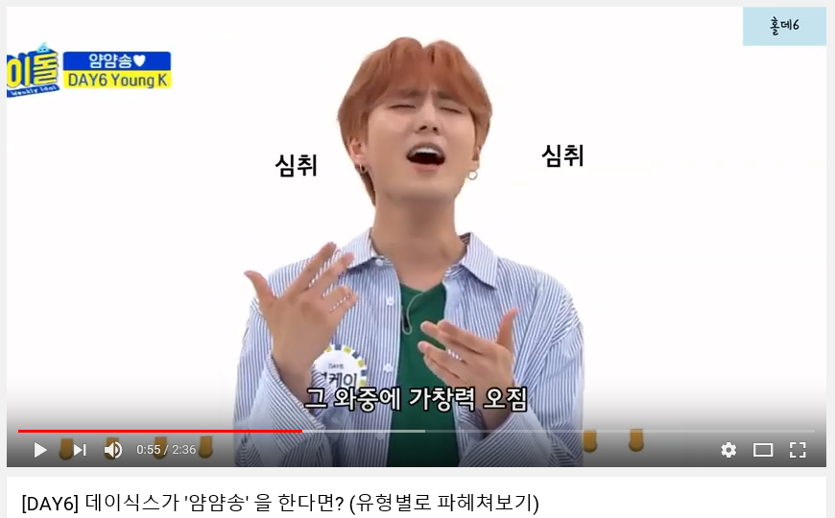
https://www.youtube.com/watch?v=ZwcJlLjGg08

Slide 15
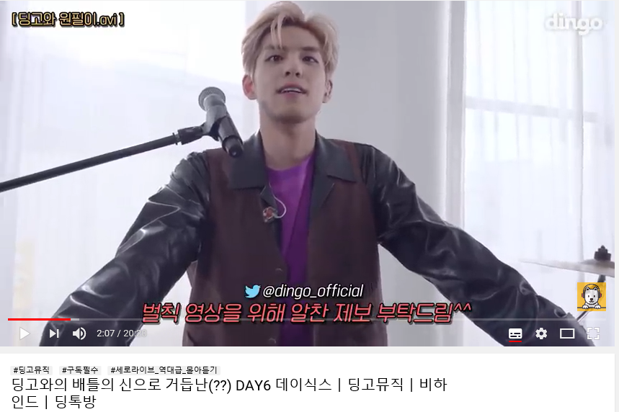
https://www.youtube.com/watch?v=G6nSf0uB4g8

Slide 16
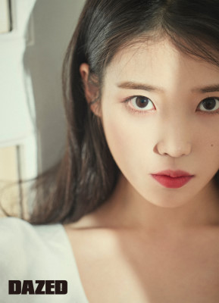
IU

Slide 17
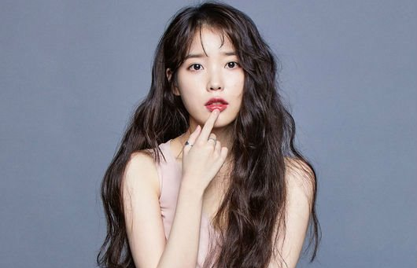
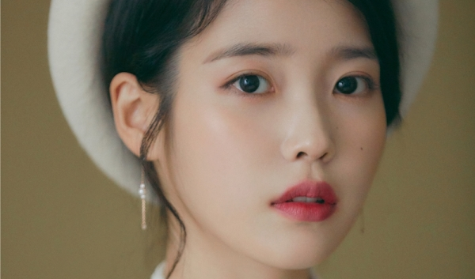
Debut: 18-09-2008
Debut Song : missing child
Meaning of the name:
The music connect I &You
Fandom: U&I
Name: IU (Lee Jieun)
Position: Sing a song writer, Actress
Birth: 16-05-1993
Physical: 160cm, 44kg

Slide 18
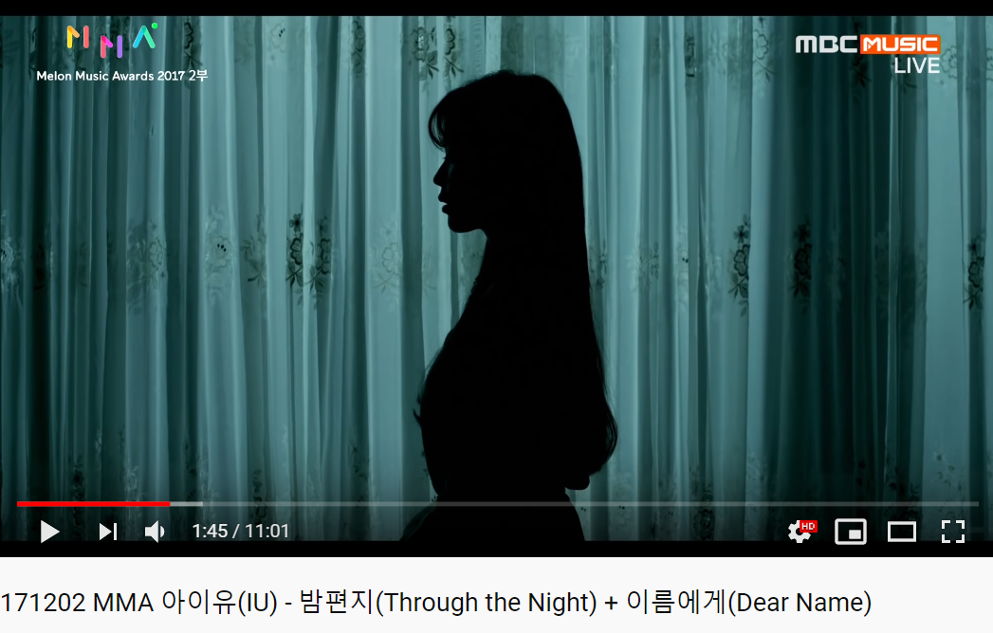
171202 IU -Through the Night + Dear Name @ MMA 2017 [LIVE] - YouTube

Slide 19
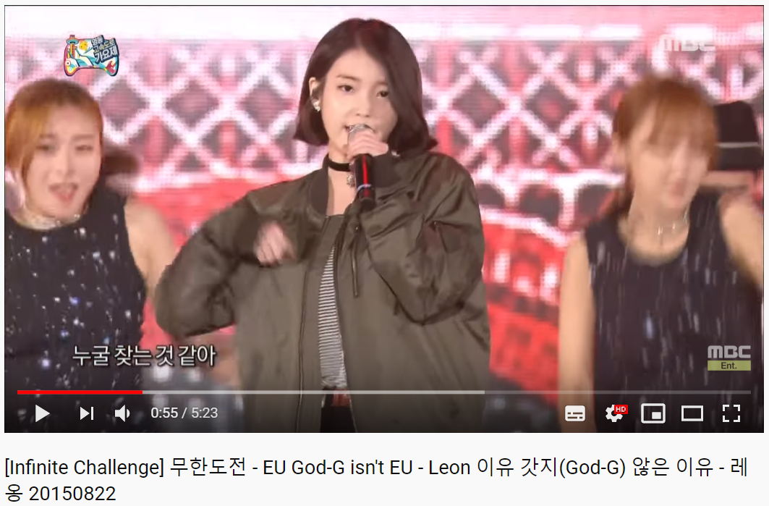
https://www.youtube.com/watch?v=U_KH7Tw97HU

Slide 20
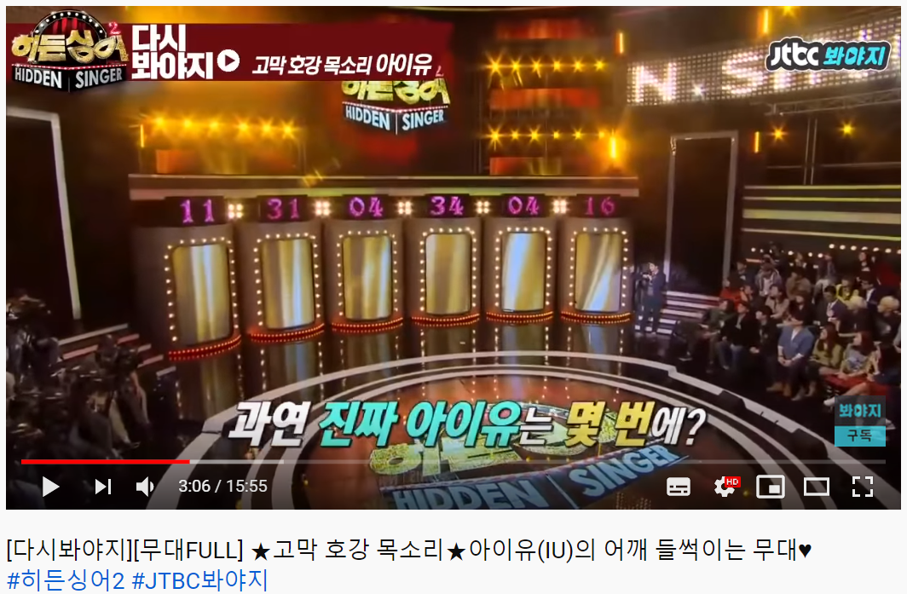
https://www.youtube.com/watch?v=9_dfn02K8b0&t=212s

Slide 21
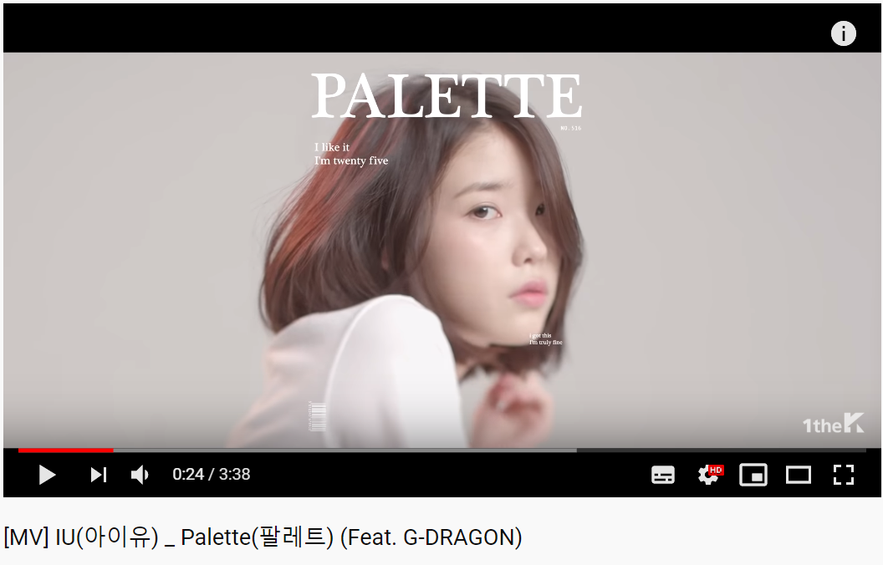
https://www.youtube.com/watch?v=d9IxdwEFk1c

Slide 22
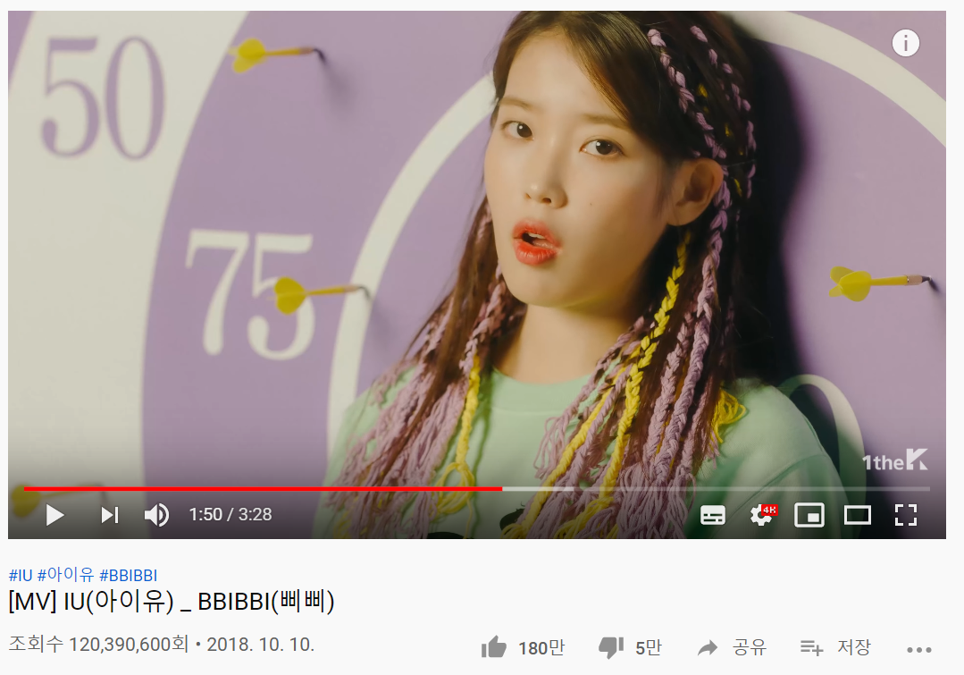
https://www.youtube.com/watch?v=nM0xDI5R50E

Slide 23
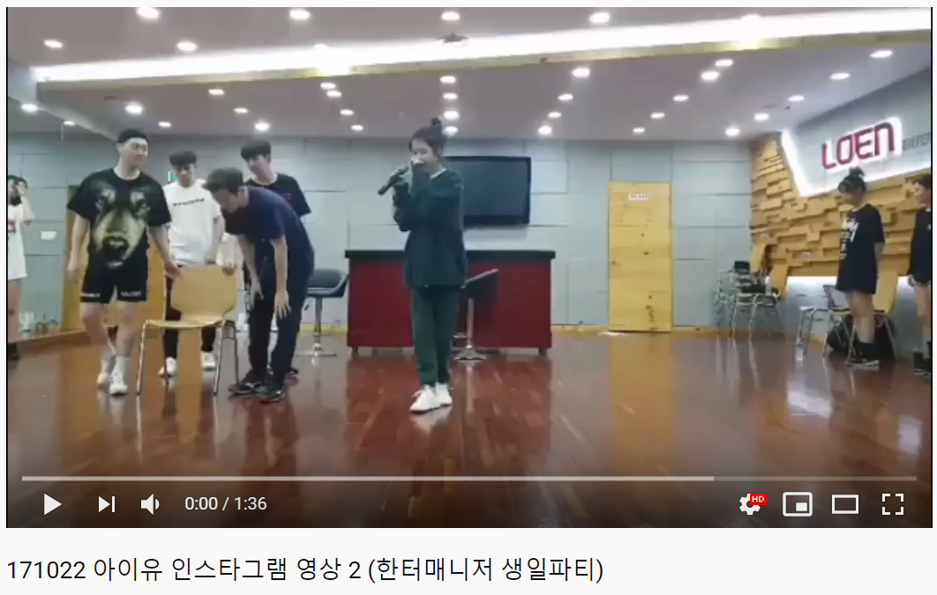
https://www.youtube.com/watch?v=2OQFQGC-jmo

Slide 24
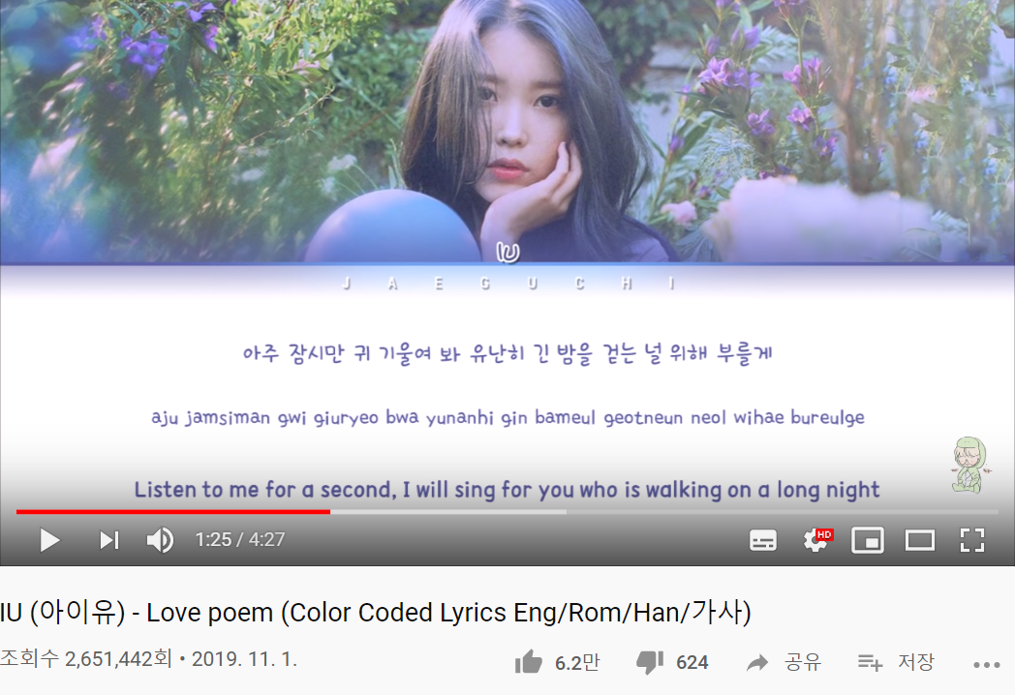
IU (아이유) - 'LOVE POEM' (러브 포엠) Lyrics [Color Coded_Han_Rom_Eng] - YouTube

Slide 25
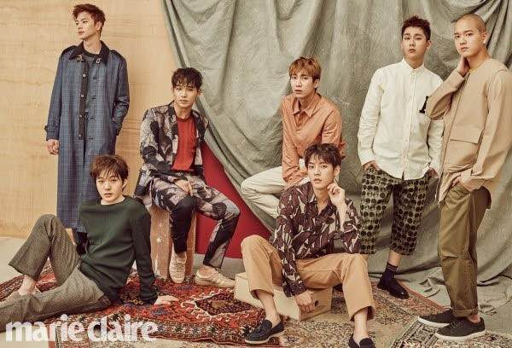
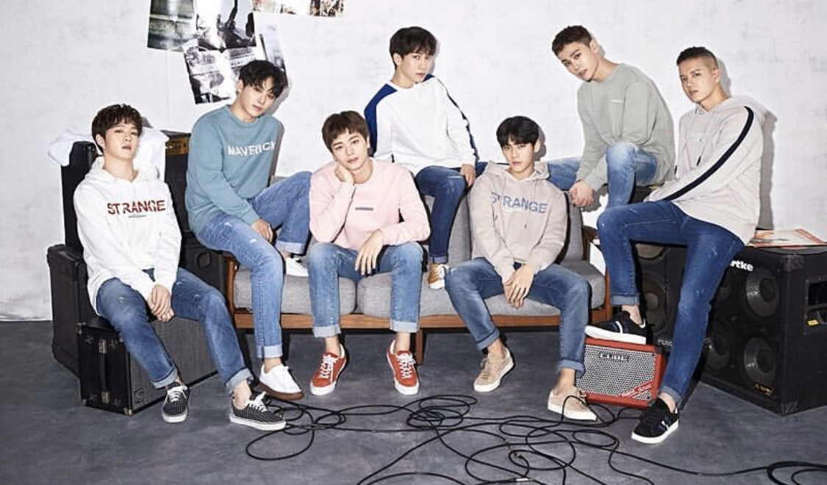
BTOB
Born TO Beat
Debut: 21.03.2012
Fandom: Melody
Famous songs:
I can’t live without you
Miss you
Beautiful but sick
MOVIE

