Slide 1


Kateřina Tomková
Prosody, Philosophy, Mentality and Psychology:
American vs. British Suprasegmentals

Slide 2
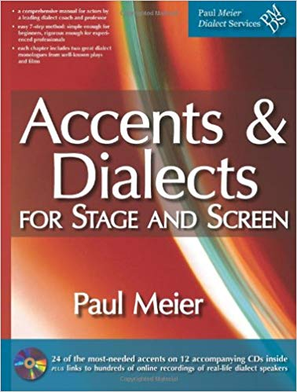
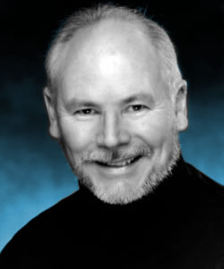
Inspiration

Slide 3
GenAm devotion to vowels;
vowels more open, nasal setting
RP (GB) devotion to consonants

Slide 4
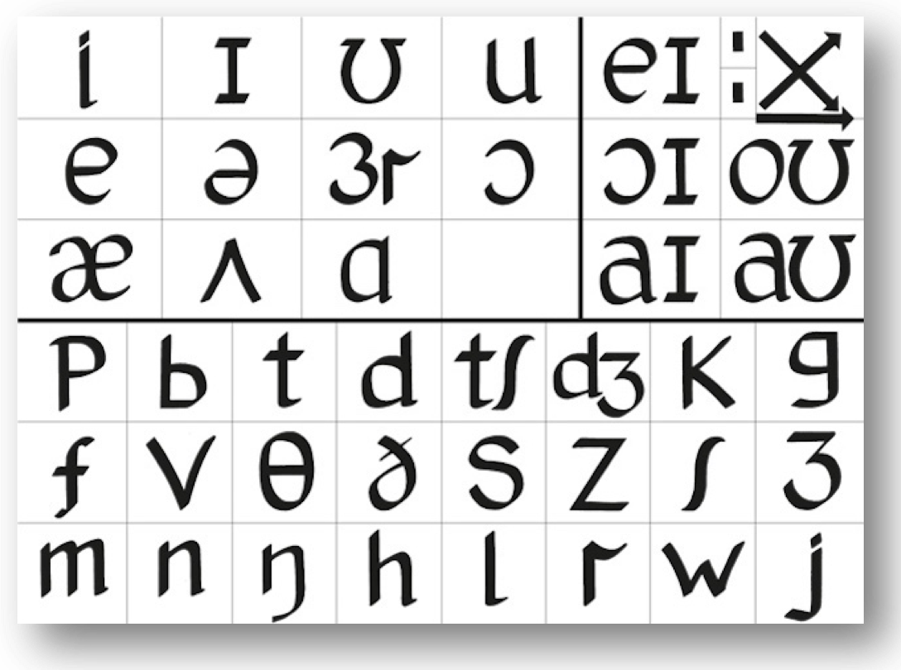
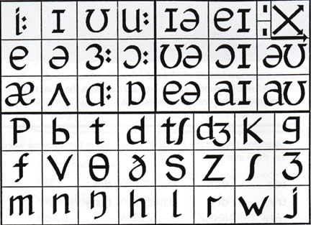

Slide 5
Difference in suprasegmentals # 2
voice carries more
voice carries less

Slide 6
Difference in suprasegmentals # 3
tempo slower, louder in vol.
tempo faster, quieter in volume

Slide 7
Difference in suprasegmentals # 4
volume decreases during utterrance
volume increases during utterrance

Slide 8
Difference in suprasegmentals # 5
more items stressed
fewer items stressed

Slide 9
Difference in suprasegmentals # 6
narrower pitch range
wider pitch range

Slide 10
Difference in suprasegmentals # 7
volume used for emphasis
pitch used for emphasis

Slide 11
Research Questions
1 Is this really so?
1a What kind of utterance should be used as corpus?
2 If proven, does this utilization of prosody reflect the respective national mentality, philosophy of life and individual speakers’ psychology?
2a If proven, do these typical/generally accepted speech behavior norms reflect the prevailing philosophy of life (positive, optimistic vs. healthily sceptical)?

Slide 12
Research Questions
3 How do non-native speakers enter in the game? Do they automatically transfer the prosodic habits of their own mother tongues into speaking English?
4 What are the teaching implications?
4b What are the implications of teaching oneself and others corresponding/correct/appropriate/authentic suprasegmentals?
4c More generally, what are the ultimate goals of teaching pronunciation to non-native speakers?

Slide 13
Research Questions
5 If this conference seeks to break boundaries, what kind of interdisciplinary study would have to be carried out involving phoneticians, sociolinguists, psycholinguists and psychologists to have all these questions answered?
6 Any other… ?

Slide 14
ANSWERS ?
NONE.
Any comments, suggestions?

Slide 15
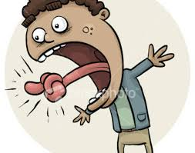
Thank you for your kind attention, comments and remarks.
Enjoy the rest of this conference, have a happy
Valentine‘s and a safe journey home!

