Slide 1
Cantonese I
Week 1

Slide 2
Cantonese I assessments
Jyutping (initial + final + tone)
Listening (quiz)
Conversation (final exam)

Slide 3
What is Cantonese 廣東話
Originates from Canton 廣東 region (Guangzhou 廣州) and its surrounding area in Southeastern China
Also known as Yue 粵語
Spoken in Canton region, Hong Kong, Macau, Singapore, Malaysia, Vietnam, Chinese communities all over the world
Estimated about 70 million Cantonese speakers around the globe
Cantonese varies in different places
This course focuses on Cantonese spoken in Hong Kong
https://www.youtube.com/watch?v=vGJCa12IxeU

Slide 5
English | Cantonese | Jyutping
Dim sum | 點心 | Dim² sam¹

Slide 6
English | Cantonese | Jyutping
Bok Choy | 白菜 | baak⁶ choi³

Slide 7
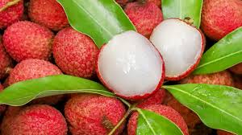
English | Cantonese | Jyutping
lychee | 荔枝 | lai6 zi1

Slide 8
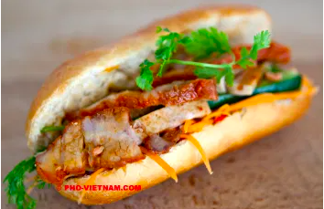
English | Cantonese | Jyutping
Char siu | 叉燒 | Cha¹ siu¹

Slide 9
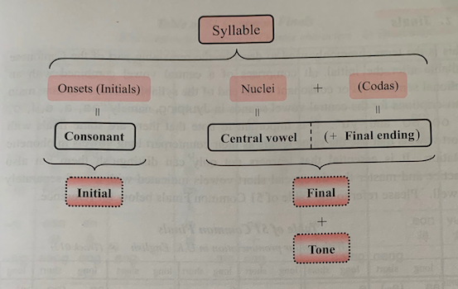
Jyutping
Ngo⁵
我

Slide 10
Jyutping or Yale?
Yale romanization of Cantonese
Limitation: unable to describe all vowels being used in Cantonese

Slide 11
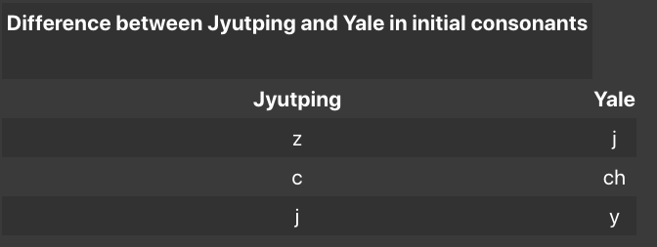
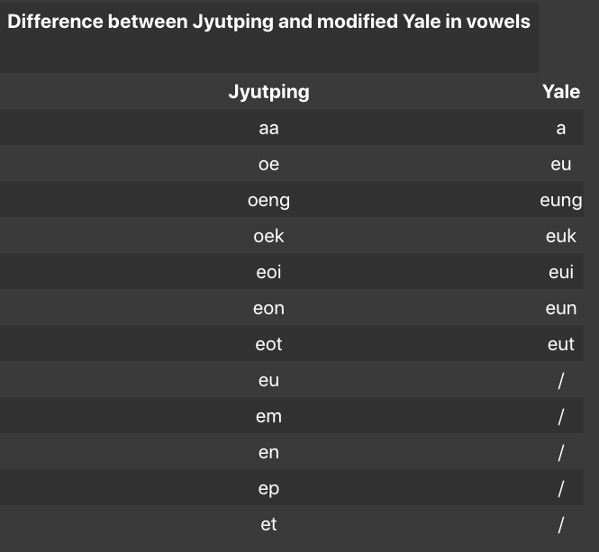
https://hongkongvision.com/tool/cc_py_conv_zh

Slide 12
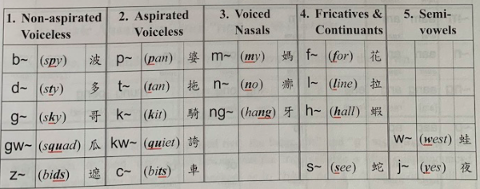
19 Initials

Slide 13
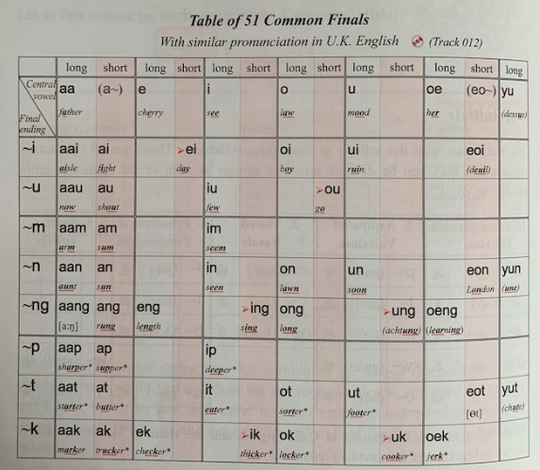
51 Finals

Slide 14
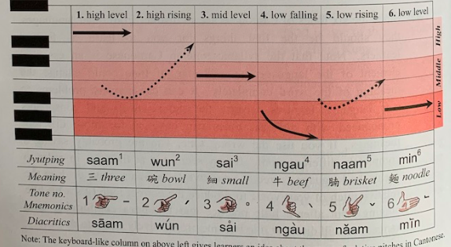
6 Tones

Slide 15
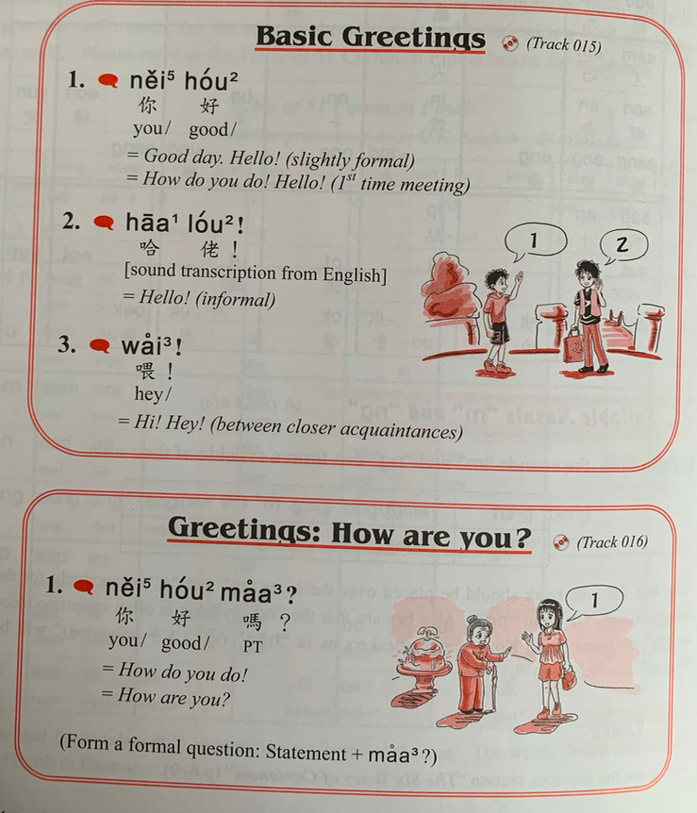
zeoi3 gan6 dim2 aa3?
最近點呀？
How are you lately?

Slide 16
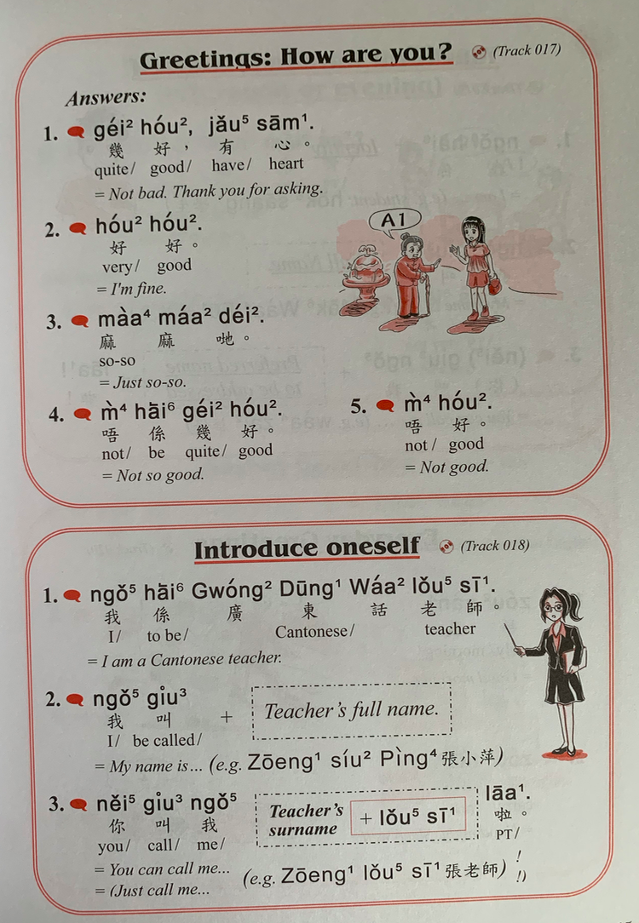
Nei5 ne1？
你呢？
And you?
Nei5 giu3 me1 meng2
你叫咩名
What is your name?
English | Cantonese | Jyutping
Thank you | 多謝 | Do¹ ze⁶
Student | 學生 | hok⁶ saang¹

Slide 17
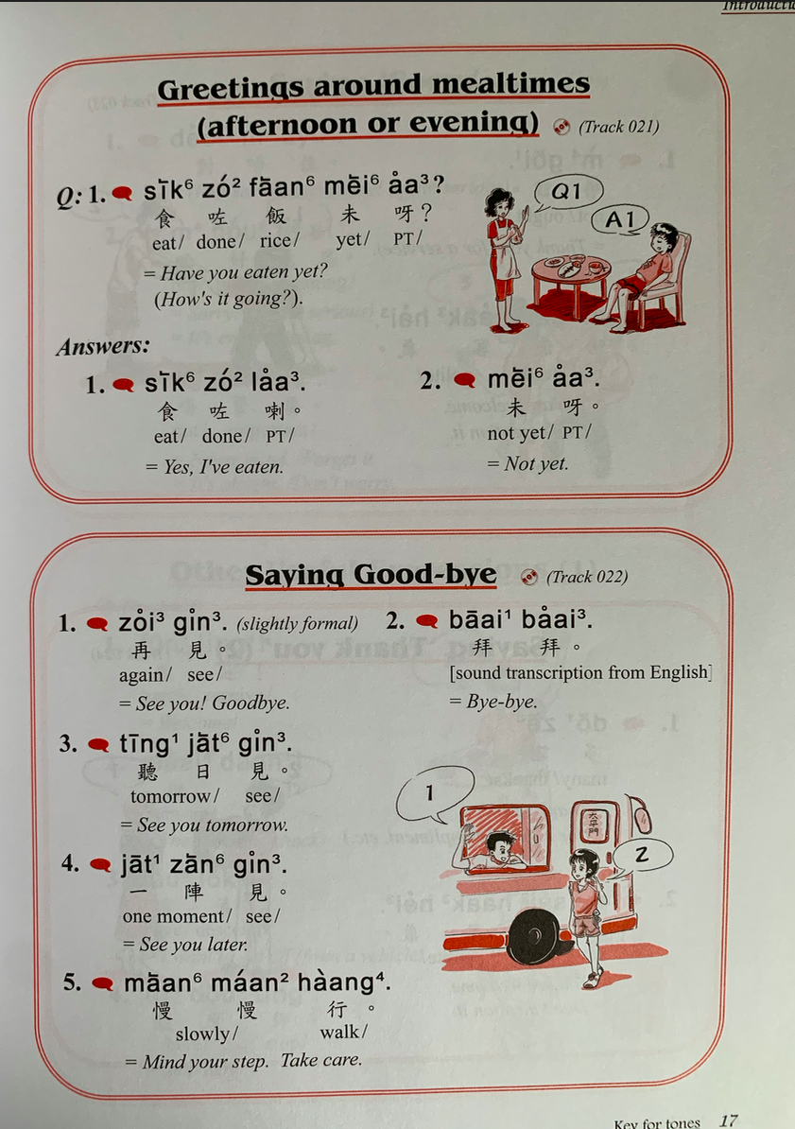
English | Cantonese | Jyutping
Good morning | 早晨 | zou² san⁴
Good afternoon | 午安 | ng⁵ on¹
Good evening | 晚安 | maan⁵ on¹

Slide 18
Homework
Listen to audio and practise 6 tones
011 Intro.mp3
012 Intro.mp3
013 Intro.mp3
Practise greetings

