Slide 1
Cantonese I
Week 10

Slide 2
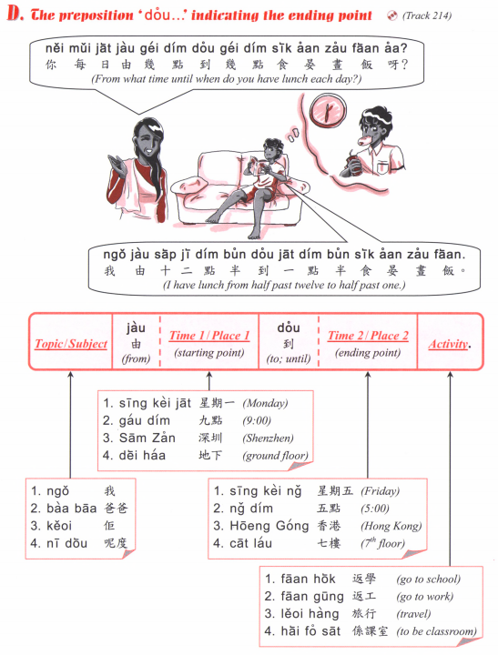

Slide 3
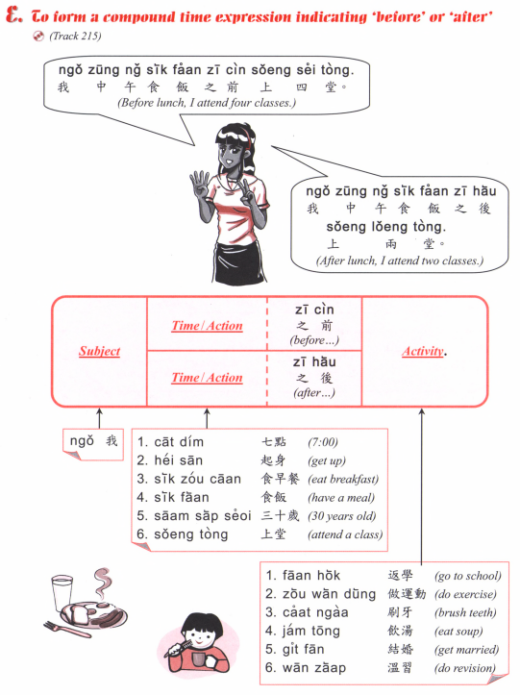

Slide 4
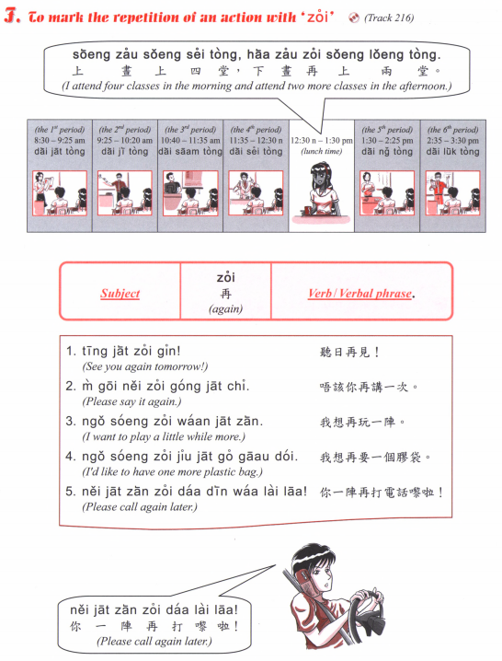

Slide 5
Tell us how you spend a typical week
For example:
From Monday to Friday wake up at ….. Go to school from … to …
Finish school at …
After school I go to [some activity] at …
Saturday…
Sunday…

Slide 6
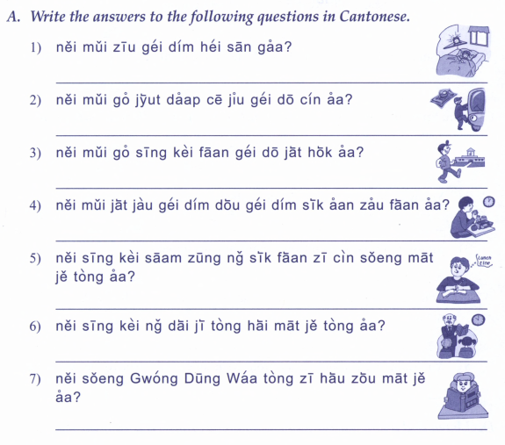

Slide 7
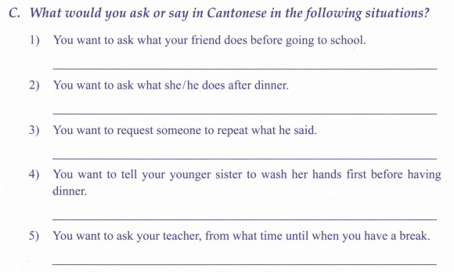
sai2 sau2
fong3 siu2 sik1
放小息

Slide 8
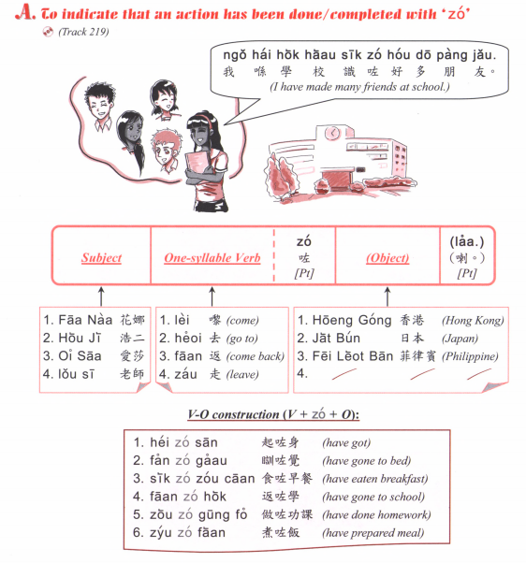
Sik6 zo2 faan6 mei6 aa3?
食咗飯未呀？
Have you eaten?
Sik6 zo2 laa3
食咗喇
Or
Mei6 aa3
未呀

Slide 9
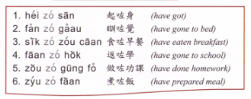
Question: [Verb] zo2 [object] mei6 aa3?
Answer: [Subject] [verb] zo2 [object] laa3.
OR [subject] mei6 [verb] aa3.

Slide 10
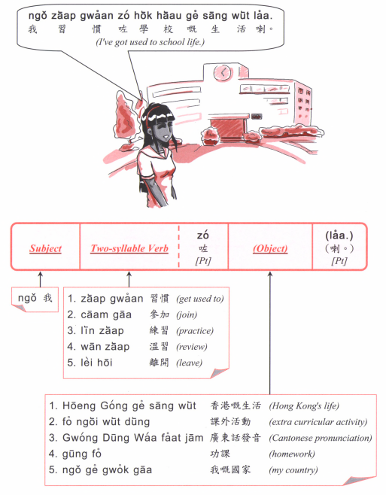
Question: [Verb] zo2 [object] mei6 aa3?
Answer: [Subject] [verb] zo2 [object] laa3.
OR [subject] mei6 [verb] aa3.

Slide 11
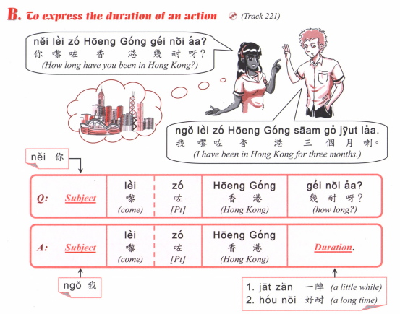

Slide 12
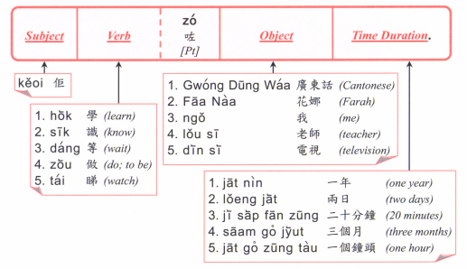

Slide 13
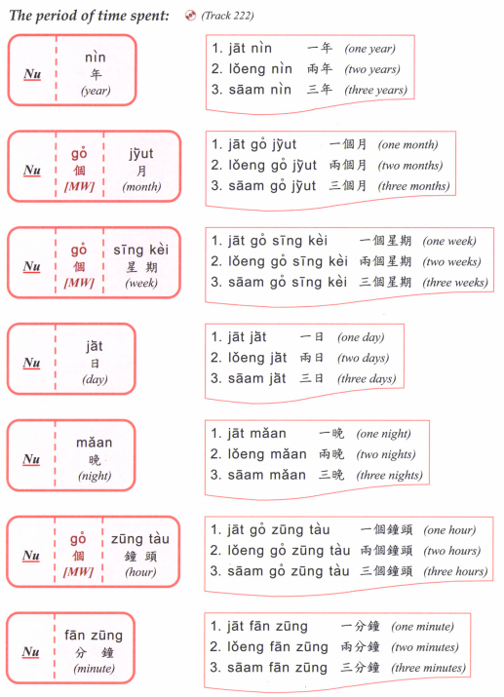

Slide 14
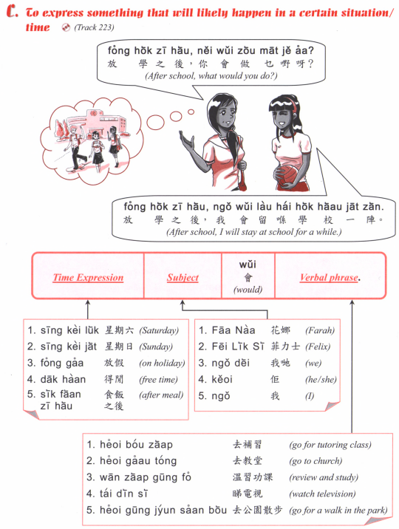

Slide 15
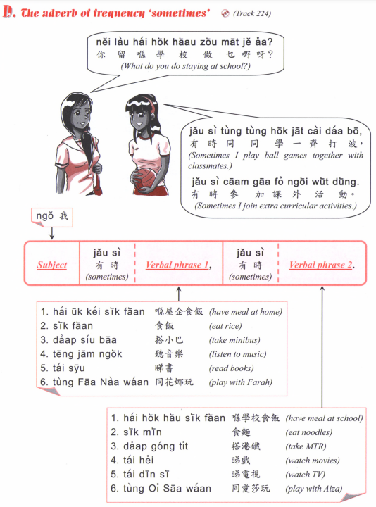

Slide 16
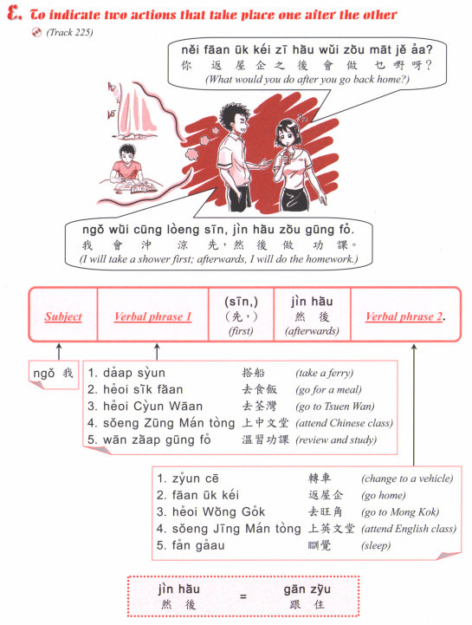

Slide 17
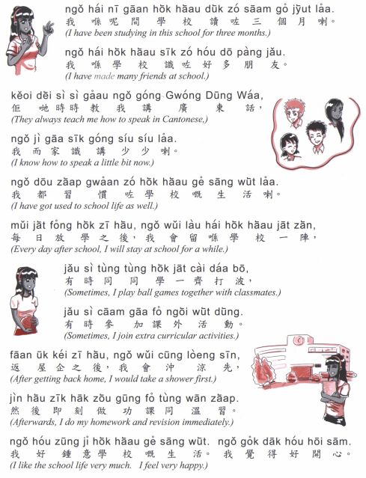

Slide 18
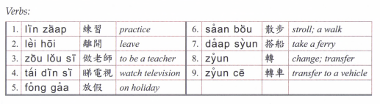

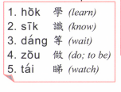
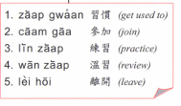

Slide 19
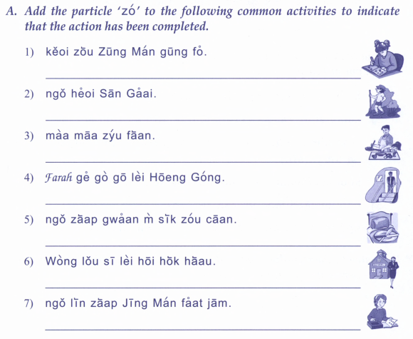
佢做中文功課
我去新界
媽媽煮飯
Farah既哥哥黎香港
我習慣唔食早餐
黃老師離開學校
我練習英文發音

Slide 20
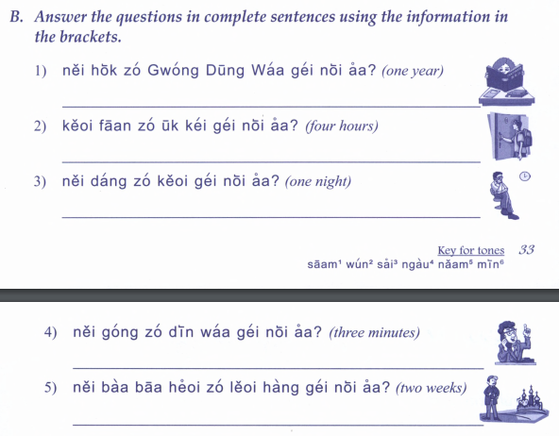
你學咗廣東話幾耐呀？
佢返咗屋企幾耐呀？
你等咗佢幾耐呀？
你講咗電話幾耐呀？
你爸爸去咗旅行幾耐呀？

Slide 21
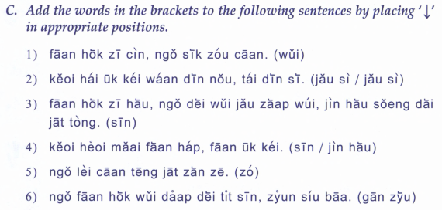
返學之前，我食早餐。
佢喺屋企玩電腦，睇電視
返學之後，我地有集會，然後上第一堂
佢去買飯盒，返屋企。
我黎餐廳一陣啫。
我返學會搭地鐵先，轉小巴

Slide 22
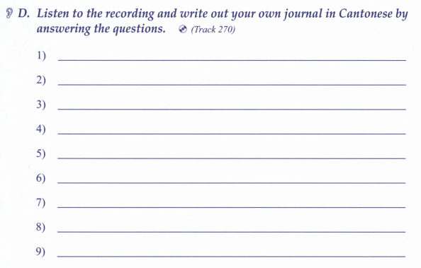

Slide 23
Game
What did you do last weekend (soeng6 go3 zau1 mut6)?
What will you do this weekend (haa6 go3 zau1 mut6)?

Slide 24
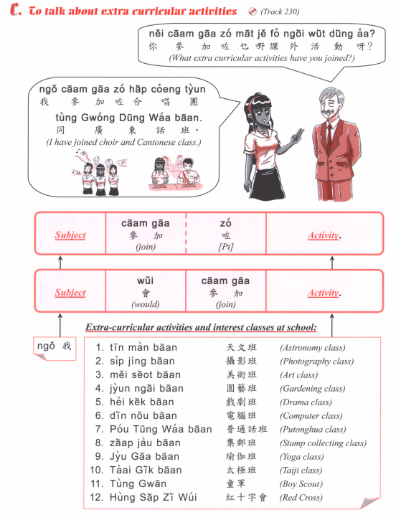

Slide 25
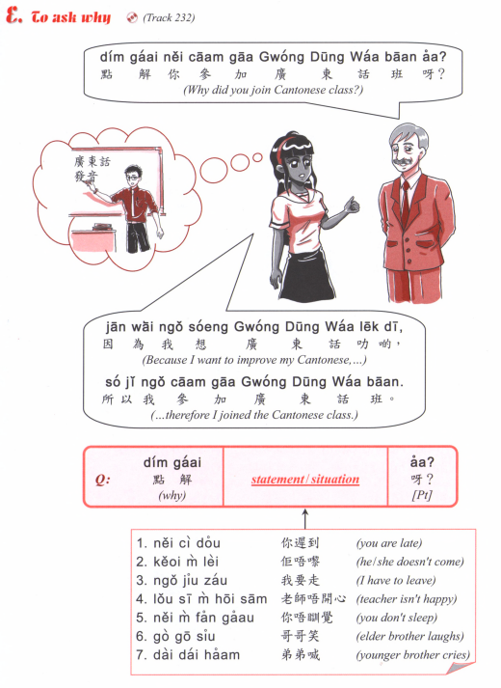

Slide 26
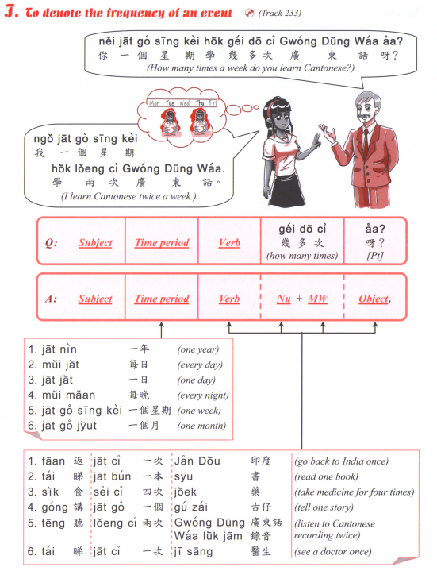
How many times a week do you go to school?
How many times a week do you learn Chinese?
How many times a month do you go hiking? (hang4 saan1)
How many times a year do you have exam? (hao2 si5)

Slide 27
