Slide 1
Cantonese I
Week 11

Slide 2
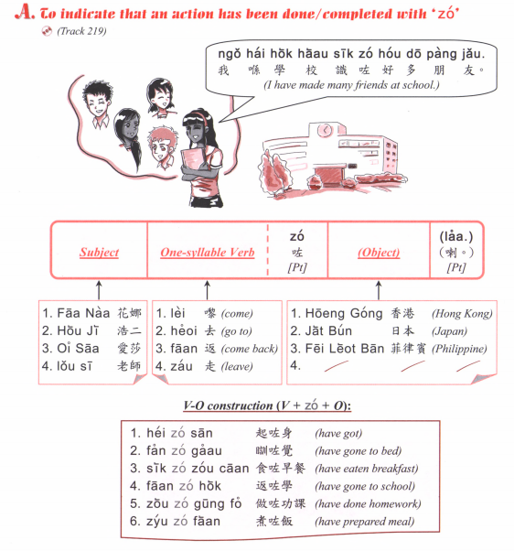
Sik6 zo2 faan6 mei6 aa3?
食咗飯未呀？
Have you eaten?
Sik6 zo2 laa3
食咗喇
Or
Mei6 aa3
未呀

Slide 3
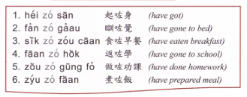
Question: [Verb] zo2 [object] mei6 aa3?
Answer: [Subject] [verb] zo2 [object] laa3.
OR [subject] mei6 [verb] aa3.

Slide 4
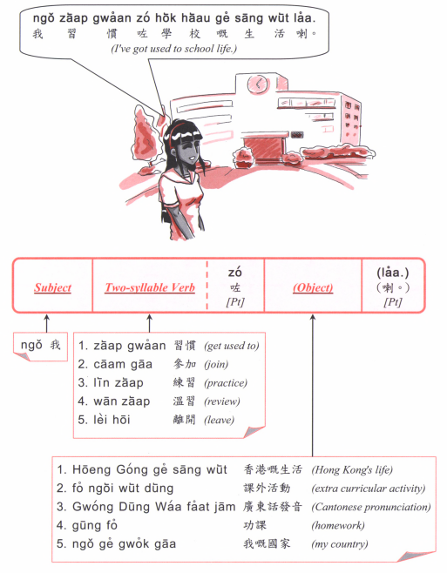
Question: [Verb] zo2 [object] mei6 aa3?
Answer: [Subject] [verb] zo2 [object] laa3.
OR [subject] mei6 [verb] aa3.

Slide 5
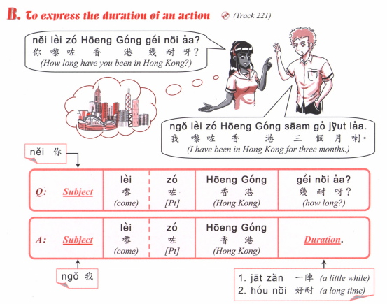

Slide 6
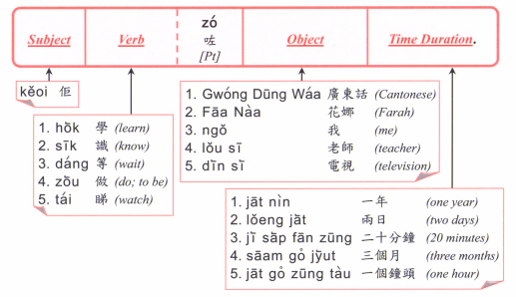

Slide 7
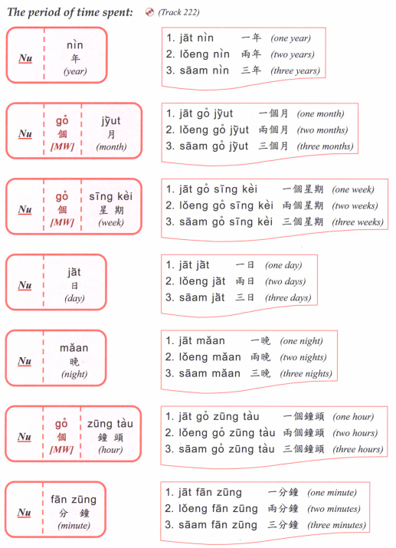

Slide 8
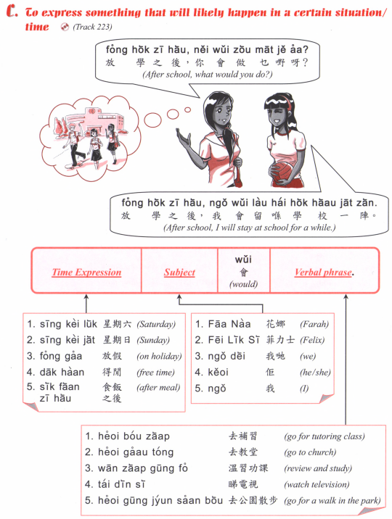

Slide 9
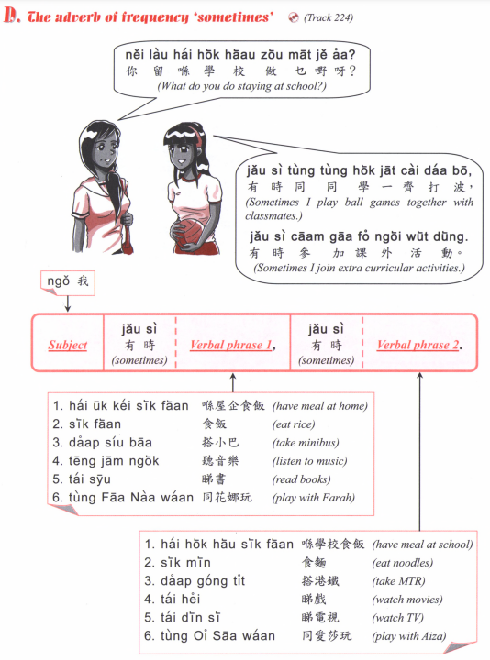

Slide 10
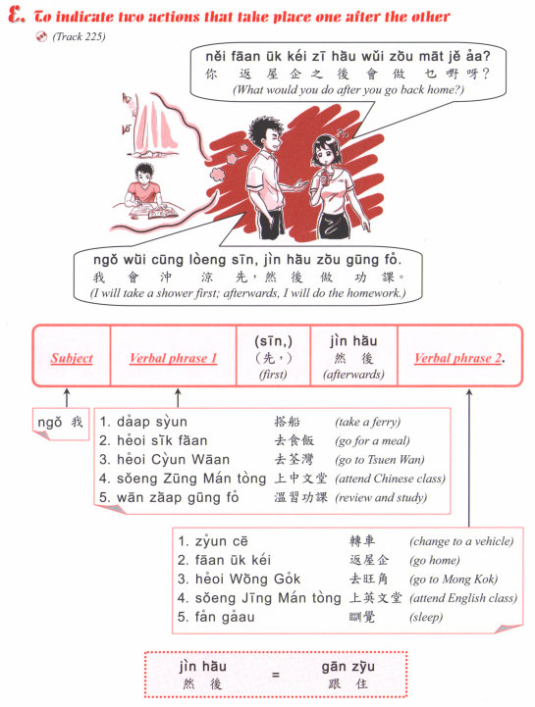

Slide 11
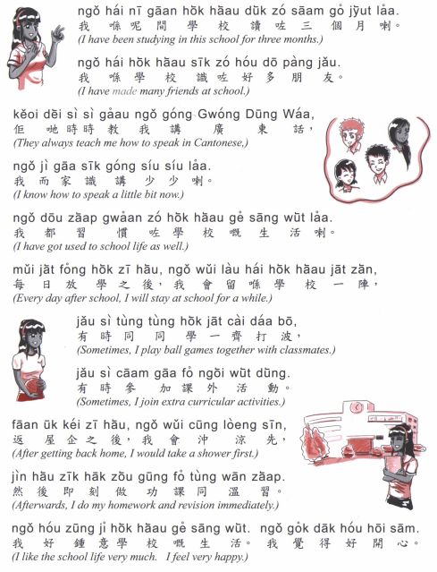

Slide 12
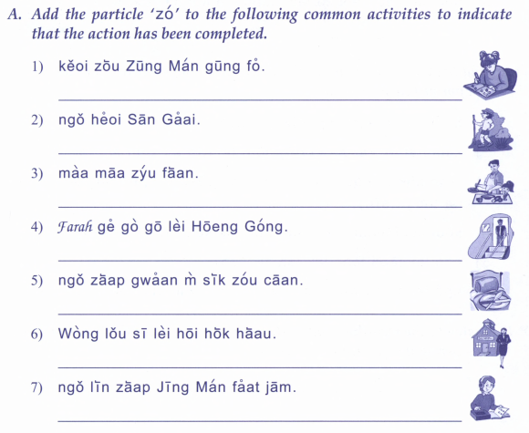
佢做中文功課
我去新界
媽媽煮飯
Farah既哥哥黎香港
我習慣唔食早餐
黃老師離開學校
我練習英文發音

Slide 13
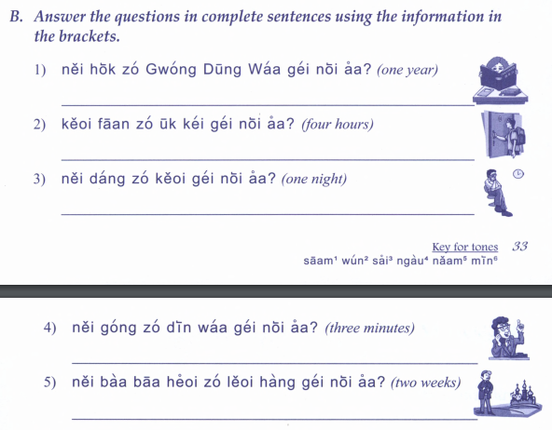
你學咗廣東話幾耐呀？
佢返咗屋企幾耐呀？
你等咗佢幾耐呀？
你講咗電話幾耐呀？
你爸爸去咗旅行幾耐呀？

Slide 14
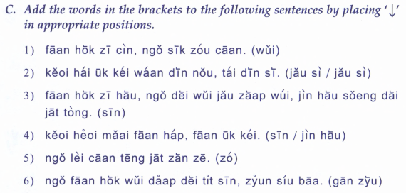
返學之前，我食早餐。
佢喺屋企玩電腦，睇電視
返學之後，我地有集會，然後上第一堂
佢去買飯盒，返屋企。
我黎餐廳一陣啫。
我返學會搭地鐵先，轉小巴

Slide 15
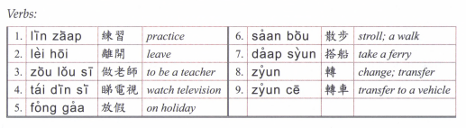

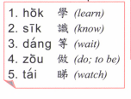
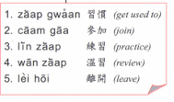

Slide 16
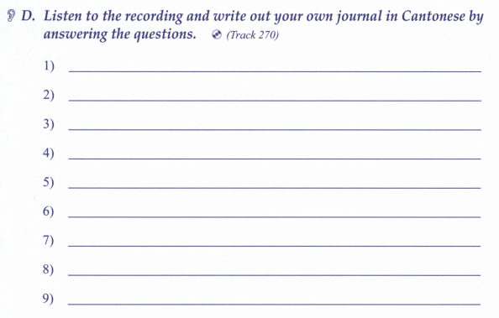

Slide 17
Game
What did you do last weekend (soeng6 go3 zau1 mut6)?
What will you do this weekend (haa6 go3 zau1 mut6)?

Slide 18
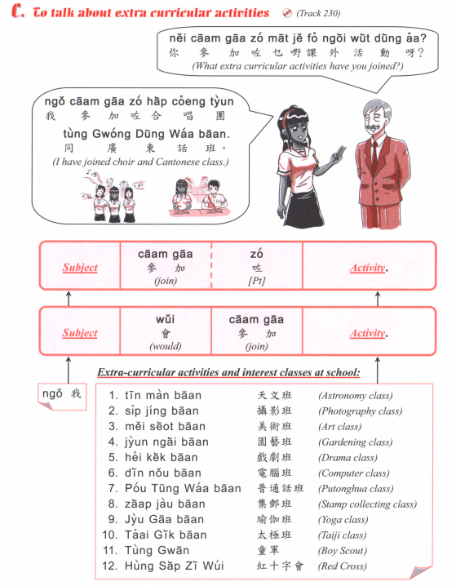

Slide 19
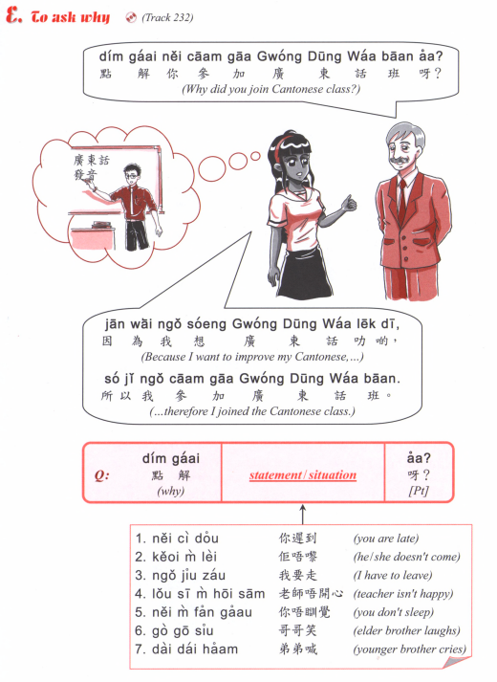

Slide 20
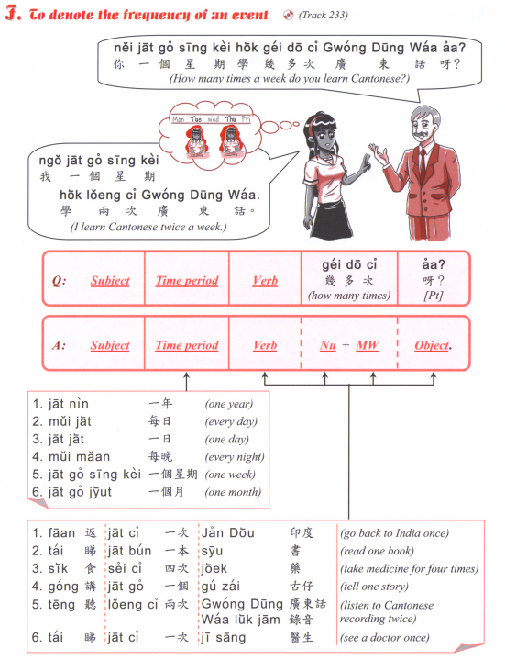
How many times a week do you go to school?
How many times a week do you learn Chinese?
How many times a month do you go hiking? (hang4 saan1)
How many times a year do you have exam? (hao2 si5)

Slide 21
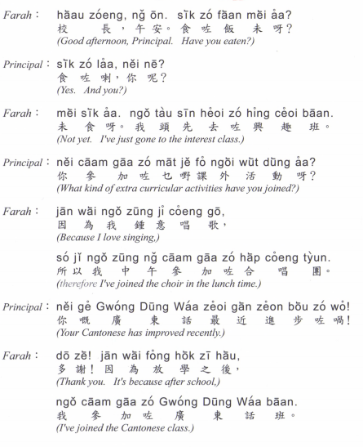
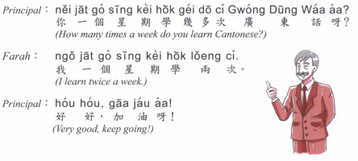

Slide 22
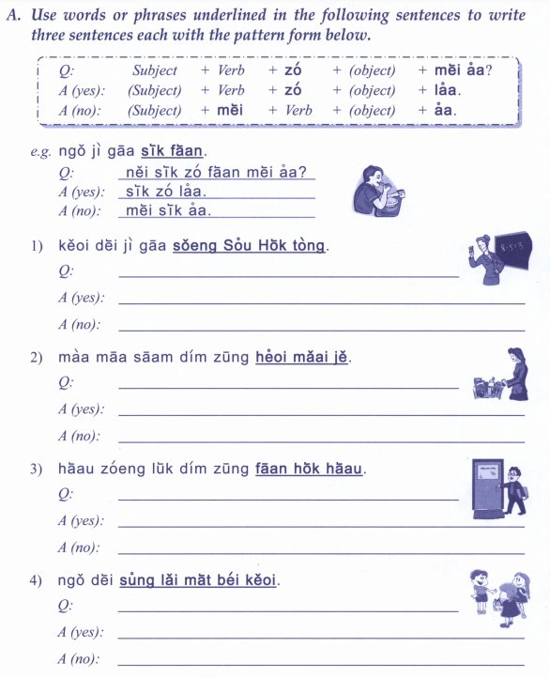
我宜家食飯
佢地宜家上數學堂
媽媽三點鐘去買嘢
校長六點鐘返學校
我地送禮物畀佢

Slide 23
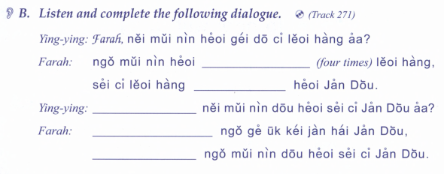
你每年去幾多次旅行呀？
我每年去
旅行
四次旅行
去印度
你每年都去四次印度呀？
我既屋企人喺印度
我每年都去四次印度

Slide 24
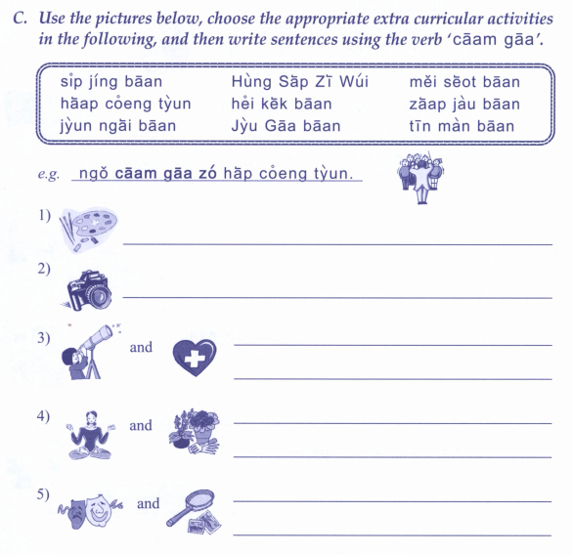
紅十字會
攝影班
美術班
合唱團
戲劇班
集郵班
園藝班
瑜珈班
天文班
我參加咗合唱團

Slide 25
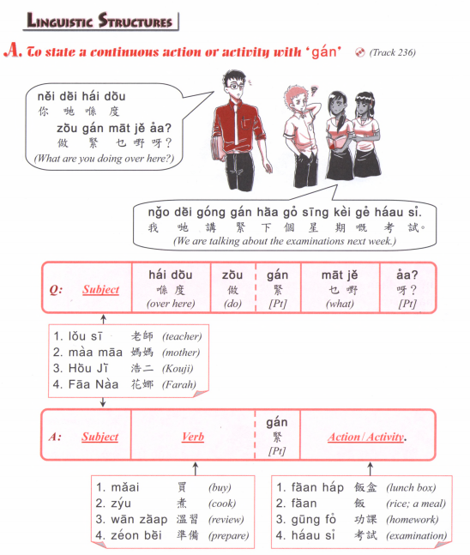

Slide 26
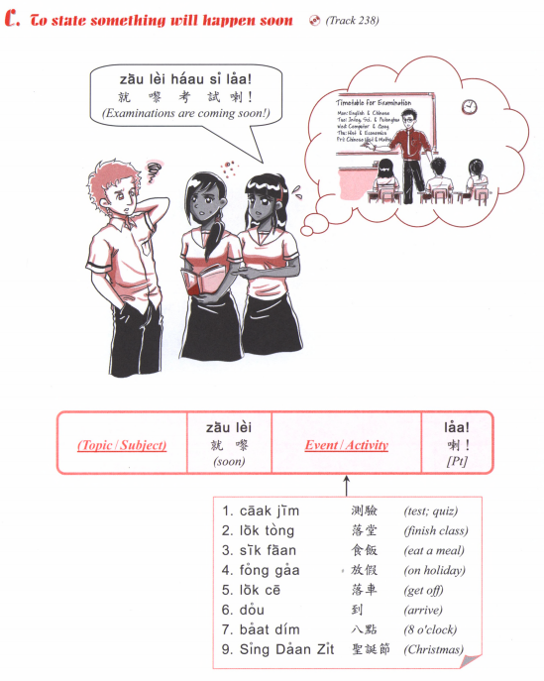
食咗飯
食緊飯
就黎食飯
會食飯

Slide 27
I will have exam soon.
I will have vacation soon. (fong3 gaa3)
3. What is he doing?
He is reading. (tai2 syu1)
4. What are you doing?
I am going to the university. (daai6 hok6)
5. What are you eating?
I am eating noodles. (min6)
6. What will you do this weekend?
I will go to the park. (gung1 jyun2)
7. What book did you read?
I read XXX.
8. How long have you been learning Mandarin?
I have been learning for X years.
9. Have you done your homework?
I am doing it!
10. What will you do in Christmas? (sing3 daan3 zit3)

