Slide 1
Cantonese I
Week 12

Slide 2
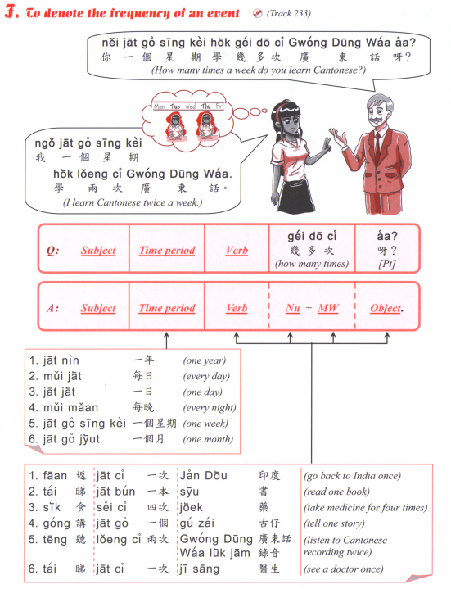
How many times a week do you go to school?
How many times a week do you learn Chinese?
How many times a month do you go hiking? (hang4 saan1)
How many times a year do you have exam? (hao2 si5)

Slide 3
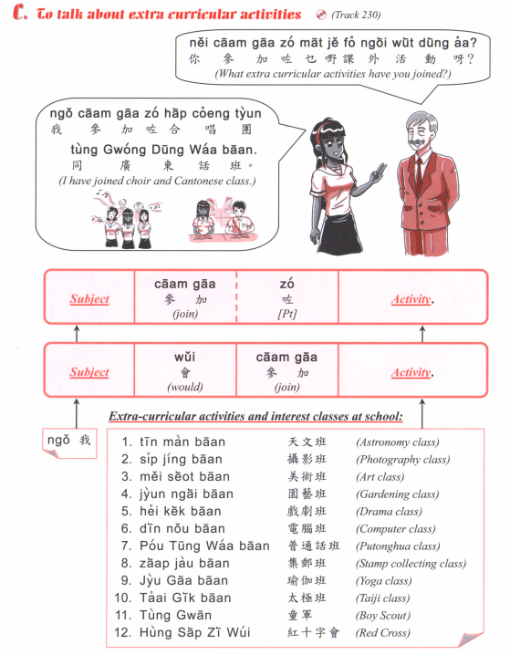

Slide 4
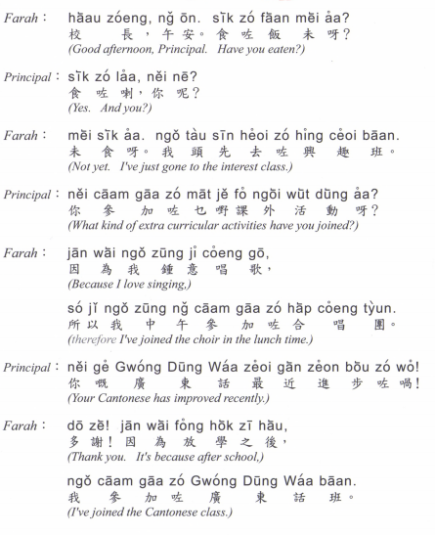
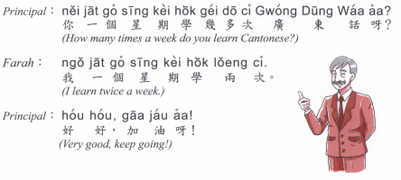

Slide 5
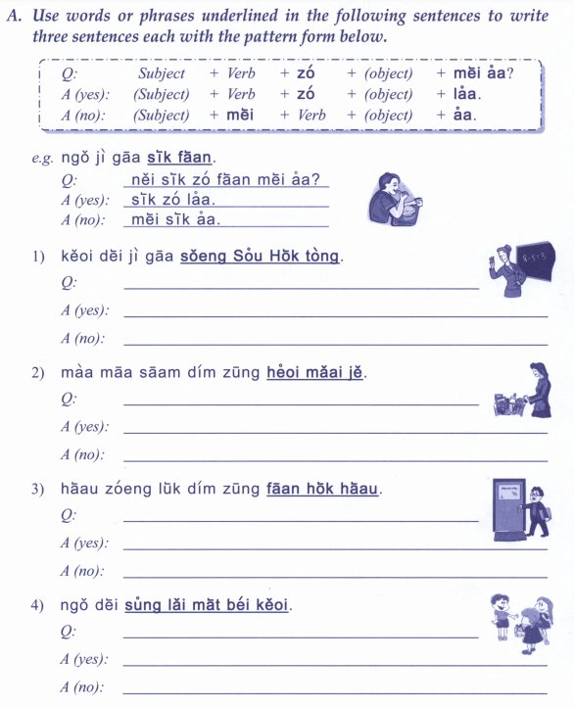
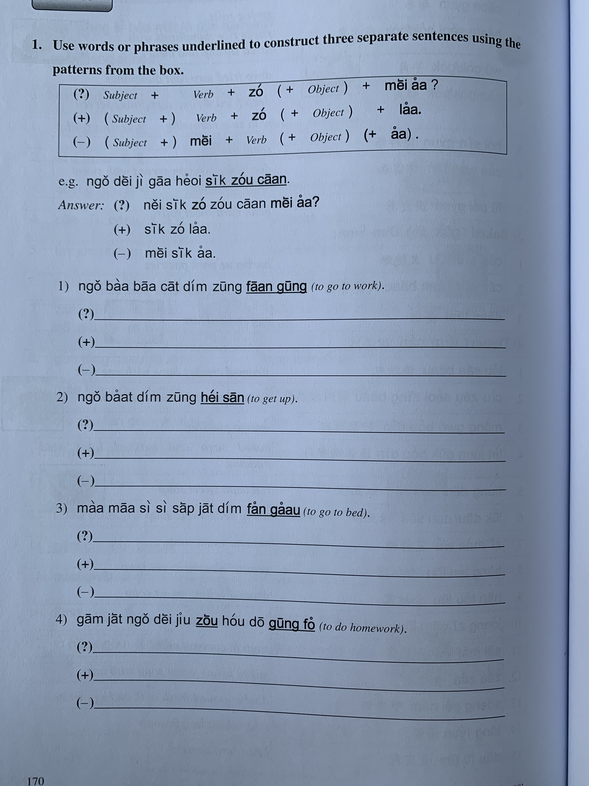
我宜家食飯
我爸爸七點鐘返工
佢地宜家上數學堂
我八點鐘起身
媽媽三點鐘去買嘢
媽媽時時十一點訓覺
校長六點鐘返學校
今日我地要做好多功課
我地送禮物畀佢

Slide 6
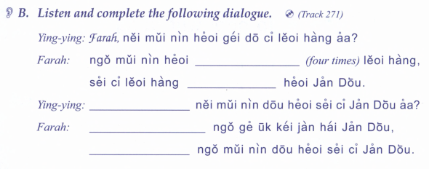
你每年去幾多次旅行呀？
我每年去
旅行
四次旅行
去印度
你每年都去四次印度呀？
我既屋企人喺印度
我每年都去四次印度

Slide 7
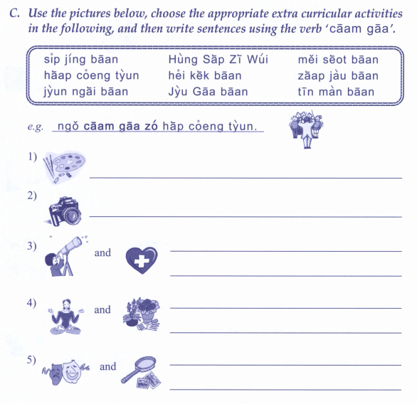
紅十字會
攝影班
美術班
合唱團
戲劇班
集郵班
園藝班
瑜珈班
天文班
我參加咗合唱團

Slide 8
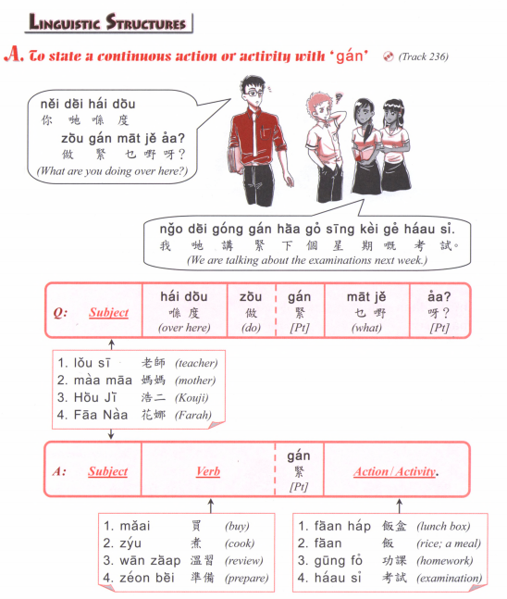

Slide 9
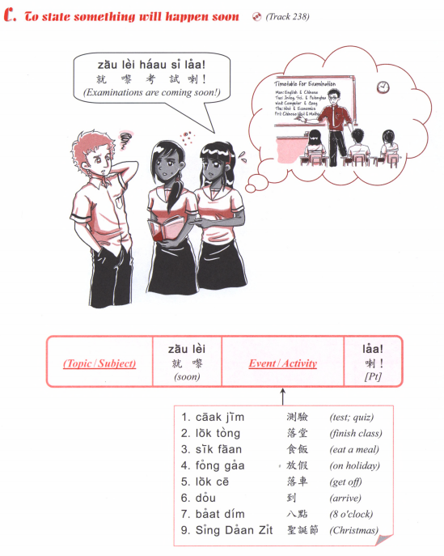
食咗飯
食緊飯
就黎食飯
會食飯

Slide 10
Listening
How did I describe last week?
What did I do on Saturday?
What did I do on Sunday?
What will I do tomorrow?

Slide 11
I will have exam soon. （haau2 si3）
I will have vacation soon. (fong3 gaa3)
3. What is he doing?
He is reading. (tai2 syu1)
4. What are you doing?
I am going to the university. (daai6 hok6)
5. What are you eating?
I am eating noodles. (min6)
6. What will you do this weekend?
I will go to the park. (gung1 jyun2)
7. What book did you read?
I read XXX.
8. How long have you been learning Mandarin?
I have been learning for X years.
9. Have you done your homework?
I am doing it!
10. We are having Cantonese lesson

Slide 12
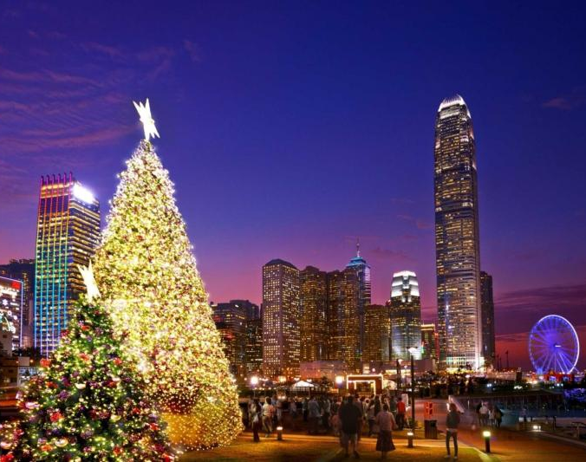
Christmas 聖誕節 sing3 daan3 zit3
Merry Christmas 聖誕快樂
sing3 daan3 faai3 lok6

Slide 13
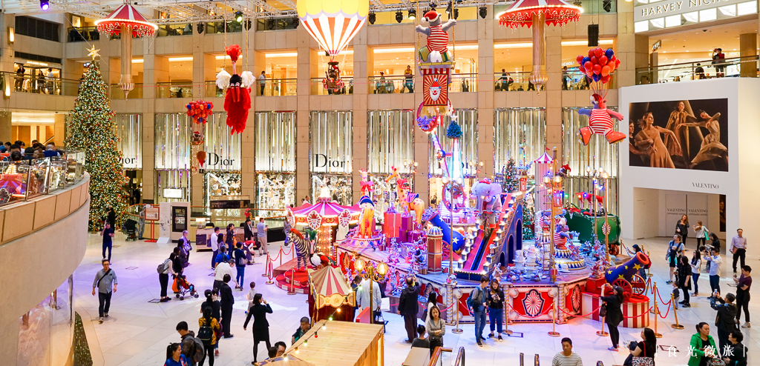
To see Christmas decorations
睇聖誕裝飾
tai2 sing3 daan3 zong1 sik1

Slide 14
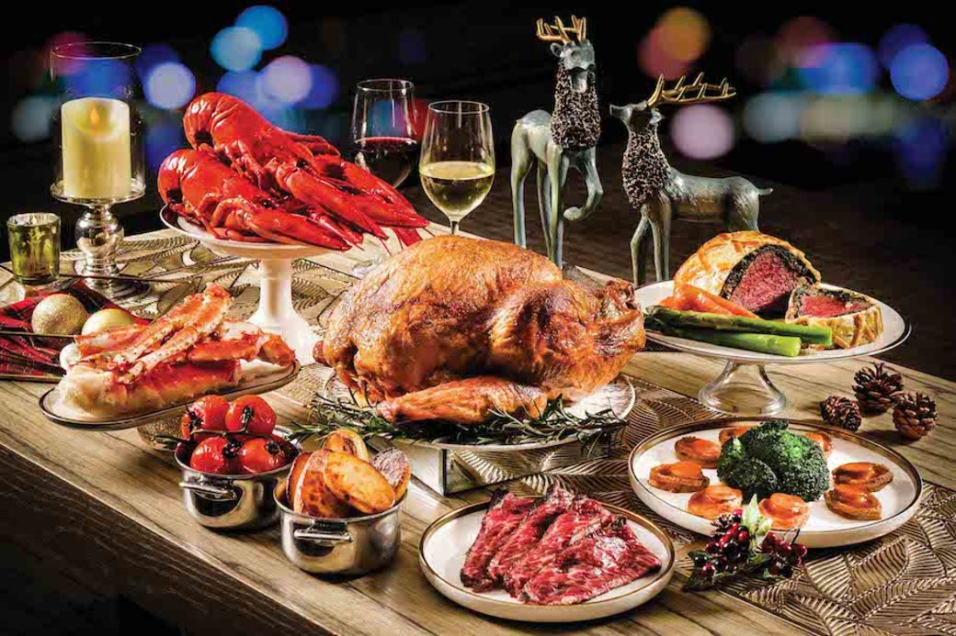
To have a Christmas feast
食聖誕大餐
sik6 sing3 daan3 daai6 caan1

Slide 15
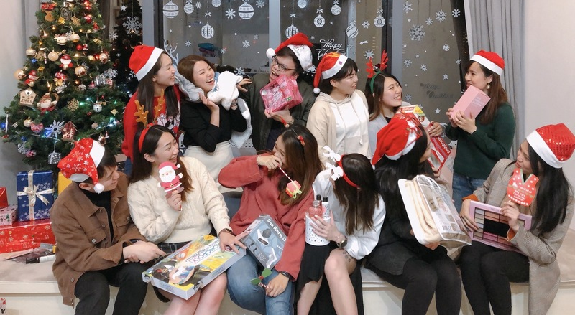
To exchange gifts
交換禮物 gaau1 wun6 lai5 mat6
聖誕party （派對）
sing3 daan3 party （paai3 deoi）

Slide 16
Ask about each other’s plan for Christmas

Slide 17
What you like to do in your spare time?
nei5 dak1 haan4 zung1 ji3 zou6 mat1 je5 aa3?
Where you want to go when traveling is normal again (we learned how to say "want to" during the last lesson)
nei5 soeng2 heoi3 bin1 dou6 leoi5 hang4?
What stores/ facilities you have near your home
nei5 uk1 kei2 fu6 gan6 jau5 mat1 je5 aa3?

