Slide 1
Cantonese I
Week 13
Ngo5 jyun4 sem laa3

Slide 2
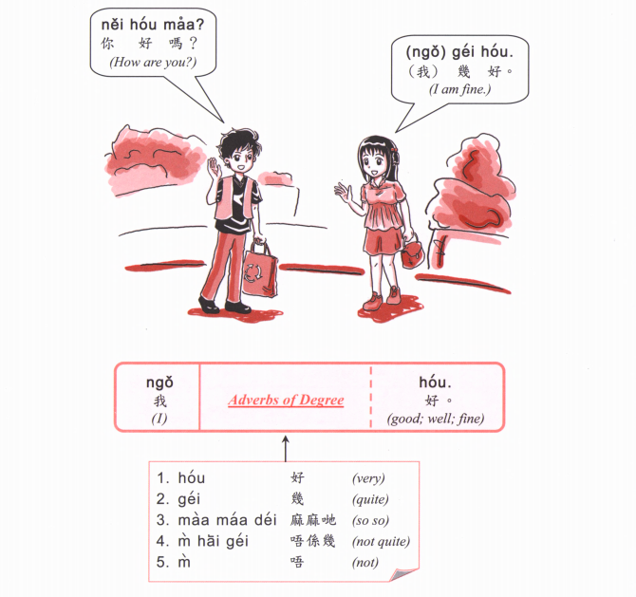
Nei5 zeoi3 gan6 dim2 aa3 ？
你最近點呀？
(How are you lately?)

Slide 3
OR
Nei5 giu3 me1 meng2 aa3?
你叫咩名呀？

Slide 4
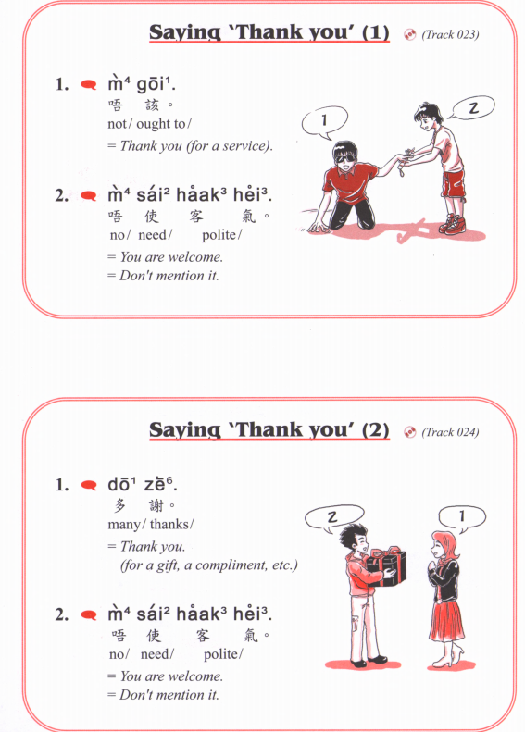

Slide 5
What is your phone numer? 你電話幾多號？nei5 din6 waa2 gei2 do1 hou6?
My phone number is 我嘅電話係XXXXX ngo5 ge3 din6 waa2 hai6 XXXXX

Slide 6
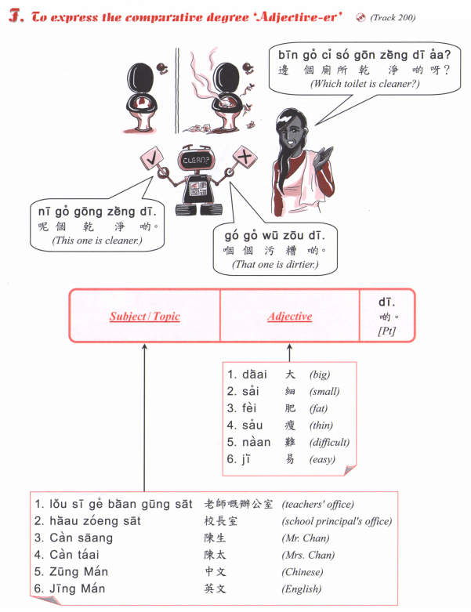

Slide 7
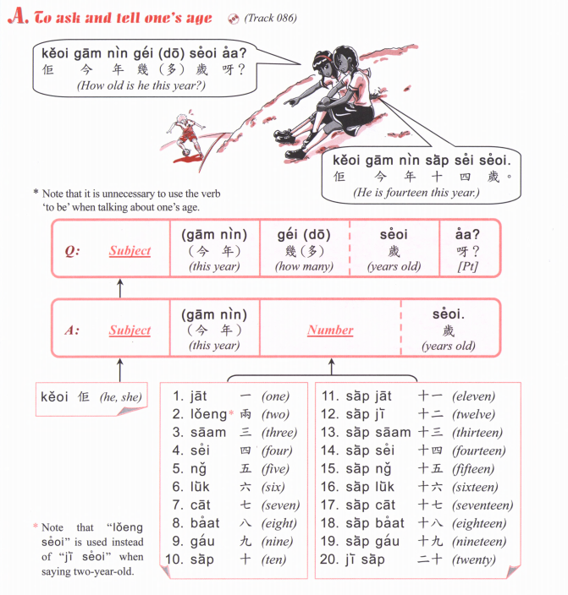

Slide 8
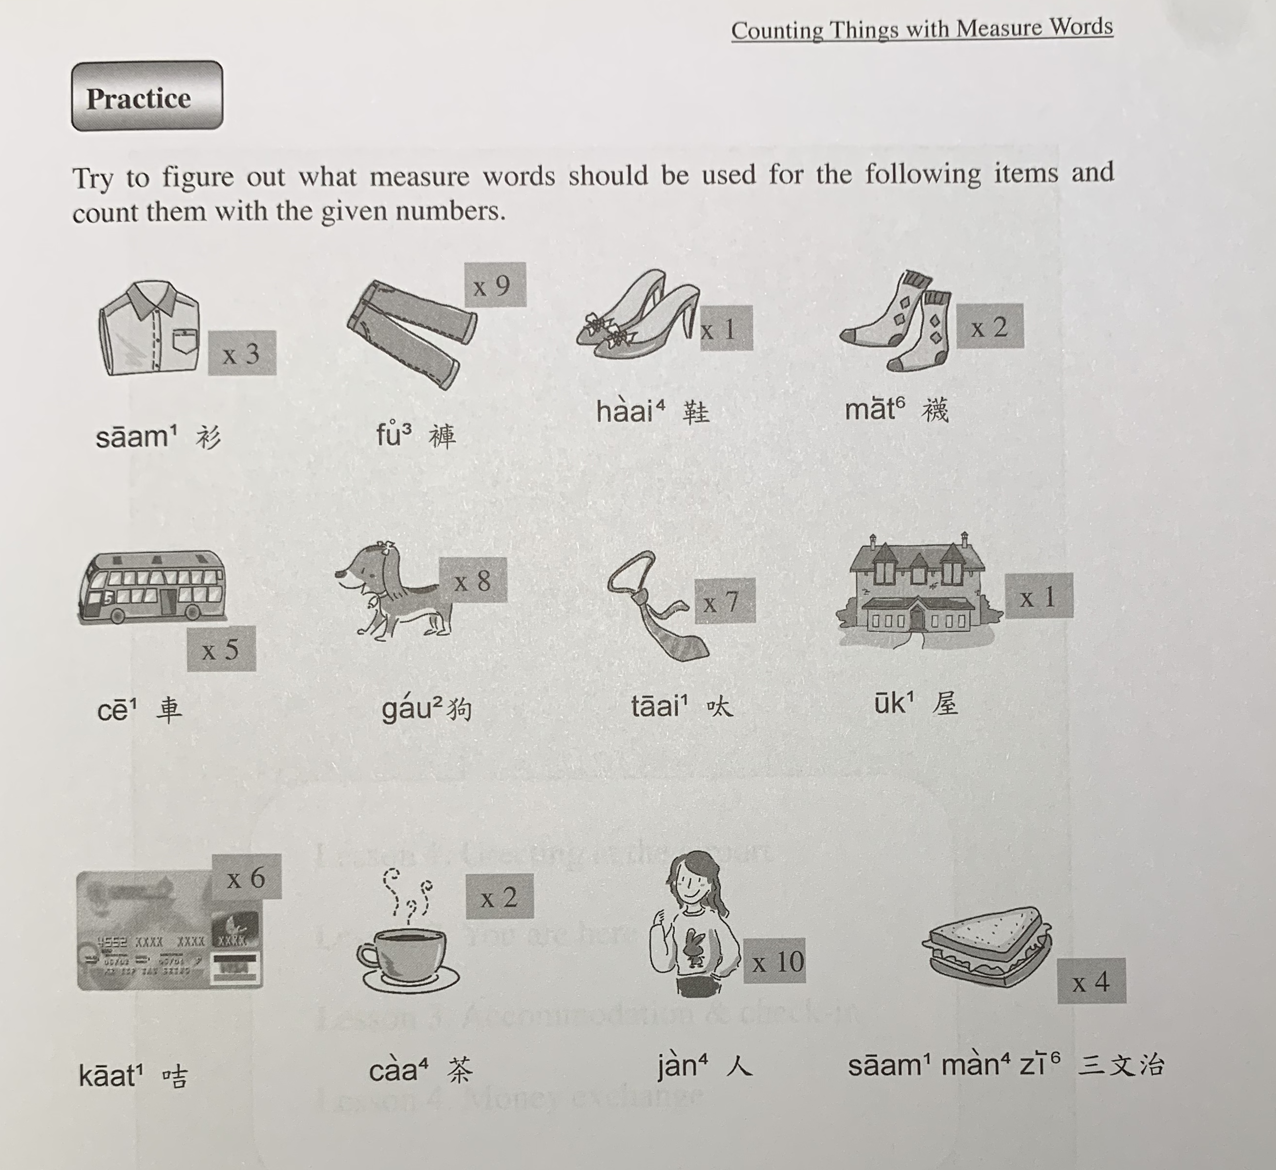
$1423
$540.8
$63.2
$160
tiu4
gin6
deoi3
deoi3
$345.4
$6345
$899.9
$3,700,000
zek3
tiu4
gaan1
gaa3
$26.9
$45
$57
bui1
go3
fan6
zoeng1

Slide 9
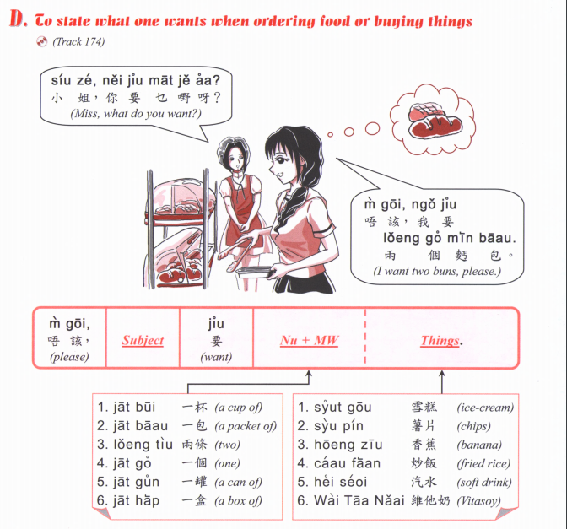

Slide 10
Zing-zing:
M4 goi1, ngo5 jiu3 A, B tung4 C
唔該，我要 A，B 同 C
(Excuse me, I want A, B and C)
Cashier:
Nei5 ge3
你嘅
(Here you go)
Zing-zing:
m4 goi1, zoi3 gin3
唔該，再見
(Thank you, goodbye)

Slide 11
Zou2 caan1 | 早餐 | Breakfast
Zung1 ng5 faan6 | 中午飯 | Lunch
Haa6 ng5 caa4 | 下午茶 | Afternoon tea
Maan5 faan6 | 晚飯 | Dinner
sik6
食
To eat

Slide 12
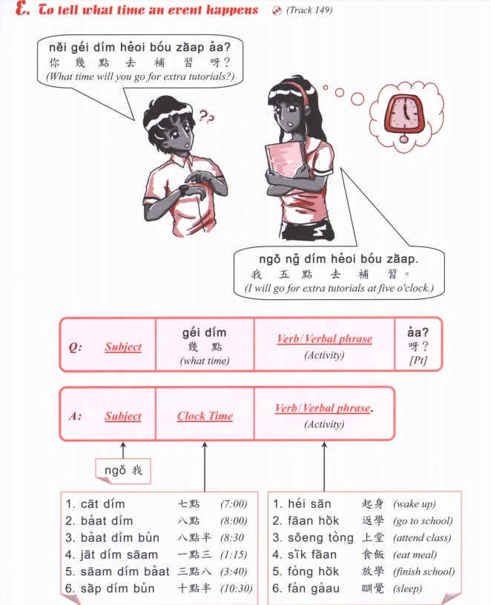

Slide 13
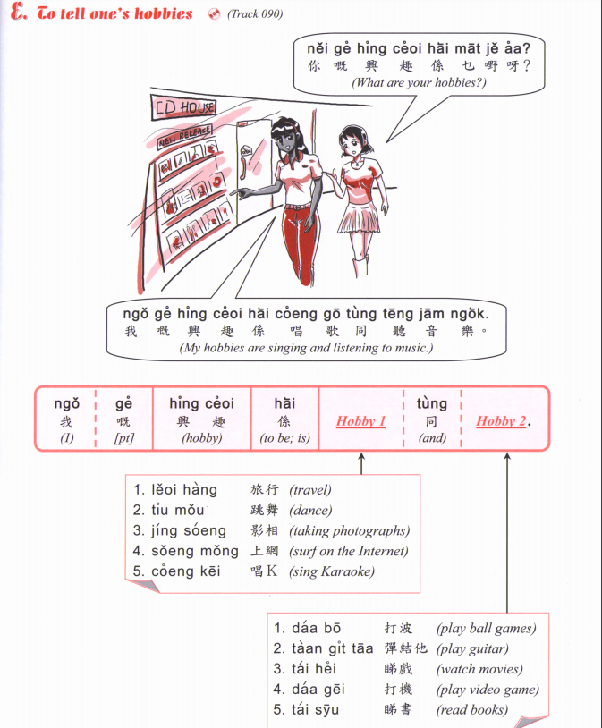
Jau4 seoi2
游水
swimming
Zou6 gym
做gym
Go to the gym
Gin6 san1
健身
Go to the gym
Zyu2 je5 sik6
煮嘢食
Cooking
Haang4 saan1
行山
Hiking
Caai2 daan1 ce1
踩單車
Cycling
Teng1 jam1 ngok6
聽音樂
Listen to music

Slide 14
Jau4 seoi2
游水
swimming
Zou6 gym
做gym
Go to the gym
Gin6 san1
健身
Go to the gym
Zyu2 je5 sik6
煮嘢食
Cooking
Haang4 saan1
行山
Hiking
Caai2 daan1 ce1
踩單車
Cycling
Teng1 jam1 ngok6
聽音樂
Listen to music
A: Nei5 zung1 m4 zung1 ji3 XXXX aa3?
B: Ngo5 (hou2) zung1 ji3 XXXXX
OR
Ngo5 (hou2) m4 zung1 ji3 XXXX
Coi3 ce1
賽車
Car racing

Slide 15
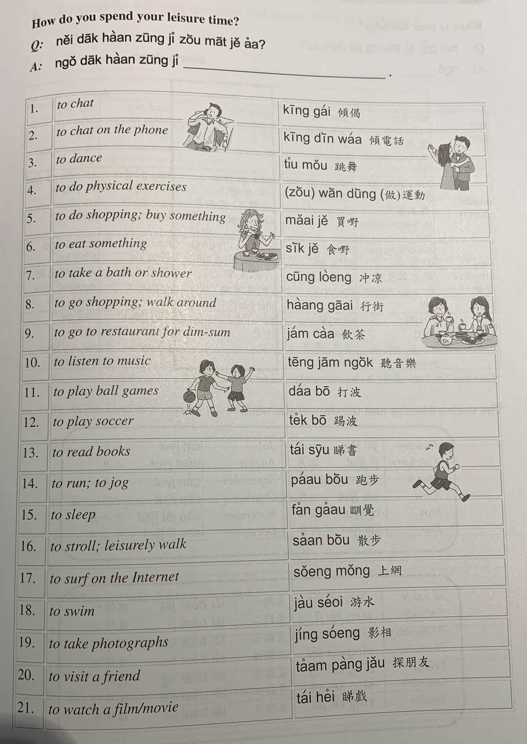

Slide 16
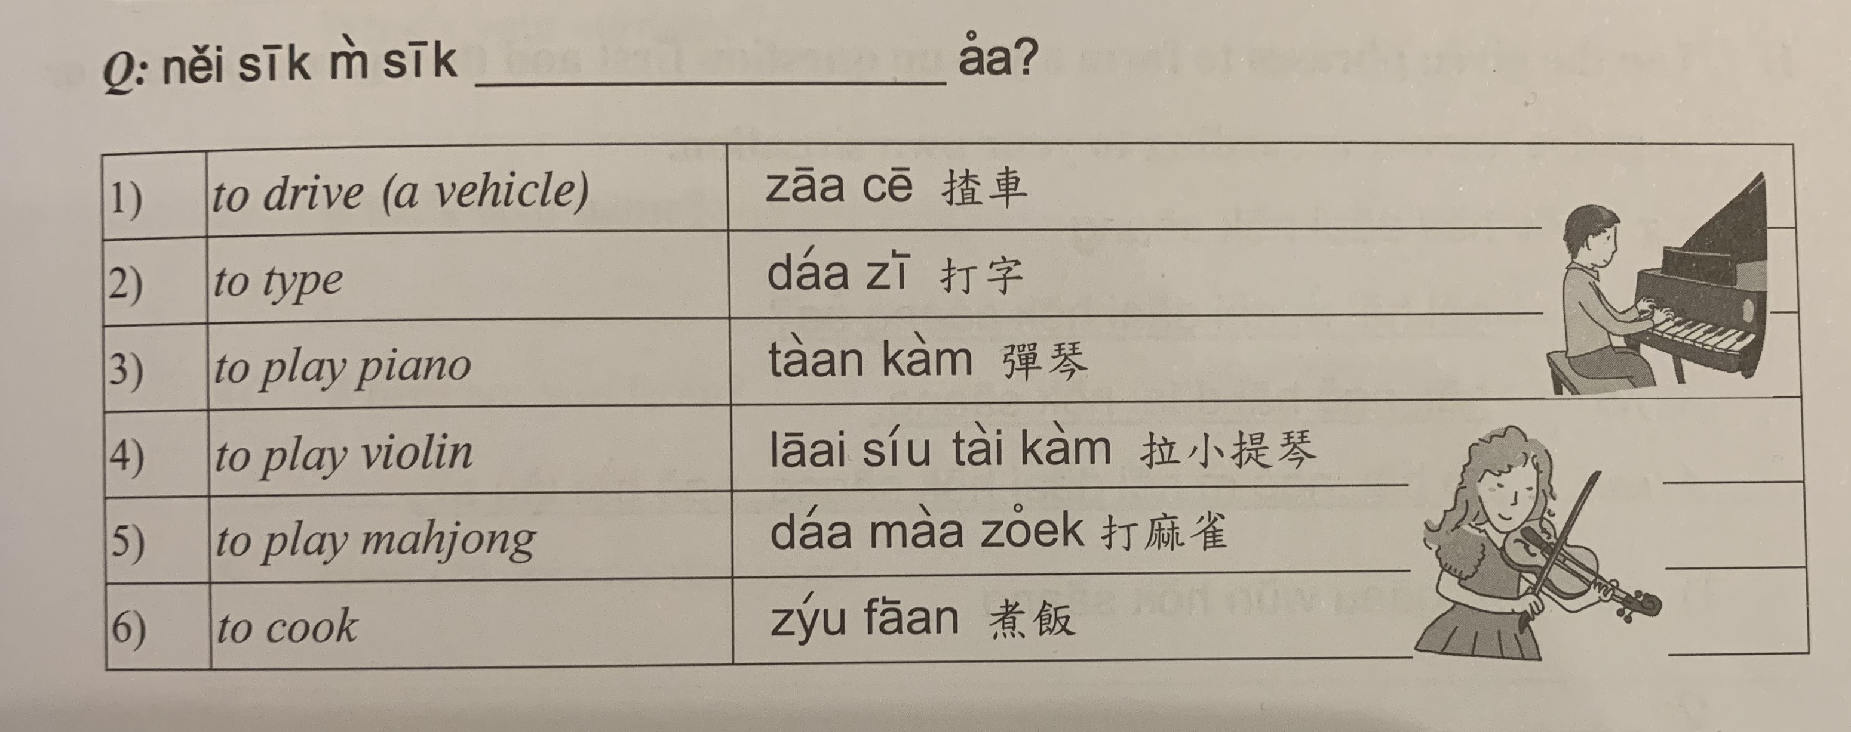
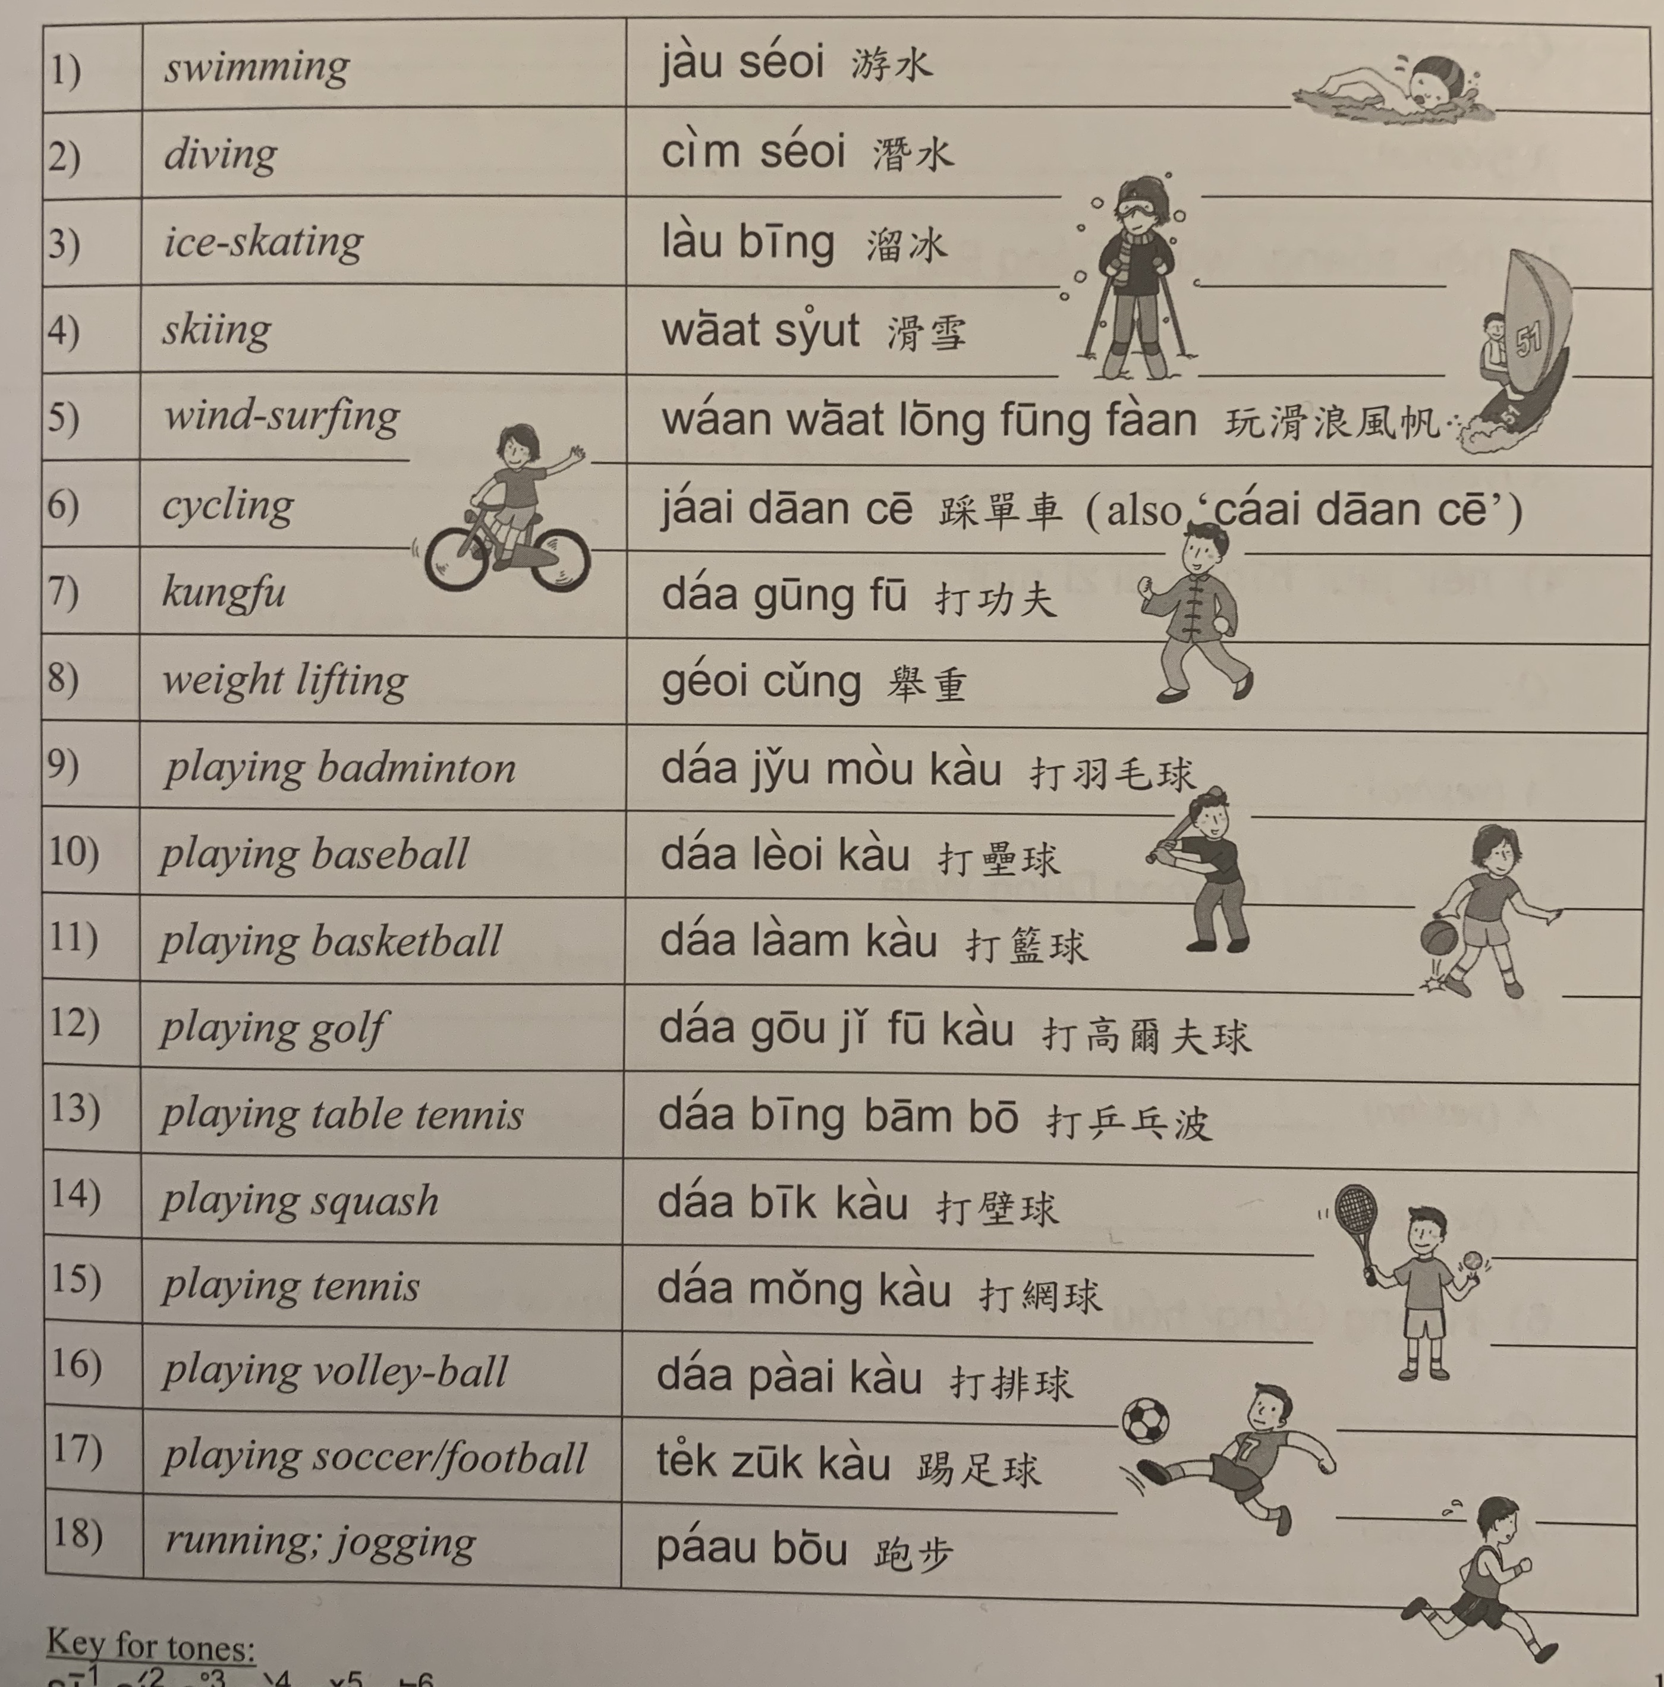

Slide 18
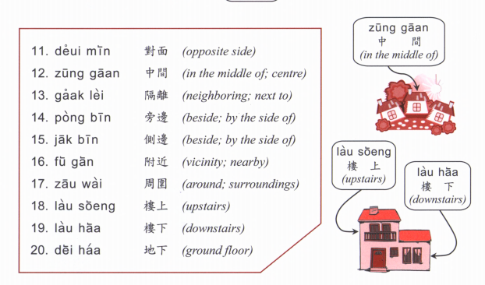

Slide 19
Where is (place)? (Place) + hai2 bin1 dou6 aa3? 喺邊度呀？
Hok6 haau6
Tou4 syu1 gun2
Ting4 ce1 coeng4
wan6 dung6 coeng4
Yi1 jyun2
Fei1 faat3 pou3
Soeng1 coeng4
Zau2 baa1
Ciu1 kap1 si5 coeng4
ngan4 hong4
Joek6 fong4
Caan1 teng1
Answer： (Place) hai2 (Place B) (position word)

Slide 20
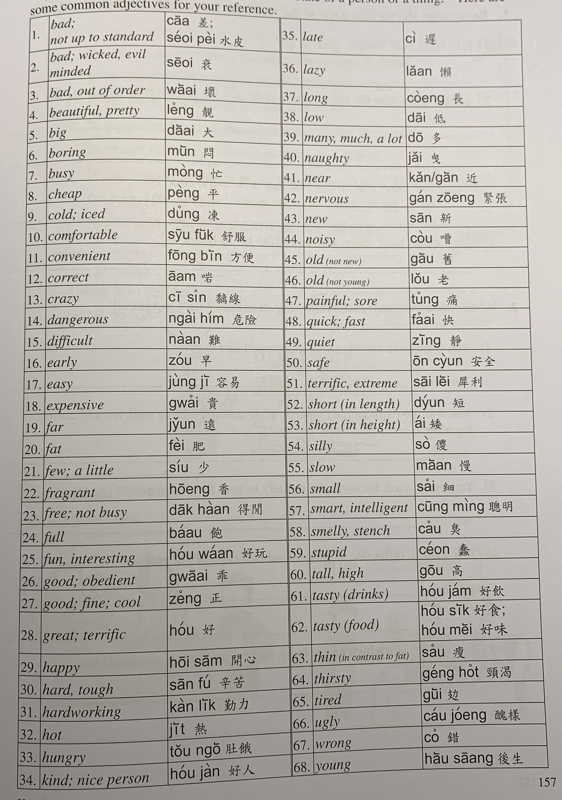

Slide 21
邊個 | Who | Bin1 go6
咩 / 乜嘢 | what | Me1 / Mat1 je5
邊度 | Where | Bin1 dou6
幾多 | How many/ much | Gei2 do1
幾時 | When | Gei2 si4
點解 | Why | dim2 gaai2
因為 | Because | jan1 wai6
鍾意 | To like | zung1 ji3 | m4 zung1 ji3
識 | To know (a skill, a person | sik1 | m4 sik1
知 | To know (information, news) | zi1 | m4 zi1
明白 /明 | To understand | ming5 baak6 / ming5 | M4 ming5 baak6 / M4 ming5
去 | To go | heoi3 | m4 heoi3
有 | To have | jau5 | Mou5 (冇)
要 | To want (object) / have to (do something) | jiu3 | M4 jiu3 (for object)/ M4 sai2 (for action)
想 | To want (to do something) | soeng2 | M4 soeng2
講 | To speak | gong2 | M4 gong2
做 | To do | zou6 | M4 zou6
覺得 | To think (feeling/opinion) | Gok3 dak1 | M4 gok3 dak1
溫習 | To revise | Wan1 zaap6 | M4 wan1 zaap6

Slide 22
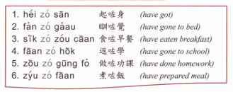
Question: [Verb] zo2 [object] mei6 aa3?
Answer: [Subject] [verb] zo2 [object] laa3.
OR [subject] mei6 [verb] aa3.

Slide 23
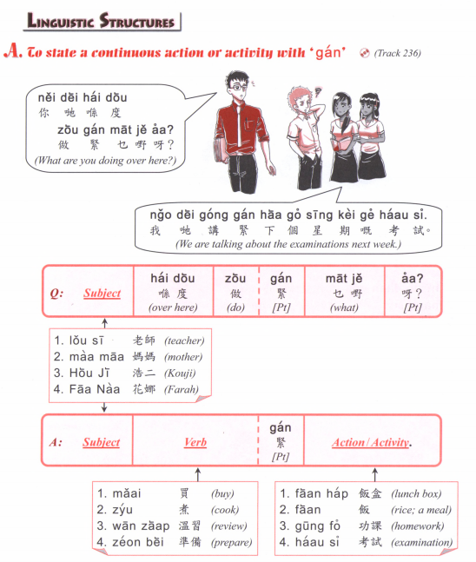

Slide 24
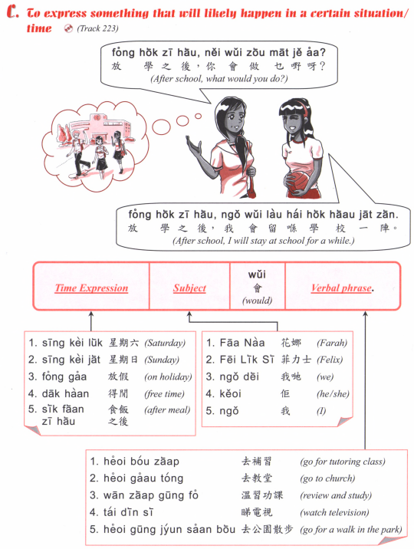

Slide 25
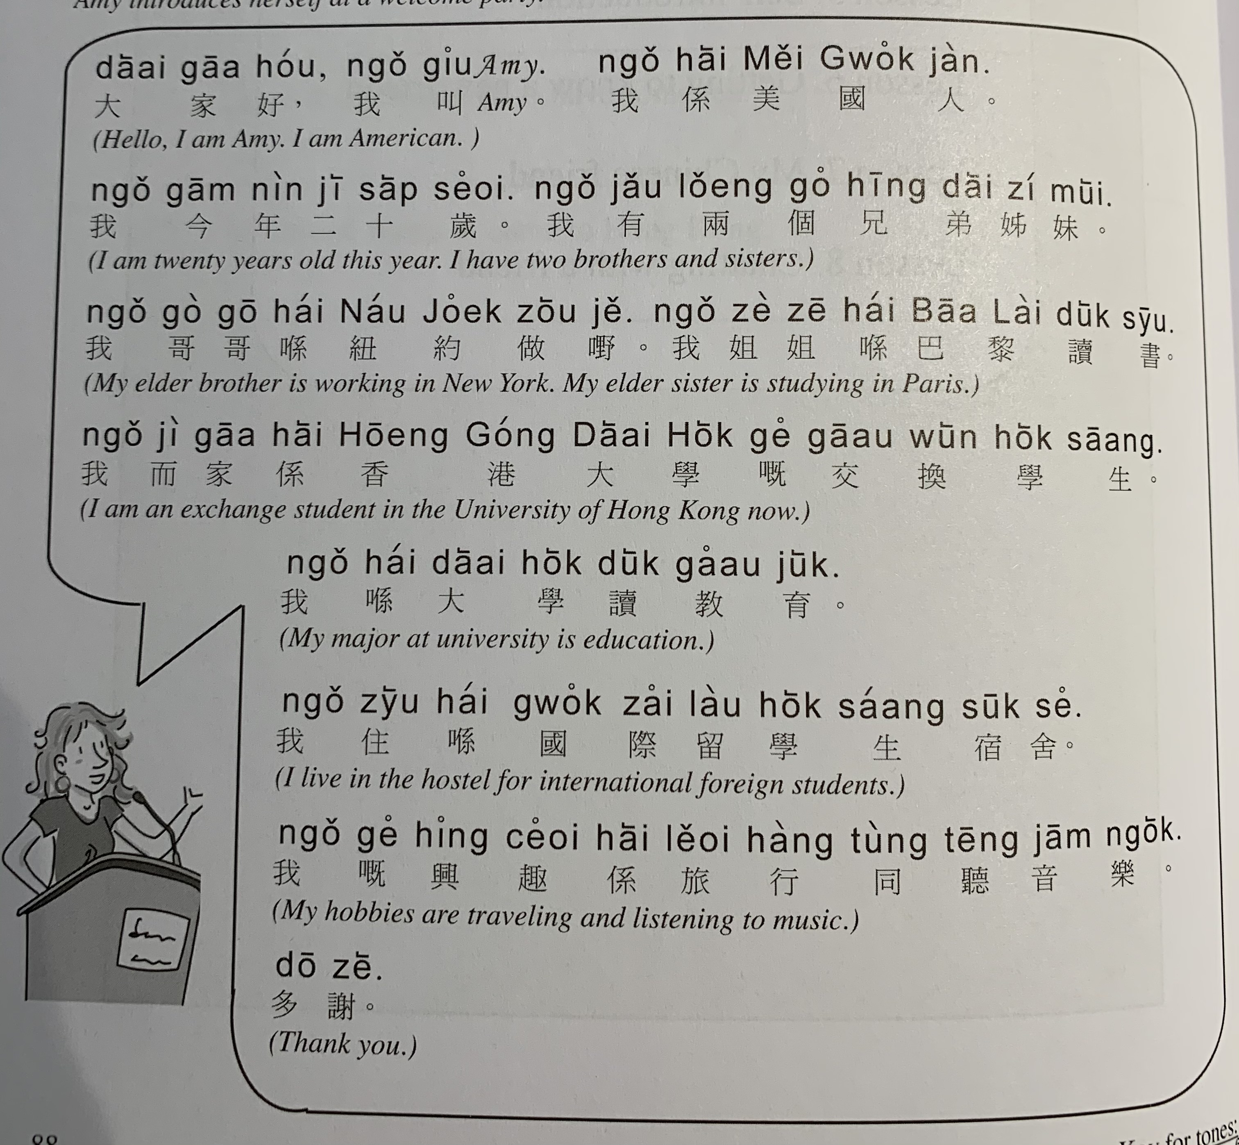

Slide 26
What you like to do in your spare time?
nei5 dak1 haan4 zung1 ji3 zou6 mat1 je5 aa3?
Where do you want to travel to? Why?
nei5 soeng2 heoi3 bin1 dou6 leoi5 hang4 aa3? Dim2 gaai2 aa3?
What stores/ facilities do you have near your home?
nei5 uk1 kei2 fu6 gan6 jau5 mat1 je5 aa3?
What have you done last weekend?
nei5 zau1 mut6 zou6 zou6 di1 me1 aa3?

Slide 27
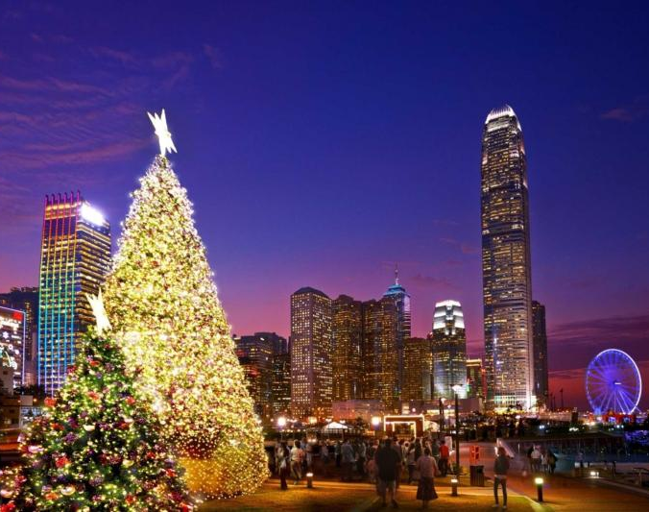
Christmas 聖誕節 sing3 daan3 zit3
Merry Christmas 聖誕快樂
sing3 daan3 faai3 lok6

Slide 28
sing3 daan3 go1
噢 聖誕節托它歸家 我阿媽話幾貴㗎
o1 sing3 daan3 zit3 tok3 taa1 gwai1 gaa1 ngo5 aa3 maa1 waa6 gei2 gwai3 gaa3 噢 聖誕節托它歸家 放喺廳度閃閃吓
o1 sing3 daan3 zit3 tok3 taa1 gwai1 gaa1 fong3 hai2 teng1 dou6 sim2 sim2 haa5 聖誕樹啲膠氣幾臭㗎 我阿爸貪佢夠呀咋
sing3 daan3 syu6 di1 gaau1 hei3 gei2 cau3 gaa3 ngo5 aa3 baa4 taam1 keoi5 gau3 aa3 zaa3 噢 聖誕節托它歸家 放系廳度幾靚架
o1 sing3 daan3 zit3 tok3 taa1 gwai1 gaa1 fong3 hai6 teng1 dou6 gei2 leng3 gaa3
https://www.youtube.com/watch?v=nQdS8GycRt0

