Slide 1
Cantonese I
Week 2

Slide 2
19 Initials

Slide 4
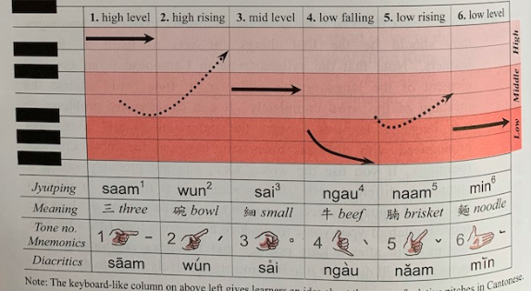

Slide 7
zeoi3 gan6 dim2 aa3?
最近點呀？
How are you lately?

Slide 8
Nei5 ne1？
你呢？
And you?
Nei5 giu3 me1 meng2
你叫咩名
What is your name?
English | Cantonese | Jyutping
Thank you | 多謝 | Do¹ ze⁶
Student | 學生 | hok⁶ saang¹

Slide 9
呀 （aa3）
1. Sentence-final particle for softening statements or questions.
OR
Nei5 giu3 me1 meng2 aa3?
你叫咩名呀？

Slide 10
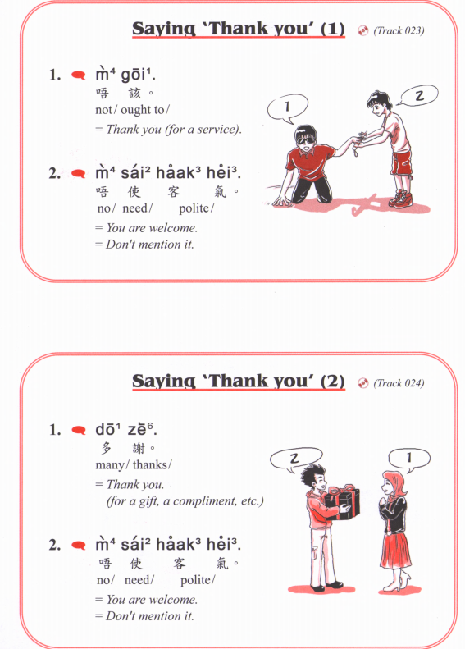

Slide 11
靚女 (pretty girl)
leng³ neoi²
靚仔 (handsome guy)
leng³ zai²
zit6 hak1 捷克 Czech Republic
si1 lok3 fat6 hak1 斯洛伐克 Slovakia

Slide 12
He/ she/ it
佢
keoi⁵
可愛 (cute)
ho² oi³
得意 (cute)
dak¹ ji³
靚 (beautiful)
leng³
醜 (ugly)
cau²

Slide 13
He/ she/ it
佢
keoi⁵
Young
細個
sai³ go³
後生
hau⁶ saang¹
年青
nin⁴ cing¹
Old
成熟 (mature)
sing⁴ suk⁶
老 (old)
lou⁵

Slide 14
He/ she/ it
佢
keoi⁵
高 (Tall)
gou¹
矮 (Short)
ai²
肥 (Fat)
fei⁴
瘦 (Thin)
sau³

Slide 15
He/ she/ it
佢
keoi⁵
開心 (happy)
hoi¹ sam¹
唔開心 (sad)
m⁴ hoi¹ sam¹
傷心 (heart broken)
soeng¹ sam¹
嬲 (angry)
nau¹

Slide 16
He/ she/ it
佢
keoi⁵
聰明 (clever)
cung¹ ming⁴
叻 (smart)
lek¹
蠢 (stupid / dumb)
ceon²

Slide 17
Describe your favourite cartoon character/ animal/ anyone

Slide 18
je⁴ je²
maa⁴ maa⁴
gung¹ gung¹
po⁴ po²
Father
Mother
baa⁴ baa¹
maa⁴ maa¹
老母 lou⁵ mou²
lou⁵ dau⁶
maa¹ mi⁴
zoeng⁶ fu¹
ze⁴ ze¹
Sister-in-law
Brother-in-law
aa³ sou²
go⁴ go¹
taai³ taai²
ze² fu¹
mui6 fu1
dai⁶ fu⁵
dai⁴ dai²
mui⁴ mui²
san¹ pou⁵
neoi⁵ sai³
zai²
neoi²
ngoi⁶ syun¹ neoi²
syun¹ zai²
syun¹ neoi²
ngoi⁶ syun¹

Slide 19
Video
https://www.youtube.com/watch?v=-ch2BCGwDGs&t=1535s
16:49

Slide 20
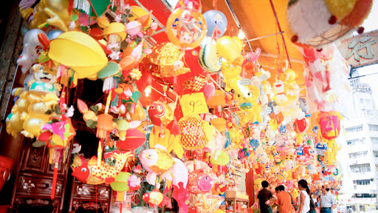
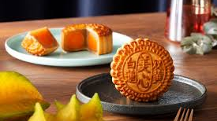
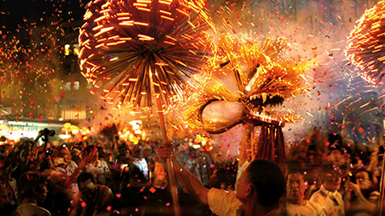
zung1 cau1 zit3 faai3 lok6
中秋節快樂
Happy Mid-Autumn Festival

