Slide 1
Cantonese I
Week 3
Movie: In the mood for love 花樣年華 faa1 joeng6 nin4 waa4

Slide 2
靚女 (pretty girl)
leng³ neoi²
靚仔 (handsome guy)
leng³ zai²
zit6 hak1 捷克 Czech Republic
si1 lok3 fat6 hak1 斯洛伐克 Slovakia

Slide 3
He/ she/ it
佢
keoi⁵
可愛 (cute)
ho² oi³
得意 (cute)
dak¹ ji³
靚 (beautiful)
leng³
醜 (ugly)
cau²

Slide 4
He/ she/ it
佢
keoi⁵
Young
細個
sai³ go³
後生
hau⁶ saang¹
年青
nin⁴ cing¹
Old
成熟 (mature)
sing⁴ suk⁶
老 (old)
lou⁵

Slide 5
He/ she/ it
佢
keoi⁵
高 (Tall)
gou¹
矮 (Short)
ai²
肥 (Fat)
fei⁴
瘦 (Thin)
sau³

Slide 6
He/ she/ it
佢
keoi⁵
開心 (happy)
hoi¹ sam¹
唔開心 (sad)
m⁴ hoi¹ sam¹
傷心 (heart broken)
soeng¹ sam¹
嬲 (angry)
nau¹

Slide 7
He/ she/ it
佢
keoi⁵
聰明 (clever)
cung¹ ming⁴
叻 (smart)
lek¹
蠢 (stupid / dumb)
ceon²

Slide 8
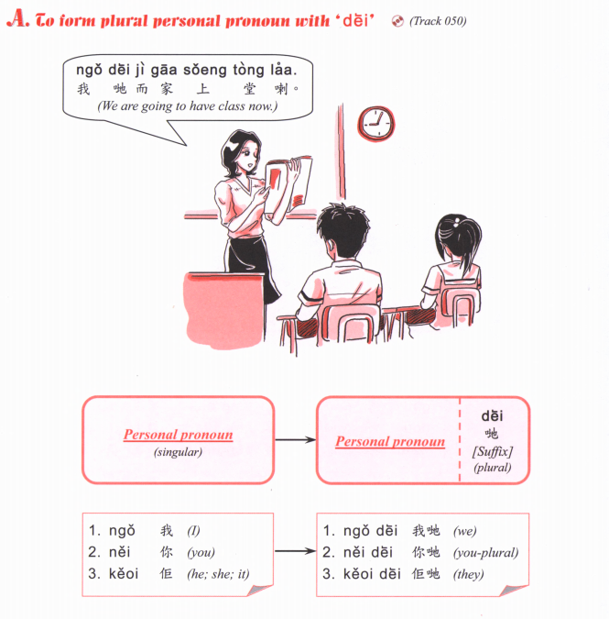

Slide 9
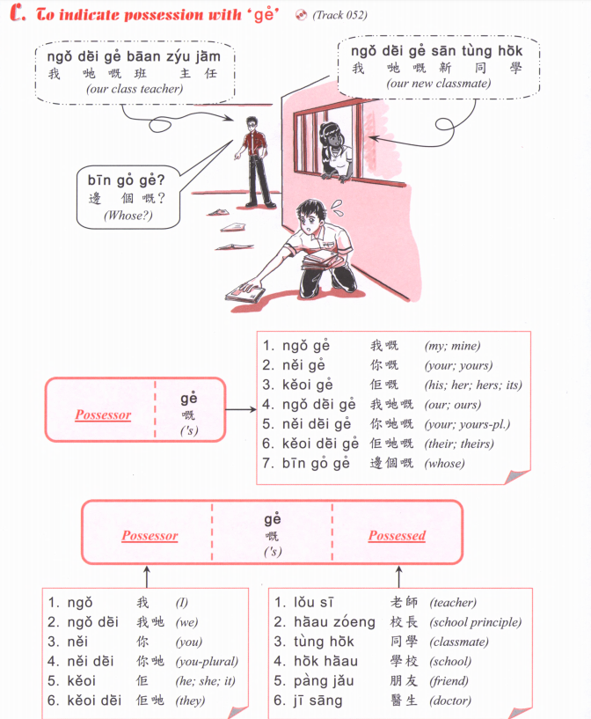

Slide 11
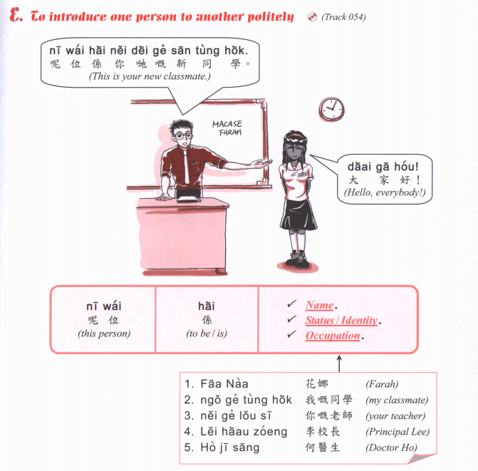

Slide 12
nei¹ go³
go² go³
嗰個
(that person/ that)

Slide 14
je⁴ je²
maa⁴ maa⁴
gung¹ gung¹
po⁴ po²
Father
Mother
baa⁴ baa¹
maa⁴ maa¹
老母 lou⁵ mou²
lou⁵ dau⁶
maa¹ mi⁴
zoeng⁶ fu¹
ze⁴ ze¹
Sister-in-law
Brother-in-law
aa³ sou²
go⁴ go¹
taai³ taai²
ze² fu¹
mui6 fu1
dai⁶ fu⁵
dai⁴ dai²
mui⁴ mui²
san¹ pou⁵
neoi⁵ sai³
zai²
neoi²
ngoi⁶ syun¹ neoi²
syun¹ zai²
syun¹ neoi²
ngoi⁶ syun¹

Slide 15
I am your 我係你嘅 Ngo⁵ hai⁶ nei⁵ ge³
She/he is my 佢係我嘅 Koei⁵ hai⁶ ngo⁵ ge³

Slide 16
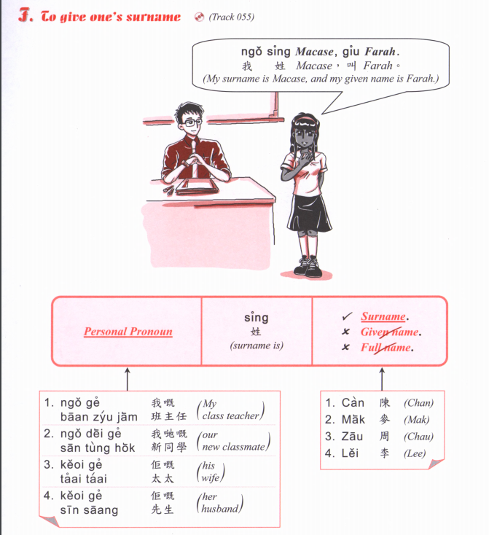

Slide 18
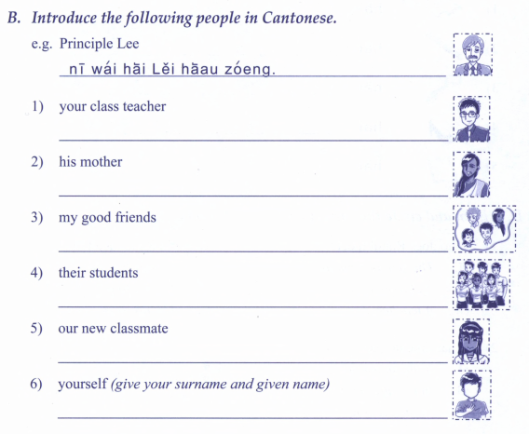

Slide 19
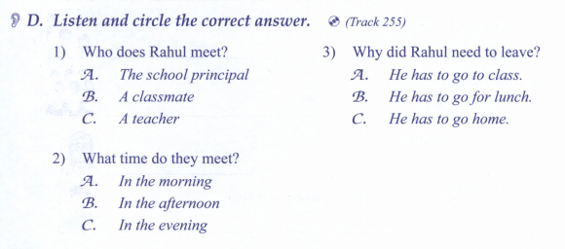

Slide 20
Cantonese Slangs

Slide 22
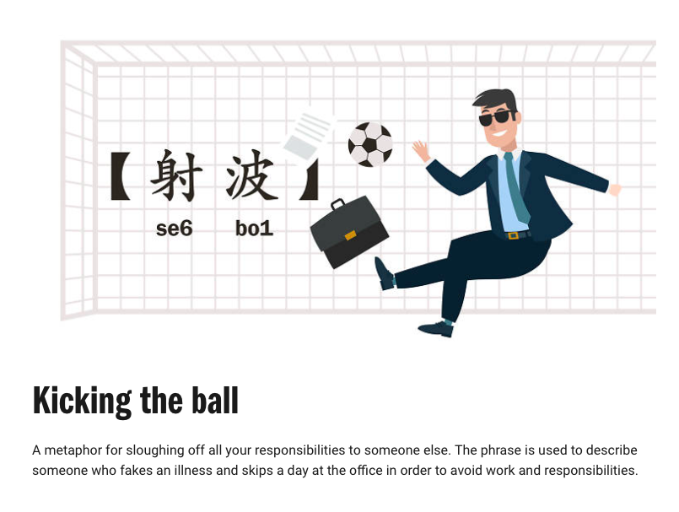

Slide 24
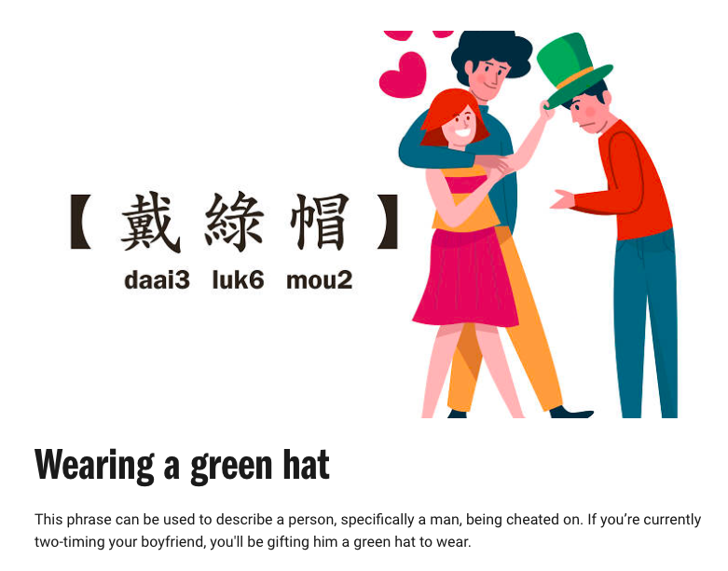

Slide 25
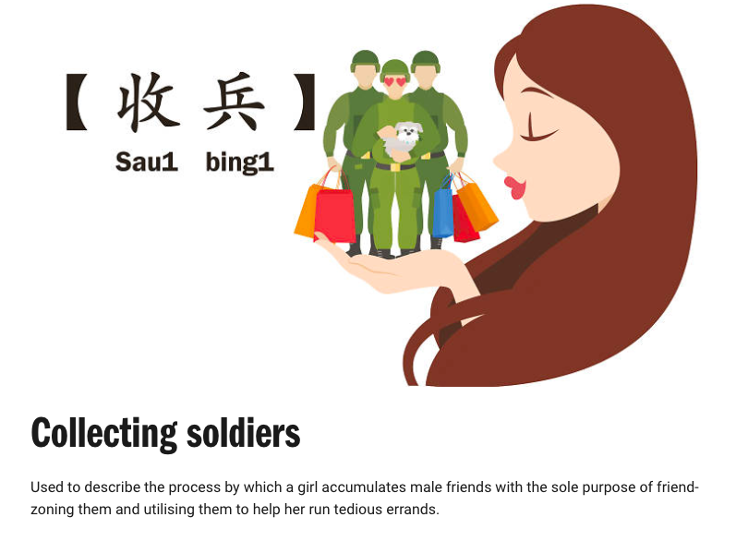

Slide 28
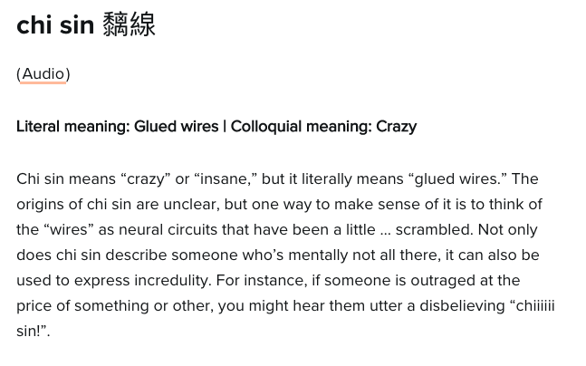
Jyutping: ci¹ sin³

Slide 30
Asking and answering yes/no questions

Slide 31
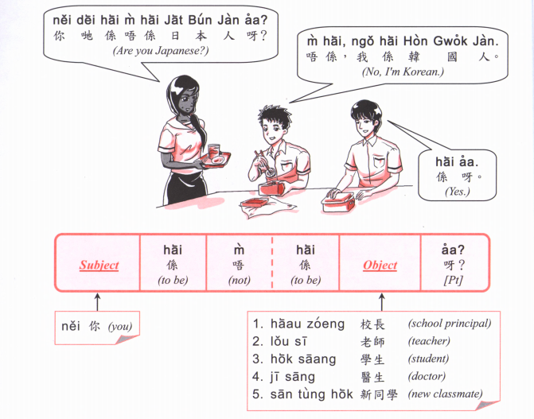
捷克 zit6 hak1
斯洛伐克 si1 lok6 fat6 hak1

Slide 32
zit6 hak1 捷克
si1 lok6 fat6 hak1 斯洛伐克

Slide 33
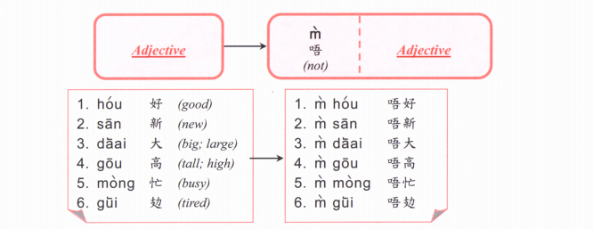

Slide 35
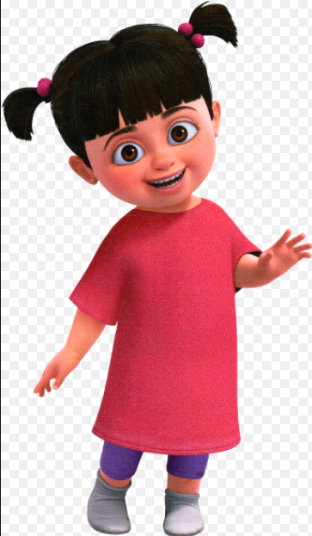
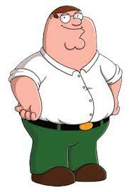
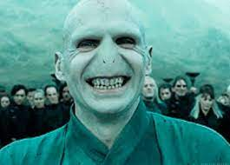
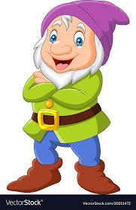
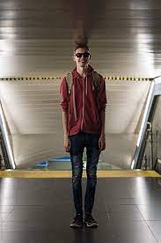
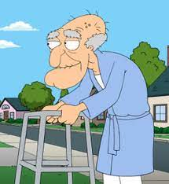
B
D
E
A
C
H
I
F
G

Slide 36
gwai² lou²
https://www.youtube.com/watch?v=A53JKmz307M

