Slide 1
Cantonese I
Week 5

Slide 2
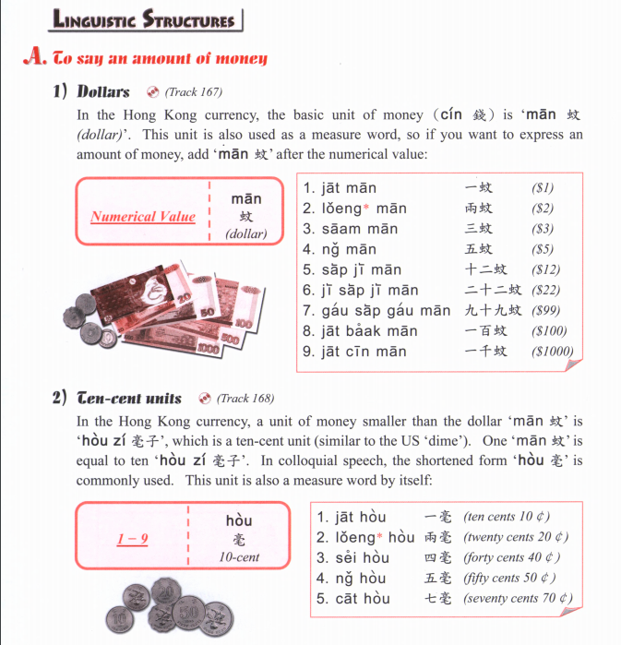
The use of the character 蚊 (mān) originate from the tone change of the currency denomination used in China in imperial times 文 (màn), which was the chief denomination until the introduction of the yuan in the late 19th century.

Slide 3
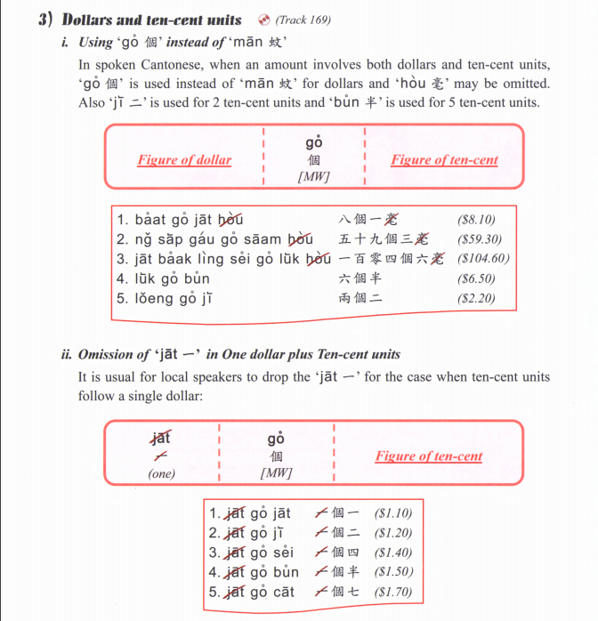

Slide 4
1) $364.3
2) $984.5
3) $1204
4) $260.2
5) $65.5
6) $83.9
7) $888.8
8) $29.9
9) $2.2
10) $510.7

Slide 5
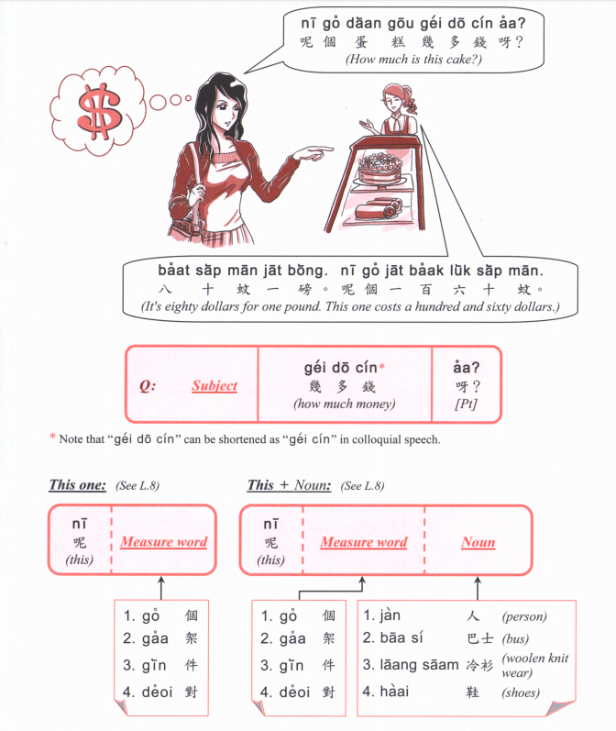

Slide 6
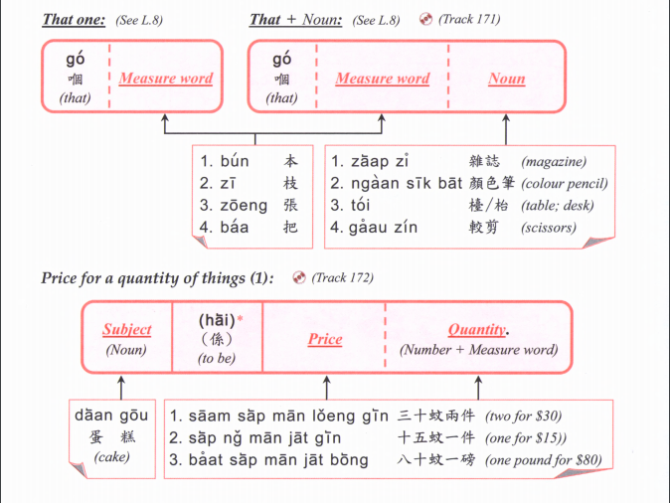

Slide 7
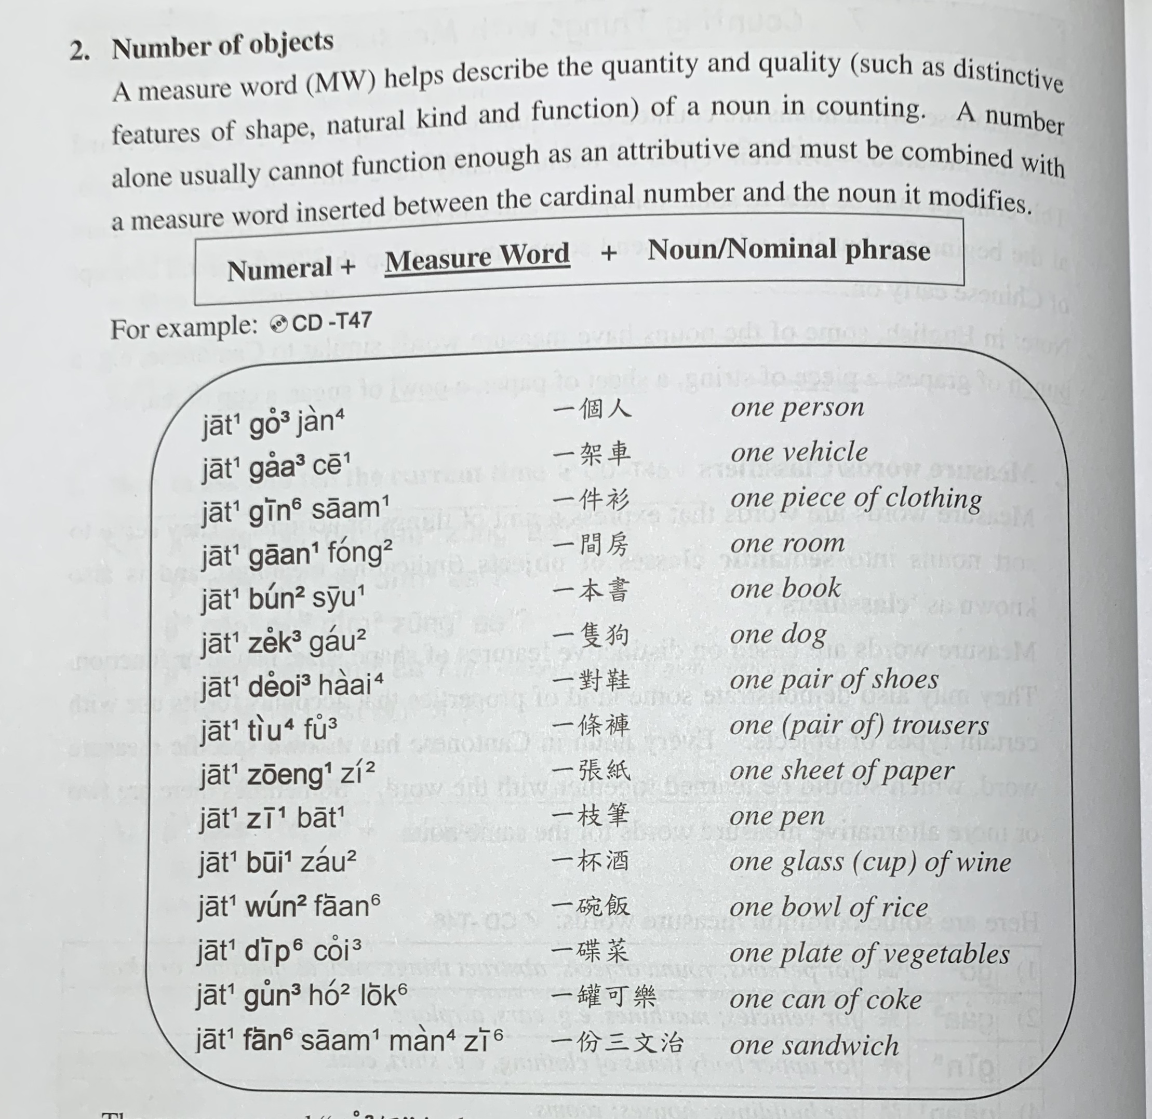

Slide 8
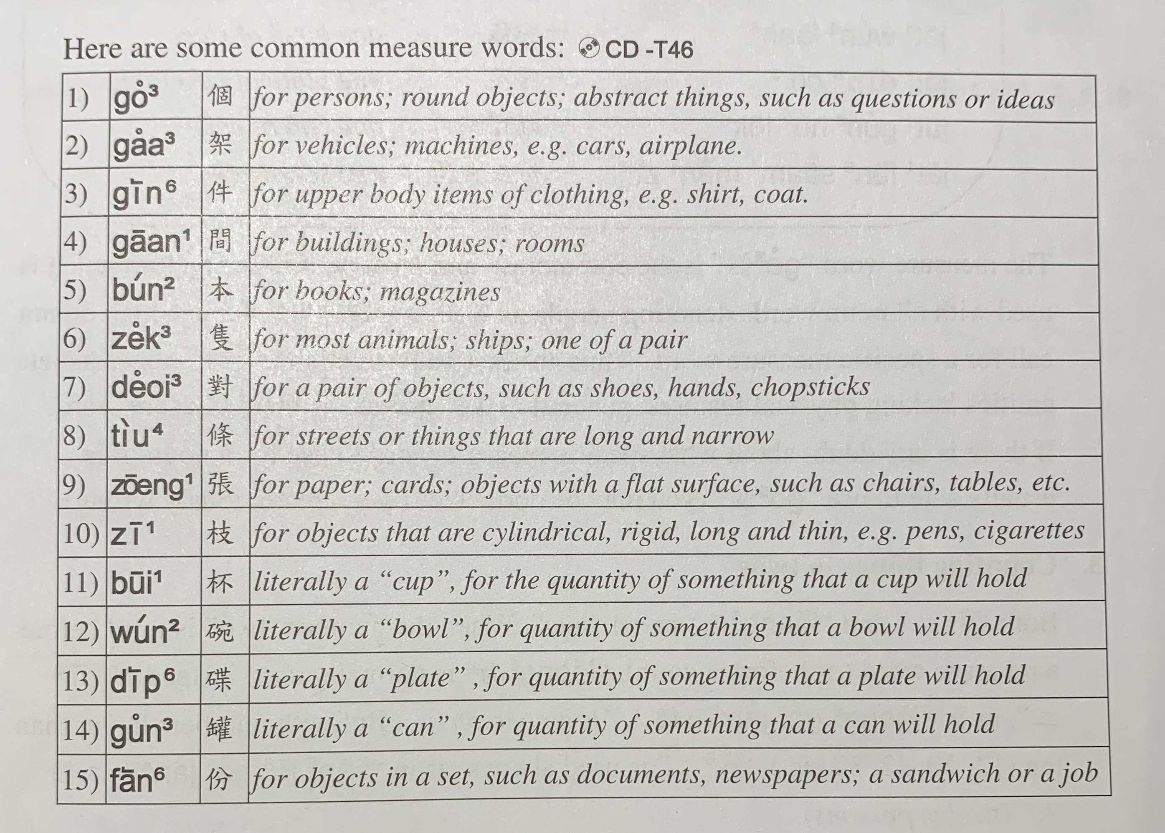

Slide 9
optional

Slide 10
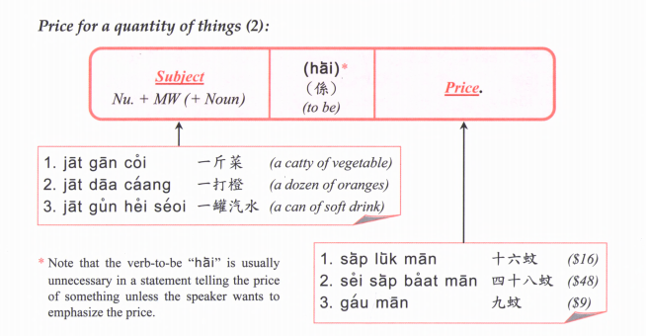
optional
Quantity +

Slide 11
Price for a quantity of things (3):
Subject + quantity + Price
Banana one $2

Slide 13
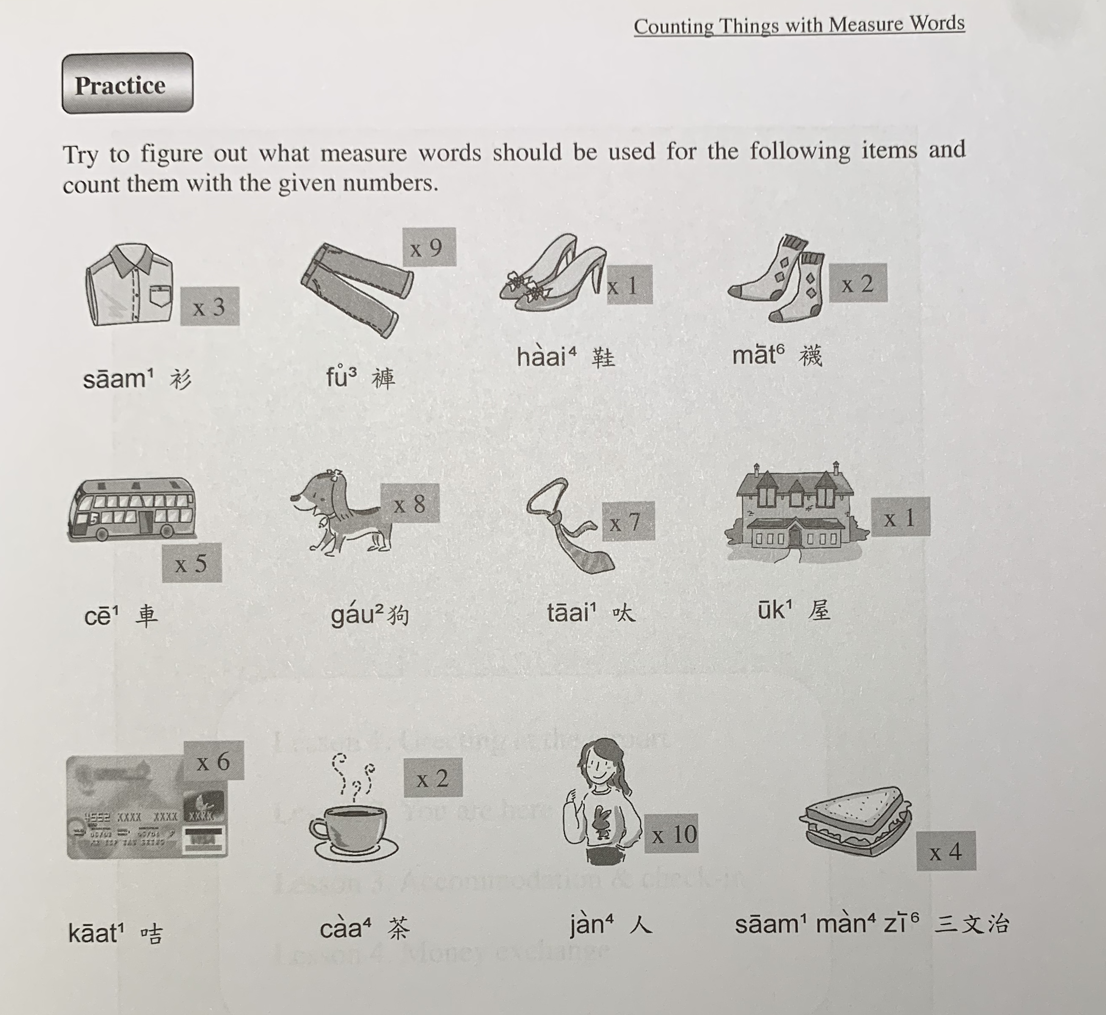

Slide 14
$1423
$540.8
$63.2
$160
tiu4
gin6
deoi3
deoi3
$345.4
$6345
$899.9
$3,700,000
zek3
tiu4
gaan1
gaa3
$26.9
$45
$57
bui1
go3
fan6
zoeng1

Slide 15
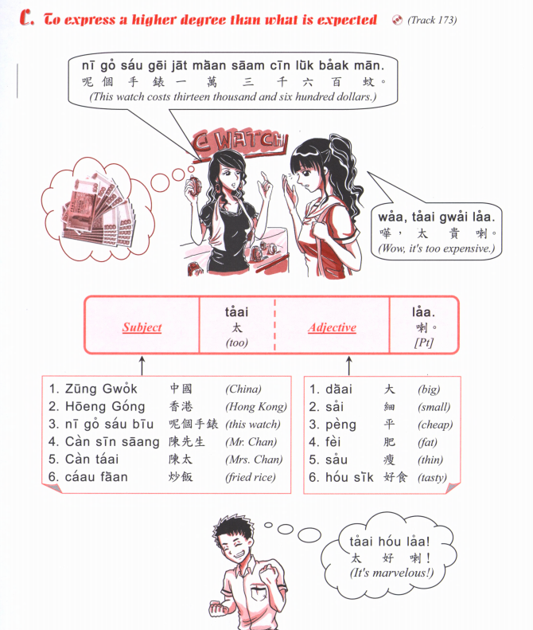
zek3
隻

Slide 16
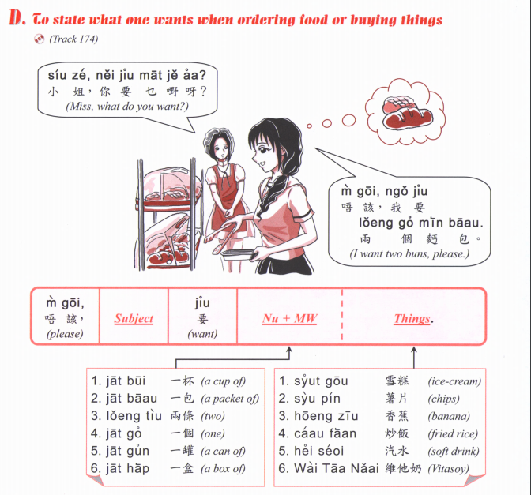

Slide 17
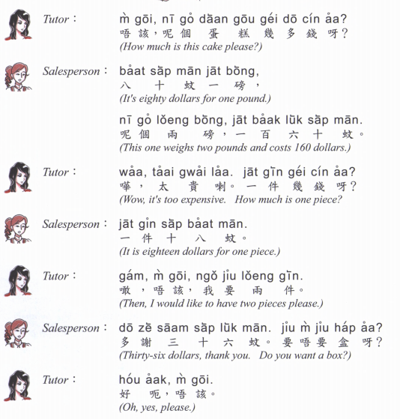

Slide 18
三文治
saam¹ man⁴ zi⁶
漢堡包
hon3 bou2 baau1
壽司
sau6 si1
daan⁶ gou¹
Cake
熱狗
Jit6 gau2
牛扒
Ngau4 paa2
冬甩
dung1 lat1
薯條
Syu4 tiu2
沙律
saa¹ leot²
咖啡
gaa³ fe¹
意粉
Ji3 fan2

Slide 19
Caa4 caan1 teng1
蛋撻
Daan6 taat1
西多士
Sai1 do1 si2
奶茶
Naai5 caa4
菠蘿油
Bo1 lo4 yau4

Slide 20
炒飯
Caau2 faan6
Fried rice
魚蛋粉
Jyu4 daan2 fan2
Fishball noodles
炒河/炒麵
Caau2 ho2/ caau2 min6
Fried flat noodles/ noodles

Slide 21
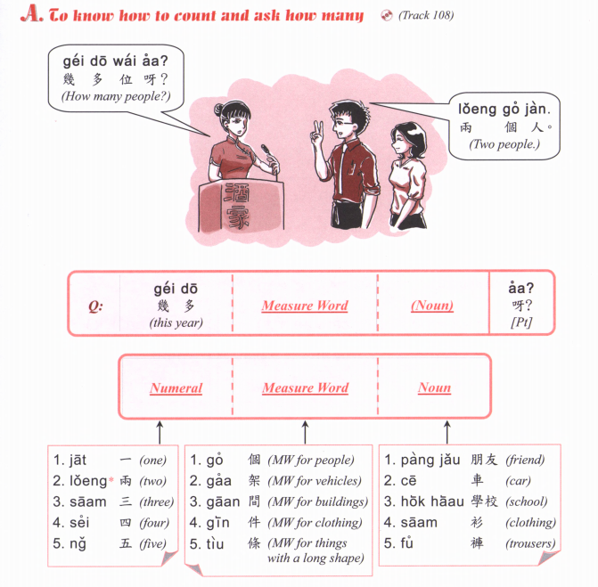

Slide 22
Zing-zing:
M4 goi1, ngo5 jiu3 A, B tung4 C
唔該，我要 A，B 同 C
(Excuse me, I want A, B and C)
Cashier:
Nei5 ge3
你嘅
(Here you go)
Zing-zing:
m4 goi1, zoi3 gin3
唔該，再見
(Thank you, goodbye)

Slide 23
m4 goi1, maai4 daan1
唔該，埋單
Excuse me, the bill please.

Slide 24
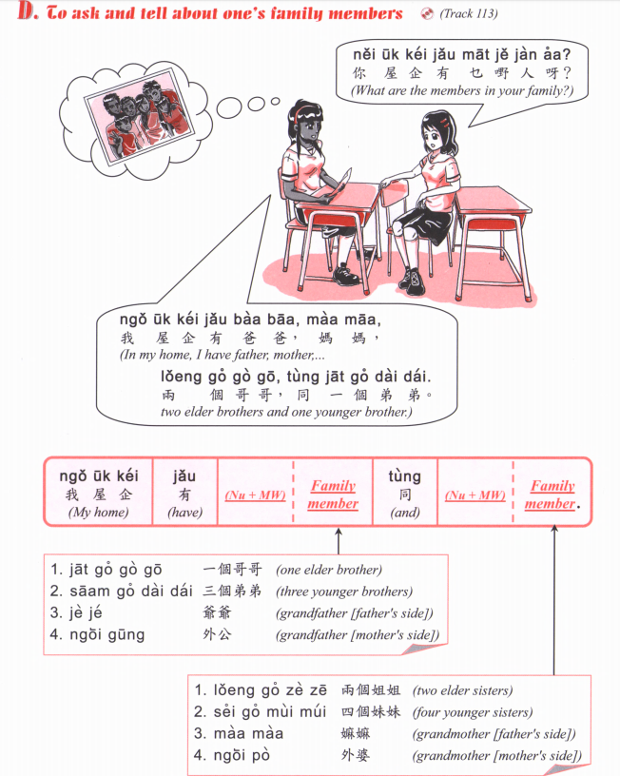
乜嘢 / 咩
Mat1 je5 / me1

Slide 25
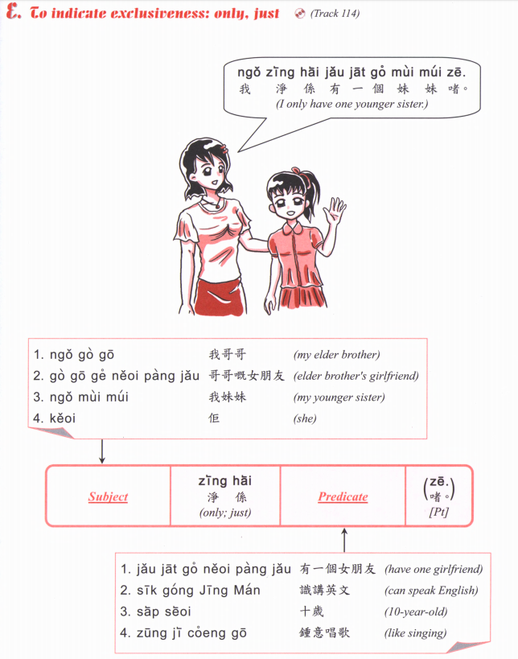

Slide 26
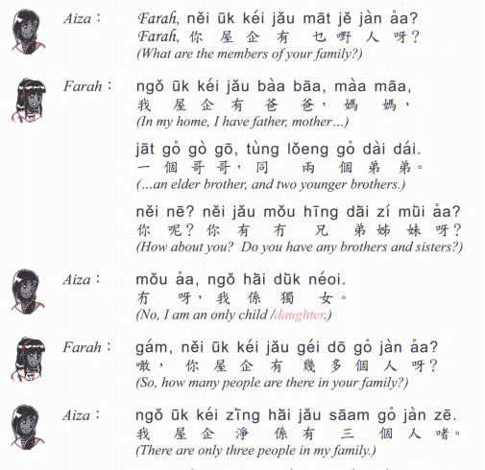

Slide 27
Ask questions
Introduce your friend
Name
Age
Nationality
How many people in their family (eg: how many brothers/sisters)
Their age

Slide 28
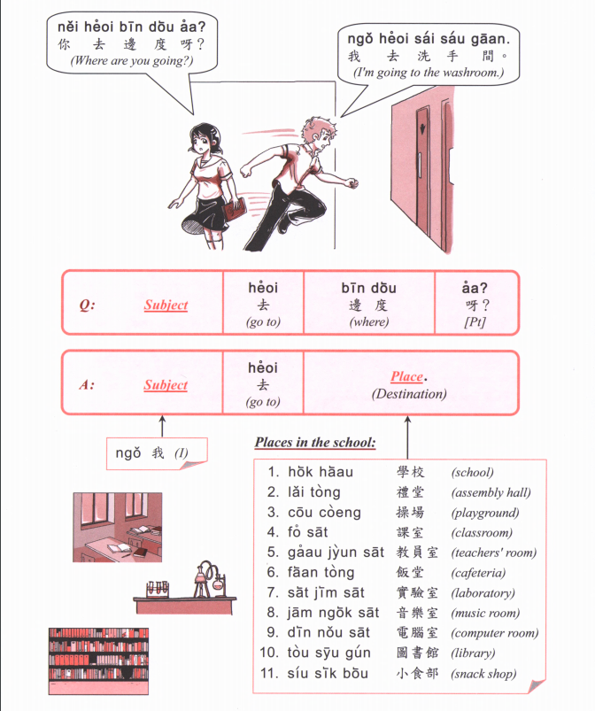

Slide 29
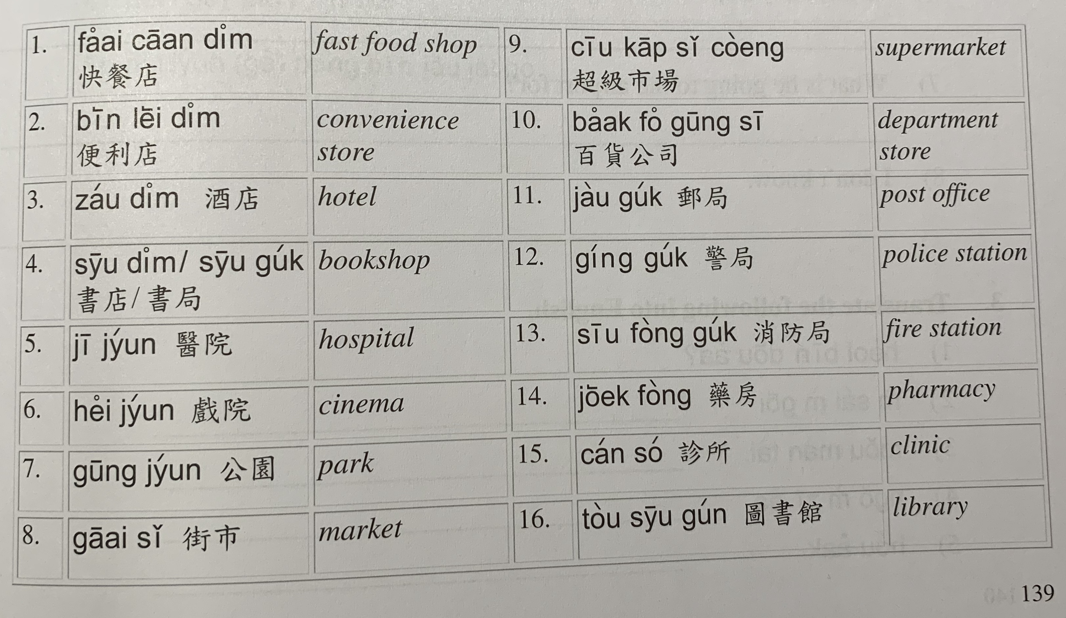

Slide 30
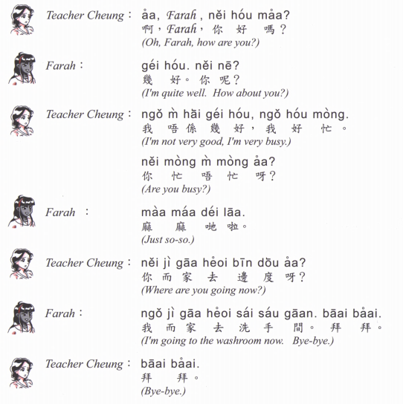

Slide 31
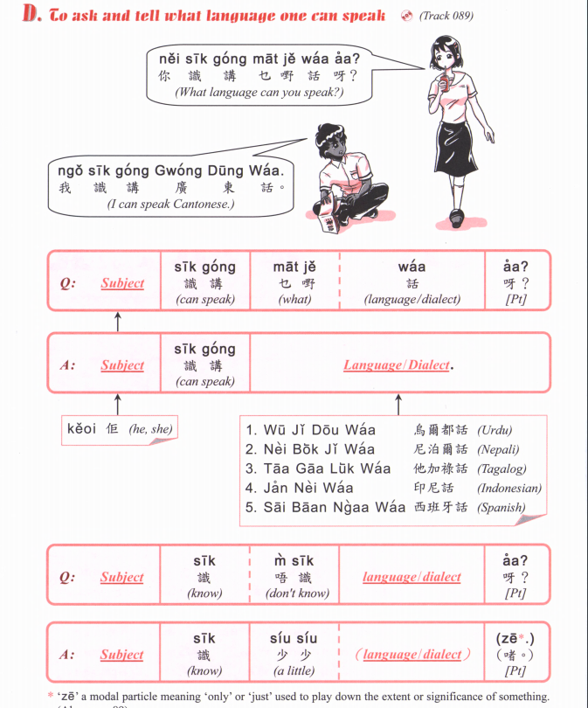
pou2 tung1 waa2
普通話
Mandarin
zit6 hak1 waa2
捷克話
Czech
si1 lok6 fat6 hak1 waa2
斯洛伐克話
Slovak
Jing1 man2
英文
English
Dak1 man2
徳文
German
Faat3 man2
法文
French

Slide 33
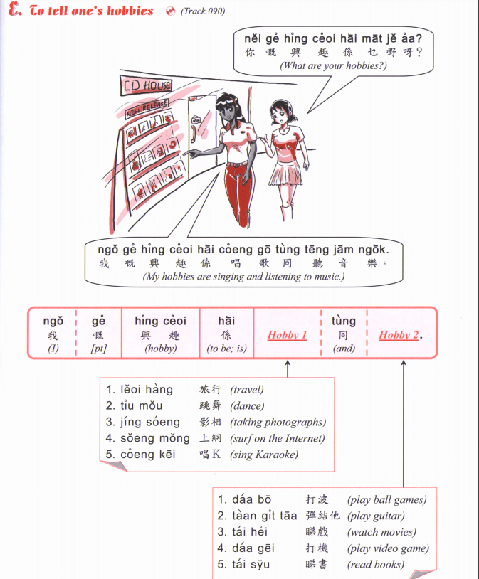
Jau4 seoi2
游水
swimming
Zou6 gym
做gym
Go to the gym
Gin6 san1
健身
Go to the gym
Zyu2 je5 sik6
煮嘢食
Cooking
Haang4 saan1
行山
Hiking
Caai2 daan1 ce1
踩單車
Cycling
Teng1 jam1 ngok6
聽音樂
Listen to music

Slide 34
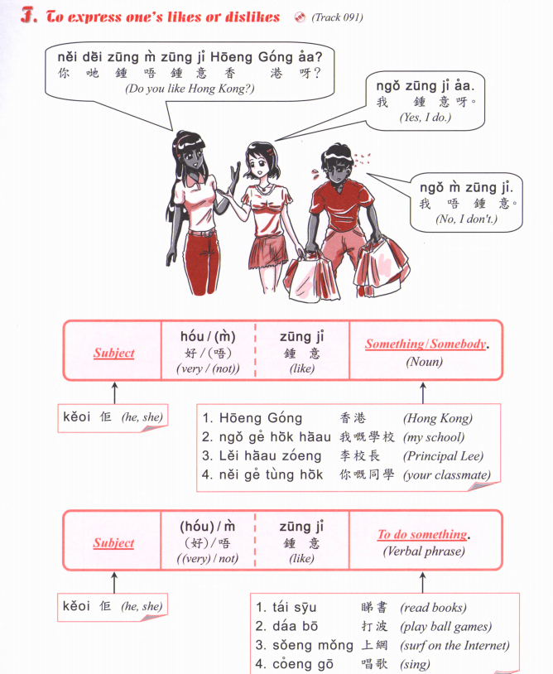

Slide 35
Jau4 seoi2
游水
swimming
Zou6 gym
做gym
Go to the gym
Gin6 san1
健身
Go to the gym
Zyu2 je5 sik6
煮嘢食
Cooking
Haang4 saan1
行山
Hiking
Caai2 daan1 ce1
踩單車
Cycling
Teng1 jam1 ngok6
聽音樂
Listen to music
A: Nei5 zung1 m4 zung1 ji3 XXXX aa3?
B: Ngo5 (hou2) zung1 ji3 XXXXX
OR
Ngo5 (hou2) m4 zung1 ji3 XXXX

