Slide 1
Cantonese I
Week 6

Slide 2
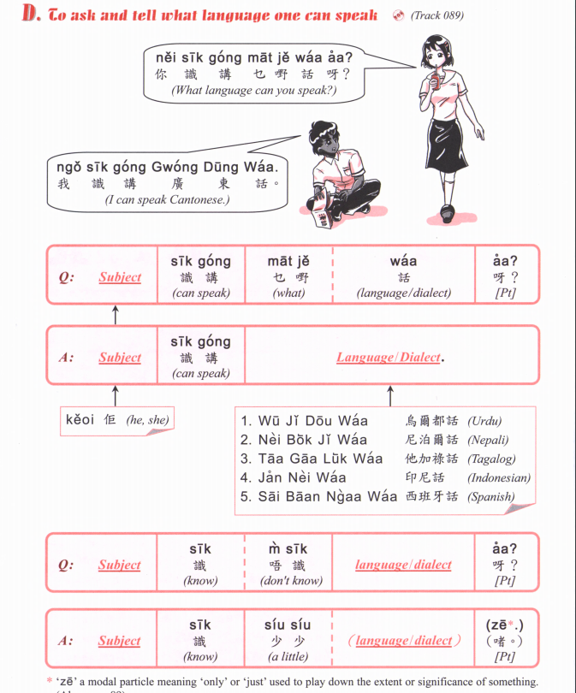
pou2 tung1 waa2
普通話
Mandarin
zit6 hak1 waa2
捷克話
Czech
si1 lok6 fat6 hak1 waa2
斯洛伐克話
Slovak
Jing1 man2
英文
English
Dak1 man2
徳文
German
Faat3 man2
法文
French

Slide 4
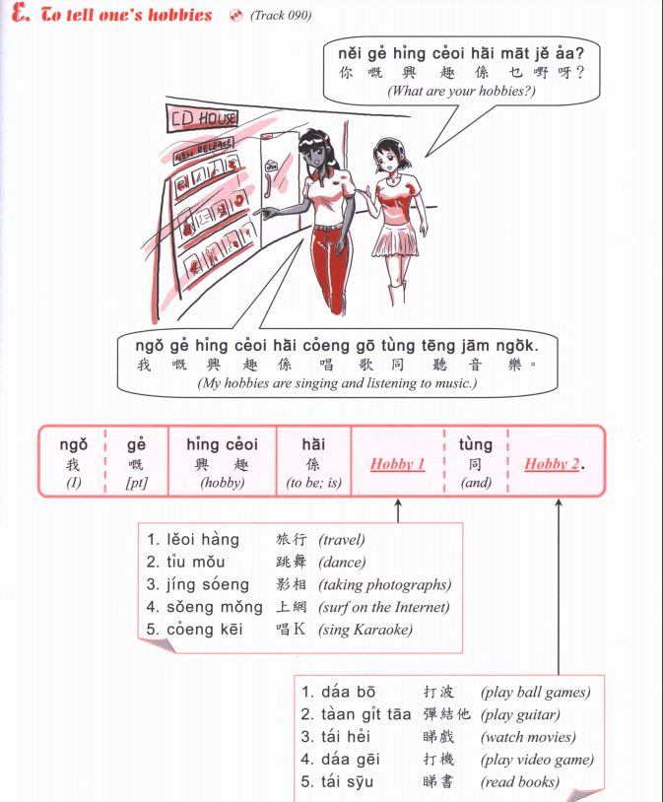
Jau4 seoi2
游水
swimming
Zou6 gym
做gym
Go to the gym
Gin6 san1
健身
Go to the gym
Zyu2 je5 sik6
煮嘢食
Cooking
Haang4 saan1
行山
Hiking
Caai2 daan1 ce1
踩單車
Cycling
Teng1 jam1 ngok6
聽音樂
Listen to music

Slide 5
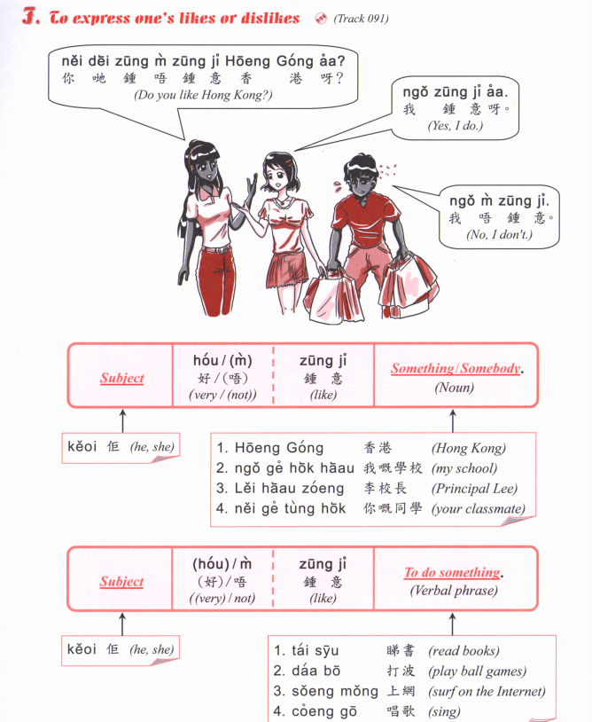

Slide 6
Jau4 seoi2
游水
swimming
Zou6 gym
做gym
Go to the gym
Gin6 san1
健身
Go to the gym
Zyu2 je5 sik6
煮嘢食
Cooking
Haang4 saan1
行山
Hiking
Caai2 daan1 ce1
踩單車
Cycling
Teng1 jam1 ngok6
聽音樂
Listen to music
A: Nei5 zung1 m4 zung1 ji3 XXXX aa3?
B: Ngo5 (hou2) zung1 ji3 XXXXX
OR
Ngo5 (hou2) m4 zung1 ji3 XXXX

Slide 7
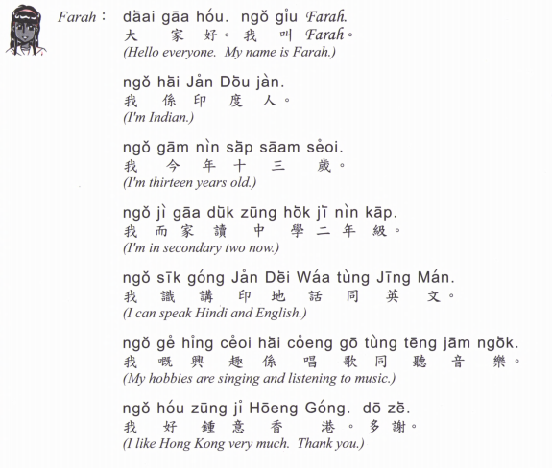

Slide 8
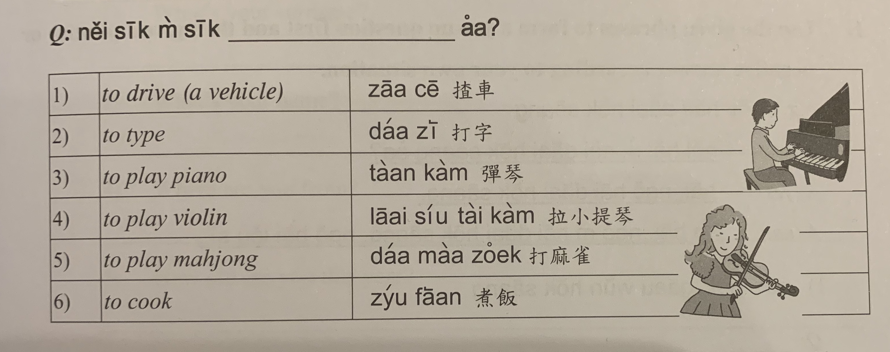
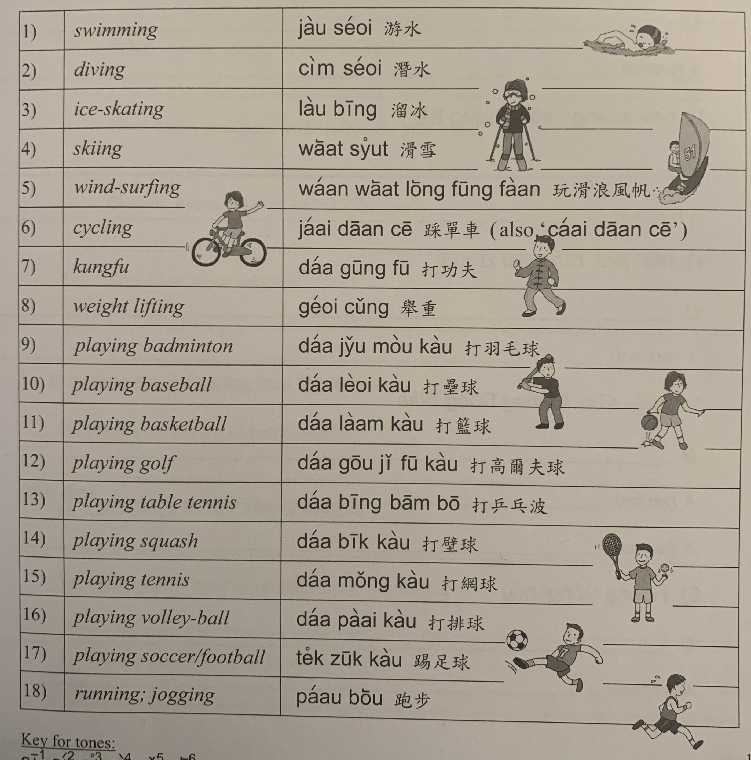

Slide 9
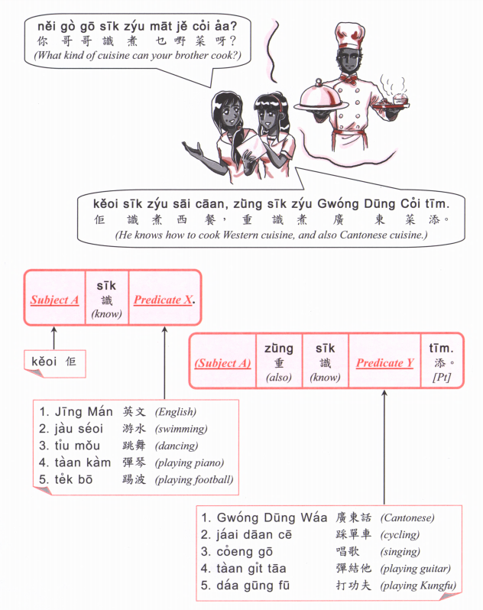

Slide 10
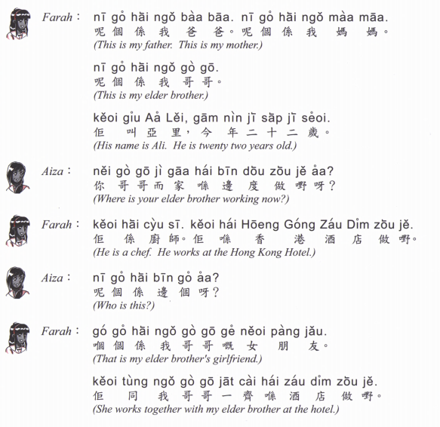
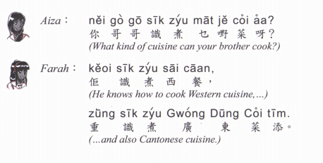

Slide 11
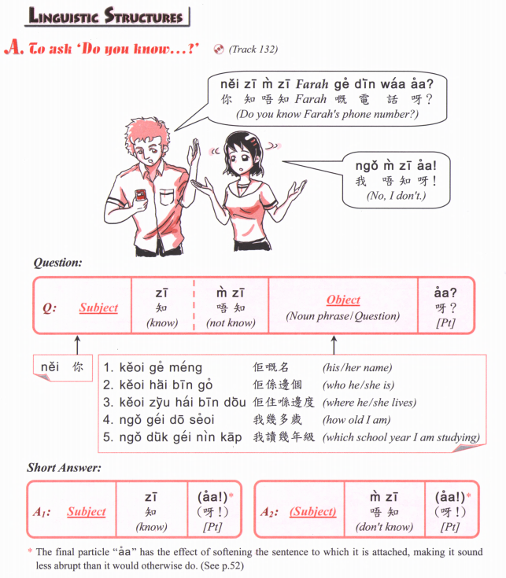

Slide 12
鍾意 | To like | zung1 ji3 | m4 zung1 ji3
識 | To know (a skill, a person | sik1 | m4 sik1
知 | To know (information, news) | zi1 | m4 zi1
去 | To go | heoi3 | m4 heoi3
有 | To have | jau5 | Mou5 (冇)
要 | To want | jiu3 | M4 jiu3
講 | To speak | gong2 | M4 gong2
做 | To do | zou6 | M4 zou6

Slide 13
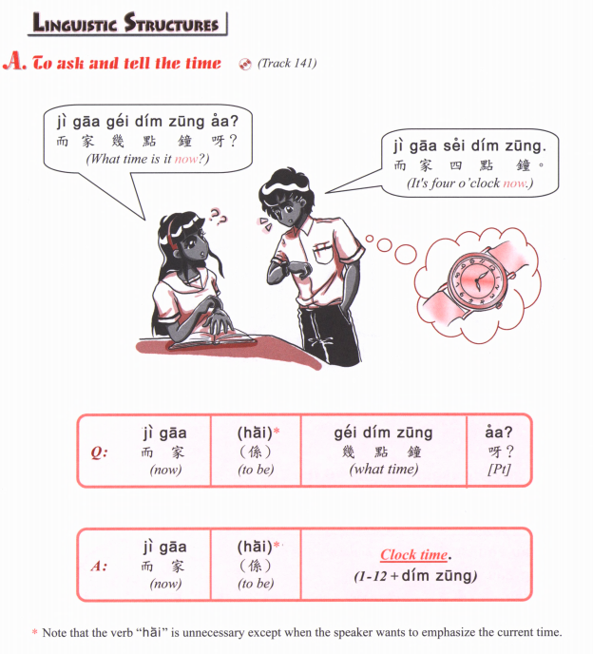

Slide 14
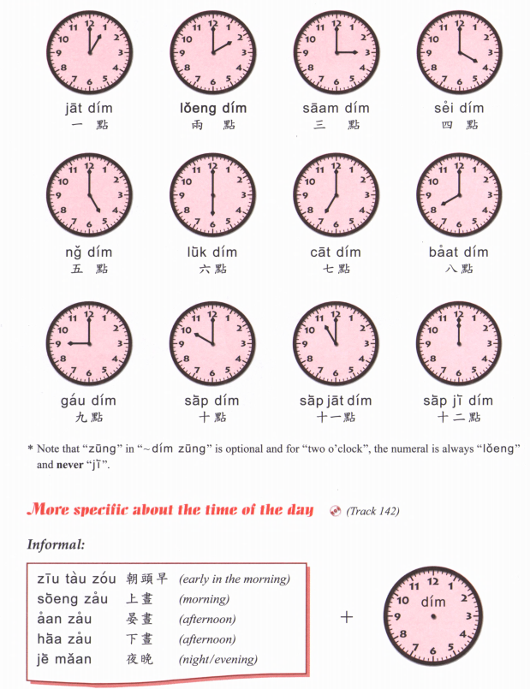

Slide 15
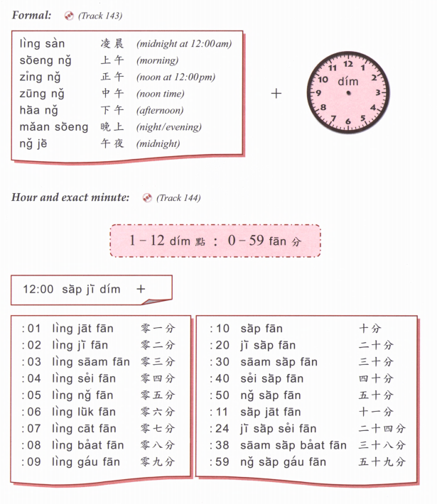

Slide 16
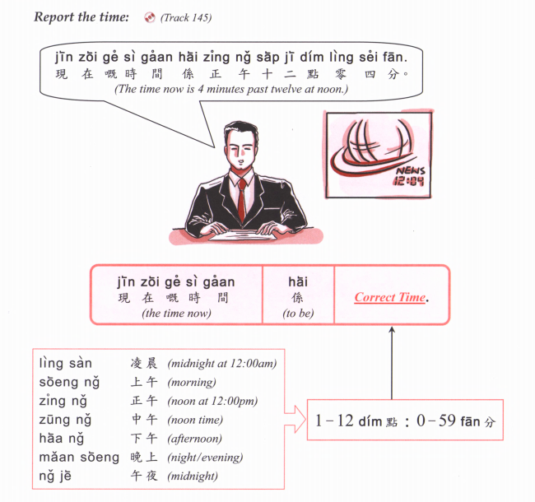

Slide 17
Zou2 caan1 | 早餐 | Breakfast
Zung1 ng5 faan6 | 中午飯 | Lunch
Haa6 ng5 caa4 | 下午茶 | Afternoon tea
Maan5 faan6 | 晚飯 | Dinner
sik6
食
To eat

Slide 18
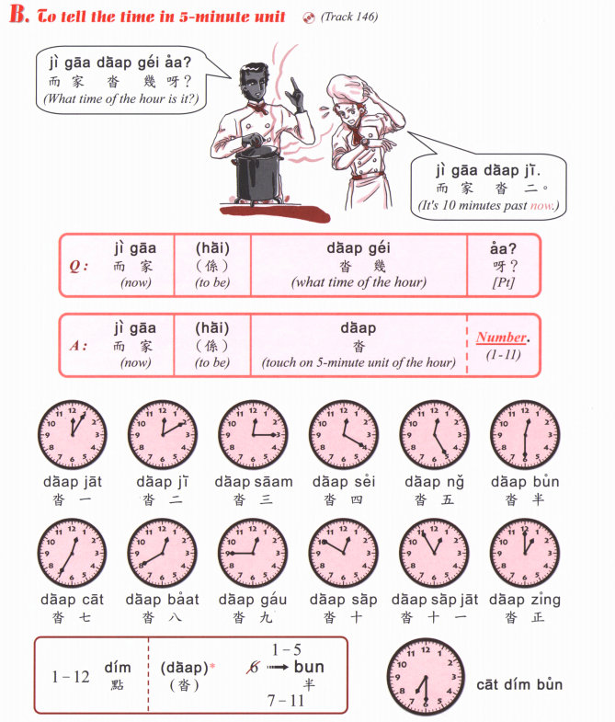

Slide 19
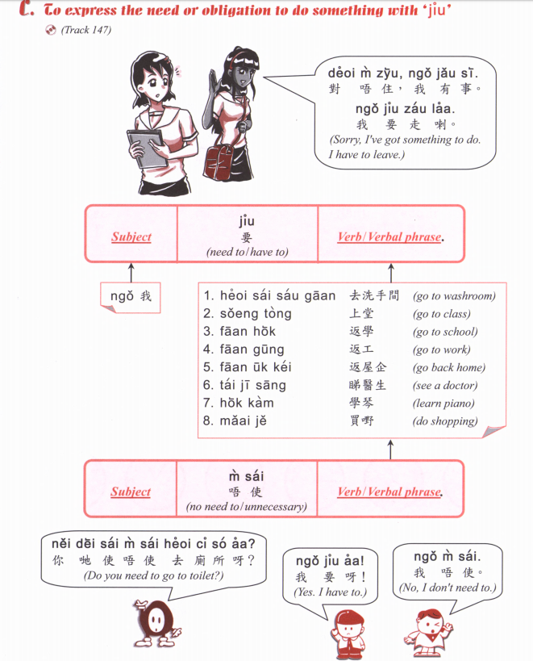

Slide 20
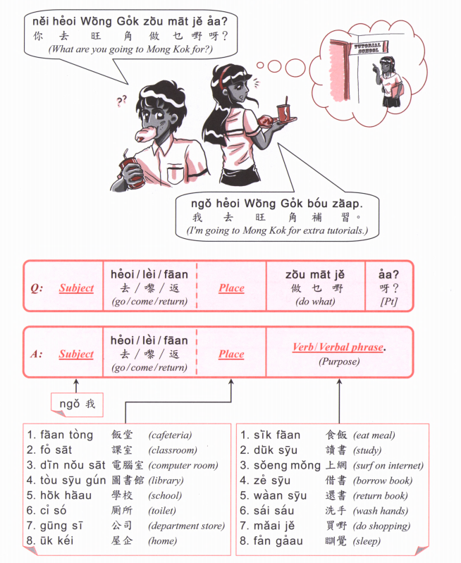

Slide 21
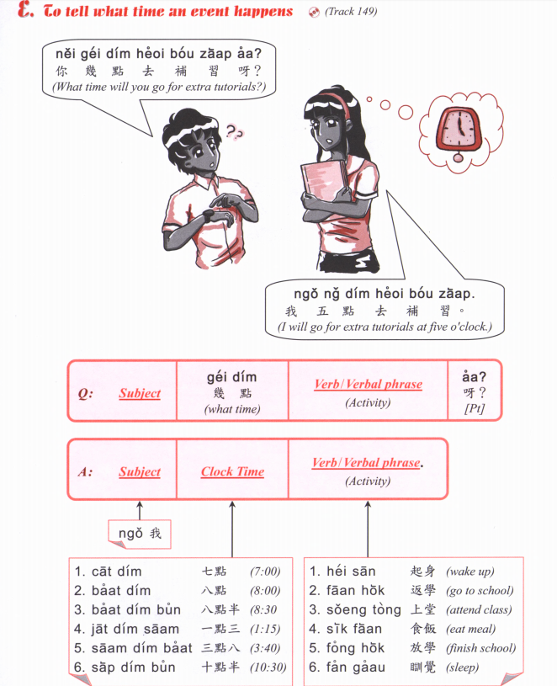

Slide 22
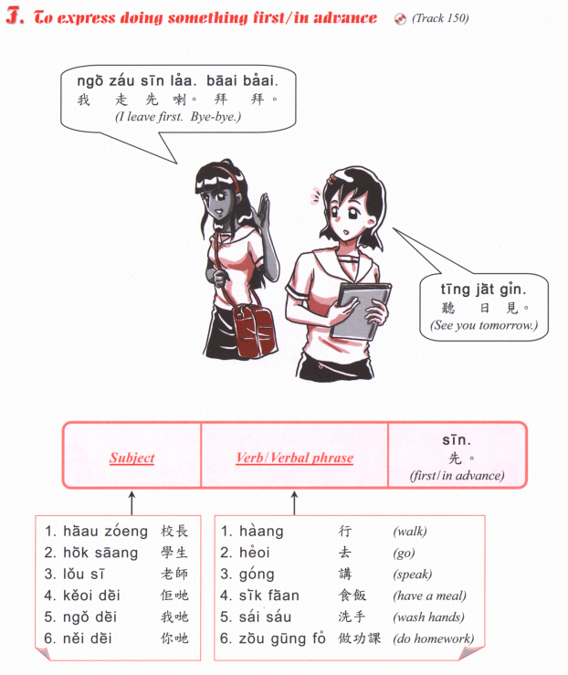

Slide 23
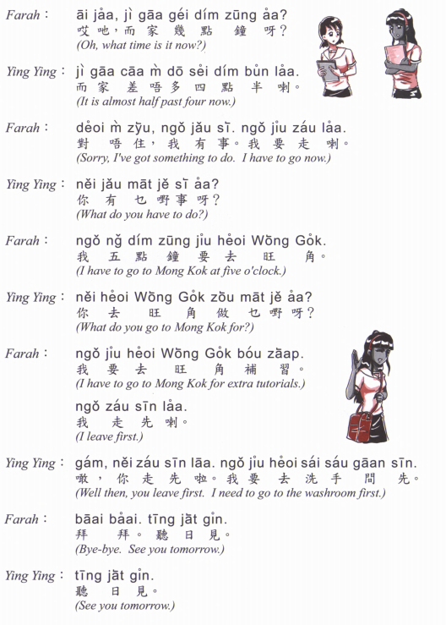

Slide 24
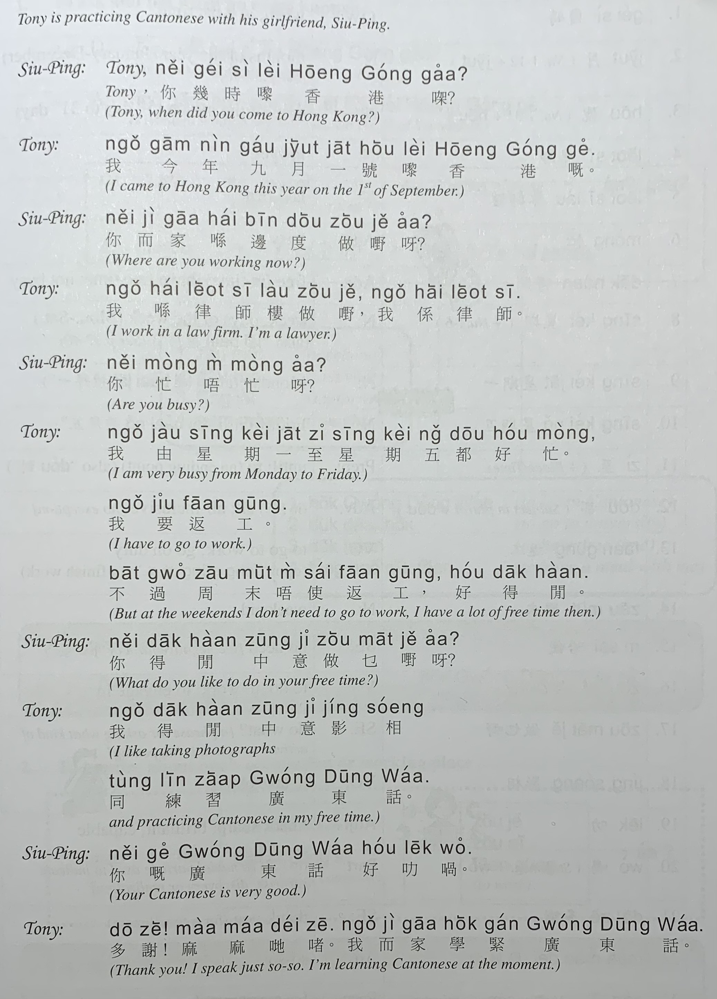

Slide 25
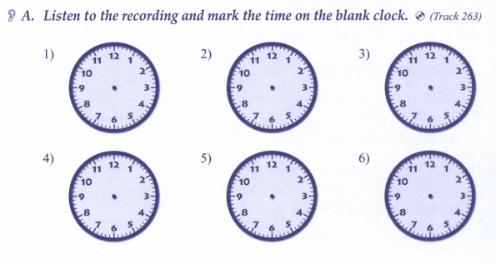

Slide 26
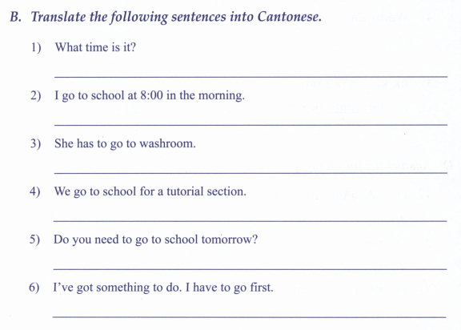

Slide 27
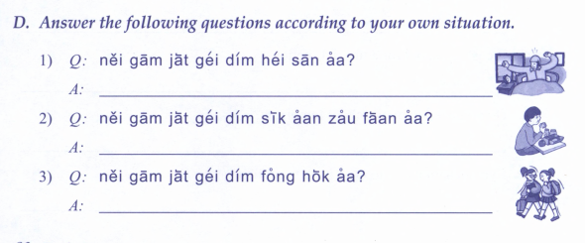

Slide 28
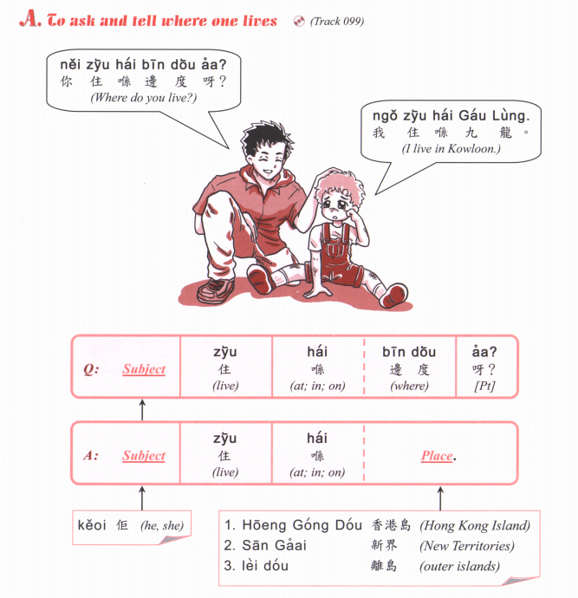

Slide 29
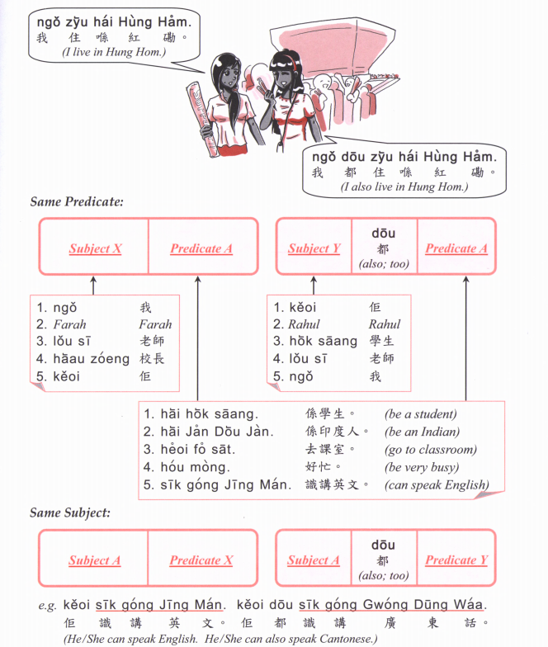

Slide 30
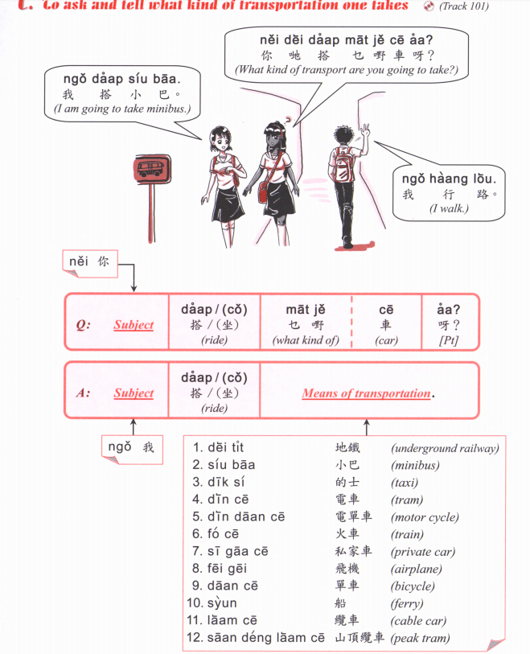

Slide 31
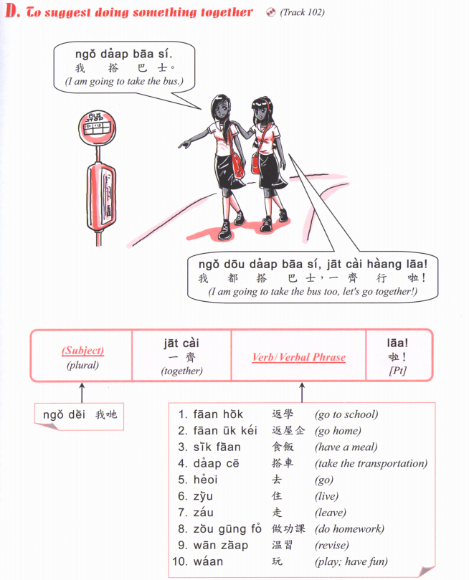

Slide 32
