Slide 1
Cantonese I
Week 8

Slide 2
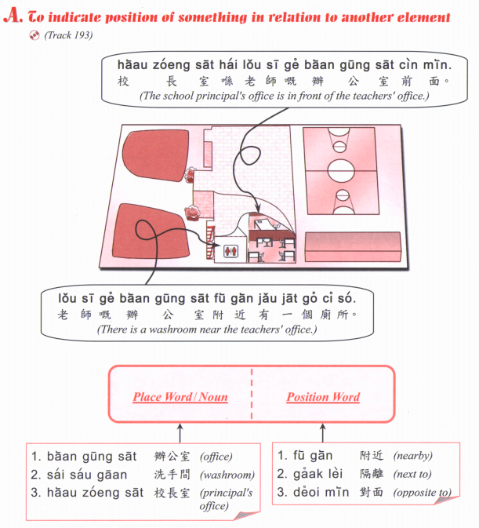

Slide 4
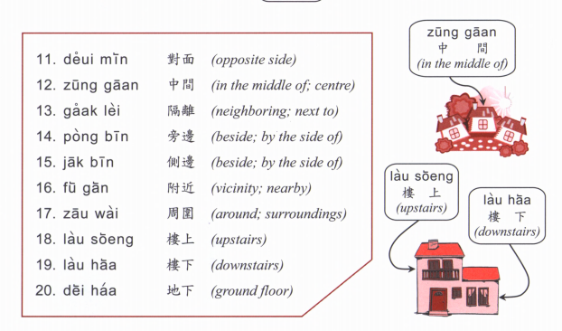

Slide 5
Where is (place)? (Place) + hai2 bin1 dou6 aa3? 喺邊度呀？
Hok6 haau6
Tou4 syu1 gun2
Ting4 ce1 coeng4
wan6 dung6 coeng4
Yi1 jyun2
Fei1 faat3 pou3
Soeng1 coeng4
Zau2 baa1
Ciu1 kap1 si5 coeng4
ngan4 hong4
Joek6 fong4
Caan1 teng1
Answer： (Place) hai2 (Place B) (position word)

Slide 6
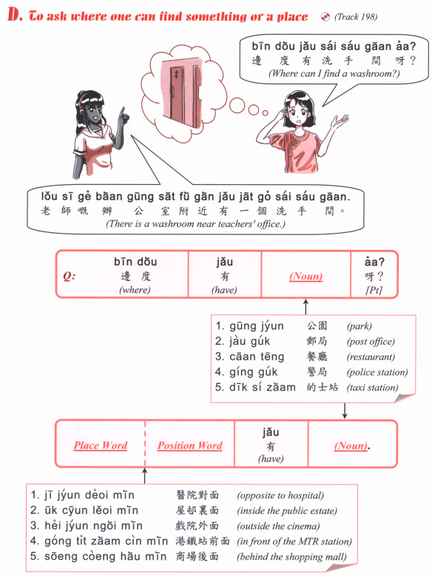

Slide 7
Hok6 haau6
Tou4 syu1 gun2
Ting4 ce1 coeng4
wan6 dung6 coeng4
Yi1 jyun2
Fei1 faat3 pou3
Soeng1 coeng4
Zau2 baa1
Ciu1 kap1 si5 coeng4
ngan4 hong4
Joek6 fong4
Caan1 teng1

Slide 8
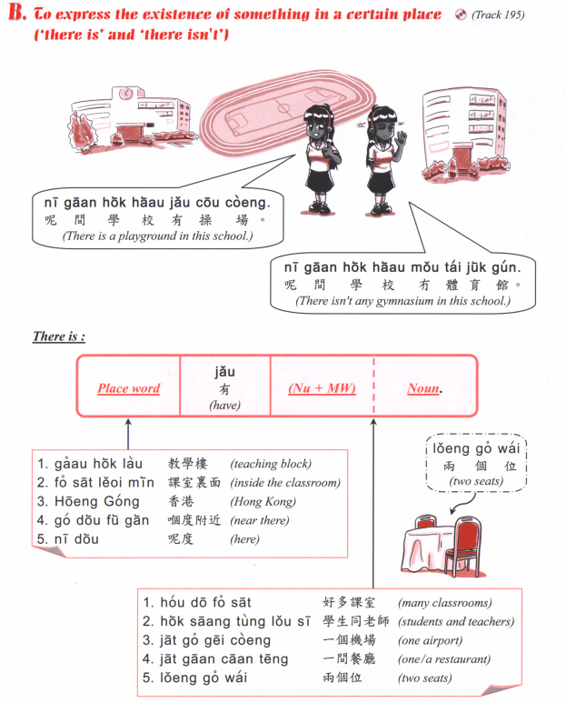

Slide 9
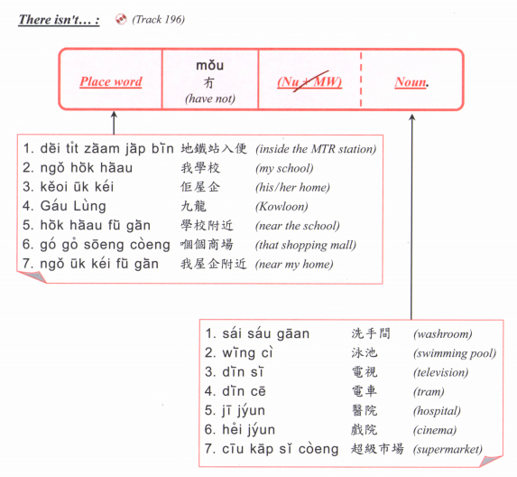

Slide 10
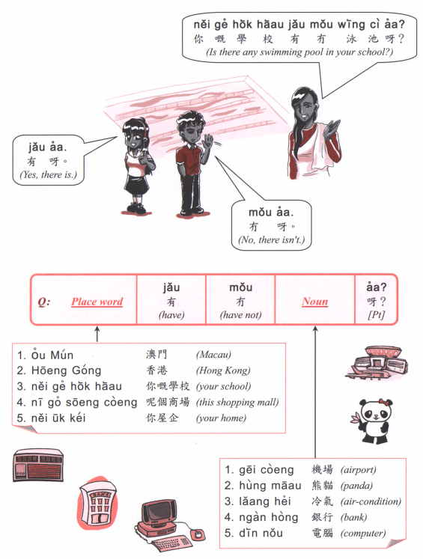

Slide 12
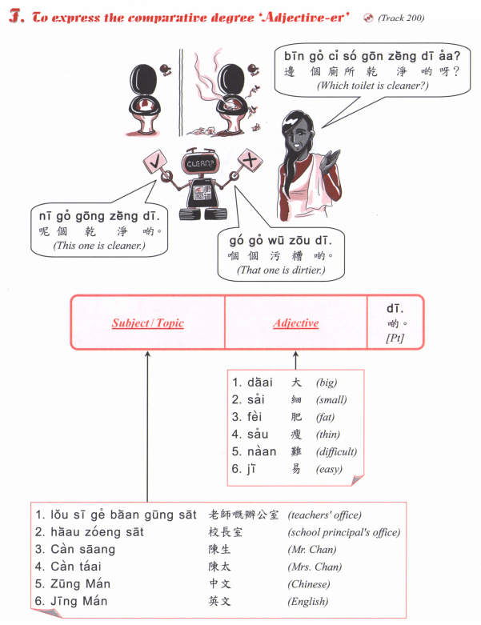

Slide 13
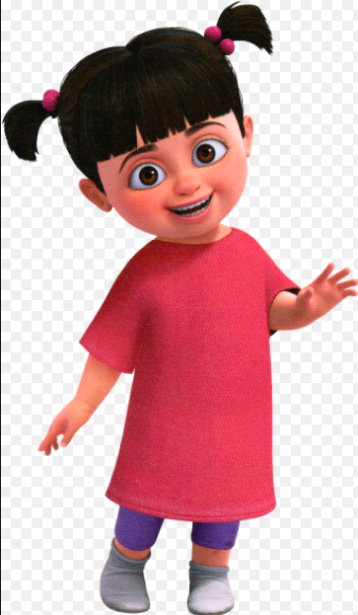
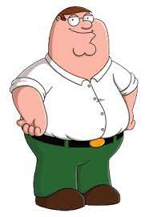
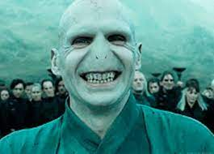
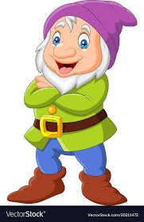
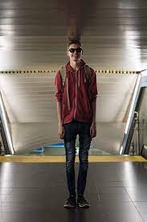
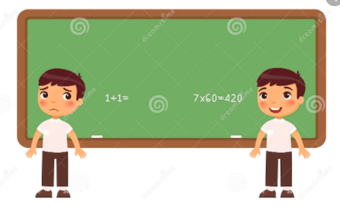
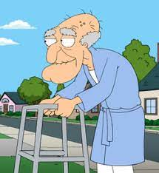
Bin1 go3 (adj.) di1 aa3?
B
D
E
A
C
H
I
F
G

Slide 14
Young
細個
sai³ go³
後生
hau⁶ saang¹
年青
nin⁴ cing¹
Old
老 (old)
lou⁵
成熟 (mature)
sing⁴ suk⁶

Slide 15
高 (Tall)
gou¹
矮 (Short)
ai²
肥 (Fat)
fei⁴
瘦 (Thin)
sau³

Slide 16
可愛 (cute)
ho² oi³
得意 (cute)
dak¹ ji³
靚 (beautiful)
leng³
醜 (ugly)
cau²

Slide 17
聰明 (clever)
cung¹ ming⁴
叻 (smart)
lek¹
蠢 (stupid / dumb)
ceon²

Slide 18
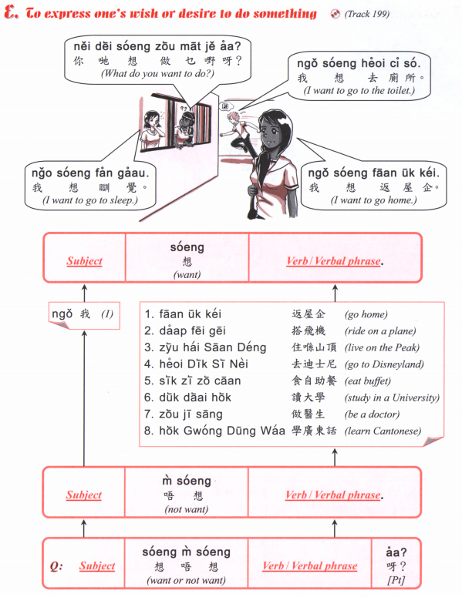

Slide 19
邊個 | Who | Bin1 go6
咩 / 乜嘢 | what | Me1 / Mat1 je5
邊度 | Where | Bin1 dou6
幾多 | How many/ much | Gei2 do1

Slide 20
鍾意 | To like | zung1 ji3 | m4 zung1 ji3
識 | To know (a skill, a person | sik1 | m4 sik1
知 | To know (information, news) | zi1 | m4 zi1
去 | To go | heoi3 | m4 heoi3
有 | To have | jau5 | Mou5 (冇)
要 | To want (something)/have to | jiu3 | M4 jiu3
講 | To speak | gong2 | M4 gong2
做 | To do | zou6 | M4 zou6
想 | To want (to do something) / wish/desire | soeng2 | M4 soeng2

