Slide 1
Mental and behavioral disorders due to psychoactive substance use
Mgr. Monika Vodová

Slide 2
What substances you can be addicted to?

Slide 3
Literally any!

Slide 4
F10-F19
F10 Alcohol related disorders
F11 Opioid related disorders
F12 Cannabis related disorders
F13 Sedative, hypnotic, or anxiolytic related disorders
F14 Cocaine related disorders
F15 Other stimulant related disorders
F16 Hallucinogen related disorders
F17 Nicotine dependence
F18 Inhalant related disorders
F19 Other psychoactive substance related disorders

Slide 5
What is addiction?
5 factors:
A) regular usage of psychoactive drug
B) presence of wish to change the situation with drug
C) tendency to increase dosage
D) Presence of physical and mental symptoms connected to withdrawal
E) decreased control above drug usage

Slide 6
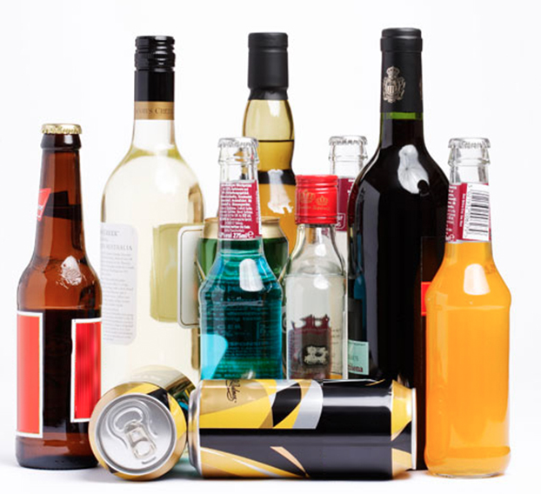
F10 Alcohol related disorders
Alcohol affects people differently
Lack of control
107 million people are estimated to have a problem with alcohol usage

Slide 7
F10 Alcohol related disorders
Symptoms:
slurred speech
slowing of reflexes
inability to control bodily movements
difficulty concentrating
gaps in memory
poor decision-making abilities
risky behaviour
In the case of very high level of alcohol consumption breathing problems, coma, or even death.

Slide 8
F10 Alcohol related disorders
Why would people do that?
Relax
Socialization
A great influence on behavior

Slide 9
F10 Alcohol related disorders
Who is at risk?
People with hereditary in alcoholism
People in serious life events
People suffering with other mental disorders like depression
People who are lonely, in emotional stress
People after physical, especially head, trauma

Slide 10
F10 Alcohol related disorders
Diagnosis factors?
Impact on their relationships
Physical or mental injuries
Negative effect on quality of life
Diagnosing is subjective according to habits of the person!

Slide 11
F10 Alcohol related disorders – questions you can use?
Have you had times when you ended up drinking more, or longer than you intended?
Did you wanted more than once to cut down or stop drinking, or tried to, but couldn’t?
Have you spent a lot of time drinking? Or being sick or getting over the after effects?
Experienced craving — Have you ever had a strong need, or urge, to drink?
Have you ever found out that drinking — or being sick from drinking — often interfered with taking care of your home or family? Or caused job troubles? Or school problems?
Have you given up or cut back on activities that were important or interesting to you, or gave you pleasure, in order to drink?

Slide 12
F10 Alcohol related disorders – questions you can use?
Have you gotten more than once into situations while or after drinking that increased your chances of getting hurt (such as driving or using machinery)?
Have you ever continued to drink even though it was making you feel depressed or anxious or adding to another health problem? Or after having had a memory blackout?
Have you ever had to drink much more than you once did to get the effect you want? Or found that your usual number of drinks had much less effect than before?
Found that when the effects of alcohol were wearing off, you had withdrawal symptoms, such as trouble sleeping, shakiness, irritability, anxiety, depression, nausea, or sweating?

Slide 13
F10 Alcohol related disorders
Treatment: withdrawal
Withdrawal is connected to:
nausea
shaking
sweating
irritability
Anxiety
Fever
Vomiting
Seizures

Slide 14
F10 Alcohol related disorders
Controlled drinking vs. abstinence
Abstinence and moderation is equally effective!
Controlled drinking is alternative to abstinence supported by AA

Slide 15
F11 Opioid related disorders
The most common opioids:
prescription opioids, such as OxyContin and Vicodin
fentanyl, a synthetic opioid 50–100 times more potent than morphine
heroin

Slide 16
F11 Opioid related disorders
Signs of addiction:
Spending time alone or changing friends
Being tired
Changes in eating
Being cranky
Quick change of moods
Sleeping at odd hours
Risk of overdose (opposite effects of Naloxone)

Slide 17
F11 Opioid related disorders
Treatment: also withdrawal
Symptoms of withdrawal:
Drug cravings
Anxiety/irritability
Insomnia
Abdominal pain
Vomiting
Diarrhea
Tremors (shaking)
Feeling cold

Slide 18
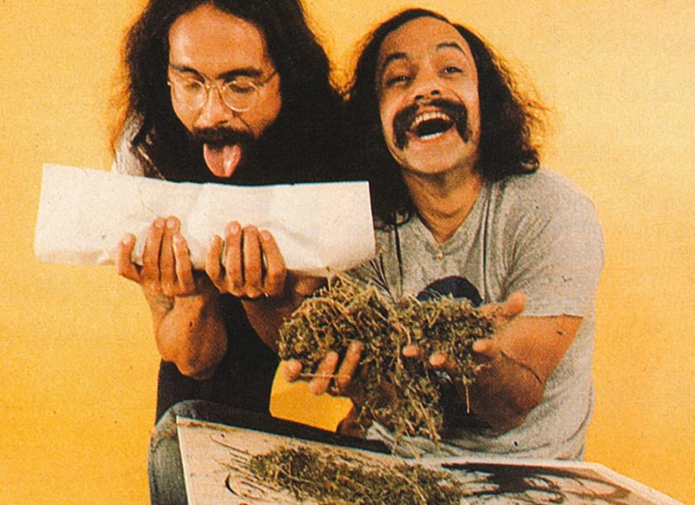
F12 Cannabis related disorders
Psychoactive consituent THC
= (tetrahydrocannabinol)
- Annual prevalence is 2.5% worldwide

Slide 19
F12 Cannabis related disorders
Acute health effects
Chronic health effects
Cognitive deficit, mostly in memory, attention, motivation, ability to learn
Impairs psychomotor performance (coordination)
Loss of control over usage
Breathing problems
Potential risk for developing other disorders (like schizophrenia or cancer)

Slide 20
F12 Cannabis related disorders
It is not all that bad!
Cannabis contains components with therapeutic potential like antidepressant, appetite stimulant and anticonvulsant. It provides treatment for asthma, glaucoma or symptoms of advanced stages of cancer.

Slide 21
F13 Sedative, hypnotic, or anxiolytic related disorders
Benzodiazepines – Ativan, Halcion, Librium, Valium, Xanax, Rohypnol
Barbiturates – Amytal, Nembutal, Seconal, phenobarbital
Other drugs – with chloral hydrate (Quaalude, Sopor, other „ludes“) and meprobamate (Equanil, Miltown)

Slide 22
F13 Sedative, hypnotic, or anxiolytic related disorders
Symptoms of dependence:
Cravings for the drug
Physical dependence
Drug-related psychological, interpersonal and physical problems
Developing of tolerance
Slurred speech, problems with coordination, inattention, memory difficulties
Can lead to stupor, coma or death (overdose)

Slide 23
F13 Sedative, hypnotic, or anxiolytic related disorders
Treatment is the same as previous drugs – withdrawal with gradual reducing
2-5% of deaths by overdosing

Slide 24
F14 Cocaine related disorders
Cocaine effects on person:
Talkativeness
Excitement
Alertness
Anxiety
Overconfidence
Fast heartbeat

Slide 25
F14 Cocaine related disorders
2 ways how to use cocaine:
Snorting – lasts up to 30 minutes
Injecting – lasts 5 to 10 minutes
Treatment: detox and therapy of inpatient rehabilitation program

Slide 26
F15 Other stimulant related disorders
People use it to increase cognitive functioning and alertness.
Amphetamines (Adderall)
Methylphenidates (Ritalin)
Ephedrine
Also other ADHD treatment
And illegal drugs like cocaine (previous chapter), crack or meth

Slide 27
F15 Other stimulant related disorders
Effects on person:
Euphoria
Decreased appetite
Wakefulness
Talkativeness
Energy
Increased concentration
Difficulty sleeping
Nervousness
Increased pulse and blood pressure

Slide 28
F15 Other stimulant related disorders
Long-term symptoms of abuse:
Weight loss
Lying or stealing
Aggressive behavior, mood swings
Nervousness
Confidence
Rapid heartbeat, risk of stroke, high blood pressure

Slide 29
F16 Hallucinogen related disorders
2 kinds of hallucinogen substances:
Classic hallucinogens like LSD, Psylocybin, mescaline, DMT
Dissociative hallucinogens like PCP (Phencyclidine), Ketamine, Dextromethorphan, Salvia

Slide 30
F16 Hallucinogen related disorders
Hallucinogens interfere to brain chemical systems, which regulates mood, sensory perception (pain included), sleep, hunger, muscle control,…
People who use hallucinogens, have symptoms like increased heart rate, nausea, sensory experiences, changes in sense of time. Also, increased blood pressure, dry mouth, sleep problems, panic, paranoia, bizarre behaviours, uncoordinated movements and excessive sweating.
Hallucinogens can be addictive but it is not mostly considered to be addictive.

Slide 31
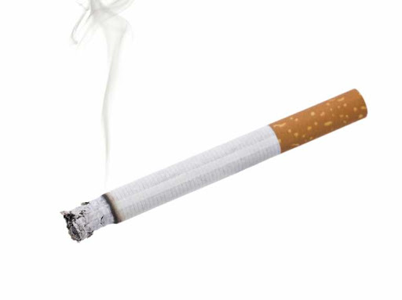
F17 Nicotine dependence
Symptoms like other addictions but nicotine addiction usually isn´t diagnosed.
Nicotine is connected to serious health issues like lung cancer, diabetes, eye problems, tooth issues or complication during pregnancy.

Slide 32
F17 Nicotine dependence
Treatment is to stop smoking.
There is also medication for reducing appetite for cigarette or counselling how to handle cravings.
There are many ways for alternatives for regular cigarettes like:
Dissolvable tobacco products
Smokeless tobacco
Nicotine lollipops and balms
Cigars and pipes
Hookahs

Slide 33
F18 Inhalant related disorders
Inhalation as "huffing„ or „glue sniffing“.
Volatile hydrocarbons, nitrous oxide and poppers
Inhalants are usually toxic gases typically found in glue, paint thinners or cleaning products.

Slide 34
F18 Inhalant related disorders
Signs of inhalants abuse:
Chemical smell
Redness, sores, or spots around the mouth
Redness of eyes
Runny or red nose
Paint stains on clothing or body
Nausea or loss of appetite
Dazed appearance
Dizziness
Irritability, anxiety
Slow verbal responses in conversation
Sudden behavior change
Sensitivity to light
Sore or irritated throat
Rashes or redness on hands

Slide 35
F19 Other psychoactive substance related disorders
the use of one or more substances leads to a clinically significant impairment or distress.
F19 is used when the substance is not described in one of the previous chapters.

Slide 36
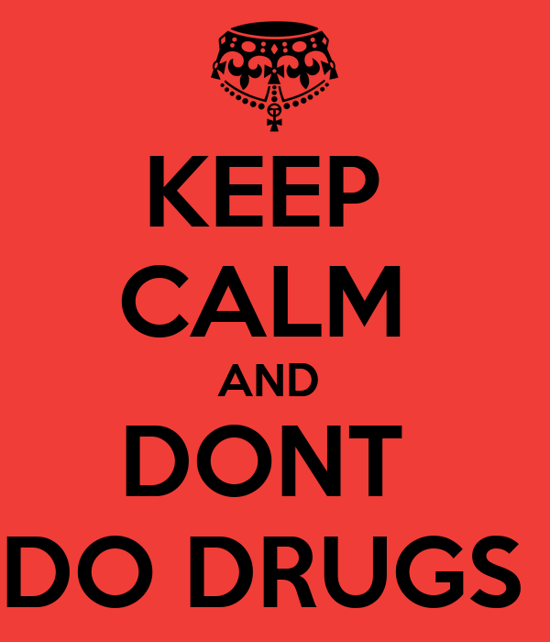
Thank you for your attention.

