Slide 1

History of clinical psychology
Lucie Stroupková, 5.3.2020

Slide 2
Clinical Psychology

Slide 3
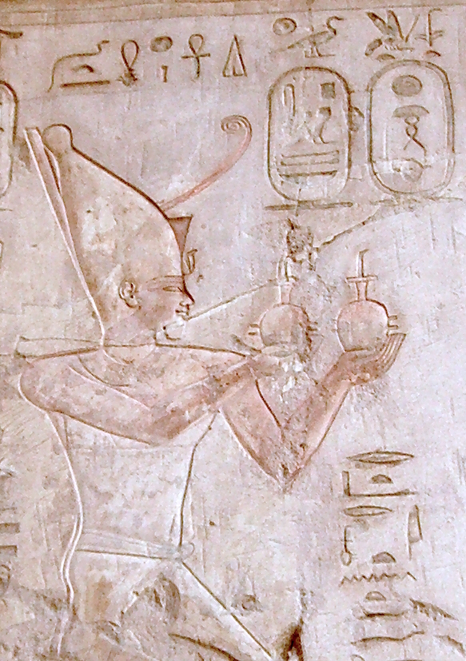
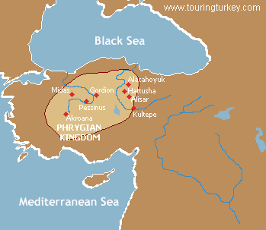
First psychological experiment..
Psamtik I.
7th cent BC
Hypothesis: Egyptians are the most ancient nation in the world
Method: King Psamtik took two children from their families and sent
Them to a herder and his wife who lived in the countryside and ordered
the carers to remain silence and not to speak to the children. In this way
Psamtik wanted to prove, that Egyptians were
the most ancient nation.
Result: The children said: „Bekos, bekos!“ as their first words.
Bekos meand bread in old Phrygians language
Psamtik´s conclusion: Phrygians are more ancient than Egyptians

Slide 4
Ancient history
Our thoughts come from God/Gods
Illiad, Odysey – Gods tell the protagonists what to do, speak to the warriors
Bible: mental illness seen as a punishment or a test from God
„The Lord will afflict you with madness, blindness and confusion of mind.“ (Deuteonomium, 28, 28)

Slide 5
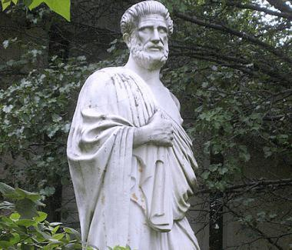
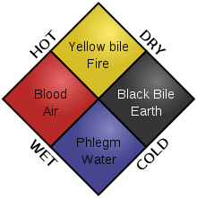
Antique Greece
Expansion of education and philosophy
Psychological questions in philosophy
Alkmaion – found optic nerve -> optic organs send perceptions to the brain by air canals and in the brain the ideas are derived
Demokritos - everything is made of atoms -> things reflect their picture to the atoms of air -> atoms of eye -> atoms of brain -> perception
Protagoras – „Man is the measure of all things“
Hippocrates – mental balance = balance of 4 bodily fluids
– bile, black bile phlegm, blood -> disbalance = mental disease

Slide 6
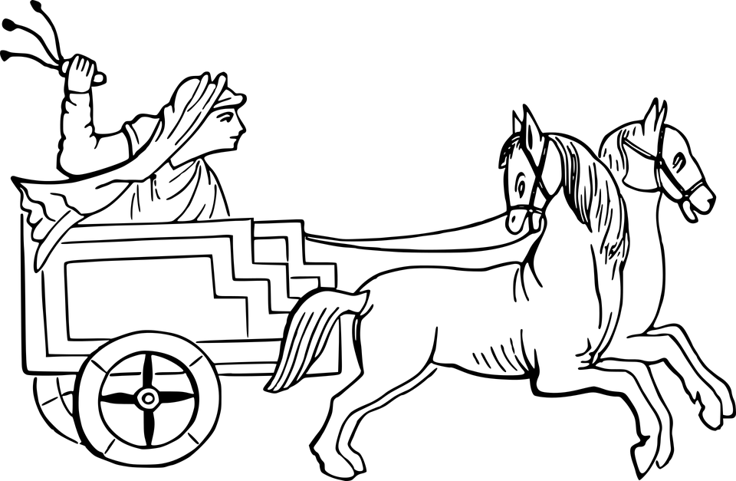
Antique Greece
Socrates
  we already know everything, we just have to recall that -> questioning
Plato
  we do not know everything but we cannot trust our senses -> logical deduction
  Cart with horses – first theory of personality
Aristotle
  All the things has their forms/similarities (heavy, round, etc.)
  -> connection of the forms in heart -> ideas

Slide 7
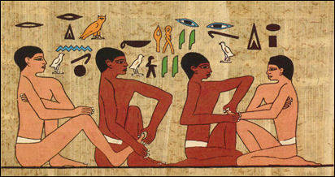
Ancient history - treatment
Egypt 15 cent. BC
  Prayers to chase away demons
  Temple treatment – Imhotep temple
    Suggestion, hypnoses, sleep

Slide 8
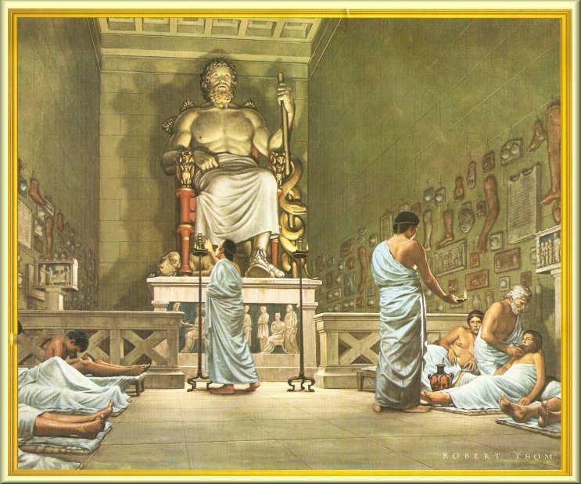
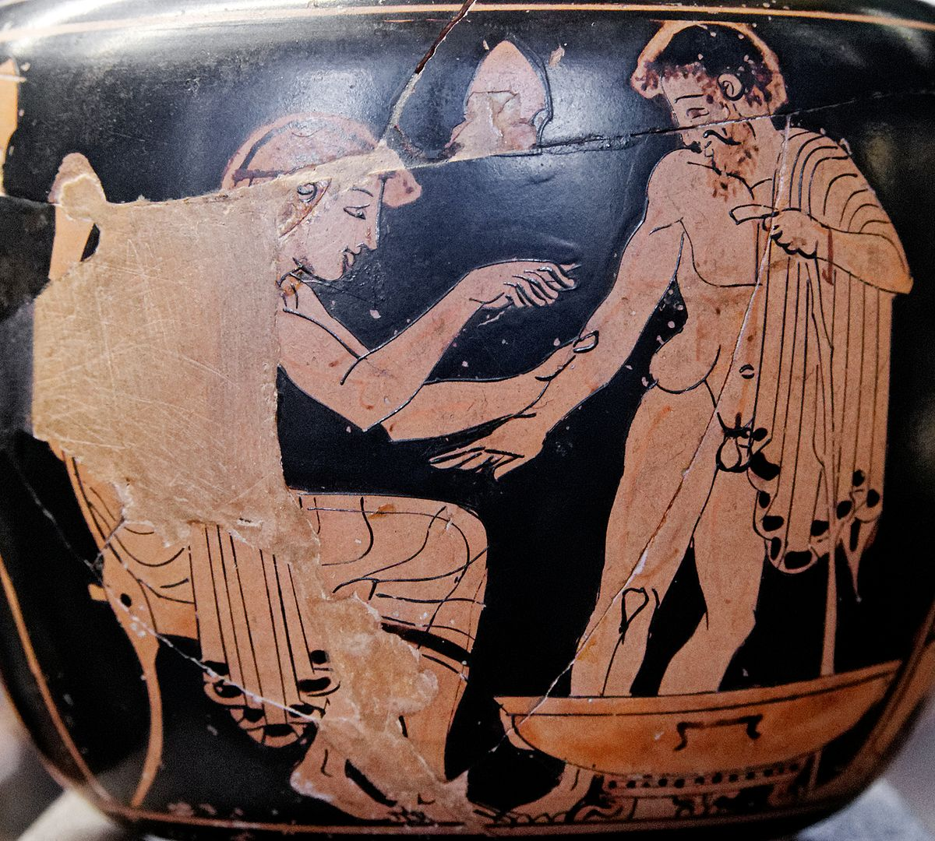
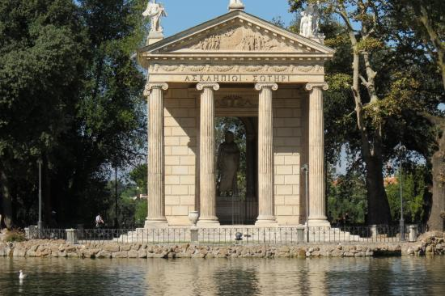
Antique Greece - treatment
Antique Greece 1000 BC
Asklepion´s temples (asklepions)
  in the countryside
  diet, climate, baths
Galenos (130-200BC)
  Based on Hippocrates theory -> bloodletting

Slide 9
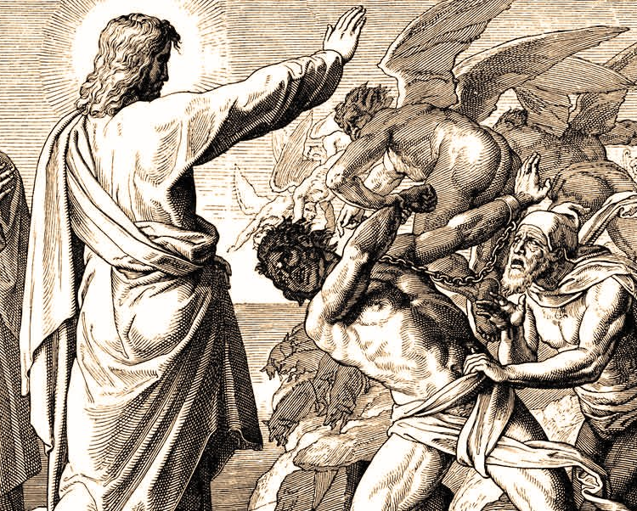
Middle ages
The end of the Western Roman Empire Roman Empire (476) / America Discovery (1453) – 17th century
Impact of Catholic Church
Causes of mental diseases („insanity“): demons, witches, sins
bishop Nicholas Oresme – although he was a bishop, described so called „melancholy“ that was rather a statem of disseas than a devil possessions

Slide 10
Middle ages - treatment
Impact the hands of Catholic Church
Mental disease = caused by Evil, demonic possessions
Witches processions – Hammer of Witches (1487) – Jakob Sprener
„Treatment“ of the „fools“
  Cages of the fools
  Settlements of the fools near monasteries
  Asylums
  Bloodletting, burning top of the head with iron bars
Savonarola – sleep, putting flasks, baths in tepid water, laxatives

Slide 11
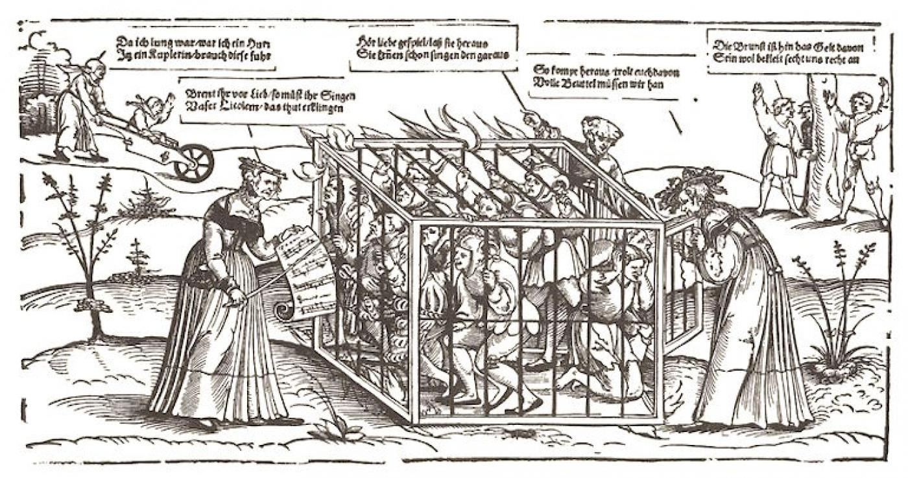
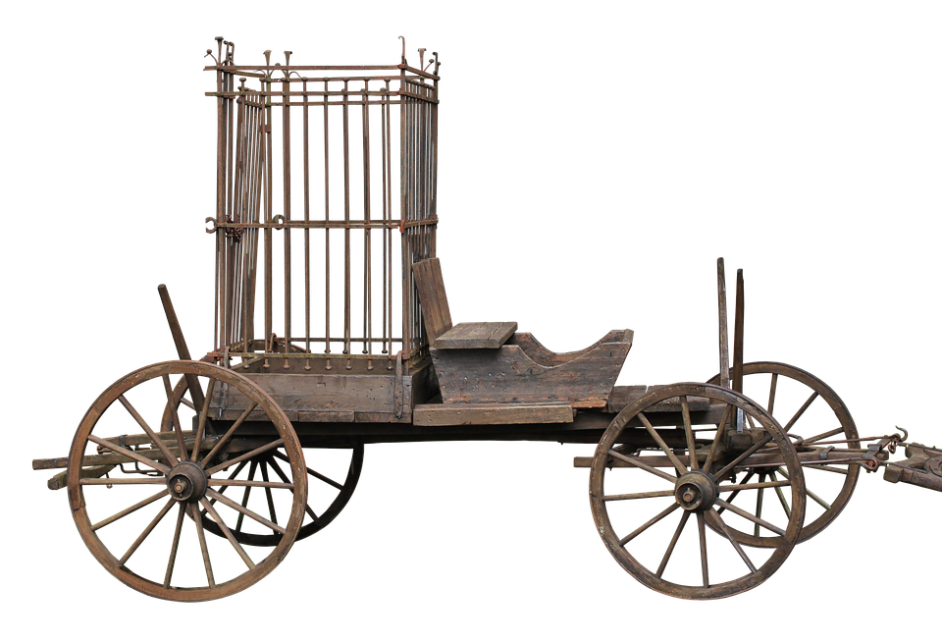

Slide 12
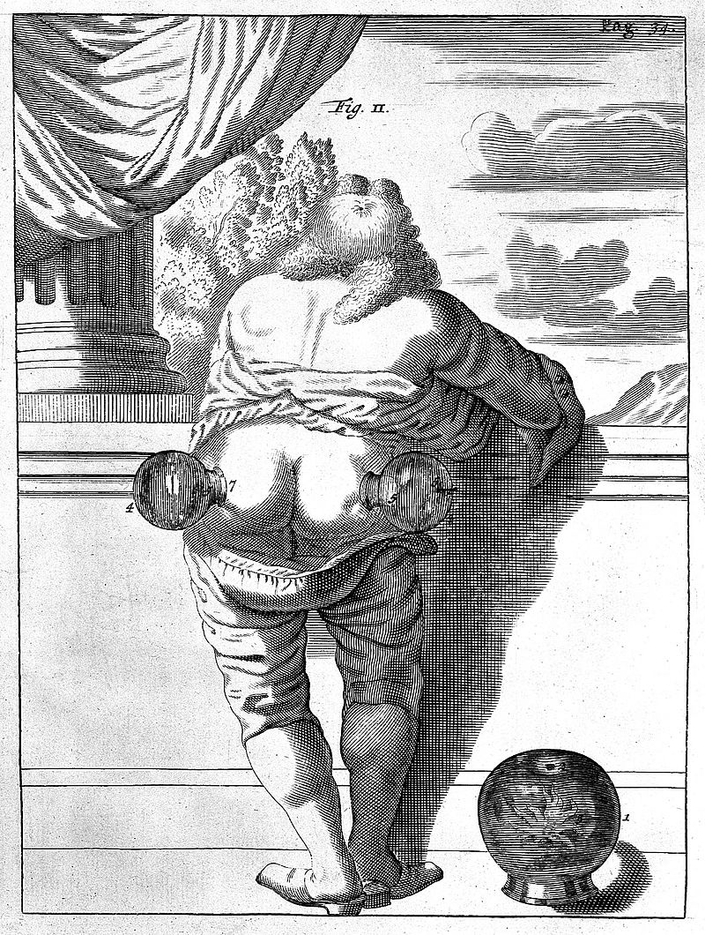
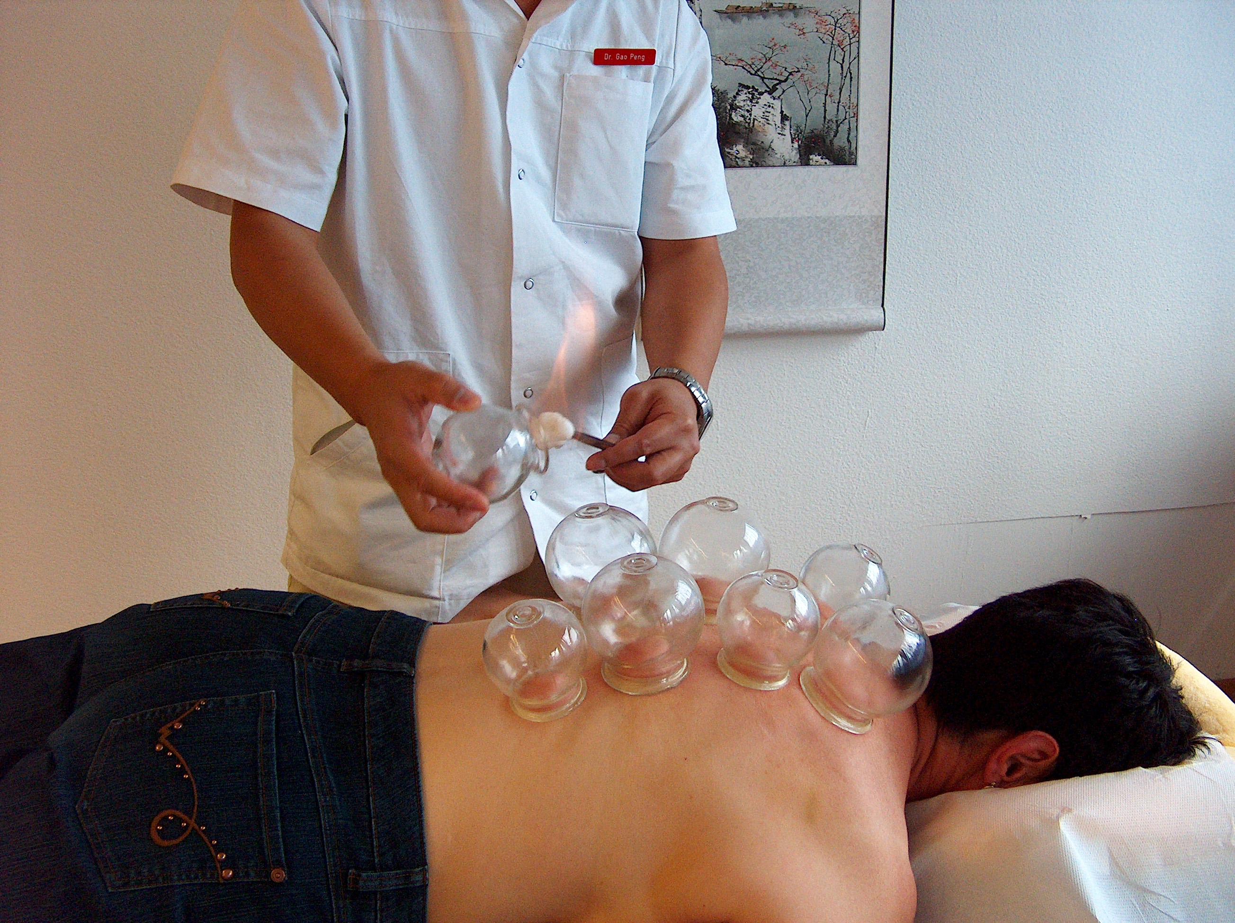

Slide 13
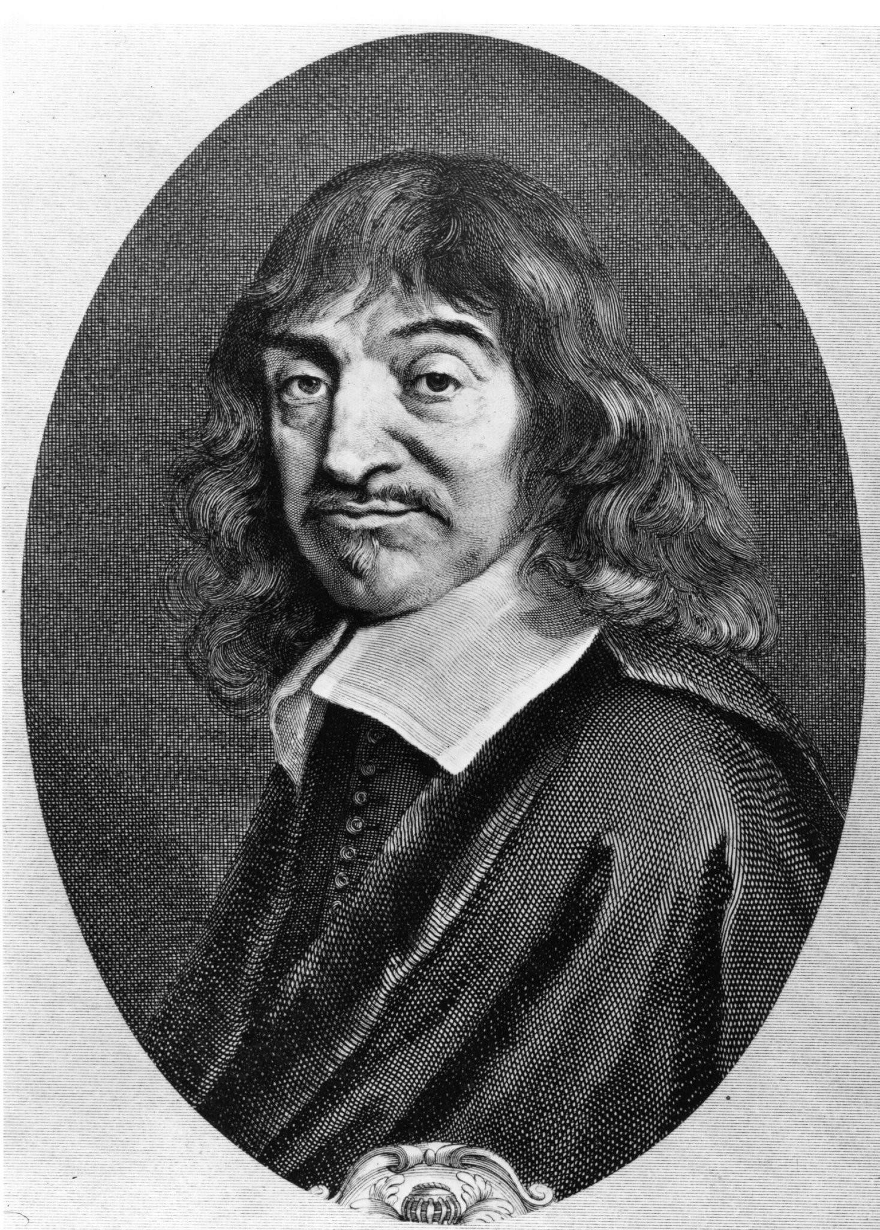
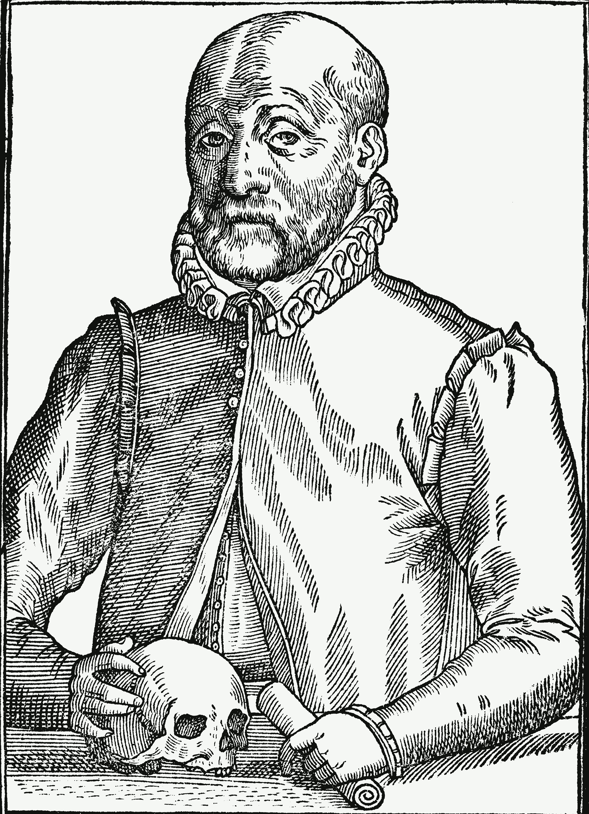
Renaissance
Observation and physical view on the world overshadows religious viewpoints
Biological explanations for psychological problems
René Descartes: duality of the soul and body ->
  basis for western understanding of mental illness until recently
Johan Weyer – observation of patients -> described psychopathological symptoms
    - first who published against the persecution of witches

Slide 14
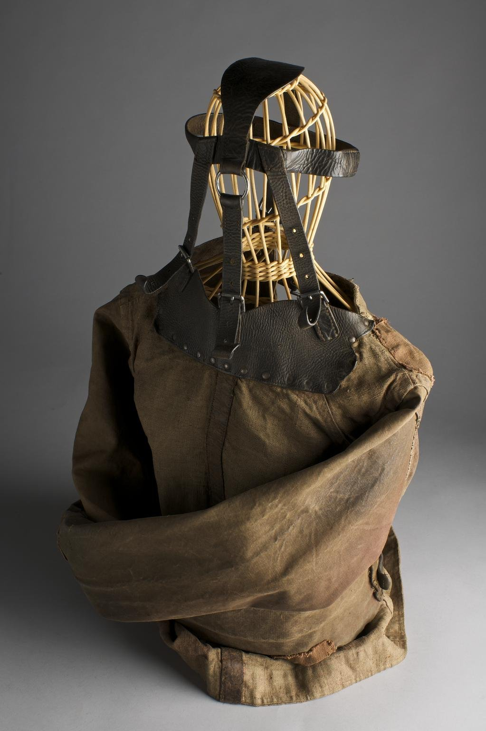
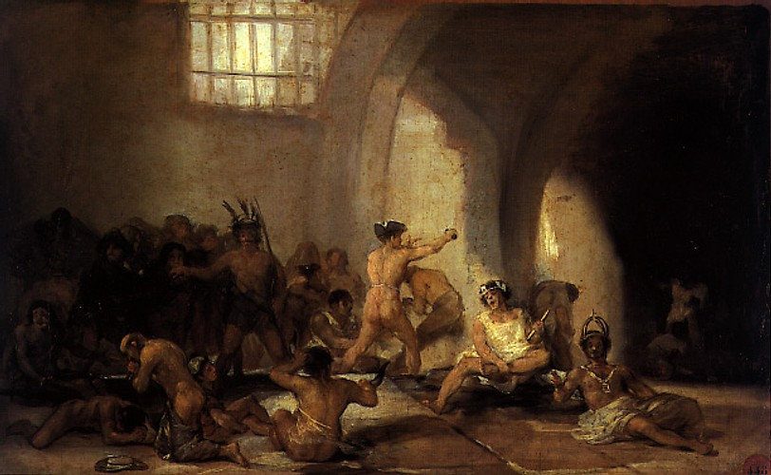
Reinnesance - treatment
Treatment of the people with mental illness gets to the hands of doctors
Mental illness is believed to be caused by brain, brain demage, tumors
Asylums aside the society
Water treatment, massages, physical exercise, sleep-inducing substances
Dangerous patients – locked in towers or cells

Slide 15
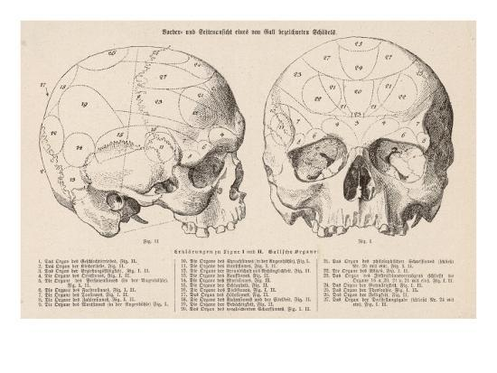
Late 18th and 19th century
Knowledge and care in the hands of doctors – Birth of Psychiatry
Benjamin Rush – first psychiatric text in psychiatry admitting that mental illness might be caused by our mind
Phillipe Pinel – Psychiatrist – book on the classification of diseases
Gall – skull physiology -> organology -> phrenology
Mental illness is primarily physical condition but may be influenced or caused by our mind

Slide 16
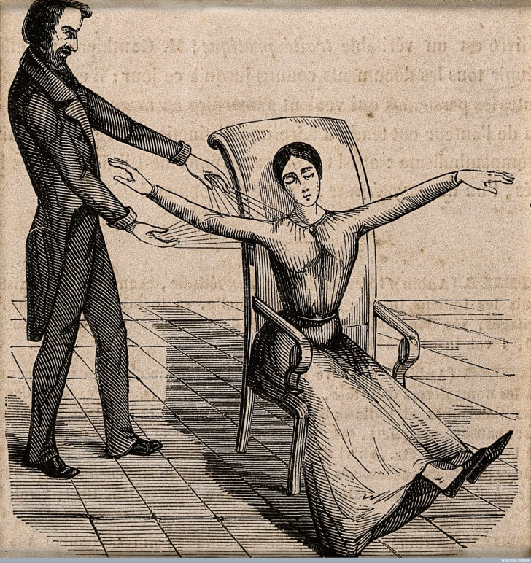
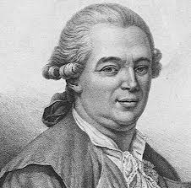
Late 18th and 19th century treatment
Franz Mesmer
magnetic force in our bodies influenced by gravitation of the planets
Magnets, iron bars, his own magnetic force
Experiment with „magneting“ over doors
Mesmerism -> hypnoses x placebo

Slide 17
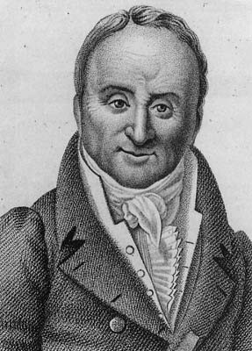
Late 18th and 19th century treatment
Philipe Pinel
physician
Improved living conditions of the patients in hospitals
Bicetre – male asylum – horrible conditions, patients restrained by chains for years
  Removed chains from those with no violent behaviour
  Bleeding, purging, blistering -> „psychodrama“, working
60% death patients/first two years -> 10% …
La Salpetriere – female asylum
Keeping case histories
-> soon in whole Europe

Slide 18
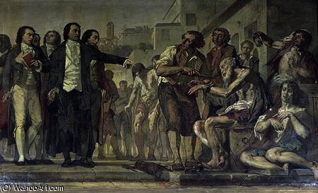
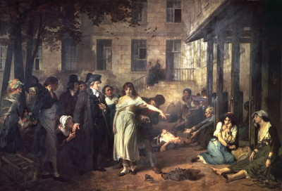

Slide 19
Birth of Psychology
Helmoltz, Müller, Fechner, James, …
1879 Wilhelm Wundt – first laboratory of psychology in Liebzig, Germany – birth of psychology
1892 Foundation of American Psychological Association
One of very few fields that first had a science and then clinical approach

Slide 20
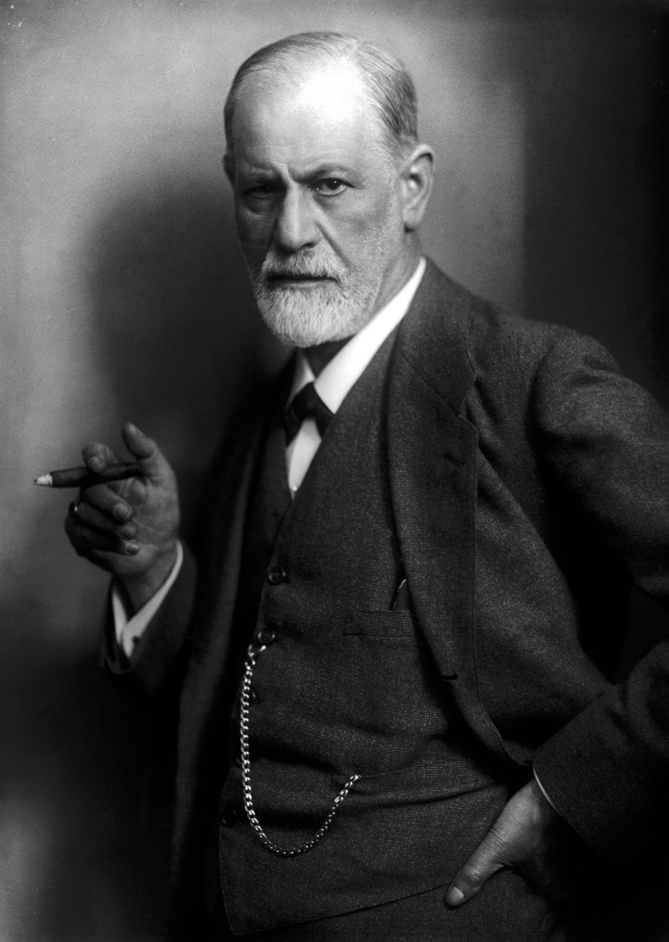
Birth of Psychoanalysis
Sigmund Freud (1856-1939)
  Austrian neurologist
  Psychological explanations of the disorders
  Baseline for clinical approach

Slide 21
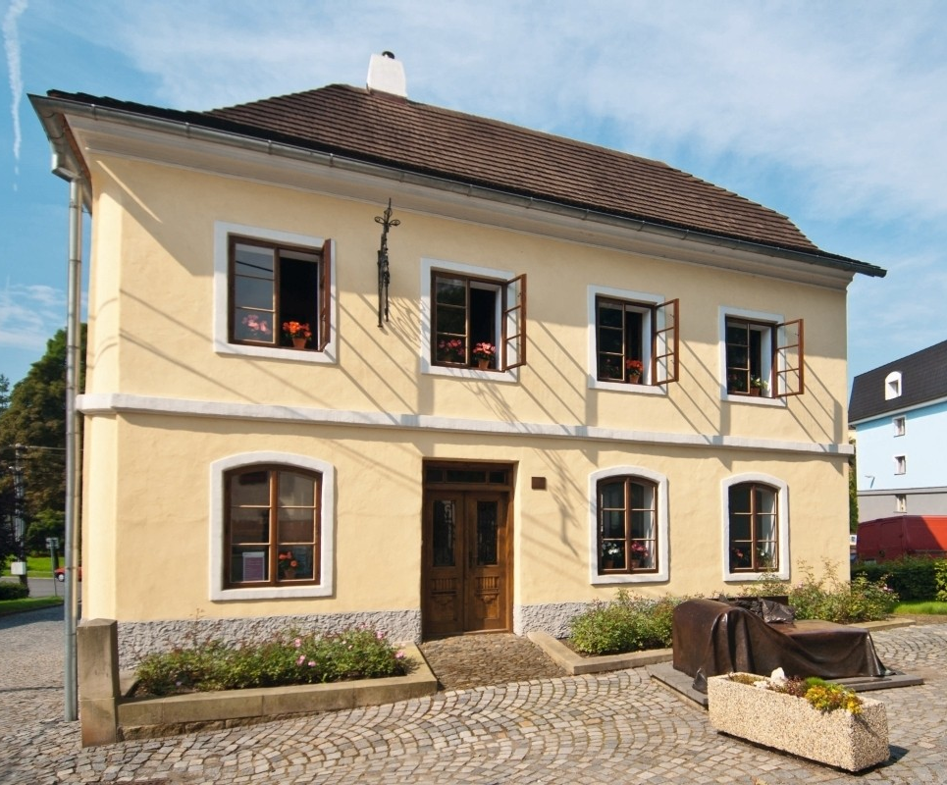
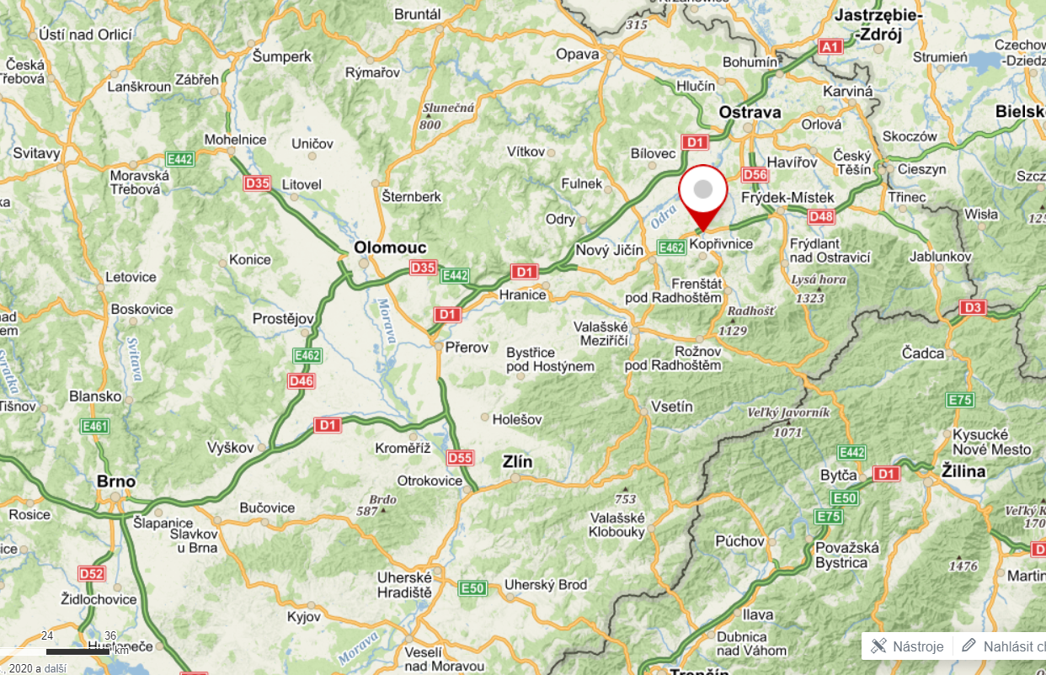
Travel tip
Příbor – birthtown of Sigmund Freud

Slide 22
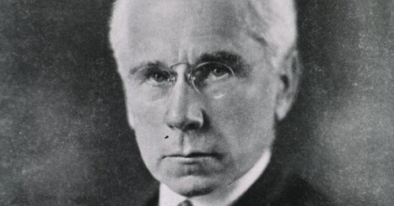
Birth of Clinical Psychology
Lightner Witmer (1867-1956)
Born in USA
Wunds doctoral student
Back in USA – University of Pennsylvania – was asked to work with 14 year-old boy with severe difficulty with spelling and recognising witten words -> founded the first Psychological clinic -> CLINICAL PSYCHOLOGY
Clinical psychology – careful application of scientific psychological knowledge into human problems solving -> APA rejected
-> Witmer established training in Clinical Psychology at University of Pennsylvania -> hospial for kids with mental disabilities
-> 1917 American Association of Clinical psychology -> APA loosing members -> Clinical section

Slide 23
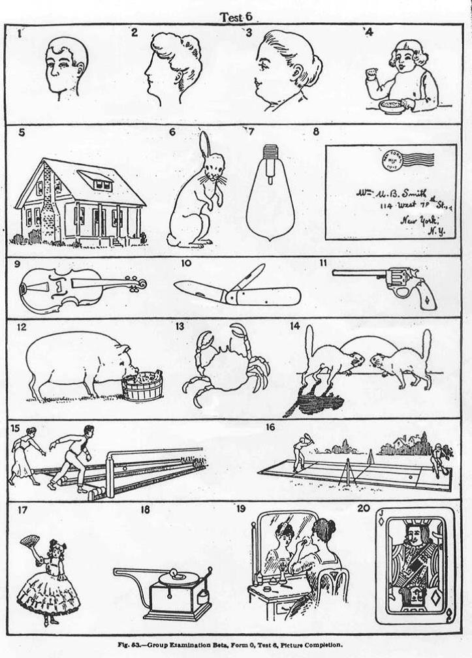
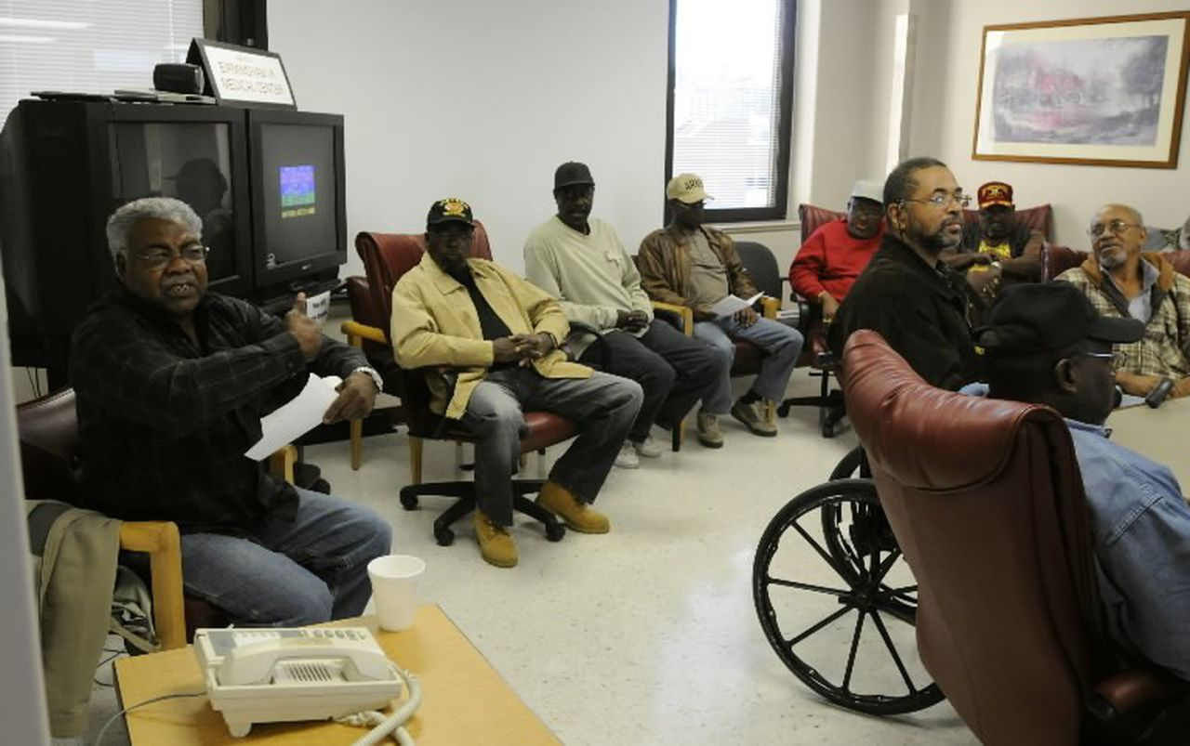
Milestones in 19th and 20th century
Galton
Binet
World War I. – need to asess -> Army Alpha and Beta -> Assessment in PsychologyPsychologists assesses psychological assessment – Army Alpha and Beta
World War II. –> PTSD -> need to treat -> more PhD students necessary -> New psychoterapeutic approaches

Slide 24
Clinical Psychology
Research
  Characteristics of psychopathology, basic understanding of psychopathology, prevalence, effectiveness of psychotherapy
Treatment – Application of Scientific knowledge psychoterapeutical approaches
Assessment
Prevention

Slide 25
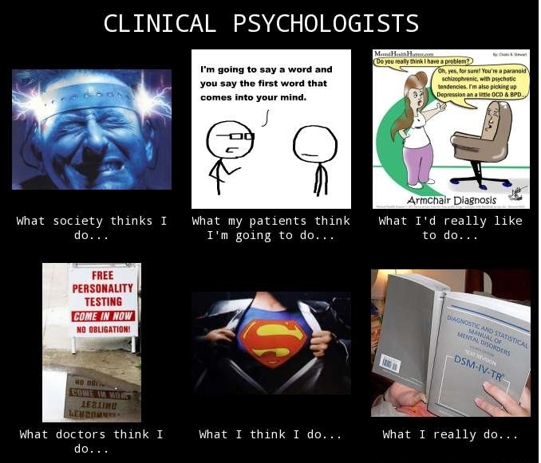
Thank you for reading ☺

Slide 26
References:
Gould, S. J. (1996). The mismeasure of man. New York: Norton.
Hunt, M. M. (2007). The story of psychology. New York: Anchor Books
Svoboda, M., Češková, E., Kučerová, H. (2006). Psychopatologie a psychiatrie. Praha: Portál.
Historical overview of clinical psychology (n.d.). https://www.zeepedia.com/read.php?historical_overview_of_clinical_psychology_the_greek_period_clinical_psychology&b=84&c=4
History of clinical psychology (n.d.). https://www.zeepedia.com/read.php?history_of_clinical_psychology_research_assessment_conclusion_clinical_psychology&b=84&c=5
How clinical psychologist became involved in treatment (n.d.). https://www.zeepedia.com/read.php?how_clinical_psychologists_became_involved_in_treatment_clinical_psychology&b=84&c=6

