Slide 1
Korean class (week 3)
김예리 (YERY KIM) & 김예은 (YEEUN KIM)

Slide 2
TODAY’S INDEX
1. Informal / Polite expression
2. Basic Grammar (order of sentence)
3. Today ’s word (food)
4. Today ‘s dialogue
5. Korean culture (texting)
6. Today’s K-pop
Notes:
Korean has a different sentence structure than English, so I'm going to teach you that today

Slide 3
1. Informal/polite expression
Hi informal / polite
안녕 / 안녕하세요
[An-nyeong / An-nyeong-ha-sae-yo]
Bye
잘가 or 안녕/ 안녕히가세요
[Jal-ga or An-nyeong / An-nyeong-hee-ga-sae-yo]
* 안녕히가세요 [An-nyeong-hee-ga-sae-yo] - It's used when someone older than me leaves
* 안녕히계세요 [An-nyeong-hee-gye-se-yo] - It's used when someone older than me stays there and I leave
Notes:
It's similar to last week, but since Korea is a country that uses a lot of polite expressions, we need to learn more in detail, so we put this in class this week
There are two ways to say hi
You can use this expression among your friends
We use this expression politely to those who are older than us
You asked me last week, so I wrote the difference between the two expressions

Slide 4
1. Informal/polite expression
Sorry Informal/polite
미안(해) / 미안해요 / 죄송합니다
[Mi-an-(hae) / Mi-an-hae-yo / Jwae-song-hap-ni-da]
Thank you
고마워 / 고마워요 / 감사합니다
[Go-ma-wo / Go-ma-wo-yo / Gam-sa-hap-ni-da]

Slide 5
1. Informal/polite expression
yes Informal/polite
응 or 어 / 네
[eung or eo / ne]
no
아니/ 아니요
[ani / ani-yo]

Slide 6
1. Informal/polite expression
In Korean, if you add "요" [yo] at the end, it becomes a polite expression
+ if you add "-ㅂ니다" [b/p-ni-da] it becomes more polite expression
Practice
1) I love you
사랑해 / 사랑해요/ 사랑합니다 [saranghae / sarang-hae-yo / sarang-hap-ni-da]
2) okay
알겠어 / 알겠어요/ 알겠습니다 [al-gess-seo /al-gess-seo-yo / al-gess-seub-ni-da]

Slide 7
When you call the name
AH / YA (~아 / ~야)
In Korea, when you call a person's name,
you put "아"[AH] or "야"[YA] after the person's name
아[AH] - If the name ends with consonants, you can add "아" [AH] at the end
야[YA] - If the name ends with vowels, you can add "야"[YA] at the end
Q. 1. 예리 (아[AH] / 야[YA] )
2. 니콜라스 (아[AH] / 야[YA] )
3. 정국 (아[AH] / 야[YA] )
Notes:
Before you go out, write your name in Korean, check if your name should write 아 or 야 , and we will check it one by one and you can go home

Slide 8
1. Informal/polite expression
I Informal/polite
ex) I’m drinking water
나는 물을 마시고 있어. [ Na-neun mul-eul masigo iss-eo]
저는 물을 마시고 있어요. [Jeo-neun mul-eul masigo iss-eoyo]

Slide 9
1. Informal/polite expression
My Informal/polite
ex) My hobby is jogging.
나의 취미는 조깅이야. [ Na-ui chwimineun jogging-iya ]
저의 (제) 취미는 조깅이에요. [ Jeo-ui chwimineun jogging-ieyo ]

Slide 10
1. Informal/polite expression
Me Informal/polite
ex) Please give it to me.
그것을 나에게 줘 [ Geu-geot-eul na-e-ge gwo ]
그것을 저에게 주세요 [ Geu-geot-eul jeo-e-ge ju-sae-yo ]

Slide 11
1. Informal/polite expression
You Informal/polite
ex) You are pretty
너는 예쁘다 [ Neo-neun yae-bbeu-da ]
당신은 예뻐요 [ Dang-sin-eun yae-bbeo-yo ]

Slide 12
2. Basic grammar
Korean have a different word order from English
나는 초콜렛을 좋아한다.
I like chocolate
[ naneun chokolles-eul joh-ahanda ]

Slide 13
2. Basic grammar
Be – Verb
Am , Are , Is
~다 / ~이다 [ da / I –da]
ex)
뷔는 밥을 먹는다 -V is eating a rice [V neun bab-eul meong-neun-da]
지민이는 천재이다- Jimin is a genius [Jimin-ineun cheonjae-ida]
제니는 공주이다-Jenny is a princess [Jenny neun gongju-ida]
Most Korean sentences end with '다' [da]
However, when you want to change a noun to a descriptive word, you can add ‘이다’ [I-da]

Slide 14
2. Basic grammar
Korean have a different word order from English
내 이름은 예리입니다.
My name is Yeri
[Nae ileumeun yeri ibnida]
Notes:
In English, verbs come after subjects, while in Korean, nouns or objects come after subjects, and then verbs come afterwards.

Slide 15
2. Basic grammar
Korean have a different word order from English
나는 치킨을 먹었다.
I ate chicken
[naneun chikin-eul meog-eoss-da]

Slide 16
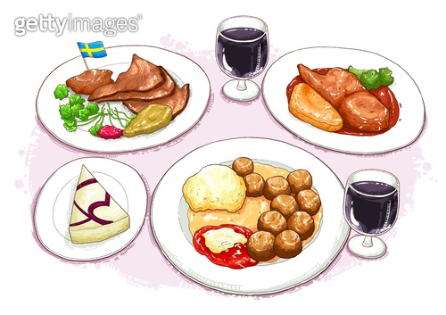
Today’s word
Food
Water - 물 [ mul ]
Rice - 밥 [ bab ]
Plate - 접시 [ jeobsi ]
Cup - 컵 [ cub ]
Spoon - 숟가락 [ sud-ga-lag ]
Chopstick - 젓가락 [ jeod-ga-lag ]
Fork - 포크 [ pokeu ]
Knife - 칼 /나이프 [ kal / nife ]

Slide 17
Today’s Dialogue
Yeri : Hi, Did you eat something?
안녕, 너 밥은 먹었어?
[ An-nyeong, neo bab-en meog-eoss-eo?]
Jimin : No, I am hungry
아니, 나 배고파
[Ani, na bae-go-pa]

Slide 18
Today’s Dialogue
Yeri : Me, too. Let’s eat dinner together.
나도. 같이 저녁 먹자
[Nado. get-i jeo-nyeog meog-ja]
Jimin : What do you want to eat?
뭐 먹고 싶어?
[mwo meog-go sip-eo?]
Yeri : I want to eat ___불고기___
나는 __불고기___ 먹고싶어
[Na-neun __Bulgogi__ meog-go sip-eo]

Slide 19
Today’s Expression
Thank you for the meal (=Bon appetit)
잘 먹겠습니다
[Jal meog-ges-sseub-ni-da]
I really enjoyed the meal
잘 먹었습니다
[Jal meog-eos-sseub-ni-da]
cheers
건배 / 짠
[gepnbae / jjan]

Slide 20
5. Korean culture (texting)
Kakao talk

Slide 21
5. Korean culture (texting)
Using initial consonants
Abbreviation/
Daily words
ㅋㅋㅋㅋㅋㅋ
ㅎㅎ
ㄱㅅ
ㅇㅇ
ㅎㅇ
ㅃㅃ
ㅊㅋㅊㅋ
ㅇㅋ
TMI
TMT
심쿵
노잼
맥날
대박
소확행
갑분싸
Notes:
현타
띵작
별다줄
사바사/케바케
JMT
어그로
인싸/아싸
이거레알
ㅇㄱㄹㅇ
안물안궁
베프
핵인싸
댕댕이
낄끼빠빠
꾸안꾸
졌잘싸

Slide 22
5. Korean culture (texting)
Using initial consonants
consonant
consonant
consonant
vowel
consonant
vowel
vowel
vowel
consonant
consonant
Initial consonants
초성 [cho-seong]
Notes:
현타
띵작
별다줄
사바사/케바케
JMT
어그로
인싸/아싸
이거레알
ㅇㄱㄹㅇ
안물안궁
베프
핵인싸
댕댕이
낄끼빠빠
꾸안꾸
졌잘싸

Slide 23
5. Korean culture (texting)
Using initial consonants
Describe Laughing sound
ㅋㅋ/ㅎㅎ
Number of consonants makes different nuance
1 consonant : ㅋ/ㅎ ⇒ feel like laugh at someone
2 consonants : ㅋㅋ ⇒ not really funny, mechanical and formal reactions / ㅎㅎ ⇒ more casual reaction than ㅋㅋ
3 or more consonants : ㅋㅋㅋㅋㅋㅋㅋ / ㅎㅎㅎㅎㅎㅎ ⇒ really funny and happy
Notes:
현타
띵작
별다줄
사바사/케바케
JMT
어그로
인싸/아싸
이거레알
ㅇㄱㄹㅇ
안물안궁
베프
핵인싸
댕댕이
낄끼빠빠
꾸안꾸
졌잘싸

Slide 24
5. Korean culture (texting)
Using initial consonants
Text just word’s initial consonants
ㄱㅅ : 감사 [gam-sa] (Thank you)
ㅇㅇ : 응응 [eung-eung] (Yes, Yes)
ㅎㅇ : 하이 [Ha-i] (Hi)
ㅃㅇㅃㅇ/ㅃㅃ : 빠이빠이 [bba-i-bba-i] / 빠빠 [bba-bba] (Bye)
ㅊㅋ : 추카 [chu-ka] (Congratulation) + 축하 [chuk-ha]
ㅇㅋ : 오키 [o-ki] (Okay)
ㅇㄱㄹㅇ : 이거레알 [i-geo-re-al] (This is ture! Real!)
Notes:
현타
띵작
별다줄
사바사/케바케
JMT
어그로
인싸/아싸
이거레알
ㅇㄱㄹㅇ
안물안궁
베프
핵인싸
댕댕이
낄끼빠빠
꾸안꾸
졌잘싸

Slide 25
5. Korean culture (texting)
Abbreviation(줄임말 [jul-im-mal])/ Daily words
대박 [dae-bak] (Great! Amazing!)
TMI : too much information
TMT : too much talker
노잼 [no-jaem] : 재미없다 (not funny, boring)
심쿵 [shim-kung] : 심장이 쿵하고 내려앉다 (surprised or excited enough to make heart drop)
맥날 [maek-nal] : 맥도날드(Mcdonald’s)
Notes:
현타
띵작
별다줄
사바사/케바케
JMT
어그로
인싸/아싸
이거레알
ㅇㄱㄹㅇ
안물안궁
베프
핵인싸
댕댕이
낄끼빠빠
꾸안꾸
졌잘싸

Slide 26
5. Korean culture (texting)
Abbreviation/ Daily words
사바사 [sa-ba-sa] : 사람 바이(by) 사람 (person by person)
케바케 [ke-ba-ke] : 케이스 바이 케이스 (case by case)
핵 [haek] (prefix means “very”, “really”)
인싸 [in-ssa] : 인싸이더 (Insider)
아싸 [a-ssa] : 아웃싸이더 (Outsider)
베프 [be-peu] : 베스트프렌드 (best friend)
현타 [hyun-ta] : 현실 자각 타임(time)
핵 [haek] + 인싸 [in-ssa]
= 핵인싸
Notes:
Insider person who actively participates in various events and gatherings and gets along well with people
Outsider A person who can't mix well with
A person who gets along really, very well with people the group.
It's time to realize the real situation that you're facing after falling into vain dreams or delusions

Slide 27
5. Korean culture (texting)
Abbreviation/ Daily words
소확행 [so-hwak-haeng] : 소소하지만 확실한 행복 (Small but definite happiness)
갑분싸 [gap-bun-ssa] : 갑자기 분위기 싸해진다 (The mood is suddenly getting cold)
졌잘싸 [jyeot-jal-ssa] : 졌지만 잘 싸웠다(We lost but we fought well)
별다줄 [byeol-da-jul] : 별걸 다 줄인다(You shorten everything)

Slide 28
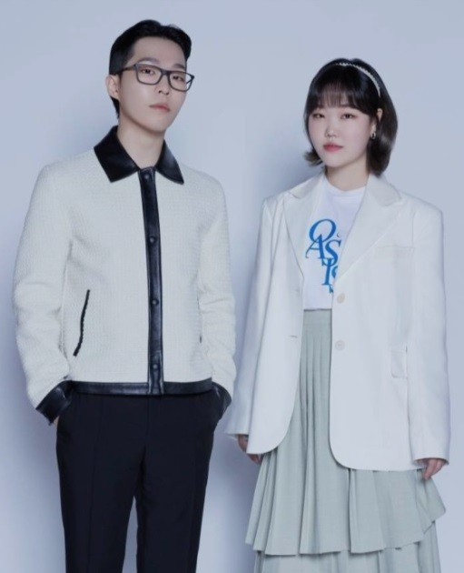
6. Today’s K-pop
AKMU(악동뮤지션)
“Dinosaur”
https://youtu.be/s_Pil-lMgZk

Slide 29
Thank you for listening
감사합니다 :)
김예리 (YERY KIM)
김예은 (YEEUN KIM)

