Slide 1
Korean class
Week 6
Yery Kim
Yeeun Kim

Slide 2
1. Number
2. Propositional particles
3. Past and future expression
4. Korean culture
5. Today’s K-pop

Slide 3
1. Number
Chinese number
0 : 영 [yeong] / 공 [gong]
22
78
141
300
이십이 [i-sib-i]
칠십팔 [chil-sib-pal]
백사십일 [baek-sa-sib-il]
삼백 [sam-baek]

Slide 4
1. Number
Chinese number
0 : 공 [gong]
1000 : 천 [cheon]
10,000 : 만 [man]
100,000 : 십만 [sib-man]
1,000,000 :
100,000,000 : 억 [eok]
1,000,000,000 : 십억 [sib-eok]
Trillion : 조 [jo]
백만 [baek-man]
원 [won]

Slide 5
1. Number
2. Korean number
Number | Korean | Pronunciation
1 | 하나 | Ha-na
2 | 둘 | Dul
3 | 셋 | Set
4 | 넷 | Net
5 | 다섯 | Da-seot
6 | 여섯 | Yeo-seot
7 | 일곱 | il-gob
8 | 여덟 | Yeo-deol
9 | 아홉 | A-hop
10 | 열 | yeol
Number | Korean | Pronunciation
0 | 영 | Yeong
20 | 스물 | Seu-mul
30 | 서른 | Seo-reun
40 | 마흔 | Ma-heun
50 | 쉰 | shin
60 | 예순 | Ye-sun
70 | 일흔 | il-heun
80 | 여든 | Yeo-deun
90 | 아흔 | A-heun

Slide 6
1. Number
Chinese number
Counting number
Date : day, month, year
ex) 4th : 사일[sa-il], 12nd : 십이일[sib-i-il]
Phone number
ex) 010-6372-0819 / 776-079-455
2. Korean number
Counting number
Counting age
Counting materials (paper, piece, things, etc)

Slide 7
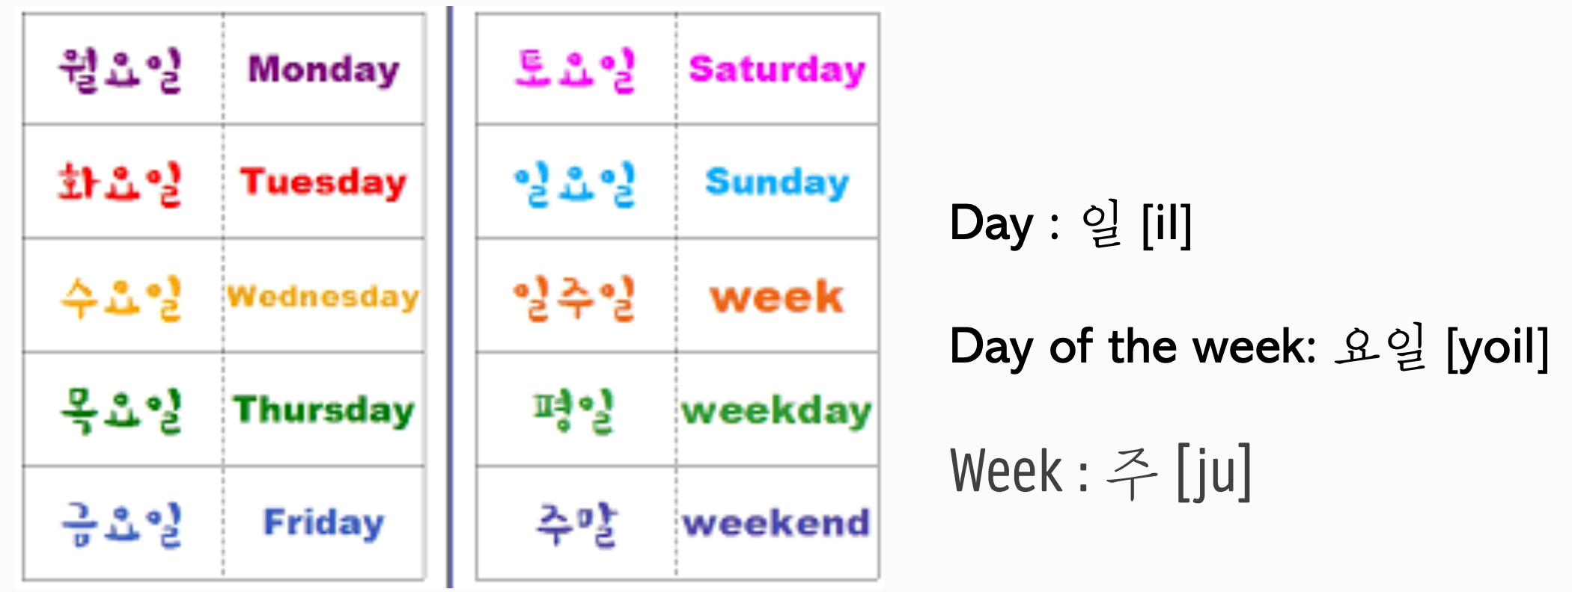
1. Number
Words related with Date

Slide 8
1. Number
Words related with Date
Monday = 월요일 [Wor-yo-il] / [Wo-ryo-il]
Tuesday = 화요일 [Hwa-yo-il]
Wednesday = 수요일 [Su-yo-il]
Thursday = 목요일 [Mok-yo-il] / [Mo-gyo-il]
Friday = 금요일 [Kum-yo-il] / [geu-myo-il]
Saturday = 토요일 [To-yo-il]
Sunday = 일요일 [il-yo-il] / [i-ryo-il]

Slide 9
1. Number
Day of week
Weekday = 평일 [Pyeong-il]
Weekend = 주말 [Ju-mal]
A Week = 일주일 [il-ju-il]

Slide 10
1. Number
Month : 월[wol]
January = 1월 [il-wol]
Febuary = 2월 [i-wol]
March = 3월 [sam-wol]
April = 4월 [sa-wol]
May = 5월 [o-wol]
June = 6월 [yu-wol]
July = 7월 [chil-wol]
August = 8월 [pal-wol]
September = 9월 [gu-wol]
October = 10월 [si-wol]
November = 11월 [sib-il-wol]
December = 12월 [sib-i-wol]

Slide 11
1. Number
살 [sal] : age
개 [gae] : things
장 [jang] : sheet
조각 [jo-gak] : piece
Number
Requires transformation of Korean native language numbers
Notes:
unit

Slide 12
1. Number
2. Korean number
Number | Korean | Pronunciation
1 | 한 | Han
2 | 두 | Du
3 | 세 | Se
4 | 네 | Ne
5 | 다섯 | Da-seot
6 | 여섯 | Yeo-seot
7 | 일곱 | il-gob
8 | 여덟 | Yeo-deol
9 | 아홉 | A-hop
10 | 열 | yeol
Number | Korean | Pronunciation
0 | 영 | Yeong
20 | 스무 | Seu-mu
30 | 서른 | Seo-reun
40 | 마흔 | Ma-heun
50 | 쉰 | shin
60 | 예순 | Ye-sun
70 | 일흔 | il-heun
80 | 여든 | Yeo-deun
90 | 아흔 | A-heun

Slide 13
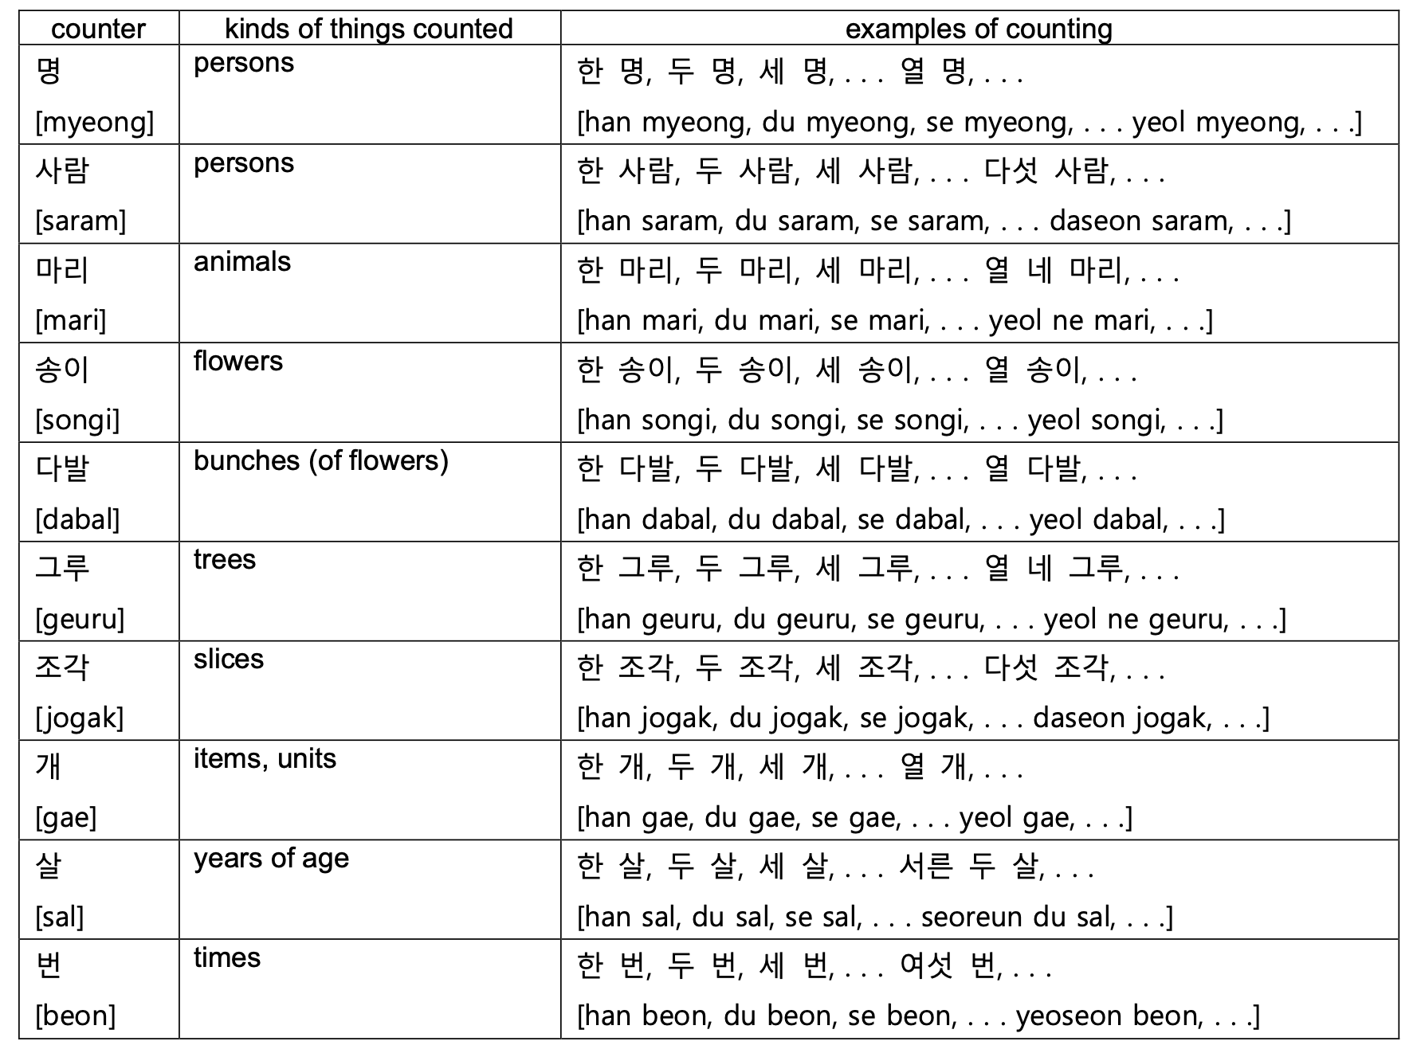
1. Number

Slide 14
1. Number
1 years old : 한 살 [han-sal]
2 years old : 두 살 [du-sal]
3 years old : 세 살 [se-sal]
4 years old : 네 살 [ne-sal]
20 years old : 스무 살 [seu-mu-sal]
Q. How old are you? 너 몇 살이야? [neo myeot-sal-i-ya?]
A. I’m 22 years old. 나는 스물 두살이야. [na-neun seu-mul-du-sal-i-ya.]

Slide 15
1. Number
1 thing : 한 개 [han-gae]
2 things : 두 개 [du-gae]
3 things : 세 개 [se-gae]
4 things : 네 개 [ne-gae]
20 things : 스무 개 [seu-mu-gae]
Two apples please : 사과 두 개 주세요. [sa-gwa du-gae ju-se-yo.]
How much is four chocolates? : 초콜릿 네 개 얼마예요? [cho-kol-lit ne-gae eol-ma-ye-yo?]

Slide 16
1. Number
1 sheet of paper : 한 장 [han-jang]
2 sheets of paper : 두 장 [du-jang]
3 sheets of paper : 세 장 [se-jang]
4 sheets of paper : 네 장 [ne-jang]
20 sheets of paper : 스무 장 [seu-mu-jang]
I have to write a report for today's assignment.
: 오늘 과제로 보고서 한 장 써야해.
[o-neul gwa-je-ro bo-go-seo han-jang sseo-ya-hae.]

Slide 17
1. Number
3. Count the order
Number + (번)째 [(beon)-jjae]
Number | Korean | Pronunciation
1st | 첫(번)째 | Cheot-(beon)-jjae
2nd | 두(번)째 | Du-(beon)-jjae
3rd | 세(번)째 | Se-(beon)-jjae
4th | 네(번)째 | Ne-(beon)-jjae
5th | 다섯(번)째 | Da-seot-(beon)-jjae
6th | 여섯(번)째 | Yeo-seot-(beon)-jjae
7th | 일곱(번)째 | il-gob-(beon)-jjae
8th | 여덟(번)째 | Yeo-deol-(beon)-jjae
9th | 아홉(번)째 | A-hop-(beon)-jjae
10th | 열(번)째 | yeol-(beon)-jjae

Slide 18
2. Propositional particles
Objective making particles
을[eul] / 를[leul]
Words ending with a consonant + -을
Words ending with a vowel + -를

Slide 19
2. Propositional particles
Examples
거울[geo-ul] + 을[eul]
=mirror
나무[na-mu] + 를[leul]
=tree
나[na] + 를[leul]
=me
기차를 봐요 ! [gi-cha-leul bwo-yo] = Look at the train !
=train

Slide 20
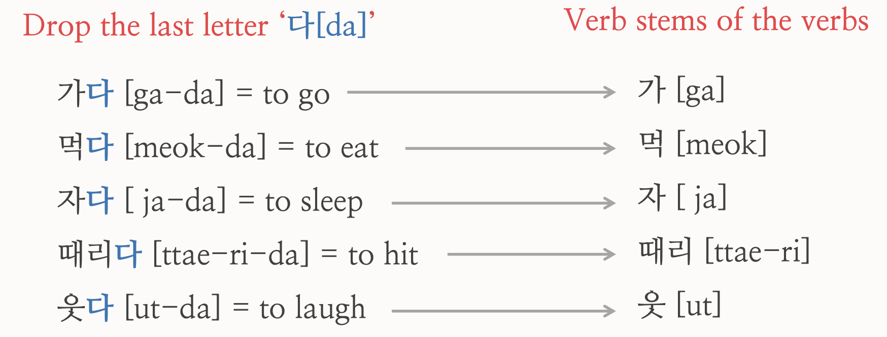
3. Past and Future expression
Present

Slide 21
3. Past and Future expression
Past
Pre-final
ending
which represents tense
가
다
Verb stem
Ending of the word
Go/[ga]
[da]

Slide 22
3. Past and Future expression
-았-[at] / -었-[eot]
1. Verb stems ending with vowels ᅩ [o] or ᅡ [a] + 았 [at]
2. Verb stems ending with vowels OTHER THAN ᅩ or ㅓ + 었 [eot]
3. Verb stem 하 + 였 [yeot]

Slide 23
3. Past and Future expression
Past
Polite ending
?
-았- / -었-
[at] [eot]
어요
Verb stem
Ending of the word
[eo-yo]

Slide 24
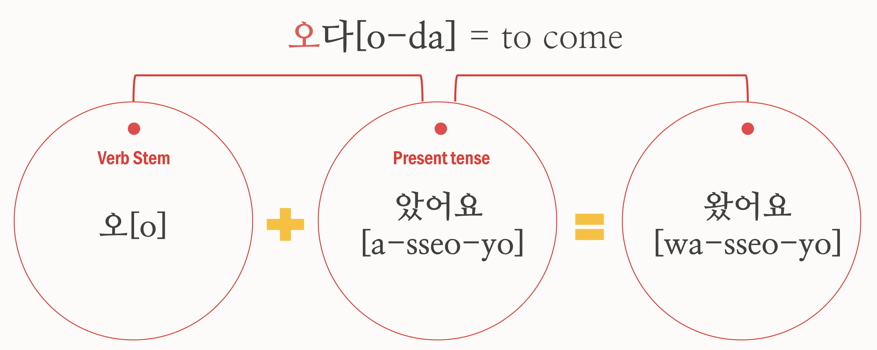
3. Past and Future expression
Pre-final ending
Past tense

Slide 25
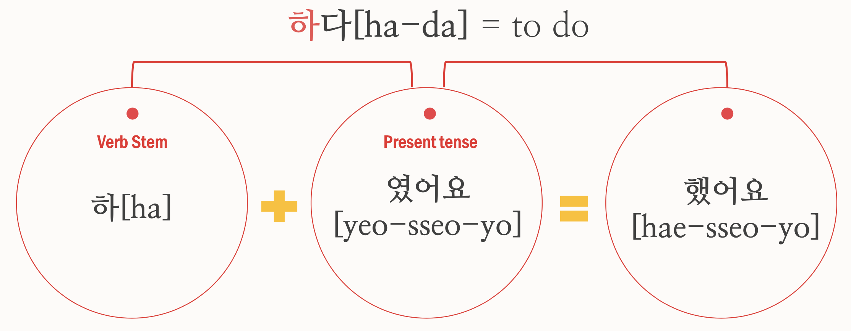
3. Past and Future expression
Pre-final ending
Past tense

Slide 26
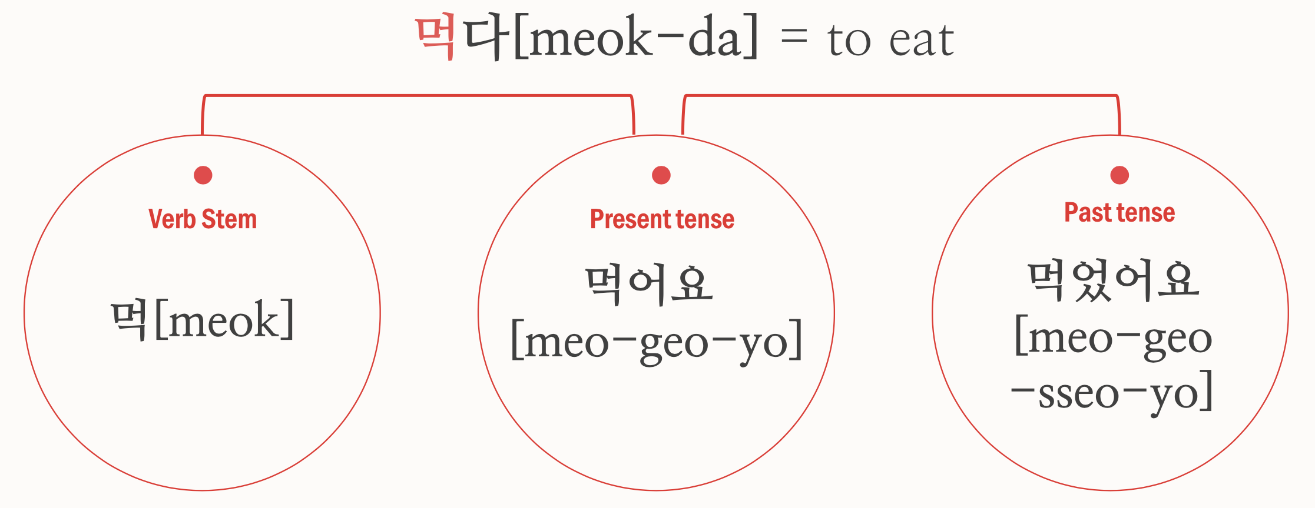
3. Past and Future expression

Slide 27
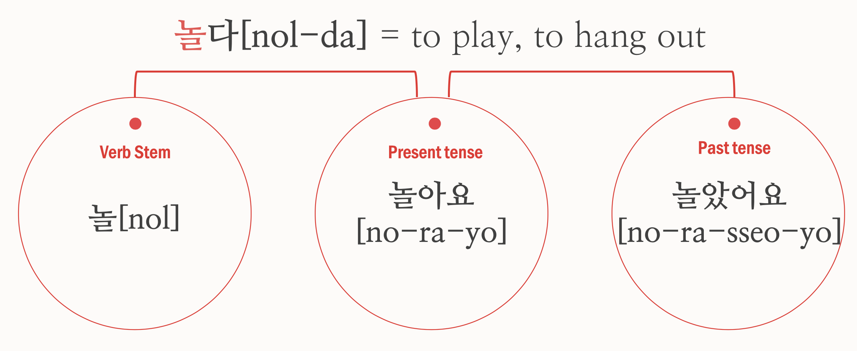
3. Past and Future expression

Slide 28
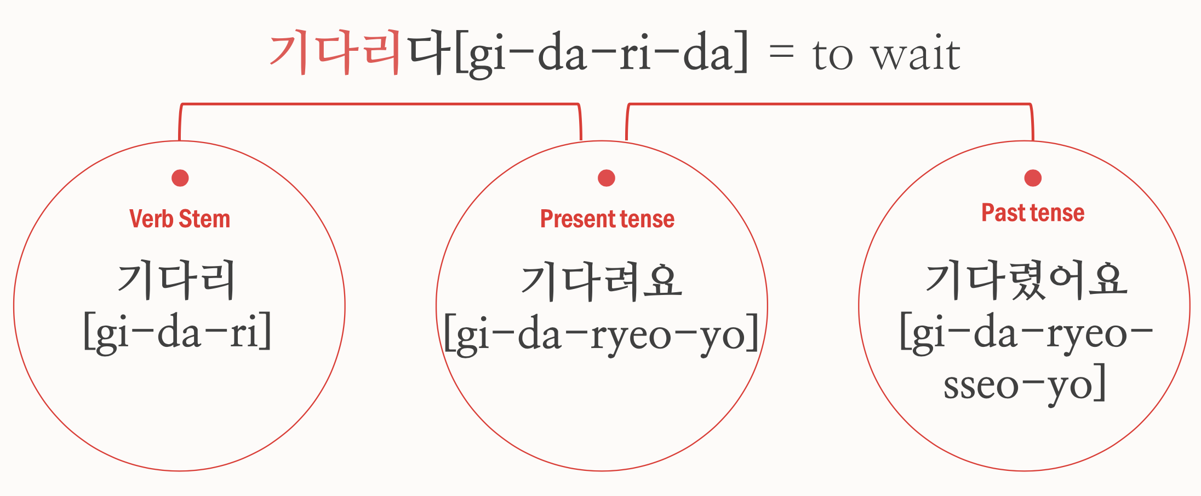
3. Past and Future expression
리[ri] + 어[eo]
= 려[ryeo]
리[ri] + 었[eot]
= 렸[ryeot]

Slide 29
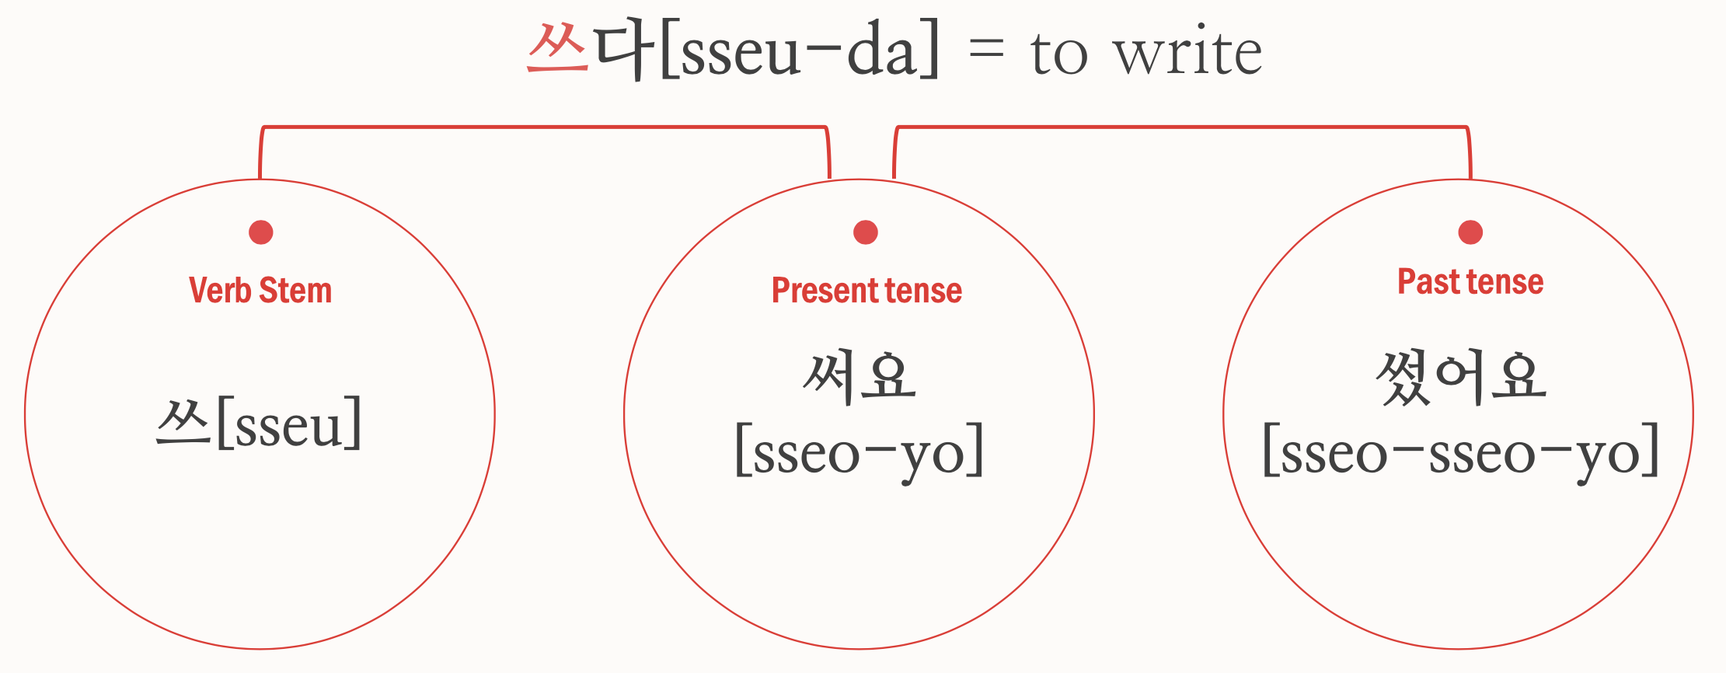
3. Past and Future expression

Slide 30
3. Past and Future expression
Dialogue
Sana : What did you do last weekend?
=지난 주말에 뭐했어?
[ji-nan ju-mal-e mwo-hae-sseo?]
Jin : I watched a movie with my friend.
= 나 친구랑 영화 봤어.
[na chin-gu-rang yeong-hwa-bwa-sseo]

Slide 31
3. Past and Future expression
Dialogue
Sana : What’s the title of movie?
= 영화 제목이 뭐야?
[yeong-hwa jae-mok-I mwo-ya?]
Jin : Parasite! Have you watched this movie?
= 기생충! 너 이 영화 봤어?
[gi-saeng-chung! Neo I yeong-hwa bwa-sseo?]

Slide 32
3. Past and Future expression
Dialogue
Sana : No, I haven't seen it yet.
=아니, 아직 안 봤어.
[a-ni, a-jik an bwa-sseo]
Jin : Really? It’s really fun.
=정말? 그거 정말 재미있어.
[jeong-mal? Geu-geo jung-mal jae-mi-i-sseo]

Slide 33
3. Past and Future expression
Future
If you want to make a future expression,
add -ㄹ 거야/거다 to verb’s ending
= will

Slide 34
3. Past and Future expression
Future
가다[ga-da]= go
Verb stem
+
=
Future tense
-ㄹ거다
[geo-da]
가
[ga]
갈 거다
[gal-geo-da]

Slide 35
3. Past and Future expression
Future
뛰다 [ddwi-da] = run
Verb stem
+
=
Future tense
-ㄹ거다
[geo-da]
뛰
[ddwi]
뛸 거다
[ddwil-geo-da]

Slide 36
3. Past and Future expression
Future
하다 [ha-da] = do
Verb stem
+
=
Future tense
-ㄹ거다
[geo-da]
하
[ha]
할 거다
[hal-geo-da]

Slide 37
3. Past and Future expression
Future
공부하다 [gong-bu-ha-da] = study
Verb stem
+
=
Future tense
-ㄹ거다
[geo-da]
공부 할 거다
[gong-bu-
hal-geo-da]
공부하
[gong-bu-ha]

Slide 38
3. Past and Future expression
Future
놀다 [nol-da] = play, hang out
Verb stem
+
=
Future tense
-ㄹ거다
[geo-da]
놀
[nol]
놀 거다
[nol-geo-da]

Slide 39
3. Past and Future expression
Future
움직이다 [um-jik-i-da] = move
Verb stem
+
=
Future tense
-ㄹ거다
[geo-da]
움직이
[um-jik-i]
움직일 거다
[um-jik-il-geo-da]

Slide 40
3. Past and Future expression
Future
자다 [ja-da] = sleep
Verb stem
+
=
Future tense
-ㄹ거다
[geo-da]
자
[ja]
잘 거다
[jal-geo-da]

Slide 41
3. Past and Future expression
Dialogue
Yoongi : 너 내일 뭐해?
[neo-nae-il mwo-hae?]
=What will you do tomorrow?
Jenny : 나 내일 프라하 갈 거야.
[na nae-il peu-ra-ha gal-geo-ya]
=I will go to Prague tomorrow.

Slide 42
4. Korean culture
1. A title for others
In English, “you” is used to call other people regardless of age or status,
but there are several types of titles in Korea
 | Older people | Younger people
woman | 언니 [eon-ni] (younger girl to older girl) 누나 [nu-na] ( younger boy to older sister) | 여동생 [yeo-dong-saeng]
man | 형 [hyung] (younger boy to older boy) 오빠 [o-bba] (younger sister to older brother) | 남동생 [nam-dong-saeng]
But usually call their name

Slide 43
4. Korean culture
2. Dating culture
1. Koreans go on blind dates a lot
2. After a blind date, they usually in a relationship after meeting 4-5 times
3. If a stranger approaches you suddenly, they will be wary
4. It's quite rude to date someone else when you're meeting one person
5. Because they prefer clear relationships, they need clear words when starting a relationship
6. From the day they started dating, they start counting, and 100 unit days are important days for couples. (But couples who date for a long time sometimes skip them)

Slide 44
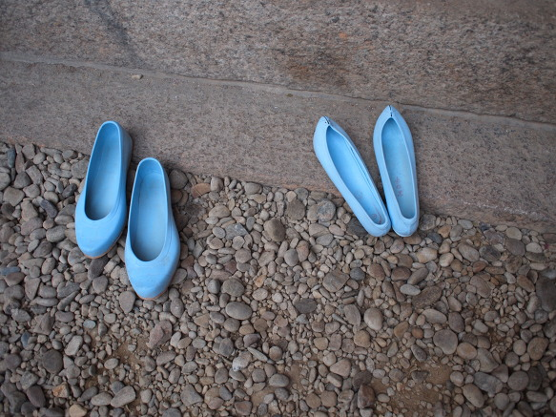
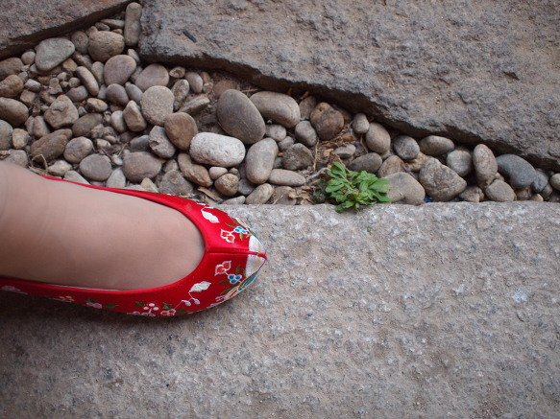
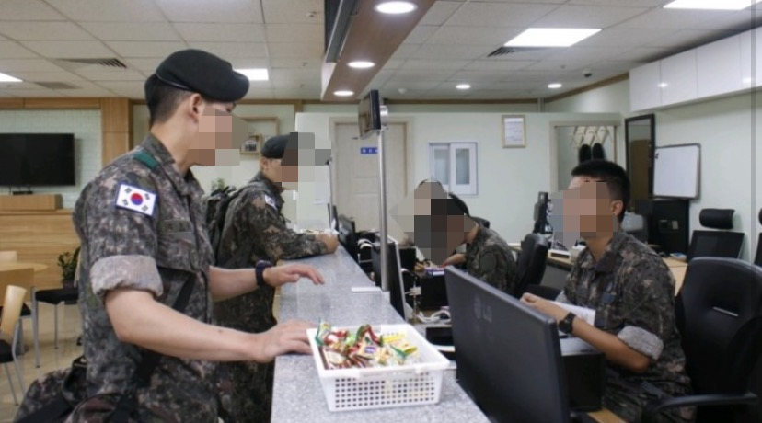
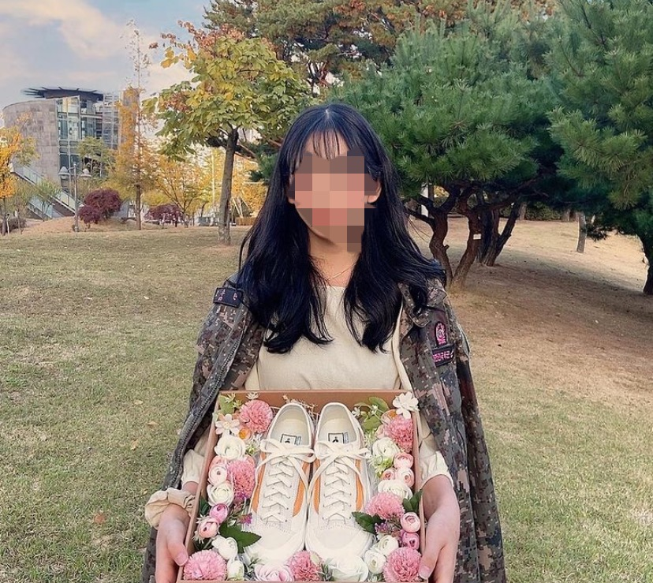
4. Korean culture
3. Military
Korea is a divided country.
Most men in South Korea have to go to the military after when they turn 18. Have to spend 18 months in the military
곰신 [ gom-sin]
"Gomsin" is a popular phrase on the Internet. It means shortening rubber shoes, a woman who sent her boyfriend to the military.
Also, “꽃신“[kkot-shin] means that a girl who has been waiting for 18 months and the boyfriend will be discharged from the military “Wearing flower shoes."

Slide 45
5. Today’s K-Pop
Twice (트와이스) – Cheer up
https://www.youtube.com/watch?v=1Kg4yomNEgs

