Slide 1
AMERICAN VOICES
Based on Wolfram and ward

Slide 2
Stereotypes and perceptions
Often unaccurate and unflattering but useful.

Slide 3
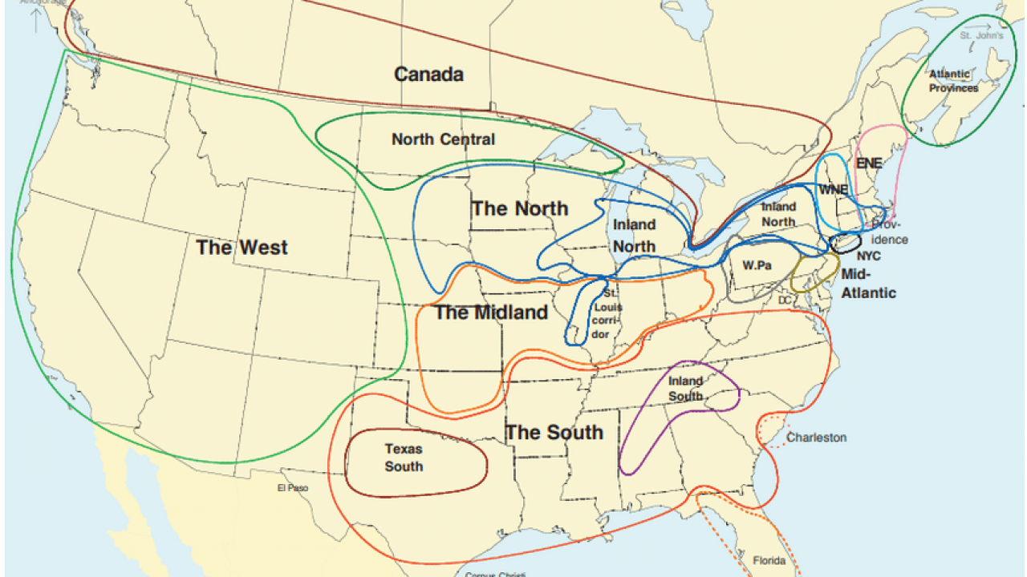

Slide 4
A perceptions quiz:
Guess which accents are being so perceived:
Yakking with the yankees New England; to speak in a lengthy, boring way
Beantown babble Boston, ma
Mainely english lobster
Ny tawk
More than just yada yada yada sociocultural dialect
Steeltown speak pittsburgh, pa
Expressions of brotherly love philadelphia, pa

Slide 5
A perceptions quiz:
Guess which accents are being so perceived:
Fading future for forhoodled english pennsylvania dutch (=german)
Maple leaf rap ppp tpscrpt 53
From cod to cool newfoundland, canada
Words of the windy city chicago, il
Talking in the buckeye state ohio
Saying ya to the yoopers michigan‘s upper peninsula
The potato state ppp tpscpt 52 kentucky

Slide 6
A perceptions quiz:
Guess which accents are being so perceived:
Bridging the great divide aave
Doing the charleston south carolina
The lone star state (of speech) PPP tpscrpt 51 texas
Talkin‘ with mi gente sociocultural dialect chicano english
Speaking the big easy new orleans, la
Stirring the linguistic gumbo sociocultural dialect called cajun based on french

Slide 7
A perceptions quiz:
Guess which accents are being so perceived:
Getting real in the golden state california
Desert dialect utah
Dialects in the mist portland, or
Arizona‘s not-so-standard english

