Slide 1
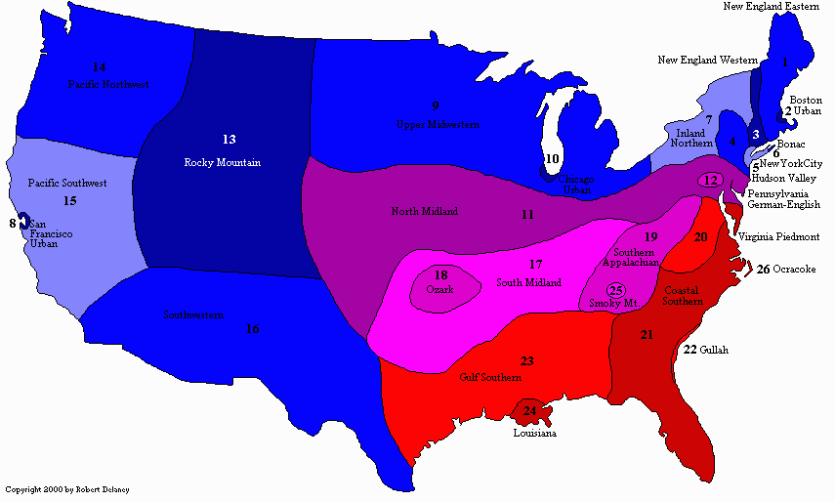
Dialect Map of American English
General Northern
Midland
General Southern

Slide 2

General Northern
Northern Dialects
New England – New England, Eastern (1)
  Boston Urban (2)
      - New England, Wetern (3)
Hudson Valley (4)
New York City (5)
Bonac (6)
Inland Northern (7)
San Francisco Urban (8)
Upper Midwestern (9)
Chicago Urban (10)

Slide 3
Eastern New England
is one of the most distinctive of all the American dialects. /r/ is often dropped, but an extra /r/ is added to words that end with a vowel. /a/ is pronounced /ah/.
San Francisco Urban
Unlike the rest of California, which in the early twentieth century saw an influx of people from the South and other parts of the West, San Francisco continued to be settled by people from the Northeast and Northern Midwest, and elements of their dialects (North Midland, Upper Midwestern, Inland Northern) can be found. Mission dialect, spoken by Irish Catholics in a specific part of the city is very much like the New York City dialect.

Slide 4
Western Dialects
Rocky Mountain (13)
Pacific Northwest (14)
Alaska (not shown)
Pacific Southwest (15)
Southwestern (16)
Hawaii (not shown)

Slide 5
Alaska
Developed out of the Northern, Midland, and Western dialects. Also influenced by the native languages of the Alutes, Innuit, and Chinook Jargon.
Hawaii
The original language of the Native Hawaiians - Polynesian family.
English speakers arrived in 1778, + many other settlers from China, Portugal, Japan, Korea, Spain, and the Philippines to influence the modern dialect.
Hawaiian Creole – from pidgin English spoken on the sugar plantations with workers from Hawaii and many other countries. It isn't widely spoken anymore.
Nonstandard Hawaiian English developed from Hawaiian Creole and is spoken mostly by teenagers.
Standard Hawaiian English is part of the Western dialect

Slide 6
Midland
North Midland (11)
Pennsylvania German-English (12)
South Midland (17)
Ozark (18)
Southern Appalachian (19)
Smoky Mountain English (25)

Slide 7
South Midland
A /th/ at the end of words or syllables is sometimes pronounced [f], and the word are is often left out of sentences as they are in Black English. An /a/ is usually placed at the beginning of a verb that ends with -ing, and the /g/ is dropped;
"They a-celebratin' his birfday by a-goin' to see 'Old Yeller' in the theatah"

Slide 8
General Southern
Southern
  Virginia Piedmont (20)
  Coastal Southern (21)
  South Florida
  Ocracoke (26)
  Gullah (22)
  Gulf Southern (23)
  Louisiana (24)

Slide 9
General Southern
Since it was largely an agricultural area, people tended to move around less than they did in the north, and as a result, the subdialects are much less uniform than those of the General Northern regions and have much more clearly defined boundaries. Other languages that had an important influence on it are French (since the western region was originally French territory) and the African languages spoken by the people brought over as slaves. People tend to speak slower here than in the north creating the famous southern "drawl."

Slide 10
Where American accents came from a what do they sound like?
https://www.businessinsider.com/animated-map-where-american-accents-come-from-2018-5

Slide 11
Bibliography
http://robertspage.com/dialects.html
https://www.businessinsider.com/animated-map-where-american-accents-come-from-2018-5

Slide 12
Thank you.
Natália Jagnešáková
Autumn 2019

