Slide 1
Understanding the Human Mind:
Cognitive Approaches to Linguistic and Cultural Diversity
Wei-lun Lu 呂維倫
Masaryk University

Slide 2
Overview of the bloack
Different languages, different minds
  Introduction
  Warm-up: How many languages do I speak and do I behave differently when speaking them?
  Grammar– the grammar of indirectness
  Words– One target, different sources
In kavárna W7:
  The social secret of baby’s bilingual brain
Time and tense in human languages
  Time, tense and the Hopi TIME debate
  Case study: “Tense shifting” in a tenseless language?
  Metaphor about TIME
How different languages talk about food
In kavárna W8:
  Tense, future and your savings

Slide 3
How many languages do we speak? (10 min)
In groups of 4-5 people, discuss the following questions:
  How many languages does your group speak? Include second languages as well.
  Do you think you behave differently when you speak those different languages?
  How exactly do you behave differently when you speak those languages?
  If you think you behave differently, does that make you suspect that you might THINK differently in that different language?

Slide 4
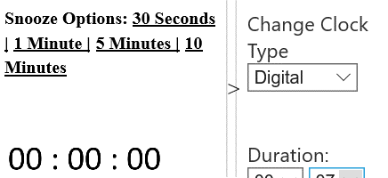
Student-student Discussion Format
Create a channel in our group and start a meeting (or simply join a meeting).
There can be multiple meetings in one channel.
Each meeting may contain only 3-5 people (so that everyone can get to speak).
In the meeting, discuss the leading questions given by the teacher.
The teacher may switch between meetings and be ready to help.
Be ready to give a summary of your discussion.
Enjoy!

Slide 5

1. If you could stand up for me, please, Julie.
2. You can put your foot down now.
3. I'd just like you to lift your left leg as high as you can.
4. (Please), If you could take off your shoes and your tights…
5. Would you mind just lifting your skirt over your knee?
6. I want you to tell me if it starts to feel uncomfortable.

Slide 6
Grammar that Empowers
Now listen to the conversation again and try to identify the grammatical devices that allow a doctor to express “indirectness” in English.
English features frequent use of:
  Conditional construction (only the protasis)
  Questions
  Past tense

Slide 7
Words to Talk About Human Body
I will give you examples of how medical terms vary across languages, in particular how different languages use different mental images (source) to create an understanding of the same medical concept (target). Largely follow the examples and come up with your own pairs ☺

Slide 8
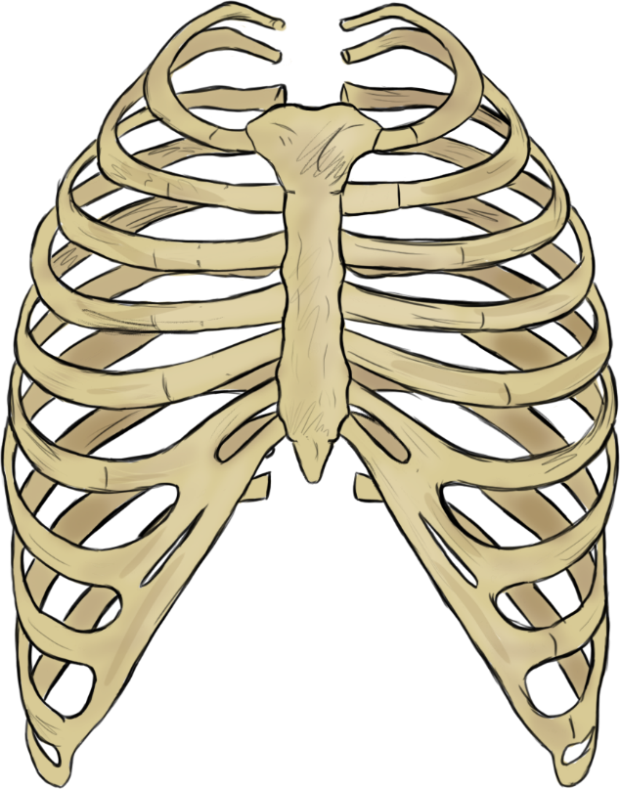



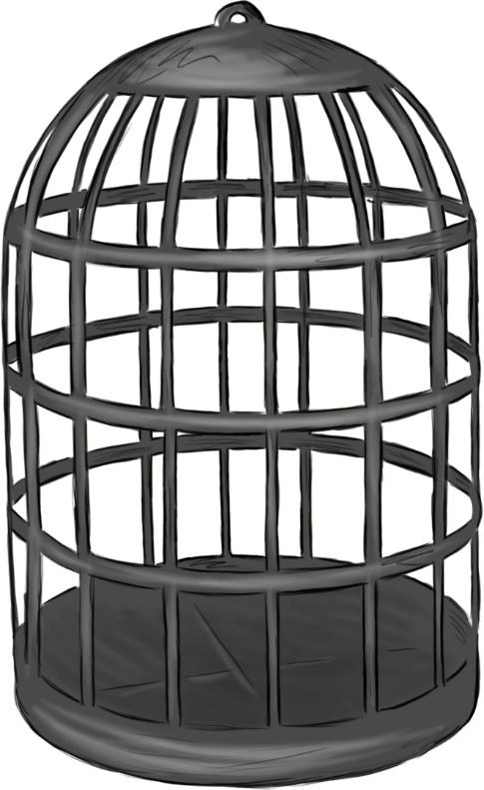
hrudní koš
rib cage

Slide 9


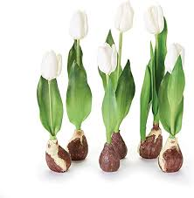

vlasová cibulka
hair bulb

Slide 10

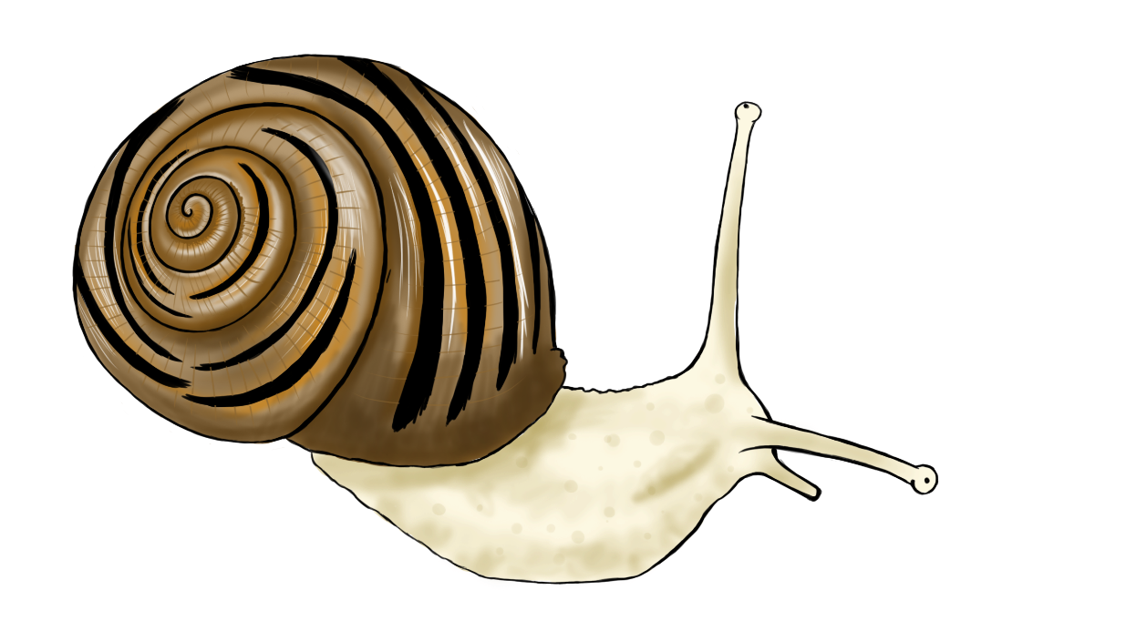

hlemýžď
cochlea

Slide 11
Now use any bi-lingual resources available to you and try to identify 2-3 pairs of counterparts in different languages. Be ready to justify your choice. (3-5 min)
In groups of 3 people, show each other your findings and discuss. When you discuss, please state whether you agree with your partner’s analysis and why (not). (3-5 min)

Slide 12
Lesson plans (W10-11)
In W10, we covered:
  How professional communication varies across languages
    Linguistic structure
    Cultural tendency
  Lexical differences across languages
  Whether I behave differently when speaking different languages?
In W11:
  Debates on “different languages, different thoughts/behaviors”
  Empirical research
This week in kavárna (10 min):
  How tense(s) in your language impacts your savings and health

Slide 13
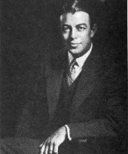
Different languages, different devices
Benjamin Lee Whorf
Hopi TIME debate, starting from:
Whorf, Bejamin L. 1944. The relation of habitual thought and behaviour to language. ETC: A Review of General Semantics 1(4): 197-215.
Question(s) asked: (1) “Are our own concepts of ‘time,’ ‘space,’ and ‘matter’ given in substantially the same form by experience to all men, or are they in part conditioned by the structure of particular languages?” (Whorf 1944: 201)

Slide 14
Time and thinking
“The three-tense system of SAE verbs colors all our thinking about time.” (Whorf 1944: 204; SAE for Standard Average European)
In Hopi however all phase terms, like summer, morning, etc., are not nouns but a kind of adverb, to use the nearest SAE analogy. They are a formal part of speech by themselves, distinct from nouns, verbs, and even other Hopi 'adverbs.' Such a word is not a case form or a locative pattern, like 'des Abends' or 'in the morning.' It contains no morpheme like one of 'in the house' or 'at the tree.’… One does not say ' this summer,' but 'summer now' or 'summer recently’. (Whorf 1944: 203-204)

Slide 15

Malotki’s Hopi Time (1983)
Malotki, Ekkehart (1983). Hopi Time: A Linguistic Analysis of the Temporal Concepts in the Hopi Language. Berlin: Mouton.
Hopi contains:
  temporal adverbs,
  time units,
  time counting practices such as the Hopi calendar, etc.
Considers Whorf’s analysis erroneous, and argues:
  that the Hopi language has an abundance of terms, words and constructions that refer to time,
  that the Hopi do cognitively conceptualize time in analogy with physical space, using spatial metaphors to describe durations and units of time,
  and that the English and Hopi systems of tense are different since the English system distinguishes past from non-past, whereas Hopi distinguishes future from non-future.

Slide 16
A summary of the Hopi time debate
https://www.youtube.com/watch?v=u6eXw0AAKZ8

Slide 17
Remaining issues of the debate
Question(s) to ask: (1) “Are our own concepts of ‘time,’ ‘space,’ and ‘matter’ given in substantially the same form by experience to all men, or are they in part conditioned by the structure of particular languages?” (Whorf 1944: 201)
The possibility that Hopi may/does have a tense marking system does not invalidate Whorf’s initial question!
Can we find more ways to test Whorf’s idea about TIME using a speeded behavioral task?

Slide 18



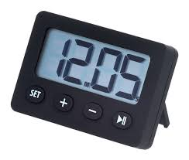
TIME for more discussion!
Question: How does my L1 talk about TIME and how does that different from my L2? Do I think about TIME differently in the two languages? (5-10 min)

Slide 19
On reasoning about TIME
Fish race experiment (Boroditsky 2001):
Task: Below you will see a picture and a statement. Based on the picture, please decide whether the statement is true.

Slide 20
You will see a picture and a statement. Raise your left hand if the statement is true. Raise your right hand if the statement is false. Be as fast as you can.

Slide 21
You will see a picture and a statement. Raise your left hand if the statement is true. Raise your right hand if the statement is false. Be as fast as you can.

Slide 22
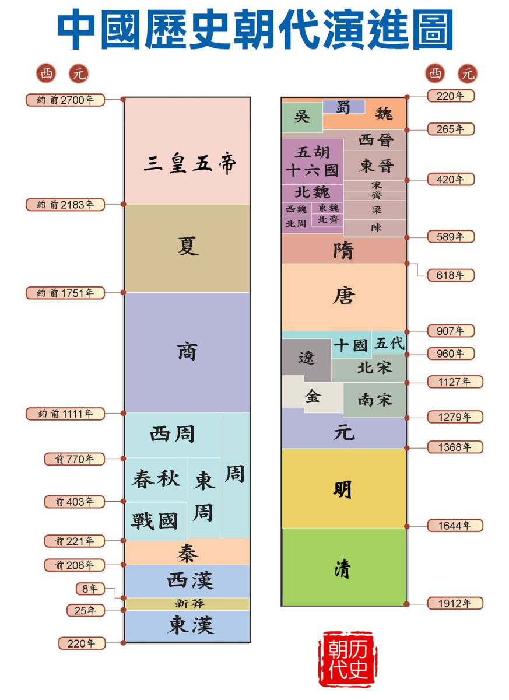
Understanding TIME using UP-DOWN
English: last month, next month
Chinese:
上個月 shàng-ge-yuè ‘up-CL-month’,
下個月 xià-ge-yuè ‘down-CL-month’,
Czech: minulý měsíc
English: first half of the year, second half of the year
Chinese:
上半年 shàng-bàn-nián ‘up-half-year’,
下半年 xià-bàn-nián ‘down-half-year’
Czech: první polovina roku

Slide 23
Mandarin-English bilinguals
Mandarin Chinese as L1, English as L2.
Strong vertical bias for CN-EN bilinguals who started English late.
Learning EN gives those CN speakers a “horizontal bias”.
Learning a different language does make one reason about TIME differently.

Slide 24
Remaining issues of the debate
Remaining issues:
What else do we do about TIME?
TIME is a concept, and its linguistic manifestations are
  Temporal adverbials
  Tense marking
What about a language that does not mark tense (a tenseless language)?
  A tenseless lg is a lg that does not have a grammatical category of tense. Examples: Burmese, Dyirbal, Chinese, Malay, Indonesian, Thai, Vietnamese.

Slide 25
How would you communicate without tense?
In-class Task 1: Try to write a short passage (3-4 sentences) of what you did yesterday/last week/last month, without using tense.
In-class Task 2: Try to communicate indirectness (which is a tense-related phenomenon) without using tense. Can you come up with a way?

Slide 26
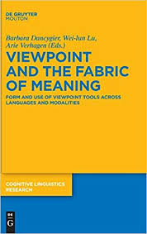
Time, tense and narrative viewpoint
Dancygier, Barbara, Wei-lun Lu and Arie Verhagen (eds.). 2016. Viewpoint and the Fabric of Meaning: Form and Use of Viewpoint Tools across Languages and Modalities. Berlin: De Gruyter.
Lu, Wei-lun. 2019. Time, tense and viewpoint shift across languages: A Multiple-Parallel-Text approach to “tense shifting” in a tenseless language. Cognitive Linguistics 30.2: 377-397.

Slide 27
Case: Tense and Narrative Viewpoint
Tense in narratives extensively studied in SAE languages.
Past as narrator’s and (historical) present as character’s consciousness (Fleischman 1990; Fludernik 2012).

Slide 28

Examples
Byl jednou jeden král…
In yesterday’s class, he shouted: “From now on I will do the job myself!”
In yesterday’s class, he shouted that from then on, he would do the job himself.
In the class, he shouts that from now on, he will do the job himself.
Use of different tenses allows different understandings of the same scene.

Slide 29
Research Issue
Tense shifting is indicative of shifting of narrative vpt in SAE languages.
What about languages that do not systematically mark tense?
To what extent does human language rely on tense marking to convey narrative vpt, and how much variation is there, among languages?
To what extent does human lg reply on the concept of TIME in managing narrative vpt?

Slide 30
Scope and Method
When we see a pattern in Language A composed of certain linguistic feature that is missing in Language B, how is the effect actually achieved in Language B?
Suitable data that allows contextualized comparison of languages.
Use of translation (parallel texts): controlling for most contextual factors (linguistic, physical, social context, production mode, etc.).
An empirical way of studying the viewpoint options in a stretch of narrative where all text producers try to get across highly similar (if not identical) messages.

Slide 31
Hypothesis 1
If Chinese cares as much about TIME as English does in managing narrative vpt, in passages where the English switches between tenses, we see elements that invoke TIME in the Chinese corresponding passage.
In cases where multiple translations exist, the phenomenon should be consistent.

Slide 32
Hypothesis 2
Chinese has a highly productive aspectual system, where the perfective aspect is reported to play a role of expressing past events (Lin 2012; Liu 2014).
If we are able to identify constructions that invoke TIME in Chinese, PFV should be an important part of it.

Slide 33
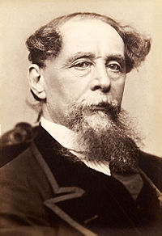
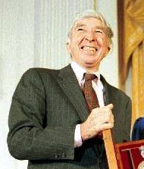
Material Choice
Published Commercial Translations.
  Great Expectations and its 9 translations.
  David Copperfield and its 5 translations.
  “A&P” and its 2 translations.

Slide 34
Sample Passage of Tense Shifting
(1) In walks these three girls in nothing but bathing suits. I'm in the third check-out slot, with my back to the door, so I don't see them until they're over by the bread. The one that caught my eye first was the one in the plaid green two-piece. (A&P)
Accompanying viewpoint strategies:
  Proximal demonstrative
  Inversion
  Ellipsis

Slide 35
Sample Passage from Great Expectations
(2) The whole scene starts out again in the vivid colours of the moment, down to the drops of April rain on the windows of the court, glittering in the rays of April sun. Penned in the dock, as I again stood outside it at the corner with his hand in mine, were the two-and-thirty men and women; some defiant, some stricken with terror, some sobbing and weeping, some covering their faces, some staring gloomily about. There had been shrieks from among the women convicts, but they had been stilled, a hush had succeeded.
S1: Perceptual deixis (Stockwell 2002): elements that refer to the perception of a participant in the text.
S2: Inversion, perceptual deixis, present participles.
Interpolation of as-clause.
Smooth transition of vpt, with a mix in S2.

Slide 36
Sample Passage from David Copperfield
(3) If the funeral had been yesterday, I could not recollect it better. The very air of the best parlour, when I went in at the door, the bright condition of the fire, the shining of the wine in the decanters, the patterns of the glasses and plates, the faint sweet smell of cake, the odour of Miss Murdstone’s dress, and our black clothes. Mr. Chillip is in the room, and comes to speak to me.
S1: distal perspective.
S2: perceptual deixis, and past tense.

Slide 37
(3) | 我 | 一 | 走进 | 那间 | 最好 | 的 | 客厅，
 | wǒ | yī | zǒu-jìn | nà-jiān | zuì-hǎo | de | kètīng
 | I | PRT | walk-enter | that-CL | best | LK | living room
 | 屋 | 里 | 的 | 气氛 | 就 | 迎面
 | wū | lǐ | de | qìfēn | jiù | yíng-miàn
 | house | in | LK | atmosphere | PRT | towards-face
 | 扑来： |  | 旺旺 | 的 | 炉火， | 瓶 | 中
 | pū-lái |  | wàng-wàng | de | lúhuǒ | píng | zhōng
 | spring-come |  | blazing-RED | LK | fire | bottle | in
 | 闪闪 | 发光 |  | 的 | 葡萄酒， |  | 杯盘
 | shǎn-shǎn | fāguāng |  | de | pútao-jiǔ |  | bēipán
 | shine-RED | radiate |  | LK | wine |  | dishes
 | 的 | 式样， | 糕饼 | 的 | 微微 | 甜 | 香，
 | de | shìyàng | gāobǐng | de | wéi-wéi | tián | xiāng
 | LK | style | cake | LK | slight-RED | sweet | aroma
 | 默德斯通 |  | 小姐 | 衣服 | 上 | 的
 | mòdésītōng |  | xiǎojiě | yīfú | shàng | de
 | Murdstone |  | Miss | clothes | on | LK
 | 气味， | 以及 | 我们 | 穿 | 的 | 黑色
 | qìwèi | yǐjí | wǒ-mén | chuān | de | hēisè
 | smell | and | we | wear | LK | black
 | 丧服。 |  | 齐力普 | 先生 | 也 | 在 | 那里，
 | sāngfú |  | qílìpǔ | xiānsheng | yě | zài | nàlǐ
 | mourning apparel |  | Chillip | Mr. | also | LOC | there
 | 并且 | 走过来 |  | 和 | 我 | 说话。
 | bìngqiě | zǒu-guòlái |  | hàn | wǒ | shuōhuà
 | and | walk-come |  | with | I | speak
 | “(Upon the time when) I walk into that best living room, atmosphere come springing towards my face: blazing fire, shining wine in bottle, style of dishes, and slight sweet aroma of cakes, smell on Miss Murdstone’s clothes, and black mourning apparel we wear. Mr. Chillip is also there, and come walking to speak to me.”

Slide 38
TIME in the Chinese Renditions
Out of the 16 Chinese passages (2+9+5), only 1 uses a temporal adverbial construction.
Only 2 passages have PFV, but where the English passage involves the present tense.
Chinese does not care about TIME in managing narrative vpt.
The perfective aspect not used for managing vpt, at least not the way past tense does in English.

Slide 39
What Chinese Systematically Adds
Increasing reduplication: mono-syllabic words and di-syllabic lexical constructions may be reduplicated to increase the degree of liveliness and vividness of the scene elaborated, with the resultant pattern AA for a mono-syllabic construction or AABB for a disyllabic AB construction (Melloni and Basciano, forthcoming).
Appearing in 9/9 Mandarin renderings of (2) and 4/5 of (3).
Perceptual deixis: 在我（的）眼前 zài wǒ de yǎn qián ‘LOC my LK eye front, (lit. in front of my eyes)’, identified in all translations of (2).

Slide 40
From Tense to Grammar and Relativity
What piggybacks the vpt function:
English: tense (obligatory) and others
Chinese: reduplication and perceptual deixis (non-obligatory)
English: vpt marking dictacted by grammar (sentence by sentence).
Chinese: vpt marking not required.
English: mixing of distinctively dichotomous vpts.
Chinese: no need to dichotomize narrative vpt.

Slide 41
Metaphor and TIME
To fit discourse to manifold actual situations all languages need to express durations... It is characteristic of SAE and perhaps of many other language-types to express them metaphorically. The metaphors are those of spatial extension, i.e. of size, number (plurality), position, shape, and motion.
We express duration by long, short, great, much, quick, slow, etc… through an almost in-exhaustible list of metaphors that we hardly recognize as such since they are virtually the only linguistic media available. (Whorf 1944: 205)

Slide 42
Another metaphor about TIME
TIME IS MONEY:
  You need to budget your time.
  You don't use your time profitably.
  You're wasting my time.
  This gadget will save you hours.
  How do you spend your time these days?
  That flat tire cost me an hour.
  I've invested a lot of time in her.

Slide 43
In your own languages!
TIME IS MONEY:
  You need to budget your time.
  You don't use your time profitably.
  You're wasting my time.
  This gadget will save you hours.
  How do you spend your time these days?
  That flat tire cost me an hour.
  I've invested a lot of time in her.
Now in groups of 4-5 people, go through the English examples together, looking for equivalents in your own language(s).
With the results, discuss whether and how the reasoning pattern TIME IS MONEY is consistent across all the languages you speak.
How do your answers help us hypothesize about linguistic relativity?

Slide 44
Some further materials to cover (in the final exam)
More case studies presented: Time Is Shaped by Language by L. Boroditsky
Please read especially this paper by L. Boroditsky (in the IS).

Slide 45
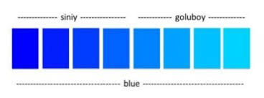
Russian blues (Winawer et al. 2007)
In English In Russian
dark blue siniy
In English In Russian
light blue goluboy

Slide 46
Russian blues (Winawer et al. 2007)
Which one of the two bottom squares matches the color of the top one?
RU speakers faster to discriminate two colors if they fell into different ling categories in RU (one siniy & the other goluboy) than two colors from the same category; not in EN.
Habitual categorical distinctions made in one’s L1 result in language-specific categorical distortions in objective perceptual tasks.

Slide 47
Implications
Not that EN speakers cannot distinguish between light and dark blues,
but rather that RU speakers cannot avoid distinguishing them:
They must do so to speak RU in a conventional manner.
This communicative requirement appears to cause RU speakers to habitually make use of this distinction even when performing a behavioural task that does not require language.
Language influences (rather than determines) one’s thinking patterns.

Slide 48
END OF WEEK 10
Questions? Comments?

