Slide 1
Academic skills
Week Three
Project Development Seminar II: Primary Sources
Dr. Šárka Gmiterková

Slide 2
Agenda
Structure
Identifying primary sources
Securing your object(s) for analysis
Targeted Learning Outcome
Identifying and securing suitable primary sources

Slide 3
What is a primary source (in your opinion)?
Let‘s unpack its characteristics…
How many of them do you need? (… the more the better..?)
True or false – works of art (novels, paintings, movies, songs) are always primary sources

Slide 4
Identifying a primary source (for a 6–8 pages long research paper)
In order to do so you have to know (or at least be aware of) what you are researching and what your research question is.
For a short paper, start small: with one source and see where it takes you, in how many different directions. Once you see how the research question and the primary source interact (supporting or undermining the hypothesis), you can add one or two more.
Works of art, archival data, official documents and records, letters and diaries, photographs and video footage (primary sources‘ usual suspects) do not always fall under this category. Some areas of research require primary materials of different nature.
And those materials might be usually considered as secondary sources, which are…

Slide 5
Primary X Secondary Sources: Differences
A first-hand or contemporary account of an event or topic
Created by people or things that were there at the time or event.
Not modified by interpretation
Providing direct access to the subject of your research
Qualitative or quantitative data that you collect yourself (e.g. through interviews, surveys, experiments) or sources produced by people directly involved in the topic
Original materials, regardless of format.
Authoritative and authentic
Anything that describes, interprets, evaluates, or analyzes information from primary sources.
Offer interpretation, analysis, methodological perspective or commentary:
Books, articles and documentaries that synthesize information on a topic
Synopses and descriptions of artistic works
Encyclopedias and textbooks that summarize information and ideas
Reviews and essays that evaluate or interpret something
The researches usually tests its arguments against new evidence or uses its ideas to help formulate his or her own.

Slide 6
However! For some projects and methodological perspectives newspaper articles, reviews or documentaries might be better suited as primary research materials.

Slide 7
Research project about Marilyn Monroe
One of the greatest acting icons of 20th century
Small chance of accessing previously unseen materials concerning Monroe herself
What can we research about her?
A project analyzing ways in which we remember Monroe (e.g. materials created after her death, without her presence)
How? Through which materials (books, posters, imagery)?
What kind of language is being used when desribing her posthumously?
What kind of values we infuse her post-image with?

Slide 8
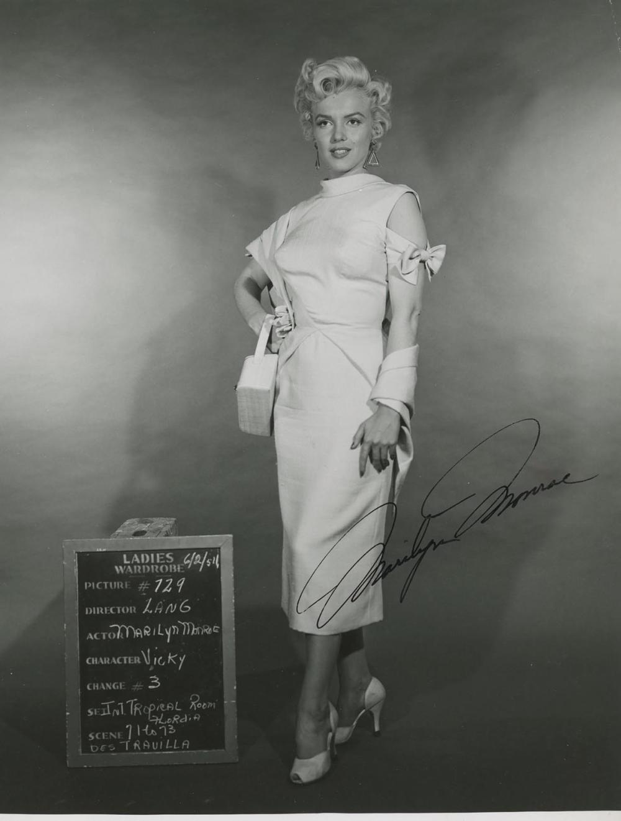
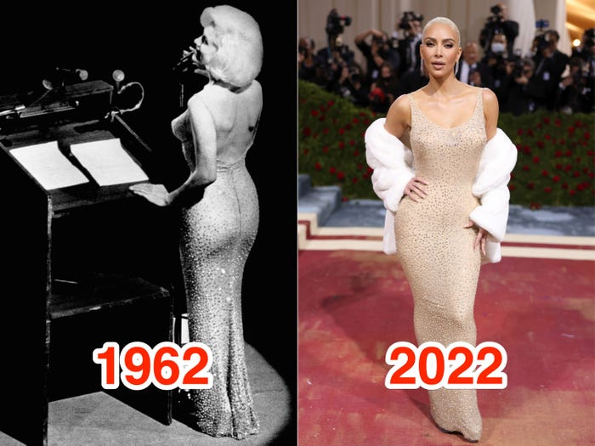
What are the primary sources in such project?
A Jean Louis gown worn by MM in 1962
As a material object – NO
As a piece of cultural heritage worn
previously by MM - YES
A signed photograph
(a collector‘s item)
Probably not
Blonde (dir. Andrew Dominik, 2022)
YES

Slide 9
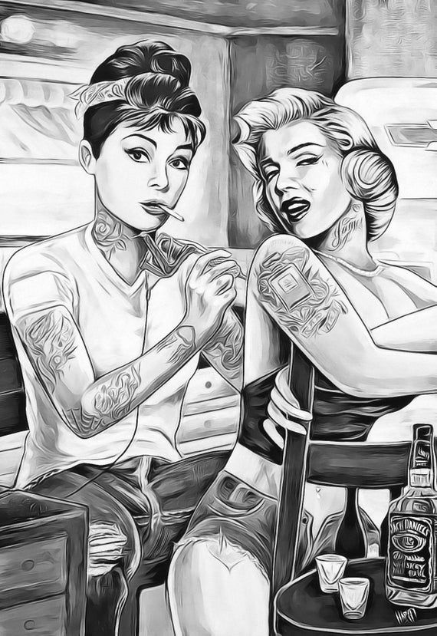
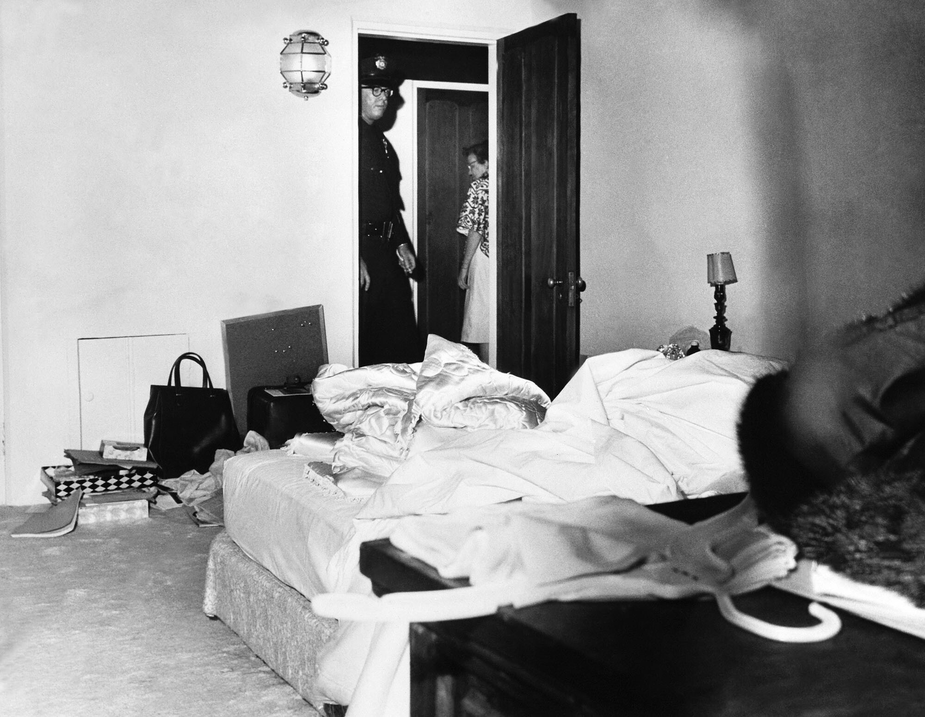
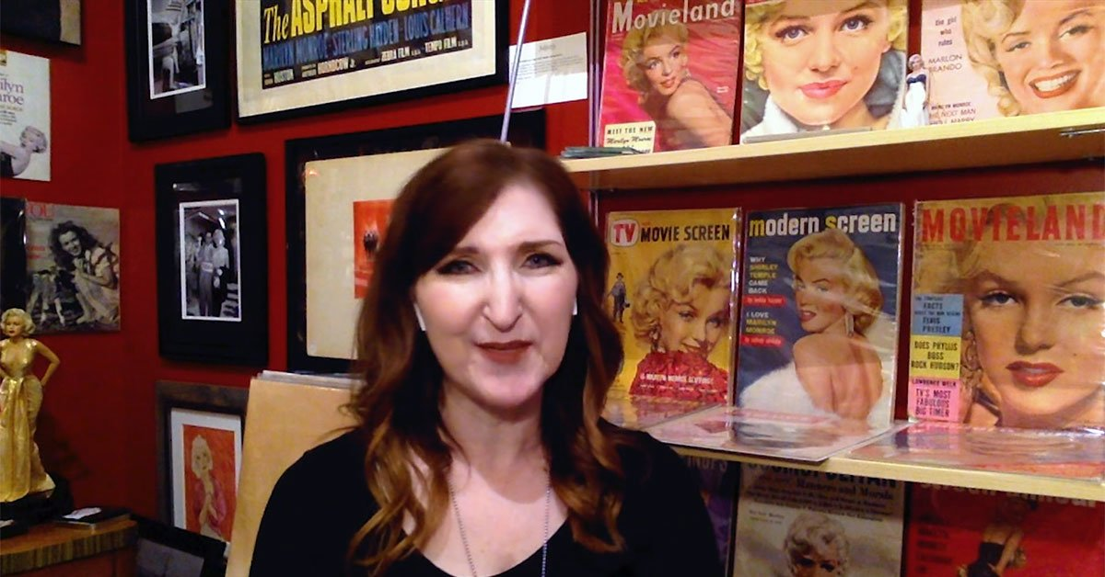
Interview with a memorabilia collector
Probably not
Police photographs from MM‘s bedroom where
her dead body was found
NO
Campy reinterpretations of famous stars
YES

Slide 10
Returning back to your own research topics…
… what are your primary sources?
Do you think you will have any issues with accessing them?
What about their amount?
Have you been shaping your research questions vis-a-vis your primary materials (films, screenshots from social media, photographs)?
Is anyone working with primary sources such as newspaper articles, essays, documentaries or any other materials interpreting already existing data?

Slide 11
Take-aways
Identifying your primary source(s) is a necessary step, right after you settle on the topic of your interest.
It generally goes hand in hand with formulating your research question and choosing the methodological perspective => your primary source excludes some research questions, welcomes others and narrows down possible conceptual frameworks
Secure your primary sources as a first practical step and remember, that with some primary sources this takes time (archival data)
Once your primary sources are with you, start analyzing them and think about…

Slide 12
Next time
… which secondary sources you are going to use. Although we value primary sources higher than the secondary ones, a good research paper combines both.
Date: 13. 10.
Instructor: Šárka
Topic: Project Development Seminar 3: Secondary Sources
Outcome: Finding and using secondary sources
Prepare: Open the portal of electronic information resources and try to find at least three secondary sources for your project.
https://ezdroje.muni.cz/index.php?lang=en

