Slide 1
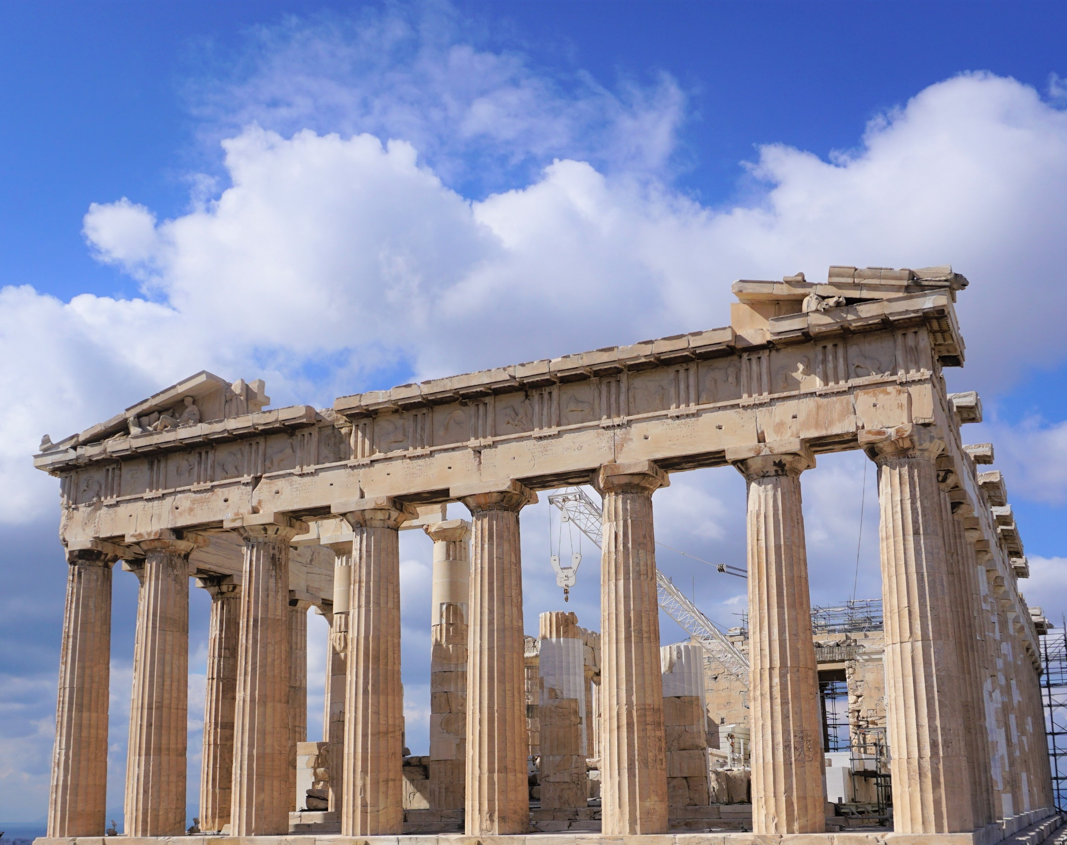
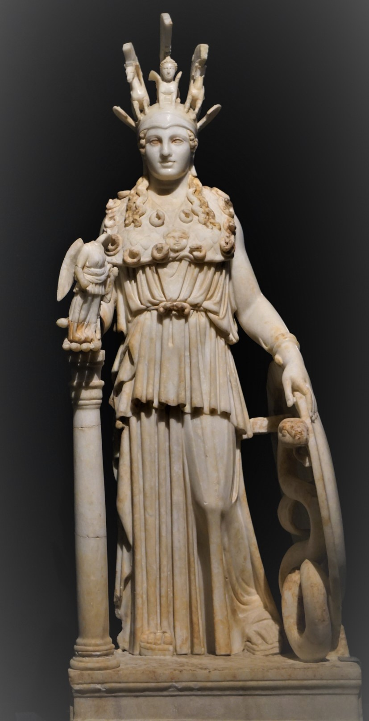

Exploring the Heartland: Pausanias and his Account on Imperial Greece’s Pre-Roman Cultural Heritage
Speaker: Aaron Plattner

Slide 2
Description of Greece vs. Geography
Ptol. geogr. 1,1,2: Τῆς δὲ γεωγραφίας ἴδιόν ἐστι τὸ μίαν τε καὶ συνεχῆ δεικνύναι τὴν ἐγνωσμένην γῆν, ὡς ἔχει φύσεώς τε καὶ θέσεως, καὶ μέχρι μόνων τῶν ἐν ὅλαις περιεκτικωτέραις περιγραφαῖς αὐτῇ συνημμένων, οἷον κόλπων καὶ πόλεων μεγάλων, ἐθνῶν τε καὶ ποταμῶν τῶν ἀξιολογωτέρων, καὶ τῶν καθ’ ἕκαστον εἶδος ἐπισημοτέρων.
The property of geography is to represent the known land mass as one and continuous, as it has grown and is situated, and down to the individual elements that are connected with it within the most comprehensive outlines, such as gulfs and large cities, the more noteworthy populations and rivers, and what is more significant in terms of the respective shape.
Book 1: Attica
Book 2: Corinth
Book 3: Laconia
Book 4: Messenia
Book 5: Elis
Book 6: Elis
Book 7: Achaea
Book 8: Arcadia
Book 9: Boeotia
Book 10: Phocis, Ozolian Locris

Slide 3
Description of Greece vs. Chorography
Ptol. geogr. 1,1,1: […] αὕτη [scil. Chorography] μὲν ἀποτεμνομένη τοὺς κατὰ μέρος τόπους χωρὶς ἕκαστον καὶ καθ’ αὑτὸν ἐκτίθεται, συναπογραφομένη πάντα σχεδὸν καὶ τὰ μικρότατα τῶν ἐμπεριλαμβανομένων, οἷον λιμένας καὶ κώμας καὶ δήμους καὶ τὰς ἀπὸ τῶν πρώτων ποταμῶν ἐκτροπὰς καὶ τὰ παραπλήσια.
Chorography divides the places into sections and presents each one separately and on its own, registering almost everything, even the smallest included elements, such as harbours, villages, demes, the branches of the first-rank rivers and the like.
Book 1: Attica
Book 2: Corinth
Book 3: Laconia
Book 4: Messenia
Book 5: Elis
Book 6: Elis
Book 7: Achaea
Book 8: Arcadia
Book 9: Boeotia
Book 10: Phocis, Ozolian Locris

Slide 4
Added Value of Studying Pausanias
Major Greek source from 2nd century AD
Knowledge about Greek local culture (cf. Herodotus)
Basis for evaluation of Greek-Roman contacts
Comparison with the teaching poem of Dionysius from Alexandria

Slide 5
Structure of Today’s Lecture
Introduction (author, work, modern scholarship)
Descriptive sections (4 different types)
Narrative sections (Galatian invasion 279 BC)
Pausanias’ intention
Description of the inhabited world by Dionysius from Alexandria
Conclusion

Slide 6
1.1. The Author: Pausanias
Born around 115 AD
Writes from around 155 AD to before 180 A.D.
Origin maybe Asia Minor (Sipylos / Magnesia)
Reasonably wealthy
Close to Second Sophistic Community

Slide 7
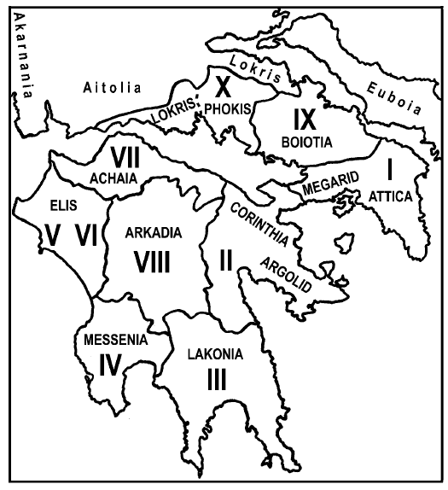
1.2. The Work: Description of Greece
Book 1: Attica
Book 2: Corinth
Book 3: Laconia
Book 4: Messenia
Book 5: Elis
Book 6: Elis
Book 7: Achaea
Book 8: Arcadia
Book 9: Boeotia
Book 10: Phocis, Ozolian Locris
Book 11?

Slide 8
1.3. Modern Scholarship
Phase 1: Before WWI
Phase 2: Second half of 20th century
Phase 3: After the turn of the millennium

Slide 9
2. Descriptive Sections
Selection of 23 descriptions of objects, rituals, and sanctuaries
Analytical category: immersive potential
Term ‘topographeme’
Theon prog. 11 (242)

Slide 10
Terms
Memorial
Monument
Sight
θεώρημα (i.e., 'object of actual or mental contemplation‘ )
Lieu de mémoire

Slide 11
Typology of Descriptions
Objective topographemes (objects)
Performative topographemes (rituals)
Objective-performative topographemes (combination object-ritual)
Sacro-spatial topographemes (sanctuaries)

Slide 12
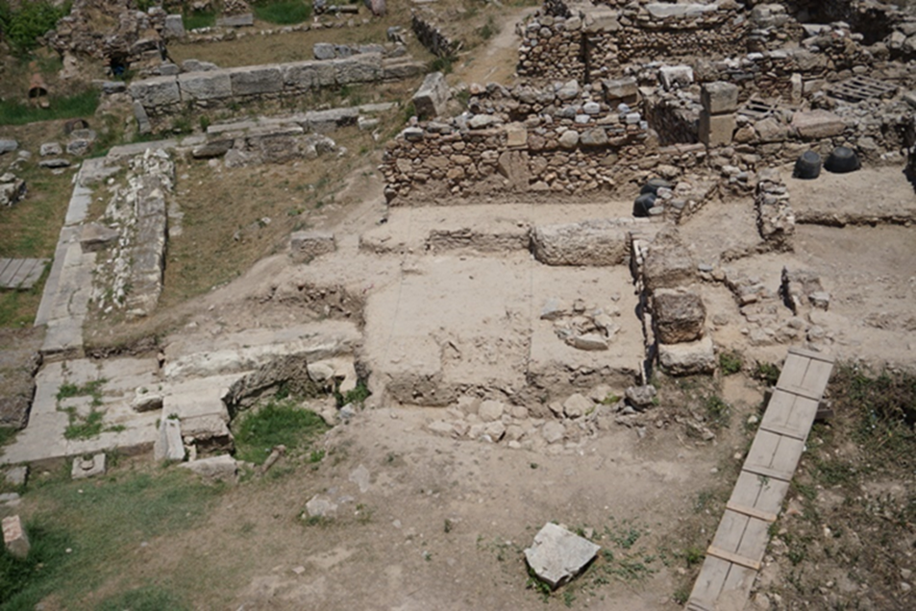
Type 1: The Paintings in the Stoa Poikile
Structural remains of the Stoa Poikile on the north-western edge of the ancient Agora in Athens. Photo: Aaron Plattner.

Slide 13
Paus. 1,15,1:
ἰοῦσι δὲ πρὸς τὴν στοάν, ἣν Ποικίλην ὀνομάζουσιν ἀπὸ τῶν γραφῶν […]
If one goes towards the portico [scil. coming from the west], which they call 'Coloured' from the paintings […]

Slide 14
Paus. 1,15,1:
στοάν, ἣν Ποικίλην ὀνομάζουσιν ἀπὸ τῶν γραφῶν
the portico, which they call 'the colourful one' because of the paintings

Slide 15
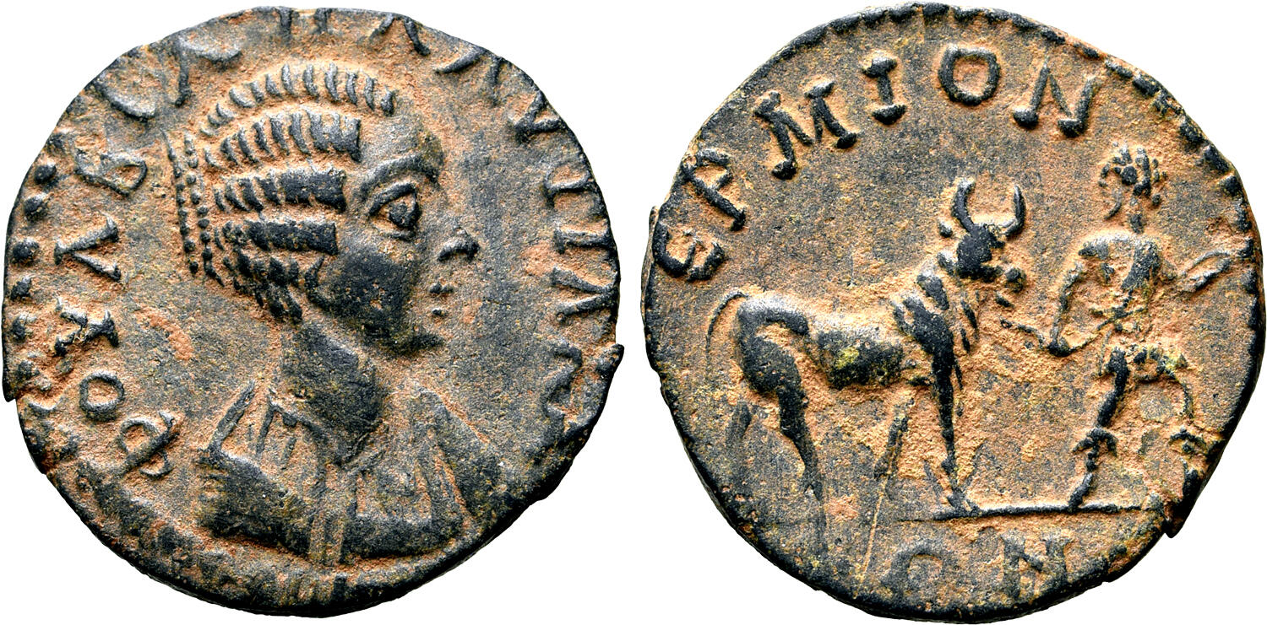
Type 2: The Chthonia Festival in Hermione
Imperial copper coin from Hermione with Fulvia Plautilla on the obverse showing a victimarius on the reverse leading a cow on a rope. Literature: Imhoof-Blumer / Gardner 1886, p. 51 and Table M, no. 3. Image source: https://www.numisbids.com/n.php?p=lot&sid=5218&lot=764

Slide 16
Paus. 2,35,1:
παρελθοῦσι δὲ ἐς τὸ τῆς Ἑστίας [scil. ἱερὸν] […]
To those who have passed by to the temple of Hestia […]

Slide 17
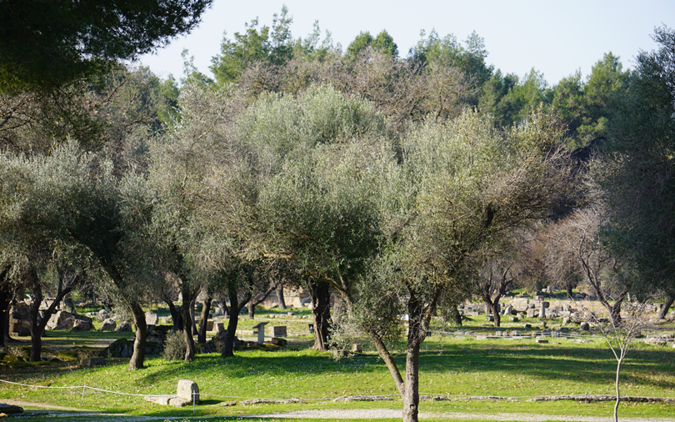
Type 3: The Pelopion
Pelopion in the Altis of Olympia (view from NE). Photo: Aaron Plattner.

Slide 18
Paus. 5,10,10:
τὰς θύρας δὲ ἐσιόντι τὰς χαλκᾶς [scil. of the temple of Zeus] […]
If one goes to the bronze doors of the temple of Zeus […]

Slide 19
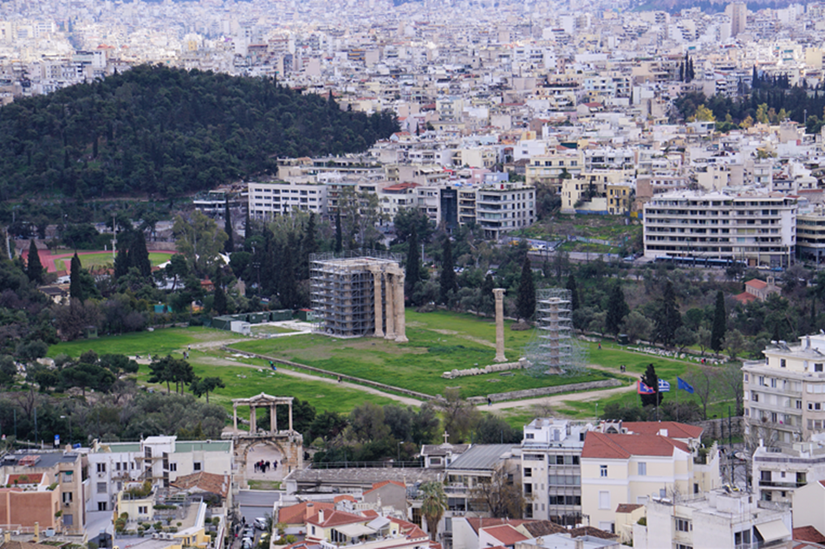
Type 4: The Olympieion in Athens
Olympieion in Athens (view from the eastern tip of the Akropolis over Hadrian's Gate to the SE). Photo: Aaron Plattner.

Slide 20
Paus. 1,18,4
ἐντεῦθεν [scil. from the prytaneion] ἰοῦσιν ἐς τὰ κάτω τῆς πόλεως […]
To those who go downtown from there […]

Slide 21
Findings Descriptive Sections
Overall distanced presentation
Main focus on content and background information
Perspectivations:
OT: visible evidence of political and cultural influence
PT: socio-religious curiosities
O-P T: destinations for pilgrims
S-S T: religious centres
Self-understanding of Greek communities from before 2nd century AD

Slide 22
3. Narrative Sections
Historical-ethnographic cuttings
Factual manner
Herodotean model
Anchored in the round trip

Slide 23
The Galatian Invasion 279 BC
Narrative 1 (Paus. 1,3,4–6)
Narrative 2 (Paus. 10,19,5–10,23)
3 similarities:
Context
Starting point
Purpose

Slide 24
Paus. 10,19,5
Γαλατῶν δὲ τῆς ἐς τὴν Ἑλλάδα ἐπιστρατείας ἔχει μέν τινα μνήμην καὶ ἡ ἐς τὸ βουλευτήριον ἡμῖν τὸ Ἀττικὸν συγγραφή· προάγειν δὲ ἐς τὸ σαφέστερον τὰ ἐς αὐτοὺς ἠθέλησα ἐν τῷ λόγῳ τῷ ἐς Δελφούς, ὅτι ἔργων τῶν ἐπὶ τοὺς βαρβάρους τὰ μέγιστα Ἕλλησιν ἐνταῦθα ἦν. […]
My report on the Attic Council building also contains a mention of the march of the Galatians to Greece, but I wanted to make it even clearer in the section on Delphi, because the greatest deeds of the Greeks against the barbarians took place at that time. [...]
Paus. 10,20,1–5:
480 BC: 11 200 Greeks vs. 279 BC: 24 690 Greeks

Slide 25
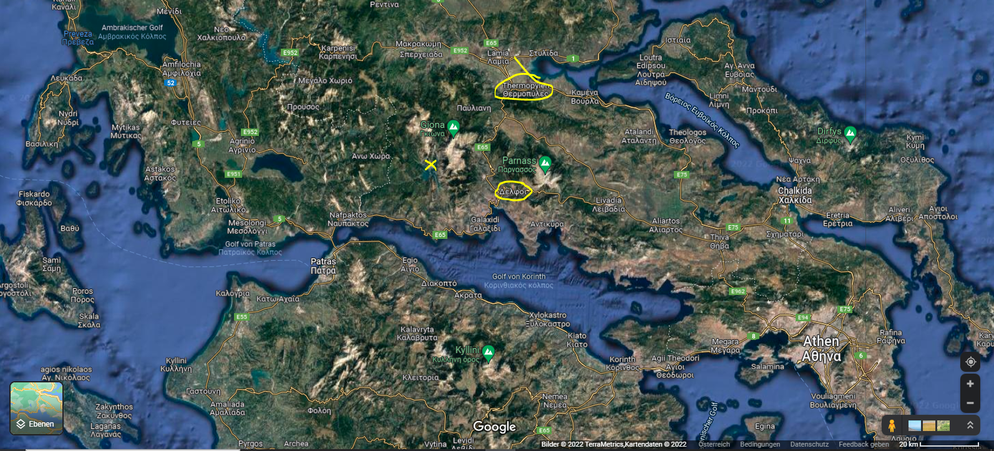
Aetolian City of Kallion (or Kallipolis)

Slide 26
Findings Narrative Sections
About background of the textual world
Voice of an omniscient narrator
Manner: more or less distanced
Purpose: conveying the significance of the related topographeme for the respective community
Immersive potential?

Slide 27
4. Pausanias’ Intention
Image of an imperial-era exhibition on 'The Cultural Heritage of Pre-Roman Greece’
Content premise
Form premise Approach: historical-critical
Historical context premise
Conclusion: The intention is to make research accessible in order to educate.
Pausanias = ἀρχαιολόγος, ἱστοριογράφος, and περιηγητής

Slide 28
5. Description of the inhabited world by Dionysius from Alexandria
Pausanias Dionysius
Description of Greece - Description of the inhabited world
2nd half 2nc century AD - 1st half 2nd century AD
Almost fully extant - Fully extant
Greek heartland - Oecumene
Prose - Verse
Intention: didactic - Intention: didactic

Slide 29
Potentially Typical Features of an Imperial-Period ‘Genre Periegesis'
Selection of material according to criteria at the author's discretion
Predominant catalogue-like character of the arrangement of knowledge
Provision of an identification figure for the reader
Joint round trip of reader-identification figure and (homodiegetic first-person) narrator
Virtuality of the round trip

Slide 30
Dion. Per. perieg. 1166–1169:
Τόσσοι μὲν κατὰ γαῖαν ὑπέρτατοι ἄνδρες ἔασιν·
ἄλλοι δ’ ἔνθα καὶ ἔνθα κατ’ ἠπείρους ἀλόωνται
μυρίοι, οὓς οὐκ ἄν τις ἀριφραδέως ἀγορεῦσαι
θνητὸς ἐών· μοῦνοι δὲ θεοὶ ῥέα πάντα δύνανται.
So many are the most important people on earth;
but others wander here and there across the continents,
infinitely many. No one could possibly name them clearly,
who is a mortal, only the gods find all things easy.

Slide 31
Paus. 1,39,3:
Τοσαῦτα κατὰ γνώμην τὴν ἐμὴν Ἀθηναίοις γνωριμώτατα ἦν ἔν τε λόγοις καὶ θεωρήμασιν, ἀπέκρινε δὲ ἀπὸ τῶν πολλῶν ἐξ ἀρχῆς ὁ λόγος μοι τὰ ἐς συγγραφὴν ἀνήκοντα.
That's how much the Athenians had, in my opinion, in terms of remarkable stories and sights. From the beginning, my report filtered what was relevant to the writing from the vast material.

Slide 32
Provision of Identification Figure for the Reader
Phrases denoting its movements
1. Participle in the dative singular or plural (often) in conjunction with a directional indication
e.g., Paus. 1,28,4: Καταβᾶσι δὲ οὐκ ἐς τὴν κάτω πόλιν ἀλλ'ὅσον ὑπὸ τὰ προπύλαια [...]
2. Finite verb in the second person singular (with additional participle or without) plus a directional indication
e.g., Dion. Per. perieg. 481–483: Ἀλλ’ ὁπότ’ Ἀδριάδος σκαιὸν πόρον ἀμφιτρίτης / εἰσελάσῃς ἐπὶ νηός, Ἰηπυγίην ἐπὶ γαίαν, / δήεις ἰφθίμου Διομήδεος αὐτίκα νῆσον.
Translation: ‘if one’

Slide 33
Joint Round Trip of Reader-Id. Figure and Narrator
Institution of the Greek guide (περιηγητής)
Acting ‘I’ = author
Complementary ‘You’ = reader
Akrostichon: Dion. Per. perieg. 112–134: ΔΙΟΝΥΣΙΟΥ ΤΩΝ ΕΝΤΟΣ ΦΑΡΟΥ
Dion. Per. perieg. 1185–1186:
[…] ἀλλά μοι ὕμνων
αὐτῶν ἐκ μακάρων ἀντάξιος εἴη ἀμοιβή.
[...] For my hymns
may I be justly rewarded by the gods!

Slide 34
Dion. Per. perieg. 172–173:
ἐκ τοῦ δ’ ἂν γεραρός τε καὶ αἰδοιέστερος εἴης,
ἀνδρὶ παρ’ ἀγνώσσοντι πιφαυσκόμενος τὰ ἕκαστα.
Then you should be venerable and more respectable,
if you tell these things in detail to an ignorant man.

Slide 35
Dion. Per. perieg. 881–886:
Ῥηϊδίως δ’ ἄν τοι λοιπὸν πόρον αὐδήσαιμι
γαιάων Ἀσίης· ὁ δέ τοι λόγος ἐν φρεσὶν ἔστω,
μηδ’ ἀνέμοις φορέοιτο πονηθέντων χάρις ἔργων.
Εἰ γάρ μοι σάφα τήνδε καταφράσσαιο κέλευθον,
ἦ τάχα κἂν ἄλλοισιν ἐπισταμένως ἀγορεύοις
καὶ ποταμοὺς πολίων τε θέσιν καὶ γαῖαν ἑκάστην.
Effortlessly could I name to you the paths
of the countries of Asia, but the words shall remain in your memory,
and not may the reward of hard labour be carried away by winds!
For when you see this path clearly before you,
– well, then perhaps you will be able to tell others
the rivers, the position of the cities and the individual countries.

Slide 36
Reception of Dionysius
4th century AD: Avienus
6th century AD: Priscian
12th century AD: Eustathius
Until 15th and 16th century AD

Slide 37
Virtuality of the Round Trip
Dion. Per. perieg. 1181–1185:
Ὑμεῖς δ’ ἤπειροί τε καὶ εἰν ἁλὶ χαίρετε, νῆσοι, / ὕδατά τ’ Ὠκεανοῖο καὶ ἱερὰ χεύματα πόντου / καὶ ποταμοὶ κρῆναί τε καὶ οὔρεα βησσήεντα. / Ἤδη γὰρ πάσης μὲν ἐπέδραμον οἶδμα θαλάσσης, / ἤδη δ’ ἠπείρων σκολιὸν πόρον· […]
You continents and islands in the sea, farewell, / you waters of Okeanos, sacred streams of the high seas, / you rivers, springs and mountains with your gorges! / For I have now passed through every bulge of the sea / And the circuit of the continents. [...]

Slide 38
References to Optical Perceptibility of the Textual World
Pausanias:
e.g., ἐνταῦθα ἴδοις ἄν (Paus. 10,11,1), θεάσαιο δ'ἄν (Paus. 10,24,2 and Paus. 10,24,4), ὄψει (Paus. 10,29,7), ἀποβλέψαντι (Paus. 10,30,6), εἰ δὲ ἀπίδοις (Paus. 10,31,1)
Dionysius:
finite form of a verbum videndi in the second person singular optative with or without the particle ἄν
e.g., 156: Ἐκ τοῦ δ’ ἂν καὶ Πόντον ἴδοις διθάλασσον ἐόντα.
From there [scil. the cape with the name 'ram's forehead'] one would see that the Pontos is divided into two seas.

Slide 39
Dion. Per. perieg. 169–171:
Τοίη μὲν μορφὴ κυαναυγέος ἀμφιτρίτης·
νῦν δέ τοι ἠπείρου μυθήσομαι εἶδος ἁπάσης,
ὄφρα καὶ οὐκ ἐσιδών περ ἔχοις εὔφραστον ὀπωπήν·
Such is the shape of the dark shimmering sea.
But now I want to tell you about the shape of each continent,
so that you may have a clear idea even without having seen it.
φράζεο (Engl. 'imagine'; 329; 1080; 1128)

Slide 40
Dion. Per. perieg. 985-986:
τόσσον ἄνευθεν ἐών, ὅσον ἕβδομον ἦμαρ ὁδεύσας
ἴφθιμος καὶ κραιπνὸς ἀνὴρ ἀνύσειεν ὁδίτης.
[The Tigris flows east of the Euphrates] at a distance,
which would take a strong and swift walker seven days.
Pausanias is no travel guide

Slide 41
Dion. Per. perieg. 706–717:
Τοῖς δ’ ἐπὶ Κασπίη κυμαίνεται ἀμφιτρίτη.
Ῥεῖα δέ τοι καὶ τήνδε καταγράψαιμι θάλασσαν,
οὐ μὲν ἰδὼν ἀπάνευθε πόρους, οὐ νηῒ περήσας·
οὐ γάρ μοι βίος ἐστὶ μελαινάων ἐπὶ νηῶν,
οὐδέ μοι ἐμπορίη πατρώϊος, οὐδ’ ἐπὶ Γάγγην
ἔρχομαι, οἷά περ ἄλλοι, Ἐρυθραίου διὰ πόντου,
ψυχῆς οὐκ ἀλέγοντες, ἵν’ ἄσπετον ὄλβον ἕλωνται,
οὐδὲ μὲν Ὑρκανίοις ἐπιμίσγομαι, οὐδ’ ἐρεείνω
Καυκασίας κνημῖδας Ἐρυθραίων Ἀριηνῶν·
ἀλλά με Μουσάων φορέει νόος, αἵτε δύνανται
νόσφιν ἀλημοσύνης πολλὴν ἅλα μετρήσασθαι
οὔρεά τ’ ἤπειρόν τε καὶ αἰθερίων ὁδὸν ἄστρων.
The Caspian Sea surges against these peoples.
I could easily write to you about this sea, too,
without having seen it from afar or reached it by ship.
For the black ships are not my world,
I am neither a merchant from my father's side, nor do I sail to the
Ganges across the Red Sea as others do without concern
for their lives, to acquire untold riches;
I neither mingle with the Hyrcanians, nor am I in search of
the Caucasian greaves of the Erythraean Arians.
But I am carried by the wits of the muses who are able,
without wandering to cover much of the sea,
mountains, continents and all the way up to the stars.

Slide 42
Conclusion Comparison Pausanias – Dionysius
Criteria for evaluation of Pausanias: Quality of
Selection of material according to criteria at the author's discretion
Predominant catalogue-like character of the arrangement of knowledge
Provision of an identification figure for the reader
Joint round trip of reader-identification figure and (homodiegetic first-person) narrator
Virtuality of the round trip

Slide 43
6. Conclusion
Descriptions: factual communication of content
Narratives: information on background
parallels to Dionysius’ teaching poem
Second Sophistic / sacralisation of past ‚Greekdom‘ and paideia
didactic intention

Slide 44
What is Pausanias’ Description of Greece?
Image of an imperial-era exhibition on 'The Cultural Heritage of Pre-Roman Greece’
Benefit 1: fits museal / antiquarian character of contemporary literature
Benefit 2: clearly and understandably expresses Pausanias' achievements:
1. Knowledge on cultural heritage: great commitment
2. Knowledge arrangement: awareness of ancient mnemonics and rhetorics
3. Knowledge presentation: thought and concern for an appealing form, despite the naturally factual character (no miscellany literature)

Slide 45
Exploring the Heartland: Pausanias and his Account on Imperial Greece’s Pre-Roman Cultural Heritage
Speaker: Aaron Plattner

