Slide 1
DSBcB49 Starověká ekumena - antické zprávy o Asii a Africe
Persie
πηλίκος ἦσθ᾽ ὅθ᾽ ὁ Μῆδος ἀφίκετο;

Slide 2
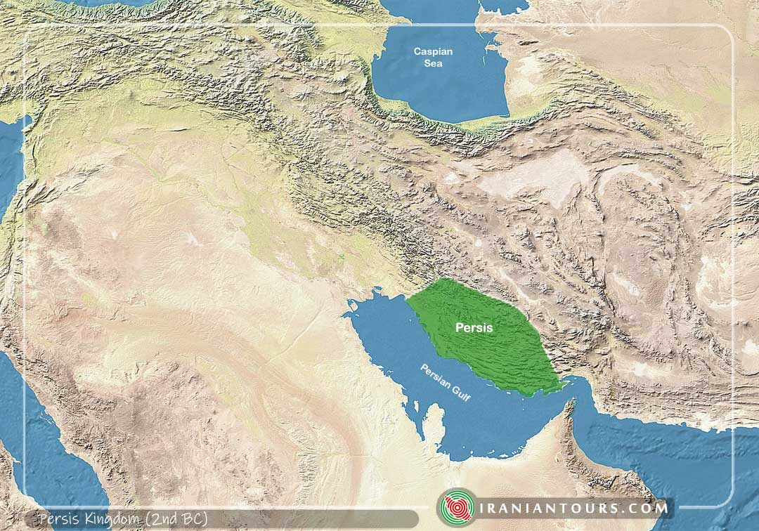
Etymologie
J Írán, JZ Írán
Persie – Fárs, Párs/Pársa → Persis (Περσίς), Persia
Pro region, celou říši
Dle Řeků od Persea → Persés, syn Persea a Andromedy
Hdt. 7.61
Snad znali i Peršané ? – Hdt. 7.150
Achaimenovci, Arsakovci (Parthové), Sásánovci
Občas pojmenování Médové, Peršané pro kohokoli

Slide 3
Dynastie
Achaimenovci – 550–330 pnl
Arsakovci – cca 250 pnl–224 nl
Sásánovci – 224–651 nl
Achaimenés – mýtický předek dynastie, z perského slova – Haxámaniš, prapraděd Kýra Velikého, řecké mýty – potomek Héraklea
Arsakés – první král Parthů (Parnů)
Sásán – kněz, správce v Persii, předek dynastie

Slide 4
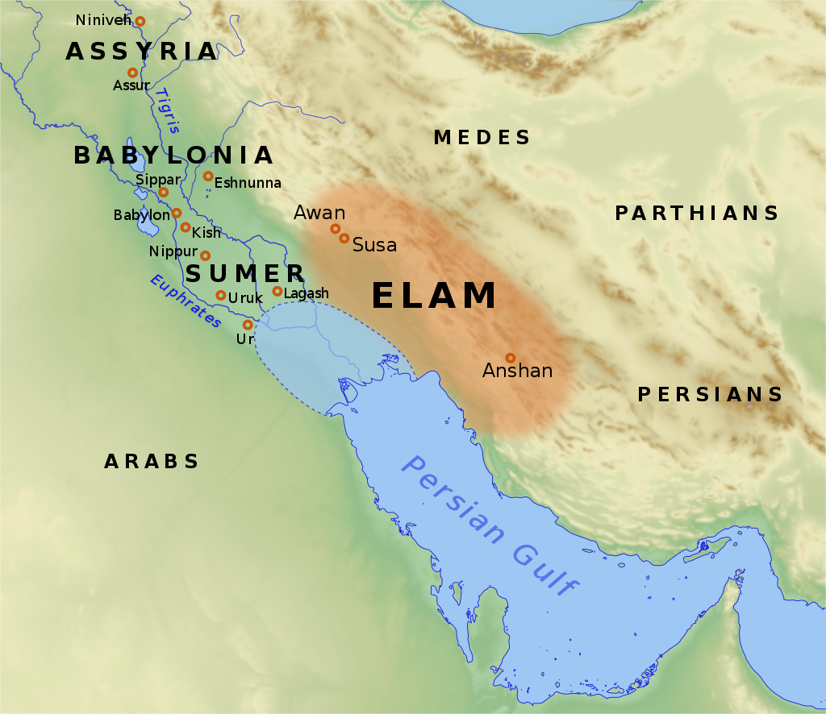
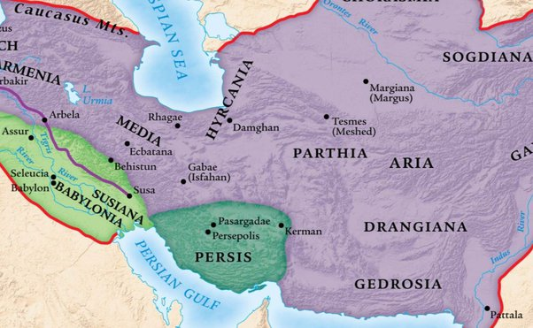
Persis, oblast Íránu
Peršané přicházejí kolem roku 1 000 pnl, kočovníci
Elam, Persis
Anšan
Teispés (praděd Kýra Velikého) obsadil město – králové Anšanu
Nová města
Pasargady – založil Kýros Veliký
Persepolis (Pársa) – založené Kýrem ?, dostavěno Dáreiem I.

Slide 5
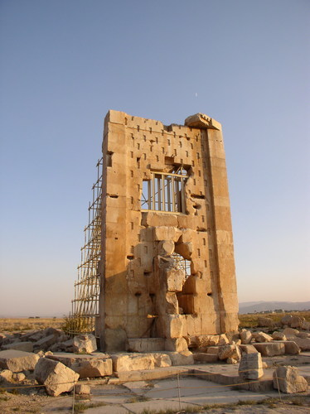
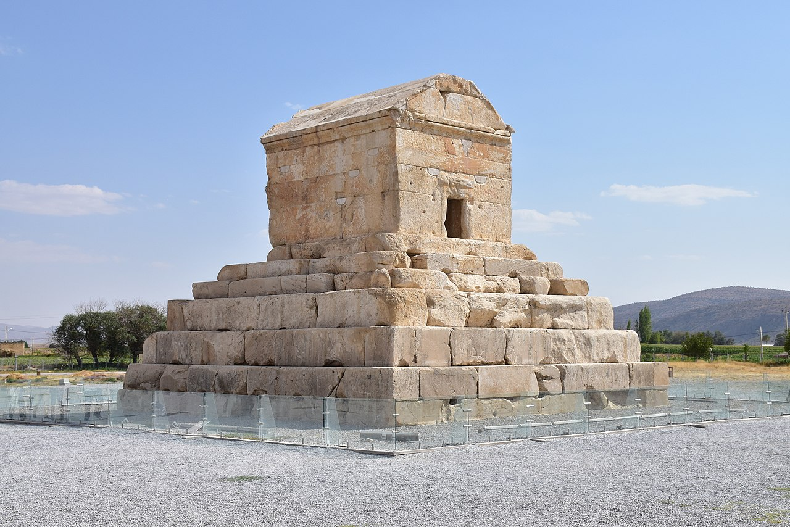
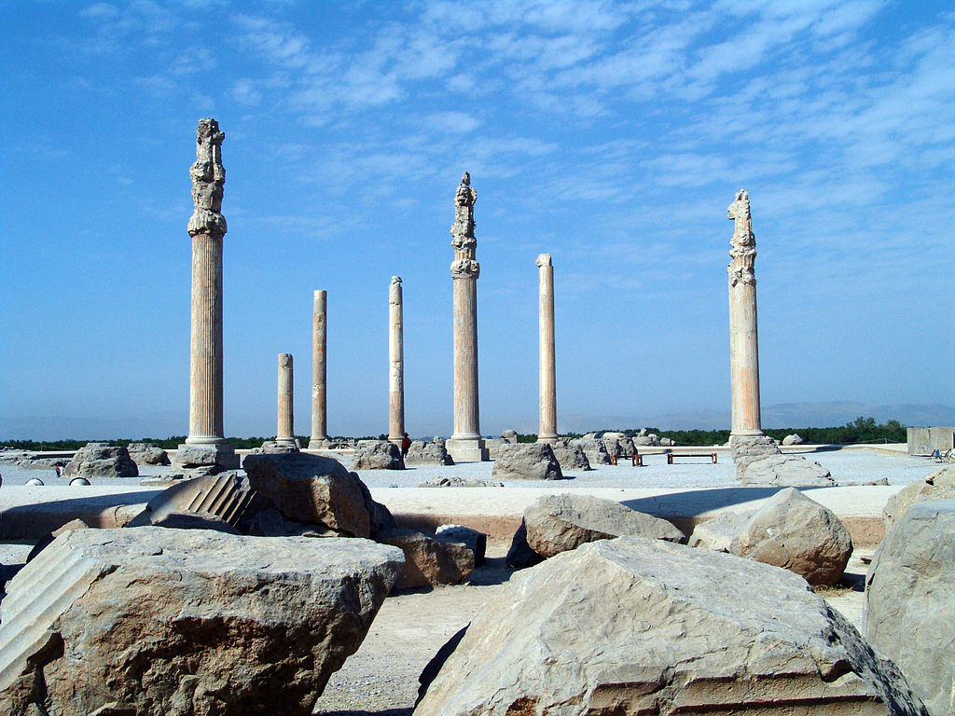
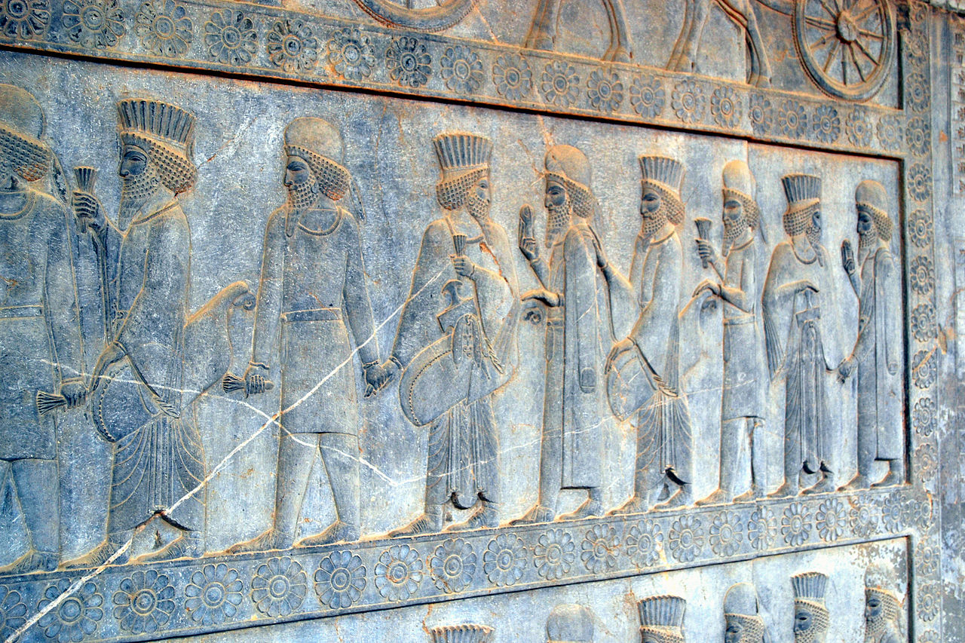
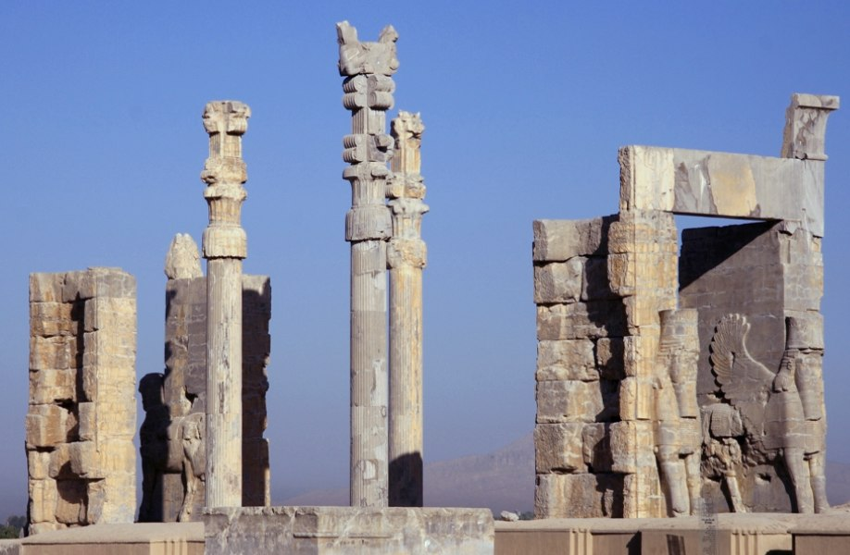
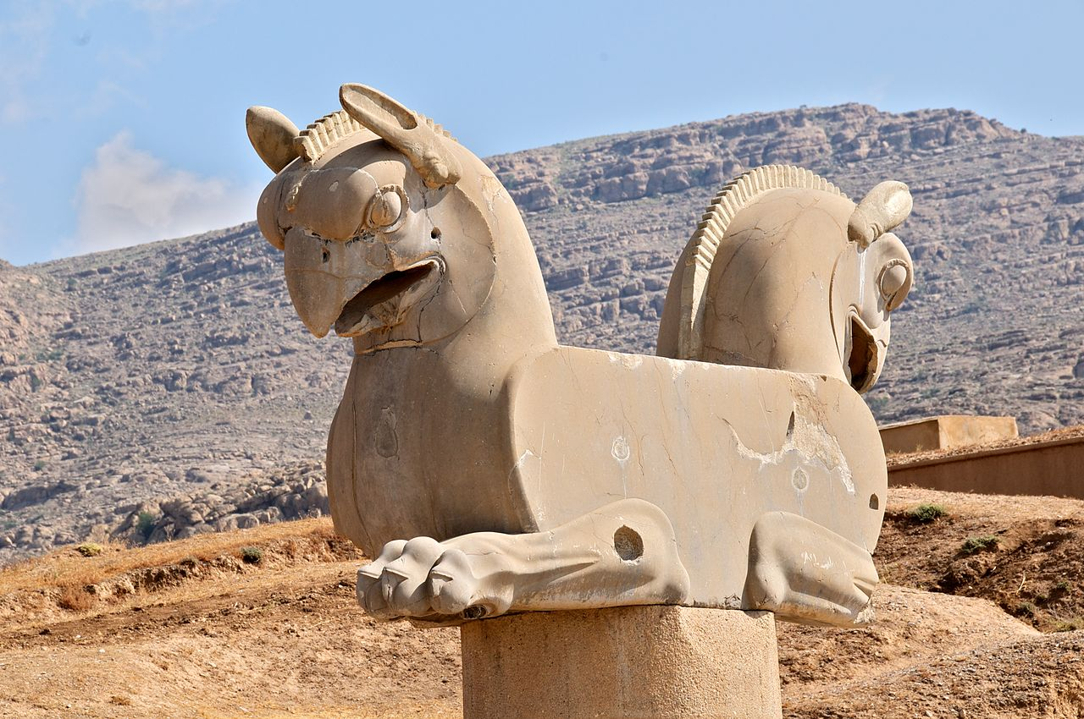
Persis
Pasargady – hrobka Kýra II., Kambýsa II.
Persepolis – Apadana (palác), brána Xerxa

Slide 6
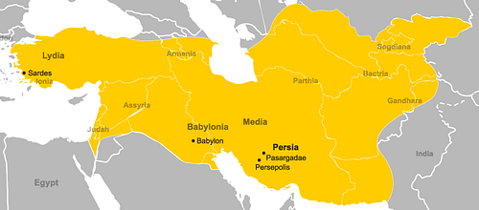
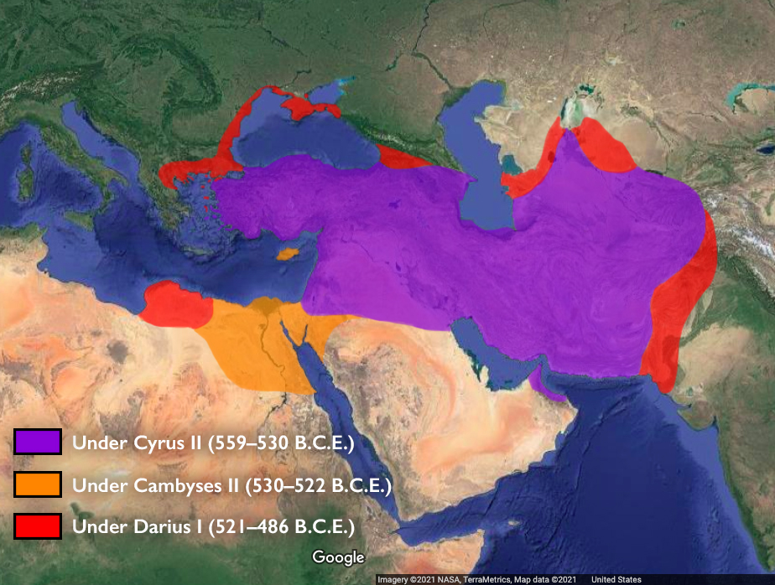
Dějiny Persie
Pod nadvládou Médů
Kolem 550 pnl, Kýros povstal proti Astyagovi, dobyl hlavní město Egbatana
Rychlá expanze
X Kroisos, Lýdie, 546 pnl
X Babylónie, Nabonidos, 539 pnl
X do Střední Asie, smrt 530 pnl
Kambýses II.
X Egypt, 525 pnl
Umírá při cestě zpět do Persie, 522 pnl

Slide 7
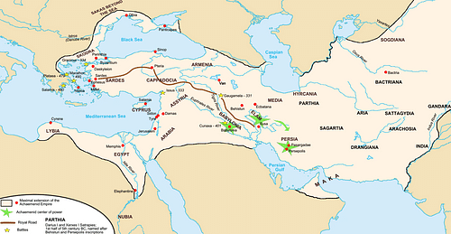
Dějiny Persie
Mág (Gaumáta)
Povstání Dáreia a zabití Mága
Dáreios I.
Dělení na satrapie
Tažení do Skythie, Indie, Makedonie vazal
Válka s Řeky
Xerxés I.
Válka s Řeky, povstání v Babylónu, zavražděn

Slide 8
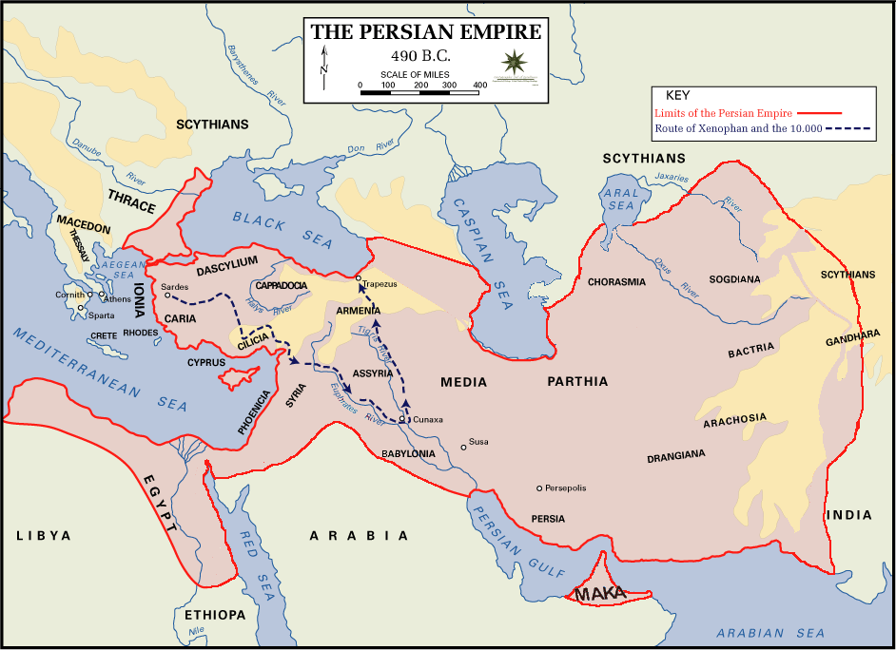
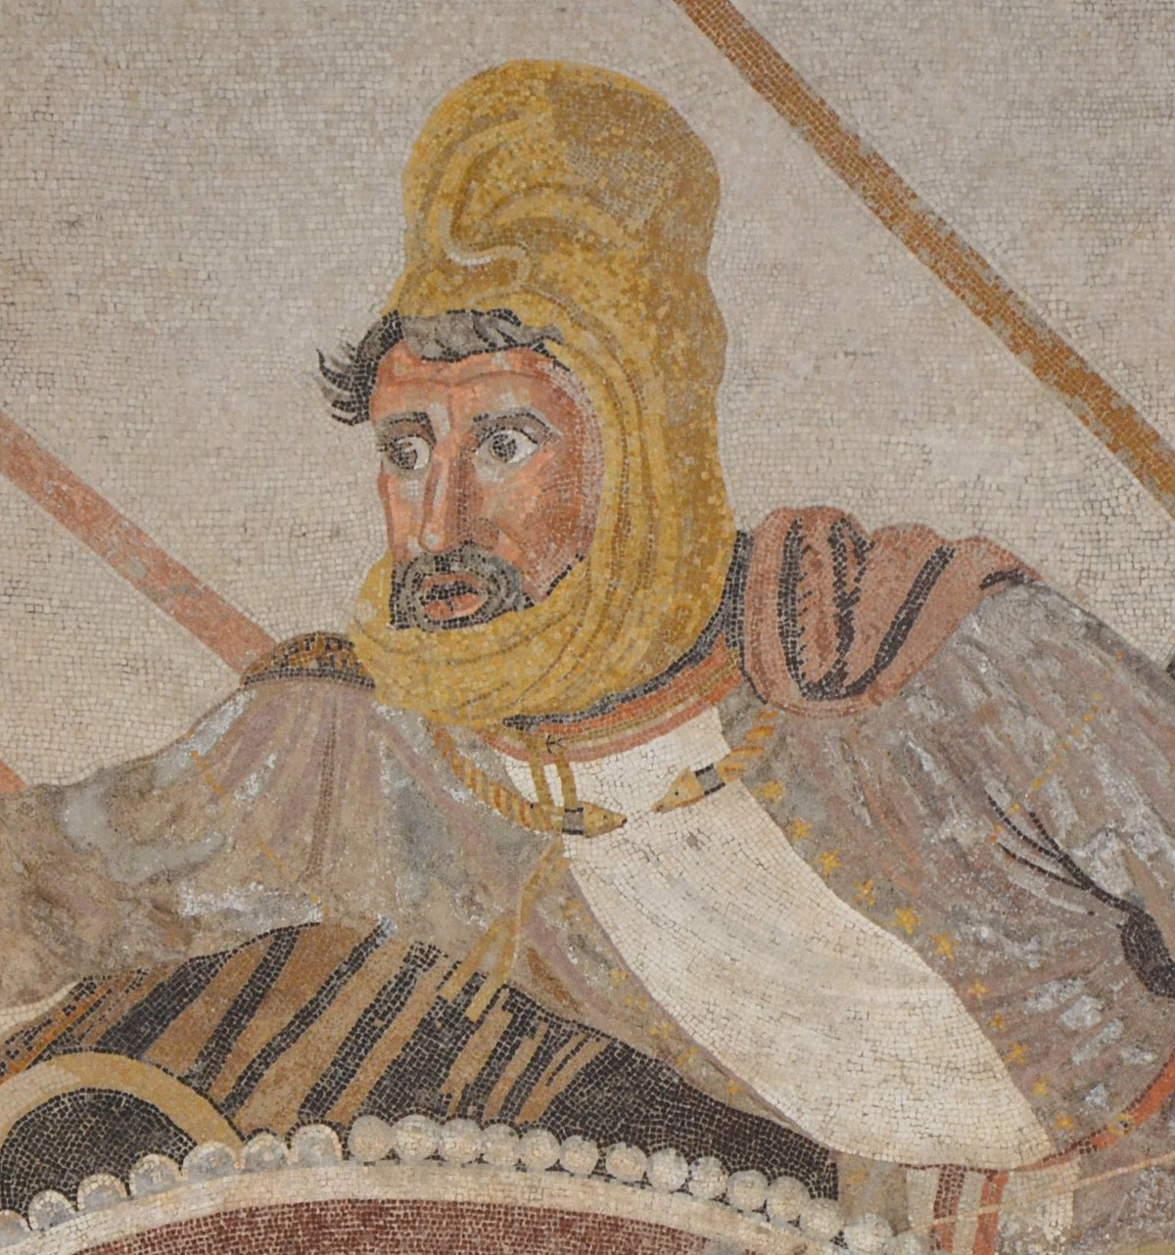
Dějiny Persie
Artaxerxés I.
Vzpoura v Egyptě
Série několika vládců, Dáreios II.,
Kýros mladší x Artaxerxés II. 401 pnl
Série vražd, spiknutí, …
Artaxerxés III.
Dáreios III. x Alexandr
330 pnl, vražda Dáreia, konec Achaimenovské říše

Slide 9
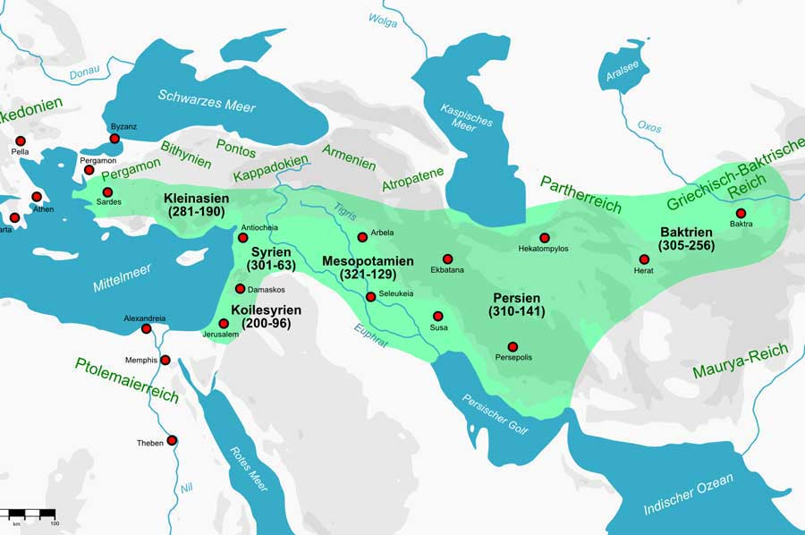
Dějiny Persie
Alexandrova říše
Seleukovci
Vzpoury
Příchod Parnů → Parthové
Postupné ovládnutí oblasti Íránu
Války s Římem
224 nl vzpoura Ardašíra I. → Sásánovci
7. stol. nl. dobytí Araby

Slide 10
Kontakty
Náhlé dobytí maloasijských měst (před tím pod nadvládou Lýdů)
545 pnl – Harpagos dobývá Mílétos a další města (Hdt. 1.163)
Xenofanés – Ath. 2
πηλίκος ἦσθ᾽ ὅθ᾽ ὁ Μῆδος ἀφίκετο; - How old were you when the Mede came?
Podpora tyrannů v maloasijských městech, spory
Žádost o podporu z Athén proti Spartě – (Kleisthenés, Artafernés) - ἐπειρώτα τίνες ἐόντες ἄνθρωποι καὶ κοῦ γῆς οἰκημένοι δεοίατο Περσέων σύμμαχοι γενέσθαι - "What men are you, and where dwell you, who desire alliance with the Persians?"

Slide 11
Kontakty
Musí přinést zemi a vodu
εἰ μὲν διδοῦσι βασιλέι Δαρείῳ Ἀθηναῖοι γῆν τε καὶ ὕδωρ, ὃ δὲ συμμαχίην σφι συνετίθετο
that if the Athenians gave king Darius earth and water, then he would make alliance with them
Povstání v Iónii – tyran z Mílétu Aristagorás – nepovedené tažení na Naxos, vyvolal povstání v Malé Asii
Podpora z Řecka – Athény a Eretria, vypálení Sard
499–493 pnl, povstání potlačeno, obyvatelé Mílétu zotročeni

Slide 12
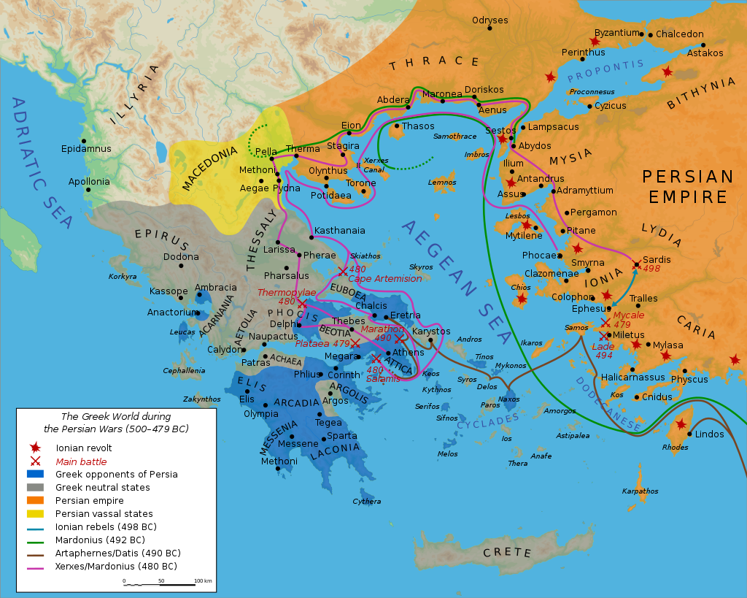
Kontakty
Řecko-perské války
492 pnl – tažení Mardónia, bouře u poloostrova Athos
490 pnl – Dátis a Artafernés, dobytí Naxu, zničení Eretrie
Bitva u Marathónu
480 pnl – tažení Xerxa
Bitva u Thermopyl, Artemísia, zničení Athén, bitva u Salamíny, Platají, Mykalé
Vzpoura v Malé Asii, tažení do Byzantia, velení ve válce – Athény
Délský spolek – tažení v Egejské oblasti, Thrákie, Kypr, Egypt
Bitva u Eurymedontu
Kalliův mír – 449 pnl x žádná dohoda

Slide 13
Kontakty
Zapojení do peloponnéské války – financování spartské flotily
Podpora sporů v Řecku – Plut. Kim. 19
Kýros ml. X Artaxerxés II. – 13 000 řeckých žoldnéřů
Spartský král Agésiláos II. – tažení do Malé Asie, začátek 4. stol. pnl
Korintská válka – financování vzpoury proti Spartě
Antalkidův (Královský) mír – 387 pnl, řecká města v Malé Asii patří Persii, král „dohlíží“ nad Řeckem

Slide 14
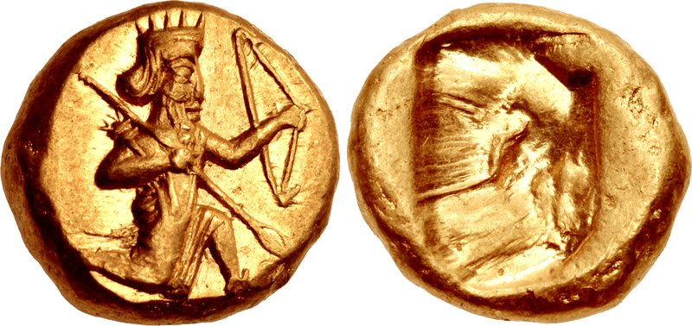
Kontakty
Plut. Ages. 15
τοῦ δὲ Περσικοῦ νομίσματος χάραγμα τοξότην ἔχοντος, ἀναζευγνύων ἔφη μυρίοις τοξόταις ὑπὸ βασιλέως ἐξελαύνεσθαι τῆς Ἀσίας: τοσούτων γὰρ εἰς Ἀθήνας καὶ Θήβας κομισθέντων καὶ διαδοθέντων τοῖς δημαγωγοῖς, ἐξεπολεμώθησαν οἱ δῆμοι πρὸς τοὺς Σπαρτιάτας.
Persian coins were stamped with the figure of an archer, and Agesilaüs said, as he was breaking camp, that the King was driving him out of Asia with ten thousand ‘archers’; for so much money had been sent to Athens and Thebes and distributed among the popular leaders there, and as a consequence those peoples made war upon the Spartans.

Slide 15
Kontakty
X. Hel. 5.1.31
Ἀρταξέρξης βασιλεὺς νομίζει δίκαιον τὰς μὲν ἐν τῇ Ἀσίᾳ πόλεις ἑαυτοῦ εἶναι καὶ τῶν νήσων Κλαζομενὰς καὶ Κύπρον, τὰς δὲ ἄλλας Ἑλληνίδας πόλεις καὶ μικρὰς καὶ μεγάλας αὐτονόμους ἀφεῖναι πλὴν Λήμνου καὶ Ἴμβρου καὶ Σκύρου: ταύτας δὲ ὥσπερ τὸ ἀρχαῖον εἶναι Ἀθηναίων. ὁπότεροι δὲ ταύτην τὴν εἰρήνην μὴ δέχονται, τούτοις ἐγὼ πολεμήσω μετὰ τῶν ταῦτα βουλομένων καὶ πεζῇ καὶ κατὰ θάλατταν καὶ ναυσὶ καὶ χρήμασιν.
“King Artaxerxes thinks it just that the cities in Asia should belong to him, as well as Clazomenae and Cyprus among the islands, and that the other Greek cities, both small and great, should be left independent, except Lemnos, Imbros, and Scyros; and these should belong, as of old, to the Athenians. But whichever of the two parties does not accept this peace, upon them I will make war, in company with those who desire this arrangement, both by land and by sea, with ships and with money.”

Slide 16
Kontakty
Plut. Ages. 23
καὶ πέμπουσιν Ἀνταλκίδαν πρὸς Τιρίβαζον, αἴσχιστα καὶ παρανομώτατα τοὺς τὴν Ἀσίαν κατοικοῦντας Ἕλληνας, ὑπὲρ ὧν ἐπολέμησεν Ἀγησίλαος, βασιλεῖ παραδιδόντες,
To that end, they sent Antalcidas to Tiribazus, and in the most shameful and lawless fashion handed over to the King the Greeks resident in Asia, in whose behalf Agesilaüs had waged war. Agesilaüs, therefore, could have had no part at all in this infamy.

Slide 17
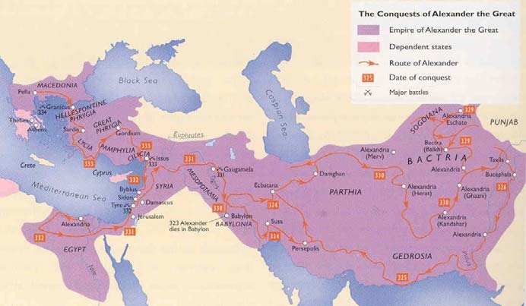
Kontakty
Filip II. – sjednocení Řecka, Korintský spolek, 337 pnl, plány na tažení do Persie
Alexandr III. – 334–330 pnl zničení Achaimenovské říše
Bitva u Gráníku, u Issu, u Gaugamél
Zničení Persepole

Slide 18
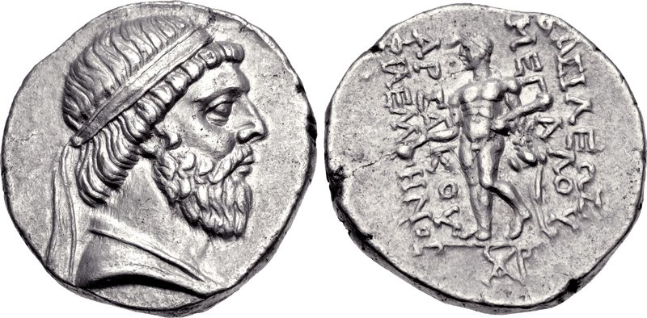
Kontakty
Vládci Persie Seleukovci, do 141 pnl
Přijetí perských zvyků již Alexandrem – oděv, proskynésis
Peršané do armády, úřadů
Řečtina na dvoře, pořečtění elit
Zůstává i za Parthů (dočasně)
Persofilie – Alexandr, Peukestás (nosil perský šat a přijal perské zvyky)
Médismos – kolaborace, spojenectví s Peršany

Slide 19
Kontakty
Mnoho Řeků ve službách Peršanů
Lékaři – Démokédés, Ktésiás
Personál paláce – tanečníci, písaři
Konkubíny
Kameníci, stavitelé
Žoldnéři – Xenofón, Klearchos – tažení 10 000; Ífikratés, Memnón z Rhodu

Slide 20
Kontakty
Místo útočiště, vyhnanci z řeckých měst
Démarátos
Themistoklés
Alkibiadés
Hippiás
Gongylos

Slide 21
Prameny
Hérodotos
Ktésiás – Persika
Xenofón
Aischylos - Peršané
Deinón – Persika
Athénaios
Arriános – Parthika, Anabasis

Slide 22
Prameny
Řecko x Persie
Demokracie x despocie
Svoboda x otroctví
Silní x slabí
Disciplína x chaos
Nedostatek x luxus
I pozitivní, neutrální, bez předsudků, dle pramene

Slide 23
Kýros
X. Cyr. 1.2.1
πατρὸς μὲν δὴ ὁ Κῦρος λέγεται γενέσθαι Καμβύσου Περσῶν βασιλέως: ὁ δὲ Καμβύσης οὗτος τοῦ Περσειδῶν γένους ἦν: οἱ δὲ Περσεῖδαι ἀπὸ Περσέως κλῄζονται: μητρὸς δὲ ὁμολογεῖται Μανδάνης γενέσθαι: ἡ δὲ Μανδάνη αὕτη Ἀστυάγους ἦν θυγάτηρ τοῦ Μήδων γενομένου βασιλέως. φῦναι δὲ ὁ Κῦρος λέγεται καὶ ᾁδεται ἔτι καὶ νῦν ὑπὸ τῶν βαρβάρων εἶδος μὲν κάλλιστος, ψυχὴν δὲ φιλανθρωπότατος καὶ φιλομαθέστατος καὶ φιλοτιμότατος, ὥστε πάντα μὲν πόνον ἀνατλῆναι, πάντα δὲ κίνδυνον ὑπομεῖναι τοῦ ἐπαινεῖσθαι ἕνεκα.
The father of Cyrus is said to have been Cambyses, king of the Persians: this Cambyses belonged to the stock of the Persidae, and the Persidae derive their name from Perseus. His mother, it is generally agreed, was Mandane; and this Mandane was the daughter of Astyages, sometime king of the Medes. And even to this day the barbarians tell in story and in song that Cyrus was most handsome in person, most generous of heart, most devoted to learning, and most ambitious, so that he endured all sorts of labour and faced all sorts of danger for the sake of praise.

Slide 24
Kýros
Sen, odložení, mládí
Hdt. 1.107–113
Hdt. 1.114–116
Na dvoře Astyaga
Poslán do Persie → vzpoura
Dobytí Lýdie, Babylónu
Tažení do Střední Asie – smrt
Zakladatel říše, dobré popisy i u Řeků a Židů, legendární postava
Mikuláš z Damašku
Z rodiny lupiče
Postupně se vypracuje na dvoře

Slide 25
Kýros
X. Cyr. 8.2.9
τίς δ᾽ ἄλλος καταστρεψάμενος ἀρχὴν ὑπὸ τῶν ἀρχομένων πατὴρ καλούμενος ἀπέθανεν ἢ Κῦρος; τοῦτο δὲ τοὔνομα δῆλον ὅτι εὐεργετοῦντός ἐστι μᾶλλον ἢ ἀφαιρουμένου.
And who, besides Cyrus, ever gained an empire by conquest and even to his death was called “father” by the people he had subdued? For that name obviously belongs to a benefactor rather than to a despoiler.

Slide 26
Kambýses
Šílenec
Hdt. 3.29
Ὡς δὲ ἤγαγον τὸν Ἆπιν οἱ ἱρέες, ὁ Καμβύσης, οἷα ἐὼν ὑπομαργότερος, σπασάμενος τὸ ἐγχειρίδιον, θέλων τύψαι τὴν γαστέρα τοῦ Ἄπιος παίει τὸν μηρόν· γελάσας δὲ εἶπε πρὸς τοὺς ἱρέας "Ὦ κακαὶ κεφαλαί, τοῖσι θεοὶ γίνονται, ἔναιμοί τε καὶ σαρκώδεες καὶ ἐπαΐοντες σιδηρίων; ἄξιος μέν γε Αἰγυπτίων οὗτός γε ὁ θεός, ἀτάρ τοι ὑμεῖς γε οὐ χαίροντες γέλωτα ἐμὲ θήσεσθε."
When the priests led Apis in, Cambyses — for he was well-nigh mad — drew his dagger and made to stab the calf in the belly, but smote the thigh; then laughing he said to the priests: "Wretched wights, are these your gods, creatures of flesh and blood that can feel weapons of iron? that is a god worthy of the Egyptians. But for you, you shall suffer for making me your laughing-stock."

Slide 27
Kambýses
Hdt. 1.30
Zabití bratra
Hdt. 1.31
Ožení se se sestrou
Hdt. 1.34
Holdování vínu
Hdt. 1.37
Otevírání hrobek, výsměch jiným náboženstvím

Slide 28
Dáreios I.
Založení institucí, řádu, efektivita vlády
Aesch. Pers. 852–859
X
Xerxés – zničil to, co králové před ním vybudovali
Další králové – už nemají takovou moc, čas vytáhnout do Persie (Xenofón, Ísokratés)

Slide 29
Pozitivní hledisko
Hdt. 7.238
ἐπεὶ τιμᾶν μάλιστα νομίζουσι τῶν ἐγὼ οἶδα ἀνθρώπων Πέρσαι ἄνδρας ἀγαθοὺς τὰ πολέμια.
Statečný boj
Hdt. 8.86, 9.71
Benevolentní k řeckým městům
Hdt. 6.43, nahrazení tyrannů demokraciemi
for the Persians are of all men known to me the most wont to honour valiant warriors.
Aesch. Pers. 87–92
And there is no man skilled to withstand the mighty stream of men, and with strong barriers keep out the sea's invincible surge; for Persia's host cannot be withstood, and her men are courageous.

Slide 30
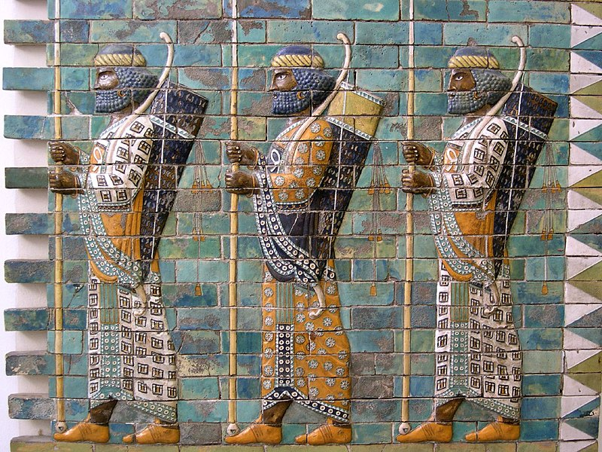
Pozitivní pohled
Hdt. 7.83
Οὗτοι ἦσαν στρατηγοὶ τοῦ σύμπαντος πεζοῦ χωρὶς τῶν μυρίων· τῶν δὲ μυρίων τούτων Περσέων τῶν ἀπολελεγμένων ἐστρατήγεε μὲν Ὑδάρηνς ὁ Ὑδάρνεος, ἐκαλέοντο δὲ ἀθάνατοι οἱ Πέρσαι οὗτοι ἐπὶ τοῦδε· εἴ τις αὐτῶν ἐξέλιπε τὸν ἀριθμὸν ἢ θανάτῳ βιηθεὶς ἡ νούσῳ, ἄλλος ἀνὴρ ἀραίρητο, καὶ ἐγίνοντο οὐδαμὰ οὔτε πλεῦνες μυρίων οὔτε ἐλάσσονες. κόσμον δὲ πλεῖστον παρείχοντο διὰ πάντων Πέρσαι, καὶ αὐτοὶ ἄριστοι ἦσαν·
These were the generals of the whole land army, saving the Ten Thousand; Hydarnes son of Hydarnes was general of these picked ten thousand Persians, who were called Immortals for this reason, that when any one of them fell out of the number by force of death or sickness, another was chosen, and so they were never more or fewer than ten thousand. The Persians showed of all the richest adornment, and were themselves the best in the army.

Slide 31
Pozitivní hledisko
X. Cyr. 1.2.3
ἔστιν αὐτοῖς ἐλευθέρα ἀγορὰ καλουμένη, ἔνθα τά τε βασίλεια καὶ τἆλλα ἀρχεῖα πεποίηται. ἐντεῦθεν τὰ μὲν ὤνια καὶ οἱ ἀγοραῖοι καὶ αἱ τούτων φωναὶ καὶ ἀπειροκαλίαι ἀπελήλανται εἰς ἄλλον τόπον, ὡς μὴ μιγνύηται ἡ τούτων τύρβη τῇ τῶν πεπαιδευμένων εὐκοσμίᾳ.
1.2.5
καὶ ἐπὶ μὲν τοῖς παισὶν ἐκ τῶν γεραιτέρων ᾑρημένοι εἰσὶν οἳ ἂν δοκῶσι τοὺς παῖδας βελτίστους ἀποδεικνύναι.
They have their so-called “Free Square,” where the royal palace and other government buildings are located. The hucksters with their wares, their cries, and their vulgarities are excluded from this and relegated to another part of the city, in order that their tumult may not intrude upon the orderly life of the cultured.
To have charge of the boys, such are chosen from the ranks of the elders as seem likely to make out of the boys the best men

Slide 32
X. Cyr. 1.2.8
διδάσκουσι δὲ αὐτοὺς καὶ πείθεσθαι τοῖς ἄρχουσι: μέγα δὲ καὶ εἰς τοῦτο συμβάλλεται ὅτι ὁρῶσι τοὺς πρεσβυτέρους πειθομένους τοῖς ἄρχουσιν ἰσχυρῶς. διδάσκουσι δὲ καὶ ἐγκράτειαν γαστρὸς καὶ ποτοῦ:
1.2.16
καὶ νῦν δὲ ἔτι ἐμμένει μαρτύρια καὶ τῆς μετρίας διαίτης αὐτῶν καὶ τοῦ ἐκπονεῖσθαι τὴν δίαιταν. αἰσχρὸν μὲν γὰρ ἔτι καὶ νῦν ἐστι Πέρσαις καὶ τὸ πτύειν καὶ τὸ ἀπομύττεσθαι καὶ τὸ φύσης μεστοὺς φαίνεσθαι, αἰσχρὸν δέ ἐστι καὶ τὸ ἰόντα ποι φανερὸν γενέσθαι ἢ τοῦ οὐρῆσαι ἕνεκα ἢ καὶ ἄλλου τινὸς τοιούτου.
And they teach them likewise to obey the officers; and it greatly conduces to this also that they see their elders implicitly obeying their officers. And besides, they teach them self-restraint in eating and drinking;
There remains even unto this day evidence of their moderate fare and of their working off by exercise what they eat: for even to the present time it is a breach of decorum for a Persian to spit or to blow his nose or to appear afflicted with flatulence

Slide 33
Náboženství, zvyky
Hdt. 1.131
Πέρσας δὲ οἶδα νόμοισι τοιοῖσιδε χρεωμένους, ἀγάλματα μὲν καὶ νηοὺς καὶ βωμοὺς οὐκ ἐν νόμῳ ποιευμένους ἱδρύεσθαι, ἀλλὰ καὶ τοῖσι ποιεῦσι μωρίην ἐπιφέρουσι, ὡς μὲν ἐμοὶ δοκέειν, ὅτι οὐκ ἀνθρωποφυέας ἐνόμισαν τοὺς θεοὺς κατά περ οἱ Ἕλληνες εἶναι· οἳ δὲ νομίζουσι Διὶ μὲν ἐπὶ τὰ ὑψηλότατα τῶν ὀρέων ἀναβαίνοντες θυσίας ἔρδειν, τὸν κύκλον πάντα τοῦ οὐρανοῦ Δία καλέοντες· θύουσι δὲ ἡλίῳ τε καὶ σελήνῃ καὶ γῇ καὶ πυρὶ καὶ ὕδατι καὶ ἀνέμοισι.
As to the usages of the Persians, I know them to be these. It is not their custom to make and set up statues and temples and altars, but those who make such they deem foolish, as I suppose, because they never believed the gods, as do the Greeks, to be in the likeness of men; but they call the whole circle of heaven Zeus,​ and to him they offer sacrifice on the highest peaks of the mountains; they sacrifice also to the sun and moon and earth and fire and water and winds.

Slide 34
Náboženství, zvyky
Hdt. 1.131
παρά τε Ἀσσυρίων μαθόντες καὶ Ἀραβίων. καλέουσι δὲ Ἀσσύριοι τὴν Ἀφροδίτην Μύλιττα, Ἀράβιοι δὲ Ἀλιλάτ, Πέρσαι δὲ Μίτραν.
Aphrodite, from the Assyrians and Arabians. She is called by the Assyrians Mylitta, by the Arabians Alilat, by the Persians Mitra.

Slide 35
Hdt. 1.133
ἐν τῇ οἱ εὐδαίμονες αὐτῶν βοῦν καὶ ἵππον καὶ κάμηλον καὶ ὅνον προτιθέαται ὅλους ὀπτοὺς ἐν καμίνοισι, οἱ δὲ πένητες αὐτῶν τὰ λεπτὰ τῶν προβάτων προτιθέαται. σίτοισι δὲ ὀλίγοισι χρέωνται, ἐπιφορήμασι δὲ πολλοῖσι καὶ οὐκ ἁλέσι· καὶ διὰ τοῦτο φασὶ Πέρσαι τοὺς Ἕλληνας σιτεομένους πεινῶντας παύεσθαι, ὅτι σφι ἀπὸ δείπνου παραφορέεται οὐδὲν λόγου ἄξιον· εἰ δέ τι παραφέροιτο, ἐσθίοντας ἂν οὐ παύεσθαι.
before the rich are set oxen or horses or camels or asses, roasted whole in ovens; the poorer serve up the lesser kinds of cattle. Their courses are few, the dainties that follow are many and not all served together. This is why the Persians say of the Greeks, that they rise from the table still hungry, because not much dessert is set before them: were this too given to the Greek (say the Persians) he would never cease eating.

Slide 36
Hdt. 1.133
οἴνῳ δὲ κάρτα προσκέαται, καί σφι οὐκ ἐμέσαι ἔξεστι, οὐκὶ οὐρῆσαι ἀντίον ἄλλου. ταῦτα μέν νυν οὕτω φυλάσσεται, μεθυσκόμενοι δὲ ἐώθασι βουλεύεσθαι τὰ σπουδαιέστατα τῶν πρηγμάτων· τὸ δ’ ἂν ἅδῃ σφι βουλευομένοισι, τοῦτο τῇ ὑστεραίῃ νήφουσι προτιθεῖ ὁ στέγαρχος, ἐν τοῦ ἂν ἐόντες βουλεύωνται, καὶ ἢν μὲν ἅδῃ καὶ νήφουσι, χρέωνται αὐτῷ, ἢν δὲ μὴ ἅδῃ, μετιεῖσι.
They are greatly given to wine; none may vomit or make water in another's presence. This then is prohibited among them. Moreover it is their custom to deliberate about the gravest matters when they are drunk; and what they approve in their counsels is proposed to them the next day by the master of the house where they deliberate, when they are now sober and if being sober they still approve it, they act thereon, but if not, they cast it aside.

Slide 37
Hdt. 1.135
Ξεινικὰ δὲ νόμαια Πέρσαι προσίενται ἀνδρῶν μάλιστα. καὶ γὰρ δὴ τὴν Μηδικὴν ἐσθῆτα νομίσαντες τῆς ἑωυτῶν εἶναι καλλίω φορέουσι, καὶ ἐς τοὺς πολέμους τοὺς Αἰγυπτίους θώρηκας· καὶ εὐπαθείας τε παντοδαπὰς πυνθανόμενοι ἐπιτηδεύουσι, καὶ δὴ καὶ ἀπ’ Ἑλλήνων μαθόντες παισὶ μίσγονται. γαμέουσι δὲ ἕκαστος αὐτῶν πολλὰς μὲν κουριδίας γυναῖκας, πολλῷ δ’ ἔτι πλεῦνας παλλακὰς κτῶνται.
But of all men the Persians most welcome foreign customs. They wear the Median dress, deeming it more beautiful than their own, and the Egyptian cuirass in war. Their luxurious practices are of all kinds, and all borrowed; the Greeks taught them unnatural vices.​l Every Persian marries many lawful wives, and keeps still more concubines.

Slide 38
Hdt. 1.136
Ἀνδραγαθίη δὲ αὕτη ἀποδέδεκται, μετὰ τὸ μάχεσθαι εἶναι ἀγαθόν, ὃς ἂν πολλοὺς ἀποδέξῃ παῖδας· τῷ δὲ τοὺς πλείστους ἀποδεικνύντι δῶρα ἐκπέμπει βασιλεὺς ἀνὰ πᾶν ἔτος. τὸ πολλὸν δ’ ἡγέαται ἰσχυρὸν εἶναι.
παιδεύουσι δὲ τοὺς παῖδας ἀπὸ πενταέτεος ἀρξάμενοι μέχρι εἰκοσαέτεος τρία μοῦνα, ἱππεύειν καὶ τοξεύειν καὶ ἀληθίζεσθαι.
After valour in battle it is most reckoned as manly merit to show the greatest number of sons: the king sends gifts yearly to him who can show most. Numbers, they hold, are strength. They educate their boys from five to twenty years old, and teach them three things only, riding and archery and truth-telling.

Slide 39
Hdt. 1.138
Ἅσσα δέ σφι ποιέειν οὐκ ἔξεστι, ταῦτα οὐδὲ λέγειν ἔξεστι. αἴσχιστον δὲ αὐτοῖσι τὸ ψεύδεσθαι νενόμισται, δεύτερα δὲ τὸ ὀφείλειν χρέος, πολλῶν μὲν καὶ ἄλλων εἵνεκα, μάλιστα δὲ ἀναγκαίην φασὶ εἶναι τὸν ὀφείλοντα καί τι ψεῦδος λέγειν.
Moreover of what they may not do neither may they speak. They hold lying to be foulest of all and next to that debt; for which they have many other reasons, but this in especial, that the debtor must needs (so they say) speak some falsehood.

Slide 40
Náboženství
D.L. 1.8
Τὴν δὲ γοητικὴν μαγείαν οὐδ᾽ ἔγνωσαν, φησὶν Ἀριστοτέλης ἐν τῷ Μαγικῷ καὶ Δείνων ἐν τῇ πέμπτῃ τῶν Ἱστοριῶν: ὃς καὶ μεθερμηνευόμενόν φησι τὸν Ζωροάστρην ἀστροθύτην εἶναι: φησὶ δὲ τοῦτο καὶ ὁ Ἑρμόδωρος. Ἀριστοτέλης δ᾽ ἐν πρώτῳ Περὶ φιλοσοφίας καὶ πρεσβυτέρους εἶναι τῶν Αἰγυπτίων: καὶ δύο κατ᾽ αὐτοὺς εἶναι ἀρχάς, ἀγαθὸν δαίμονα καὶ κακὸν δαίμονα: καὶ τῷ μὲν ὄνομα εἶναι Ζεὺς καὶ Ὠρομάσδης, τῷ δὲ ᾍδης καὶ Ἀρειμάνιος.
With the art of magic they were wholly unacquainted, according to Aristotle in his Magicus and Dinon in the fifth book of his History Dinon tells us that the name Zoroaster, literally interpreted, means "star-worshipper"; and Hermodorus agrees with him in this. Aristotle in the first book of his dialogue On Philosophy declares that the Magi are more ancient than the Egyptians; and further, that they believe in two principles, the good spirit and the evil spirit, the one called Zeus or Oromasdes, the other Hades or Arimanius.

Slide 41
Náboženství
D.L. 1.2
Ἀπὸ δὲ τῶν Μάγων, ὧν ἄρξαι Ζωροάστρην τὸν Πέρσην, Ἑρμόδωρος μὲν ὁ Πλατωνικὸς ἐν τῷ Περὶ μαθημάτων φησὶν εἰς τὴν Τροίας ἅλωσιν ἔτη γεγονέναι πεντακισχίλια: Ξάνθος δὲ ὁ Λυδὸς εἰς τὴν Ξέρξου διάβασιν ἀπὸ τοῦ Ζωροάστρου ἑξακισχίλιά φησι, καὶ μετ᾽ αὐτὸν γεγονέναι πολλούς τινας Μάγους κατὰ διαδοχήν, Ὀστάνας καὶ Ἀστραμψύχους καὶ Γωβρύας καὶ Παζάτας, μέχρι τῆς τῶν Περσῶν ὑπ᾽ Ἀλεξάνδρου καταλύσεως.
The date of the Magians, beginning with Zoroaster the Persian, was 5000 years before the fall of Troy, as given by Hermodorus the Platonist in his work on mathematics; but Xanthus the Lydian reckons 6000 years from Zoroaster to the expedition of Xerxes, and after that event he places a long line of Magians in succession, bearing the names of Ostanas, Astrampsychos, Girya's, and Pazatas, down to the conquest of Persia by Alexander.

Slide 42
Zóroastér
Pl. NH. 30.2.3
Sine dubio illic orta in Perside a Zoroastre, ut inter auctores convenit.
qui de tota ea arte diligentissime scripsit et viciens C milia versuum a Zoroastre condita indicibus
Daphnean Zoroastres morbis comitialibus demonstrat.
Without doubt magic arose in Persia with Zoroaster. On this our authorities are agreed,
and an exponent of two million verses composed by Zoroaster,
The 'daphnea,' or 'laurel stone,' is prescribed by Zoroaster as a cure for epilepsy.

Slide 43
Ahura-Mazda, Ahriman, Mithra
Plut. De Iside 46
οἱ δὲ τὸν μὲν ἀμείνονα θεόν, τὸν δὲ ἕτερον δαίμονα καλοῦσιν: ὥσπερ Ζωροάστρης ὁ μάγος, ὃν πεντακισχιλίοις ἔτεσι τῶν Τρωικῶν γεγονέναι πρεσβύτερον ἱστοροῦσιν. οὗτος οὖν ἐκάλει τὸν μὲν Ὡρομάζην, τὸν δ᾽ Ἀρειμάνιον καὶ προσαπεφαίνετο τὸν μὲν ἐοικέναι φωτὶ μάλιστα τῶν αἰσθητῶν, τὸν δ᾽ ἔμπαλιν σκότῳ καὶ ἀγνοίᾳ, μέσον δ᾽ ἀμφοῖν τὸν Μίθρην εἶναι: διὸ καὶ Μίθρην Πέρσαι τὸν μεσίτην ὀνομάζουσιν.
And some call the better of these God, and the other Daemon; as doth Zoroaster the Magian whom they report to be five thousand years elder than the Trojan times. This Zoroaster now called the one of these Horomazes, and the other Arimanius; and affirmed, moreover, that the one of them did, of any thing sensible, the most resemble light, and the other darkness and ignorance; but that Mithras was in the middle betwixt them. For which cause the Persians call Mithras the Mediator.

Slide 44
Mágové
Hdt. 1.107
ἐκ γάρ οἱ τῆς ὄψιος οἱ τῶν Μάγων ὀνειροπόλοι ἐσήμαινον
X. Cyr. 4.5.14
πρῶτον μὲν τοὺς μάγους καλέσας ὁ Κῦρος τὰ τοῖς θεοῖς νομιζόμενα ἐπὶ τοῖς τοιούτοις ἀγαθοῖς ἐξαιρεῖσθαι ἐκέλευε.
He imparted this vision to those of the Magi who interpreted dreams,
Now at peep of day the first thing that Cyrus did was to call the magi and bid them select the gifts ordained for the gods in acknowledgment of such success

Slide 45
Mágové
D.S. 5.55.3
λέγονται δ᾽ οὗτοι καὶ γόητες γεγονέναι καὶ παράγειν ὅτε βούλοιντο νέφη τε καὶ ὄμβρους καὶ χαλάζας, ὁμοίως δὲ καὶ χιόνα ἐφέλκεσθαι: ταῦτα δὲ καθάπερ καὶ τοὺς μάγους ποιεῖν ἱστοροῦσιν. ἀλλάττεσθαι δὲ καὶ τὰς ἰδίας μορφάς, καὶ εἶναι φθονεροὺς ἐν τῇ διδασκαλίᾳ τῶν τεχνῶν.
And men say that the Telchines were also wizards and could summon clouds and rain and hail at their will and likewise could even bring snow; these things, the accounts tell us, they could do even as could the Magi of Persia; and they could also change their natural shapes and were jealous of teaching their arts to others.

Slide 46
Mágové
Hdt. 1.140
τάδε μέντοι ὡς κρυπτόμενα λέγεται καὶ οὐ σαφηνέως περὶ τοῦ ἀποθανόντος, ὡς οὐ πρότερον θάπτεται ἀνδρὸς Πέρσεω ὁ νέκυς πρὶν ἂν ὑπ᾽ ὄρνιθος ἢ κυνὸς ἑλκυσθῇ. [2] Μάγους μὲν γὰρ ἀτρεκέως οἶδα ταῦτα ποιέοντας:
but what follows is reported about their dead as a secret mystery and not with clearness, namely that the body of a Persian man is not buried until it has been torn by a bird or a dog. (The Magians I know for a certainty have this practice, for they do it openly.)

Slide 47
Mágové
Str. 16.2.39
παρὰ δὲ τοῖς Πέρσαις οἱ μάγοι καὶ νεκυομάντεις καὶ ἔτι οἱ λεγόμενοι λεκανομάντεις καὶ ὑδρομάντεις, παρὰ δὲ τοῖς Ἀσσυρίοις οἱ Χαλδαῖοι, παρὰ δὲ τοῖς Ῥωμαίοις οἱ Τυρρηνικοὶ οἰωνοσκόποι.
Amm. 23.6.33
ex his, quae didicit, aliqua sensibus magorum infudit, quae illi cum disciplinis praesentiendi futura, per suam quisque progeniem, posteris aetatibus tradunt.
among the Persians, the Magi and Necyomanteis, and besides these the Lecanomanteis and Hydromanteis; among the Assyrians, were the Chaldaeans; and among the Romans, the Tyrrhenian diviners of dreams.
Of what he had learned he communicated something to the understanding of the Magi, which they, along with the art of divining the future, hand on from generation to generation to later times.

Slide 48
Jací Peršané bývali …
Hdt. 1.71
"Ὦ βασιλεῦ, ἐπ’ ἄνδρας τοιούτους στρατεύεσθαι παρασκευάζεαι, οἳ σκυτίνας μὲν ἀναξυρίδας σκυτίνην δὲ τὴν ἄλλην ἐσθῆτα φορέουσι, σιτέονται δὲ οὐκ ὅσα ἐθέλουσι ἀλλ’ ὅσα ἔχουσι, χώρην ἔχοντες τρηχέαν. πρὸς δὲ οὐκ οἴνῳ διαχρέωνται ἀλλὰ ὑδροποτέουσι, οὐ σῦκα δὲ ἔχουσι τρώγειν, οὐκ ἄλλο ἀγαθὸν οὐδέν. τοῦτο μὲν δή, εἰ νικήσεις, τί σφέας ἀπαιρήσεαι, τοῖσί γε μὴ ἔστι μηδέν;
O King, you are making ready to march against men who wear breeches of leather and their other garments of the same, and whose fare is not what they desire but what they have; for their land is stony. Further they use no wine, but are water-drinkers, nor have they figs to eat, nor aught else that is good. Now if you conquer them, of what will you deprive them, seeing that they have nothing?

Slide 49
Jací Peršané bývali …
Hdt. 9.122
καὶ οὐ θωμάσας τὸν λόγον ἐκέλευε ποιέειν ταῦτα, οὕτω δὲ αὐτοῖσι παραίνεε κελεύων παρασκευάζεσθαι ὡς οὐκέτι ἄρξοντας ἀλλ’ ἀρξομένους· φιλέειν γὰρ ἐκ τῶν μαλακῶν χώρων μαλακοὺς γίνεσθαι· οὐ γάρ τι τῆς αὐτῆς γῆς εἶναι καρπόν τε θωμαστὸν φύειν καὶ ἄνδρας ἀγαθοὺς τὰ πολέμια. ὥστε συγγνόντες Πέρσαι οἴχοντο ἀποστάντες, ἑσσωθέντες τῇ γνώμῃ πρὸς Κύρου, ἄρχειν τε εἵλοντο λυπρὴν οἰκέοντες μᾶλλον ἢ πεδιάδα σπείροντες ἄλλοισι δουλεύειν.
"But if you do, make ready to be no longer rulers, but subjects. Soft lands breed soft men; wondrous fruits of the earth and valiant warriors grow not from the same soil." Thereat the Persians saw that Cyrus reasoned better than they, and they departed from before him, choosing rather to be rulers on a barren mountain side than slaves dwelling in tilled valleys.

Slide 50
Literatura
Miller, M. C. (1995). Persians: The Oriental Other. Source: Notes in the History of Art, 15(1), 39–44.
Morgan, J. (2013). Greek Perspectives of the Achaemenid Empire: Persia through the Looking Glass. Edinburgh: Edinburgh University Press.
Hall, E. (1988). Inventing the Barbarian: Greek Self-definition through Tragedy. Oxford: Clarendon Press.
Drews, R. (1973). The Greek Accounts of Eastern History. Washingtion: Center for Hellenic Studies.

