Slide 1
DSBcB49 Starověká ekumena - antické zprávy o Asii a Africe
Persie

Slide 2
Dříve a poté
Dobří vládci – Kýros, Dáreios I.
Žijí uměřeně
Nemají luxus
Nejsou dekadentní
Dobří válečníci
Odlišná výchova
Úpadek
Slabí, dekadentní, zženštilí, špatní ve všech ohledech, bohatí
Krutí, slabí králové, mocné královny, eunuši, chaos na dvoře, intriky

Slide 3
Dříve a poté
Hérodotos, divadelní hry, Xenofón
X
Od 4. stol. pnl - Xenofón (poslední kapitola), Ktésiás, Deinón, historici Alexandra, Plútarchos
Popisy Peršanů/východních obyvatel aplikovány na Achaimenovce, Parthy i Sásánovce

Slide 4
Změna pohledu – spory v Řecku, prospěch Persie
Philostr. VS. 1.9.5
τὰ μὲν κατὰ τῶν βαρβάρων τρόπαια ὕμνους ἀπαιτεῖ, τὰ δὲ κατὰ τῶν Ἑλλήνων θρήνους.
Platón (Pl. Rep. 470c–d)
Ἕλληνας μὲν ἄρα βαρβάροις καὶ βαρβάρους Ἕλλησι πολεμεῖν μαχομένους τε φήσομεν καὶ πολεμίους φύσει εἶναι
Pl. Menex 242d
πρὸς μὲν τὸ ὁμόφυλον μέχρι νίκης δεῖν πολεμεῖν, … πρὸς δὲ τοὺς βαρβάρους μέχρι διαφθορᾶς.
Triumphs gained over barbarians demand victory hymns, those over Greeks dirges.
občanská válka mezi Řeky (στάσις), mezi Řeky a barbary přirozené nepřátelství
S Řeky bojovat jen do vítězství, s barbary až do zničení

Slide 5
Špatná vláda - monarchie
Isoc. 4.150
πῶς γὰρ ἐν τοῖς ἐκείνων ἐπιτηδεύμασιν ἐγγενέσθαι δύναιτ᾽ ἂν ἢ στρατηγὸς δεινὸς ἢ στρατιώτης ἀγαθός, ὧν τὸ μὲν πλεῖστόν ἐστιν ὄχλος ἄτακτος καὶ κινδύνων ἄπειρος, πρὸς μὲν τὸν πόλεμον ἐκλελυμένος, πρὸς δὲ τὴν δουλείαν ἄμεινον τῶν παρ᾽ ἡμῖν οἰκετῶν πεπαιδευμένος,
for it is not possible for people who are reared and governed as are the Persians, either to have a part in any other form of virtue or to set up on the field of battle trophies of victory over their foes. For how could either an able general or a good soldier be produced amid such ways of life as theirs? Most of their population is a mob without discipline or experience of dangers, which has lost all stamina for war and has been trained more effectively for servitude than are the slaves in our country.

Slide 6
Špatná vláda - monarchie
οἱ δ᾽ ἐν ταῖς μεγίσταις δόξαις ὄντες αὐτῶν ὁμαλῶς μὲν οὐδὲ κοινῶς οὐδὲ πολιτικῶς οὐδεπώποτ᾽ ἐβίωσαν, ἅπαντα δὲ τὸν χρόνον διάγουσιν εἰς μὲν τοὺς ὑβρίζοντες τοῖς δὲ δουλεύοντες, ὡς ἂν ἄνθρωποι μάλιστα τὰς φύσεις διαφθαρεῖεν, καὶ τὰ μὲν σώματα διὰ τοὺς πλούτους τρυφῶντες, τὰς δὲ ψυχὰς διὰ τὰς μοναρχίας ταπεινὰς καὶ περιδεεῖς ἔχοντες, ἐξεταζόμενοι πρὸς αὐτοῖς τοῖς βασιλείοις καὶ προκαλινδούμενοι καὶ πάντα τρόπον μικρὸν φρονεῖν μελετῶντες, θνητὸν μὲν ἄνδρα προσκυνοῦντες καὶ δαίμονα προσαγορεύοντες, τῶν δὲ θεῶν μᾶλλον ἢ τῶν ἀνθρώπων ὀλιγωροῦντες.
Those, on the other hand, who stand highest in repute among them have never governed their lives by dictates of equality or of common interest or of loyalty to the state; on the contrary, their whole existence consists of insolence toward some, and servility towards others—a manner of life than which nothing could be more demoralizing to human nature. Because they are rich, they pamper their bodies; but because they are subject to one man's power, they keep their souls in a state of abject and cringing fear, parading themselves at the door of the royal palace, prostrating themselves, and in every way schooling themselves to humility of spirit, falling on their knees before a mortal man, addressing him as a divinity, and thinking more lightly of the gods than of men.

Slide 7
Dekadentní, zženštilí, slabí
Isoc. 5.124
ὅπου παρὰ μὲν τοῖς βαρβάροις, οὓς ὑπειλήφαμεν μαλακοὺς εἶναι καὶ πολέμων ἀπείρους καὶ διεφθαρμένους ὑπὸ τῆς τρυφῆς,
Isoc. Pan. 106, 134, 160–166, …
Řecko se má sjednotit proti Persii a ovládnout ji
when among the barbarians, whom we have come to look upon as effeminate and unversed in war and utterly degenerate from luxurious living,

Slide 8
Úpadek
Pl. Leg. 694c–695
γυναικείαν μὲν οὖν βασιλίδων γυναικῶν νεωστὶ γεγονυιῶν πλουσίων, καὶ ἐν ἀνδρῶν ἐρημίᾳ, διὰ τὸ μὴ σχολάζειν ὑπὸ πολέμων καὶ πολλῶν κινδύνων, τοὺς παῖδας τρεφουσῶν.
διεφθαρμένην δὲ παιδείαν ὑπὸ τῆς λεγομένης εὐδαιμονίας τὴν Μηδικὴν περιεῖδεν ὑπὸ γυναικῶν τε καὶ εὐνούχων παιδευθέντας αὑτοῦ τοὺς ὑεῖς, ὅθεν ἐγένοντο οἵους ἦν αὐτοὺς εἰκὸς γενέσθαι, τροφῇ ἀνεπιπλήκτῳ τραφέντας.
Say rather, a womanish rearing by royal women lately grown rich, who, while the men were absent, detained by many dangers and wars, reared up the children.
He overlooked the fact that his sons were trained by women and eunuchs and that the indulgence shown them as “Heaven's darlings” had ruined their training, whereby they became such as they were likely to become when reared with a rearing that “spared the rod.”

Slide 9
Úpadek
X. Cyr. 8.8
ἐπεὶ μέντοι Κῦρος ἐτελεύτησεν, εὐθὺς μὲν αὐτοῦ οἱ παῖδες ἐστασίαζον, εὐθὺς δὲ πόλεις καὶ ἔθνη ἀφίσταντο, πάντα δ᾽ ἐπὶ τὸ χεῖρον ἐτρέποντο.
πολὺ δὲ καὶ τάδε χείρονες νῦν εἰσι. πρόσθεν μὲν γὰρ εἴ τις ἢ διακινδυνεύσειε πρὸ βασιλέως ἢ πόλιν ἢ ἔθνος ὑποχείριον ποιήσειεν ἢ ἄλλο τι καλὸν ἢ ἀγαθὸν αὐτῷ διαπράξειεν, οὗτοι ἦσαν οἱ τιμώμενοι: νῦν δὲ καὶ ἤν τις ὥσπερ Μιθριδάτης τὸν πατέρα Ἀριοβαρζάνην προδούς
Still, as soon as Cyrus was dead, his children at once fell into dissension, states and nations began to revolt, and everything began to deteriorate.
But at the present time they are still worse, as the following will show: if, for example, any one in the olden times risked his life for the king, or if any one reduced a state or a nation to submission to him, or effected anything else of good or glory for him, such an one received honour and preferment; now, on the other hand, if any one seems to bring some advantage to the king by evil-doing, whether as Mithradates did, by betraying his own father Ariobarzanes

Slide 10
ταῦτ᾽ οὖν ὁρῶντες οἱ ἐν τῇ Ἀσίᾳ πάντες ἐπὶ τὸ ἀσεβὲς καὶ τὸ ἄδικον τετραμμένοι εἰσίν: ὁποῖοί τινες γὰρ ἂν οἱ προστάται ὦσι, τοιοῦτοι καὶ οἱ ὑπ᾽ αὐτοὺς ὡς ἐπὶ τὸ πολὺ γίγνονται. ἀθεμιστότεροι δὴ νῦν ἢ πρόσθεν ταύτῃ γεγένηνται.
Witnessing such a state of morality, all the inhabitants of Asia have been turned to wickedness and wrong-doing. For, whatever the character of the rulers is, such also that of the people under them for the most part becomes. In this respect they are now even more unprincipled than before.

Slide 11
εἴς γε μὴν χρήματα τῇδε ἀδικώτεροι: οὐ γὰρ μόνον τοὺς πολλὰ ἡμαρτηκότας, ἀλλ᾽ ἤδη τοὺς οὐδὲν ἠδικηκότας συλλαμβάνοντες ἀναγκάζουσι πρὸς οὐδὲν δίκαιον χρήματα ἀποτίνειν: ὥστ᾽ οὐδὲν ἧττον οἱ πολλὰ ἔχειν δοκοῦντες τῶν πολλὰ ἠδικηκότων φοβοῦνται: καὶ εἰς χεῖρας οὐδ᾽ οὗτοι ἐθέλουσι τοῖς κρείττοσιν ἰέναι. οὐδέ γε ἁθροίζεσθαι εἰς βασιλικὴν στρατιὰν θαρροῦσι.
In money matters, too, they are more dishonest in this particular: they arrest not merely those who have committed many offences, but even those who have done no wrong, and against all justice compel them to pay fines; and so those who are supposed to be rich are kept in a state of terror no less than those who have committed many crimes, and they are no more willing than malefactors are to come into close relations with their superiors in power; in fact, they do not even venture to enlist in the royal army.

Slide 12
ὡς δὲ οὐδὲ τῶν σωμάτων ἐπιμέλονται ὥσπερ πρόσθεν, νῦν αὖ τοῦτο διηγήσομαι.
καὶ μὴν πρόσθεν μὲν ἦν αὐτοῖς μονοσιτεῖν νόμιμον, ὅπως ὅλῃ τῇ ἡμέρᾳ χρῷντο εἰς τὰς πράξεις καὶ εἰς τὸ διαπονεῖσθαι.
τοσοῦτον δὲ πίνουσιν ὥστε ἀντὶ τοῦ εἰσφέρειν αὐτοὶ ἐκφέρονται, ἐπειδὰν μηκέτι δύνωνται ὀρθούμενοι ἐξιέναι.
In the next place, as I will now show, they do not care for their physical strength as they used to do.
In former times it was their custom also to eat but once in the day, so that they might devote the whole day to business and hard work.
but they drink so much that, instead of carrying anything in, they are themselves carried out when they are no longer able to stand straight enough to walk out.

Slide 13
ἀλλὰ μὴν καὶ ἐπὶ θήραν πρόσθεν μὲν τοσαυτάκις ἐξῇσαν ὥστε ἀρκεῖν αὐτοῖς τε καὶ ἵπποις γυμνάσια τὰς θήρας: ἐπεὶ δὲ Ἀρταξέρξης ὁ βασιλεὺς καὶ οἱ σὺν αὐτῷ ἥττους τοῦ οἴνου ἐγένοντο, οὐκέτι ὁμοίως οὔτ᾽ αὐτοὶ ἐξῇσαν οὔτε τοὺς ἄλλους ἐξῆγον ἐπὶ τὰς θήρας: ἀλλὰ καὶ εἴ τινες φιλόπονοι γενόμενοι καὶ σὺν τοῖς περὶ αὑτοὺς ἱππεῦσι θαμὰ θηρῷεν, φθονοῦντες αὐτοῖς δῆλοι ἦσαν καὶ ὡς βελτίονας αὑτῶν ἐμίσουν.
Again, in times past they used to go out hunting so often that the hunts afforded sufficient exercise for both men and horses. But since Artaxerxes and his court became the victims of wine, they have neither gone out themselves in the old way nor taken the others out hunting; on the contrary, if any one often went hunting with his friends out of sheer love for physical exertion, the courtiers would not hide their jealousy and would hate him as presuming to be a better man than they.

Slide 14
τὸ μέντοι τὰ ἱππικὰ μανθάνειν καὶ μελετᾶν ἀπέσβηκε
καὶ τοῦτο παντάπασιν ἀνέστραπται: σαφῶς γὰρ ὁρῶσι νικῶντας ὁπότεροι ἂν πλέον διδῶσιν.
οὐδαμοῦ γοῦν πλείους ἢ ἐκεῖ οὔτ᾽ ἀποθνῄσκουσιν οὔτε διαφθείρονται ὑπὸ φαρμάκων.
but instruction and practice in horsemanship have died out
for now they see all too clearly that whichever party gives the larger bribe wins the case.
there is no place where more people die or lose their lives from poisons than there.

Slide 15
ἀλλὰ μὴν καὶ θρυπτικώτεροι πολὺ νῦν ἢ ἐπὶ Κύρου εἰσί. τότε μὲν γὰρ ἔτι τῇ ἐκ Περσῶν παιδείᾳ καὶ ἐγκρατείᾳ ἐχρῶντο, τῇ δὲ Μήδων στολῇ καὶ ἁβρότητι: νῦν δὲ τὴν μὲν ἐκ Περσῶν καρτερίαν περιορῶσιν ἀποσβεννυμένην, τὴν δὲ τῶν Μήδων μαλακίαν διασῴζονται.
Furthermore, they are much more effeminate now than they were in Cyrus's day. For at that time they still adhered to the old discipline and the old abstinence that they received from the Persians, but adopted the Median garb and Median luxury; now, on the contrary, they are allowing the rigour of the Persians to die out, while they keep up the effeminacy of the Medes.

Slide 16
καὶ μὴν τὰ πεττόμενα ἐπὶ τράπεζαν ὅσα τε πρόσθεν ηὕρητο, οὐδὲν αὐτῶν ἀφῄρηται, ἄλλα τε ἀεὶ καινὰ ἐπιμηχανῶνται: καὶ ὄψα γε ὡσαύτως: καὶ γὰρ καινοποιητὰς ἀμφοτέρων τούτων κέκτηνται.
Again, whatever sorts of bread and pastry for the table had been discovered before, none of all those have fallen into disuse, but they keep on always inventing something new besides; and it is the same way with meats; for in both branches of cookery they actually have artists to invent new dishes.

Slide 17
ἀλλὰ μὴν καὶ ἐν τῷ χειμῶνι οὐ μόνον κεφαλὴν καὶ σῶμα καὶ πόδας ἀρκεῖ αὐτοῖς ἐσκεπάσθαι, ἀλλὰ καὶ περὶ ἄκραις ταῖς χερσὶ χειρῖδας δασείας καὶ δακτυλήθρας ἔχουσιν. ἔν γε μὴν τῷ θέρει οὐκ ἀρκοῦσιν αὐτοῖς οὔθ᾽ αἱ τῶν δένδρων οὔθ᾽ αἱ τῶν πετρῶν σκιαί, ἀλλ᾽ ἐν ταύταις ἑτέρας σκιὰς ἄνθρωποι μηχανώμενοι αὐτοῖς παρεστᾶσι.
Again, in winter they are not satisfied with having clothing on their heads and bodies and legs, but they must have also sleeves thickly lined to the very tips of their fingers, and gloves besides. In summer, on the other hand, they are not satisfied with the shade afforded by the trees and rocks, but amid these they have people stand by them to provide artificial shade.

Slide 18
νῦν δὲ τούς τε θυρωροὺς καὶ τοὺς σιτοποιοὺς καὶ τοὺς ὀψοποιοὺς καὶ οἰνοχόους καὶ λουτροχόους καὶ παρατιθέντας καὶ ἀναιροῦντας καὶ κατακοιμίζοντας καὶ ἀνιστάντας, καὶ τοὺς κοσμητάς, οἳ ὑποχρίουσί τε καὶ ἐντρίβουσιν αὐτοὺς καὶ τἆλλα ῥυθμίζουσι, τούτους πάντας ἱππέας οἱ δυνάσται πεποιήκασιν, ὅπως μισθοφορῶσιν αὐτοῖς.
πλῆθος μὲν οὖν καὶ ἐκ τούτων φαίνεται, οὐ μέντοι ὄφελός γε οὐδὲν αὐτῶν εἰς πόλεμον: δηλοῖ δὲ καὶ αὐτὰ τὰ γιγνόμενα: κατὰ γὰρ τὴν χώραν αὐτῶν ῥᾷον οἱ πολέμιοι ἢ οἱ φίλοι ἀναστρέφονται.
But now the rulers make knights out of their porters, bakers, cooks, cup-bearers, bath-room attendants, butlers, waiters, chamberlains who assist them in retiring at night and in rising in the morning, and beauty-doctors who pencil their eyes and rouge their cheeks for them and otherwise beautify them; these are the sort that they make into knights to serve for pay for them.
From such recruits, therefore, a host is obtained, but they are of no use in war; and that is clear from actual occurrences: for enemies may range up and down their land with less hindrance than friends.

Slide 19
καὶ οὐδεὶς ἔτι ἄνευ Ἑλλήνων εἰς πόλεμον καθίσταται, οὔτε ὅταν ἀλλήλοις πολεμῶσιν οὔτε ὅταν οἱ Ἕλληνες αὐτοῖς ἀντιστρατεύωνται: ἀλλὰ καὶ πρὸς τούτους ἐγνώκασι μεθ᾽ Ἑλλήνων τοὺς πολέμους ποιεῖσθαι.
and no one ever goes to war any more without the help of Greek mercenaries, be it when they are at war with one another or when the Greeks make war upon them; but even against Greeks they recognize that they can conduct their wars only with the assistance of Greeks.

Slide 20
Otroci
Arr. An. 2.7.4
Μακεδόνας τε γὰρ Πέρσαις καὶ Μήδοις, ἐκ πάνυ πολλοῦ τρυφῶσιν, αὐτοὺς ἐν τοῖς πόνοις τοῖς πολεμικοῖς πάλαι ἤδη μετὰ κινδύνων ἀσκουμένους, ἄλλως τε καὶ δούλοις ἀνθρώποις ἐλευθέρους, εἰς χεῖρας ἥξειν:
for the Macedonians, who had long been practised in warlike toils accompanied with danger, were coming into close conflict with Persians and Medes, men who had become enervated by a long course of luxurious ease; and, to crown all, they, being freemen, were about to engage in battle with men who were slaves.

Slide 21
Slaboši
Arr. An. 2.7.5
βαρβάρων τε αὖ Θρᾷκας καὶ Παίονας καὶ Ἰλλυριοὺς καὶ Ἀγριᾶνας τοὺς εὐρωστοτάτους τε τῶν κατὰ τὴν Εὐρώπην καὶ μαχιμωτάτους πρὸς τὰ ἀπονώτατά τε καὶ μαλακώτατα τῆς Ἀσίας γένη ἀντιτάξεσθαι:
Again, of foreigners, the Thracians, Paeonians, Illyrians, and Agrianians, who were the most robust and warlike of men in Europe, were about to be arrayed against the most sluggish and effeminate races of Asia.

Slide 22
Alexandr
Plut. De Alex. 1.6
οὐ γάρ, ὡς Ἀριστοτέλης συνεβούλευεν αὐτῷ, τοῖς μὲν Ἕλλησιν ἡγεμονικῶς τοῖς δὲ βαρβάροις δεσποτικῶς χρώμενος, καὶ τῶν μὲν ὡς φίλων καὶ οἰκείων ἐπιμελούμενος τοῖς δ᾽ ὡς ζῴοις ἢ φυτοῖς προσφερόμενος,
For Alexander did not follow Aristotle's advice to treat the Greeks as if he were their leader, and other peoples as if he were their master ; to have regard for the Greeks as for friends and kindred, but to conduct himself toward other peoples as though they were plants or animals;

Slide 23
Ale také Alexandr
Arr. An. 4.7.4
καὶ ὑπαχθῆναι Ἀλέξανδρον ξύμφημι ἐς ζῆλον τοῦ Μηδικοῦ τε καὶ Περσικοῦ πλούτου καὶ τῆς κατὰ τοὺς βαρβάρους βασιλέας οὐκ ἴσης ἐς τοὺς ὑπηκόους ξυνδιαιτήσεως, ἐσθῆτά τε ὅτι Μηδικὴν ἀντὶ τῆς Μακεδονικῆς τε καὶ πατρίου Ἡρακλείδης ὢν μετέλαβεν, οὐδαμῇ ἐπαινῶ, καὶ τὴν κίταριν τὴν Περσικὴν τῶν νενικημένων ἀντὶ ὧν αὐτὸς ὁ νικῶν πάλαι ἐφόρει ἀμεῖψαι οὐκ ἐπῃδέσθη,
and I agree with those who say that Alexander was induced to indulge his desire of emulating the Median and Persian wealth and to treat his subjects as inferior beings according to the custom of the foreign kings. Nor do I by any means commend him for changing the Macedonian style of dress which his fathers had adopted, for the Median one, being as he was a descendant of Heracles. Besides, he was not ashamed to exchange the head-dress which he the conqueror had so long worn, for that of the conquered Persians.

Slide 24
Ale také Alexandr
Diod. 17.77
καὶ τὴν βασιλείαν ἀδήριτον ἔχειν ἤρξατο ζηλοῦν τὴν Περσικὴν τρυφὴν καὶ τὴν πολυτέλειαν τῶν Ἀσιανῶν βασιλέων.
εἶτα τό τε Περσικὸν διάδημα περιέθετο καὶ τὸν διάλευκον ἐνεδύσατο χιτῶνα καὶ τὴν Περσικὴν ζώνην καὶ τἄλλα πλὴν τῶν ἀναξυρίδων καὶ τοῦ κάνδυος.
πρὸς δὲ τούτοις τὰς παλλακίδας ὁμοίως τῷ Δαρείῳ περιήγετο, τὸν μὲν ἀριθμὸν οὔσας οὐκ ἐλάττους πλήθει τῶν κατὰ τὸν ἐνιαυτὸν ἡμερῶν, κάλλει δὲ διαπρεπεῖς ὡς ἂν ἐξ ἁπασῶν τῶν κατὰ τὴν Ἀσίαν γυναικῶν ἐπιλελεγμένας.
he began to imitate the Persian luxury and the extravagant display of the kings of Asia.
Then he put on the Persian diadem and dressed himself in the white robe and the Persian sash and everything else except the trousers and the long-sleeved upper garment.
In addition to all this, he added concubines to his retinue in the manner of Dareius, in number not less than the days of the year and outstanding in beauty as selected from all the women of Asia.

Slide 25
Slabost
Plut. Ages. 9
ἐπεὶ δὲ κελεύσαντος αὐτοῦ τοὺς αἰχμαλώτους ἀποδύοντες ἐπίπρασκον οἱ λαφυροπῶλαι, καὶ τῆς μὲν ἐσθῆτος ἦσαν ὠνηταὶ πολλοί, τῶν δὲ σωμάτων λευκῶν καὶ ἁπαλῶν παντάπασι διὰ τὰς σκιατραφίας γυμνουμένων κατεγέλων ὡς ἀχρήστων καὶ μηδενὸς ἀξίων.
And once when, by his orders, his prisoners of war were stripped of their clothing and offered for sale by the venders of booty, their clothing found many purchasers, but their naked bodies, which were utterly white and delicate, owing to their effeminate habits, were ridiculed as useless and worthless.

Slide 26
Proskynésis
Hdt. 1.134
Ἐντυγχάνοντες δ’ ἀλλήλοισι ἐν τῇσι ὁδοῖσι, τῷδε ἄν τις διαγνοίη εἰ ὅμοιοι εἰσὶ οἱ συντυγχάνοντες· ἀντὶ γὰρ τοῦ προσαγορεύειν ἀλλήλους φιλέουσι τοῖσι στόμασι
When one man meets another in the way, it is easy to see if the two are equals; for then without speaking they kiss each other on the lips; if the difference in rank be but little, it is the cheek that is kissed; if it be great, the humbler bows down and does obeisance to the other

Slide 27
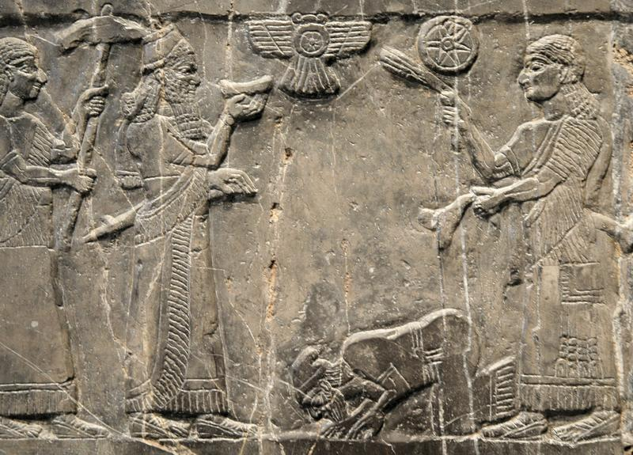
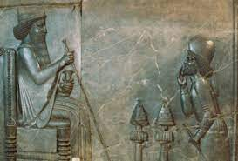
Proskynésis

Slide 28
Proskynésis
Arr. An. 4.11–12
εἰ δὲ ὑπὲρ Κύρου τοῦ Καμβύσου λέγεται πρῶτον προσκυνηθῆναι ἀνθρώπων Κῦρον καὶ ἐπὶ τῷδε ἐμμεῖναι Πέρσαις τε καὶ Μήδοις τήνδε τὴν ταπεινότητα,
ἀλλὰ σιγῆς γὰρ γενομένης ἐπὶ τοῖς λόγοις ἀναστάντας Περσῶν τοὺς πρεσβυτάτους ἐφεξῆς προσκυνεῖν. Λεοννάτον δέ, ἕνα τῶν ἑταίρων, ἐπειδή τις ἐδόκει τῶν Περσῶν αὐτῷ οὐκ ἐν κόσμῳ προσκυνῆσαι, τὸν δὲ ἐπιγελάσαι τῷ σχήματι τοῦ Περσοῦ ὡς ταπεινῷ: καὶ τούτῳ χαλεπήναντα τότε Ἀλέξανδρον ξυναλλαγῆναι αὖθις.
It may be said that Cyrus the son of Cambyses was the first man to receive the honor of obeisance, and that it is this which has kept the Persians and Medes submissive as you can see.
Silence fell after these words, but the eldest of the Persians came forward to perform obeisance one after the other. Leonnatus, one of the Companions, thought that one of the Persians had not bowed properly, and made fun of the Persian's air of submissiveness.

Slide 29
Úpadek, luxus, dekadence
Ath. 12
προφέρειν δ᾽ ἔξεστι νῦν μὲν τοὺς Περσῶν βασιλεῖς καὶ εἲ τίς που τυραννίδος ἀξιολόγου κύριος ὢν τυγχάνει: πρότερον δὲ τούς τε Λυδῶν καὶ τοὺς Μήδων καὶ ἔτι ἀνώτερον καὶ τοὺς Σύρων οἷς οὐδὲν γένος ἡδονῆς ἀζήτητον γενέσθαι, ἀλλὰ καὶ δῶρα παρὰ τοῖς Πέρσαις προκεῖσθαι λέγεται τοῖς δυναμένοις ἐξευρίσκειν καινὴν ἡδονὴν καὶ μάλα ὀρθῶς,
And we may adduce the example of the Persian king at present, and every other tyrant possessed of any power worth speaking of,- and in former times, the sovereigns of the Lydians and of the Medes,- and even in earlier times still, the tyrants of the [Assyrians] behaved in the same manner; for all these men left no kind of pleasure unexplored: and it is even said that rewards were offered by the Persians to any one who was able to invent a new pleasure.

Slide 30
εἰπὼν δὲ τούτοις ἑξῆς τὰ περὶ τῆς θεραπείας τῆς τοῦ Περσῶν βασιλέως, οἵους καὶ ὅσους ἔχει θεραπευτῆρας, καὶ περὶ τῆς τῶν ἀφροδισίων αὐτοῦ χρήσεως καὶ τῆς περὶ τὸν χρῶτα αὐτοῦ ὀδμῆς καὶ τῆς εὐμορφίας καὶ τῆς ὁμιλίας καὶ περὶ τῶν θεωρημάτων καὶ τῶν ἀκροαμάτων, εὐδαιμονέστατον ἔφη κρῖναι τῶν νῦν τὸν τῶν Περσῶν βασιλέα. ‘
And having discussed after this all the attendance with which the king of the Persians is surrounded, and what a number of servants he has, and what their different offices are, and also about his amorous indulgences, and also about the sweet perfume of his skin, and his personal beauty, and the way in which he lives among his friends, and the pleasing sights or sounds which are sought out to gratify him, he said that he considered "the king of Persia the happiest of all men now alive.

Slide 31
πλεῖσται γάρ εἰσιν αὐτῷ καὶ τελειόταται παρεσκευασμέναι ἡδοναί. δεύτερον δέ,’ φησί, ‘τὸν ἡμέτερον τύραννον θείη τις ἂν καίπερ πολὺ λειπόμενον. ἐκείνῳ μὲν γὰρ ἥ τε Ἀσία ὅλη χορηγεῖ.
For there are pleasures prepared for him which are both most numerous and most perfect in their kind. And next to him," said he, "any one may fairly rank our sovereign, though he falls far short of the king of Persia. [546] For this latter has all Asia to supply him with luxury,

Slide 32
Κτησίας ἐν τρίτῃ Περσικῶν καὶ πάντας μέν φησι τοὺς βασιλεύσαντας τῆς Ἀσίας περὶ τρυφὴν σπουδάσαι, μάλιστα δὲ Νίνυαν τὸν Νίνου καὶ Σεμιράμιδος υἱόν.
Ctesias, in the third book of his History of Persia, says that all those who were ever kings in Asia devoted themselves mainly to luxury; and above all of them, Ninyas did so, the son of Ninus and Semiramis.

Slide 33
ὁ Περσῶν βασιλεὺς ἀθλοθετῶν τοῖς τὰς ἡδονὰς αὐτῷ πορίζουσιν ὑπὸ πάντων τῶν ἡδέων ἡττωμένην ἀπέδειξε τὴν βασιλείαν
διαβόητοι δὲ ἐπὶ τρυφῇ ἐγένοντο πρῶτοι πάντων ἀνθρώπων Πέρσαι, ὧν καὶ οἱ βασιλεῖς ἐχείμαζον μὲν ἐν Σούσοις, ἐθέριζον δὲ ἐν Ἐκβατάνοις.
The king of the Persians offered prizes to those who could invent pleasures for him, and by this conduct allowed his whole empire and sovereignty to be subverted by pleasures.
But of all nations the Persians were the first to become notorious for their luxury, and the Persian kings even spent their winters at Susa and their summers at Ecbatana.

Slide 34
ἧκον τρυφῆς οἱ τῶν Περσῶν βασιλεῖς ὥστε ἔχεσθαι τῆς βασιλικῆς κλίνης ὑπὲρ κεφαλῆς οἴκημά τι πεντάκλινον, ἐν ᾧ χρυσίου πεντακισχίλια διὰ παντὸς ἔκειτο τάλαντα,
The Persian kings had come to such a pitch of luxury, that at the head of the royal couch there was a supper-room laid with five couches, in which there were always kept five thousand talents of gold

Slide 35
Oči a uši krále
Hdt. 1.114
ὃ δὲ αὐτῶν διέταξε τοὺς μὲν οἰκίας οἰκοδομέειν, τοὺς δὲ δορυφόρους εἶναι, τὸν δέ κου τινά αὐτῶν ὀφθαλμῶν βασιλέος εἶναι
X. Cyr. 8.6
ἐφοδεύει γὰρ ἀνὴρ κατ᾽ ἐνιαυτὸν ἀεὶ στράτευμα ἔχων, ὡς ἢν μέν τις τῶν σατραπῶν ἐπικουρίας δέηται, ἐπικουρῇ, … ἢ ἄλλο τι τῶν τεταγμένων παραλίπῃ, ταῦτα πάντα κατευτρεπίζῃ: ἢν δὲ μὴ δύνηται, βασιλεῖ ἀπαγγέλλῃ: … καὶ οἱ πολλάκις λεγόμενοι ὅτι βασιλέως υἱὸς καταβαίνει, βασιλέως ἀδελφός, βασιλέως ὀφθαλμός
Then he set them severally to their tasks, some to the building of houses, some to be his bodyguard, one (as I suppose) to be the King's Eye
year by year a man makes the circuit of the provinces with an army, to help any satrap that may need help, … or if any one is neglectful of anything else that he has been ordered to attend to; but if he cannot set it right, it is his business to report it to the king, … And those of whom the report often goes out that “the king's son is coming,” or “the king's brother” or “the king's eye,”

Slide 36
Oči a uši krále
Arist. De Caelo 398
Outside these the leaders and most eminent men were drawn up in order, some as personal bodyguards and attendants to the King himself, some as guardians of each outer wall, called Guards and the Listening-Watch, so that the King himself, who had the name of Master and God, might see everything and hear everything.

Slide 37
Eunuši
Strážci harému
Původní význam – strážci postele
Vliv na krále
Účast na spiknutích
Věrní x zrádní
Úředníci
Nemusejí být vykastrováni
I odvážní, dobří bojovníci
Moudří rádcové
Personál paláce
Blízký kruh kolem krále (ša réši)

Slide 38
Eunuši
Phot. Bibl. 72 §13
Βαγαπάτης δὲ καὶ Ἀρτασύρας, πρὶν ἢ Καμβύσης τελευτήσει, ἐβουλεύσαντο βασιλεῦσαι τὸν μάγον.
Καὶ γίνεται πάντα δῆλα τὰ εἰργασμένα ἐπὶ Ξέρξῃ καὶ Δαρειαίῳ, καὶ ἀπόλλυται πικρῷ καὶ κακίστῳ θανάτῳ Ἀσπαμίτρης, ὃς ἦν κοινωνὸς ἐπὶ τοῖς φόνοις Ξέρξου καὶ Δαρειαίου·
Before Cambyses died, Bagapates and Artasyras plotted to make the Magus king.
And everything that had been done to Xerxes and [Prince] Darius came to light. Aspamitres, who had been an accomplice in the deaths of Xerxes and Darius also suffered a very nasty and painful death.

Slide 39
Eunuši
§53
Ἀρτοξάρης ὁ εὐνοῦχος, ὃς μέγα ἠδύνατο παρὰ βασιλεῖ, ἐπιβουλεύει βασιλέα θέλων αὐτὸς βασιλεῦσαι. Πώγωνα γὰρ καὶ ὑπόρρινα προσέταξεν αὑτῷ γυναικὶ κατασκευάσαι, ἵνα ὡς ἀνὴρ φαίνοιτο, δι´ ἧς καὶ καταμηνύεται· καὶ συλλαμβάνεται καὶ παραδίδοται Παρυσάτιδι, καὶ ἀναιρεῖται.
Artoxares the eunuch, who was very influential with the King, plotted against the King because he wished to rule himself. As he was a eunuch he ordered a woman to procure a moustache and beard for him so he could look like a man. She informed against him and he was arrested and handed over to Parysatis. And he was killed.

Slide 40
Eunuši
§19
Καὶ ὁ Βαγαπάτης δὲ τὸ σῆμα Δαρείου παρακαθίσας ἔτη ζʹ ἐτελεύτησε.
Plut. Art. 12
γνωρίσας οὖν τοὺς εὐνούχους ὀλοφυρομένους ἠρώτησε τὸν πιστότατον αὐτῶν
Ἀρτασύρας τῷ μὲν εὐνούχῳ θαρρεῖν παρεκελεύσατο καὶ φυλάττειν τὸν νεκρόν,
as did Bagapates after sitting beside Darius’ tomb for seven years.
recognizing the eunuchs as they lamented, he asked the trustiest of them
Artasyras bade the eunuch be of good courage and guard the dead body

Slide 41
Eunuši
Hdt. 8.105
παρὰ γὰρ τοῖσι βαρβάροισι τιμιώτεροι εἰσὶ οἱ εὐνοῦχοι πίστιος εἰ τῆς πάσης τῶνἐνορχίων.
Curt. 5.12.10
Ingens ergo in tabernaculo solitudo erat paucis spadonibus, quia, quo discederent, non habebant, circumstantibus regem.
for the foreigners value eunuchs more than perfect men, by reason of the full trust that they have in them.
Hence there was a vast solitude in the tent except for a few eunuchs who stood around the king because they had no place to which to withdraw.

Slide 42
Eunuši
Curt. 3.3.23
In his erant liberi regis et quae educabant eos spadonumque grex, haud sane illis gentibus vilis.
6.6.8
Pelices CCC et LXV, totidem quot Darei fuerant, regiam inplebant, quas spadonum greges, et ipsi muliebria pati adsueti, sequebantur.
In these were the king’s children, and their governess, and a herd of eunuchs, who are not at all despised by those people.
Three hundred and sixty-five concubines, the same number that Darius had had, filled his palace, attended by herds of eunuchs, also accustomed to prostitute themselves.

Slide 43
Ženy
Hdt. 1.135
γαμέουσι δὲ ἕκαστος αὐτῶν πολλὰς μὲν κουριδίας γυναῖκας, πολλῷ δ᾽ ἔτι πλεῦνας παλλακὰς κτῶνται.
Plut. Conjug. 16
τοῖς τῶν Περσῶν βασιλεῦσιν αἱ γνήσιαι γυναῖκες παρακάθηνται δειπνοῦσι καὶ συνεστιῶνται: βουλόμενοι δὲ παίζειν καὶ μεθύσκεσθαι ταύτας μὲν ἀποπέμπουσι, τὰς δὲ μουσουργοὺς καὶ παλλακίδας καλοῦσιν, ὀρθῶς τοῦτὸ γ᾽ αὐτὸ ποιοῦντες, ὅτι τὸ συνακολασταίνειν καὶ παροινεῖν οὐ μεταδιδόασι ταῖς γαμεταῖς.
Every Persian marries many lawful wives, and keeps still more concubines.
The lawful wives of the Persian kings sit beside them at dinner, and eat with them. But when the kings wish to be merry and get drunk, they send their wives away, and send for their music-girls and concubines.​ In so far they are right in what they do, because they do not concede any share in their licentiousness and debauchery to their wedded wives.

Slide 44
Ženy
Ath. 13.3
παρὰ δὲ Πέρσαις ἀνέχεται ἡ βασίλεια τοῦ πλήθους τῶν παλλακίδων διὰ τὸ ὡς δεσπότην ἄρχειν τῆς γαμετῆς τὸν βασιλέα, ἔτι δὲ καὶ διὰ τὸ τὴν βασιλίδα, ὥς φησιν Δίνων ἐν τοῖς Περσικοῖς, ὑπὸ τῶν παλλακίδων θρησκεύεσθαι προσκυνοῦσι γοῦν αὐτήν.
But among the Persians the queen tolerates the king's having a number of concubines, because there the king rules his wife like her master; and also because the queen, as Dinon states in his history of Persia, receives a great deal of respect from the concubines.

Slide 45
Ženy
Atossa
Kassandané
Améstris
Parysátis
Mohou vlastnit majetek
Konat transakce
Vést vlastní jednání
Volnost pohybu
Hierarchie

Slide 46
Intriky, spiknutí, pletichy
Dvůr je nebezpečné místo
Vraždy
Povstání
Osnování plánů
Harpagos – Kýros a Astyagés
Mág Gaumáta
Zabití Xerxa I.
Artaxerxés I., Xerxés II., Sogdiános
Kýros mladší x Artaxerxés II.
Artaxerxés II. a následníci trůnu
Artaxerxés III., Artaxerxés IV. x Bagoás

Slide 47
Intriky, spiknutí, pletichy
Kambýses II. x Smerdis
Pád Intaferna
Oibarás
Artapanos
Příběh o Megabyzovi
Artoxarés
Parysátis, Státeira (matka x manželka Artaxerxa II.)
Tissafernés
Povstání
Egypt
Babylón
Satrapové v Malé Asii
Foiníkie
Kypr
Řekové v Malé Asii

Slide 48
Krutost
Astyagés x Harpagos
Hdt. 1.119
Ἀστυάγης δέ, ὥς οἱ ἀπίκετο ὁ Ἁρπάγου παῖς, σφάξας αὐτὸν καὶ κατὰ μέλεα διελὼν τὰ μὲν ὤπτησε τὰ δὲ ἥψησε τῶν κρεῶν, … Ἁρπάγῳ δὲ τοῦ παιδὸς τοῦ ἑωυτοῦ, πλὴν κεφαλῆς τε καὶ ἄκρων χειρῶν τε καὶ ποδῶν, τἄλλα πάντα· ταῦτα δὲ χωρὶς ἔκειτο ἐπὶ κανέῳ κατακεκαλυμμένα.
But when Harpagus' son came, Astyages cut his throat and tearing him limb from limb roasted some and boiled some of the flesh … but Harpagus was served with the flesh of his own son, all but the head and hands and feet, which lay apart covered upon in a basket.

Slide 49
Krutost
Hdt. 5.25
τοῦ τὸν πατέρα Σισάμνην βασιλεὺς Καμβύσης γενόμενον τῶν βασιληίων δικαστέων, ὅτι ἐπὶ χρήμασι δίκην ἄδικον ἐδίκασε, σφάξας ἀπέδειρε πᾶσαν τὴν ἀνθρωπέην, σπαδίξας δὲ αὐτοῦ τὸ δέρμα ἱμάντας ἐξ αὐτοῦ ἔταμε καὶ ἐνέτεινε τὸν θρόνον ἐς τὸν ἵζων ἐδίκαζε·
Cambyses had cut his throat and flayed off all his skin because he had been bribed to give an unjust judgment; and he had then cut leather strips of the skin which had been torn away and covered therewith the seat whereon Sisamnes had sat to give judgment

Slide 50
Krutost
D.S. 17.5.3
Φιλίππου γὰρ ἔτι βασιλεύοντος ἦρχε τῶν Περσῶν Ὦχος καὶ προσεφέρετο τοῖς ὑποτεταγμένοις ὠμῶς καὶ βιαίως. μισουμένου δὲ αὐτοῦ διὰ τὴν χαλεπότητα τῶν τρόπων Βαγώας ὁ χιλίαρχος, εὐνοῦχος μὲν ὢν τὴν ἕξιν, πονηρὸς δὲ καὶ πολεμικὸς τὴν φύσιν, ἀνεῖλε φαρμάκῳ τὸν Ὦχον διά τινος ἰατροῦ, τὸν δὲ νεώτατον τῶν υἱῶν τοῦ βασιλέως Ἀρσὴν εἰσήγαγεν εἰς τὴν βασιλείαν.
While Philip was still king, Ochus​ ruled the Persians and oppressed his subjects cruelly and harshly. Since his savage disposition made him hated, the chiliarch Bagoas, a eunuch in physical fact but a militant rogue in disposition, killed him by poison administered by a certain physician and placed upon the throne the youngest of his sons, Arses.

Slide 51
Krutost
Xerxés a Pýthios (Hdt. 7.38–39)
σὺ δέ, ὦ βασιλεῦ, ἐμὲ ἐς τόδε ἡλικίης ἥκοντα οἰκτείρας τῶν μοι παίδων ἕνα παράλυσον τῆς στρατηίης τὸν πρεσβύτατον, ἵνα αὐτοῦ τε ἐμεῦ καὶ τῶν χρημάτων ᾖ μελεδωνός· … ὡς δὲ ταῦτα ὑπεκρίνατο, αὐτίκα ἐκέλευε τοῖσι προσετέτακτο ταῦτα πρήσσειν, τῶν Πυθίου παίδων ἐξευρόντας τὸν πρεσβύτατον μέσον διαταμεῖν, διαταμόντας δὲ τὰ ἡμίτομα διαθεῖναι τὸ μὲν ἐπὶ δεξιὰ τῆς ὁδοῦ τὸ δ’ ἐπ’ ἀριστερά, καὶ ταύτῃ διεξιέναι τὸν στρατόν.
I pray you, O king! take pity on me that am so old, and release one of my sons, even the eldest, from service, that he may take care of me and my possessions; … With that reply, he straightway bade those who were charged to do the like to find the eldest of Pythius' sons and cut him asunder, then having so done to set the one half of his body on the right hand of the road and the other on the left, that the army might pass this way between them.

Slide 52
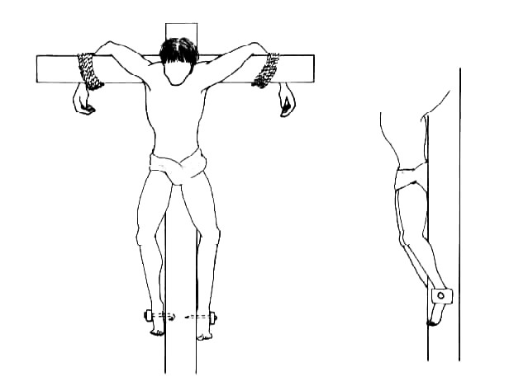
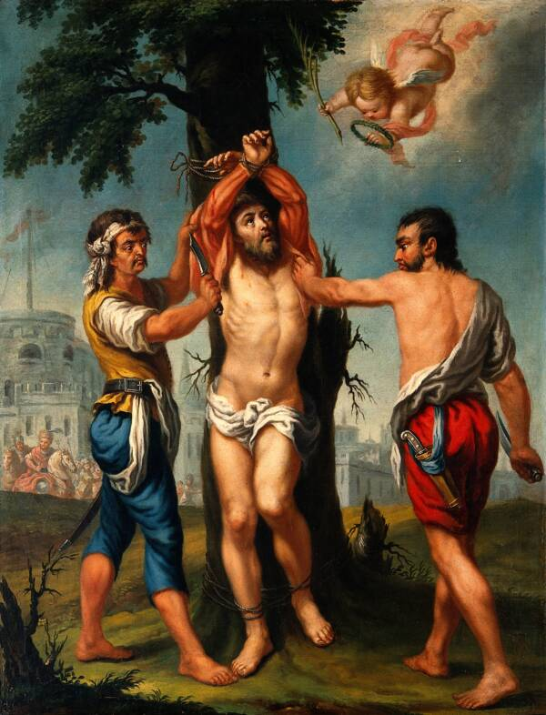
Krutost
Phot. Bibl. 72 §5
ἡ δέ, τοὺς ὀφθαλμοὺς ἐξορύξασα καὶ τὸ δέρμα περιδείρασα, ἀνεσταύρισεν.
§59
καὶ ὃν τρόπον τὸ δέρμα περιαιρεθεὶς ἀνεσταυρίσθη ὑπὸ Παρυσάτιδος,
She gouged out his eyes, flayed his skin, and crucified him.
And he relates the way in which Bagapates was flayed alive and how he was crucified by Parysatis.

Slide 53
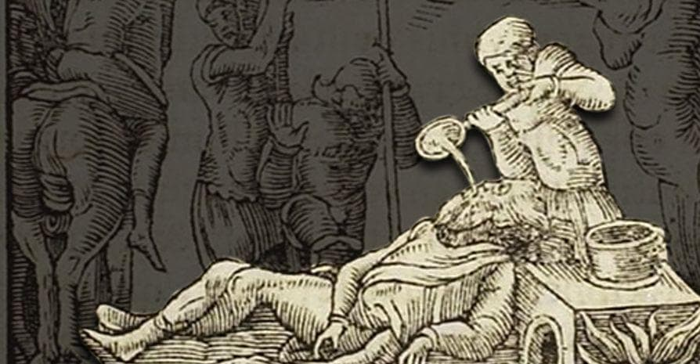
Krutost
Diod. 2.1.10
καὶ αὐτὸς μετὰ τέκνων ἑπτὰ καὶ γυναικὸς αἰχμάλωτος ληφθεὶς ἀνεσταυρώθη.
Plut. Art. 14.5
ἐπιτρέψαντος δὲ τοῦ βασιλέως ἐκέλευσε τοὺς ἐπὶ τῶν τιμωριῶν ἡ Παρύσατις λαβόντας τὸν ἄνθρωπον ἐφ᾽ ἡμέρας δέκα στρεβλοῦν, εἶτα τοὺς ὀφθαλμοὺς ἐξορύξαντας εἰς τὰ ὦτα θερμὸν ἐντήκειν χαλκὸν ἕως ἀποθάνῃ.
he was himself taken prisoner along with his wife and seven of his children and was crucified.
So the king consigned the man to Parysatis, who ordered the executioners to take him and rack him on the wheel for ten days, then to gouge out his eyes, and finally to drop molten brass into his ears until he died.

Slide 54
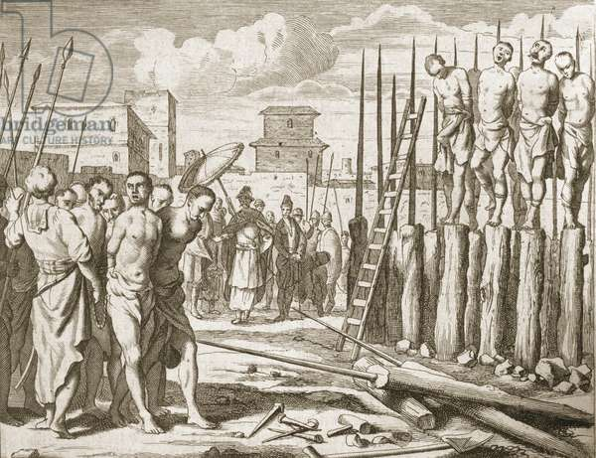
Krutost
Plut. Art. 17.1
καὶ πρὶν ἐν ὑποψίᾳ, γενέσθαι βασιλέα τοῦ πράγματος ἐγχειρίσασα τοῖς ἐπὶ τῶν τιμωριῶν προσέταξεν ἐκδεῖραι ζῶντα, καὶ τὸ μὲν σῶμα πλάγιον διὰ τριῶν σταυρῶν ἀναπῆξαι, τὸ δὲ δέρμα χωρὶς διαπατταλεῦσαι.
Phot. §36
λαμβάνει τὸν Ἴναρον παρὰ βασιλέως καὶ τοὺς Ἕλληνας καὶ ἀνεσταύρισε μὲν ἐπὶ τρισὶ σταυροῖς· πεντήκοντα δὲ Ἑλλήνων, ὅσους λαβεῖν ἴσχυσε, τούτων ἔτεμε τὰς κεφαλάς.
And before the King’s suspicions were aroused, she personally handed him over to the executioners whom she ordered to flay him alive, impale his body sideways on three stakes, and separately peg out his stretched-out skin.
And she impaled him on three stakes; and she beheaded as many Greeks as she was able to get hold of – fifty in all.

Slide 55
Krutost
Plut. Art. 19.6
ἀποθνῄσκουσι δὲ οἱ φαρμακεῖς ἐν Πέρσαις κατὰ νόμον οὕτως: λίθος ἐστὶ πλατύς, ἐφ᾽ οὗ τὴν κεφαλὴν καταθέντες αὐτῶν ἑτέρῳ λίθῳ παίουσι καὶ πιέζουσιν, ἄχρι οὗ συνθλάσωσι τὸ πρόσωπον καὶ τὴν κεφαλήν,
Now, the legal mode of death for prisoners in Persia is as follows. There is a broad stone, and on this the head of the culprit is placed; and then with another stone they smite and pound until they crush the face and head to pulp.

Slide 56
Krutost
Phot. §51
Κατελεύσθη δὲ καὶ Φαρνακΰας ὁ συνανελὼν Σεκυνδιανῷ Ξέρξην.
Πείθεται δ´ οὖν ὅμως καὶ ἁλίσκεται καὶ εἰς τὴν σποδὸν ἐμβάλλεται καὶ ἀπόλλυται βασιλεύσας μῆνας ἕξ, ἡμέρας δεκάπεντε.
καὶ ἐμβάλλεται εἰς τὴν σποδὸν Ἀρτύφιος καὶ Ἀρσίτης,
Valerius Maximus 9.2
And Pharnacyas who, along with Secyndianus, had killed Xerxes was also stoned to death.
But he trusted him nevertheless and was captured and thrown into the ashes and killed after a reign of six months and fifteen days.
Artyphius and Aristes were thrown in the ashes.

Slide 57
Krutost
Plut. Art. 19
τοῦτό φησιν ὁ Κτησίας μικρᾷ μαχαιρίδι κεχρισμένῃ τῷ φαρμάκῳ κατὰ θάτερα τὴν Παρύσατιν διαιροῦσαν ἐκμάξαι τῷ ἑτέρῳ μέρει τὸ φάρμακον: καὶ τὸ μὲν ἄχραντον καὶ καθαρὸν εἰς τὸ στόμα βαλοῦσαν αὐτὴν ἐσθίειν, δοῦναι δὲ τῇ Στατείρᾳ.
It was a bird of this species, according to Ctesias, that Parysatis cut in two with a little knife smeared with poison on one side, thus wiping the poison off upon one part only of the bird; the undefiled and wholesome part she then put into her own mouth and ate, but gave to Stateira the poisoned part.

Slide 58
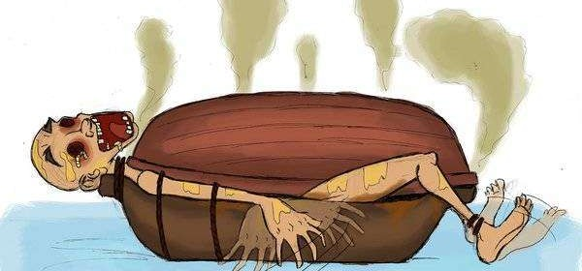
Krutost
Plut. Art. 16.
ἐκέλευσεν οὖν τὸν Μιθριδάτην ἀποθανεῖν σκαφευθέντα. τὸ δὲ σκαφευθῆναι τοιοῦτόν ἐστι: σκάφας δύο πεποιημένας ἐφαρμόζειν ἀλλήλαις λαβόντες, εἰς τὴν ἑτέραν κατακλίνουσι τὸν κολαζόμενον ὕπτιον: εἶτα τὴν ἑτέραν ἐπάγοντες καὶ συναρμόζοντες, ὥστε τὴν κεφαλὴν καὶ τὰς χεῖρας ἔξω καὶ τοὺς πόδας ἀπολαμβάνεσθαι, τὸ δὲ ἄλλο σῶμα πᾶν ἀποκεκρύφθαι.
He therefore gave orders that Mithridates should be put to death by the torture of the boats. Now, this torture of the boats is as follows. Two boats are taken, which are so made as to fit over one another closely; in one of these the victim is laid, flat upon his back; then the other is laid over the first and carefully adjusted, so that the victim's head, hands, and feet are left projecting, while the rest of his body is completely covered up.

Slide 59
Krutost
διδόασιν ἐσθίειν τῷ ἀνθρώπῳ, κἂν μὴ θέλῃ, προσβιάζονται κεντοῦντες τὰ ὄμματα: φαγόντι δὲ πιεῖν μέλι καὶ γάλα συγκεκραμένον ἐγχέουσιν εἰς τὸ στόμα καὶ κατὰ τοῦ προσώπου καταχέουσιν. εἶτα πρὸς τὸν ἥλιον ἀεὶ στρέφουσιν ἐναντία τὰ ὄμματα, καὶ μυιῶν προσκαθημένων πλῆθος πᾶν ἀποκρύπτεται τὸ πρόσωπον, ἐντὸς δὲ ποιοῦντος ὅσα ποιεῖν ἀναγκαῖόν ἐστιν ἐσθίοντας ἀνθρώπους καὶ πίνοντας, εὐλαὶ καὶ σκώληκες ὑπὸ φθορᾶς καὶ σηπεδόνος ἐκ τοῦ περιττώματος ἀναζέουσιν, ὑφ᾽ ὧν ἀναλίσκεται τὸ σῶμα διαδυομένων εἰς τὰ ἐντός.
Then they give him food to eat, and if he refuse it, they force him to take it by pricking his eyes. After he has eaten, they give him a mixture of milk and honey to drink, pouring it into his mouth, and also deluge his face with it. Then they keep his eyes always turned towards the sun, and a swarm of flies settles down upon his face and hides it completely. And since inside the boats he does what must needs be done when men eat and drink, worms and maggots seethe up from the corruption and rottenness of the excrement, devouring his body, and eating their way into his vitals.

Slide 60
ὅταν γὰρ ἤδη φανερὸς ᾖ τεθνηκὼς ὁ ἄνθρωπος, ἀφαιρεθείσης τῆς ἐπάνω σκάφης ὁρῶσι τὴν μὲν σάρκα κατεδηδεσμένην, περὶ δὲ τὰ σπλάγχνα τοιούτων θηρίων ἑσμοὺς ἐσθιόντων καὶ προσπεφυκότων. οὕτως ὁ Μιθριδάτης ἑπτακαίδεκα ἡμέρας φθειρόμενος μόλις ἀπέθανε.
For when at last the man is clearly dead and the upper boat has been removed, his flesh is seen to have been consumed away, while about his entrails swarms of such animals as I have mentioned are clinging fast and eating. In this way Mithridates was slowly consumed for seventeen days, and at last died.

