Slide 1

DSBcB49 Starověká ekumena - antické zprávy o Asii a Africe
Indie

Slide 2
Etymologie
India, India (Ἰνδῐ́ᾱ)
Indos (Ἰνδός), hinduš (pers.), sindhu (řeka Indus)

Slide 3
Dějiny
Harappská kultura (Harappa, Mohendžodaro)
Indo-árjské kmeny kolem 2000 pnl do Indie
Védské období – Védy (Rgvéda, Sámavéda, Jadžurvéda, Atharvavéda)
Indo-evropské kmeny, severní část Indie
Dělení na varny (bráhmani, kšatrijové, vaišjové, šúdrové) + páriové

Slide 4
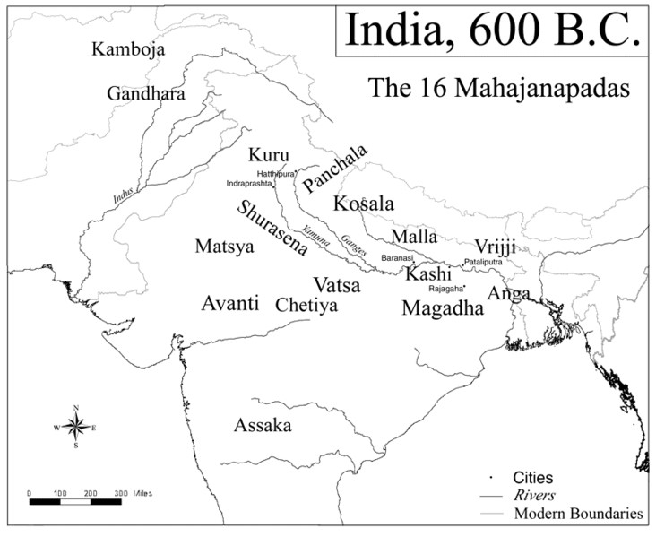
Dějiny
Mahádžanapady (16)
Vznik džinismu a buddhismu cca 500 pnl
Mahávíra, Siddhártha Gautama Buddha
Urbanizace
Magadha
Eposy – Mahábhárata, Rámájana

Slide 5
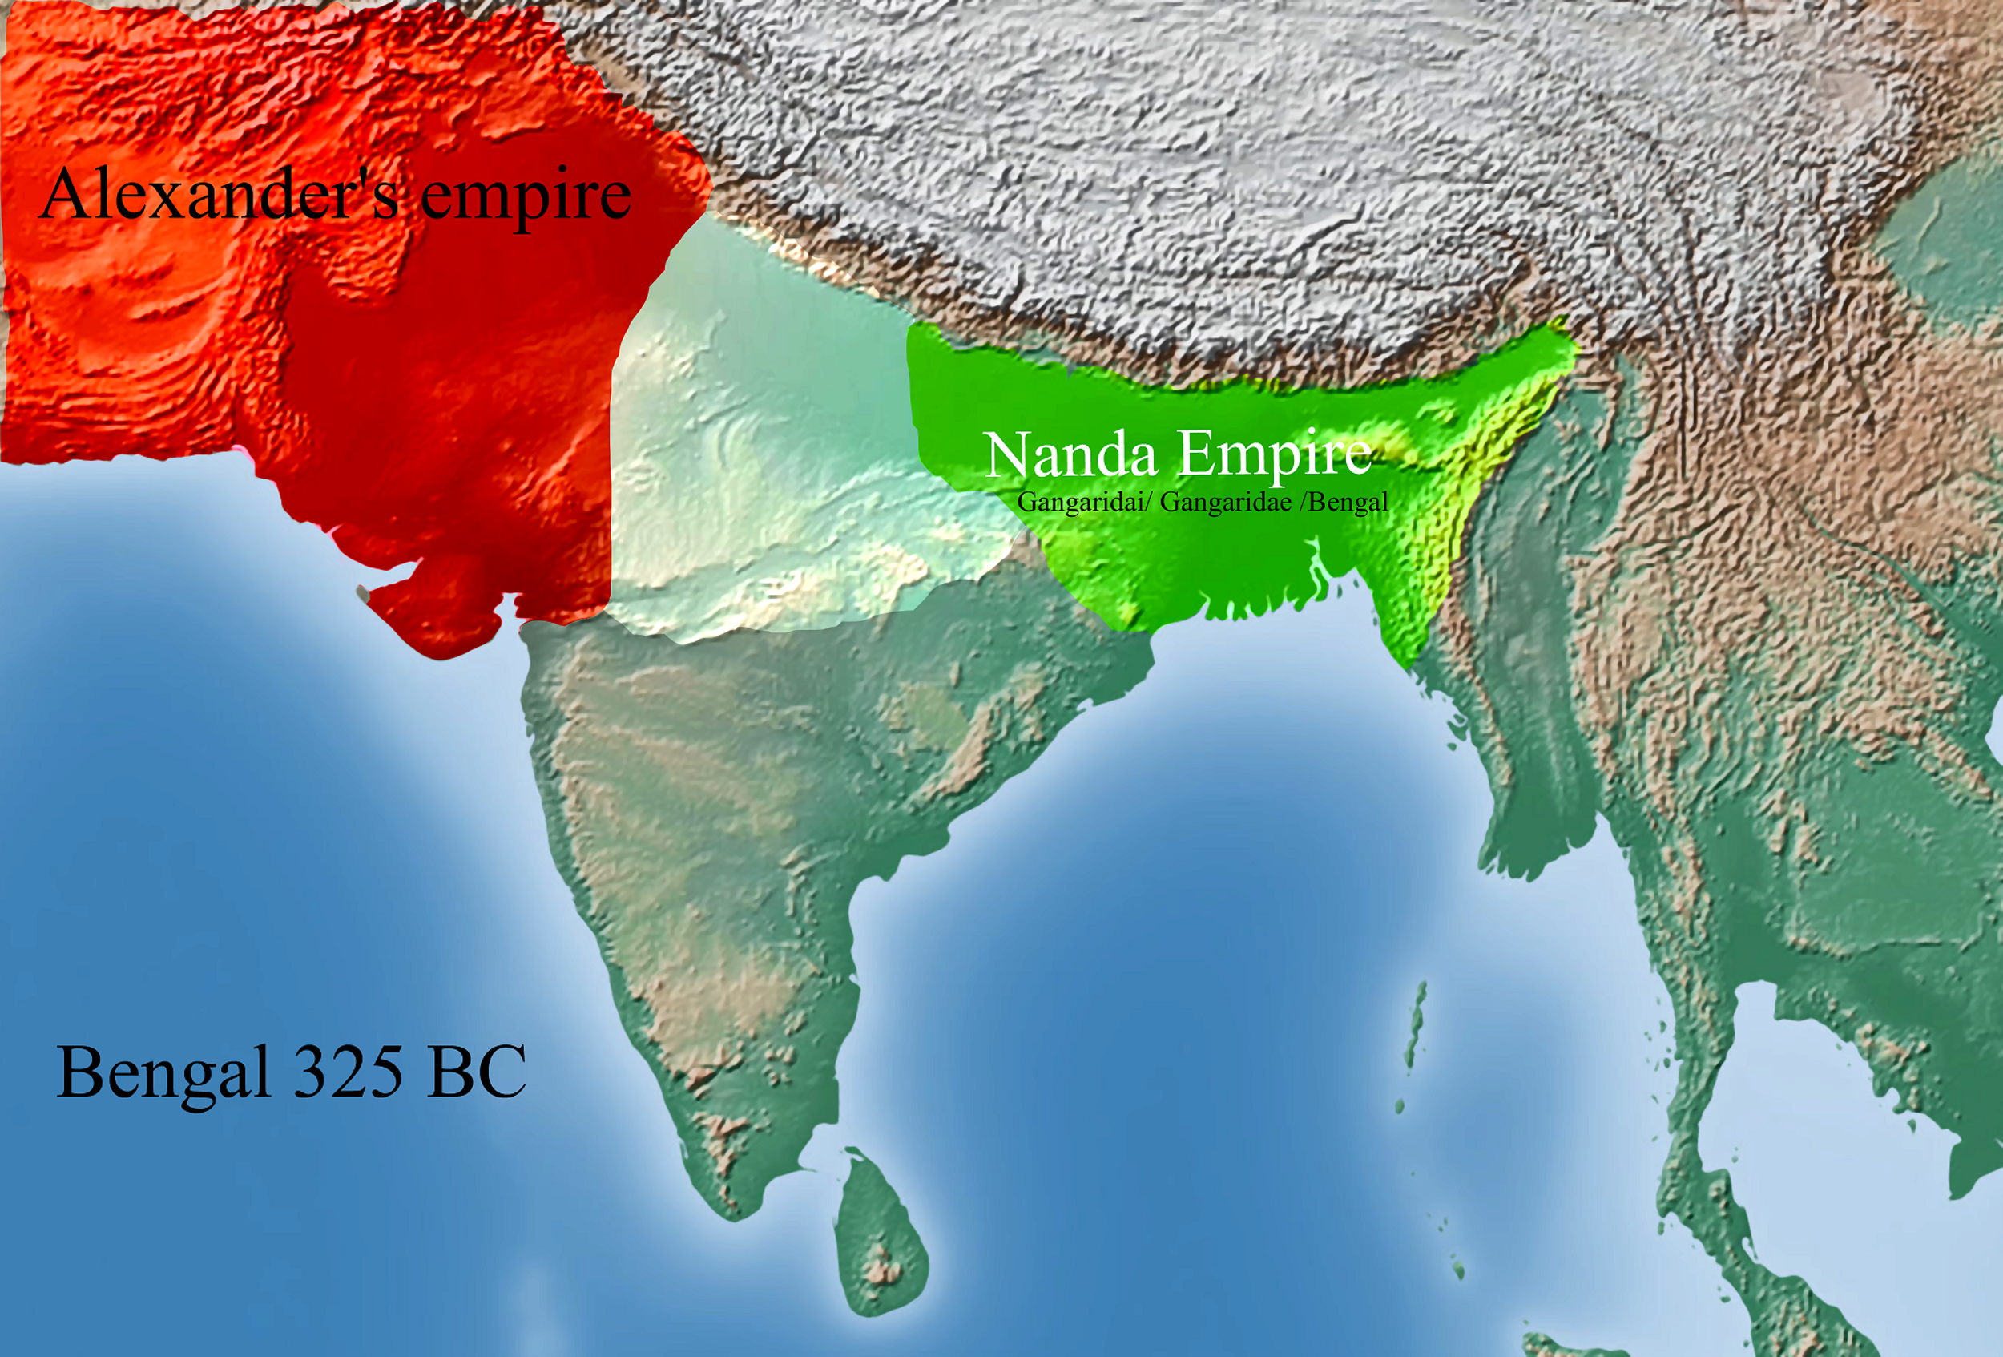
Dějiny
Magadha
Dynastie Nandovců (4. stol. pnl)
Pátaliputra
Maurjská říše (322–184 pnl)
Čandragupta Maurja
Bindusára
Ašóka

Slide 6
Maurjská říše
Čandragupta – svrhnutí Nandovců, rádce Čánakja (Kautilja) - Arthašástra
Dobytí severní Indie, včetně bývalého území Alexandra
Válka se Seleukem I.
Sandrakottos v řeč.
Bindusára
Upevnění moci, rozšíření území
Amitrochatés v řeč.

Slide 7
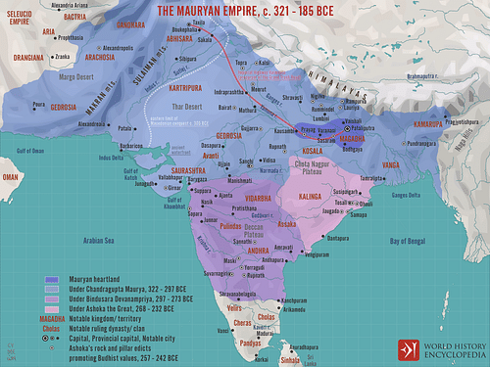
Maurjská říše
Ašóka (270–232 pnl)
Válka proti Kalinze
Kromě jihu celá Indie
Podpora buddhismu
Misie i do Středomoří
Edikty

Slide 8
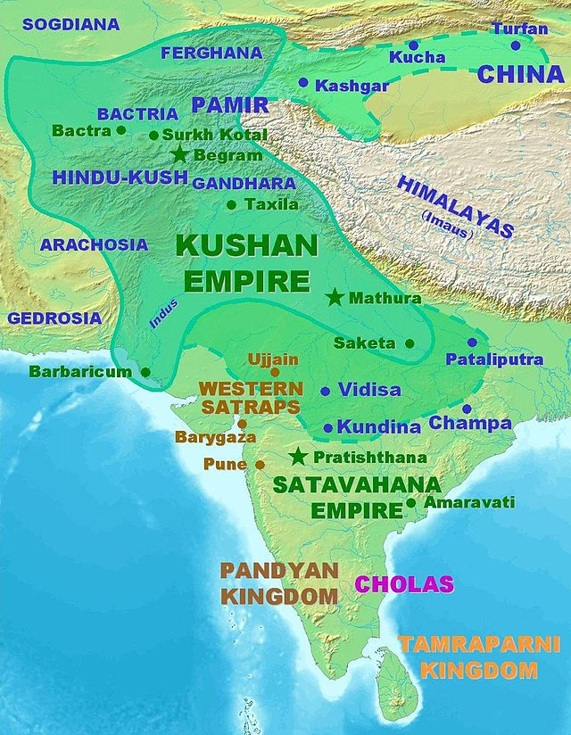
Dějiny
Rozpad 185/4 pnl, dynastie Šungů
Tažení Řeků do Indie
Příchod Skythů, Jüe-č
Říše Kušánů (Kaniška)
Guptovská říše (Čandragupta I., Samudragupta)
Vrchol věd – Kálidása (básník), Árjabhata (matematika), Varáhamihira (astronomie)
Vpád Hefthalitů (Bílí Hunové)

Slide 9
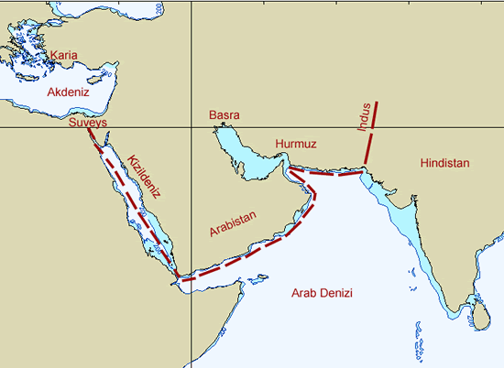
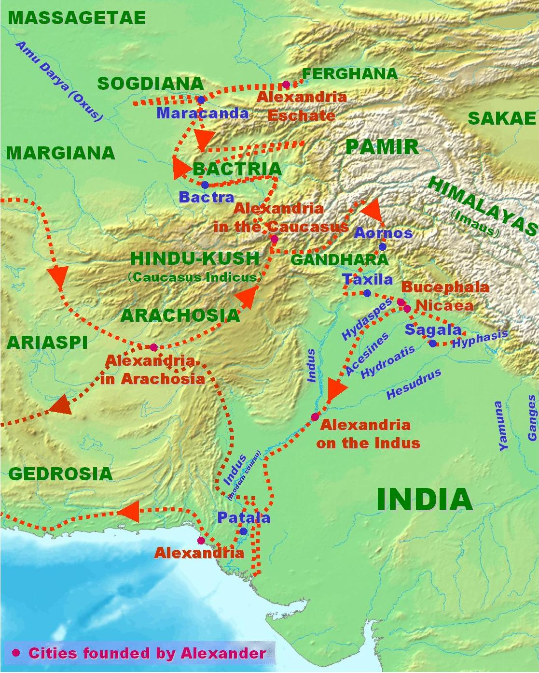
Kontakty
Skylax z Karyandy
Satrapie Achaimenovské říše
Alexandr Veliký (x Póros, Taxilés)
Krátce vláda jeho velitelů na SZ Indie
Tažení Seleuka I. (305 pnl)

Slide 10
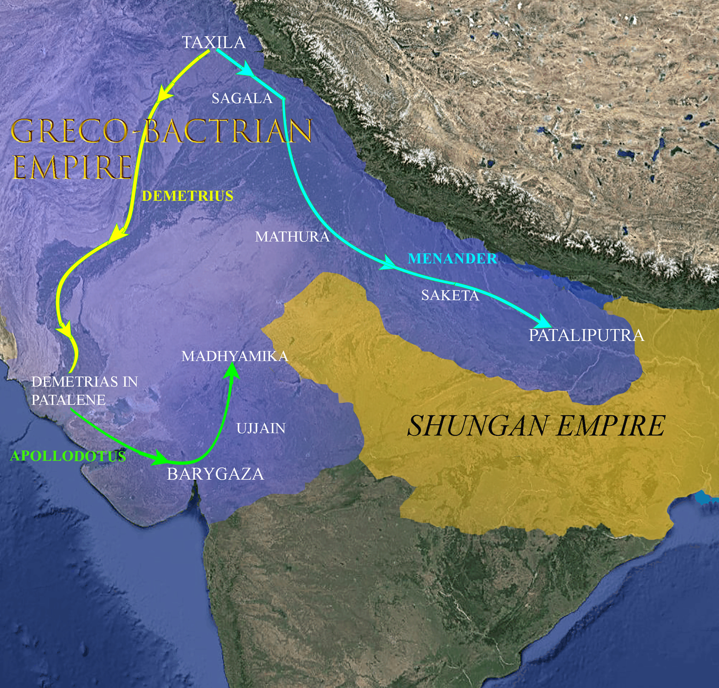
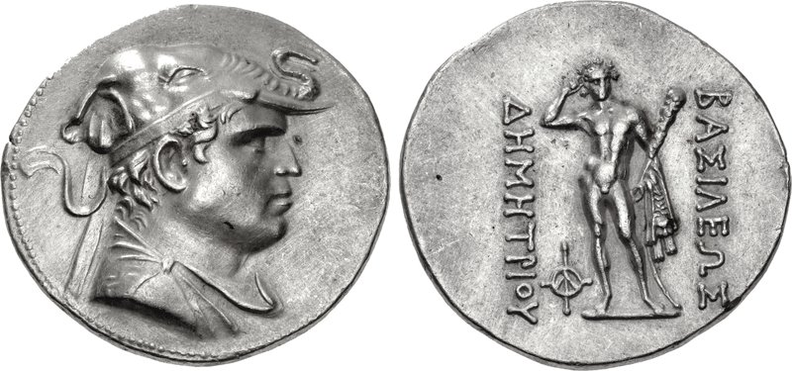
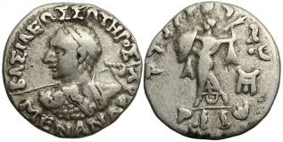
Kontakty
Další tažení Řeků
Démétrios I.
Apollodotos I.
Menandros I.
Dále než Alexandr, až k Pátaliputře (?)
Vznik Indo-řeckého království

Slide 11
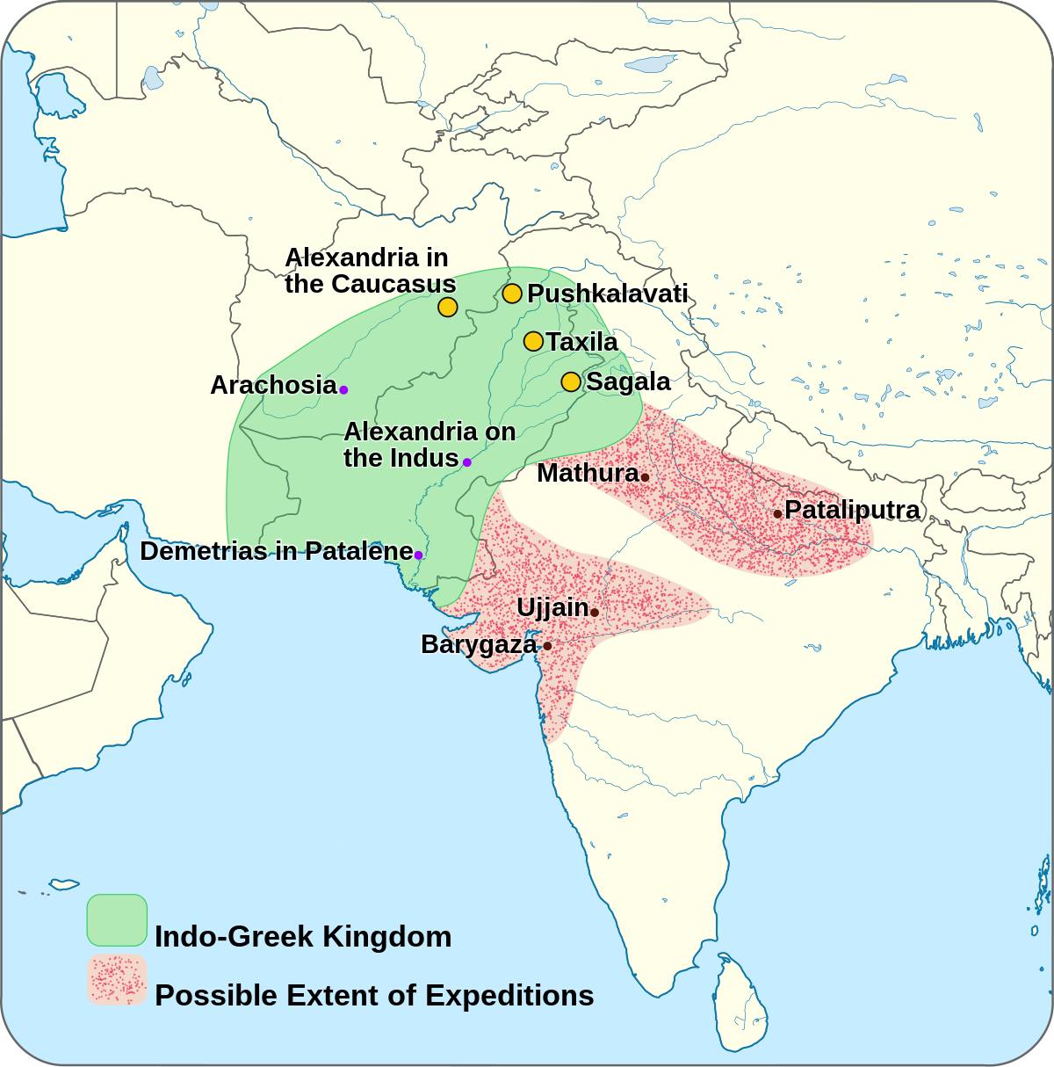
Kontakty
Řecké království v Indii
Cca 190 pnl–10 nl
Od Démétria I.
Centra Taxila, Sangala, Peukeláotis
Po smrti Menandra I. rozpad do menších celků
Zánik po dobytí Indy, Skythy

Slide 12
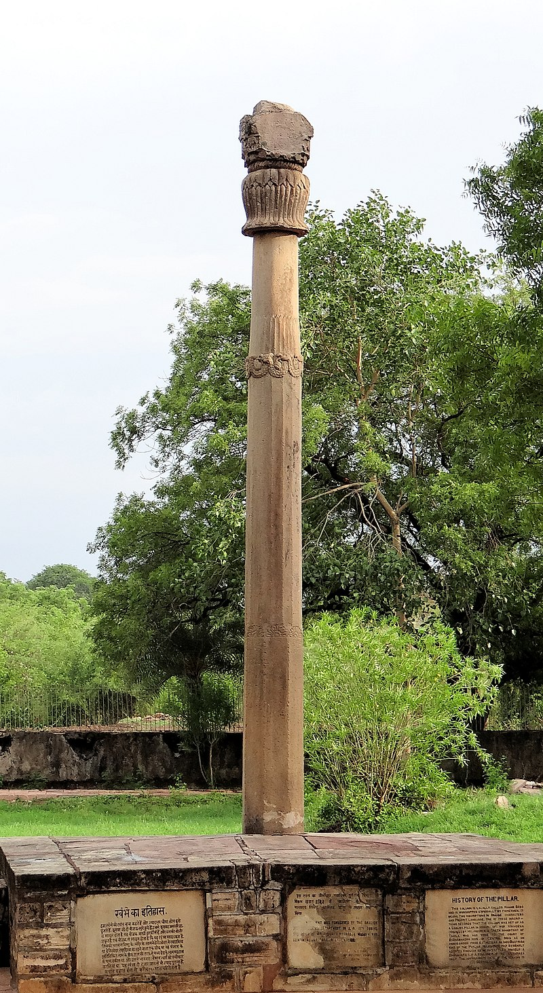
Kontakty
Vyslanci
Megasthenés – Seleukos I.↔Čandragupta Maurja
Déimachos – Antiochos I.̼↔Bindusára
Dionýsios – Ptolemaios II.↔Bindusára/Ašóka
Héliodóros – Antialkidás↔Bhagabhadra

Slide 13
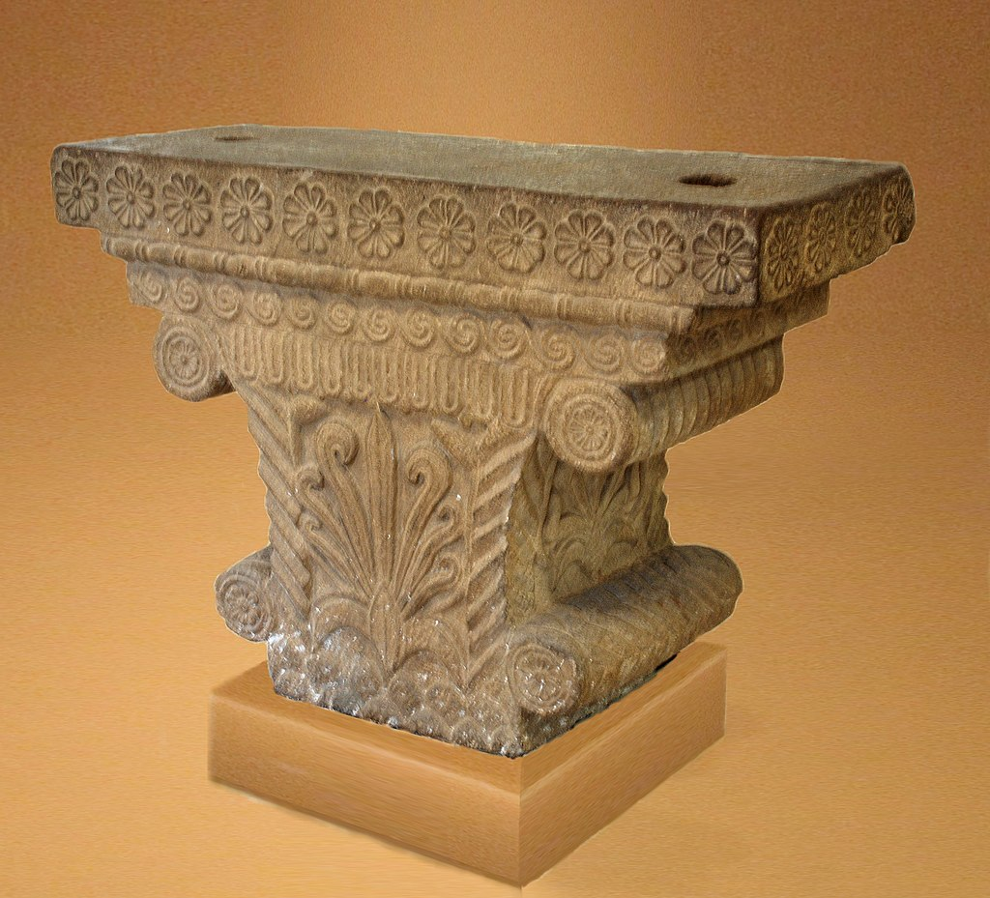
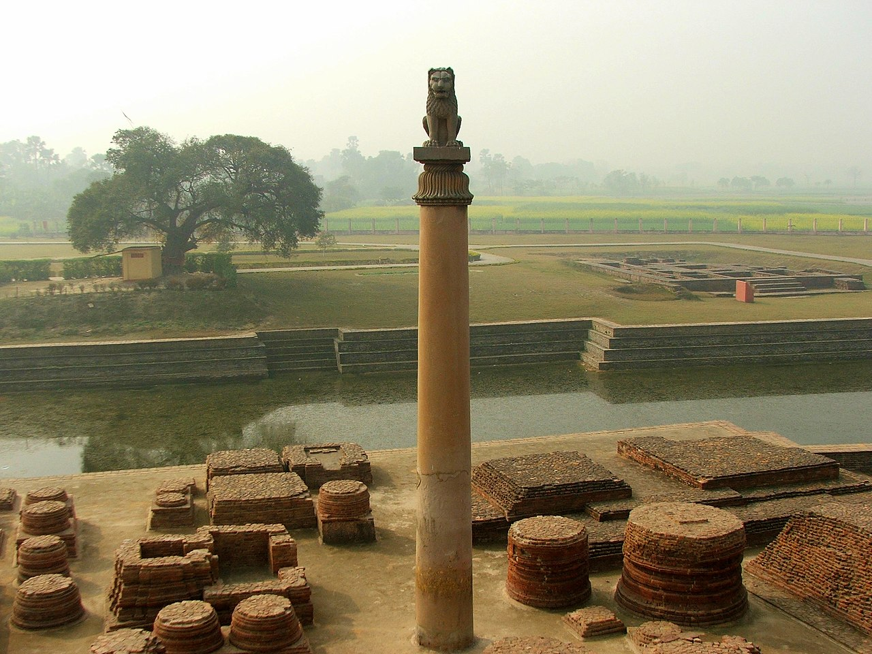
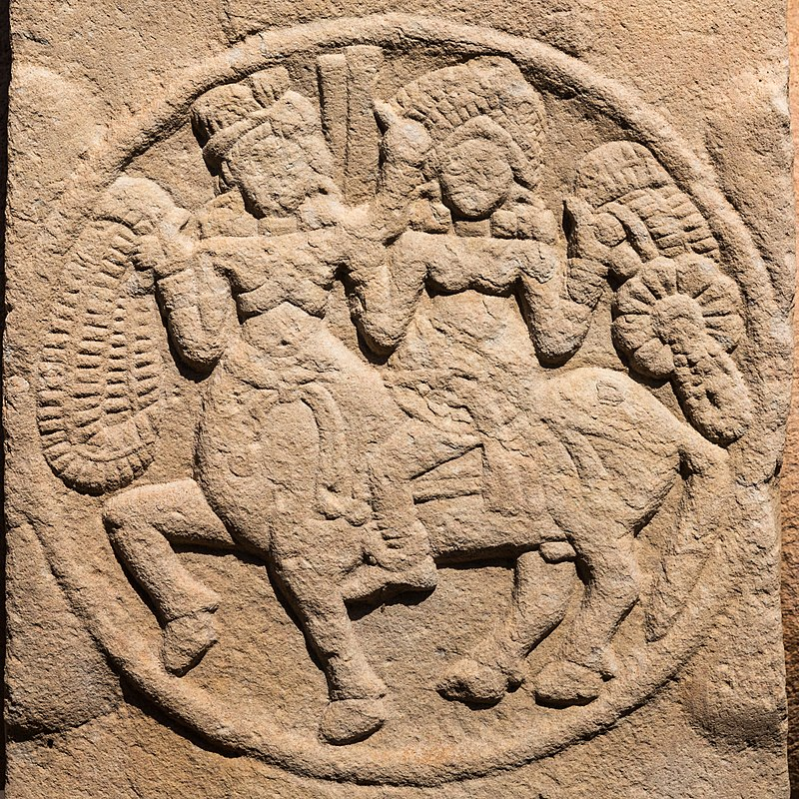
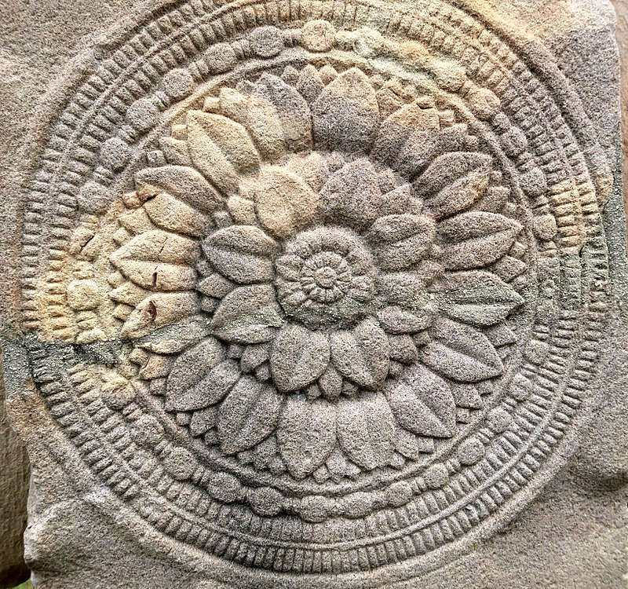
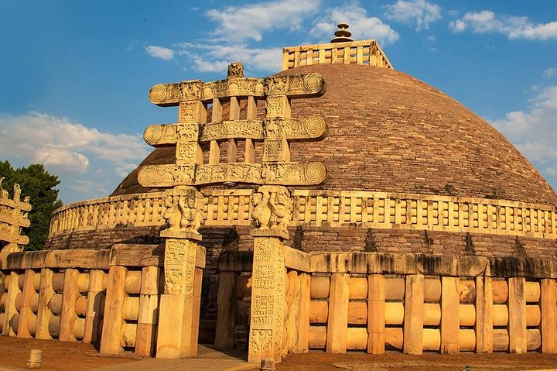
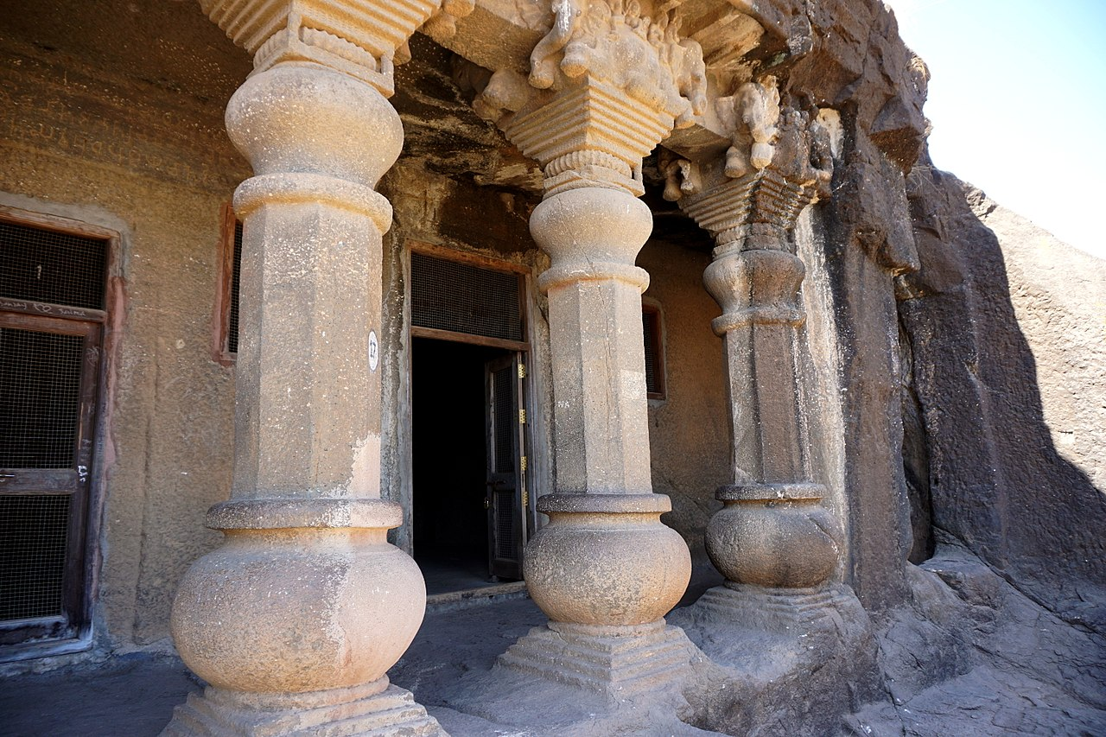
Kontakty
Architektura
Řecké prvky smíšené s indickými
Hlavice sloupů/sloupy – Pátaliputra (Ašóka)
Chrámy (Sančí – stúpy, reliéfy), jeskyně Nasik

Slide 14
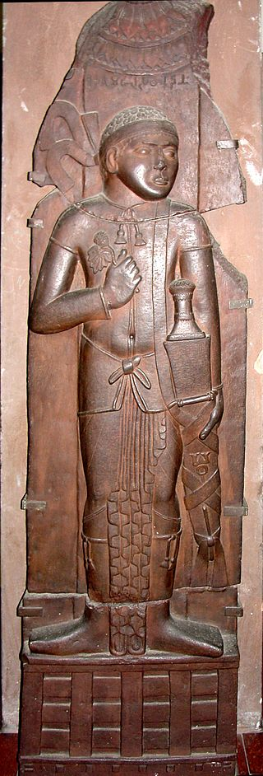
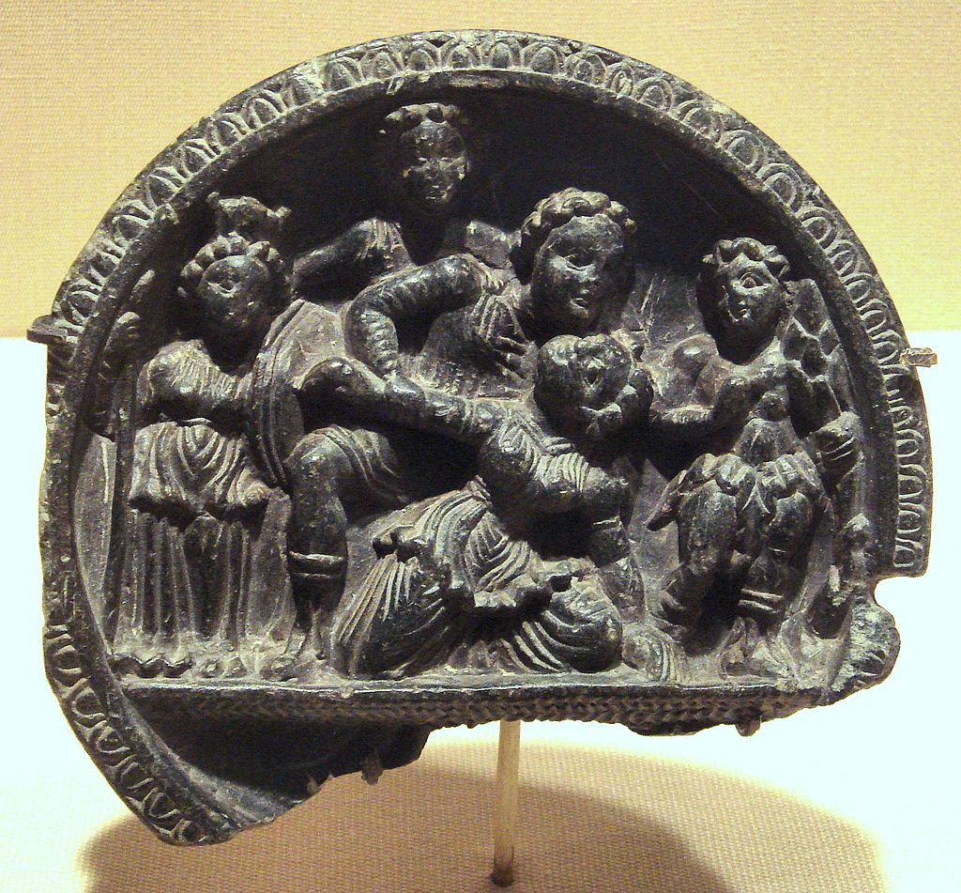
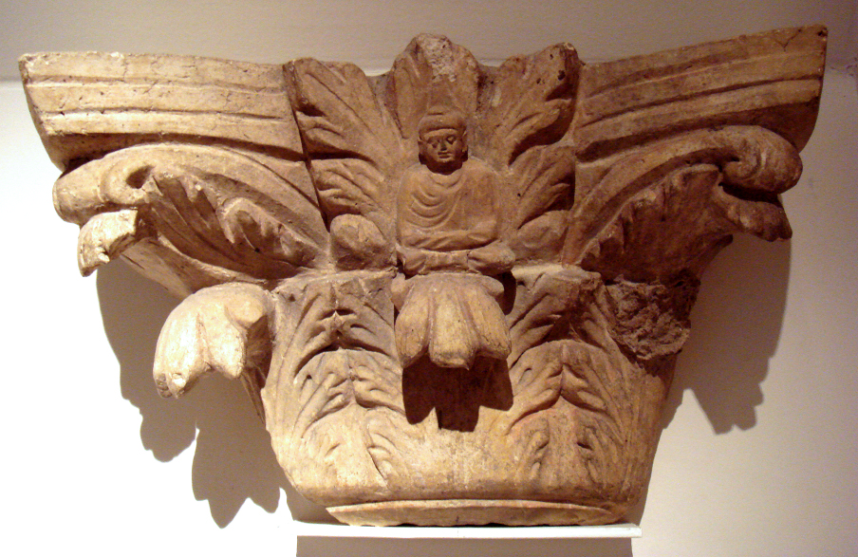
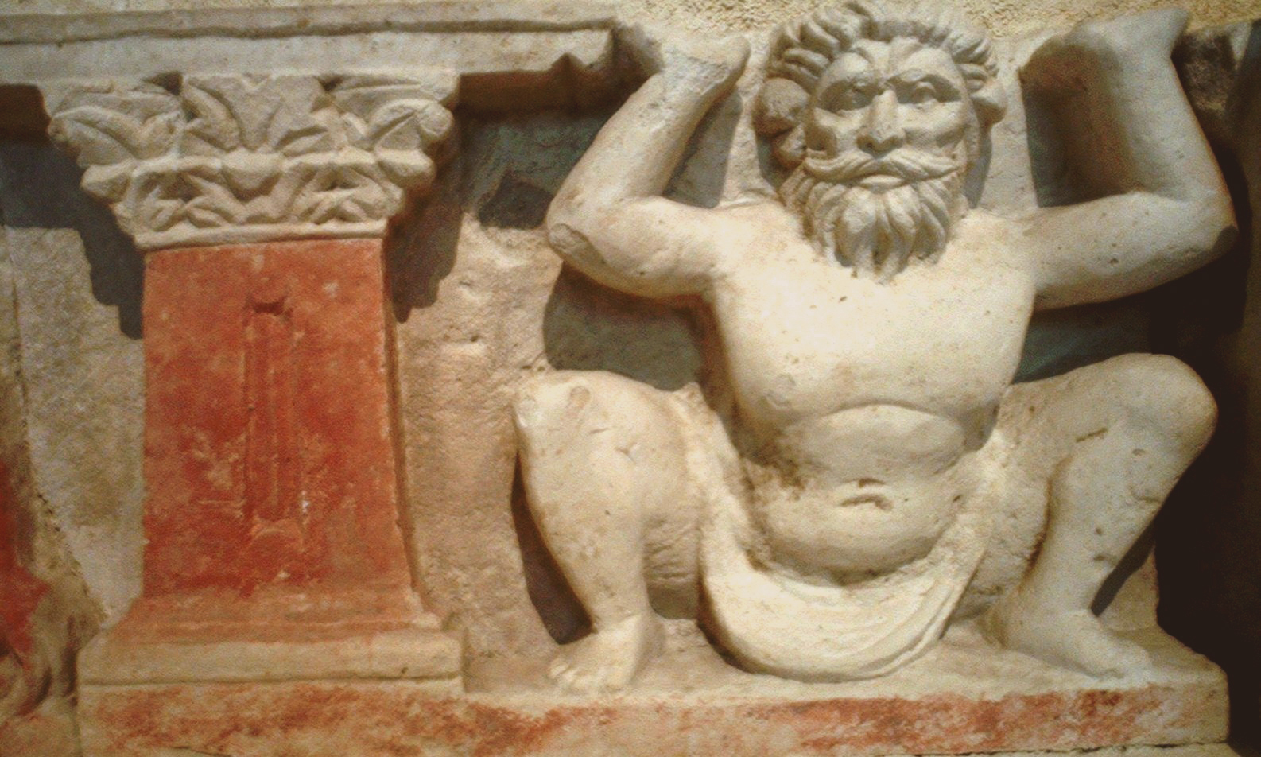
Kontakty
Umění
Mathura
Gandhára
Bharhut

Slide 15
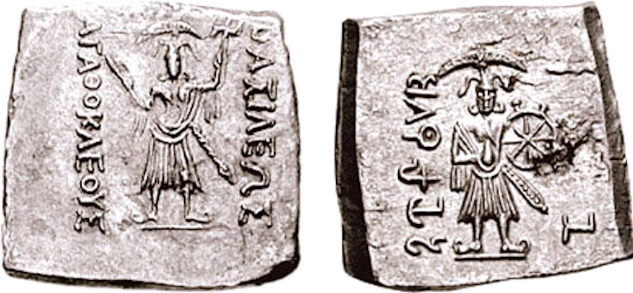
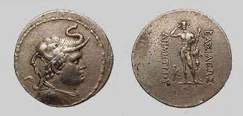
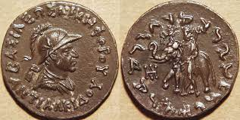
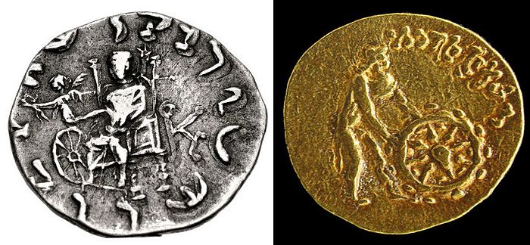
Kontakty
Mince
Řecký vzor
Portrét vládce
Indičtí bohové
Buddhistické motivy
Řecké písmo, bráhmí, charóští

Slide 16
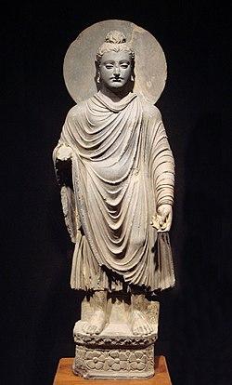
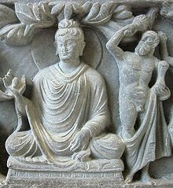
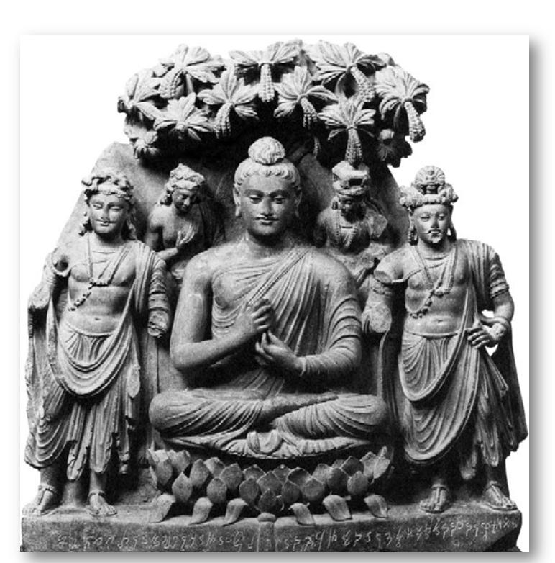
Kontakty
Řekové a buddhismus
Rozkvět, podpora buddhismu od řeckých vládců
Možné konverze
Vyobrazení Buddhy v lidské podobě

Slide 17
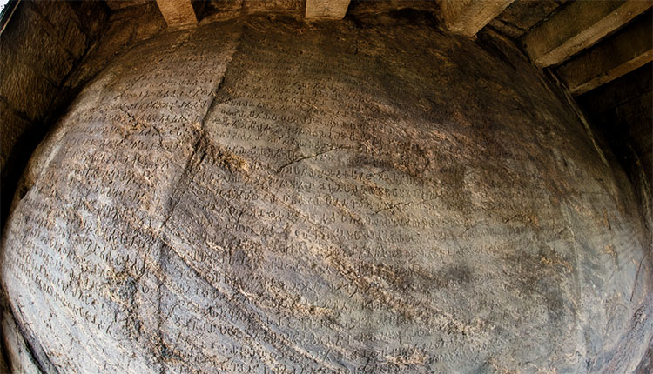
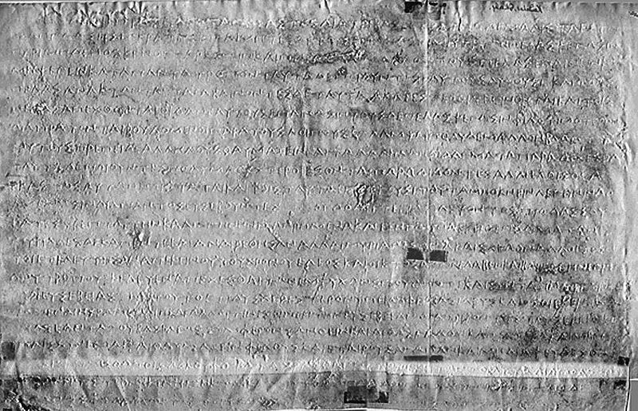
Kontakty
Řekové z pohledu Indů
Jávana
Mléččha
Milinda (Menandros I.) – hovory s buddhistickým učencem
Překlady řeckých astronomických textů do sanskrtu (Javanadžátaka)
Řekové jako barbaři
Ašokovy edikty – 2 řecky
Misionářská činnost Ašóky – na dvůr Egypta, Makedonie, Seleukovců

Slide 18
Prameny
Ktésiás – Indika
Megasthenés – Indika
Isidóros z Charaku – Parthské stanice
Onésikritos, Déimachos, Nearchos, Patroklos – spisy o Indii
Periplus Maris Erythraei
Arriános – Indika
Klaudios Ailiános – De Natura Animalium
Strabón - Geógrafika

Slide 19
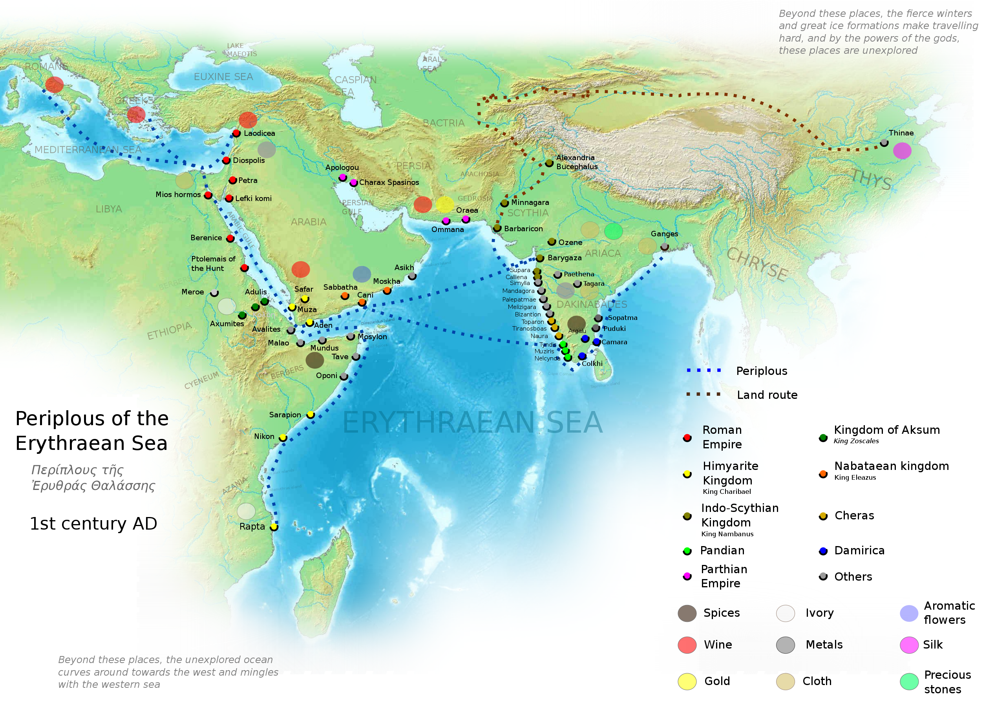
Objevování
Skylax z Karyandy, Hérodotos – jen kolem řeky Indu
Alexandr – dále na východ
Vyslanci – do střední a východní Indie, Ganga
Eudoxos z Kyziku
Západní pobřeží – obchodní trasy do Egypta
Kosmas Indikopleustés – 6. stol. nl.

Slide 20
Obecně Indie v řeckých pramenech
Země plná bohatství
(Téměř) vše je zde největší na světě (řeky, zvířata)
Extrémně úrodná
„Pohádková“ země
Prakticky nic o dějinách
Nejpočetnější kmen světa
Země protikladů

Slide 21
Místa v Indii
Paropamisos/Kaukasos/Imaos – Hindúkuš/Pamír
Taprobané – Šrí Lanka
Řeky v Paňdžábu – známe i Řekům, jiné názvy oproti indickým
Východní výběžek Indie – nejvýchodnější místo světa
Kosodélník, třetina Asie, největší část Asie

Slide 22
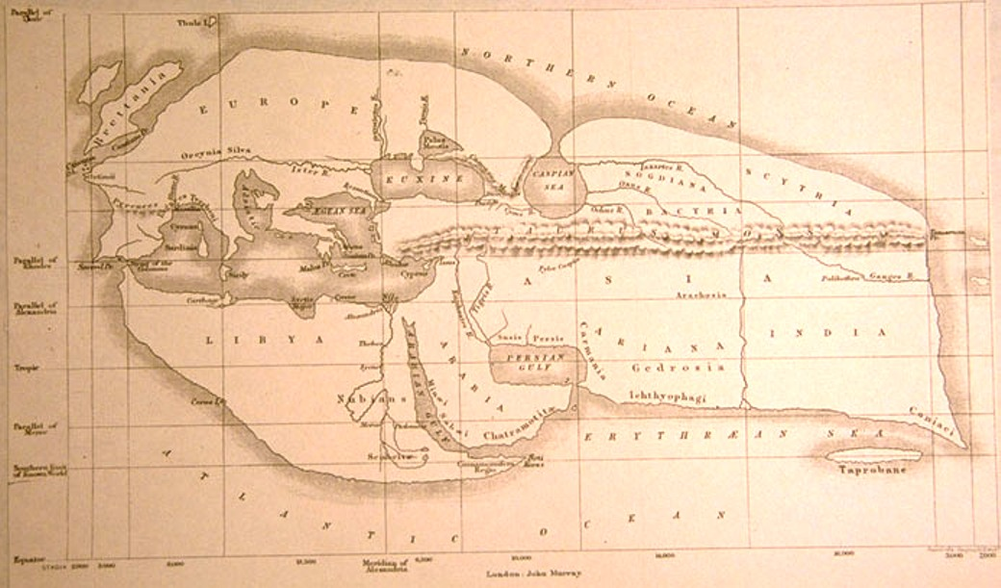

Slide 23
Řeky
Arr. Ind. 3
ποταμοὶ δὲ τοσοίδε εἰσὶν ἐν τῇ Ἰνδῶν γῇ, ὅσοι οὐδὲ ἐν τῇ πάσῃ Ἀσίῃ. μέγιστοι μὲν ὁ Γάγγης τε καὶ ὁ Ἰνδός, ὅτου καὶ ἡ γῆ ἐπώνυμος, ἄμφω τοῦ τε Νείλου τοῦ Αἰγυπτίου καὶ τοῦ Ἴστρου τοῦ Σκυθικοῦ, καὶ εἰ ἐς τωὐτὸ συνέλθοι αὐτοῖσι τὸ ὕδωρ, μέζονες.
The Indian rivers are greater than any others in Asia; greatest are the Ganges and the Indus, whence the land gets its name; each of these is greater than the Nile of Egypt and the Scythian Ister, even were these put together;

Slide 24
Řeky
Arr. Ind. 4
οὔκουν ἀπιστίην χρὴ ἔχειν ὑπέρ τε τοῦ Ἰνδοῦ καὶ τοῦ Γάγγεω, μηδὲ συμβλητοὺς εἶναι αὐτοῖσι τόν τε Ἴστρον καὶ τὸν Νεῖλον. ἐς μέν γε τὸν Νεῖλον οὐδένα ποταμὸν ἐκδιδόντα ἴδμεν, ἀλλὰ ἀπ᾽ αὐτοῦ διώρυχας τετμημένας κατὰ τὴν χώρην τὴν Αἰγυπτίην: ὁ δὲ Ἴστρος ὀλίγος μὲν ἀνίσχει ἀπὸ τῶν πηγέων, δέκεται δὲ πολλοὺς ποταμούς, ἀλλὰ οὐδὲ πλήθεϊ ἴσους τοῖσιν Ἰνδῶν ποταμοῖσιν, οἳ τὸν Ἰνδὸν καὶ τὸν Γάγγεα ἐκδιδοῦσι, πλωτοὺς δὲ δὴ κάρτα ὀλίγους,
It should not then be incredible that neither Nile nor Ister can be even compared with Indus or Ganges in volume of water. For we know of no tributary to the Nile; rather from it canals have been cut through the land of Egypt. As for the Ister, it emerges from its springs a meagre stream, but receives many tributaries; yet not equal in number to the Indian tributaries which flow into Indus or Ganges; and very few of these are navigable;

Slide 25
Monzuny
Arr. Ind. 6
ὕεται δὲ ἡ Ἰνδῶν γῆ τοῦ θέρεος, μάλιστα μὲν τὰ οὔρεα … ὕεται δὲ τοῦ θέρεος καὶ τὰ πεδία τῶν Ἰνδῶν, ὥστε λιμνάζει τὰ πολλὰ αὐτῶν. καὶ ἔφυγεν ἡ Ἀλεξάνδρου στρατιὴ ἀπὸ τοῦ Ἀκεσίνου ποταμοῦ μέσου θέρεος, ὑπερβαλόντος τοῦ ὕδατος ἐς τὰ πεδία,
In the summer there is rain through India; especially on the mountains, … The plains of India also receive rain in summer, and much part of them becomes swamp; in fact Alexander's army retired from the river Acesines in midsummer, when the river had overflowed on to the plains;

Slide 26
Přírodní podmínky
D.S. 2.35
τὰ πολλὰ δὲ τῆς χώρας ἀρδεύεται, καὶ διὰ τοῦτο διττοὺς ἔχει τοὺς κατ᾽ ἔτος καρπούς: ζῴων τε παντοδαπῶν γέμει διαφόρων τοῖς μεγέθεσι καὶ ταῖς ἀλκαῖς, τῶν μὲν χερσαίων, τῶν δὲ καὶ πτηνῶν.
=Hdt. 3.106
The larger part of the country is well watered and for this reason yields two crops each year; and it abounds in all kinds of animals, remarkable for their great size and strength, land animals as well as birds.

Slide 27
Lidé
Hdt. 3.98
ἔστι τῆς Ἰνδικῆς χώρης τὸ πρὸς ἥλιον ἀνίσχοντα ψάμμος· τῶν γὰρ ἡμεῖς ἴδμεν, τῶν καὶ πέρι ἀτρεκές τι λέγεται, πρῶτοι πρὸς ἠῶ καὶ ἡλίου ἀνατολὰς οἰκέουσι ἀνθρώπων τῶν ἐν τῇ Ἀσίῃ Ἰνδοί· Ἰνδῶν γὰρ τὸ πρὸς τὴν ἠῶ ἐρημίη ἐστὶ διὰ τὴν ψάμμον.
All to the east of the Indian country is sand; among all men of whom hearsay gives us any clear knowledge the Indians dwell farthest to the east and the sunrise of all the nations of Asia; for on the eastern side of India all is desert by reason of the sand.

Slide 28
Lidé
Arr. Ind. 10
εἶναι δὲ καὶ τόδε μέγα ἐν τῇ Ἰνδῶν γῇ, πάντας Ἰνδοὺς εἶναι ἐλευθέρους, οὐδέ τινα δοῦλον εἶναι Ἰνδόν. τοῦτο μὲν Λακεδαιμονίοισιν ἐς τωὐτὸ συμβαίνει καὶ Ἰνδοῖσι. Λακεδαιμονίοισι μέν γε οἱ εἵλωτες δοῦλοί εἰσι καὶ τὰ δουλων ἐργάζονται, Ἰνδοῖσι δὲ οὐδὲ ἄλλος δοῦλός ἐστι, μήτι γε Ἰνδῶν τις.
This also is remarkable in India, that all Indians are free, and no Indian at all is a slave. In this the Indians agree with the Lacedaemonians. Yet the Lacedaemonians have Helots for slaves, who perform the duties of slaves; but the Indians have no slaves at all, much less is any Indian a slave.

Slide 29
Lidé, společnost
Arr. Ind. 11
νενέμηνται δὲ οἱ πάντες Ἰνδοὶ ἐς ἑπτὰ μάλιστα γένεα.
Σοφισταί, γεωργοί, νομέες, οἱ ποιμένες τε καὶ οἱ βουκόλοι, δημιουργικόν τε καὶ καπηλικὸν , πολεμισταί, ἐπίσκοποι, ὑπὲρ τῶν κοινῶν βουλευόμενοι
The Indians generally are divided into seven castes.
Kněží, zemědělci, pastevci, řemeslníci/obchodníci/námořníci, vojáci, kontroloři, rádci

Slide 30
Lidé, společnost
γαμέειν δὲ ἐξ ἑτέρου γένεος οὐ θέμις, οἷον τοῖσι γεωργοῖσιν ἐκ τοῦ δημιουργικοῦ ἢ ἔμπαλιν. οὐδὲ δύο τέχνας ἐπιτηδεύειν τὸν αὐτὸν οὐδὲ τοῦτο θέμις, οὐδὲ ἀμείβειν ἕτερον ἐξ ἑτέρου γένος, οἷον γεωργικὸν ἐκ νομέος γίνεσθαι, ἢ νομέα ἐκ δημιουργικοῦ. μοῦνόν σφισιν ἀνεῖται σοφιστὴν ἐκ παντὸς γένεος γίνεσθαι, ὅτι οὐ μαλθακὰ τοῖσι σοφιστῇσίν ἐστι τὰ πρήγματα ἀλλὰ πάντων ταλαιπωρότατα.
To marry out of any class is unlawful -- as, for instance, into the farmer class from the artisans, or the other way; nor must the same man practice two pursuits; nor change from one class into another, as to turn farmer from shepherd, or shepherd from artisan. It is only permitted to join the wise men out of any class; for their business is not an easy one, but of all most laborious.

Slide 31
Lidé
Arr. Ind. 6
τῶν δὲ ἀνθρώπων αἱ ἰδέαι οὐ πάντη ἀπᾴδουσιν αἱ Ἰνδῶν τε καὶ Αἰθιόπων. οἱ μὲν γὰρ πρὸς νότου ἀνέμου Ἰνδοὶ τοῖσιν Αἰθίοψι μᾶλλόν τι ἐοίκασι, μέλανές τε ἰδέσθαι εἰσὶ, καὶ ἡ κόμη αὐτοῖσι μέλαινα, πλήν γε δὴ ὅτι σιμοὶ οὐκ ὡσαύτως οὐδὲ οὐλόκρανοι ὡς Αἰθίοπες: οἱ δὲ βορειότεροι αὐτῶν καὶ Αἰγυπτίους μάλιστα ἂν εἶεν τὰ σώματα.
The appearance of the inhabitants, too, is not so far different in India and Ethiopia; the southern Indians resemble the Ethiopians a good deal, and, are black of countenance, and their hair black also, only they are not as snub-nosed or so woolly-haired as the Ethiopians; but the northern Indians are most like the Egyptians in appearance.

Slide 32
Lidé
Arr. Ind. 17
τὰ δὲ σώματα ἰσχνοί τέ εἰσιν Ἰνδοὶ καὶ εὐμήκεες, καὶ κοῦφοι πολλόν τι ὑπὲρ τοὺς ἄλλους ἀνθρώπους. ὀχήματα δὲ τοῖσι μὲν πολλοῖσιν Ἰνδῶν κάμηλοί εἰσι καὶ ἵπποι καὶ ὄνοι, τοῖσι δὲ εὐδαίμοσιν ἐλέφαντες. [2] βασιλικὸν γὰρ ὄχημα ὁ ἐλέφας παρ᾽ Ἰνδοῖσίν ἐστι, δεύτερον δὲ τιμῇ τὰ τέθριππα, τρίτον δὲ αἱ κάμηλοι. τὸ δὲ ἐπ᾽ ἑνὸς ἵππου ὀχέεσθαι ἄτιμον. [3] αἱ γυναῖκες δὲ αὐτοῖσιν, ὅσαι κάρτα σώφρονες, ἐπὶ μὲν ἄλλῳ μισθῷ οὐκ ἄν τι διαμάρτοιεν, ἐλέφαντα δὲ λαβοῦσα γυνὴ μίσγεται τῷ δόντι
The Indians in shape are thin and tall and much lighter in movement than the rest of mankind. They usually ride on camels, horses, and asses; the richer men on elephants. For the elephant in India is a royal mount; then next in dignity is a four-horse chariot, and camels come third; to ride on a single horse is low. Their women, such as are of great modesty, can be seduced by no other gift, but yield themselves to anyone who gives an elephant

Slide 33
Lidé
D.S. 2.36
ὁμοίως δὲ καὶ τοὺς ἀνθρώπους ἡ πολυκαρπία τρέφουσα τοῖς τε ἀναστήμασι τῶν σωμάτων καὶ τοῖς ὄγκοις ὑπερφέροντας κατασκευάζει: εἶναι δ᾽ αὐτοὺς συμβαίνει καὶ πρὸς τὰς τέχνας ἐπιστήμονας, ὡς ἂν ἀέρα μὲν ἕλκοντας καθαρόν, ὕδωρ δὲ λεπτομερέστατον πίνοντας.
The same is true of the inhabitants also, the abundant supply of food making them of unusual height and bulk of body; and another result is that they are skilled in the arts, since they breathe a pure air and drink water of the finest quality.

Slide 34
Zvyky, kmeny
Hdt. 3.99
Ἄλλοι δὲ τῶν Ἰνδῶν πρὸς ἠῶ οἰκέοντες τούτων νομάδες εἰσὶ κρεῶν ἐδεσταὶ ὠμῶν, καλέονται δὲ Παδαῖοι, νομαίοισι δὲ τοιοῖσιδε λέγονται χρᾶσθαι· ὃς ἂν κάμῃ τῶν ἀστῶν, ἤν τε γυνὴ ἤν τε ἀνήρ, τὸν μὲν ἄνδρα ἄνδρες οἱ μάλιστά οἱ ὁμιλέοντες κτείνουσι, φάμενοι αὐτὸν τηκόμενον τῇ νούσῳ τὰ κρέα σφίσι διαφθείρεσθαι· ὁ δὲ ἄπαρνος ἐστὶ μὴ μὲν νοσέειν, οἳ δὲ οὐ συγγινωσκόμενοι ἀποκτείναντες κατευωχέοντα. … τὸν γὰρ δὴ ἐς γῆρας ἀπικόμενον θύσαντες κατευωχέονται· ἐς δὲ τούτου λόγον οὐ πολλοί τινες αὐτῶν ἀπικνέονται· πρὸ γὰρ τοῦ τὸν ἐς νοῦσον πίπτοντα πάντα κτείνουσι.
Other Indians, to the east of these, are nomads and eat raw flesh; they are called Padaei. It is said to be their custom that when any of their countryfolk male or female are sick, a man's closest friends kill him, saying that they lose his flesh by the wasting of the disease; though he denies that he is sick, yet they will not believe him, but kill and eat him. … As for one that has come to old age, they sacrifice him and feast on his flesh; but there are not many who come thereto, for all who fall sick are killed ere that.

Slide 35
Zvyky, kmeny
Hdt. 3.100
Ἑτέρων δὲ ἐστὶ Ἰνδῶν ὅδε ἄλλος τρόπος· οὔτε κτείνουσι οὐδὲν ἔμψυχον οὔτε τι σπείρουσι οὔτε οἰκίας νομίζουσι ἐκτῆσθαι ποιηφαγέουσί τε· καὶ αὐτοῖσι ἐστὶ ὅσον κέγχρος τὸ μέγαθος ἐν κάλυκι, αὐτόματον ἐκ τῆς γῆς γινόμενον, τὸ συλλέγοντες αὐτῇ τῇ κάλυκι ἕψουσί τε καὶ σιτέονται.
There are other Indians, again, who kill no living creature, nor sow, nor are wont to have houses; they eat grass, and they have a grain growing naturally from the earth in its calyx, about the size of a millet-seed, which they gather with the calyx and roast and eat.

Slide 36
Zvyky, kmeny
Hdt. 3.38
Δαρεῖος ἐπὶ τῆς ἑωυτοῦ ἀρχῆς καλέσας Ἑλλήνων τοὺς παρεόντας εἴρετο ἐπὶ κόσῳ ἂν χρήματι βουλοίατο τοὺς πατέρας ἀποθνήσκοντας κατασιτέεσθαι· οἳ δὲ ἐπ’ οὐδενὶ ἔφασαν ἔρδειν ἂν τοῦτο. Δαρεῖος δὲ μετὰ ταῦτα καλέει Ἰνδῶν τοὺς καλεομένους Καλλατίας, οἳ τοὺς γονέας κατεσθίουσι, εἴρετο, παρεόντων τῶν Ἑλλήνων καὶ δι’ ἑρμηνέος μανθανόντων τὰ λεγόμενα, ἐπὶ τίνι χρήματι δεξαίατ’ ἂν τελευτῶντας τοὺς πατέρας κατακαίειν πυρί· οἳ δὲ ἀμβώσαντες μέγα εὐφημέειν μιν ἐκέλευον.
When Darius was king, he summoned the Greeks who were with him and asked them what price would persuade them to eat their fathers' dead bodies. They answered that there was no price for which they would do it. Then he summoned those Indians who are called Callatiae,​ who eat their parents, and asked them (the Greeks being present and understanding by interpretation what was said) what would make them willing to burn their fathers at death. The Indians cried aloud, that he should not speak of so horrid an act.

Slide 37
Zvyky, kmeny
Str. 15.1.53
Téměř nemají krádeže
Neznají písmo, vše z paměti
Gymnosofisté (bráhmani, šramani)
Spravedliví

Slide 38
Mudrci, asketi
Str. 15.1.60
τοὺς μὲν ἐντιμοτάτους ὑλοβίους φησὶν ὀνομάζεσθαι, ζῶντας ἐν ταῖς ὕλαις ἀπὸ φύλλων καὶ καρπῶν ἀγρίων, ἐσθῆτος φλοιῶν δενδρείων, ἀφροδισίων χωρὶς καὶ οἴνου
he says that the most honourable of them are named Hylobii​ and that they live in forests, subsisting on leaves and wild fruits, clothed with the bark of trees, and abstaining from wine and the delights of love

Slide 39
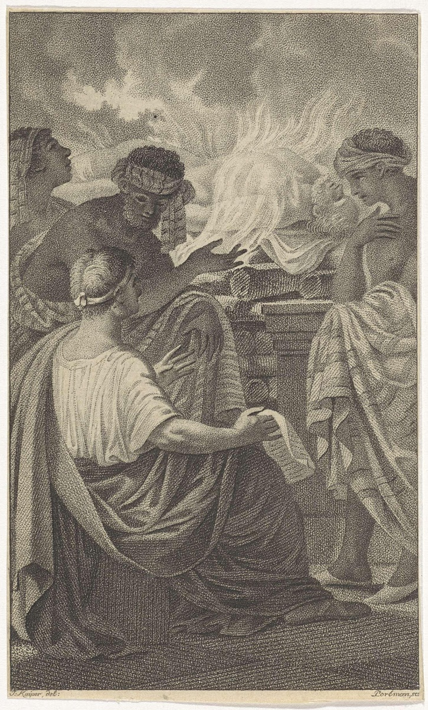
Mudrci, asketi
Kalanos
Zarmanochégás
Sebeupálení

Slide 40
Lidé
Arr. Ind. 9
ἐν δὲ τῇ χώρῃ ταύτῃ, ἵνα ἐβασίλευσεν ἡ θυγάτηρ τοῦ Ἡρακλέος, τὰς μὲν γυναῖκας ἑπταέτεας ἐούσας ἐς ὥρην γάμου ἰέναι, τοὺς δὲ ἄνδρας τεσσαράκοντα ἔτεα τὰ πλεῖστα βιώσκεσθαι.
ἐσθῆτι δὲ Ἰνδοὶ λινέῃ χρέονται, κατάπερ λέγει Νέαρχος, λίνου τοῦ ἀπὸ τῶν δενδρέων, ὑπὲρ ὅτων μοι ἤδη λέλεκται.
In this country where Heracles' daughter was queen, the girls are marriageable at seven years, and the men do not live longer than forty years.
The Indians wear linen garments, as Nearchus says, the linen coming from the trees of which I have already made mention.

Slide 41
Lidé
Pl. NH. 7.27
Cyrnos Indorum genus Isigonus annis centenis quadragenis vivere, …
Onesicritus, quibus locis Indiae umbrae non sint, corpora hominum cubitorum quinum et binorum palmorum existere, et vivere annos CXXX nec senescere, sed ut medio aevo mori. Crates Pergamenus Indos, qui centenos annos excedant, Gymnetas appellat, non pauci Macrobios. Ctesias gentem ex his, quae appellatur Pandae, in convallibus sitam annos ducenos vivere, in iuventa candido capillo, qui in senectute nigrescat,
The Indian race of Cyrni according to Isigonus live to 140; …
Onesicritus says that in the parts of India where there are no shadows there are men five cubits and two spans a high, and people live a hundred and thirty years, and do not grow old but die middle-aged. Crates of Pergamum tells of Indians who exceed a hundred years, whom he calls Gymnetae, though many call them Macrobii. Ctesias says that a tribe among them called the Pandae, dwelling in the mountain valleys, live two hundred years, and have white hair in their youth that grows black in old age

Slide 42
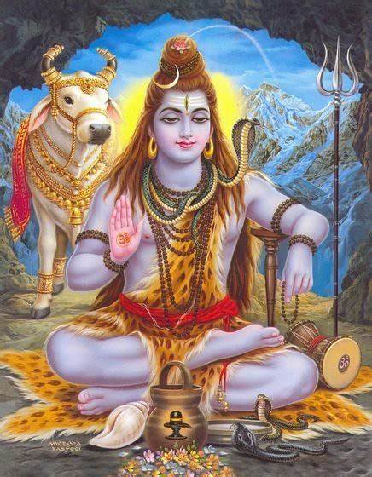
Náboženství
Dionýsos (=Šiva)
Arr. Ind. 7
οὔτε πόλιας οἰκέοντες οὔτε ἱρὰ θεῶν σέβοντες. [3] οὕτω μηδὲ Ἰνδοῖσι πόλιας εἶναι μηδὲ ἱρὰ θεῶν δεδομημένα, ἀλλὰ ἀμπίσχεσθαι μὲν δορὰς θηρίων ὅσων κατακάνοιεν, σιτέεσθαι δὲ τῶν δενδρέων τὸν φλοιόν. καλέεσθαι δὲ τὰ δένδρεα ταῦτα τῇ Ἰνδῶν φωνῇ τάλα, καὶ φύεσθαι ἐπ᾽ αὐτῶν, κατάπερ τῶν φοινίκων ἐπὶ τῇσι κορυφῇσιν, οἷά περ τολύπας. [4] σιτέεσθαι δὲ καὶ τῶν θηρίων ὅσα ἕλοιεν ὠμοφαγέοντας, πρίν γε δὴ Διόνυσον ἐλθεῖν ἐς τὴν χώρην τὴν Ἰνδῶν. [5] Διόνυσον δὲ ἐλθόντα, ὡς καρτερὸς ἐγένετο Ἰνδῶν, πόλιάς τε οἰκίσαι καὶ νόμους θέσθαι τῇσι πόλισιν, οἴνου τε δοτῆρα Ἰνδοῖσι γενέσθαι κατάπερ Ἕλλησι, καὶ σπείρειν διδάξαι τὴν γῆν διδόντα αὐτὸν σπέρματα,
just so the Indians also had no cities and built no temples; but were clothed with the skins of animals slain in the chase, and for food ate the bark of trees; these trees were called in the Indian tongue Tala, and there grew upon them, just as on the tops of palm trees, what look like clews of wool. They also used as food what game they had captured, eating it raw, before, at least, Dionysus came into India. But when Dionysus had come, and become master of India, he founded cities, and gave laws for these cities, and became to the Indians the bestower of wine, as to the Greeks, and taught them to sow their land, giving them seed.

Slide 43
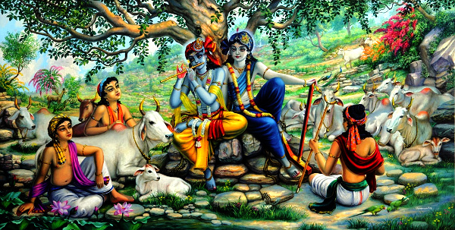
Náboženství
Héraklés (Vásudéva, Kršna)
Arr. Ind. 8
Ἡρακλέα δέ, ὅντινα ἐς Ἰνδοὺς ἀπικέσθαι λόγος κατέχει, παρ᾽ αὐτοῖσιν Ἰνδοῖσι γηγενέα λέγεσθαι. [5] τοῦτον τὸν Ἡρακλέα μάλιστα πρὸς Σουρασηνῶν γεραίρεσθαι, Ἰνδικοῦ ἔθνεος, ἵνα δύο πόλιες μεγάλαι, Μέθορά τε καὶ Κλεισόβορα: καὶ ποταμὸς Ἰωβάρης πλωτὸς διαρρέει τὴν χώρην αὐτῶν. [6] τὴν σκευὴν δὲ οὗτος ὁ Ἡρακλέης ἥντινα ἐφόρεε Μεγασθένης λέγει ὅτι ὁμοίην τῷ Θηβαίῳ Ἡρακλέϊ, ὡς αὐτοὶ Ἰνδοὶ ἀπηγέονται.
But Heracles, whom tradition states to have arrived as far as India, was called by the Indians themselves 'Indigenous.' This Heracles was chiefly honoured by the Surasenians, an Indian tribe, among whom are two great cities, Methora and Cleisobora, and the navigable river Iobares flows through their territory. Megasthenes also says that the garb which this Heracles wore was like that of the Theban Heracles, as also the Indians themselves record.

Slide 44
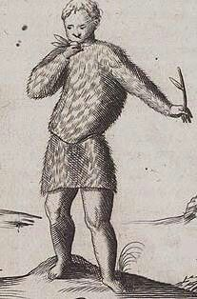
Kmeny
Pl. NH. 7.28
ad extremos fines Indiae ab oriente circa fontem Gangis Astomorum gentem sine ore, corpore toto hirtam vestiri frondium lanugine, halitu tantum viventem et odore, quem naribus trahant. nullum illis cibum nullumque potum, radicum tantum florumque varios odores et silvestrium malorum, quae secum portant longiore itinere, ne desit olfactus; graviore paulo odore haut difficulter exanimari.
At the extreme boundary of India to the East, near the source of the Ganges, he puts the Astomi tribe, that has no mouth and a body hairy all over; they dress in cottonwool and live only on the air they breath and the scent they inhale through their nostrils; they have no food or drink except the different odours of the roots and flowers and wild apples, which they carry with them on their longer journeys so as not to lack a supply of scent; he says they can easily be killed by a rather stronger odour than usual.

Slide 45
Kmeny
Pl. NH. 7.25
Megasthenes gentem inter Nomadas Indos narium loco foramina tantum habentem, anguium modo loripedem, vocari Sciratas.
Pl. NH. 7.24
Ctesias scribit, et in quadam gente Indiae feminas semel in vita parere genitosque confestim canescere.
Megasthenes tells of a race among the Nomads of India that has only holes in the place of nostrils, like snakes, and bandy-legged; they are called the Sciritae.
Ctesias writes that also among a certain race of India the women bear children only once in their life time, and that the children begin to turn grey directly after birth

Slide 46
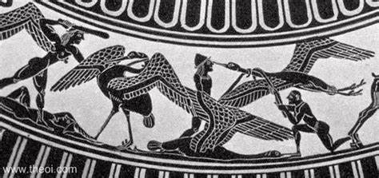
Kmeny
Pygmaiové (=pygmé, loket)
Hom. Il. 3.3ff
Podobně jeřábů křik zní pod klenbou vysokých nebes,
kteří unikše zimě a dešťům nesmírně dlouhým,
k proudům Ókeanovým se rozletí s velikým křikem,
nesouce zhoubu a smrt všem mužům Pídimužíkům,
s kterými ihned zrána se v zhoubný pouštějí rozbroj.

Slide 47
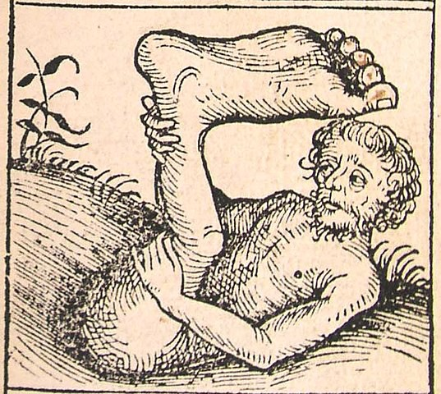
Kmeny
Pl. NH. 7.23
idem hominum genus, qui Monocoli vocarentur, singulis cruribus, mirae pernicitatis ad saltum; eodem Sciapodas vocari, quod in maiore aestu humi iacentes resupini umbra se pedum protegant.
He also describes a tribe of men called Monocoli (One-Legged) who have only one leg, and who move in jumps with surprising speed; the same are called Sciapodes (Shadow-Foots) tribe, because in the hotter weather they lie on their backs on the ground and protect themselves with the shadow of their feet.

Slide 48
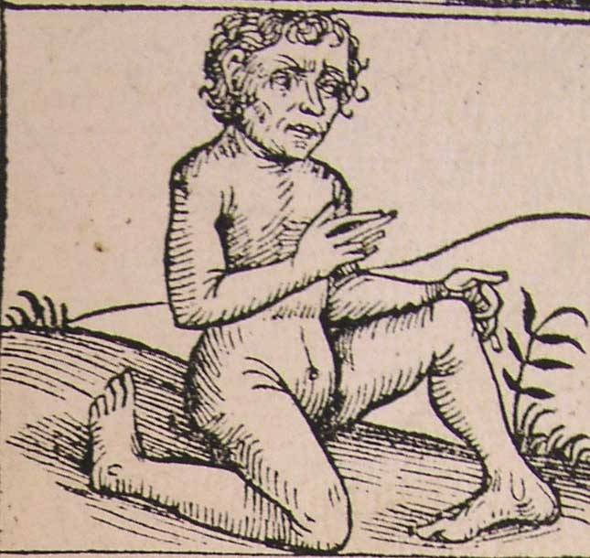
Kmeny
Pl. NH. 7.22
in monte, cui nomen est Nulo, homines esse aversis plantis octonos digitos in singulis habentes auctor est Megasthenes.
Megasthenes states that on the mountain named Nulus there are people with their feet turned backwards and with eight toes on each foot.

Slide 49
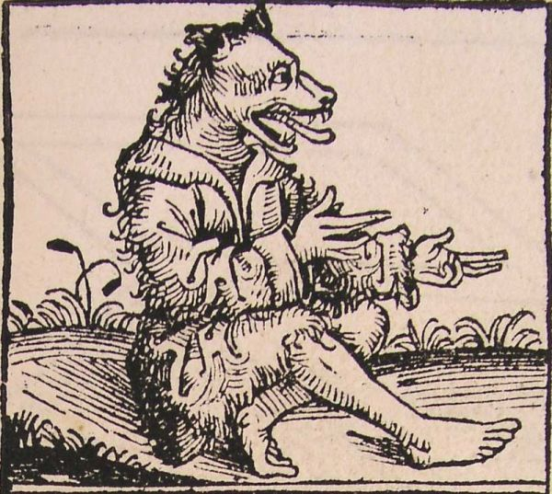
Kmeny
Ael. NA. 4.46
γίνονται δὲ ἐνταῦθα τῆς Ἰνδικῆς, ἔνθα οἱ κάνθαροι, καὶ οἱ καλούμενοι κυνοκέφαλοι, οἷς τὸ ὄνομα ἔδωκεν ἡ τοῦ σώματος ὄψις τε καὶ φύσις: τὰ δὲ ἄλλα ἀνθρώπων ἔχουσι, καὶ ἠμφιεσμένοι βαδίζουσι δορὰς θηρίων. καί εἰσι δίκαιοι, καὶ ἀνθρώπων λυποῦσιν οὐδένα, καὶ φθέγγονται μὲν οὐδὲ ἕν, ὠρύονται δέ, τῆς γε μὴν Ἰνδῶν φωνῆς ἐπαΐουσι. τροφὴ δὲ αὐτοῖς τῶν ζῴων τὰ ἄγρια: αἱροῦσι δὲ αὐτὰ ῥᾷστα, καὶ γάρ εἰσιν ὤκιστοι, … τρέφουσι δὲ καὶ αἶγας καὶ οἶς. καὶ σῖτον μὲν ποιοῦνται τὰ ἄγρια, πίνουσι δὲ τὸ ἐκ τῶν θρεμμάτων γάλα ὧν τρέφουσι. μνήμην δὲ αὐτῶν ἐν τοῖς ἀλόγοις ἐποιησάμην, καὶ εἰκότως: ἔναρθρον γὰρ καὶ εὔσημον καὶ ἀνθρωπίνην φωνὴν οὐκ ἔχουσιν.
"In the same part of India as the beetles, are born the Kynokephaloi (Dog-Heads), as they are called--a name which they owe to their physical appearance and nature. For the rest they are of human shape and go about clothes in the skins of beasts; and they are upright and injure no man; and though they have no speech they howl; yet they understand the Indian language. Wild animals are their food, and they catch them with the utmost ease, for they are exceedingly swift of foot; They also keep goats and sheep, and while their food is the flesh of wild beasts, their drink is the milk of the animals they keep. I have mentioned them along with brute beasts, as is logical, for their speech is inarticulate, unintelligible, and not that of man.

Slide 50
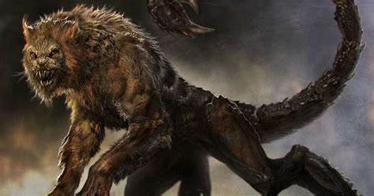
Phot. Bibl. 72 §7
Καὶ περὶ τοῦ μαρτιχόρα τοῦ ἐν αὐτοῖς ὄντος θηρίου, ὡς τὸ πρόσωπον ἐοικὼς ἀνθρώπῳ· μέγεθος μέν ἐστιν ὥσπερ λέων, καὶ χροὰν ἐρυθρὸς ὡς κιννάβαρι. Τρίστιχοι δὲ ὀδόντες, ὦτα δὲ ὥσπερ ἀνθρώπου, καὶ ὀφθαλμοὺς γλαύκους ὁμοίους ἀνθρώπῳ. Τὴν δὲ κέρκον ἔχει οἵανπερ σκορπίος ὁ ἠπειρώτης, ἐν ᾗ καὶ τὸ κέντρον ἔχει, μείζω ὑπάρχουσαν πήχεος. … Βάλλει δὲ ὅσον πλέθρον εἰς μῆκος, καὶ πάντα, οἷς ἂν βάλῃ, πάντως ἀποκτείνει πλὴν ἐλέφαντος. Τὰ δὲ κέντρα αὐτοῦ ἐστι τὸ μὲν μῆκος ὅσον ποδιαῖα, τὸ δὲ πλάτος ὅσον σχοῖνος λεπτότατος. Μαρτιχόρα δὲ ἑλληνιστὶ ἀνθρωποφάγον, ὅτι πλεῖστα ἐσθίει ἀναιρῶν ἀνθρώπους· ἐσθίει δὲ καὶ τὰ ἄλλα ζῷα· μάχεται δὲ καὶ τοῖς ὄνυξι καὶ τοῖς κέντροις. Τὰ δὲ κέντρα πάλιν, φησίν, ἐπειδὰν ἐκτοξευθῇ, ἀναφύεσθαι. Ἔστι δὲ πολλὰ ἐν τῇ Ἰνδικῇ. Ἀποκτείνουσι δὲ αὐτὰ τοῖς ἐλέφασιν ἐποχούμενοι ἄνθρωποι κἀκεῖθεν βάλλοντες.
The Martikhora is an animal found in this country. It has a face like a man's, a skin red as cinnabar, and is as large as a lion. It has three rows of teeth, ears and light-blue eyes like those of a man; its tail is like that of a land scorpion, containing a sting more than a cubit long at the end … The wound inflicted is fatal to all animals except the elephant. The stings are about a foot long and about as thick as a small rush. The Martikhora [the Persian word for man-eater] is called in Greek Anthropophagos (Man-Eater), because, although it preys upon other animals, it kills and devours a greater number of human beings. It fights with both its claws and stings, which, according to Ktesias (Ctesias), grow again after they have been discharged. There is a great number of these animals in India, which are hunted and killed with spears or arrows by natives mounted on elephants.

Slide 51
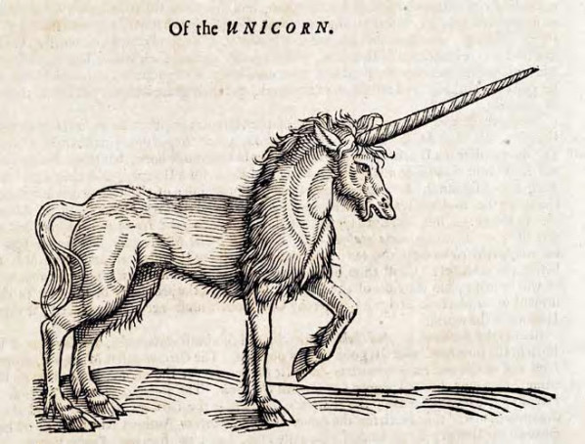
Ael. NA. 4.52
ὄνους ἀγρίους οὐκ ἐλάττους ἵππων τὰ μεγέθη ἐν Ἰνδοῖς γίνεσθαι πέπυσμαι. καὶ λευκοὺς μὲν τὸ ἄλλο εἶναι σῶμα, τήν γε μὴν κεφαλὴν ἔχειν πορφύρᾳ παραπλησίαν, τοὺς δὲ ὀφθαλμοὺς ἀποστέλλειν κυανοῦ χρόαν. κέρας δὲ ἔχειν ἐπὶ τῷ μετώπῳ ὅσον πήχεως τὸ μέγεθος καὶ ἡμίσεος προσέτι, καὶ τὸ μὲν κάτω μέρος τοῦ κέρατος εἶναι λευκόν, τὸ δὲ ἄνω φοινικοῦν, τό γε μὴν μέσον μέλαν δεινῶς. ἐκ δὴ τῶνδε τῶν ποικίλων κεράτων πίνειν Ἰνδοὺς ἀκούω …. καί φασι νόσων ἀφύκτων ἀμαθῆ καὶ ἄπειρον γίνεσθαι τὸν ἀπογευσάμενον ἐκ τοῦδε τοῦ κέρατος: μήτε γὰρ σπασμῷ ληφθῆναι ἂν αὐτὸν μήτε τῇ καλουμένῃ ἱερᾷ νόσῳ, μήτε μὴν διαφθαρῆναι φαρμάκοις. ἐὰν δέ τι καὶ πρότερον ᾖ πεπωκὼς κακόν, ἀνεμεῖν τοῦτο, καὶ ὑγιᾶ γίνεσθαι αὐτόν.
I have learned that in India are born Wild Asses (Onoi) as big as horses [i.e. the Monokerata (Unicorns)]. All their body is white except for the head, which approaches purple, while their eyes give off a dark blue colour. They have a horn on their forehead as much as a cubit and half long; the lower part of the horn is white, the upper part is crimson, while the middle is jet-black. From these variegated horns, I am told, the Indians drink, … . And they say that a man who has drunk from this horn knows not, and is free from, incurable diseases: he will never be seized with convulsions nor with the sacred sickness (epilepsy), as it is called, nor be destroyed by poisons. Moreover if he had previously drunk some deadly stuff, he vomits it up and is restored to health.

Slide 52
Phot. Bibl. 72 §27
Ὅτι ἐν τῷ ποταμῷ τῶν Ἰνδῶν σκώληξ γίνεται τὸ μὲν εἶδος οἷόν περ ἐν ταῖς συκαῖς εἴωθε γίνεσθαι, τὸ δὲ μῆκος πήχεις ζʹ, καὶ μείζους δὲ καὶ ἐλάττους, τὸ δὲ πάχος, δεκαετέα παῖδα μόλις φασὶ ταῖς χερσὶ περιλαβεῖν. Ἔχουσι δὲ ὀδόντας δύο, ἕνα ἄνω καὶ ἕνα κάτω, καὶ ὅ τι ἂν λάβωσι τοῖς ὀδοῦσι, κατεσθίουσι. Καὶ τὴν μὲν ἡμέραν ἐν τῇ ἰλύϊ τοῦ ποταμοῦ διαιτῶνται, τῇ δὲ νυκτὶ ἐξέρχονται, καὶ ἐάν τινι ἐντύχῃ ἐν τῇ γῇ βοῒ ἢ καμήλῳ καὶ δάκῃ, συλλαβὼν ἕλκει εἰς τὸν ποταμὸν καὶ πάντα κατεσθίει πλὴν τῆς κοιλίας.
In the river Indos (Indus) a worm is found resembling those which are usually found on fig-trees. Its average length is seven cubits, though some are longer, others shorter. It is so thick that a child ten years old could hardly put his arms round it. It has two teeth, one in the upper and one in the lower jaw. Everything it seizes with these teeth it devours. By day it remains in the mud of the river, but at night it comes out, seizes whatever it comes across, whether ox or camel, drags it into the river, and devours it all except the intestines.

Slide 53
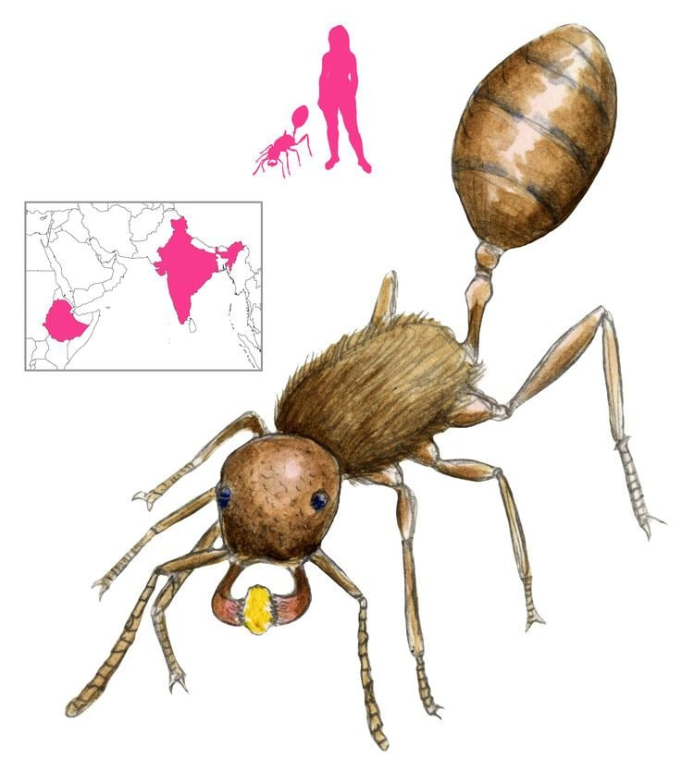
Hdt. 3.102
ἐν δὴ ὦν τῇ ἐρημίῃ ταύτῃ καὶ τῇ ψάμμῳ γίνονται μύρμηκες μεγάθεα ἔχοντες κυνῶν μὲν ἐλάσσονα ἀλωπέκων δὲ μέζονα· εἰσὶ γὰρ αὐτῶν καὶ παρὰ βασιλέι τῷ Περσέων ἐνθεῦτεν θηρευθέντες. οὗτοι ὦν οἱ μύρμηκες ποιεύμενοι οἴκησιν ὑπὸ γῆν ἀναφορέουσι τὴν ψάμμον κατά περ οἱ ἐν τοῖσι Ἕλλησι μύρμηκες κατὰ τὸν αὐτὸν τρόπον, εἰσὶ δὲ καὶ αὐτοὶ τὸ εἶδος ὁμοιότατοι· ἡ δὲ ψάμμος ἡ ἀναφερομένη ἐστὶ χρυσῖτις.
Ἐπεὰν δὲ ἔλθωσι ἐς τὸν χῶρον οἱ Ἰνδοὶ ἔχοντες θυλάκια, ἐμπλήσαντες ταῦτα τῆς ψάμμου τὴν ταχίστην ἐλαύνουσι ὀπίσω· αὐτίκα γὰρ οἱ μύρμηκες ὀδμῇ, ὡς δὴ λέγεται ὑπὸ Περσέων, μαθόντες διώκουσι. εἶναι δὲ ταχυτῆτα οὐδενὶ ἑτέρῳ ὅμοιον, οὕτω ὥστε, εἰ μὴ προλαμβάνειν τοὺς Ἰνδοὺς τῆς ὁδοῦ ἐν ᾧ τοὺς μύρμηκας συλλέγεσθαι, οὐδένα ἂν σφέων ἀποσώζεσθαι.
In this sandy desert are ants, not as big as dogs but bigger than foxes; the Persian king has some of these, which have been caught there. These ants live underground, digging out the sand in the same way as the ants in Greece, to which they are very similar in shape, and the sand which they carry from the holes is full of gold. It is for this sand that the Indians set forth into the desert.
So when the Indians come to the place with their sacks, they fill these with the sand and drive back as fast as possible; for the ants at once scent them out, the Persians say, and give chase. They say nothing is equal to them for speed, so that unless the Indians have a headstart while the ants were gathering, not one of them would get away.

Slide 54
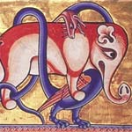
Ael. NA. 6.21
ἐν Ἰνδοῖς, ὡς ἀκούω, ἐλέφας καὶ δράκων ἐστὶν ἔχθιστα. οὐκοῦν οἱ μὲν ἐλέφαντες ἀποσπῶντες τῶν δένδρων τοὺς κλάδους, ἐκείνους νέμονται. ὅπερ οὖν εἰδότες οἱ δράκοντες ἐπ᾽ αὐτὰ μὲν ἀνέρπουσιν, … καὶ ὃ μὲν προσῆλθεν ἀποδρέψασθαι τῶν ἀκρεμόνων ὁ ἐλέφας, ὁ δὲ δράκων ἐμπηδᾷ τοῖς ὀφθαλμοῖς καὶ ἐξορύττει, εἶτα τῷ τραχήλῳ περιερπύσας, τείνων τῷ οὐραίῳ μέρει καὶ σφίγγων θατέρῳ ἀπάγχει τὸ θηρίον ἀήθει βρόχῳ καὶ καινῷ.
In India, I am told, the Elephant and the Drakon (Dragon-Serpent) are the bitterest enemies. Now Elephants draw down the branches of trees and feed upon them. And the Drakones, knowing this, crawl up the trees … Next the Drakon winds round the Elephant's neck, and as it clings to the tree with the lower part of its body, it tightens its hold with the upper part and strangles the Elephant with an unusual and singular noose.

Slide 55
Fauna
Tygr
Papoušci
Opice
Hadi

Slide 56
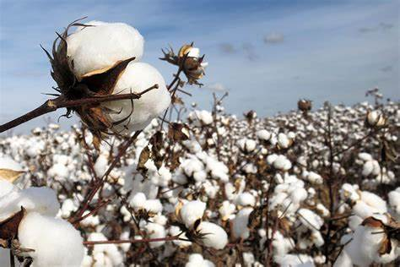
Hdt. 3.106
τὰ δὲ δένδρεα τὰ ἄγρια αὐτόθι φέρει καρπὸν εἴρια καλλονῇ τε προφέροντα καὶ ἀρετῇ τῶν ἀπὸ τῶν ὀίων καὶ ἐσθῆτι Ἰνδοὶ ἀπὸ τούτων τῶν δενδρέων χρέωνται.
There too grows on wild trees wool more beauti­ful and excellent than the wool of sheep; these trees supply the Indians with clothing.

Slide 57
Arr. Ind. 7.3
σιτέεσθαι δὲ τῶν δενδρέων τὸν φλοιόν. καλέεσθαι δὲ τὰ δένδρεα ταῦτα τῇ Ἰνδῶν φωνῇ τάλα, καὶ φύεσθαι ἐπ᾽ αὐτῶν, κατάπερ τῶν φοινίκων ἐπὶ τῇσι κορυφῇσιν, οἷά περ τολύπας.
and for food ate the bark of trees; these trees were called in the Indian tongue Tala, and there grew upon them, just as on the tops of palm trees, what look like clews of wool.

Slide 58
Parker, G. (2008). The Making of Roman India. Cambridge: Cambridge University Press.
Karttunen, K. (1989). India in Early Greek Literature. Helsinki: Finnish Oriental Society.
Karttunen, K. (2017). India and the Hellenistic World. Delhi: Motilal Banarsidas.

