Slide 1
DSBcB49 Starověká ekumena - antické zprávy o Asii a Africe
Židé
sceleratissima gens, taeterrima gens, perniciosa gens

Slide 2
Etymologie
Palestina – Παλαιστίνη, Palaestina → od sousedního kmene
Kanaán - Χνᾶ
Judea - Ἰουδαία, Iudaea
Židé - Ἰουδαῖος, Iudaeus → z hebrejštiny

Slide 3
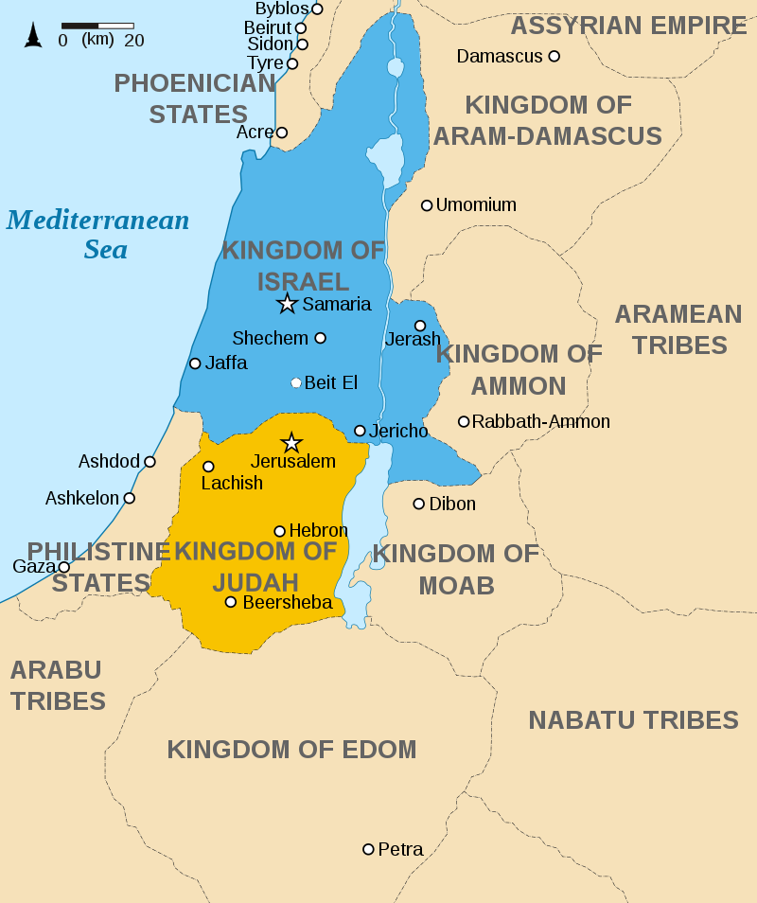
Izrael, Palestina
Exodus
Kanaán
12 kmenů
Pelištejci
Království Izrael (Saúl, David, Šalamoun)
Izrael a Judea (Samaří; Jeruzalém)
Cca 720 př. n. l. dobytí Izraele Assyřany
Vzpoura proti Babylónu → 586 dobytí Jeruzaléma Nabukadnezzarem II.
Babylónské zajetí, Kýrův edikt, znovuvybudování chrámu

Slide 4
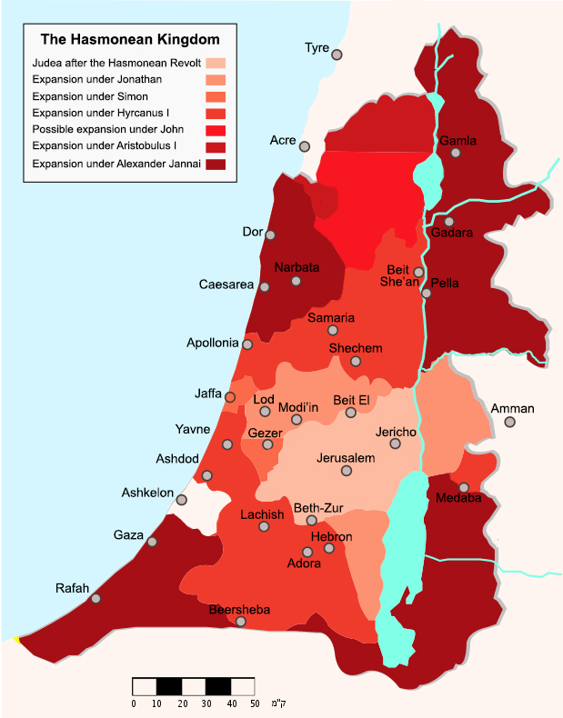
Judea
Pod nadvládou Peršanů
Alexandr
Seleukovci x Ptolemaiovci, syrské války
Šestá syrská válka – dobytí Seleukovci
Antiochos IV. Epifanés – hellenizace, vyplenění chrámu, zákaz židovské věrouky
Vzpoura Makkabejských
Hasmóneovské království
Království Héróda

Slide 5
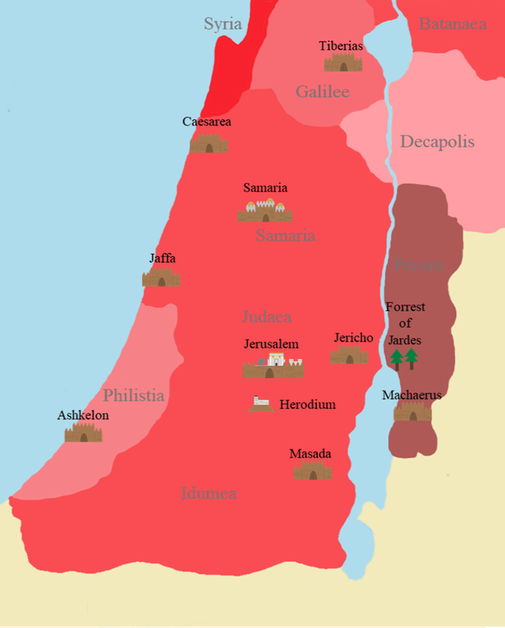
Judea
Zásahy Říma od 63 pnl
Vazal Říma
Diaspora
Proměna v provincii (správce prefectus, procurator, legatus)
První židovská válka – 66–73 nl, dobytí Jeruzaléma 70, zničení chrámu
Povstání Bar-Kochby – 132–135 nl, zákaz židovského náboženství, město Aelia Capitolina na místě Jeruzaléma, přejmenování provincie na Syria Palaestina
Rozdělení do 3 provincií za Diocletiana
Pokračující neshody Římané x Židé, později i křesťané x Židé

Slide 6
Hellenizace
Během nadvlády Ptolemaiovců, Seleukovců
Přijetí řeckých jmen, oděvu, jazyka, gymnasion, výuka
Část obyvatel, elita
Centra – Alexandrie (Egypt), Antiochie na Orontu
Překlad Starého zákona – Septuaginta, Nový zákon – koiné řečtina

Slide 7
Autoři
Vládci – Antigonos II. Mattathiás, kněží – Meneláos, Iásón
Aristobúlos z Alexandrie
Filón z Alexandrie – snaha o propojení řecké a židovské filosofie
Flavius Josephus – Židovské starožitnosti, Židovská válka
Apión – Proti Židům (část Dějin Egypta) x Josephus – Contra Apionem
Tacitus – Dějiny – 13 kapitol v páté knize
Apollónios Molón, Alexandr Polyhistor, Porfyrios, Kelsos (x Origenés)

Slide 8
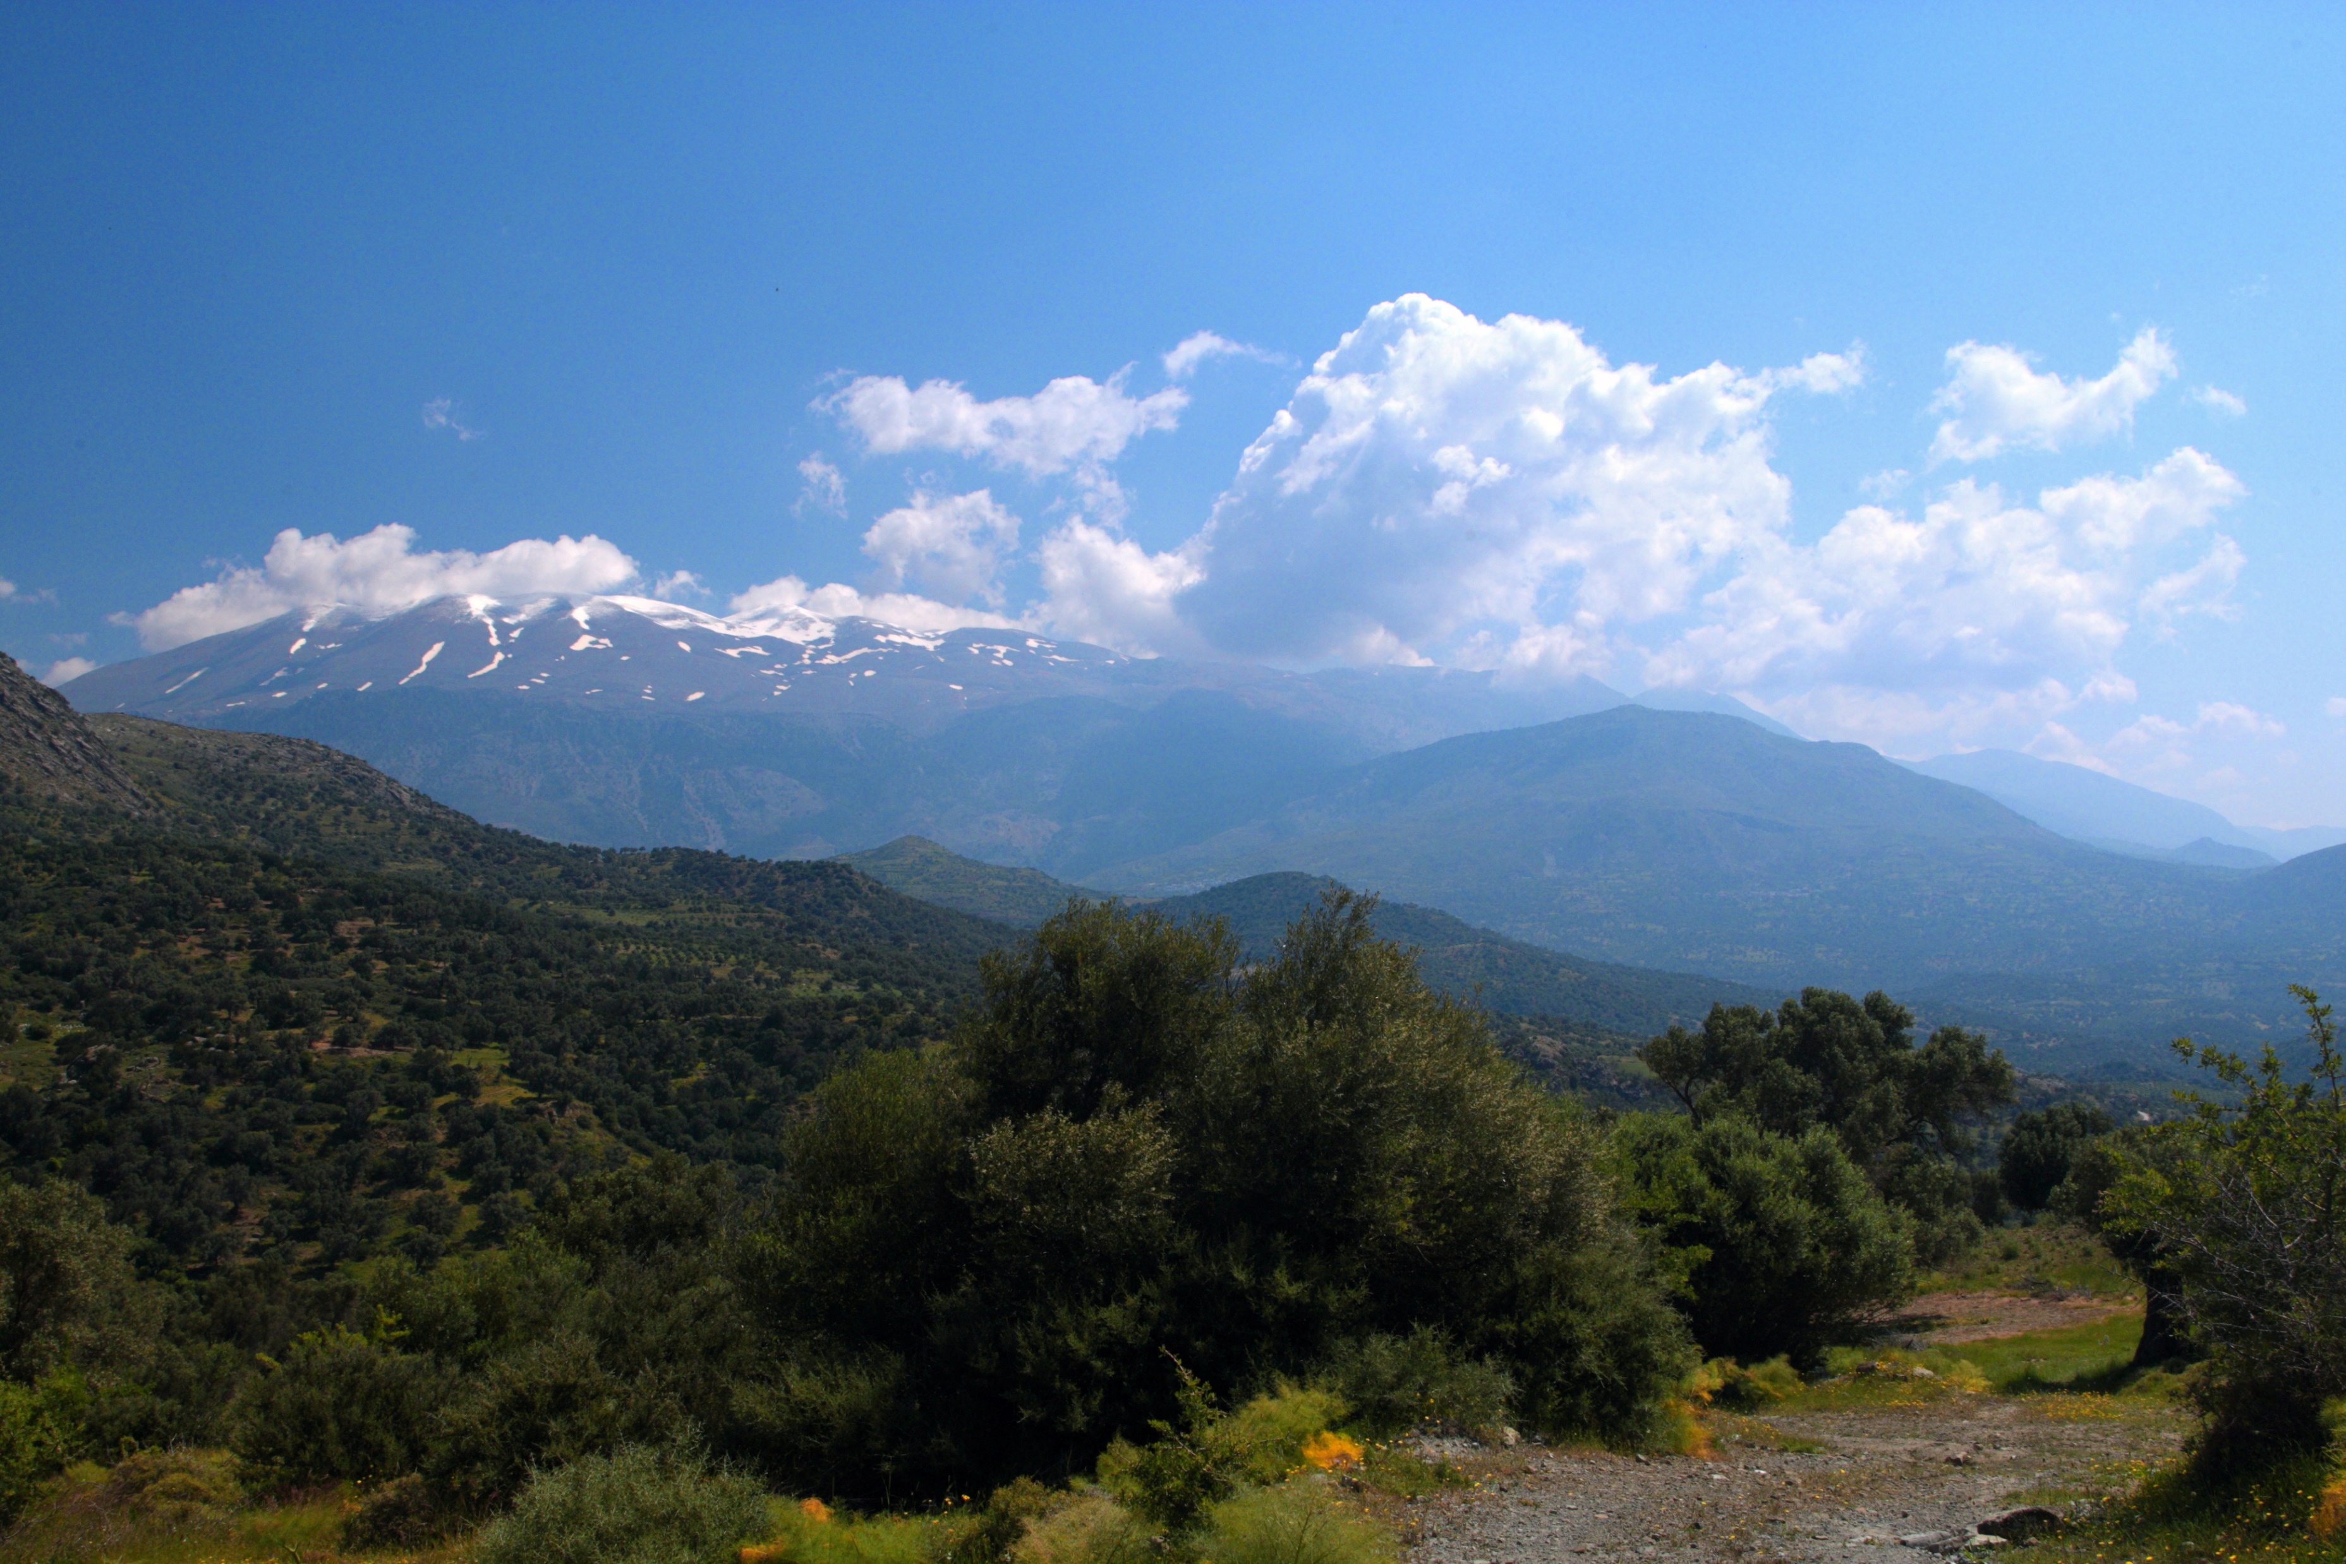
Dějiny - původ
Tacitus
Tac. Hist. 5.2
Z Kréty
Iudaeos Creta insula profugos novissima Libyae insedisse memorant, qua tempestate Saturnus vi Iovis pulsus cesserit regnis. Argumentum e nomine petitur: inclutum in Creta Idam montem, accolas Idaeos aucto in barbarum cognomento Iudaeos vocitari.
It is said that the Jews were originally exiles from the island of Crete who settled in the farthest parts of Libya at the time when Saturn had been deposed and expelled by Jove. An argument in favour of this is derived from the name: there is a famous mountain in Crete called Ida, and hence the inhabitants were called the Idaei, which was later lengthened into the barbarous form Iudaei.

Slide 9
Původ
Z Egypta
Tac. Hist. 5.2
Quidam regnante Iside exundantem per Aegyptum multitudinem ducibus Hierosolymo ac Iuda proximas in terras exoneratam; plerique Aethiopum prolem, quos rege Cepheo metus atque odium mutare sedis perpulerit.
Str. 16.2.35
μωσῆς γάρ τις τῶν Αἰγυπτίων ἱερέων ἔχων τι μέρος τῆς κάτω καλουμένης χώρας, ἀπῆρεν ἐκεῖσε ἐνθένδε δυσχεράνας τὰ καθεστῶτα, καὶ συνεξῆραν αὐτῷ πολλοὶ τιμῶντες τὸ θεῖον.
D.S. 40.3
Some hold that in the reign of Isis the superfluous population of Egypt, under the leader­ship of Hierosolymus and Iuda, discharged itself on the neighbouring lands; many others think that they were an Egyptian stock, which in the reign of Cepheus was forced to migrate by fear and hatred.
An Egyptian priest named Moses, who possessed a portion of the country called the Lower [Egypt] , being dissatisfied with the established institutions there, left it and came to Judæa with a large body of people who worshipped the Divinity.

Slide 10
Původ
Assýrie
Tac. Hist. 5.2
Sunt qui tradant Assyrios convenas, indigum agrorum populum, parte Aegypti potitos, mox proprias urbis Hebraeas- que terras et propiora Syriae coluisse.
Jos. Ant. 1.7.2 (Níkoláos z Damašku)
Ἁβράμης ἐβασίλευσεν ἔπηλυς σὺν στρατῷ ἀφιγμένος ἐκ τῆς γῆς τῆς ὑπὲρ Βαβυλῶνος Χαλδαίων λεγομένης.
Still others report that they were Assyrian refugees, a landless people, who first got control of a part of Egypt, then later they had their own cities and lived in the Hebrew territory and the nearer parts of Syria.
"Abram reigned at Damascus, being a foreigner, who came with an army out of the land above Babylon, called the land of the Chaldeans: …

Slide 11
Původ
Tac. Hist. 5.2
Solymové
Clara alii Iudaeorum initia, Solymos, carminibus Homeri celebratam gentem, conditae urbi Hierosolyma nomen e suo fecisse.
Still others say that the Jews are of illustrious origin, being the Solymi, a people celebrated in Homer's poems,​ who founded a city and gave it the name Hierosolyma, formed from their own.

Slide 12
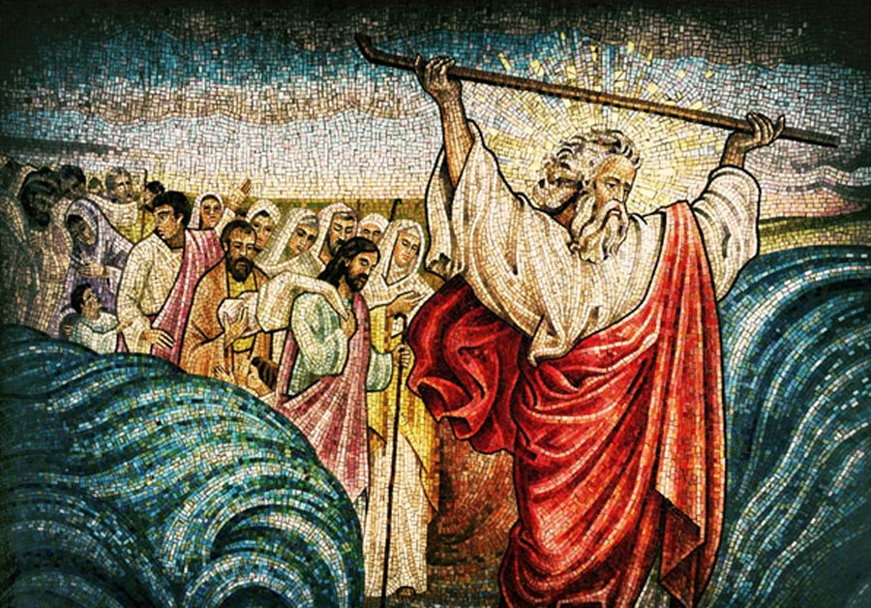
Exodus
Tac. Hist. 5.3
Plurimi auctores consentiunt orta per Aegyptum tabe quae corpora foedaret, regem Bocchorim adito Hammonis oraculo remedium petentem purgare regnum et id genus hominum ut invisum deis alias in terras avehere iussum. Sic conquisitum collectumque vulgus, postquam vastis locis relictum sit, ceteris per lacrimas torpentibus, Moysen unum exulum monuisse ne quam deorum hominumve opem expectarent utrisque deserti, sed sibimet duce caelesti crederent, primo cuius auxilio praesentis miserias pepulissent. Adsensere atque omnium ignari fortuitum iter incipiunt.
Jos. Ant. 2.13–16
Most authors agree that once during a plague in Egypt which caused bodily disfigurement, King Bocchoris​ approached the oracle of Ammon​ and asked for a remedy, whereupon he was told to purge his kingdom and to transport this race into other lands, since it was hateful to the gods. So the Hebrews were searched out and gathered together; then, being abandoned in the desert, while all others lay idle and weeping, one only of the exiles, Moses by name, warned them not to hope for help from gods or men, for they were deserted by both, but to trust to themselves, regarding as a guide sent from heaven the one whose assistance should first give them escape from their present distress. They agreed, and then set out on their journey in utter ignorance, but trusting to chance.

Slide 13
Další dějiny
Tac. Hist. 5.9–13 – židovská válka
Josephus Flavius
Níkoláos z Damašku
Diodóros Sicilský
Dión Kassios
Pasáže Starého zákona

Slide 14
Filosofové, mudrci
Clem. Alex. Strom. 1.15.72
Filosofové, citace Megasthena
Mojžíš (jako zákonodárce, zakladatel)
Tac. Hist. 5.3–4
Str. 16.2.35–36, 39
"All that was said about nature by the ancients is said also by those who philosophise beyond Greece: some things by the Brahmins among the Indians, and others by those called Jews in Syria."

Slide 15
Mojžíš
D.S. 40.3.3–4 (Hekataios z Abdér)
ἡγεῖτο δὲ τῆς ἀποικίας ὁ προσαγορευόμενος Μωσῆς, φρονήσει τε καὶ ἀνδρείᾳ πολὺ διαφέρων. οὗτος δὲ καταλαβόμενος τὴν χώραν ἄλλας τε πόλεις ἔκτισε καὶ τὴν νῦν οὖσαν ἐπιφανεστάτην, ὀνομαζομένην Ἱεροσόλυμα. ἱδρύσατο δὲ καὶ τὸ μάλιστα παρ' αὐτοῖς τιμώμενον ἱερόν, καὶ τὰς τιμὰς καὶ ἁγιστείας τοῦ θείου κατέδειξε, καὶ τὰ κατὰ τὴν πολιτείαν ἐνομοθέτησέ τε καὶ διέταξε. διεῖλε δὲ τὸ πλῆθος εἰς δώδεκα φυλὰς διὰ τὸ τὸν ἀριθμὸν τοῦτον τελειότατον νομίζεσθαι καὶ σύμφωνον εἶναι τῷ πλήθει τῶν μηνῶν τῶν τὸν ἐνιαυτὸν συμπληρούντων. 4 ἄγαλμα δὲ θεῶν τὸ σύνολον οὐ κατεσκεύασε διὰ τὸ μὴ νομίζειν ἀνθρωπόμορφον εἶναι τὸν θεόν, ἀλλὰ τὸν περιέχοντα τὴν γῆν οὐρανὸν μόνον εἶναι θεὸν καὶ τῶν ὅλων κύριον.
The leader of this colony was one Moses, a very wise and valiant man, who, after he had possessed himself of the country, amongst other cities, built that now most famous city, Jerusalem, and the temple there, which is so greatly revered among them. He instituted the holy rites and ceremonies with which they worship God; and made laws for the methodical government of the state. He also divided the people into twelve tribes, which he regarded as the most perfect number; because it corresponds to the twelve months within a whole year. 4 He made no representation or image of gods, because he considered that nothing of a human shape was applicable to God; but that heaven, which surrounds the earth, was the only God, and that all things were in its power.

Slide 16
Asociální, nepřátelé lidstva, všechny nenávidí
Tac. Hist. 5.3.1
et id genus hominum ut invisum deis alias in terras avehere iussum.
Jos. Ap. 2.34
Εἶτα Λυσίμαχοι καὶ Μόλωνες καὶ τοιοῦτοί τινες ἄλλοι συγγραφεῖς, ἀδόκιμοι σοφισταί, μειρακίων ἀπατεῶνες, ὡς πάνυ ἡμᾶς φαυλοτάτους ἀνθρώπων λοιδοροῦσιν.
and to transport this race into other lands, since it was hateful to the gods.
Yet do the Lysimachi and the Molones, and some other writers, [unskillful sophists as they are, and the deceivers of young men,] reproach us as the vilest of all mankind.

Slide 17
Jos. Ap. 2.15
ἄλλως τε καὶ τὴν κατηγορίαν ὁ Ἀπολλώνιος οὐκ ἀθρόαν ὥσπερ ὁ Ἀπίων ἔταξεν, ἀλλὰ σποράδην, καὶ δὴ εἴπας ποτὲ μὲν ὡς ἀθέους καὶ μισανθρώπους λοιδορεῖ …
Jos. Ap. 1.26
ὁ δὲ πρῶτον μὲν αὐτοῖς νόμον ἔθετο μήτε προσκυνεῖν θεοὺς μήτε τῶν μάλιστα ἐν Αἰγύπτῳ θεμιστευομένων ἱερῶν ζῴων ἀπέχεσθαι μηδενός, πάντα δὲ θύειν καὶ ἀναλοῦν, συνάπτεσθαι δὲ μηδενὶ πλὴν τῶν συνομωμοσμένων.
Moreover, since this Apollonius does not do like Apion, and lay a continued accusation against us, but does it only by starts, and up and clown his discourse, while he sometimes reproaches us as atheists, and man-haters, …
He (Osarséfos=Mojžíš) then, in the first place, made this law for them, That they should neither worship the Egyptian gods, nor should abstain from any one of those sacred animals which they have in the highest esteem, but kill and destroy them all; that they should join themselves to nobody but to those that were of this confederacy.

Slide 18
Jos. Ant. 13.8.3
τὸ ἔθνος διὰ τὴν πρὸς ἄλλους αὐτῶν τῆς διαίτης ἀμιξίαν οὐκ ἐφρόντιζεν,
D.S. 40.3.4
τὰς δὲ θυσίας ἐξηλλαγμένας συνεστήσατο τῶν παρὰ τοῖς ἄλλοις ἔθνεσι καὶ τὰς κατὰ τὸν βίον ἀγωγάς· διὰ γὰρ τὴν ἰδίαν ξενηλασίαν ἀπάνθρωπόν τινα καὶ μισόξενον βίον εἰσηγήσατο.
which was to others unsociable, and did not regard what they said.
But he so arranged the rites and ceremonies of the sacrifices, and the manner and nature of their customs, as that they should be wholly different from all other nations; for, as a result of the expulsion of his people, he introduced a most inhuman and unsociable manner of life.

Slide 19
D.S. 34.1.1
μόνους γὰρ ἁπάντων ἐθνῶν ἀκοινωνήτους εἶναι τῆς πρὸς ἄλλο ἔθνος ἐπιμιξίας καὶ πολεμίους ὑπολαμβάνειν πάντας. ἀπεδείκνυον δὲ καὶ τοὺς προγόνους αὐτῶν ὡς ἀσεβεῖς καὶ μισουμένους ὑπὸ τῶν θεῶν ἐξ ἁπάσης τῆς Αἰγύπτου πεφυγαδευμένους. τοὺς γὰρ ἀλφοὺς ἢ λέπρας ἔχοντας ἐν τοῖς σώμασι καθαρμοῦ χάριν ὡς ἐναγεῖς συναθροισθέντας ὑπερορίους ἐκβεβλῆσθαι· τοὺς δὲ ἐξορισθέντας καταλαβέσθαι μὲν τοὺς περὶ τὰ Ἱεροσόλυμα τόπους, συστησαμένους δὲ τὸ τῶν Ἰουδαίων ἔθνος παραδόσιμον ποιῆσαι τὸ μῖσος τὸ πρὸς τοὺς ἀνθρώπους· διὰ τοῦτο δὲ καὶ νόμιμα παντελῶς ἐξηλλαγμένα καταδεῖξαι, τὸ μηδενὶ ἄλλῳ ἔθνει τραπέζης κοινωνεῖν μηδ' εὐνοεῖν τὸ παράπαν.
for they only of all people hated to mix with any other nations, and treated them all as enemies. They suggested to him that the ancestors of the Jews were driven out of Egypt, as impious and hateful to the gods: for seeing that their bodies were infected with white marks and leprosy, by way of expiation the Egyptians gathered them all together, and expelled them out of their county, as profane and wicked wretches. After they were thus expelled, they settled around Jerusalem, and were afterwards united into one nation, called the nation of the Jews; but their hatred of all other men descended with their blood to their posterity. And therefore they made strange laws, and quite different from other people; they never will eat nor drink with any of other nations, or wish them any prosperity.

Slide 20
Tac. Hist. 5.5
et quia apud ipsos fides obstinata, misericordia in promptu, sed adversus omnis alios hostile odium. Separati epulis, discreti cubilibus, proiectissima ad libidinem gens, alienarum concubitu abstinent; inter se nihil inlicitum. Circumcidere genitalia instituerunt ut diversitate noscantur.
Také Jos. Ap. 2.11
again, the Jews are extremely loyal toward one another, and always ready to show compassion, but toward every other people they feel only hate and enmity. They sit apart at meals, and they sleep apart, and although as a race, they are prone to lust, they abstain from intercourse with foreign women; yet among themselves nothing is unlawful. They adopted circumcision to distinguish themselves from other peoples by this difference.

Slide 21
Orig. Cels. 5.41
Εἰ δ' ὥς τι σοφώτερον εἰδότες σεμνύνονταί τε καὶ τὴν ἄλλων κοινωνίαν <ὡς> οὐκ ἐξ ἴσου καθαρῶν ἀποστρέφονται,
Philostr. VA. 5.33
ἐκεῖνοι μὲν γὰρ πάλαι ἀφεστᾶσιν οὐ μόνον Ῥωμαίων, ἀλλὰ καὶ πάντων ἀνθρώπων: οἱ γὰρ βίον ἄμικτον εὑρόντες καὶ οἷς μήτε κοινὴ πρὸς ἀνθρώπους τράπεζα μήτε σπονδαὶ μήτε εὐχαὶ μήτε θυσίαι, πλέον ἀφεστᾶσιν ἡμῶν ἢ Σοῦσα καὶ Βάκτρα καὶ οἱ ὑπὲρ ταῦτα Ἰνδοί:
And if they pride themselves on it, as being possessed of superior wisdom, and keep aloof from intercourse with others, as not being equally pure with themselves,
For the Jews have long been in revolt not only against the Romans, but against humanity; and a race that has made its own a life apart and irreconcilable, that cannot share with the rest of mankind in the pleasures of the table nor join in their libations or prayers or sacrifices, are separated from ourselves by a greater gulf than divides us from Susa or Bactra or the more distant Indies.

Slide 22
Synésios
Syn. Ep. 4
ὑπὲρ ἥμισυ μὲν καὶ ὁ κυβερνήτης ἦσαν Ἰουδαῖοι, γένος ἔκσπονδον καὶ εὐσεβεῖν ἀναπεπεισμένον ἢν ὅτι πλείστους ἄνδρας Ἕλληνας ἀποθανεῖν αἴτιοι γένωνται
More than half of them, including the skipper, were Jews - a graceless race and fully convinced of the piety of sending to Hades as many Greeks as possible.

Slide 23
Náboženství
Tac. Hist. 5.4.1
Moyses quo sibi in posterum gentem firmaret, novos ritus contrariosque ceteris mortalibus indidit. Profana illic omnia quae apud nos sacra, rursum concessa apud illos quae nobis incesta.
Lýdos – debaty o povaze židovského boha – Lyd. De Mens. 4.53
Ἰαὼ (Iaó), Σαβαώθ (Sabaóth), Kronos/Saturn
To establish his influence over this people for all time, Moses introduced new religious practices, quite opposed to those of all other religions. The Jews regard as profane all that we hold sacred; on the other hand, they permit all that we abhor.
But Livy asserts in his general Roman history that the god worshipped there is unknown.​ Following him, Lucan says that the temple in Jerusalem belongs to an "obscure/unseen"​ god.​ And Numenius says that he is "incommunicable/unique,"​ and the father of all the gods, who does not consider it worthy for any to share in his honor.

Slide 24
Bůh – D.S. 1.94
παρὰ δὲ τοῖς Ἰουδαίοις Μωυσῆν τὸν Ἰαὼ ἐπικαλούμενον θεόν,
C.D. 37.17.2
κεχωρίδαται δὲ ἀπὸ τῶν λοιπῶν ἀνθρώπων ἔς τε τἆλλα τὰ περὶ τὴν δίαιταν πάνθ᾽ ὡς εἰπεῖν, καὶ μάλισθ᾽ ὅτι τῶν μὲν ἄλλων θεῶν οὐδένα τιμῶσιν, ἕνα δέ τινα ἰσχυρῶς σέβουσιν. οὐδ᾽ ἄγαλμα οὐδὲν οὐδ᾽ ἐν αὐτοῖς ποτε τοῖς Ἱεροσολύμοις ἔσχον, ἄρρητον δὲ δὴ καὶ ἀειδῆ αὐτὸν νομίζοντες εἶναι περισσότατα ἀνθρώπων θρησκεύουσι.
and among the Jews Moyses referred his laws to the god who is invoked as Iao.
They are distinguished from the rest of mankind in practically every detail of life, and especially by the fact that they do not honour any of the usual gods, but show extreme reverence for one particular divinity. They never had any statue of him even in Jerusalem itself, but believing him to be unnamable and invisible, they worship him in the most extravagant fashion on earth.

Slide 25
Tac. Hist. 5.5
Iudaei mente sola unumque numen intellegunt: profanos qui deum imagines mortalibus materiis in species hominum effingant; summum illud et aeternum neque imitabile neque interiturum. Igitur nulla simulacra urbibus suis, nedum templis sistunt; non regibus haec adulatio, non Caesaribus honor.
the Jews conceive of one god only, and that with the mind alone: they regard as impious those who make from perishable materials representations of gods in man's image; that supreme and eternal being is to them incapable of representation and without end. Therefore they set up no statues in their cities, still less in their temples; this flattery is not paid their kings, nor this honour given to the Caesars.

Slide 26
superstitio
Tac. Hist. 5.8
rex Antiochus demere superstitionem et mores Graecorum dare adnisus
fratrum coniugum parentum neces aliaque solita regibus ausi superstitionem fovebant, quia honor sacerdotii firmamentum potentiae adsumebatur.
5.13
Evenerant prodigia, quae neque hostiis neque votis piare fas habet gens superstitioni obnoxia, religionibus adversa.
King Antiochus endeavoured to abolish Jewish superstition and to introduce Greek civilization
killed brothers, wives, and parents, and dared essay every other kind of royal crime without hesitation; but they fostered the national superstition, for they had assumed the priesthood to support their civil authority.
Prodigies had indeed occurred, but to avert them either by victims or by vows is held unlawful by a people which, though prone to superstition, is opposed to all propitiatory rites.

Slide 27
Superstitio
Cic. Flacc. 67
huic autem barbarae superstitioni resistere severitatis, multitudinem Iudaeorum flagrantem non numquam in contionibus pro re publica contemnere gravitatis summae fuit.
Plut. De Stoic. 38
ὅρα γὰρ οἷα: Ἰουδαῖοι καὶ Σύροι περὶ θεῶν φρονοῦσιν, ὅρα τὰ τῶν ποιητῶν πόσης ἐμπέπλησται δεισιδαιμονίας.
But to resist this barbarous superstition were an act of dignity, to despise the multitude of Jews, which at times was most unruly in the assemblies in defence of the interests of the republic, was an act of the greatest wisdom.
For see what the Jews and Syrians think of the Gods; see also with how much superstition the poets are filled.

Slide 28
Zvyky - Šabat
Plu. De Super. 8
ἀλλ’ Ἰουδαῖοι σαββάτων ὄντων ἐν ἀγνάμπτοις​ καθεζόμενοι, τῶν πολεμίων κλίμακας προστιθέντων καὶ τὰ τείχη καταλαμβανόντων, οὐκ ἀνέστησαν ἀλλ’ ἔμειναν ὥσπερ ἐν σαγήνῃ μιᾷ τῇ δεισιδαιμονίᾳ συνδεδεμένοι.
Jos. Ant. 12.6.2
C.D. 37.16; 49.22
καὶ οὕτως ἑάλωσάν τε ἐν τῇ τοῦ Κρόνου ἡμέρᾳ μηδ᾽ ἀμυνόμενοι
But the Jews,​ because it was the Sabbath day, sat in their places immovable, while the enemy were planting ladders against the walls and capturing the defences, and they did not get up, but remained there, fast bound in the toils of superstition as in one great net.
Thus the defenders were captured on the day of Saturn, without making any defence

Slide 29
Šabat
Aug. De Civ. 6.11
Hic inter alias ciuilis theologiae superstitiones reprehendit etiam sacramenta Iudaeorum et maxime sabbata, inutiliter eos facere adfirmans, quod per illos singulos septenis interpositos dies septimam fere partem aetatis suae perdant uacando et multa in tempore urgentia non agendo laedantur.
Seneca, among the other superstitions of civil theology, also found fault with the sacred things of the Jews, and especially the sabbaths, affirming that they act uselessly in keeping those seventh days, whereby they lose through idleness about the seventh part of their life, and also many things which demand immediate attention are damaged.

Slide 30
ŠABAT
Tac. Hist. 5.4.3
Septimo die otium placuisse ferunt, quia is finem laborum tulerit; dein blandiente inertia septimum quoque annum ignaviae datum. Alii honorem eum Saturno haberi, …
Pl. NH. 31.24
in Iudaea rivus sabbatis omnibus siccatur.
They say that they first chose to rest on the seventh day because that day ended their toils; but after a time they were led by the charms of indolence to give over the seventh year as well to inactivity.​ Others say that this is done in honour of Saturn,
In Judæa there is a river that is dry every Sabbath day.

Slide 31
Šabat
Just. 36.2.14
Itaque Moyses Damascena, antiqua patria, repetita montem Sinam occupat, in quo septem dierum ieiunio per deserta Arabiae cum populo suo fatigatus cum tandem uenisset, septimum diem more gentis Sabbata appellatum in omne aeuum ieiunio sacrauit, quoniam illa dies famem illis erroremque finierat.
Jos. CAp. 2.21 – původ názvu
and Moses, having reached Damascus, the birth-place of his forefathers, took possession of mount Sinai, on his arrival at which, after having suffered, together with his followers, from a seven days' fast in the deserts of Arabia, he consecrated every seventh day (according to the present custom of the nation) for a fast-day, and to be perpetually called a sabbath, because that day had ended at once their hunger and their wanderings.

Slide 32
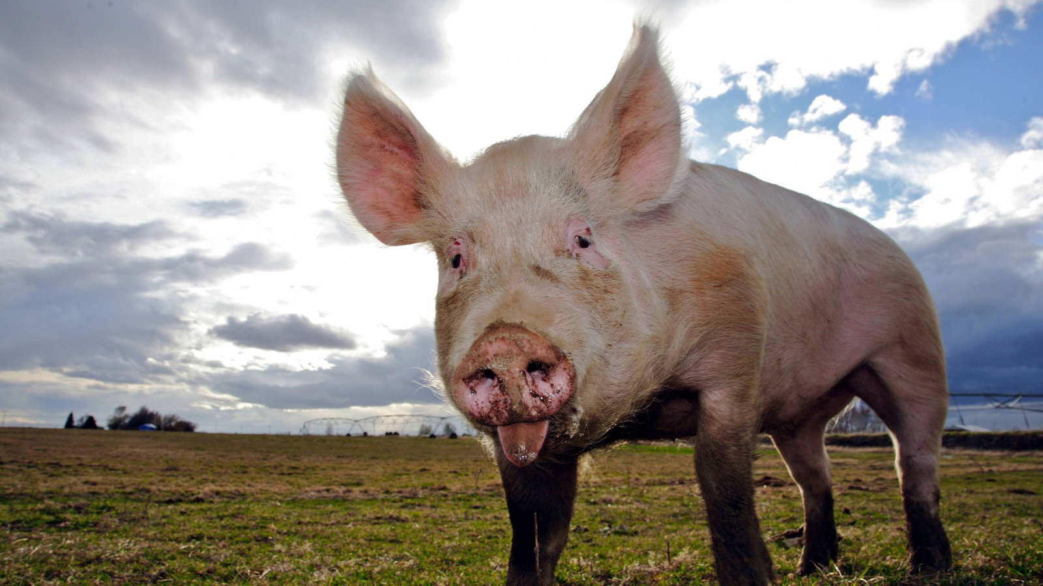
vepřové
Tac. Hist. 5.4
Sue abstinent memoria cladis, quod ipsos scabies quondam turpaverat, cui id animal obnoxium. Longam olim famem crebris adhuc ieiuniis fatentur, et raptarum frugum argumentum panis Iudaicus nullo fermento detinetur.
They abstain from pork, in recollection of a plague, for the scab to which this animal is subject once afflicted them. By frequent fasts even now they bear witness to the long hunger with which they were once distressed, and the unleavened Jewish bread is still employed in memory of the haste with which they seized the grain.

Slide 33
vepřové
Petr. Poem, 24
Iudaeus licet et porcinum numen adoret et caeli summas advocet auriculas, ni tamen et ferro succiderit inguinis oram et nisi nodatum solverit arte caput, exemptus populo sacra migrabit ab urbe et non ieiuna sabbata lege premet.
Juv. Sat. 6.159–160
obseruant ubi festa mero pede sabbata reges et uetus indulget senibus clementia porcis.
The Jew may worship his pig-god and clamour in the ears of high heaven, but unless he also cuts back his foreskin with the knife, he shall go forth from the holy city cast forth from the people, and transgress the sabbath by breaking the law of fasting.
Where barefoot kings observe their day of rest on the Sabbath,
And their tradition grants merciful indulgence to elderly pigs.

Slide 34
vepřové
Plut. Quaes. Conv. 4.5
πότερον οἱ ἄνδρες τιμῇ τινι τῶν ὑῶν ἢ μυσαττόμενοι τὸ ζῷον ἀπέχονται τῆς βρώσεως αὐτοῦ: τὰ γὰρ παρ᾽ ἐκείνοις λεγόμενα μύθοις ἔοικεν, εἰ μή τινας ἄρα λόγους σπουδαίους ἔχοντες οὐκ ἐκφέρουσιν.’
οἶμαι δὲ καὶ τοὺς Ἰουδαίους, εἴπερ ἐβδελύττοντο τὴν ὗν, ἀποκτείνειν ἄν, ὥσπερ οἱ μάγοι τοὺς μῦς ἀποκτείνουσι: νῦν δ᾽ ὁμοίως τῷ φαγεῖν τὸ ἀνελεῖν ἀπόρρητόν ἐστιν αὐτοῖς.
τὸ δ᾽ ὕειον κρέας οἱ ἄνδρες ἀφοσιοῦσθαι δοκοῦσιν, ὅτι μάλιστα ... οἱ βάρβαροι τὰς ἐπιλευκίας καὶ λέπρας δυσχεραίνουσι, καὶ τῇ προσβολῇ τὰ τοιαῦτα καταβόσκεσθαι πάθη τοὺς ἀνθρώπους οἴονται.
for that is a thing I very much question, whether it was that the Jews abstained from swine's flesh because they conferred divine honor upon that creature, or because they had a natural aversion to it. For whatever we find in their own writings seems to be altogether fabulous, except they have some more solid reasons which they have no mind to discover.
But I should think that if the Jews had such an antipathy against a hog, they would kill it as the magicians do mice; when, on the contrary, they are by their religion as much prohibited to kill as to eat it.
But the Jews do hate swine's flesh, because all the barbarians are naturally fearful of a scab and leprosy, which they presume comes by eating such kind of flesh.

Slide 35
obřízka
Hor. Sat. 1.9.68–70
memini bene, sed meliore tempore dicam; hodie tricensima sabbata: vin tu curtis Iudaeis oppedere?‘
Mart. 7.30
Nec recutitorum fugis inguina Iudaeorum
Petr. 102
inquit Giton, etiam circumcide nos, ut Iudaei videamur
Yes I remember, I’ll tell you at some more convenient time: it’s the thirtieth Sabbath: do you want to offend the circumcised Jews?’
nor do you shun the embraces of circumcised Jews
“Oh! yes,” said Giton, “and please circumcise us too, so that we look like Jews

Slide 36
obřízka
Phil. Spec. Leg. 1.1–2
and we will begin with that which is turned into ridicule by people in general. (2) The ordinance of circumcision of the parts of generation is ridiculed, though it is an act which is practised to no slight degree among other nations also, and most especially by the Egyptians, who appear to me to be the most populous of all nations, and the most abounding in all kinds of wisdom.

Slide 37
obřízka
SHA Hadrian 14.2
Moverunt ea tempestate et Iudaei bellum, quod vetabantur mutilare genitalia.
Str. 16.2.37
ἔπειτ᾽ ἐφισταμένων ἐπὶ τὴν ἱερωσύνην τὸ μὲν πρῶτον δεισιδαιμόνων, ἔπειτα τυραννικῶν ἀνθρώπων, ἐκ μὲν τῆς δεισιδαιμονίας αἱ τῶν βρωμάτων ἀποσχέσεις, ὧνπερ καὶ νῦν ἔθος ἐστὶν αὐτοῖς ἀπέχεσθαι, καὶ αἱ περιτομαὶ καὶ αἱ ἐκτομαὶ καὶ εἴ τινα τοιαῦτα ἐνομίσθη, ἐκ δὲ τῶν τυραννίδων τὰ λῃστήρια.
At this time also the Jews began war, because they were forbidden to practice circumcision.
Afterwards superstitious persons were appointed to the priesthood, and then tyrants. From superstition arose abstinence from flesh, from the eating of which it is now the custom to refrain, circumcision, excision, and other practices which the people observe. The tyrannical government produced robbery;

Slide 38
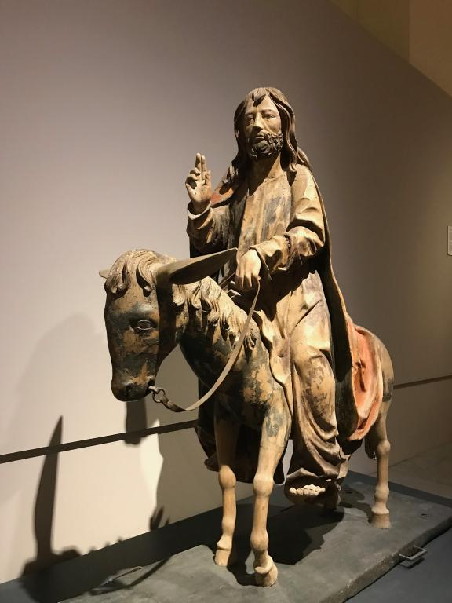
Socha v chrámu
Tac. Hist. 5.4.2
Effigiem animalis, quo monstrante errorem sitimque depulerant, penetrali sacravere, caeso ariete velut in contumeliam Hammonis;
D.S. 34.1.3
εὑρὼν δὲ ἐν αὐτῷ λίθινον ἄγαλμα ἀνδρὸς βαθυπώγωνος καθήμενον ἐπ' ὄνου, μετὰ χεῖρας ἔχον βιβλίον, τοῦτο μὲν ὑπέλαβε Μωυσέως εἶναι τοῦ κτίσαντος τὰ Ἱεροσόλυμα καὶ συστησαμένου τὸ ἔθνος,
They dedicated, in a shrine, a statue of that creature whose guidance enabled them to put an end to their wandering and thirst,​ sacrificing a ram, apparently in derision of Ammon.​ (osel)
When he found in there the image of a man with a long beard, carved in stone sitting upon an ass, he took it to be Moses, who built Jerusalem and brought the nation together,

Slide 39
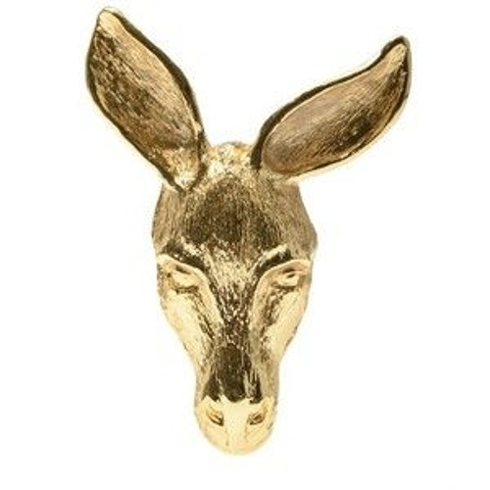
Uctívání osla
Jos. CAp. 2.7
in hoc enim sacrario Apion praesumpsit edicere asini caput collocasse Iudaeos et eum colere ac dignum facere tanta religione, et hoc affirmat fuisse depalatum, dum Antiochus Epiphanes expoliasset templum et illud caput inuentum ex auro compositum multis pecuniis dignum.
X Tac. Hist. 5.5.4 (žádná socha), C.D. 37.17.2, Lýdos 4.53
For Apion hath the impudence to pretend, that „The Jews placed an asse’s head in their holy place.” And he affirms, that “this was discovered when Antiochus Epiphanes spoiled our temple; and found that asse’s head there made of gold; and worth a great deal of money.”

Slide 40
Konvertité (prosylétismus)
Tac. Hist. 5.5.3
Transgressi in morem eorum idem usurpant, nec quicquam prius imbuuntur quam contemnere deos, exuere patriam, parentes liberos fratres vilia habere.
5.5.1
Nam pessimus quisque spretis religionibus patriis tributa et stipes illuc congerebant, unde auctae Iudaeorum res,
C.D. 57.18.5a
τῶν τε Ἰουδαίων πολλῶν ἐς τὴν Ῥώμην συνελθόντων καὶ συχνοὺς τῶν ἐπιχωρίων ἐς τὰ σφέτερα ἔθη μεθιστάντων, τοὺς πλείονας ἐξήλασεν.
Those who are converted to their ways follow the same practice, and the earliest lesson they receive is to despise the gods, to disown their country, and to regard their parents, children, and brothers as of little account.
For the worst rascals among other peoples,​ renouncing their ancestral religions, always kept sending tribute and contributions to Jerusalem, thereby increasing the wealth of the Jews;
As the Jews flocked to Rome in great numbers and were converting many of the natives to their ways, he banished most of them.

Slide 41
žebráci
Juv. Sat. 3.10–16
(nunc sacri fontis nemus et delubra locantur Iudaeis, quorum cophinus fenumque supellex; omnis enim populo mercedem pendere iussa est arbor et eiectis mendicat silva Camenis),
6.542–547
cophino fenoque relicto arcanam Iudaea tremens mendicat in aurem…
Mart. 12.57.13
A matre doctus nec rogare Iudaeus,
The grove and shrine of the sacred fount are rented out To the Jews, who’re equipped with straw-lined baskets; Since the grove has been ordered to pay the nation rent, The Muses have been ejected, and the trees go begging.
No sooner does he give way, than a palsied Jewess will leave Her hay-lined begging-basket to mutter her requests in an ear.
nor the Jew boy, brought up to begging by his mother

Slide 42
Lidské oběti, kanibalismus
Jos. CAp. 2.8
… ac postremum consulentem a ministris ad se accedentibus audisse legem ineffabilem Iudaeorum, pro qua nutriebatur, et hoc illos facere singulis annis quodam tempore constituto. et compraehendere quidem Graecum peregrinum eumque annali tempore saginare et deductum ad quandam siluam occidere quidem eum hominem eiusque corpus sacrificare secundum suas sollemnitates et gustare ex eius uisceribus et iusiurandum facere in immolatione Graeci, ut inimicitias contra Graecos haberent, et tunc in quandam foueam reliqua hominis pereuntis abicere. …
… that at last he inquired of the servants that came to him and was by them informed that it was in order to the fulfilling a law of the Jews, which they must not tell him, that he was thus fed; and that they did the same at a set time every year: that they used to catch a Greek foreigner, and fat him thus up every year, and then lead him to a certain wood, and kill him, and sacrifice with their accustomed solemnities, and taste of his entrails, and take an oath upon this sacrificing a Greek, that they would ever be at enmity with the Greeks; and that then they threw the remaining parts of the miserable wretch into a certain pit. …

Slide 43
Lidské oběti, kanibalismus
C.D. 68.32.1
τούς τε Ῥωμαίους καὶ τοὺς Ἕλληνας ἔφθειρον, καὶ τάς τε σάρκας αὐτῶν ἐσιτοῦντο καὶ τὰ ἔντερα ἀνεδοῦντο τῷ τε αἵματι ἠλείφοντο καὶ τὰ ἀπολέμματα ἐνεδύοντο, πολλοὺς δὲ καὶ μέσους ἀπὸ κορυφῆς διέπριον: θηρίοις ἑτέρους ἐδίδοσαν, καὶ μονομαχεῖν ἄλλους ἠνάγκαζον, ὥστε τὰς πάσας δύο καὶ εἴκοσι μυριάδας ἀπολέσθαι.
They would eat the flesh of their victims, make belts for themselves of their entrails, anoint themselves with their blood and wear their skins for clothing; many they sawed in two, from the head downwards; others they gave to wild beasts, and still others they forced to fight as gladiators. In all two hundred and twenty thousand persons perished.

Slide 44
Dámokritos, O Židech (Súda)
Ἰούδας καὶ Ἰουδαῖος. ὅτι Δαμόκριτος ἱστορικὸς περὶ Ἰουδαίων φησί: χρυσῆν ὄνου κεφαλὴν προσεκύνουν καὶ κατὰ τριετίαν ξένον ἀγρεύοντες προσέφερον καὶ κατὰ λεπτὰ τὰς σάρκας διέξαινον καὶ οὕτως ἀνῄρουν.
Concerning the Jews, the historian Damocritus says that they used to worship the golden head of an ass, and every three years they hunted and attacked a stranger. They tore his flesh into thin strips and in this manner they killed him.

Slide 45
Žádný přínos pro lidstvo
Jos. CAp. 2.13
Ἀλλὰ θαυμαστοὺς ἄνδρας οὐ παρεσχήκαμεν οἷον τεχνῶν τινων εὑρετὰς ἢ σοφίᾳ διαφέροντας, …
Jos. CAp. 2.15
λέγει δὲ καὶ ἀφυεστάτους εἶναι τῶν βαρβάρων καὶ διὰ τοῦτο μηδὲν εἰς τὸν βίον εὕρημα συμβεβλῆσθαι μόνους.
But," says Apion, "we Jews have not had any wonderful men amongst us, not any inventors of arts, nor any eminent for wisdom. …
he says that we are the weakest of all the barbarians, and that this is the reason why we are the only people who have made no improvements in human life

Slide 46
Orig. Cels. 1.16
… ὁ Κέλσος, τοὺς δὲ Ἰουδαίους οὐκ ἠξίωσεν οὔτε εἰς σοφοὺς παραδέξασθαι οὔτε εἰς ἀρχαίους·
Orig. Cels. 4.31
φησιν Ἰουδαίους ἀπ' Αἰγύπτου δραπέτας γεγονέναι, μηδὲν πώποτε ἀξιόλογον πράξαντας, οὔτ' ἐν λόγῳ οὔτ' ἐν ἀριθμῷ αὐτούς ποτε γεγενημένους.
(Kelsos) among the most ancient and learned nations, and should not deem the Jews worthy of a place among such, either for their learning or their antiquity,
Dále vynechání Mojžíše ze seznamu významných osob/učenců
he asserts that the Jews „were fugitives from Egypt, who never performed anything worthy of note, and never were held in any reputation or account.“

Slide 47
Jul. Contra Gal. 176
πάντων δὲ ἐθνῶν κηδόμενος ἔδωκεν ἐκείνοις μὲν οὐδὲν σπουδαῖον ἢ μέγα, ἡμῖν δὲ μακρῷ κρείττονα καὶ διαφέροντα, σκοπεῖτε λοιπὸν τὸ ἐντεῦθεν.
Furthermore observe from what follows that God did not take thought for the Hebrews alone, but though he cared for all nations, he bestowed on the Hebrews nothing considerable or of great value, whereas on us he bestowed gifts far higher and surpassing theirs.

Slide 48
Vyhlazení, zničení
Sulpicius Severus Chron. 2.30.7
at contra alii et Titus ipse evertendum in primis templum censebant, quo plenius Iudaeorum et Christianorum religio tolleretur; quippe has religiones, licet contrarias sibi, isdem tamen ab auctoribus profectas; Christianos ex Iudaeis exstitisse; radice sublata stirpem facile perituram.
But on the opposite side, others and Titus himself thought that the temple ought specially to be overthrown, in order that the religion of the Jews and of the Christians might more thoroughly be subverted; for that these religions, although contrary to each other, had nevertheless proceeded from the same authors; that the Christians had sprung up from among the Jews; and that, if the root were extirpated, the offshoot would speedily perish.

Slide 49
D.S. 34.1
Ὡς Ἀντίοχος ὁ βασιλεύς, φησίν, ἐπολιόρκει τὰ Ἱεροσόλυμα, οἱ δὲ Ἰουδαῖοι μέχρι μέν τινος ἀντέσχον, ἐξαναλωθέντων δὲ τῶν ἐπιτηδείων ἁπάντων ἠναγκάσθησαν περὶ διαλύσεως διαπρεσβεύσασθαι. οἱ δὲ πλείους αὐτῷ τῶν φίλων συνεβούλευον κατὰ κράτος αἱρήσειν τὴν πόλιν καὶ τὸ γένος ἄρδην ἀνελεῖν τῶν Ἰουδαίων· μόνους γὰρ ἁπάντων ἐθνῶν ἀκοινωνήτους εἶναι τῆς πρὸς ἄλλο ἔθνος ἐπιμιξίας καὶ πολεμίους ὑπολαμβάνειν πάντας. ἀπεδείκνυον δὲ καὶ τοὺς προγόνους αὐτῶν ὡς ἀσεβεῖς καὶ μισουμένους ὑπὸ τῶν θεῶν ἐξ ἁπάσης τῆς Αἰγύπτου πεφυγαδευμένους.
King Antiochus besieged Jerusalem. The Jews withstood the siege for some time; but when all their provisions were used up, they were forced to send ambassadors to him, to seek terms for a truce. Many of his friends urged him to storm the city, and to root out the whole nation of the Jews; for they only of all people hated to mix with any other nations, and treated them all as enemies. They suggested to him that the ancestors of the Jews were driven out of Egypt, as impious and hateful to the gods

Slide 50
he took it to be Moses, who built Jerusalem and brought the nation together, and who established by law all their wicked customs and practices, abounding in hatred and enmity to all other men. Antiochus therefore, abhorring their antagonism to all other people, tried his utmost to abolish their laws. 4 To that end he sacrificed a great swine at the image of Moses, and at the altar of God that stood in the outward court, and sprinkled them with the blood of the sacrifice. He commanded likewise that the books, by which they were taught to hate all other nations, should be sprinkled with the broth made of the swine's flesh. And he put out the lamp (called by them immortal) which burns continually in the temple. Lastly he forced the high priest and the other Jews to eat swine's flesh.
οῦτο μὲν ὑπέλαβε Μωυσέως εἶναι τοῦ κτίσαντος τὰ Ἱεροσόλυμα καὶ συστησαμένου τὸ ἔθνος, πρὸς δὲ τούτοις νομοθετήσαντος τὰ μισάνθρωπα καὶ παράνομα ἔθη τοῖς Ἰουδαίοις· αὐτὸς δὲ στυγήσας τὴν μισανθρωπίαν πάντων ἐθνῶν ἐφιλοτιμήθη καταλῦσαι τὰ νόμιμα. 4 διὸ τῷ ἀγάλματι τοῦ κτίστου καὶ τῷ ὑπαίθρῳ βωμῷ τοῦ θεοῦ μεγάλην ὗν θύσας, τό τε αἷμα προσέχεεν αὐτοῖς, καὶ τὰ κρέα σκευάσας προσέταξε τῷ μὲν ἀπὸ τούτων ζωμῷ τὰς ἱερὰς αὐτῶν βίβλους καὶ περιεχούσας τὰ μισόξενα νόμιμα καταρρᾶναι, τὸν δὲ ἀθάνατον λεγόμενον παρ' αὐτοῖς λύχνον καὶ καιόμενον ἀδιαλείπτως ἐν τῷ ναῷ κατασβέσαι, τῶν τε κρεῶν ἀναγκάσαι προσενέγκασθαι τὸν ἀρχιερέα καὶ τοὺς ἄλλους Ἰουδαίους.

Slide 51
Jos. Ant. 13.8.2
ὁ δὲ ἀπωσάμενος τὴν ἐπιβουλὴν τῶν μὲν παραινούντων ἐξελεῖν τὸ ἔθνος διὰ τὴν πρὸς ἄλλους αὐτῶν τῆς διαίτης ἀμιξίαν οὐκ ἐφρόντιζεν, …
Súda – Atasthala (Arriános, Parthika)
ὁ δὲ Τραϊανὸς ἔγνω μὲν, εἰ παρείκοι, ἐξελεῖν τὸ ἔθνος: εἰ δὲ μὴ, ἀλλὰ συντρίψας γε παῦσαι τῆς ἄγαν ἀτασθαλίας.
So he rejected the counsel of those that would have him utterly destroy the nation, by reason of their way of living, which was to others unsociable, …
"Trajan decided, if it was possible, that he should remove the tribe; but if not, that he should crush them and put an end to their exceeding recklessness."

Slide 52
Různé poznámky
Juv. Sat. 14.96–106
quidam sortiti metuentem sabbata patrem nil praeter nubes et caeli numen adorant, nec distare putant humana carne suillam, qua pater abstinuit, mox et praeputia ponunt; Romanas autem soliti contemnere leges Iudaicum ediscunt et seruant ac metuunt ius, tradidit arcano quodcumque uolumine Moyses: non monstrare uias eadem nisi sacra colenti, quaesitum ad fontem solos deducere uerpos. sed pater in causa, cui septima quaeque fuit lux ignaua et partem uitae non attigit ullam.
Then there are those that, blessed with a father who Reveres the Sabbath, worship only the clouds in the sky And its spirit, who draw no distinction between the pork From which their father had to abstain, and human flesh, And who swiftly rid themselves of even their foreskins. It’s their custom to ignore the laws of Rome, the Judaic Code being that which they study, adhere to, and revere; The Pentateuch, the mystic scroll handed down by Moses: Nor do they reveal the way to anyone but a fellow-believer; Leading only the circumcised, when asked, to the fountain. It’s the father that’s to blame, treating every seventh day As a day of idleness, separate from the rest of daily life.

Slide 53
Rutilius Namatianus, de Reditu suo 1.387–398
reddimus obscaenae convicia debita genti
quae genitale caput propudiosa metit:
radix stultitiae, cui frigida sabbata cordi,
sed cor frigidius religione sua.
septima quaeque dies turpi damnata veterno,
tamquam lassati mollis imago dei.
cetera mendacis deliramenta catastae
nec puerum in somnis​ credere posse reor.
atque utinam numquam Iudaea subacta​ fuisset
Pompeii bellis imperiisque​ Titi!
latius excisae pestis contagia serpunt,
victoresque suos natio victa premit.
We pay the abuse due to the filthy race that infamously practises circumcision: a root of silliness they are: chill Sabbaths are after their own heart, yet their heart is chillier than their creed. Each seventh day is condemned to ignoble sloth, as 'twere an effeminate picture of a god fatigued.​ The other wild ravings from their lying bazaar methinks not even a child in his sleep could believe. And would that Judaea had never been subdued by Pompey's wars and Titus' military power.​ The infection of this plague, though excised, still creeps abroad the more: and 'tis their own conquerors that a conquered race keeps down

Slide 54
křesťanství
Suet. Cl. 25.4
Iudaeos impulsore Chresto assidue tumultuantis Roma expulit.
Since the Jews constantly made disturbances at the instigation of Chrestus,​ he expelled them from Rome.

Slide 55
křesťanství
Tac. Ann. 15.44
ergo abolendo rumori Nero subdidit reos et quaesitissimis poenis adfecit quos per flagitia invisos vulgus Christianos appellabat. auctor nominis eius Christus Tiberio imperitante per procuratorem Pontium Pilatum supplicio adfectus erat; repressaque in praesens exitiabilis superstitio rursum erumpebat, non modo per Iudaeam, originem eius mali, sed per urbem etiam quo cuncta undique atrocia aut pudenda confluunt celebranturque.
Therefore, to scotch the rumour, Nero substituted as culprits, and punished with the utmost refinements of cruelty, a class of men, loathed for their vices,​ whom the crowd styled Christians.​ Christus, the founder of the name, had undergone the death penalty in the reign of Tiberius, by sentence of the procurator Pontius Pilatus,​ and the pernicious superstition was checked for a moment, only to break out once more, not merely in Judaea, the home of the disease, but in the capital itself, where all things horrible or shameful in the world collect and find a vogue

Slide 56
Literatura
Bloch, R. (2000). Geography without Territory: Tacitus’ Digression on the Jews and its Ethnographic Context. In
Feldman, L. (1988). Pro-Jewish Intimations in Anti-Jewish Remarks Cited in Josephus’ “Against Apion.” The Jewish Quarterly Review, 78(3/4), 187–251.
Stern, M. (1974–1984). Greek and Latin Authors on Jews and Judaism. 3 Vols. Jerusalem: Israel Academy of Sciences and Humanities.
Schäfer, P. (1997). Judeophobia: Attitudes towards the Jews in the Ancient World. Cambridge: Harvard University Press.

