Slide 1
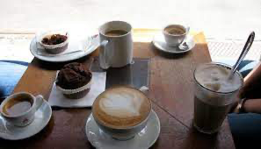
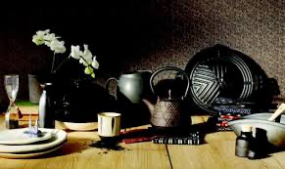
FF:ESBA01 Aesthetics of Everyday Life
Lenka Lee

Slide 2
What is Everyday Aesthetics?

Slide 3
Resources:
Aesthetics of the Everyday
First published Wed Sep 30, 2015; substantive revision Mon Nov 18, 2019
https://plato.stanford.edu/entries/aesthetics-of-everyday/

Slide 4

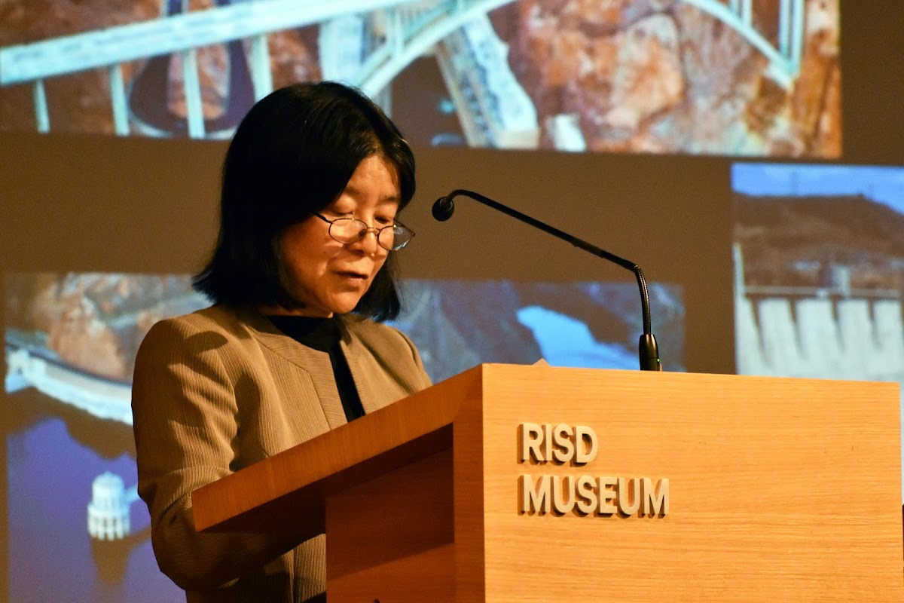
Yuriko Saito: Everyday Aesthetics (2007)

Slide 5

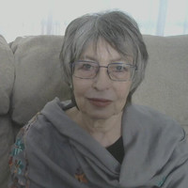
Katya Mandoki: Everyday Aesthetics (2007)

Slide 6


ESPES: The Slovak Journal of Aesthetics
Vol 10, No 2 (2021)
Everyday Aesthetics: European Perspectives
https://espes.ff.unipo.sk/index.php/ESPES/issue/view/20

Slide 7

Popular Inquiry: The Journal of Kitsch, Camp and Mass Culture
2021:2 (Vol 9) Forgotten Everydays

Slide 8

Everydayness: Contemporary Aesthetic Approaches
https://www.researchgate.net/publication/356420635_Everydayness_Contemporary_Aesthetic_Approaches

Slide 9

Dept. of Aesthetics MU is a member of:
Everyday Aesthetics Network
https://www.facebook.com/Evanet2022

Slide 10
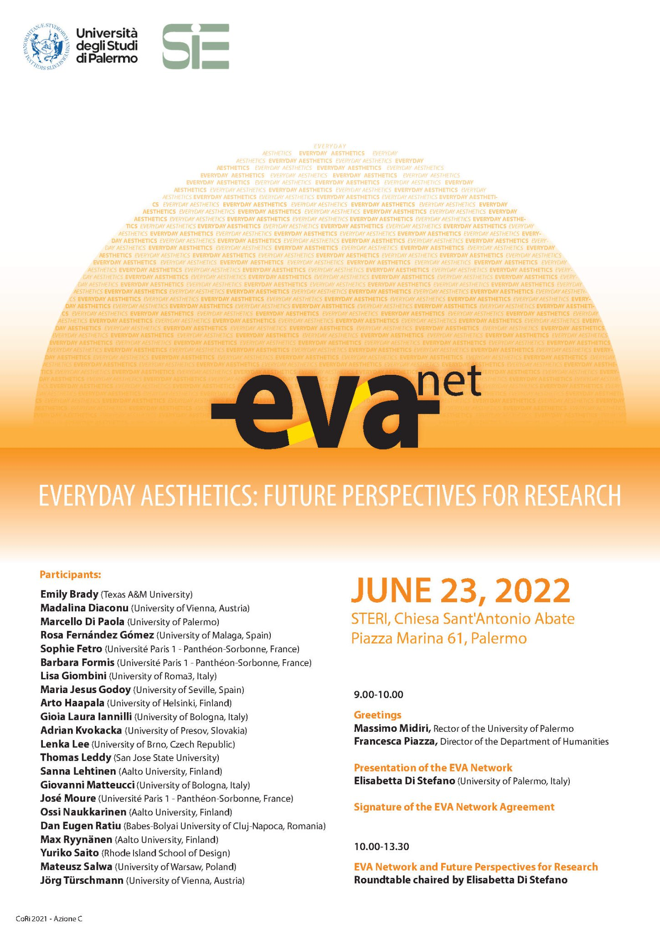

Slide 11
Requirements:
Active participation
Homeworks
Presentations
an article, a chapter from a book (15 - 25 pp.)
send me the bibliographic data by October 18
15 minutes in a classroom
PP presentation
PP (Google Pres. etc.) presentation (submit a day before the presentation to IS -> Homework Vaults -> Presentations_PP)
b) In advance: 600 - 900 words abstract (submit three days before the presentation to IS -> Homework Vaults -> Presentations_abstract)

Slide 12
Homework
Stanford Encyclopedia of Philosophy
Aesthetics of the Everyday
First published Wed Sep 30, 2015; substantive revision Mon Nov 18, 2019

Slide 13
Chapters:
1. Recent History
2. ‘Everyday’ and ‘Aesthetics’ in Everyday Aesthetics
3. Defamiliarization of the Familiar
4. Negative Aesthetics
5. Everyday Aesthetic Qualities
6. Ambient Aesthetics and Social Aesthetics
7. Action-Oriented Aesthetics
8. Blurring the Line between Art and Life
9. Significance of Everyday Aesthetics
Deadline: Oct 2th 2022, 23:59
Homework Vaults- Aesthetics of the Everyday - 3-4 pp summary of the text

