Slide 1
Anthropology of travel and tourism
Ethical issues & tourism

Slide 2
Recapitulation from 22.11.2022
Pilgrimage: a journey of the religious imagination, a spiritual and a temporal movement, may be collective or individual, physical movement from one place to another
The complexity of a pilgrimage site
Modern perspectives of pilgrimage in anthropology/related studies: communitas - Victor & Edith Turner, contestation - John Eade, Michael Sallnow
Other perspectives of pilgrimage in anthropology: tourism as the 'successor' par excellence of pilgrimage in this age of 'liquid modernity’ (Bauman), shift of identities based on the level of importance attribute to the peoples, places, or practices with which pilgrims/tourists interact at the moment
Pilgrimage and tourism difference: The pilgrim, and the ‘pilgrim-tourist’ peregrinate toward their sociocultural center, while the traveler and the ‘traveler- tourist’ move in the opposite direction.
Ideal place of pilgrimage according to you: nature, art, historical areas, etc. (a place where a human can think, reflect and expirence himself/herself)
Song comments by: Miyu and Eliška. Thank you ☺

Slide 3
Neocolonialism
tourism as a new form of imperialism
tourism as a way to legally and effectively reach for the different resources of distant lands in the post-decolonization era

Slide 4
Countries with the highest outbound tourism expenditure worldwide from 2019 to 2021 (in billion U.S. dollars)
From: https://www.statista.com/

Slide 5
From World Travel & Tourism Council, https://wttc.org/research/economicimpact

Slide 6
From: www.marriott.com

Slide 7
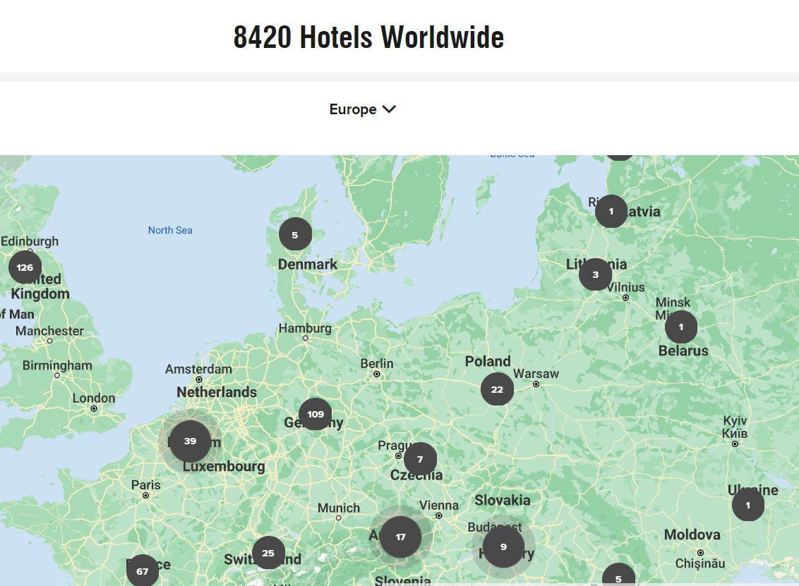
From: https://www.marriott.com/hotel-search.mi

Slide 8
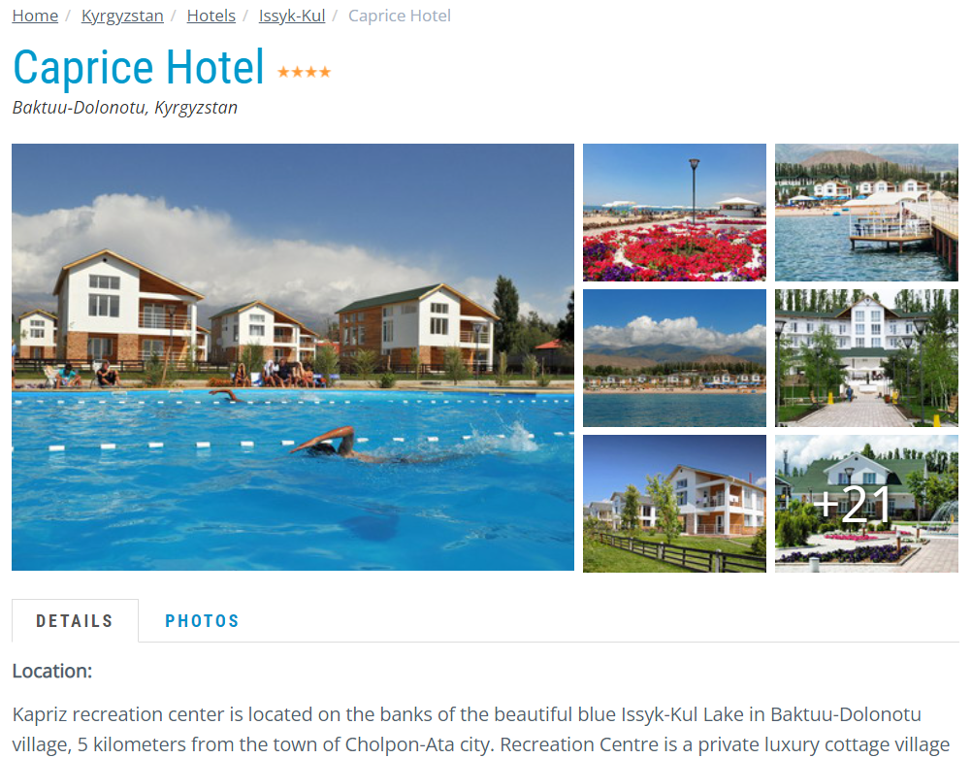
Private water areas

Slide 9
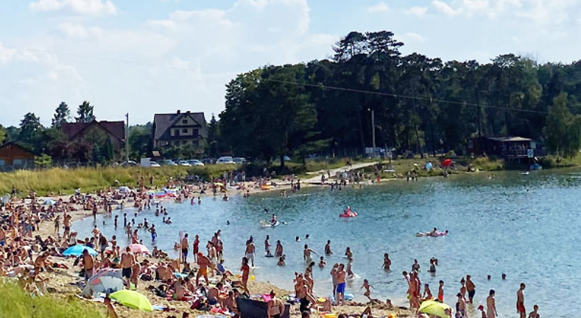
Kryspinów Lake, Kraków

Slide 13
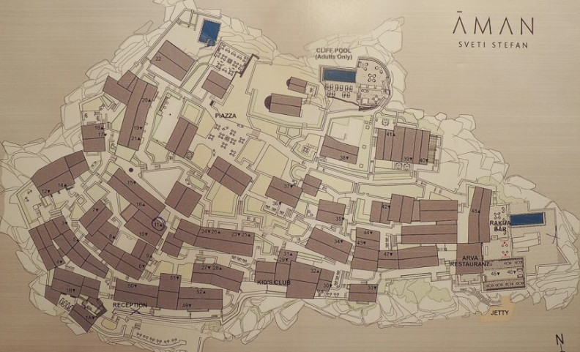
Sveti Stefan Island

Slide 14
From: https://saigoneer.com/vietnam-heritage/16278-photos-on-the-cusp-of-a-tourism-boom,-a-pristine-sapa-of-the-1920s

Slide 15
From: https://vietnamnet.vn/en/unsustainable-tourism-ruins-sapa-E198084.html

Slide 16
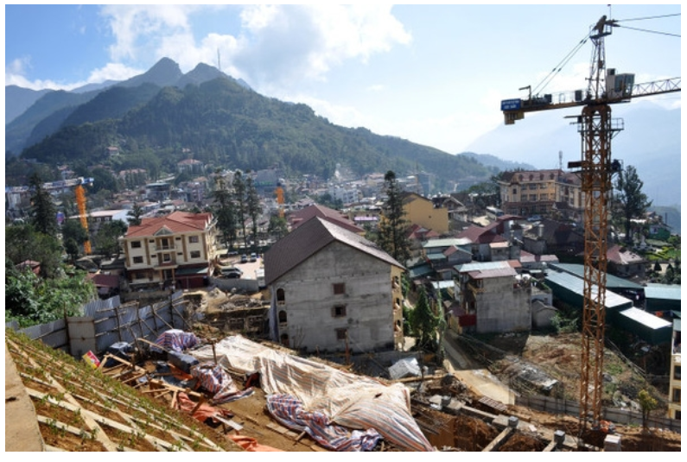

Slide 17
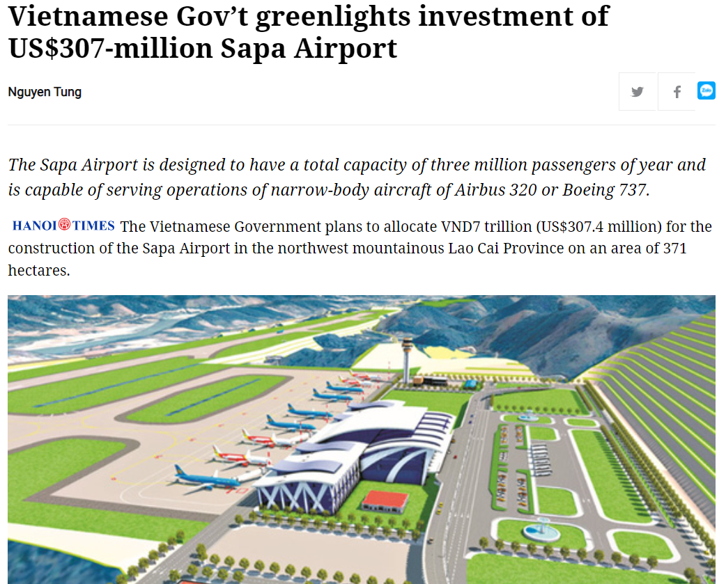
From: https://hanoitimes.vn/vietnam-govt-greenlights-investment-of-us307-million-sapa-airport-319061.html

Slide 18
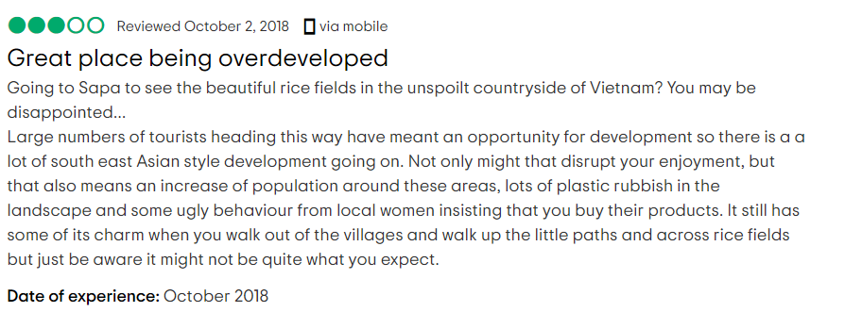

Slide 19
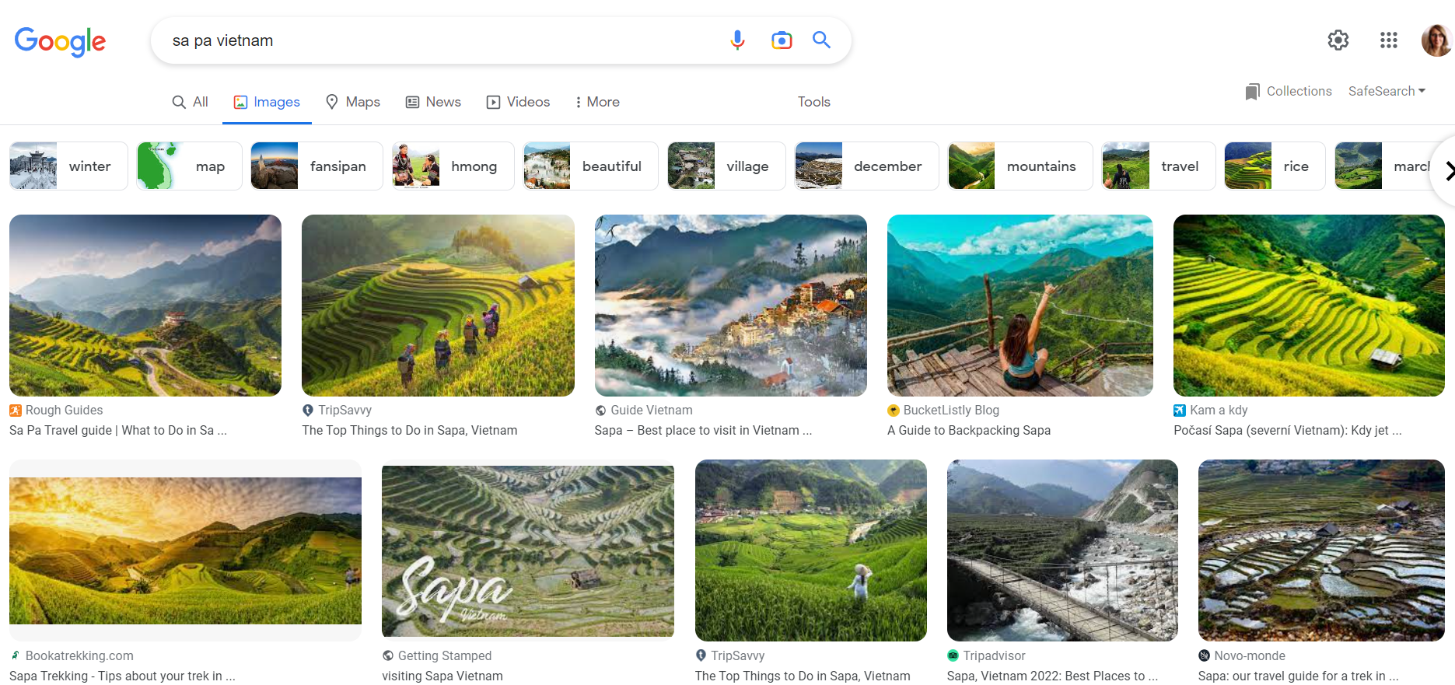

Slide 20
The Maasai
livestock such as cattle, goats and sheep are traditionally the primary source of income for the Maasai
the concept of private ownership was a foreign concept to the Maasai. (till 1960s - 1980s), a program of commercializing livestock and land was forced
"We would like to be agents of our change rather than victims of change." Kakuta Ole Maimai, Managing Director, Maasai Association.

Slide 21
From: https://www.maasaimarakenyapark.com/information/masai-mara-gates/

Slide 22
From: https://www.olduvai-gorge.org/

Slide 23
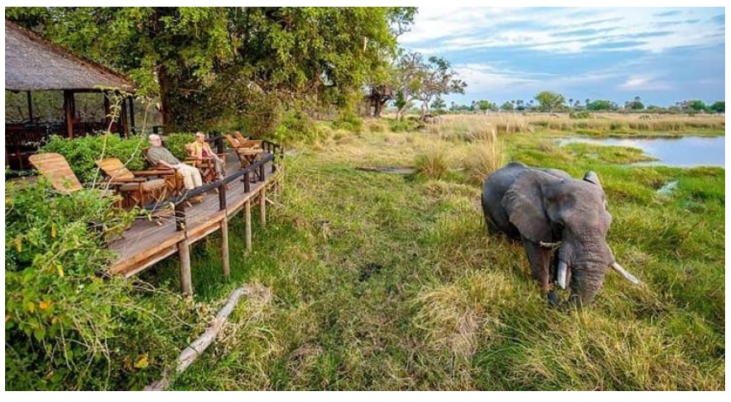

Slide 24
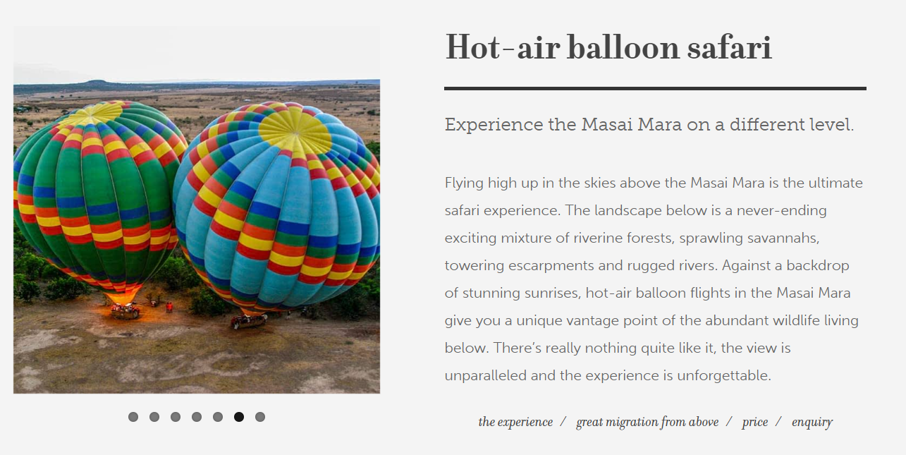

Slide 25
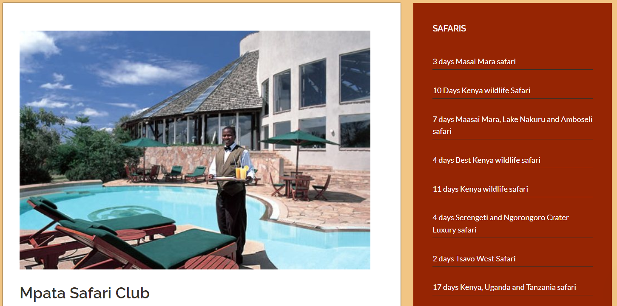

Slide 26
Community-based ecotourism?
cooperation with the local population
respecting natural resources
“The sanctuary is communally owned by 844 local Maasai, who in 1996 had the vision to set-aside this land as the very first community conservancy in Kenya. Tourism provides a much needed revenue stream for this community, and is therefore a critical incentive for preserving this important piece of land. “ [official website of Kimana project]
From: https://www.kimanasanctuary.com/wildlifesecurity

Slide 27
Stereotyping in tourism
"The tourist's gaze is about signs, and tourism is about collecting signs." John Urry

Slide 29
Stereotyping in tourism
markers - an information board on the trail, description in a folder, photograph, film, souvenir - a given view becomes an attraction, i.e. the purpose of visits and the object of a tour or visit,
markers refer to stereotypes, repeat and perpetuate them, creating easily identifiable schematic images about certain facts, phenomena, and above all - people and groups,
can either facilitate mutual relations or inhibit them when is simplifying the way of perceiving reality.

Slide 30
Stereotyping in tourism
refers not only to the cognitive sphere, it also evokes an emotional reaction and, consequently, influences behavior,
sometimes neutral, it usually arises around features with a strong positive or, much more often, negative sign,
a stereotype that positively portrays one group tends to attribute negative characteristics to other groups (including its own),
ethnic stereotypes – ethnocentrism - expressing both the assessment of other groups (heterostereotype) and the self-esteem of representatives of a given community (autostereotype),

Slide 31
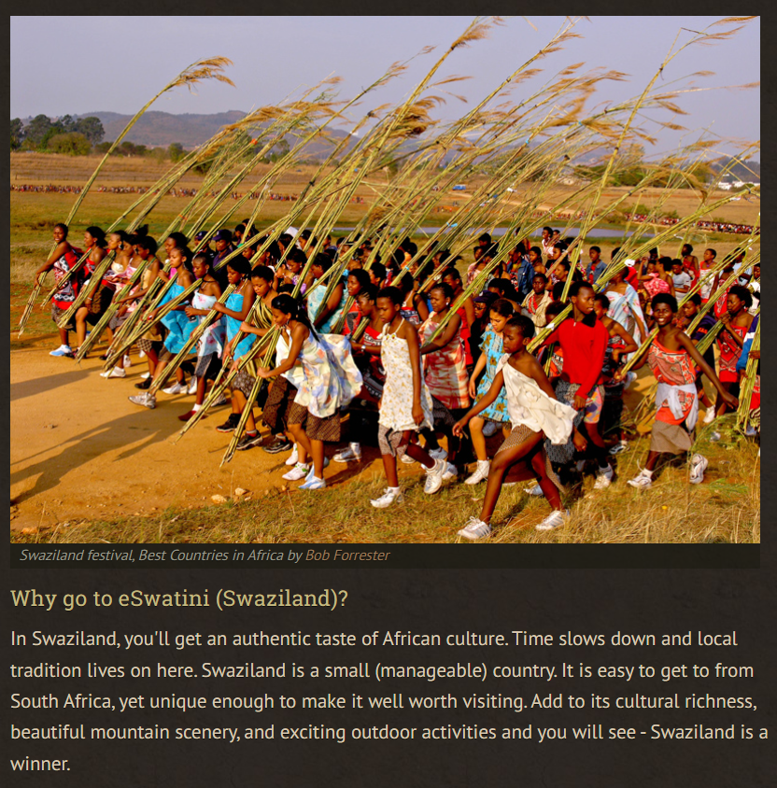

Slide 37
the 2 million-strong migrant workforce (India, Nepal, Bangladesh)
some migrant workers were denied food and water, had their passports taken away and were not paid for their work
in the last 10 years, there have been several hundred fatal accidents in the construction sector in Qatar, probably as a result of failing to meet safety standards

Slide 38
Is it ethical to go to Doha to participate (as a supporter/fan) in the Fifa World Cup 2022 competition?

Slide 39
Song comments…

