Slide 1
Anthropology of Travel and Tourism
Travel/tourism & a thing

Slide 2
Final presentation/essay - December
a presentation ( around 10 min., during last lecture 13.12) or an essay (3-5 pages, deadline 13.12),
a place considered to be touristic
short general characteristic & deeper analysis
History context (when a place started to be seen as touristic), what attracts tourist to a place, if/how a place changed since is touristic, what are strategies for promoting a place, souvenirs, how many people go there every year, tourists-hosts relations & influences etc., ethical questions, your own reflections
on 6.12 course summary
text formatting: Times New Roman, size 12pt, 1.5 line spacing
photos are welcomed, but a minimum text of 3 pages must be kept

Slide 3
Recapitulation from 18.10
the concept of time in ethnology / anthropology and related humanities studies: time as a qualitative unit, dimensions associated with important meanings and regulations in society, for an individual human being, sacred time vs secular, ordinary time; time as a separate abstract category in modern societes, the fragmentation of linear and quantitative time nowadays
free time, half-free time - real free time vs. busy free time - leisure time
changes in working time - within the 19th and 20th centuries, working hours were cut in half, from around 80 hours a week to 40-48 hours
time in tourism: myths (ownership of time, exceptional time, escape from time, the paradise metaphor)
song comments by – Riko, Mao and Zsofia. Thank you ☺

Slide 4
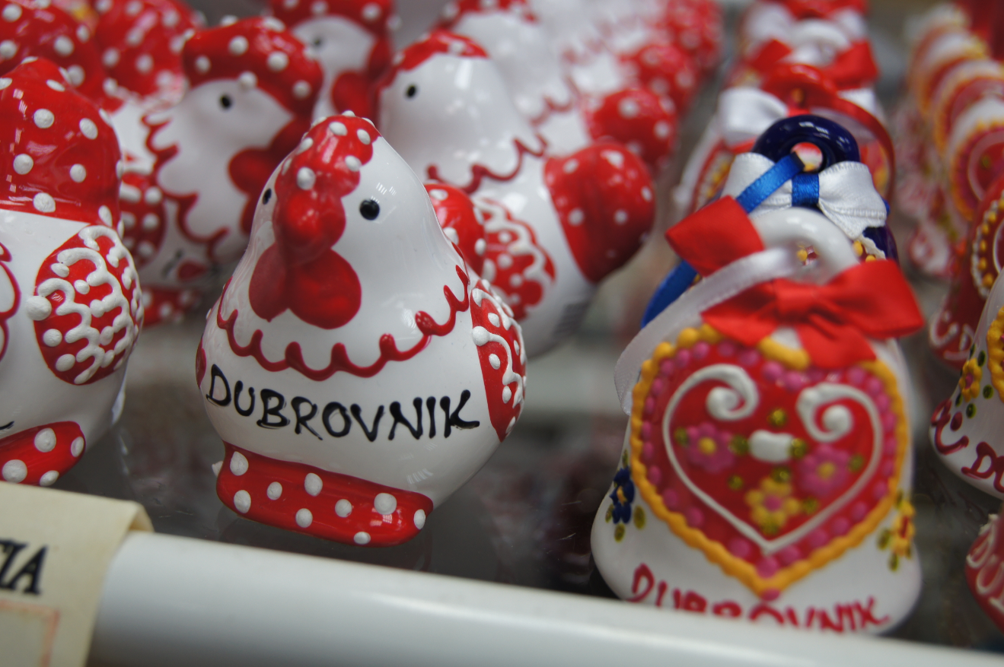
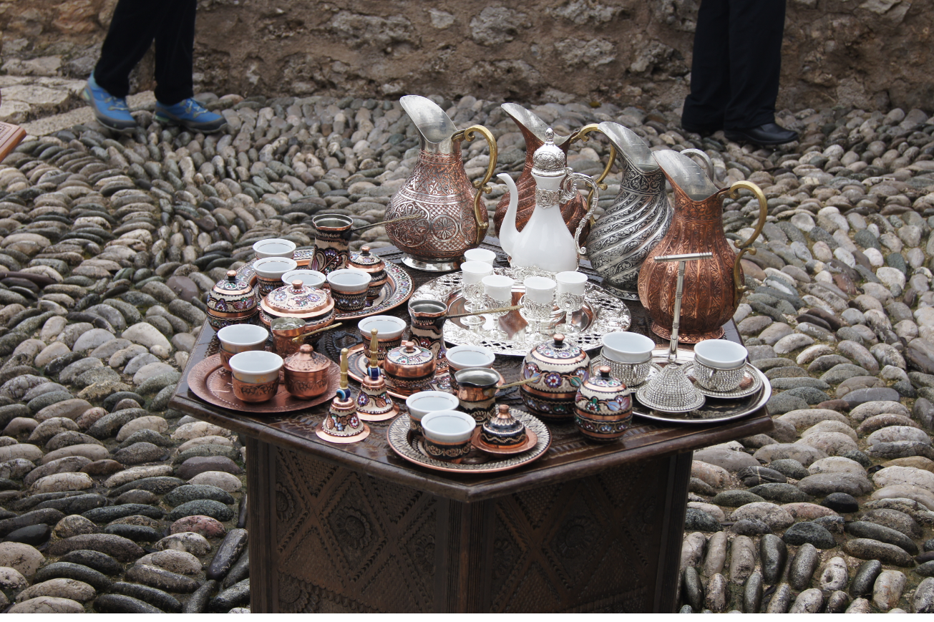
A souvenir…
a material document of a travel, an extension of tourist experience
a gift
materialized memory

Slide 5
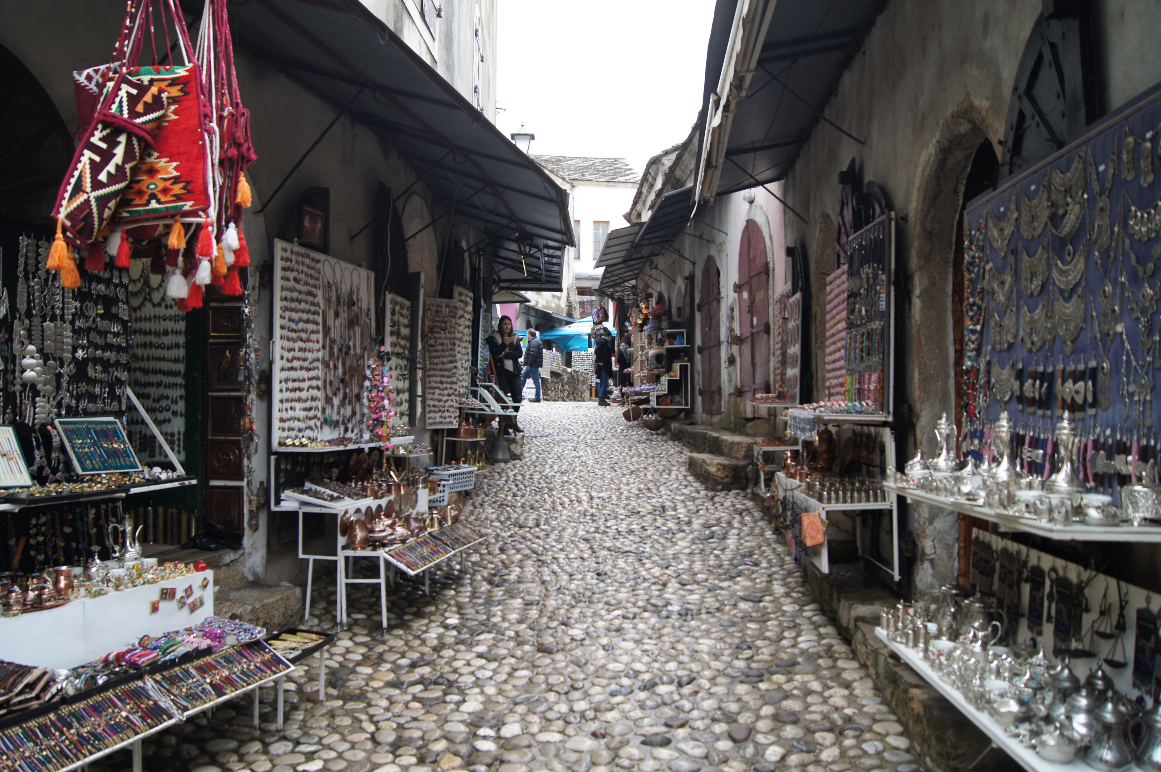
A souvenir…
a thing
an object
a commodity

Slide 6
Why does a thing / an artefact become a souvenir?
commodification of a native artifact into a souvenir,
mass production of things for the tourism industry,
giving status of a souvenir to a neutral thing by a tourist.

Slide 7
Commodification of a native artifact into a souvenir
the reduction or, on the contrary, the amplification of some original elements and signs (structure, size, color),
standardization, the replacement of traditional materials with industrial ones,
the transformation of functional objects into decorative objects, which lead to their repetitive production,
new cultural meanings are created
giving a portable form, easy to transport

Slide 8
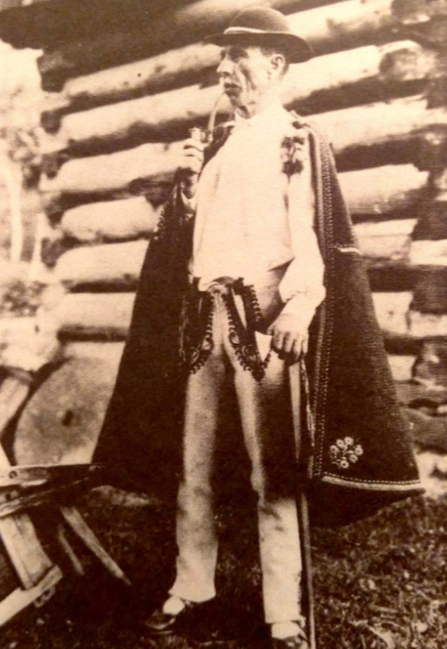
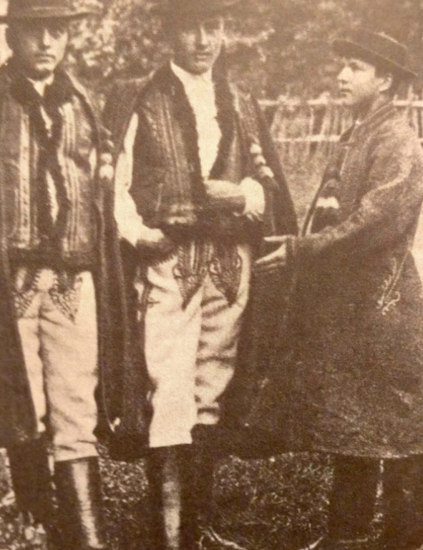


Slide 9
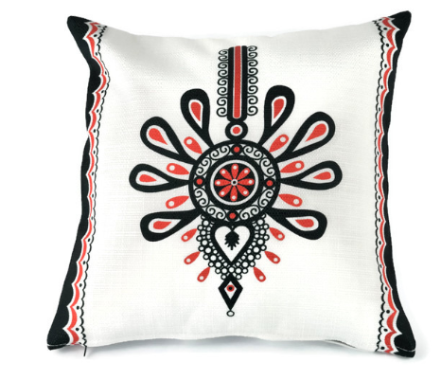
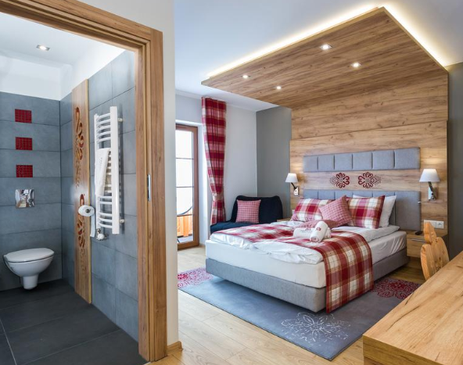
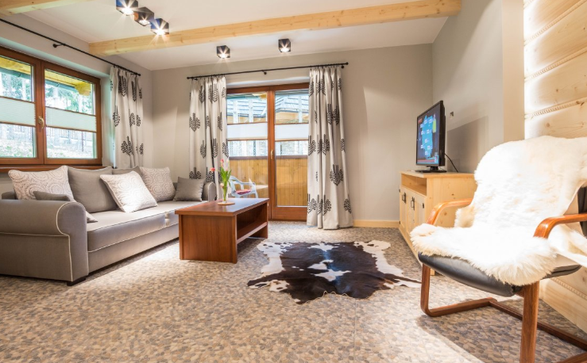
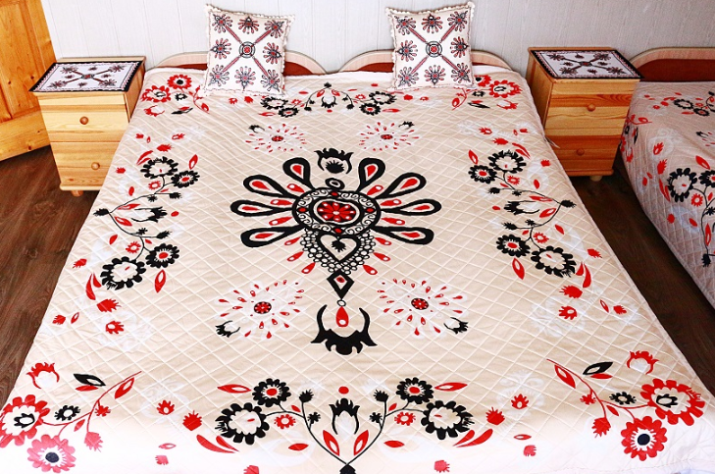
Notes:
In hotels it started to be everywhere.

Slide 10
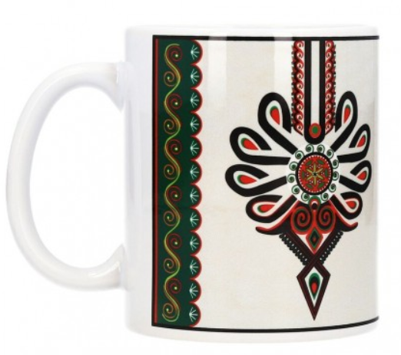
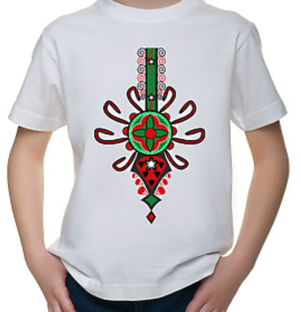
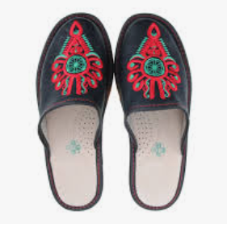
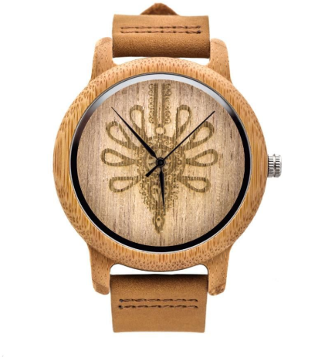
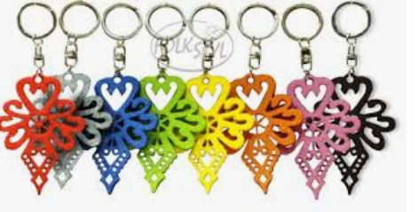
Notes:
On suvenirs and objects. People who manage tourism. Try to make it so geniunie, that is not really authentic anymore.
The highlanders are considered to be strong and brave because of difficult circumstanes they lived in. So everything must be highland: highland shoes, watch, T-shirt, bed, pillow. Parzenica, the pattern started to be a marker of geniuity, but what you can expect if it is everywhere?
Do you know some other examples of an objected or motive which was reproduced to the level that it started to be overwhelming?

Slide 11
The mass production of tourist souvenirs
the role of mass production (industrial revolution),
reaches its peak in the second half of the twentieth century and the beginning of twentieth first,
mechanical reproduction of the representation of the object (Dean MacCannell, the fifth faze of six stages of creating a tourist attraction),
usually produced in countries with cheap labor such as China, Indonesia and Vietnam,
often chosen due to their low price.

Slide 12
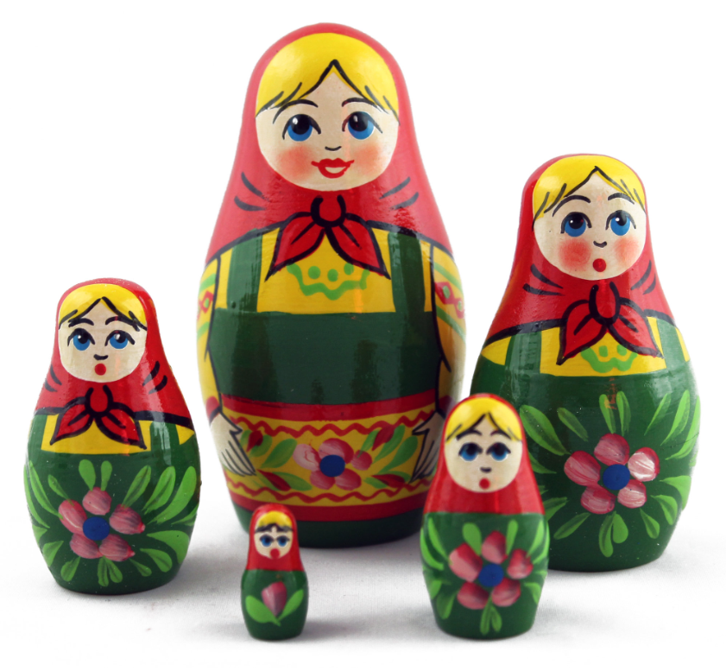
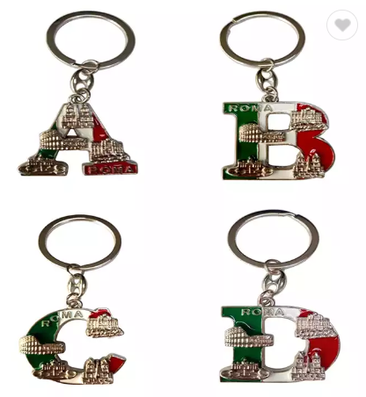
The mass production of tourist souvenirs

Slide 13
The status of a souvenir granted by a tourist
it can be any thing,
„a subjective” tourist souvenir,
symbolically refers to a specific event or destination and a period of time in the tourist's personal history
A part of an individual's identity and his/her "narrative of self-identity”

Slide 14


The status of a souvenir granted by a tourist

Slide 15
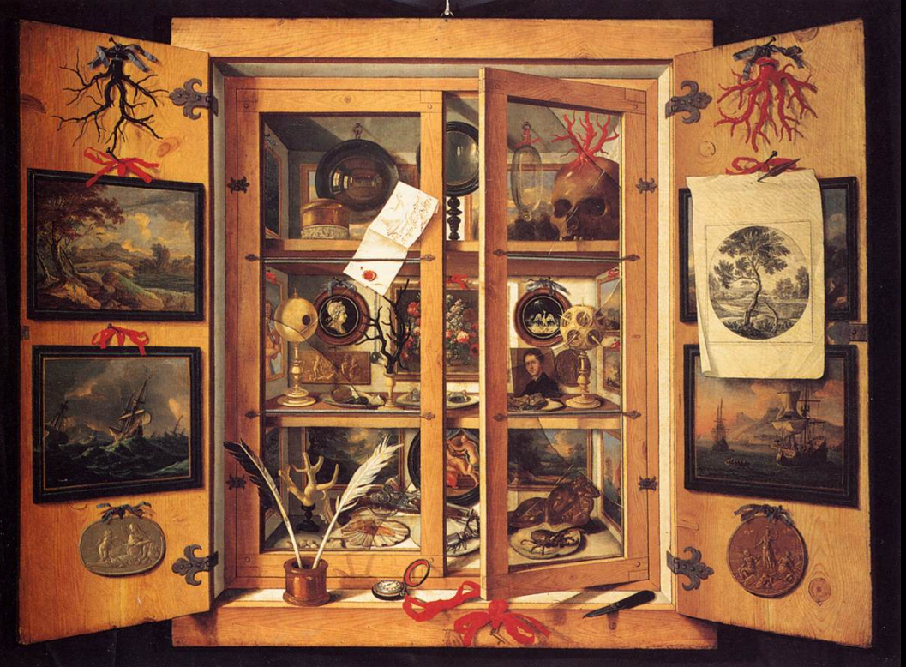
How old is the souvenir?
the ancient world, medieval times (i.e. handful of soil),
Cabinets of curiosities,
replicas of the European sites from Grand Tours,
mass production of souvenirs became a global phenomenon after World War II, acceleration in 2nd half of 20th century.
Domenico Remps, Cabinet of curiosities

Slide 16
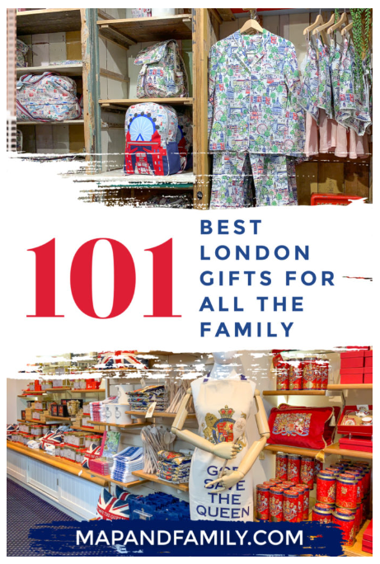
Typology of souvenirs
by a target group:
    personal
    as a gift

Slide 17
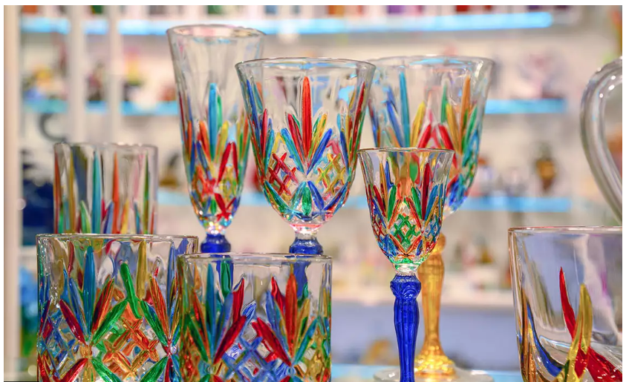
Typology of souvenirs
by forms of commodification:
  a direct commodification (mass production souvenirs)
  an indirect commodification (commodification of a native artifact into a souvenir)
  non-commodified souvenirs (status of a souvenir granted by a tourist)
  partially commodified (local utility products that are given an importance by a tourist)

Slide 18
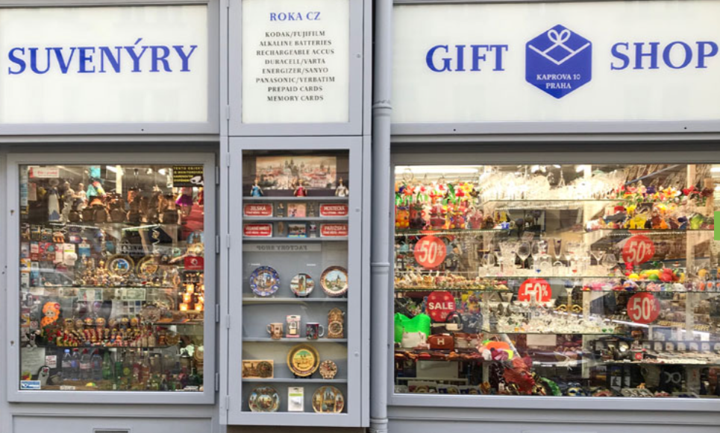
Typology by Alain Decrop and Julie Masse:
tourist trinkets (inexpensive, bought in souvenir shops),
destination stereotypes (typical object representing a given destination or a local specialty, such as a Russian matryoshka doll, Egyptian papyrus, etc.),
paper mementos (tickets, guides, brochures, maps of cities and countries or airline tickets),
collected objects (personal and private meanings, i. e. beach sand).

Slide 19
SOUVENIR ATTRIBUTES:
authenticity, uniqueness, appeal, affordability, portability, quality, relative value, artistic & aesthetic rendering…
“Souvenirs must be a) cheap, b) portable, c) understandable and d) (…) dusty! Sometimes it helps if they are useful, at least the owners will know what to do with them, and they will have some meaning of their own in the traveler's home environment.” Nelson Graburn
size, fragility, and maneuverability (e.i. Dawn Pysarchik)
uniqueness, aesthetic and functional elements, attached value, product display properties (e.i. Mary Ann Littrell, Lindsay Turner, Yvette Reisinger)
authenticity (e. i. Atsuko Hashimoto, David Telfer)

Slide 20
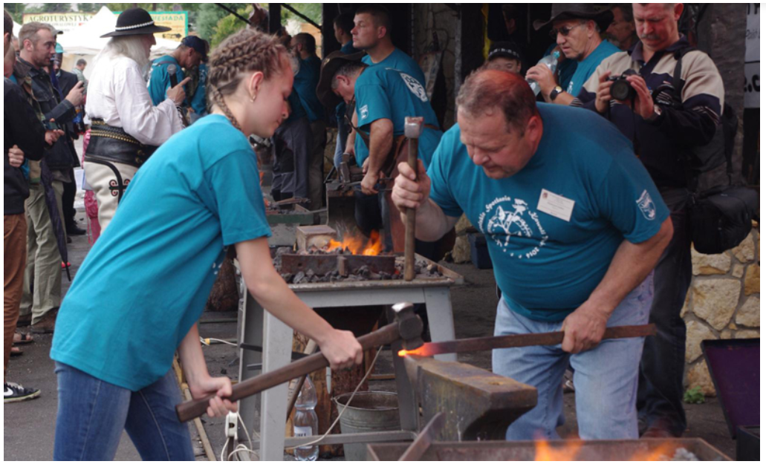
The authenticity of souvenirs
authentication” - process by which something – a role, product, site, object or event – is confirmed as “original”, “genuine”, “real” or “trustworthy”,
hot authenticity (subjective perspective) and cold/cool authenticity (objective features) of souvenirs by Tom Selwyn,

Slide 21
The authenticity of souvenirs
in one subject, entire image of culture owned by a tourist, but also created by him/her is materialized,
a sense of authenticity given by a tourist,
exchange value vs. sentimental value,
a relation to the local area, relation to the history and geography of the destination,
authenticity of materials and techniques,
an object used by the local population,
a certificate or stamp.

Slide 22
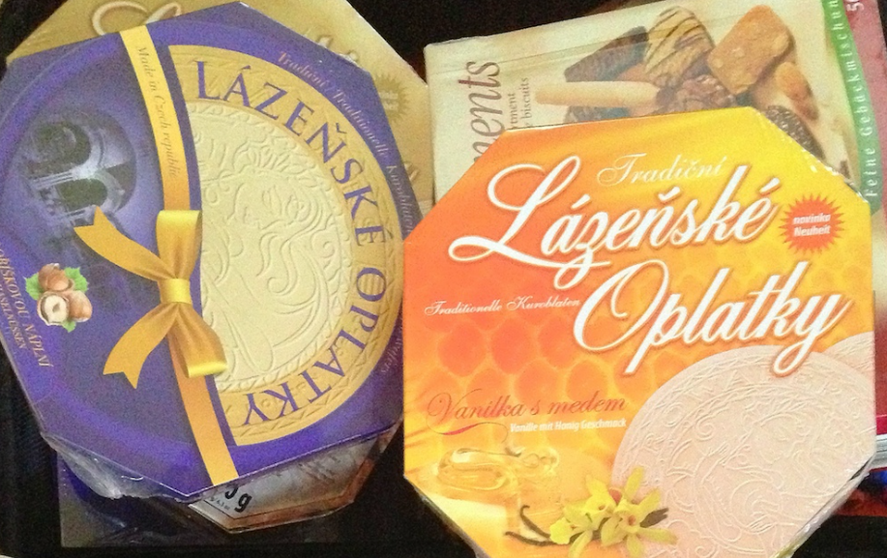

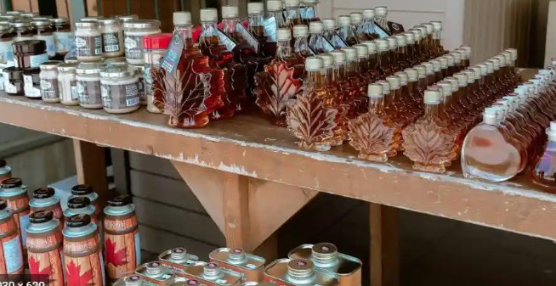
Food as a souvenir?
For tourists, food contains various meanings expressing the destination visited and also serves to induce the attractiveness of the destination to potential tourists. Local food and foodstuffs are considered symbols and iconic products that reinforce the identity of a place. Each destination is characterized by specific gastronomic customs, which include the way of preparation, serving and consumption.

Slide 23
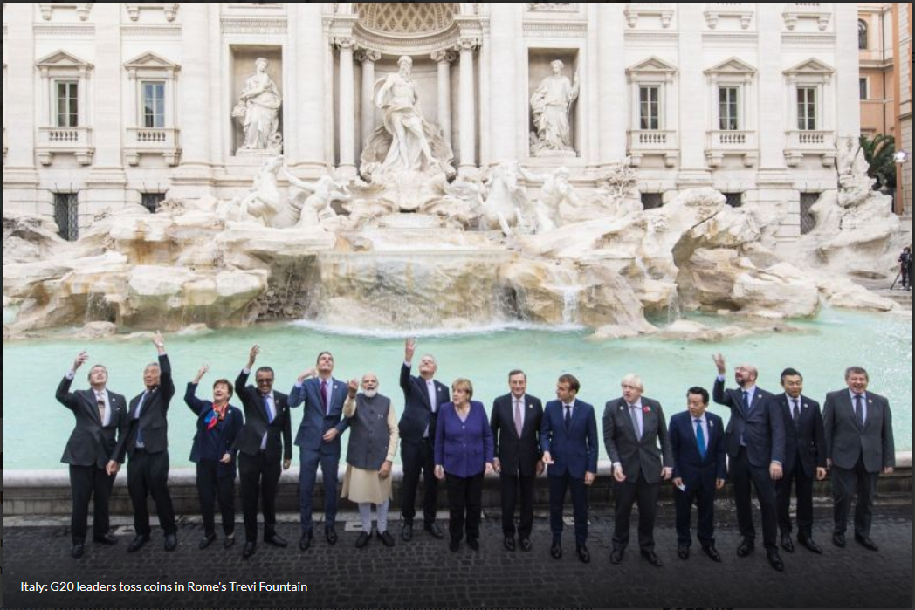
When the tourist does not take, but gives ...

Slide 24
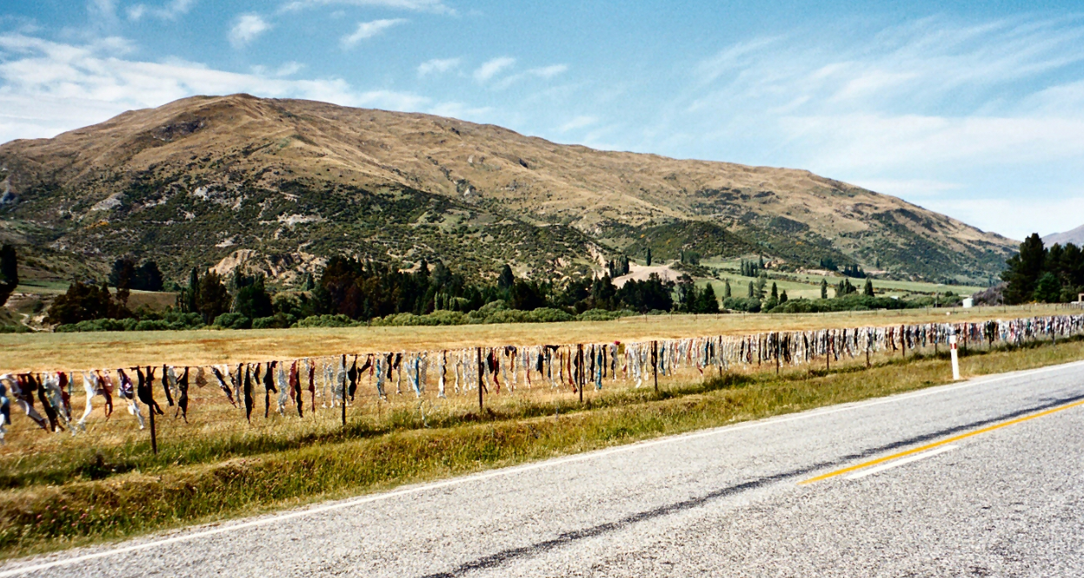
When the tourist does not take, but gives ...

Slide 25
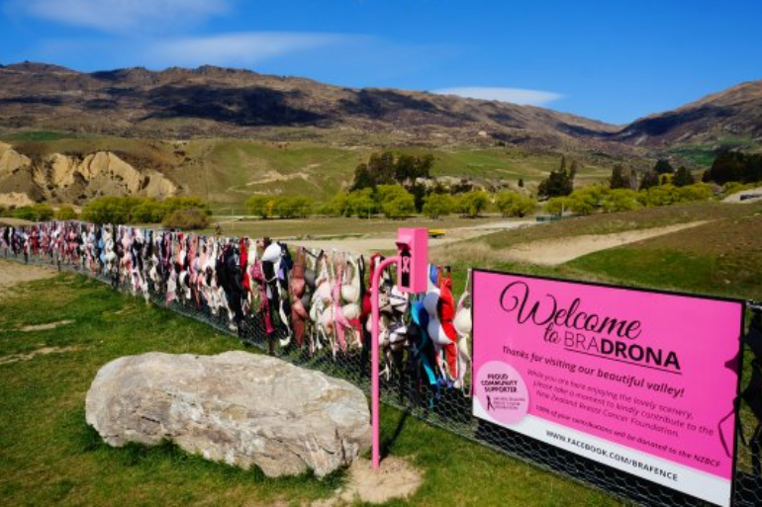
Notes:
The Cardrona Bra Fence is a controversial tourist attraction in Central Otago, in New Zealand. At some point between 1998 and 1999, passers-by began to attach bras to a rural fence. The fence gradually became a well known site as the number of bras grew to hundreds. The Bra Fence began at some point between Christmas 1998 and New Year 1999, when four bras were attached to the wire fence alongside the road. The original reason for the bras being attached to the fence is unknown. News spread, and more bras began to appear. By the end of February there were some 60 bras, but atter that time they were all removed anonymously. This was reported in the local press, and the story spread in New Zealand media, leading to more bras appearing.^{[2]} By October 2000, the number of bras had reached around 200, and again the fence was cleared of bras. This time the story spread even wider, as the fence had become to some a quirky tourist attraction, and even some international media started to be intered in it.

Slide 26
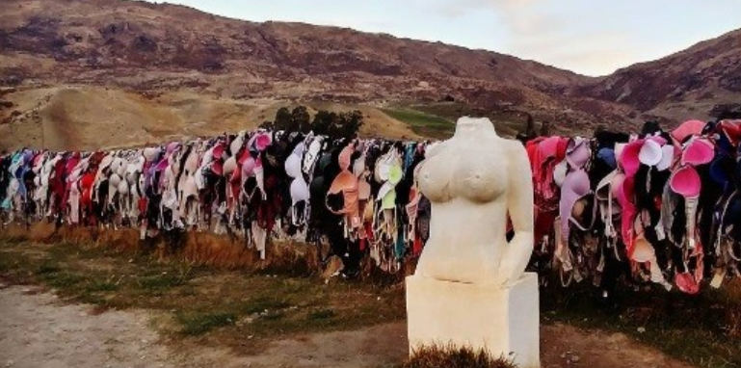
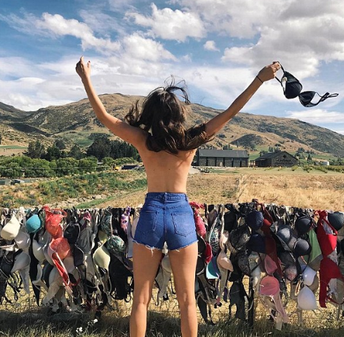
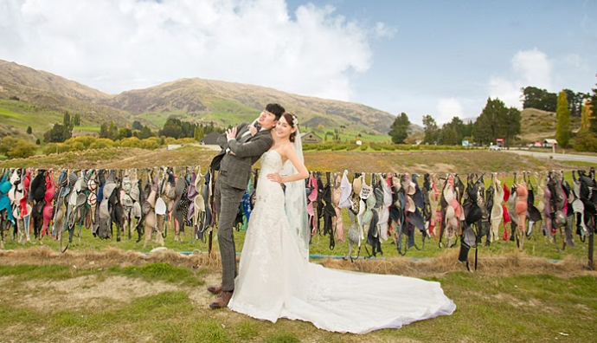
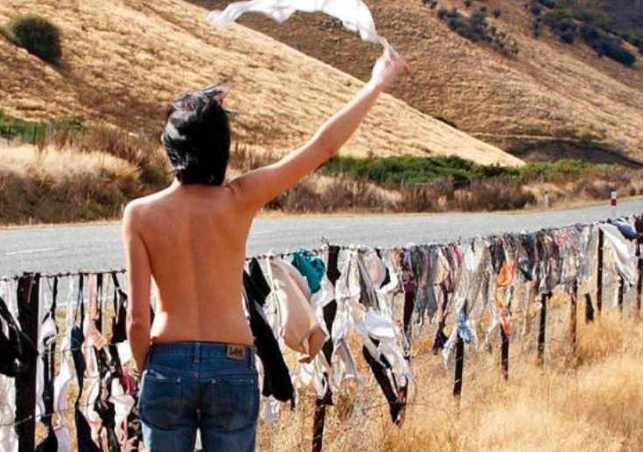

Slide 27
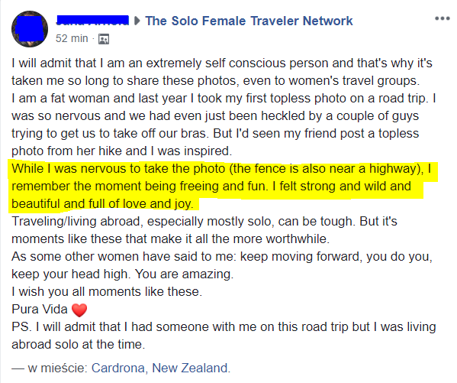
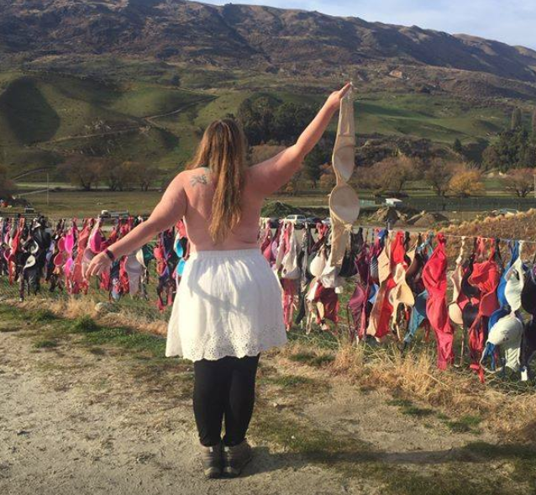

Slide 28
A brief discussion in groups
Can a souvenir in the 21st century be authentic?
What are the positive (if any) and negative (if any) sides of mass production of souvenirs?
You received a souvenir from a friend from work who just came back from vacation. In your opinion, the thing has no aesthetic value and is useless. What will you do with it?

Slide 29
The songs presentations…

