Slide 2
Anthropology of travel and tourism
The Other

Slide 3
Recapitulation from 25.10.2022
A souvenir (thing, object, commodity) - a material document of a travel, an extension of tourist experience, a gift, materialized memory.
Processes of an artefact to become a souvenir: (commodification of a native artifact into a souvenir, mass production of things for the tourism industry, giving the status of a souvenir to a neutral thing by a tourist).
History of souvenirs - the ancient world, medieval times (i.e. handful of soil), Cabinets of curiosities, replicas of the European sites from Grand Tours, mass production of souvenirs became a global phenomenon after World War II, acceleration in 2nd half of 20th century.
Souvenir attributes: authenticity, uniqueness, appeal, affordability, portability, quality, relative values, artistic values and so on …
The authenticity of souvenirs (hot & cool/cold by Tom Selwyn).
The item can not only be picked up by the tourist, but also left (e.g. a coin in a font).
Song comments by: Clara and Miu. Thank you ☺

Slide 4
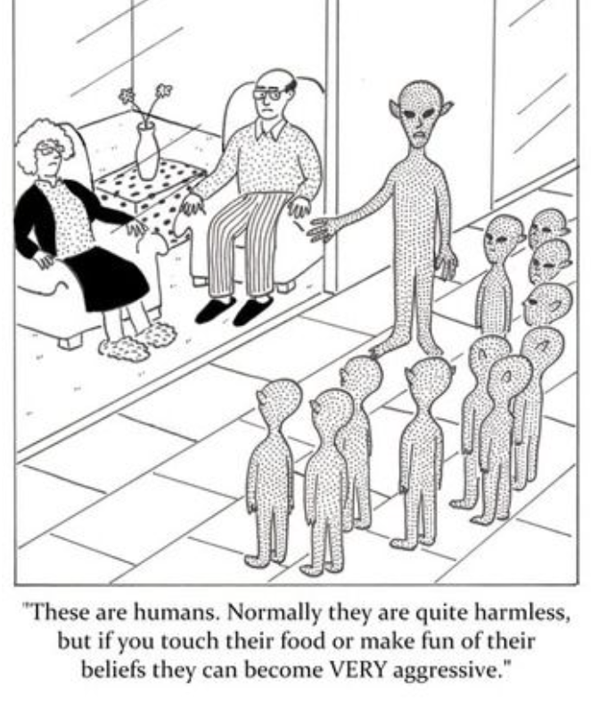
The concept of the other (otherness) in ethnology / anthropology and related humanities studies
the other: a person as a representative of a different culture
in the past, „a culture of an other” were often considered inferior to the culture of the researcher's origin
paradigm shift, end of the 20th century - we are all in the category of „ the other"
From: New York Cartoons

Slide 5
Host
hosts represent the local community and its inhabitants, but also tourism workers, owners, animators and suppliers
traditionally is considered territorial and static
Guest
incoming tourists, but also intermediaries, investors, tourism workers, sellers and service providers, professional and business experts, migrant workers or expats, press and media
traditionally considered in movement and mobile
fluid, contested social roles that people enter, exit, and move between while negotiating extensive overlapping mobilities and social memberships

Slide 6
Sociocultural impacts of tourism on hosts changes affect the wider cultural, social, political, economic and ecological processes that are characteristic of guests and hosts
the revitalization of traditions and the transmission of cultural knowledge,
income,
employment
infrastructure development
the commodification of culture
the misbehavior of tourists
ecological changes,
transforming the original environment of the destination, positive (income, employment or infrastructure development)

Slide 7
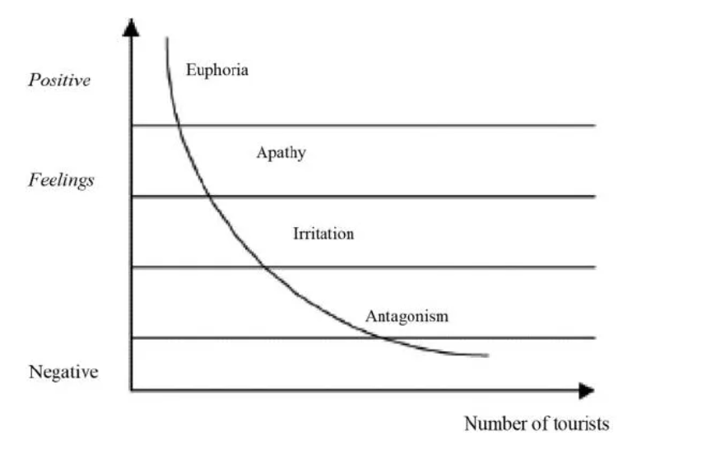
Doxey's Irritation Index (1975)

Slide 8
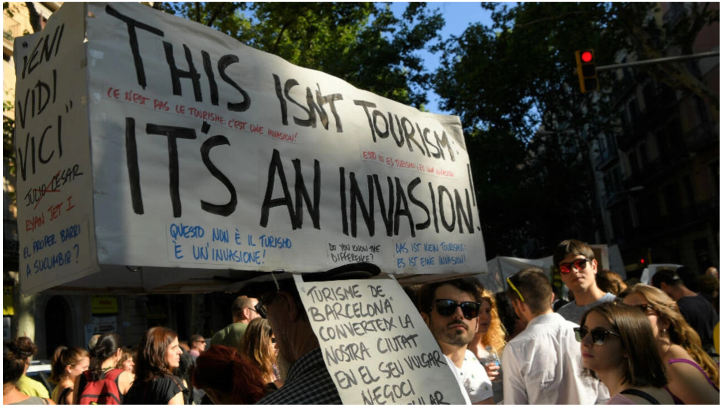

Slide 9
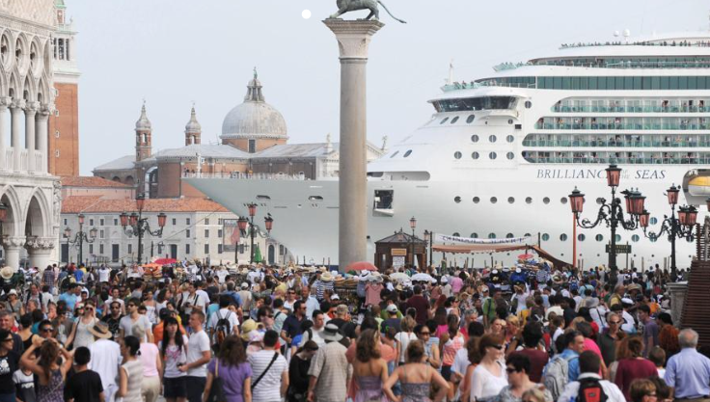

Slide 10
The 20 Most Visited Cities in the World
From: travelness.com, data updated in October 2022

Slide 11
The most overloaded cities in Europe
From: holidu.co.uk

Slide 12
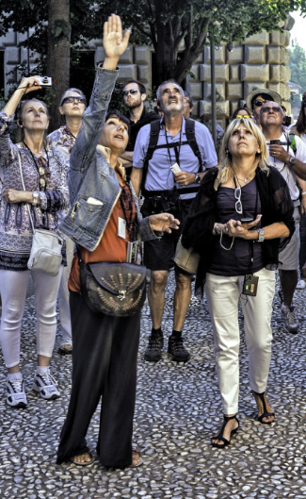
The role of cultural brokers or mediators:
located between two (or more) cultures and possess the attributes of their membership, translators, a role in making decisions about what is and is not presented, and how cultural elements are presented, a key role in developing and promoting tourism
in the past: individuals who mediated contacts between indigenous peoples and colonial administrations, e. i. members of the local culture, missionaries or teachers
nowadays: tour guides, tourist guides, travel assistants, migrant workers, second-generation immigrants, people of mixed ethnicity, anthropologists,
their role partially superseded by book travel guides, materials available at tourist points and, above all, information available on the internet

Slide 13
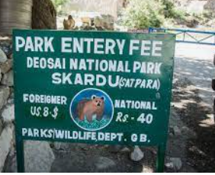
Host-tourist interaction by Willis Sutton (five sociocultural characteristics )
the mutual recognition of the guest and the host,
the fact that both guest and host share a "focus on immediate pleasure“,
the cognitive asymmetry between guests and hosts,
the mutual enrichment,
the problem of relative compatibility of values ​​and norms of host and guest cultures.

Slide 14
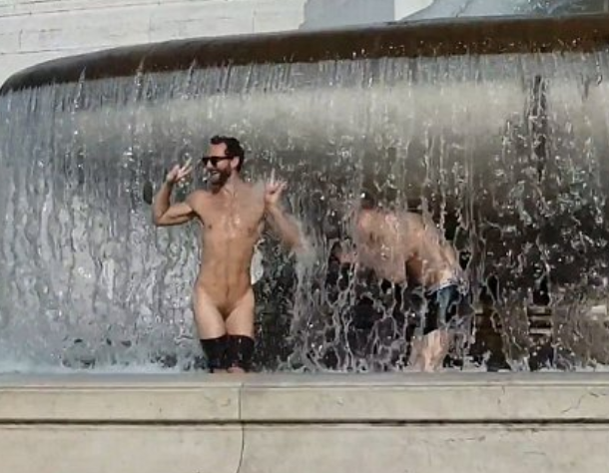
Three tourists were convicted in a Sri Lankan court after taking pictures of themselves in which they pretended to kiss a Buddhist statue, 2012
Italian police hunts tourists who stripped naked at famous Roman statue, 2014

Slide 15
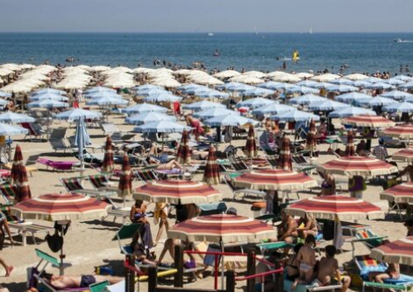
Host-tourist interaction by Alister Mathieson and Geoffrey Wall
the transitory, short-term and superficial nature of the relationship,
the pressure on tourists to experience a wide variety of experiences in a short period of time,
the isolation of tourists, who often separate themselves from local residents and spend most of their time with other tourists,
the relations between hosts and tourists are not spontaneous but formalized and planned,
inequality, unsymmetry of the relation.

Slide 16
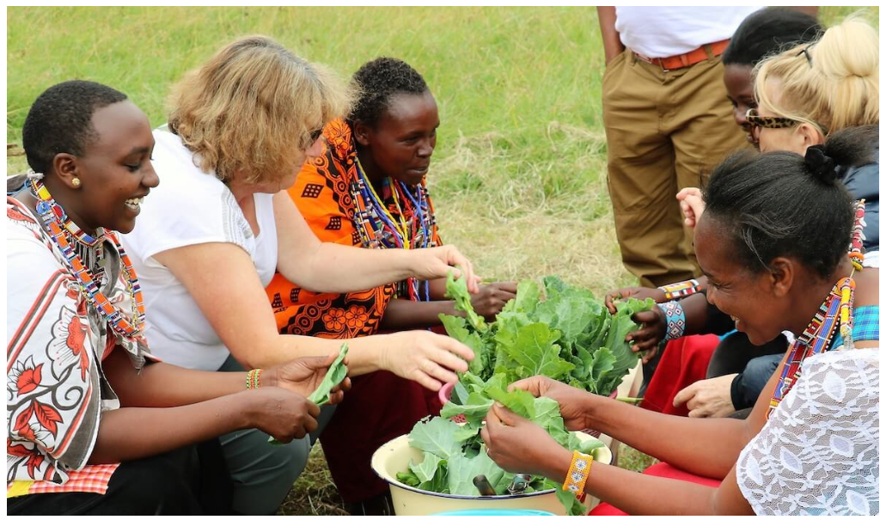
Host-tourist interaction by Pierre van den Berghe
a form of ethnic relations involving three economically unequal groups, which include the tourist and the performer
a performer becomes a native the moment he begins to interact with the tourist and influence his behavior,
tourists belong to different cultures and subcultures, thus forming a multi-ethnic group, however common tourist experiences unite them in a "super-ethnicity"
the creation and remaking of the original ethnic identity of the hosts
Maasai village, from: thealtruistictraveller.com

Slide 17
Host-tourist interaction - constructed ethnicity by Dean MacCannell
a type of identity that has been formed in response to the demands of Western culture and tourism,
the presentation, display and preservation of ethnic life forms,
local culture and its elements are preserved or enhanced as a product.
From: vietnamnet.vn

Slide 19
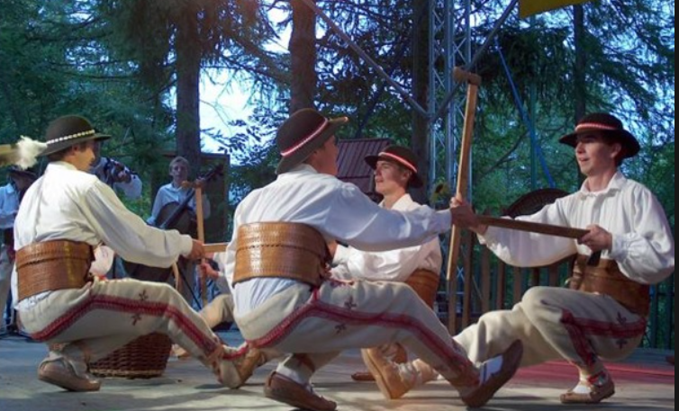
Host-tourist interaction - the concept of commodification of culture
the process by which cultural elements are transformed into commodities,
"The ritual became a show for money. Its meaning has disappeared.” (David Greenwood),
objectification and appropriation - e. i. everyday life, archaeological ruins or the environment.
Highlanders' dance from the Carpathian Mountains, once performed during celebrations, at certain times of the year, today only during festivals for tourists.

Slide 20
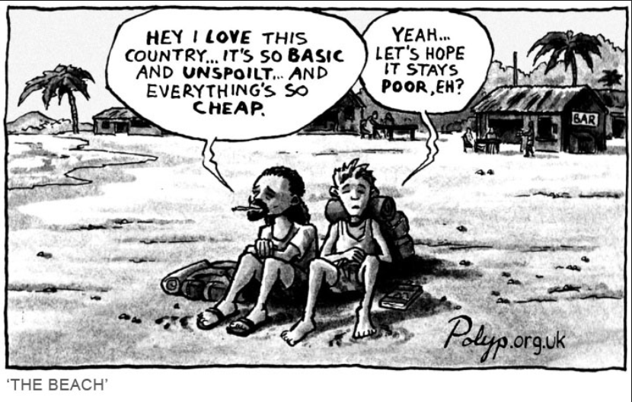
Host-tourist interaction - the concept of commodification of a tourist experience (Gareth Shaw, Allan Williams)
the direct commodification of tourist experiences,
the indirect commodification, based on the possibility of purchasing services that support tourist experiences,
the partial commodification, when tourists in the destination provide their own meals, accommodation, car rental or excursions,
the non-commodification of tourist experiences, e. i. tourists are provided with accommodation, meals, guiding and other services by their family members or friends

Slide 21
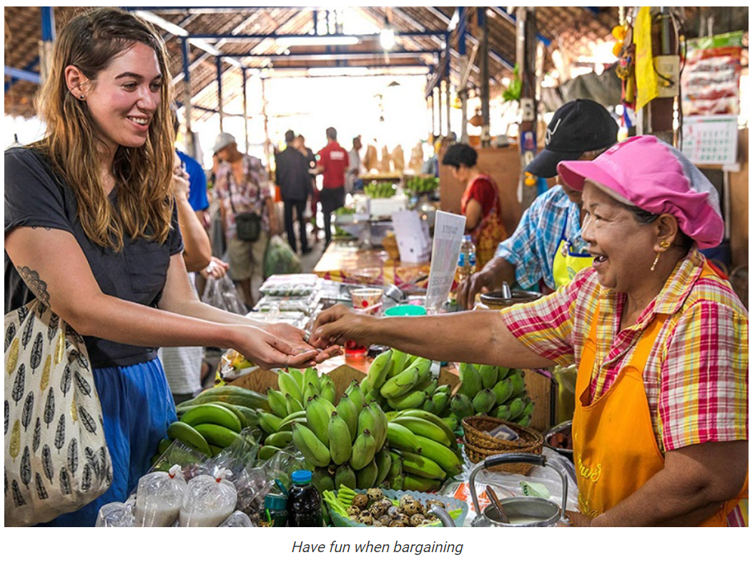
Host-tourist interaction - culture shock
involves sudden uncertainty, fear, anxiety, disorientation or confusion in relation to a foreign language, values, norms, customs, rules and social situations
“Value differences between home and foreign cultures are the strongest predictors of the shock. The closer one gets to the core values ​​and behaviors, the easier the adaptation is.” (Adrian Furnham)
culture shock can lead to cultural conflict (tourist-host conflicts, tourist-tourist conflicts, and host-host conflicts)
From: www.bestpricetravel.com/travel-guide/bargain-tips-for-shopping-in-vietnam

Slide 22
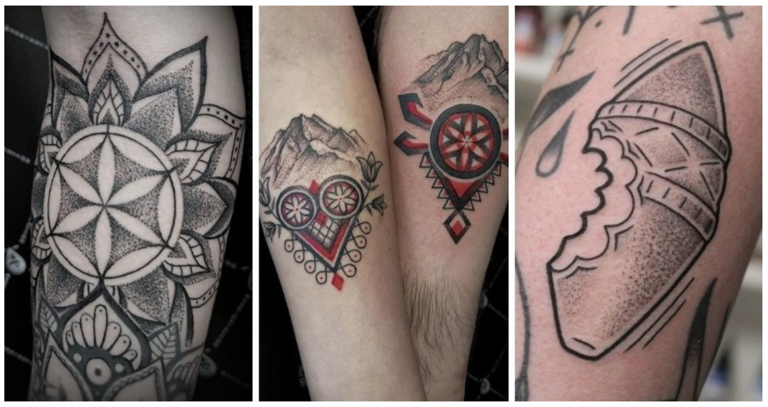
Theories considering the positive effects of tourism on the host culture (since the 1990s)
tourism enables the revision of interest and the strengthening of host pride in local culture, cultural heritage and ethnic identity, hosts use “new ways to access centuries-old traditions" (Laurie Kroshus Medina)
cultural commodification as a means of strengthening ethnic and cultural identity (Stroma Cole)
positive commodification (Barbora Půtová)
re-evaluation of their value by the local community (Erik Cohen)
commodification as part of the revitalization process, "The very ways in which societies change have their own authenticity, so that global modernity is often reproduced as local diversity." (Marshall Sahlins)
Tattoos with local folk motifs (decorative elements, mountains, traditional cheese)

Slide 23
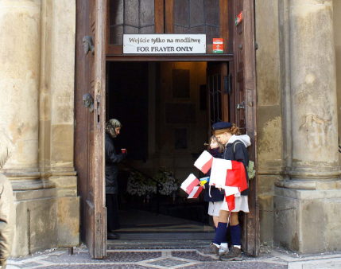
Acculturation vs transculturation
Acculturation - a culture adopts a practice or practices from another culture, changes in a lifestyle according to a way of life of another culture/society (e.i. behaviors, values, customs, language), understood one-sidedly.
Transculturation - two-way flow of traits between two (or more) cultural groups, an equal exchange, melting certain parts of cultures.
active host strategies towards the tourism industry

Slide 24
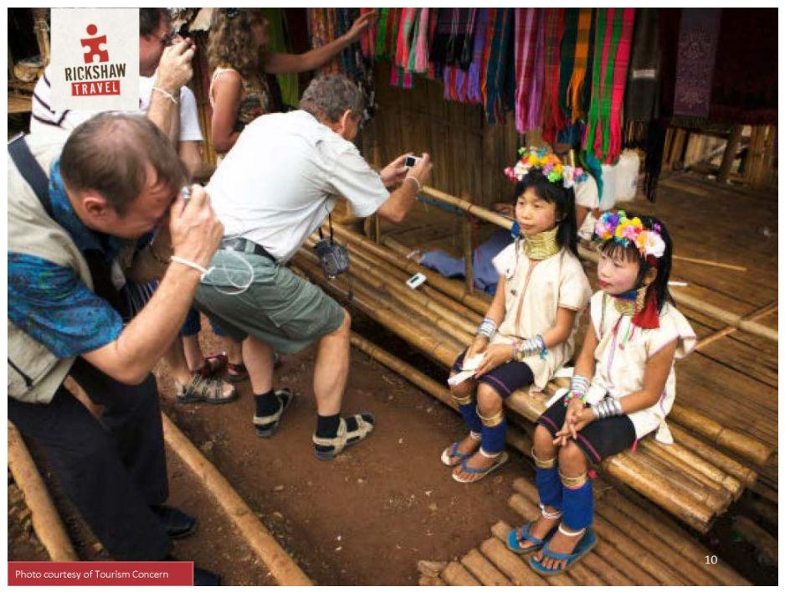
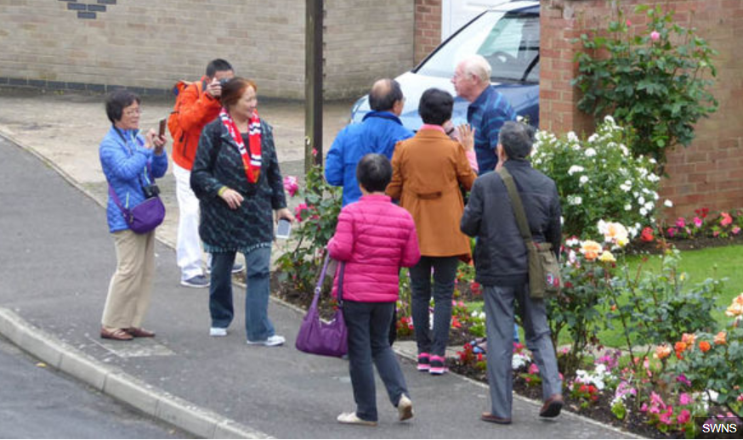
Host-tourist interaction - "Tourist gaze" (John Urry)
1. Photography subordinates the photographed object in some way.
2. Photography only seemingly reflects reality.
3. It is commonly believed that the camera does not lie, but images are constructed.
4. The power of photography comes from the fact that it is considered a miniature of reality.
5. Anyone can be an intermediary in telling the "truth" about other cultures in the destination.
6. Photography is part of the postmodernisation trend.
7. Traveling as a strategy of acquiring photos.
8. Photography circle: seen before departure, e.g. on the Internet - taking pictures - showing others or watch oneself after departure

Slide 25
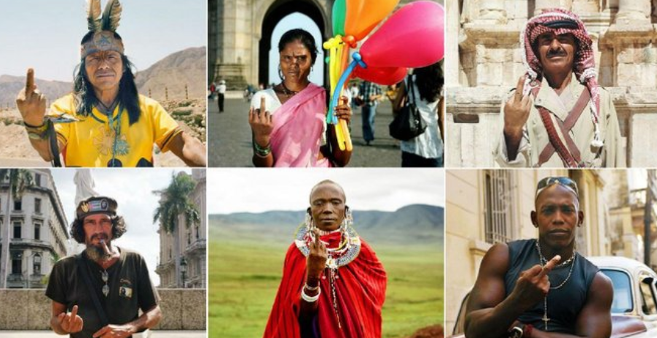
„I was inspired by a local who refused to let me take his picture. His literal response was: 'fuck off, I don't want to end up on a postcard.‘ First I thought to myself, 'fucking local ...', but then I thought okay, why not ask him to portray his feelings in the photo? He gave the middle finger, I took the picture, and that was how the series, ‘Fucking Tourist’, was born.”, Nicolas Demeersman, photographer
https://www.flickr.com/photos/9082231@N05/albums/72157625511855017/page2

Slide 26
Song presentations…

