Slide 1
Anthropology of travel and tourism
Pilgrimages

Slide 2
Recapitulation from 8.11.2022
Types of tourism: domestic, international, inbound, outbound
Types of tourism: Natural based tourism (nature trips, sun and sand, ecotourism, agrotourism, hiking etc.), Cultural based tourism (Cultural and Traditional Tourism (food, customs, architecture, literature, famous people), Ethnic Tourism (ethnic villages), Historical Tourism (events, reconstructions), etc.),Special/specific interest tourism (Religious tourism (pilgrims), Health tourism, Meditation tourism, Adventure tourism, Sport tourism, Dark tourism, etc.), Other forms/hybrid forms (between tourism and migration, year gaps, work & travel, backpackers, digital nomads, seasonal tourism, etc.).
Erik Cohen’s tourist typology: the drifter, the explorer, the individual mass tourists, the organized mass tourist, but no one fix type
Digital nomadism
Song comment by: Hadar. Thank you ☺

Slide 3
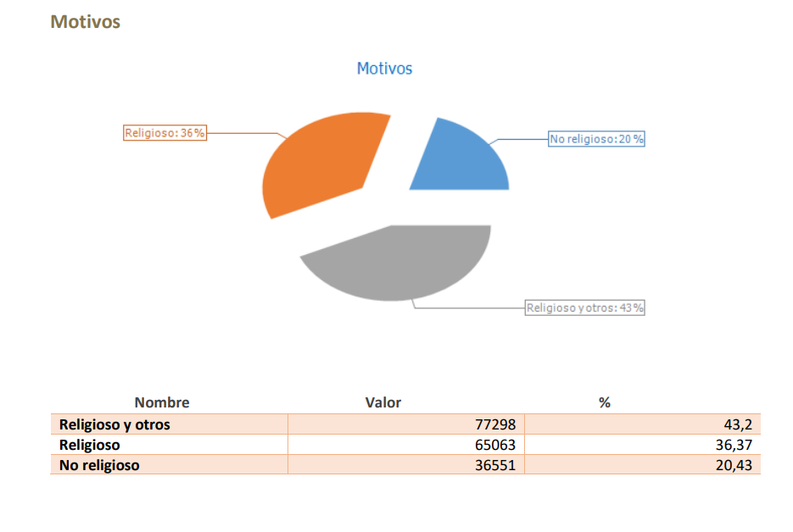
An example of a contemporary pilgrimage to Santiago de Compostela, Spain, leading Catholic pilgrimage route since the 9th century
From: https://oficinadelperegrino.com/en/statistics/

Slide 4
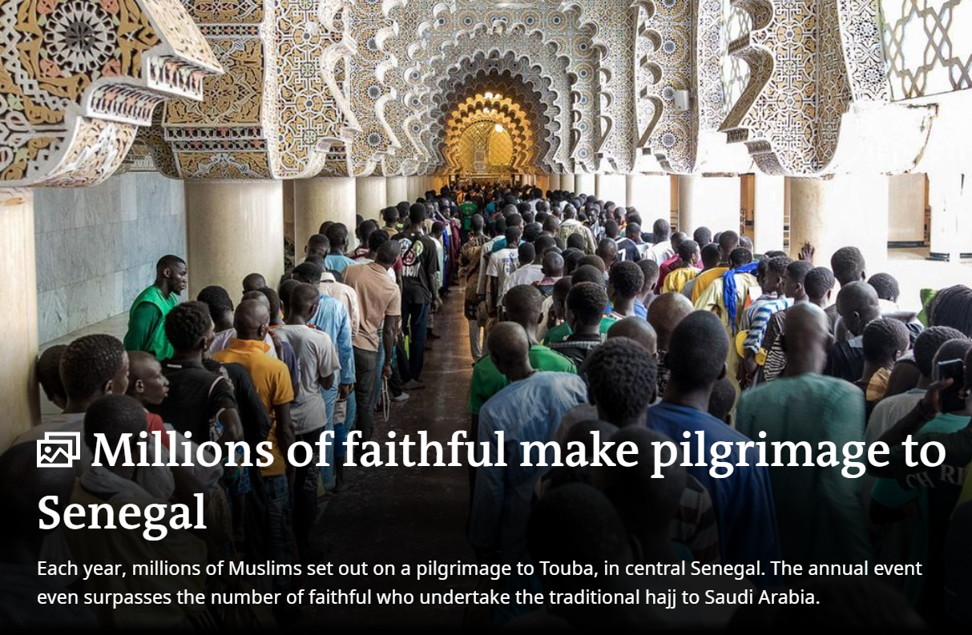
What is a pilgrimage?
a journey of the religious imagination,
a spiritual and a temporal movement
may be collective or individual
physical movement from one place to another
may lead to the emergence of an imagined community
the destination of the pilgrimage can be understood as a home or „final home”

Slide 5
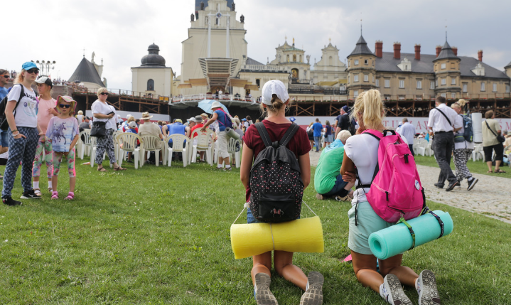
Is pilgrimage a form of tourism?
the basis of religious practice in some cases
traveling for pleasure vs traveling for duty (and the border between them)
for some people, pilgrimage may be the only form of tourism, for others, visiting holy places may be a kind of entertainment
"sacred journeys", "religions migrations“, "pilgrimages"
From: https://podroze.onet.pl/ciekawe/piesze-pielgrzymki-na-jasna-gore-w-czestochowie-tradycja-historia/myqjnn7

Slide 6
Definitions of pilgrimage…
A journey to a sacred place as an act of religious devotion (Sykes 1982).
Pilgrimage involves three factors: a holy place; attraction of individuals or crowds to this place; a specific aim, i.e., to obtain some spiritual or material benefit (Brandon 1970).
(1) There is first the "interior pilgrimage," the "journey of the soul" in a lifetime of growth from spiritual infancy to maturity. (2) There is, second, the literal pilgrimage to some sacred place as a paradigm of the intent of religion itself. This literal journey may be called "extroverted mysticism" (Turner 1973). (3) Finally, every trek to one's local sanctuary is a pilgrimage in miniature insofar as it acts out on a small scale some transition or growth and experience of the sacred and new community which pilgrimage in general affords (Crim 1981).
From: https://digitalcommons.unl.edu/cgi/viewcontent.cgi?article=1001&context=geographyfacpub

Slide 7
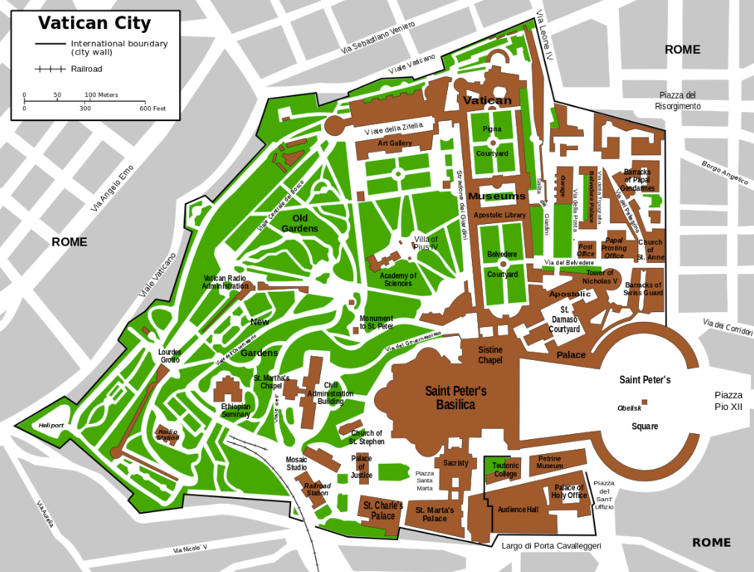
Basic elements in a definition of pilgrimage…
the movement…

Slide 8
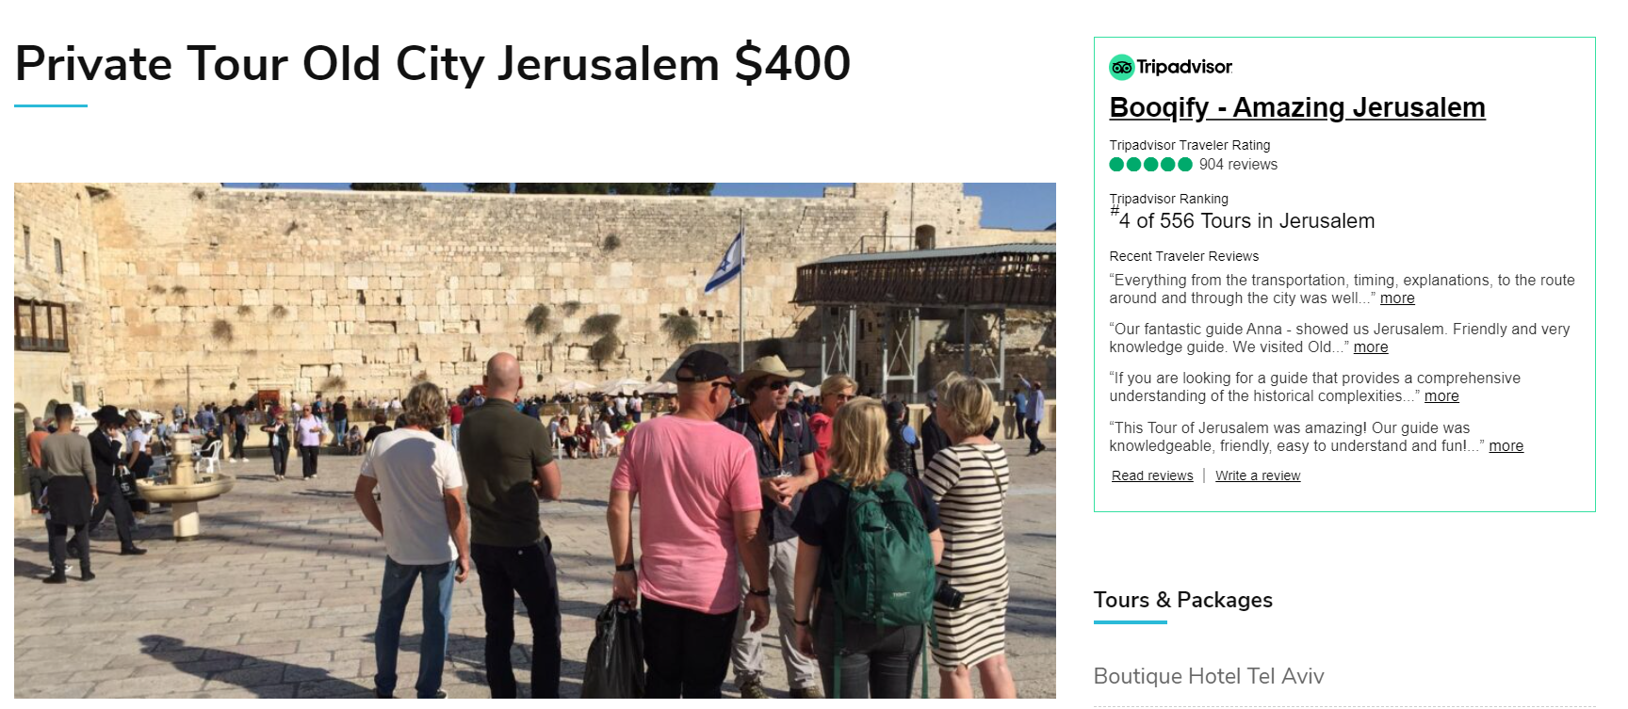
Basic elements in a definition of pilgrimage…
the motivation…
From: https://www.amazingjerusalem.com/trip/private-tour-old-city-jerusalem

Slide 9
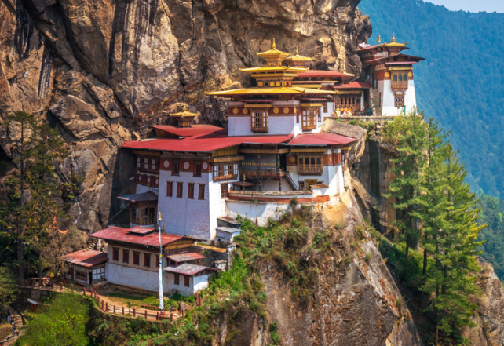
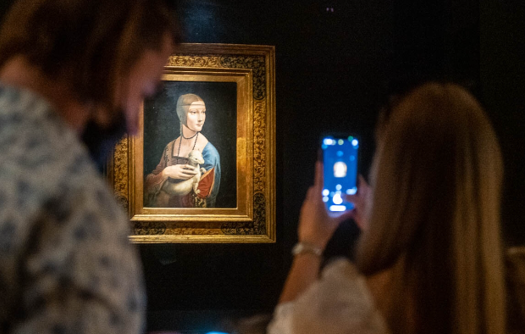
Basic elements in a definition of pilgrimage…
the destination (or event?)…
The Taktsang Palphug Monastery, Buthan
The Lady with an Ermine, Czartoryski Musem, Poland

Slide 10
Most visited pilgrims sites in the world are…

Slide 11
Sensō-ji, Tokyo, Japan, Buddhist temple - over 30 million visitors annually

Slide 12
The Kashi Vishwanath Temple, Varanasi, India, Hindu temple - over 21 million visitors annually

Slide 13
The Basilica of Santa María de Guadalupe, Mexico City, Mexico, Roman catholic temple - 21 million visitors annually

Slide 14
Tirupati Tirumala Devasthanams Temple, AndhraPradesh, Hindu, Vaishnavism and related sects, India – 18-19 million visitors annually

Slide 15
Notre-Dame, Paris, France, Catholic cathedral - 13 million visitors annually

Slide 16
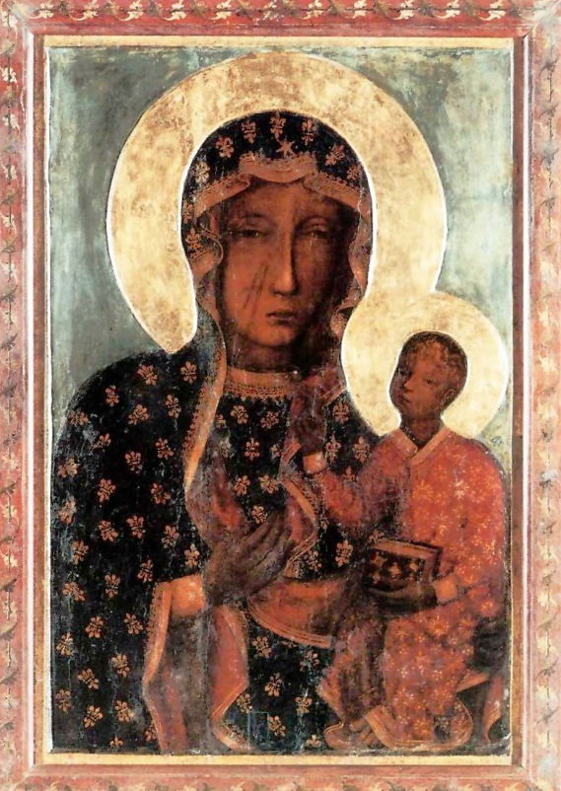
The complexity of a pilgrimage site, example 1 - The Jasna Góra Monastery, Poland

Slide 17
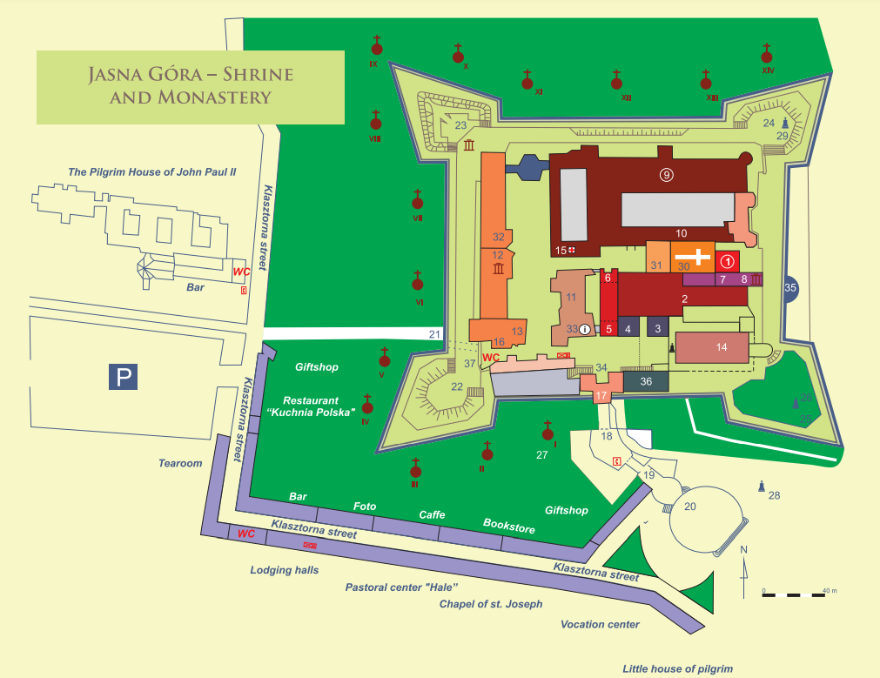
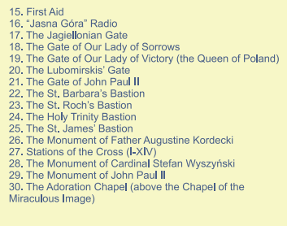

Slide 18
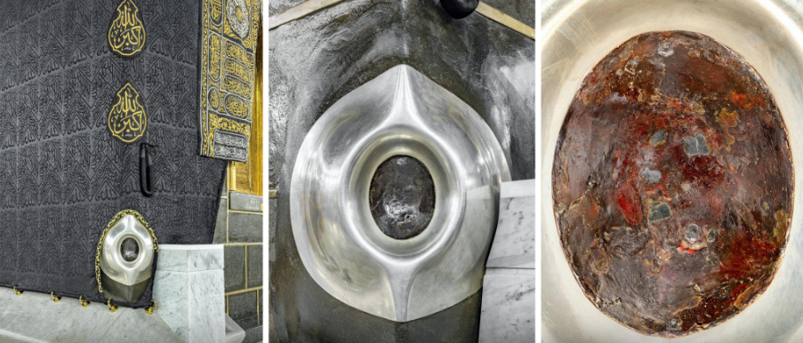
The complexity of a pilgrimage site, example 2 - Mecca, Saudi Arabia
From: https://smarthistory.org/the-kaaba/

Slide 19
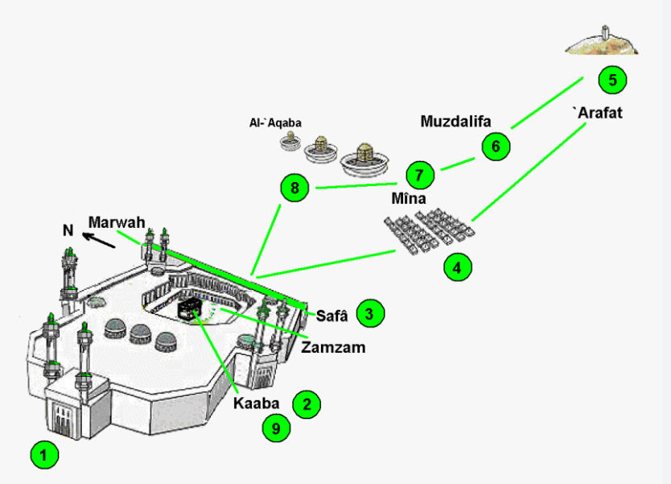

Slide 20
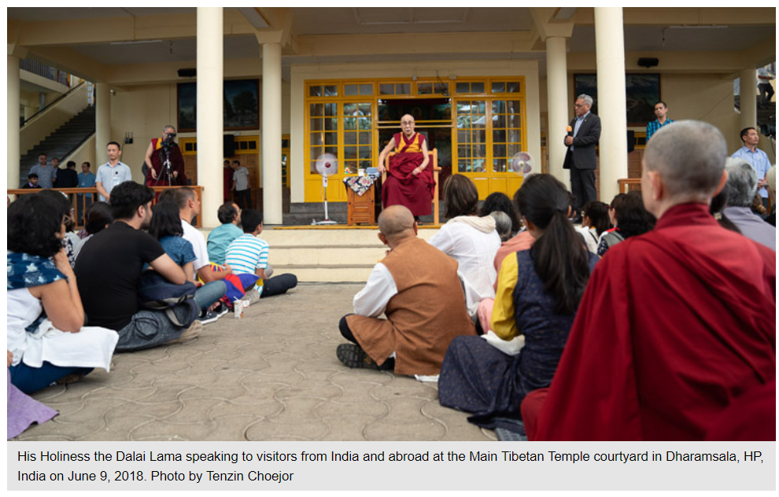
The main traditional (modern) perspectives of pilgrimage in anthropology/related studies
communitas - Victor & Edith Turner
contestation - John Eade, Michael Sallnow
'a pilgrim is half a tourist if a tourist is half a pilgrim’ – Nelson Graburn, Victor Turner

Slide 21
Communitas
the 'direct, immediate, and total confrontation of human identities, which, when it happens, tends to make those experiencing it think of mankind as a homogeneous, unstructured, and free community' (Turner, 1973)
Turners proposed that communitas comes in three processual forms or phases:
existential communitas
normative communitas
ideological communitas
an individual and his/her fellow pilgrim companions temporarily transcend the hierarchical social roles that often serve to divide them in their everyday life
separation (pre-liminal), transition (liminal) and re-aggregation (post-liminal) phases

Slide 22
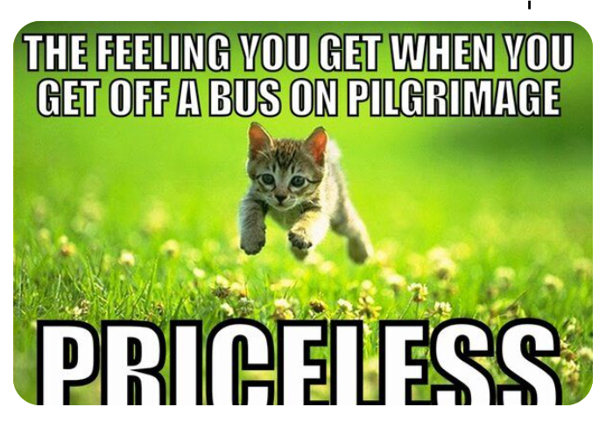
Contestation
pilgrimages should be seen as a contestation and competing discourses,
pilgrimages are not monolithic
while the physical place may stay the same, different actors, who consume and re-produce different meanings of the site,
the synergy of person-place-text (narrative) and it is individualized

Slide 23
Postmodern perspectives of pilgrimage in anthropology
tourism as the 'successor' par excellence of pilgrimage in this age of 'liquid modernity’ (Zygmunt Bauman 1996, 2000),
shift of identities based on the level of importance attribute to the peoples, places, or practices with which pilgrims/tourists interact at the moment,
a pilgrimage can have religious and secular motivations, can be organized or individual
a place of sacred, unique experiences can be subjective (e. i. a part of nature, a place of origin).

Slide 24
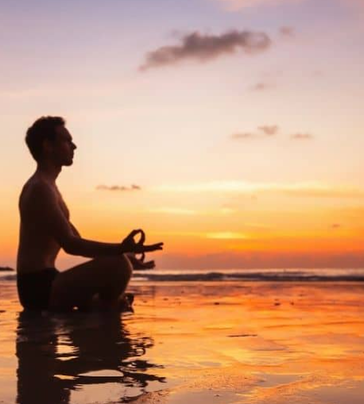
Pilgrimage and tourism difference… ?
There is no homogeneous tourist type and develops a continuum where ‘existential tourists’ resemble many pilgrims in the seriousness of their journey and the search for local ‘authenticity’ (Erik Cohen),
Pilgrimage and tourism difference - The pilgrim, and the ‘pilgrim-tourist’ peregrinate toward their sociocultural center, while the traveler and the ‘traveler- tourist’ move in the opposite direction.

Slide 25
If we assume that a pilgrimage can be understood not only as a collective or individual journey to a holy place related to religion, but also as a journey to discover one's own spirituality and get to know oneself, what, in your opinion, should be included in the ideal place of pilgrimage (e.g. element of the natural environment, architecture, characteristic feature, story related to or material thing?)

Slide 26
Song presentations…

