Slide 1
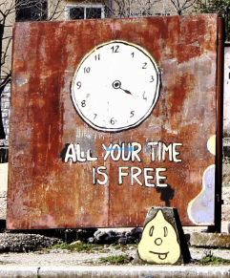

Slide 2
Anthropology of Travel and Tourism
Travel/tourism & time

Slide 3
Recapitulation from 11.10
Place categories in ethnology/anthropology (the place (and time) understood in a qualitative way (not quantitative), the symbolic level, ownership of a place, (cosmos vs. chaos), culture as a link not only between humans, but also between a man and a space.
Tourist destination - A geographical place conditioned to receive tourists and visitors who are interested in gazing certain attractions.
Tourist attraction - attracts people to a given place and makes them curious about it, to such a level that they are determined to invest money and time to see it/experience it.
Development of attractions during 20/21 century (increase in the wealth of society, increase in free time both in the form of paid holidays (holidays) and a two-day weekend, technology development combined with modern booking systems, increased mobility due to the development of the automotive industry, popularizing attractions in the media.
Six stages of creating a tourist attraction (Dean MacCannell) - naming the object, distinguishing the object from the environment, visibility and elevation of the object, placing on the altar, mechanical reproduction of the representation of the object social reproduction (eg naming a restaurant just like an object).
Song comments by – Yui and Noelia. Thank you ☺

Slide 4
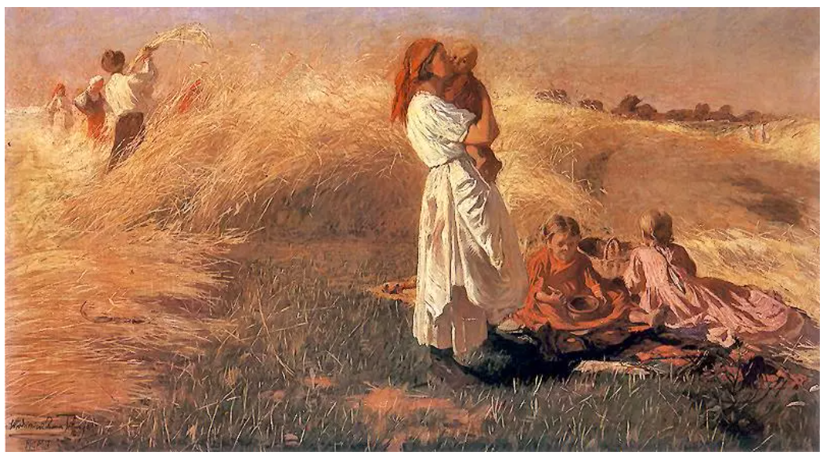
The concept of time in ethnology / anthropology and related humanities studies
time associated with nature, work, and religious ceremonies
a person's time subordinated to the time of the community, the church, feudal lords, etc.
time as a natural part of being, not as an external abstract unit
the role of turning points, such as natural cataclysms – floods, epidemics, wars, etc.

Slide 5
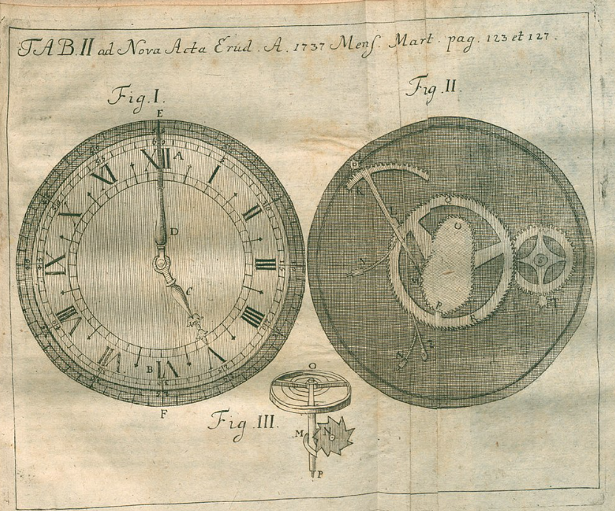
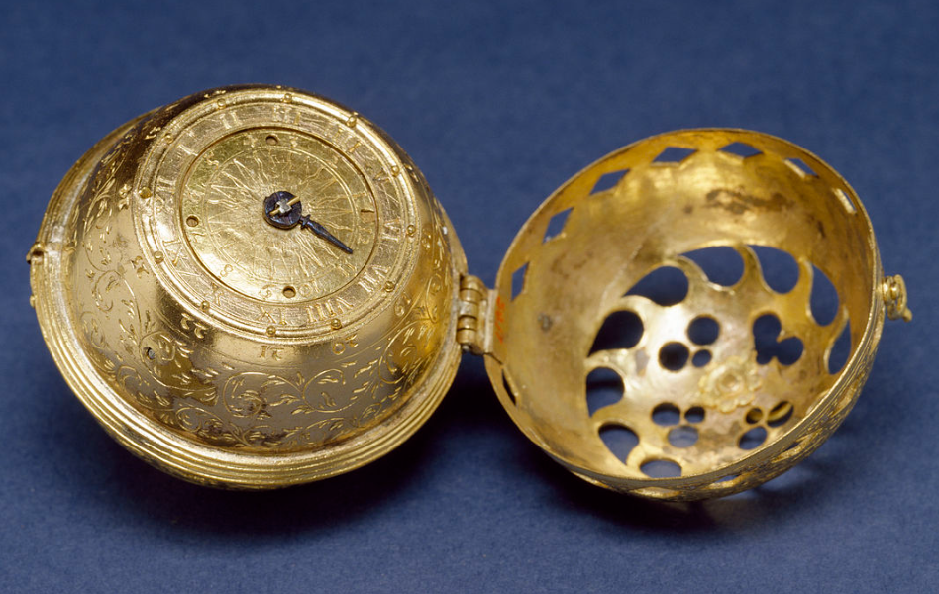
Watches….
personal watches invented at the turn of the 16th and 17th,
pocket watches till World War I,
wristwatch initially as a fashion,
usefulness for the army and popularization after World War II,

Slide 6
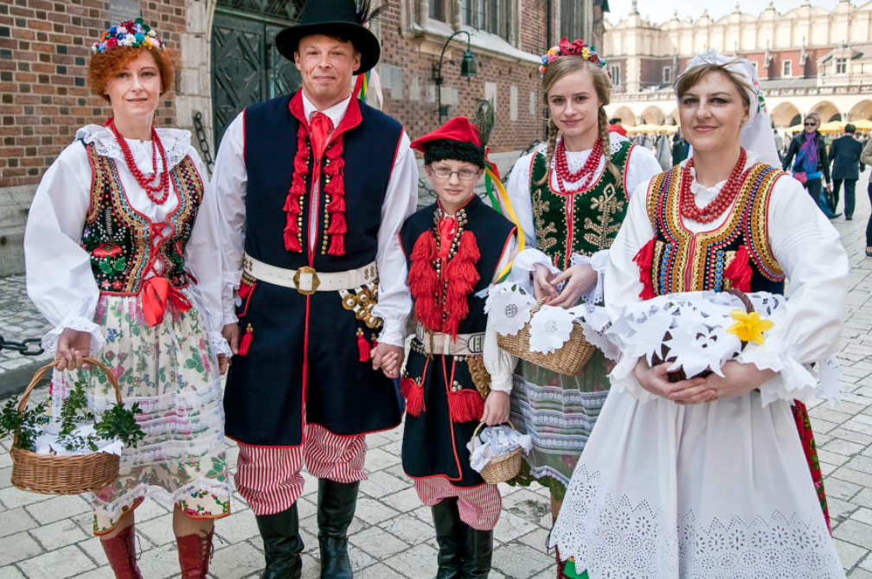
The concept of time in ethnology / anthropology and related humanities studies
time as a qualitative unit
dimensions associated with important meanings and regulations in society, for an individual human being
sacred time vs secular, ordinary time (eg. Working days vs. Holiday days)
Henri Bergson, quantitative time (fr. temps) is only a symbolic representation of pure duration (fr. la durée), a subjective perception of each individual
the continuity between sacred and secular time is ensured by the rituals present in individual societies (Mircea Eliade)
Edmund Leach: the human perception of time is based on the observation of successive changes: life/death, summer/winter, day/night, young/old, hot/cold
Émil Durkheim and Marcel Mauss - pointed to society and individuals as the source and determinant of time and space, historically and culturally diverse

Slide 7
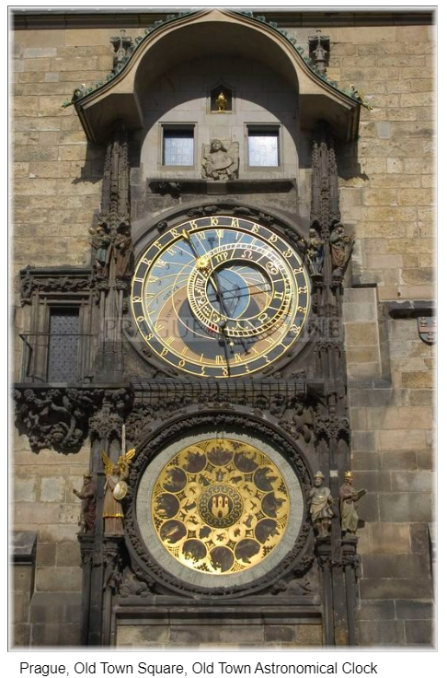
The concept of time in ethnology / anthropology and related humanities studies
Émil Durkheim and Marcel Mauss - pointed to society and individuals as the source and determinant of time and space, historically and culturally diverse
Edward Hall: time is a "deep system" of cultural and communal life
a linear form of the time (Christianity), but also key role of agricultural schedule and the pre-Christian understanding of time and the ceremonies associated with it
"merchant and craft time”

Slide 8
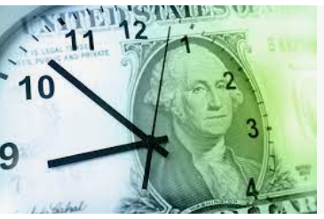

The concept of time in ethnology / anthropology and related humanities studies
the economic understanding of time - Benjamin Franklin - "time is money„ (1748)
time as a separate abstract category in modern societes
the fragmentation of linear and quantitative time
Thomas Eriksen: a multiplicity of reference points or a metaphorical approach, motionless moment-points
Michael Maffesoli: the time of society as devoid of the cyclical and linear dimension, but consisting of disordered points, moments
postmodern society, the fragmentation of daily activities
off-line time vs. on-line time

Slide 9



Free time?
contrasting free time with work time
free time, half-free time
real free time vs. busy free time
leisure time
the boundary between free and non-free time?

Slide 10
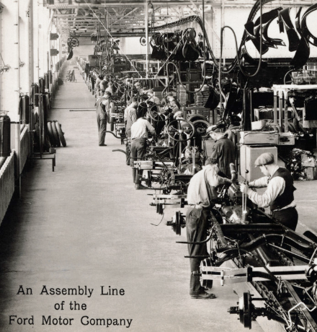
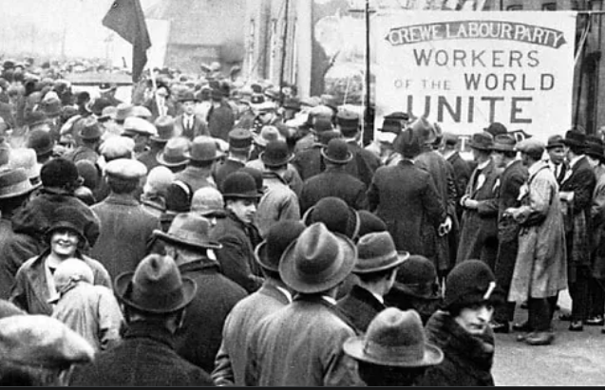
Historical changes related to free time
in pre-industrialization, time off work is often a time of celebration, related to belief and religion
industrial changes (from the end of the 18th century)
the 19th century - the working hours of laborers generally reached 14-16 hours a day
the beginning of the 20th century – the working hours across Europe ranged from 10 to 11.5
since 1919 - 8 hours a day and 48 hours a week
within the 19th and 20th centuries, working hours were cut in half, from around 80 hours a week to 40-48 hours

Slide 11
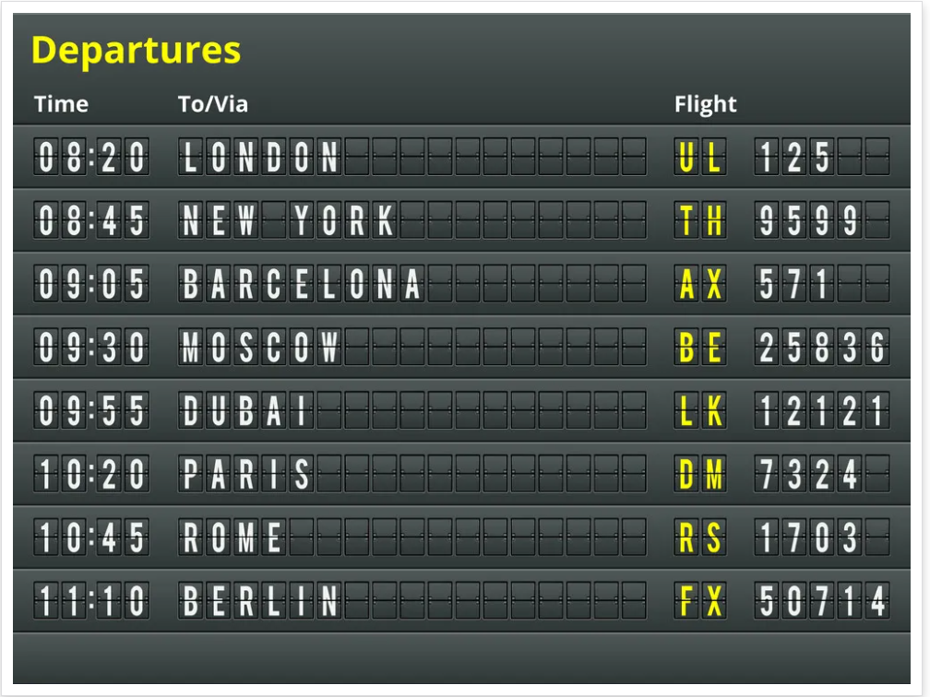

Time in tourism
physical time (travel length, timetables, time zones…)
social, qualitative time (the emphasis on the content of time)

Slide 12

The ownership of time

Slide 13
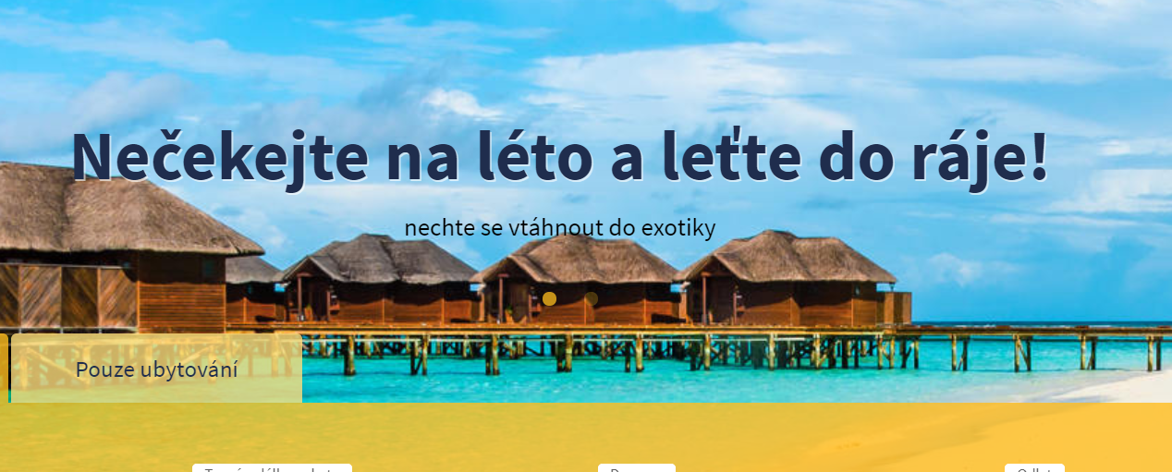
The ownership of time

Slide 14
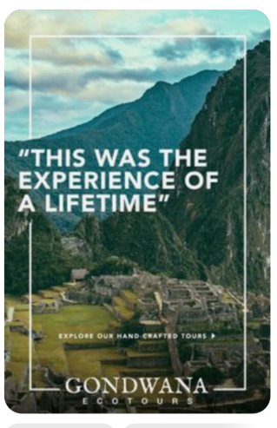

The myth of exceptional time (exceptional experience)

Slide 15

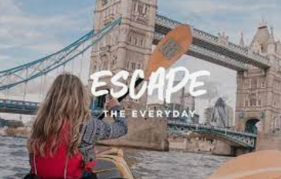
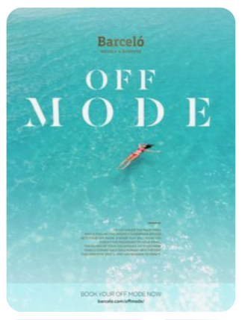
The escape from time (and place)

Slide 16
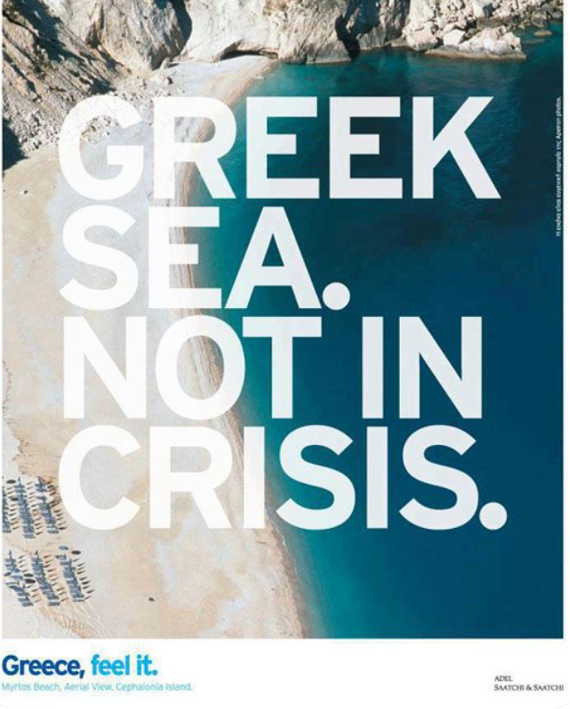
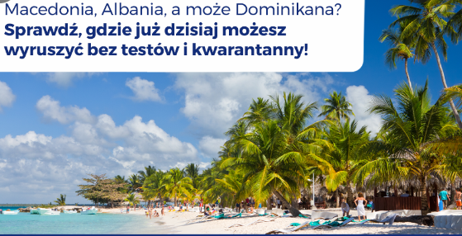
The escape from time (and place) during the crisis - example of the covid-19 pandemic or the so-called migration crisis

Slide 17

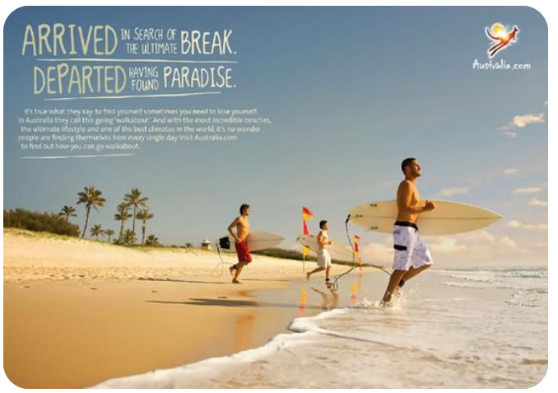
The paradise metaphor

Slide 18
Types of paradise (Graham Dann, 1996 ):
• Paradise contrived: no people; natives as scenery; natives as cultural markers;
• Paradise confined: tourists only—tourist ghetto;
• Paradise controlled: limited contact with locals: natives as servants, natives as entertainers, natives as vendors;
• Paradise confused: further contact with locals, attempt to enter locals-only zones: natives as seducers, natives as intermediaries, natives as familiar, natives as tourists, tourists as natives.
Notes:
There are also another types of paradise, in sense of imagiem presented in tourist brochuers which Graham Dann presented in his work The people of tourist brochures in the book edited by Tom Selwyn, The tourist image. Myths and myths making in tourism.
Dann studied over 5,000 images featured on almost 1,500 pages in 11 British holiday brochures. Dann’s main point is that ‘less than 10 per cent of the were tourists and locals shown together, an indication that, for the media-makers at least, the idea of tourism as a meeting of peoples was somehow not to be encouraged.
There is rather tendency to promote holiday or travel as alienated, luxurious expedition. It is mainly oriented on the relationship tourist - nature, tourist - lonely trip, tourist - relaxation, tourist – rest.

Slide 19
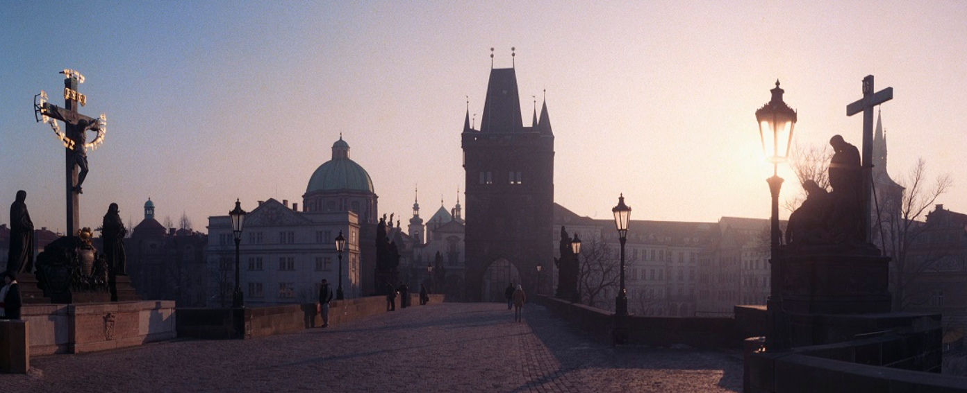
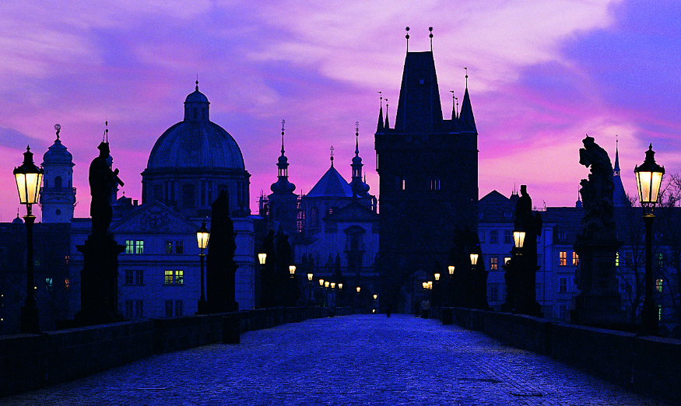
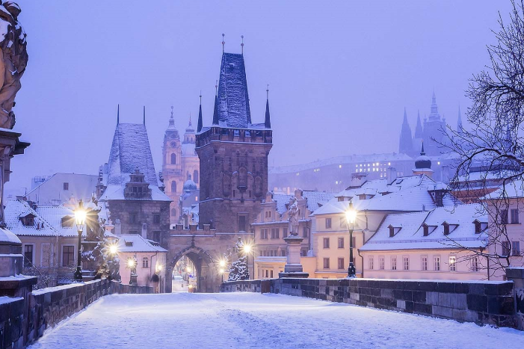
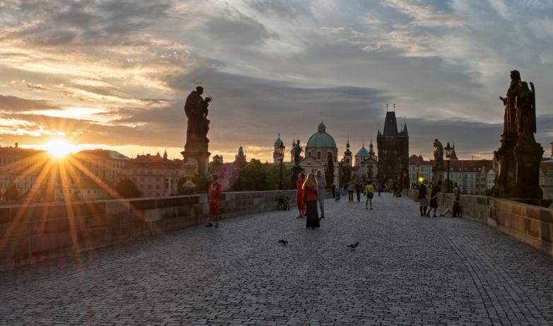
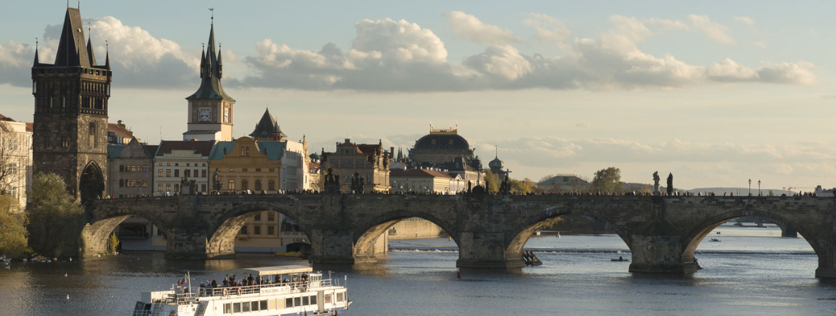
Paradise contrived
Notes:
There is similar situation with old bridge in Charles bridge in Prague (Karluv most). On the promotional site, WWW.prague.eu, which is official site, we have this kind of pictuers of the bridge:

Slide 20


Paradise confined

Slide 21
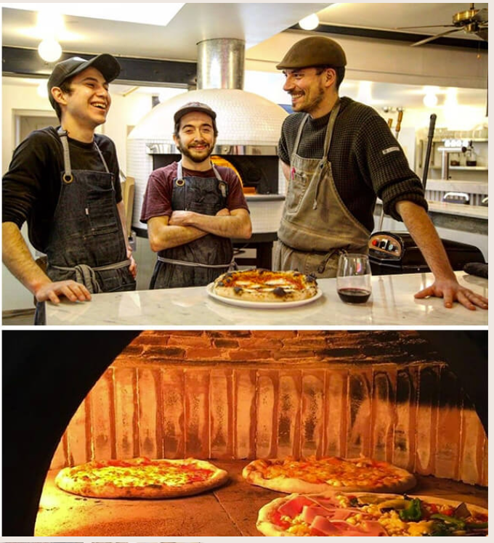
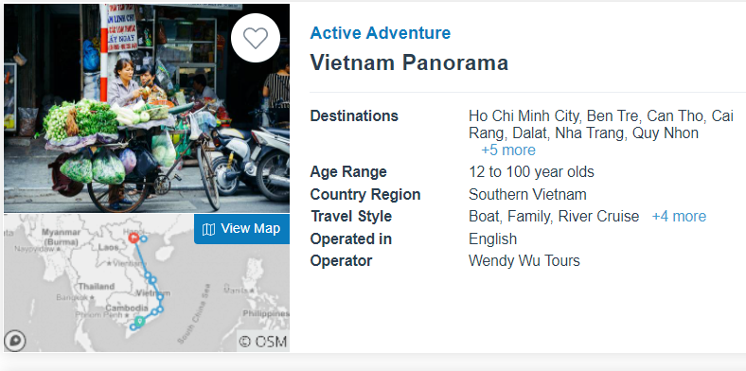
Paradise controlled

Slide 22
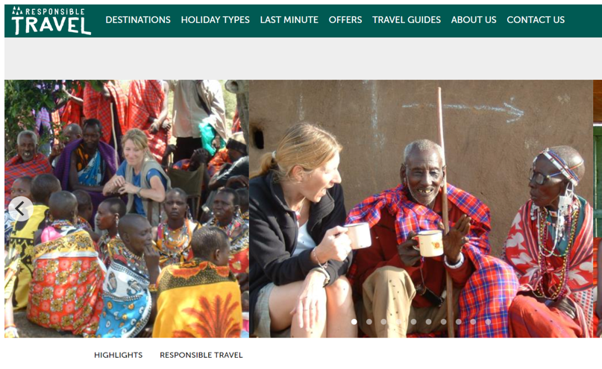
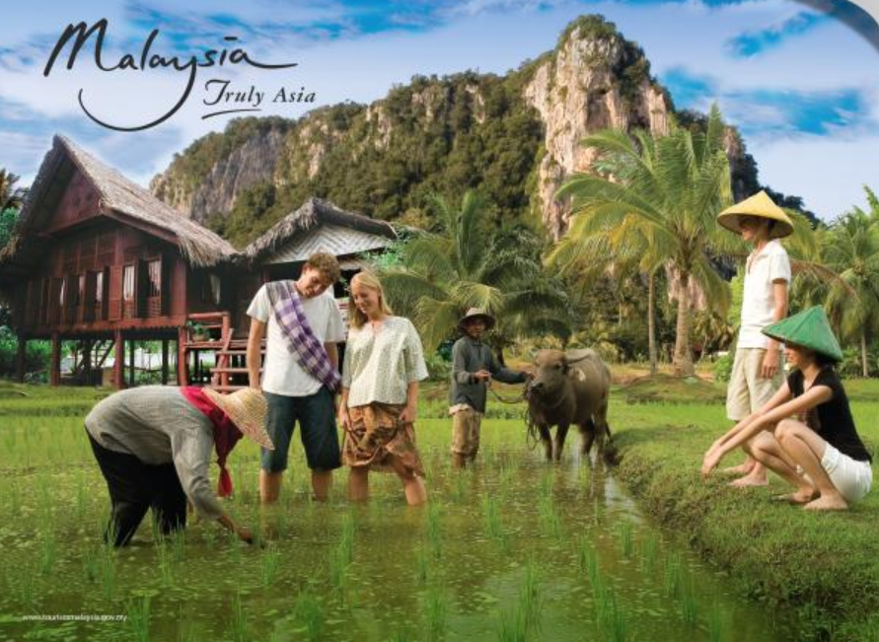
Paradise confused

Slide 23
The songs presentations…

