Slide 1
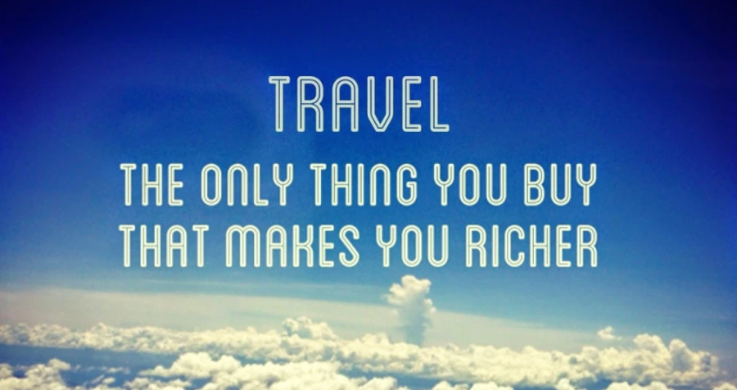

Slide 2
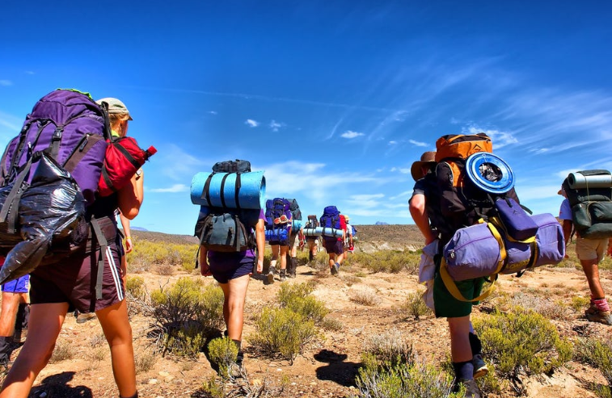
Anthropology of Travel and Tourism
Joanna Maurer
joannamonika.maurer@gmail.com

Slide 3
today ☺ - Introduction
27. 9 - History of tourism I
4.10 - History of tourism II & Anthropological perspective on tourism
11.10 – Travel/tourism & the place
18.10 – Travel/tourism & the time
25.10 – Travel/tourism & the thing
1.11 – Travel/tourism & the Other
8.11 - Types of tourism
22.11 – Pilgrimages and its rituals
29.11 - Ethical issues in tourism
6.12 & 13.12 – Presentations (or also tourism & migration)

Slide 4
Presentation of a song (text or videoclip or both ☺) – during the semester
song or video clip related to traveling experience, tourist experience, available on youtube
a short comment (a few sentences, 2-3 minutes) on how the travel theme was used, what images, references appear in the piece,
the main aim is to look / capture how the travel (journey) - understood as a collection of meanings, symbols, imaginations, myths and motifs - is presented in popular culture.

Slide 5
Final presentation/essay - December
a presentation ( around 10 min., 6.12 & 13.12) or an essay (3-5 pages, deadline 13.12),
a place considered to be touristic
short general characteristic & deep analysis
History context (when a place started to be seen as touristic), what attracts tourist to a place, if/how a place changed since is touristic, what are strategies for promoting a place, how many people go there every year, tourists-hosts relations & influences etc., your own reflections.

Slide 6
European/Central-Eastern European perspective,

Slide 7
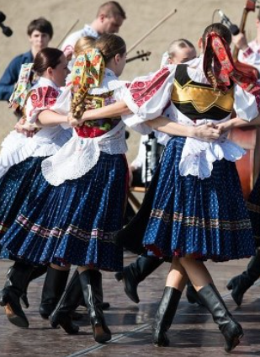
Anthropology
gr. ἄνθρωπος anthropos "man", λόγος logos "science“
interdisciplinary field of science (humanities, social and natural sciences); deals with the study of man as an individual in society in the context of historical changeability, taking into account socio-economic and cultural conditions; seeks understanding of the role of culture, power structures, rituals in human life
has two main trends: 1. physical anthropology dealing with biological and physiological variability of humans; 2. cultural anthropology (social anthropology) dealing with people in the community (similar to sociology)
in Europe (the Czech Republic, Slovakia, Germany, Poland, the Baltic countries) it is also called ethnology; with a stronger interest in folk culture (customs, rituals, traditional costumes, music, etc.)

Slide 8
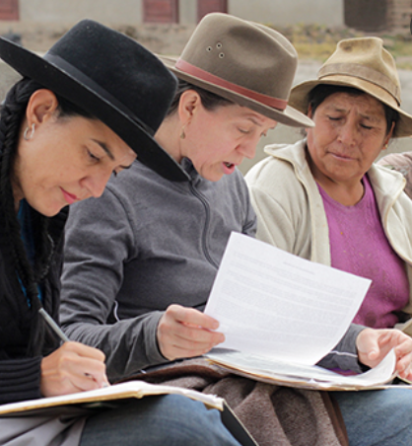
Why should we talk about tourism from an anthropological point of view?
anthropology as a branch of science focused on the study of cultural variation among humans, analyzing the ways of life of the so-called the others, has excellent tools to capture and understand human experiences related to tourism - participant observation, face-to-face interviews, in-depth analysis

Slide 9
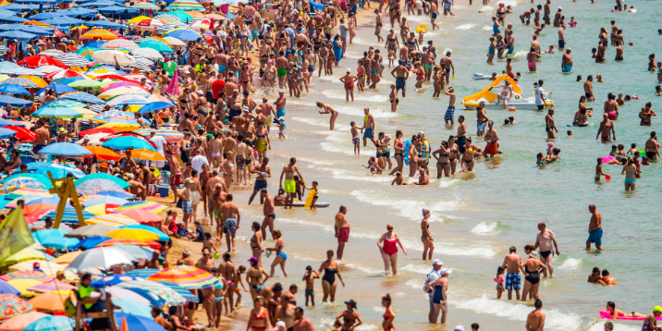
Why should we talk about tourism from an anthropological point of view?
a great, global social phenomenon, concerning many spheres of life and influencing the way of life and earning of thousands of people
it concerns all of us, probably we have all been, we are or will be in the role of tourist or host; universal experience

Slide 10
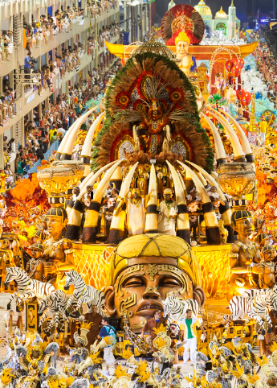
Why should we talk about tourism from an anthropological point of view?
tourism change societies and cultures, rituals and values, social structures, etc.,
change places (infrastructure, landscape),
represents processes of globalization, etc.
reflects human behavior, rules, habits, desires

Slide 11
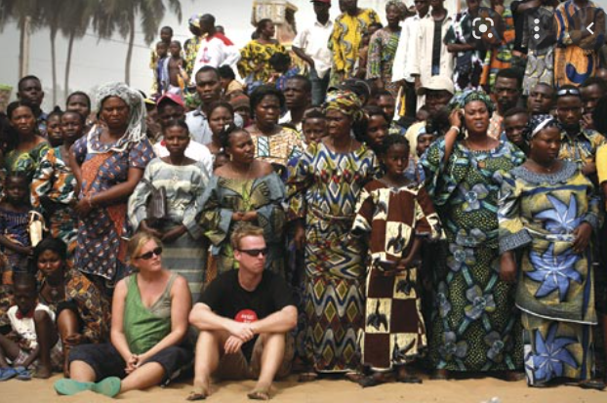
Anthropologists and tourists… ?
anthropological filed sites <–> tourist destinations

Slide 12
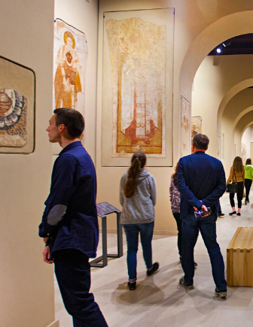
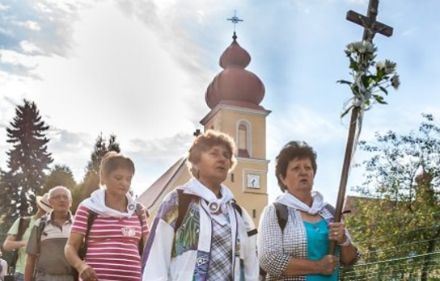
What is tourism?
tourism is a phenomenon with no universally accepted definition, due to complexity and individualism of the travellers themselves and the activities they undertake

Slide 13
What is tourism?
"the business of providing services such as transport, places to stay or entertainment for people who are on holiday" The Cambridge Dictionary
"the sum of the phenomena and relationships arising from the travel and stay of non-residents, insofar as they do not lead to permanent residence and are not connected with any earning activity” Walter Hunziker and Krapf Kurt, 1941
“the largest scale movement of goods, services, and people that humanity has perhaps every seen”, David Greenwood , 1989

Slide 14
What is tourism?
"the phenomenon of tourism occurs only when three elements—temporary leisure + disposable income + travel ethic — simultaneously occur. If travel is not deemed culturally appropriate, then time and resources may be channelled elsewhere” Valene Smith, 1981
"travelling to and staying in places outside of usual environment for not more than one consecutive year for leisure and not less than 24 hours, business and other purposes” World Tourism Organization, 1995
"tourism is a complex phenomenon with psychological, sociological and cultural dimensions" John Urry, 2002
"tourism shall be constitued of any kind of travel activity that includes the self-conscious experience of another place” Erve Chambers, 2010

Slide 15
What is tourism?
Traveling, the status of a tourist or a host is an important role, a framework/reference point in the life story of every person who finds himself in the process of traveling in one way or another. Traveling brings meanings that affect our behavior. An important aspect is the liminality of traveling, being in a kind of alternative place and time. The ritual role is also very important.

Slide 16
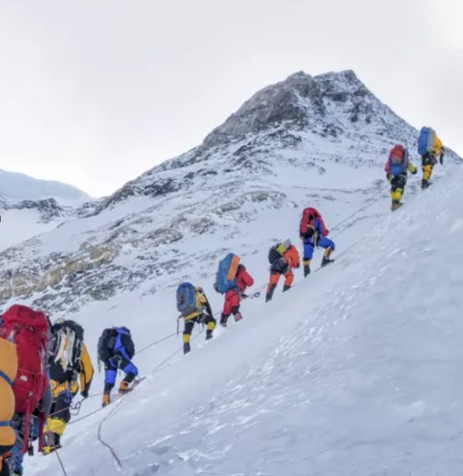
Liminality (Arnold van Gennep, Victor Turner)
the middle stage of a rite of passage (preliminal – liminal – postliminal),
between identities, places, times, social statuses,
e.g. wedding, baptism, boot camps, graduation, pilgrimages, travels

Slide 18
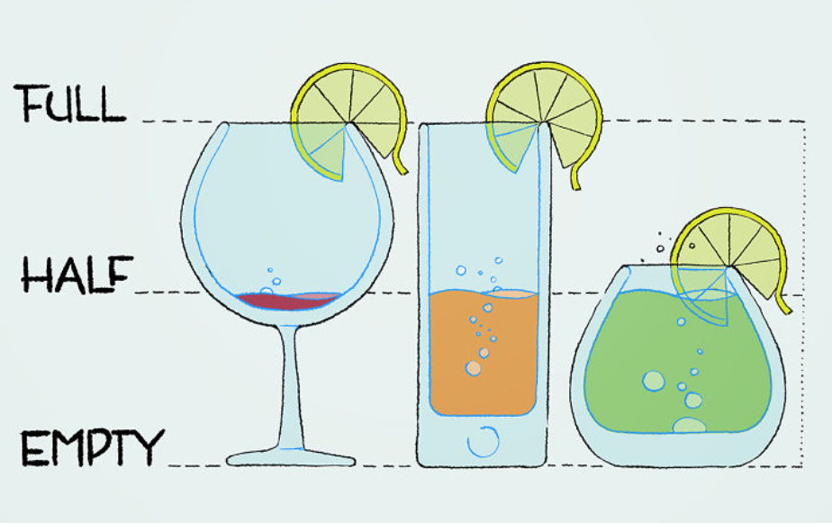
Statistics…

Slide 19
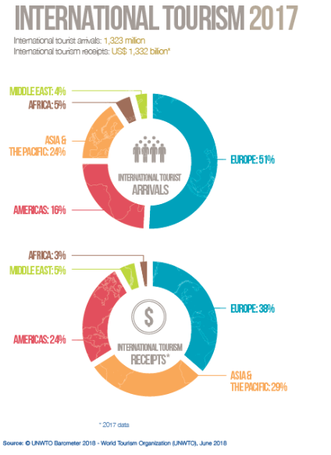
people movement (1, 323 milion)
economic power (1,332 bilion)
labour market (1/10 jobs are connected somehow with tourism)

Slide 20
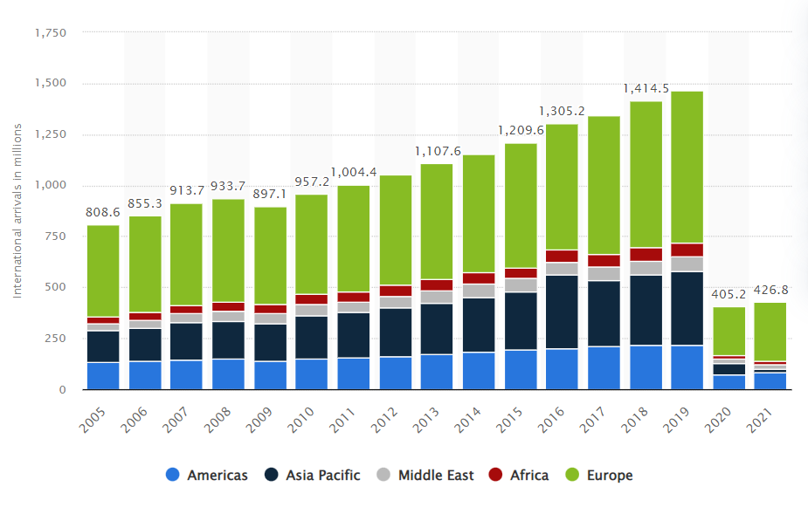
Number of international tourist arrivals worldwide from 2010 to 2021, by region (in millions)

Slide 21
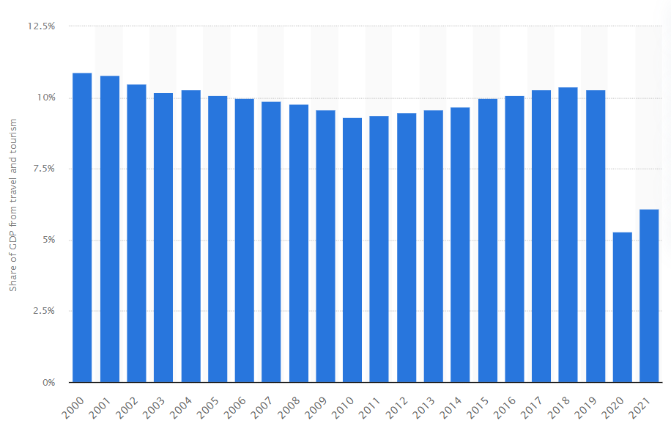
Share of the total GDP generated by travel and tourism worldwide

Slide 22
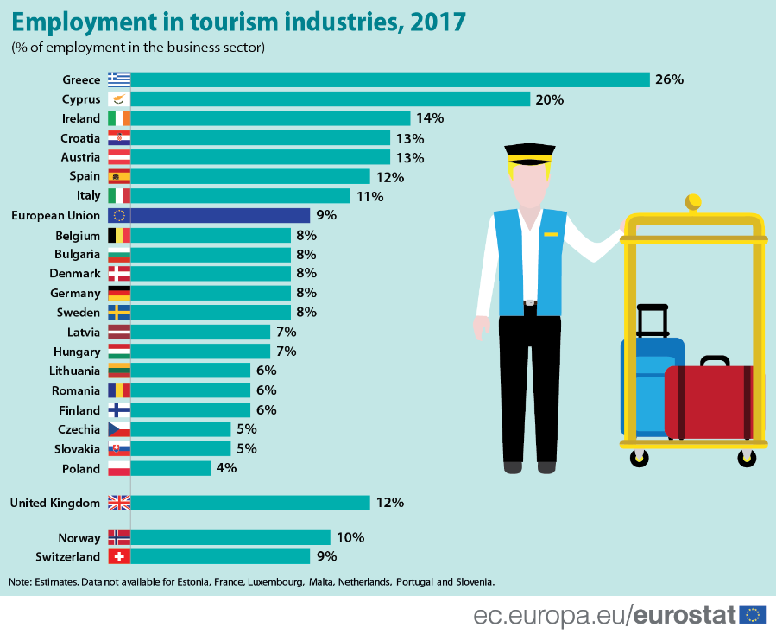

Slide 23
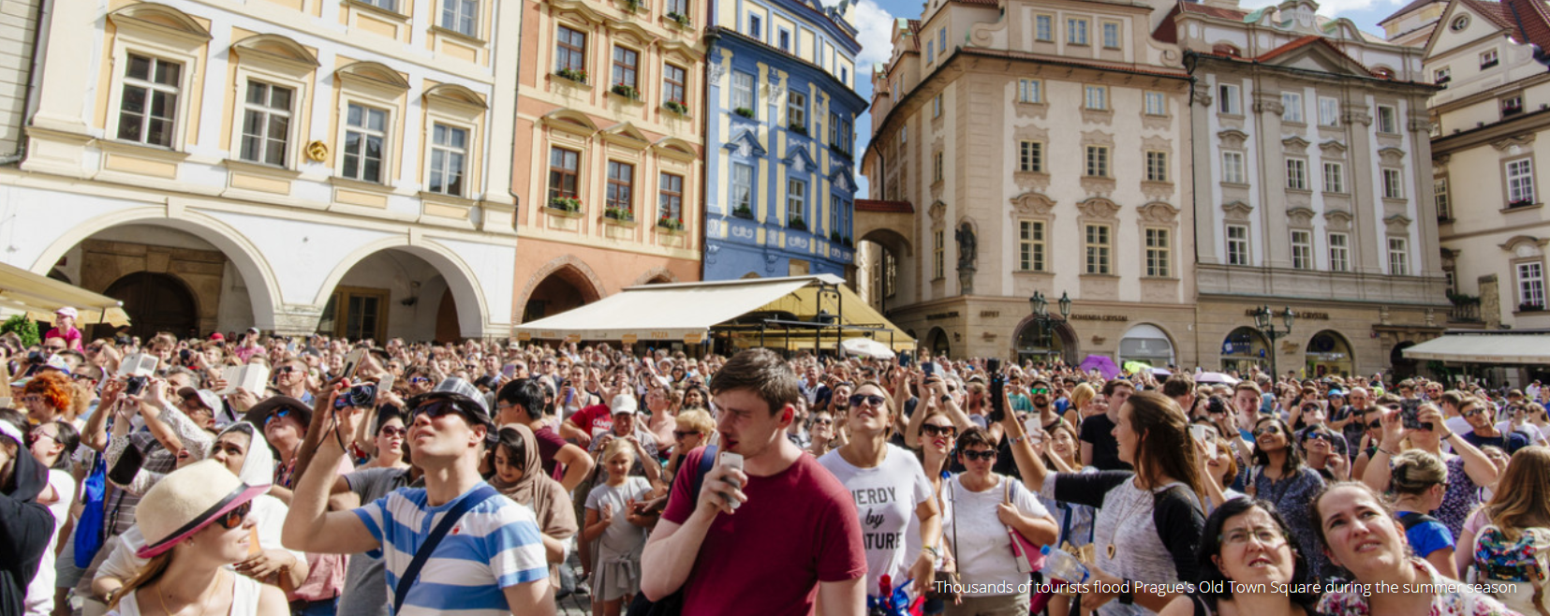
Why do you travel? Our own definition of tourism from the perspective of its meanings/importance to us ☺

Slide 24
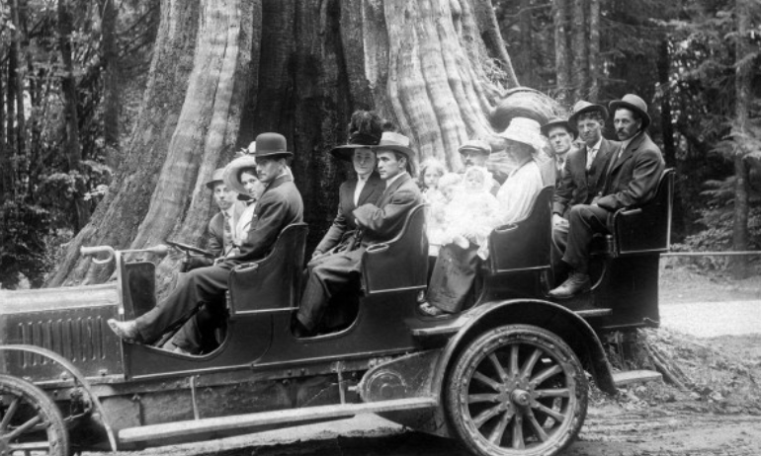
Next time…
…history of tourism ☺

Slide 25
The song example…

