Slide 2
Anthropology of Travel and Tourism
Travel/tourism & the place

Slide 3
Recapitulation from 4.10.2022
the rise of tourism im modern times 1840 – 1914 – impact of industrialization and urbanization
the first tourist agency – Thomas Cook, UK
development of hotels, motels & campsites
transport is an integral part of tourism (1. functional role 2. transport as tourism)
individualization of tourism and its mass character (turn of the 20th / 21st century)
changing the nature of tourism - traveling for rest and relaxation & accessible to all „social classes”
interesting song comments by – Petr and Jo-Ann

Slide 4
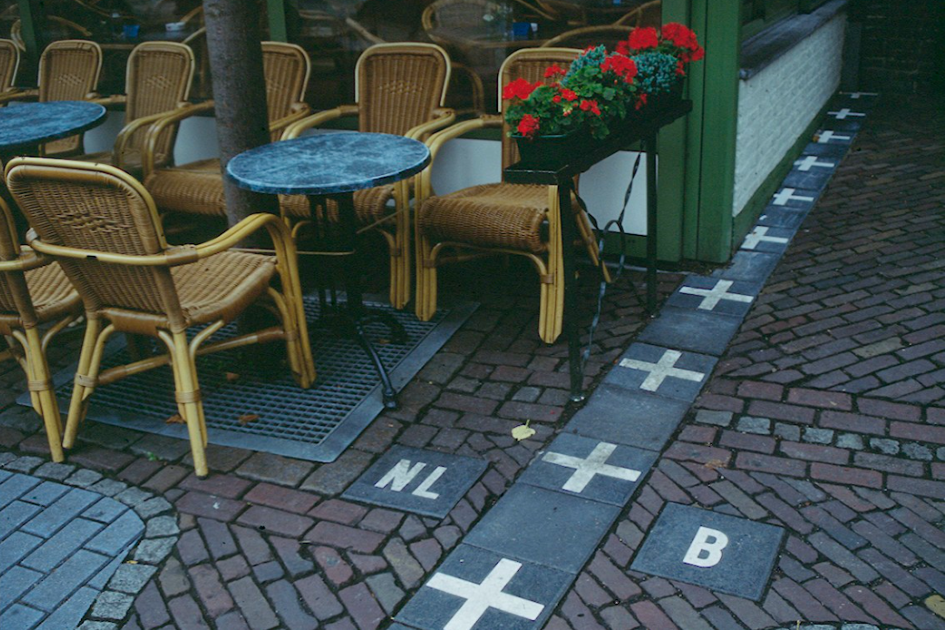
Place categories in ethnology/anthropology
the place (and time) understood in a qualitative way (not quantitative)
the symbolic level
ownership of a place, (cosmos vs. chaos)
an important factor in the construction of an individual's identity
Arnold van Gennep: exclusion, liminal and re-inclusion
Mircea Eliade: sacrum – profanum, hierophany
A person belonging to a place causes a place to belong to a person
Border in Baarle, between Belgium and the Netherlands

Slide 5
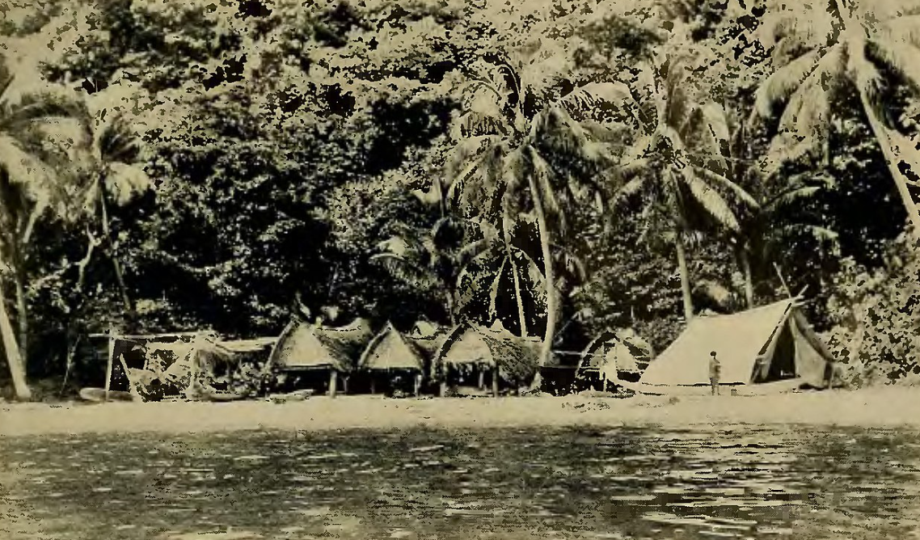
Place categories in ethnology/anthropology
Bronisław Malinowski - myth is a factor that transforms the landscape into something familiar, thereby giving it meaning. At the same time, the features of the surrounding scenery – hills, rocks, sea, land – are for the natives a confirmation of the truth of the myth.
Leslie White - culture as a link not only between humans, but also between a man and a space.
Anthony Giddens discusses the "emptying" not only of space, but also of time, which he understands precisely as abstraction and neutralization (loss of meaning and action).
The native village and Malinowski's tent in The Trobriand Island

Slide 6
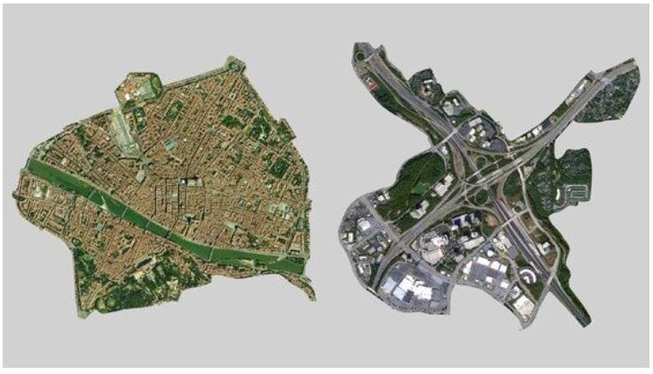
Place categories in ethnology/anthropology
Erving Goffman talks about place in the context of exploring social life as play.
Eric Hirsch also emphasizes that human actions and experiences, as well as ideas about them, are "written" into the landscape. He defines the concepts of "foreground" and "background" of social life as everyday subconscious events taking place in a certain space and patterns
Marc Augé the distinction between places of significance and insignificance for individuals – place vs. non-place
Zygmunt Baumann "no part of space is privileged and has no special value"
place vs. non-place, from strongtowns.org

Slide 7
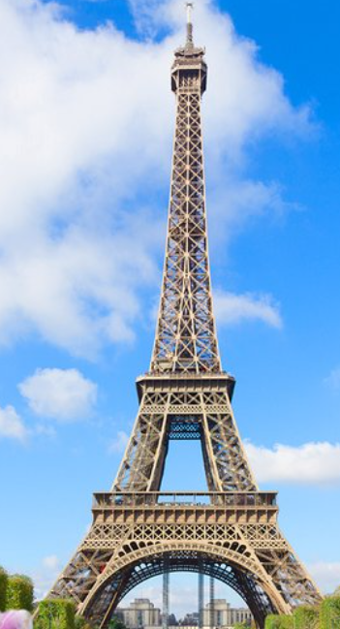
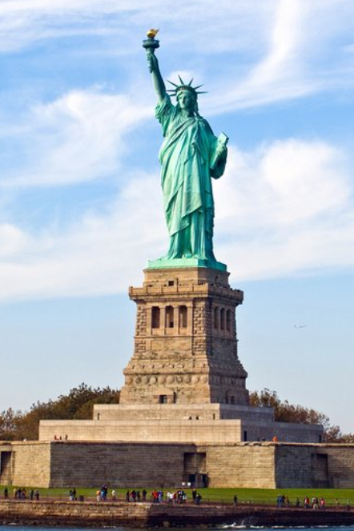
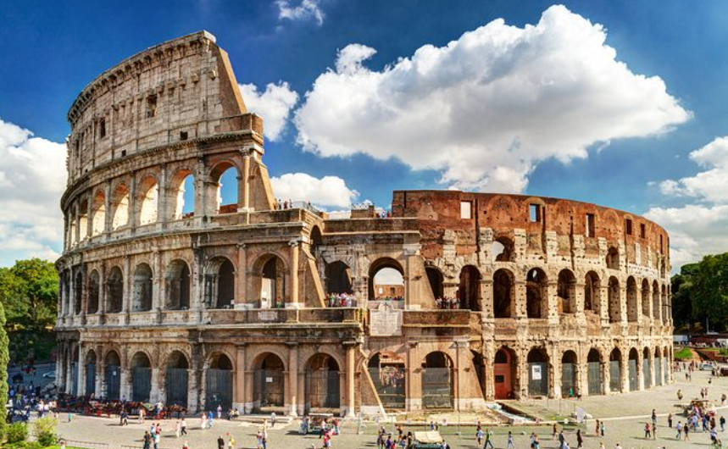
Tourist destination
A geographical place conditioned to receive tourists and visitors who are interested in gazing certain attractions. Singular territory receiver of tourist flows. It locates the tourist resources that generate the activity, as well as the infrastructures and equipment that make it possible, also having an image and marketing channels that make the destination recognizable and accessible by the demand.

Slide 8
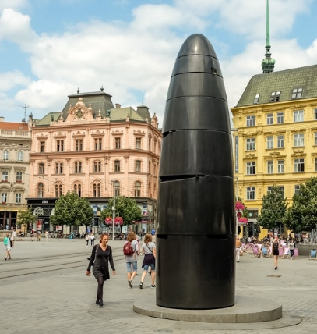
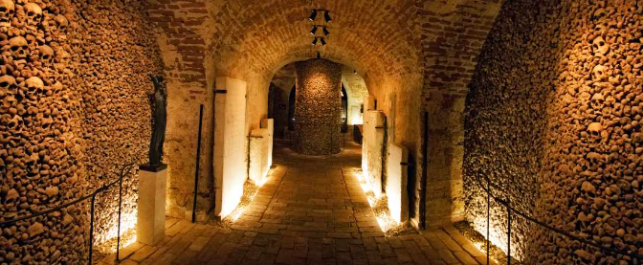
Tourist attraction
attracts people to a given place and makes them curious about it, to such a level that they are determined to invest money and time to see it/experience it
places of natural beauty, historic sites, monuments, ancient temples, zoos, museums and art galleries, botanical gardens, buildings, theme parks and carnivals, items of public art, historical cultural events, but also places associated with tragic events, such as war…

Slide 9
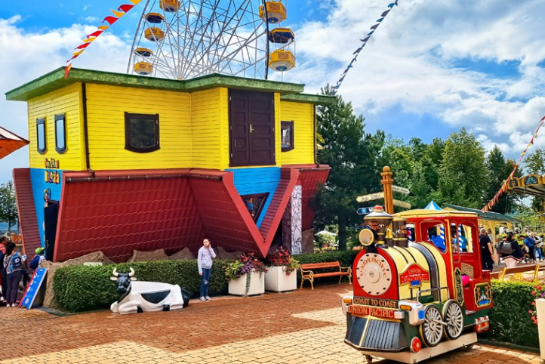
Development of attractions during 20/21 century
increase in the wealth of society,
increase in free time both in the form of paid holidays (holidays) and a two-day weekend,
technology development combined with modern booking systems,
increased mobility due to the development of the automotive industry,
popularizing attractions in the media,
intensive marketing of places destinations run by governments, local communities and tourism enterprises,
development of travel packages that make travel to distant places comfortable.
Rabkoland, the amusement park in south Poland

Slide 10
Some examples of tourist attractions…

Slide 11
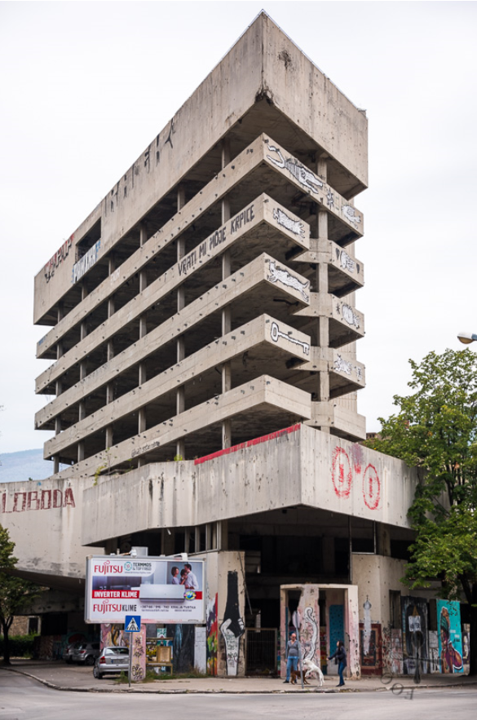

Slide 12
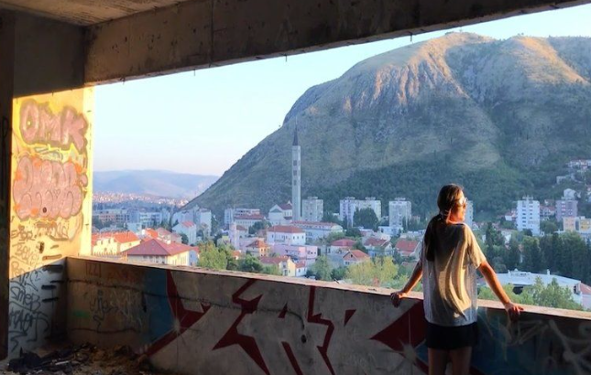
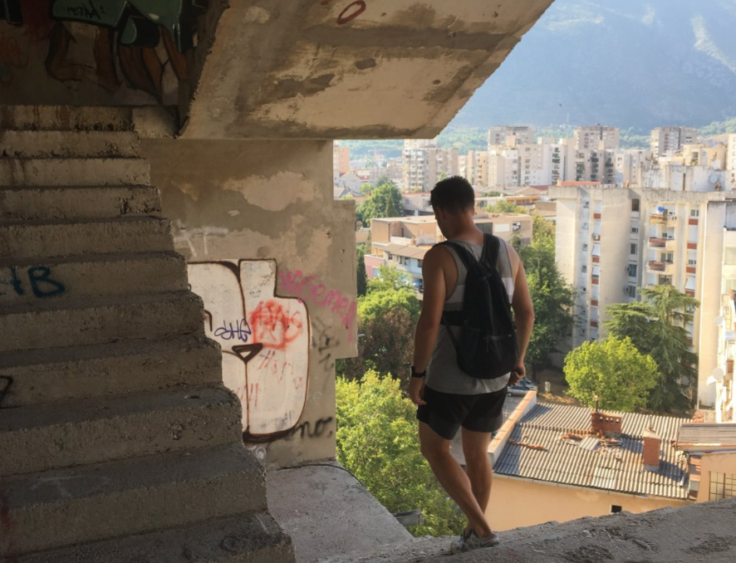
The Sniper Tower
Mostar, Bosnia and Herzegovina
former bank, used as a sniper tower during the initial Siege of Mostar
the building is officially closed,
as a tourist attraction since the beginning of the 20th century

Slide 13
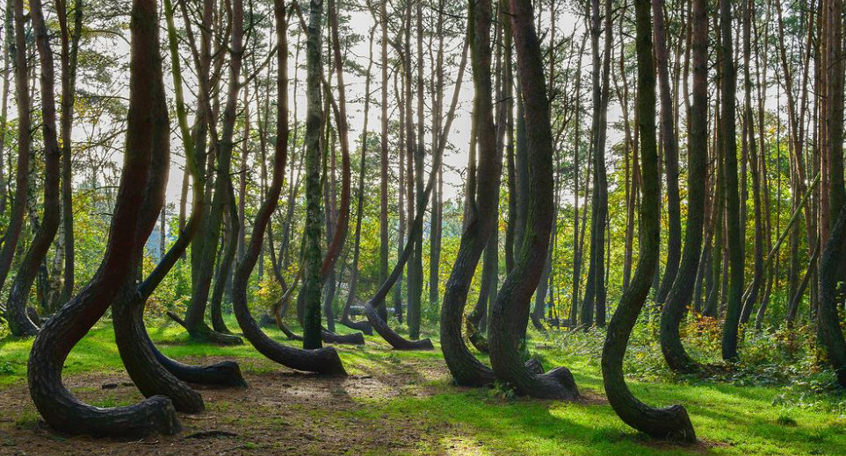

Slide 14
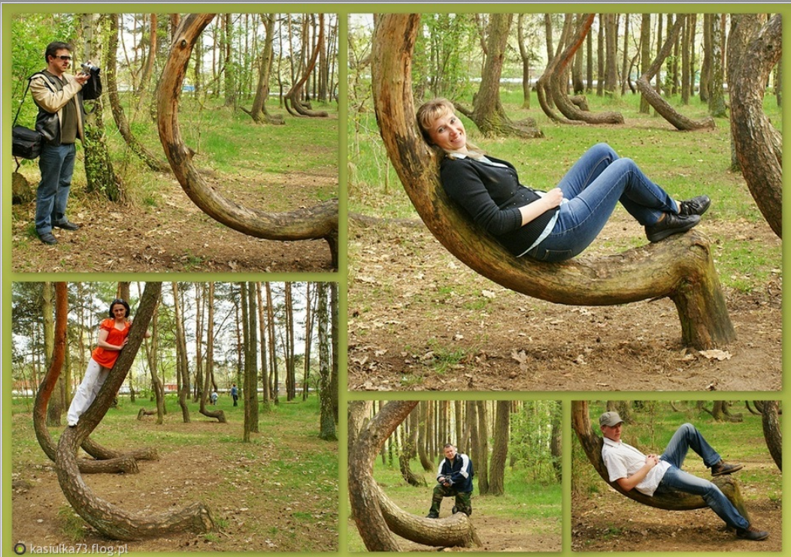
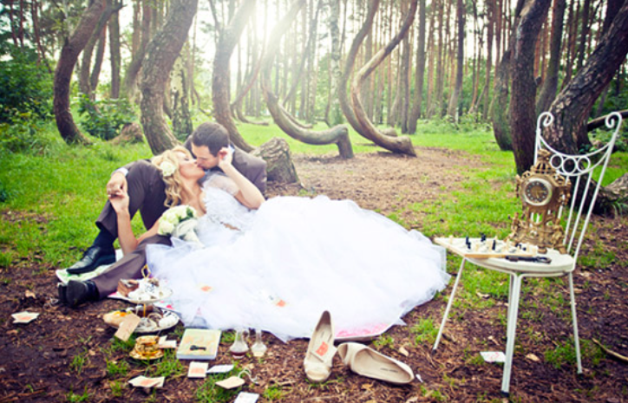
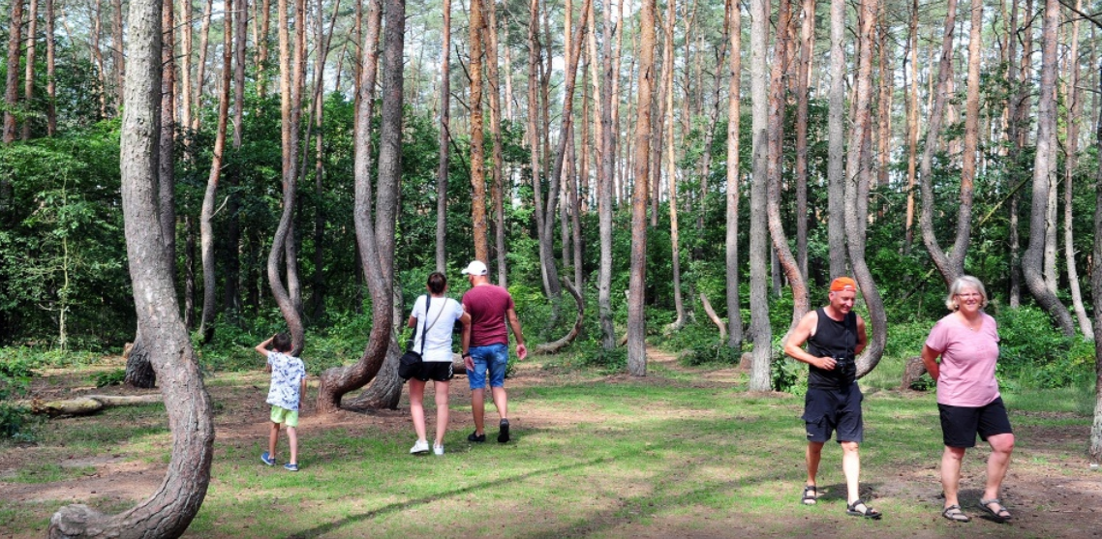
The Crooked Forest
Nowe Czarnowo, Poland
it is not known exactly how it was created
tourist interest since the 90s of the 20th century

Slide 15
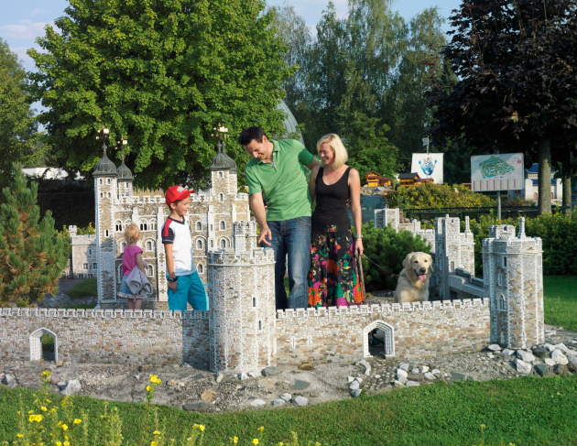

Slide 16
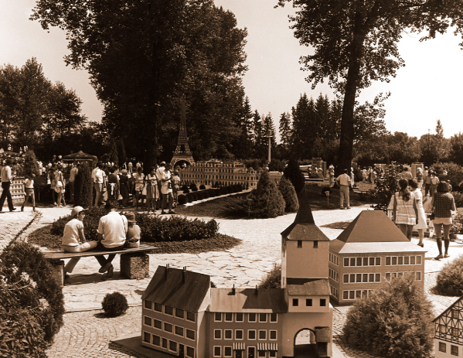
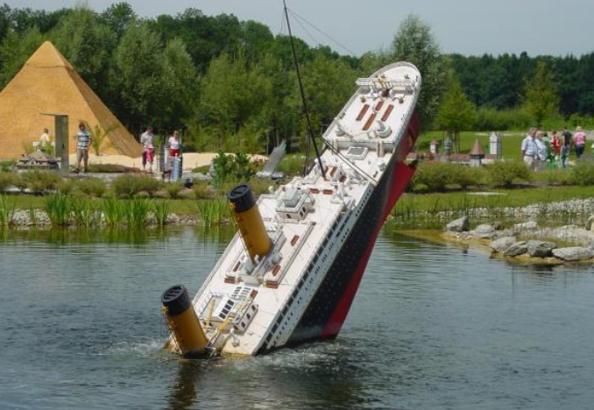
The miniature park Minimundus
Klagenfurt, Austria,
established in 1958,
models recreated in detail according to original plans

Slide 17
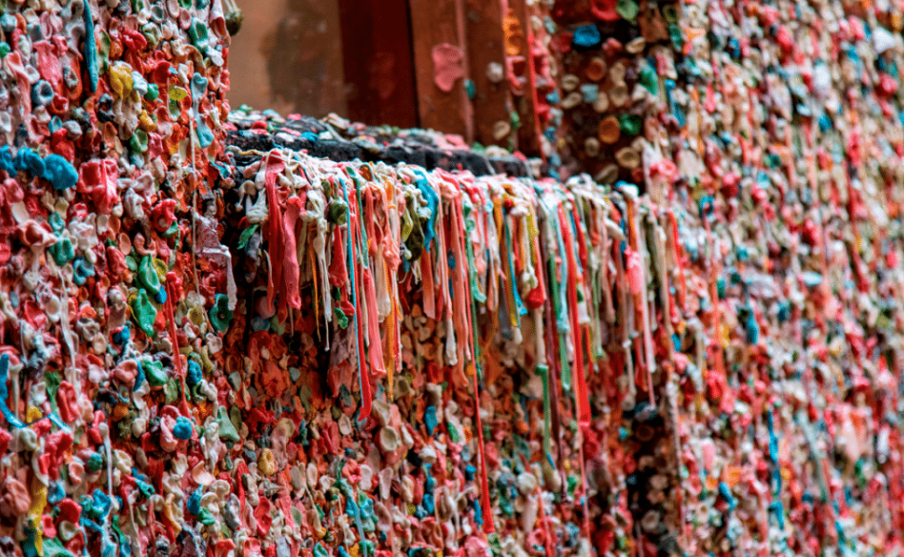

Slide 18
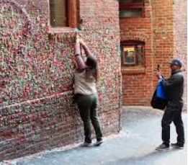
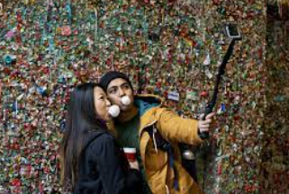
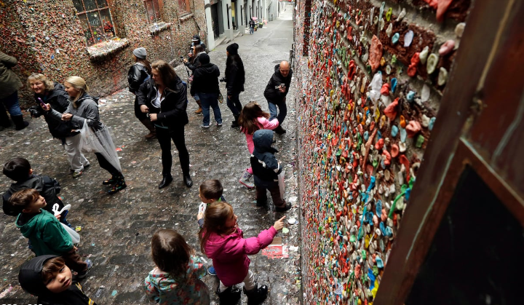
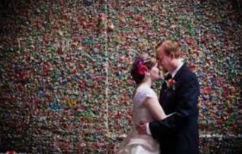
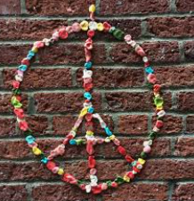
The Gum Wall
Seattle, USA
a brick wall covered in used chewing gum
a tourist attraction from around 1999

Slide 19
Why have the above places become tourist attractions?

Slide 20
Six stages of creating a tourist attraction (Dean MacCannell)
naming the object
distinguishing the object from the environment (eg placing a ticket, fencing)
visibility and elevation of the object (eg making it more attractive by including the tourist route)
placing on the altar (eg building special buildings where attractions can be viewed)
mechanical reproduction of the representation of the object (eg by circulating postcards with the image of the object)
social reproduction (eg naming a restaurant just like an object)

Slide 21
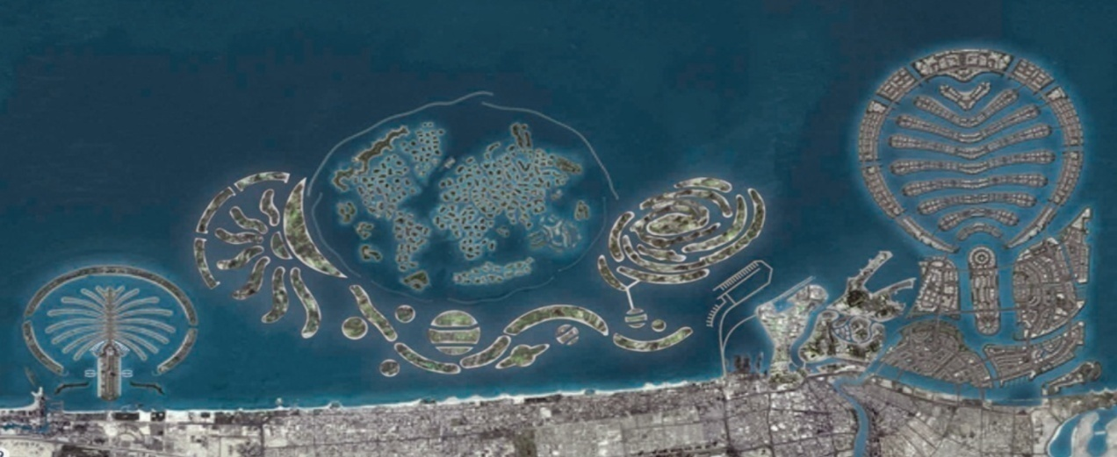
1. naming the object/the place
historical, traditional names,
„the bests” (the oldest, the highest) or the specific feature is underlined (old, ancient, Czech),
symbolic, metaphorical names (eg. Palm Islands)

Slide 22
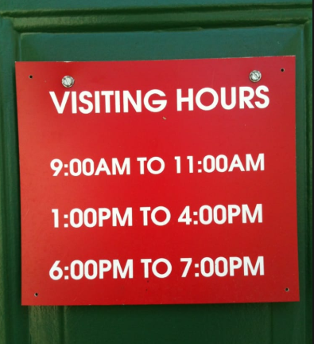
2. distinguishing the object/the place from the environment
placing a ticket, fencing, visit hours,
it can not be available always and for everyone,
must be treated as special

Slide 23
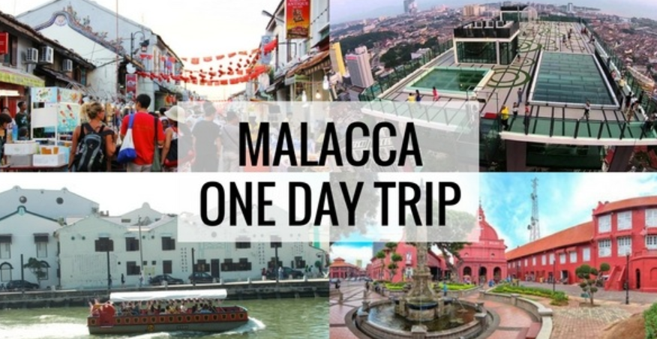
3. visibility and elevation of the object/the place
including the object in descriptions in guides, on information boards, on maps,
one day tours, tourist routes,
tourist agencies and on the Internet

Slide 24
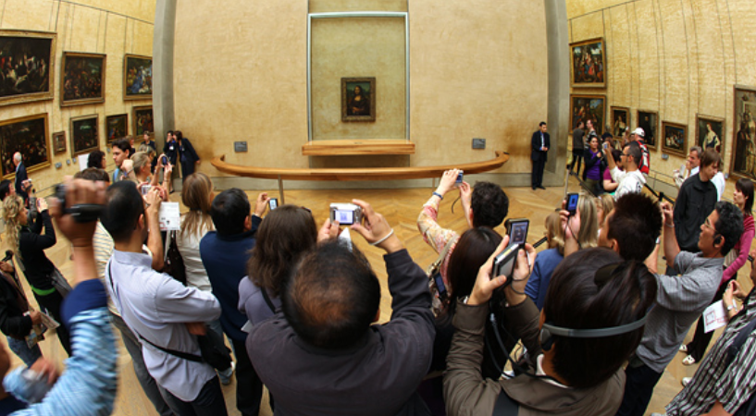
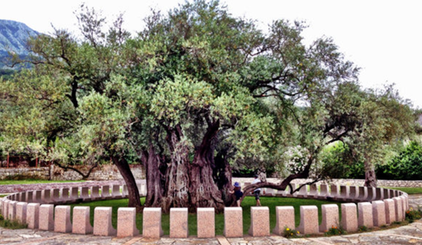
4. placing on the altar
Notes:
special place, protected, unrechable, covered,

Slide 25
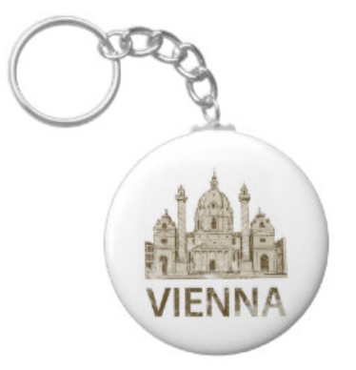
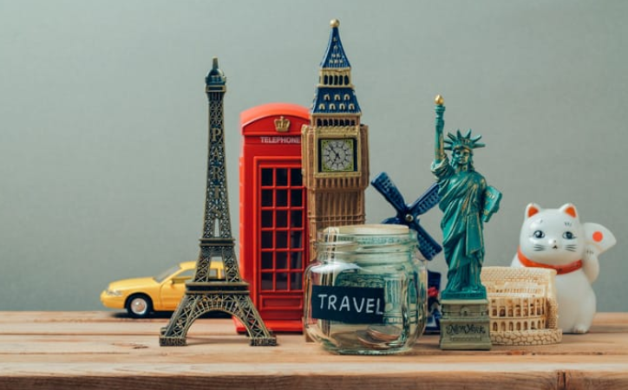
5. mechanical reproduction of the representation of the object
Notes:
postcards, suvenirs, pictuers and so on
not spontanoues

Slide 26
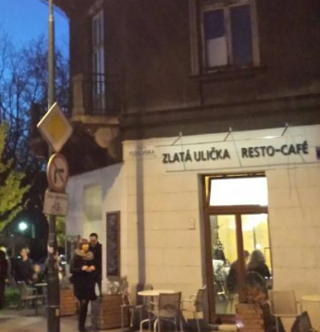
6. social reproduction
Notes:
spontanious reprodaction with society, like name restaurants, an example: Zlata ulica from Prague in Kraków Poland or tatooes with effile tower.

Slide 27
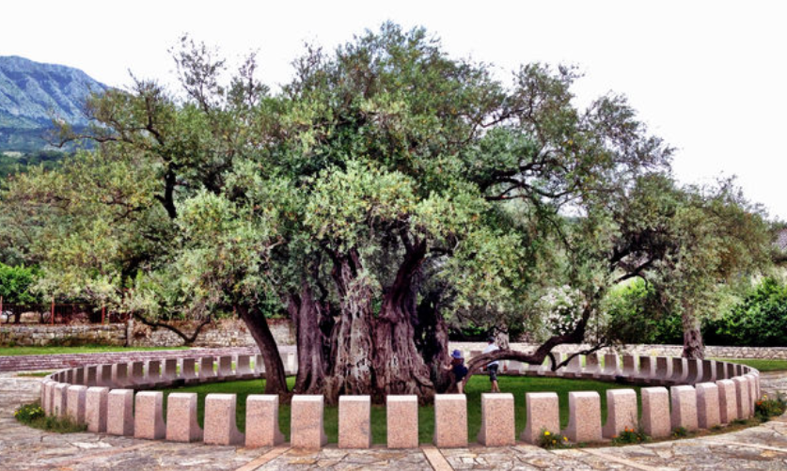
Difference?

Slide 28
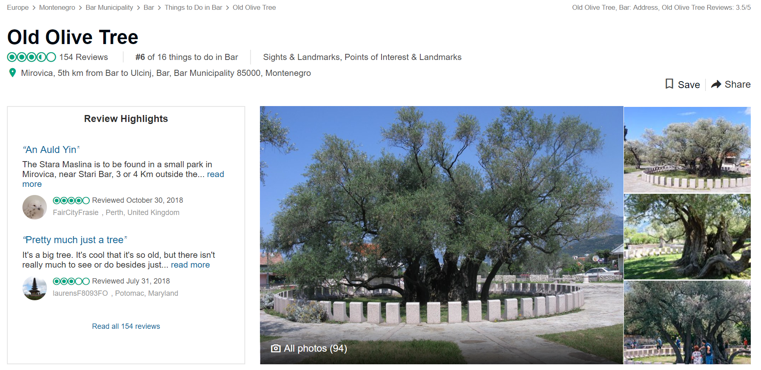

Slide 29
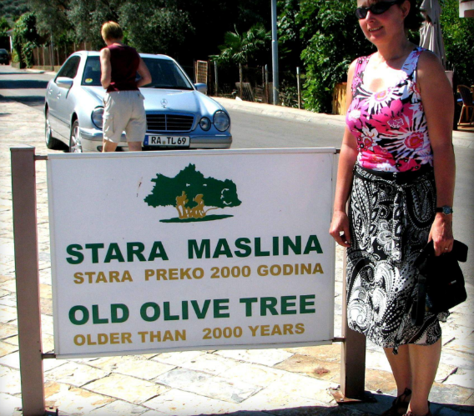
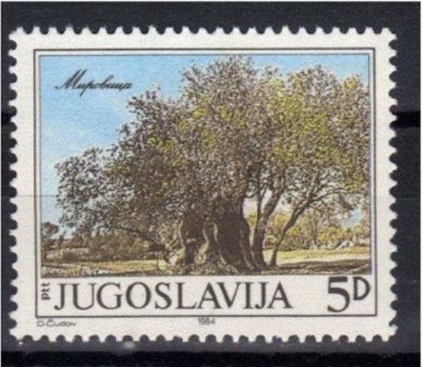

Slide 30
The songs presentations…

