Slide 1
Technology in Japan
Ghost in the Shell

Slide 2
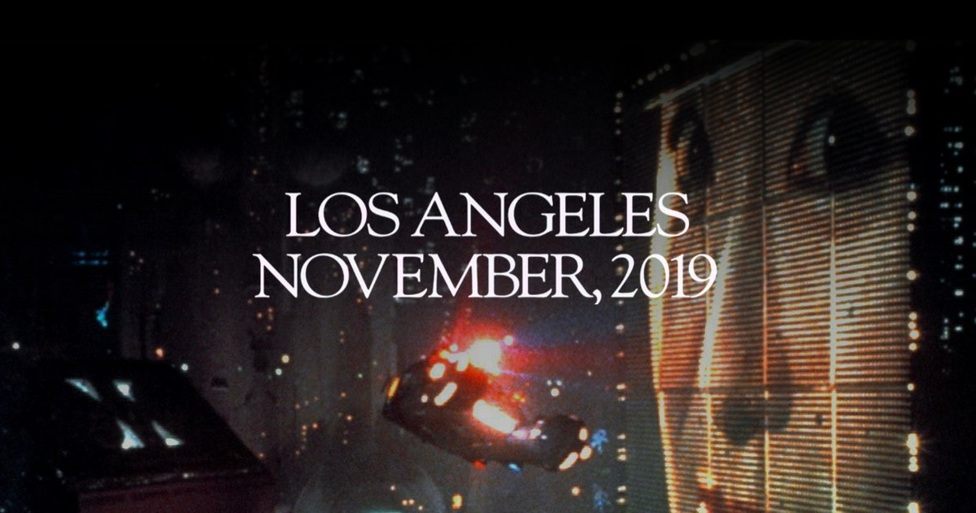
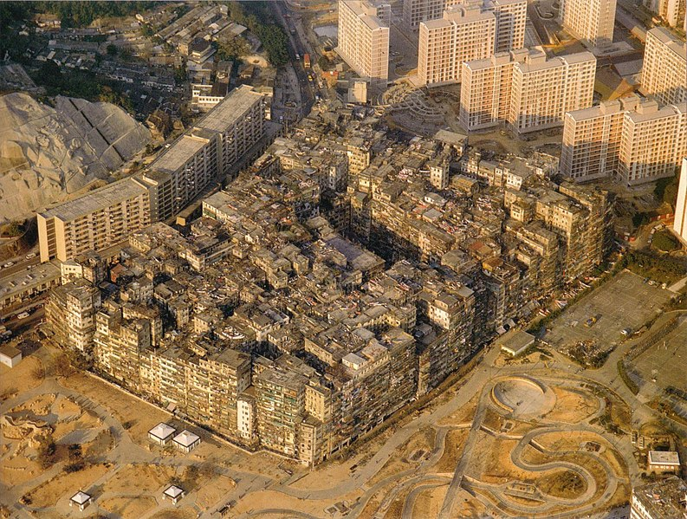
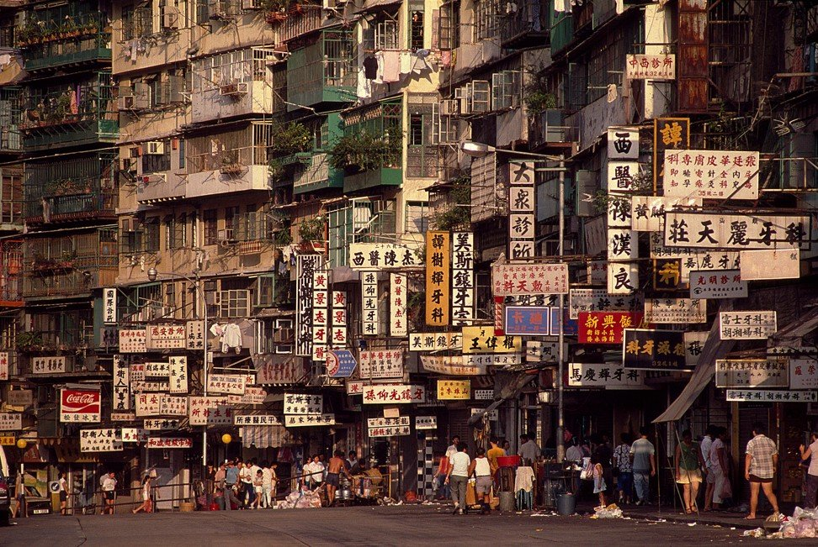
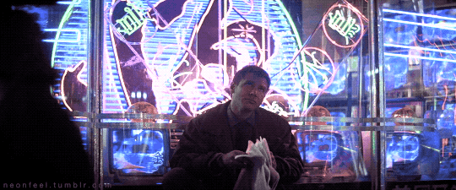
Blade Runner creates a futuristic noir atmosphere by heavily borrowing from Asian motifs, albeit vague and general ones, in its design of city icons and social spaces. (Wong Kin Yuen)
I hope to validate Antony King's argument that colonial cities have the best chance of establishing a cityscape of the future that embraces racial and cultural differences (Wong Kin Yuen)

Slide 3
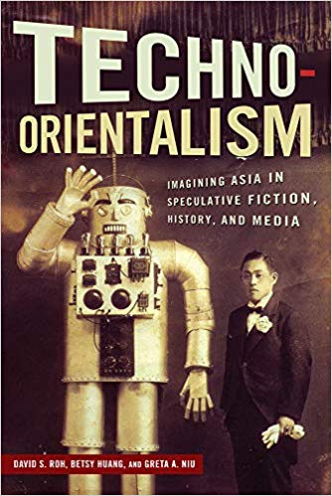
Introduction
Orientalism > Techno-Orientalism
„The phenomenon of imagining Asia and Asians in hypo-or hypertechnological terms in cultural productions and political discourse“ (Roh et al)
„Cyberpunk, with its fetishizing gaze upon Japan as a seductive and contradictory space of futuristic innovation and ancient mystique, sharply focused the SF critical and creative lenses upon Asia.“ (Roh et al)
„Japan has been located in the future of technology. Morley and Rovins say: ‚If the future is technological, and if technology has become 'Japanised', then the syllogism would suggest that the future is now Japanese, too.‘ (Ueno)

Slide 4
Is Japan a hi-tech country?
late 70‘s and 80‘s – Japan‘s success on the consumer electronics market
Sony, Toshiba, Panasonic…
TV, VCR, Walkman, CD, DVD…
technology as a big factor in the Japanese „economic miracle“
big companies in worse condition in present day
more focus on technology development, less focus on consumers (application)

Slide 5
Technology and the economic miracle
postwar Japan importing foreign technological know-how and improving technologies
keiretsu groups trying to cover as much market share as possible
funds for technological innovations
environment of extreme competition
copying of design and production techniques
investments in large, high-value sectors as automobiles or electronics
state support of big companies, cheap and educated workforce

Slide 6
Japan as a follower
Robert J. Crawford: Reinterpreting the Japanese Economic Miracle
Japanese society not as supportive of innovative approaches, preferring collectivism

Slide 7
Japanese craftmanship in history
Karakuri ningyō
mechanized puppets, 17th-19th century
archer puppet
tea serving puppet
only after the introduction of the clockwork from the West

Slide 8
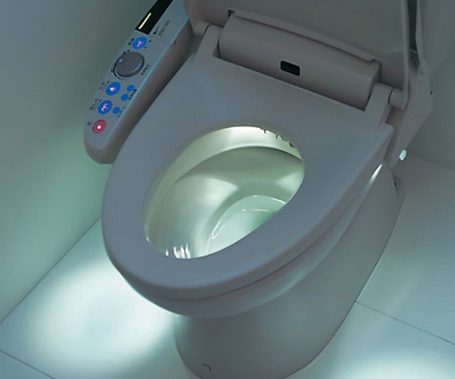
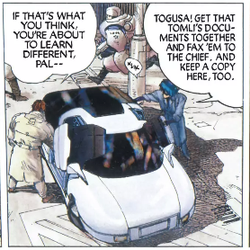
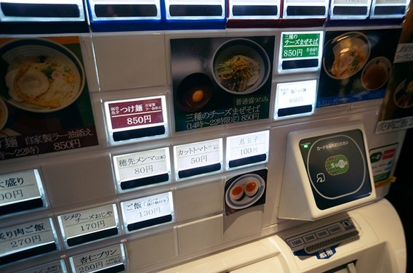
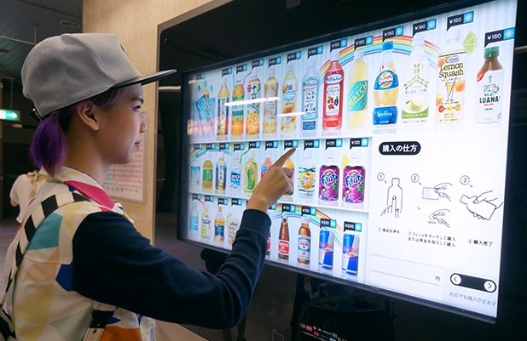
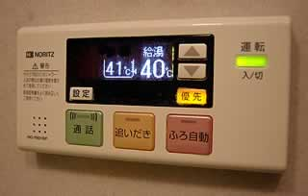
Daily life and technology
different technologies in use
„gadgets“ vs. practical daily needs
cell phones, e-readers, wi-fi access, e-mail…
washlets, bath warming, automated orders…
"Japanese companies generally lag foreign companies by roughly five-to-10 years in adoption of modern IT practices, particularly those specific to the software industry,“ (Patrick McKenzie)
Galapago syndrome?
e.g. cell phones, cash machines, videogames
conservative approach? innovations not welcome?
„shame society“

Slide 9
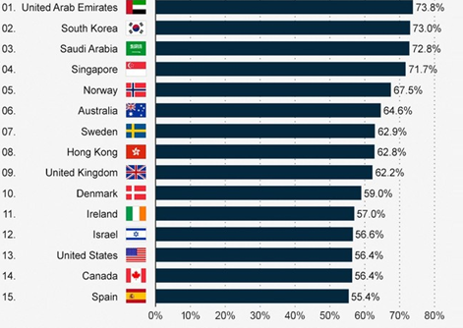
Smartphone usage in Japan
Japan ranked 44. out of 48 with 25.7% in 2013
source: „Our mobile planet“ survey

Slide 10
Technology in future Japan
high research and development spendings
Robots?
declining/aging Japanese population, workforce needed
"Robotics is to be for the Japanese economy in the 21st century what automobiles were in the 20th," says Jennifer Robertson, a professor of anthropology at the University of Michigan.
Space engineering, medical technologies...

Slide 11
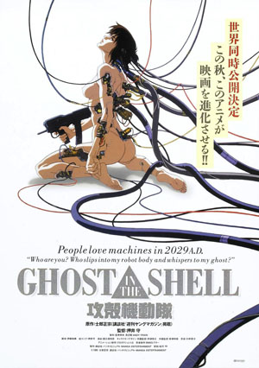
Ghost in the Shell
Kōkaku kidōtai (Mobile Armored Riot Police)
1995
directed by Mamoru Oshii
based on 1991 manga by
Masamune Shirow
2017 a Hollywood adaptation
w/ S. Johansson

Slide 12
Sources
Crawford, R. Reinterpreting the Japanese Economic Miracle. Harward Business Review, 1998. URL: https://hbr.org/1998/01/reinterpreting-the-japanese-economic-miracle
Fitzpatrick, M. Why is hi-tech Japan using casette tapes and faxes?, BBC. URL: https://www.bbc.com/news/business-34667380
Roh, D.; Huang, B.; Niu, G. (eds.). Techno-Orientalism: Imagining Asia in Speculative Fiction, History, and Media. Rutgers University Press: 2015.
Ueno, T. Japanimation and Techno-Orientalism. URL: http://www.t0.or.at/ueno/japan.htm
Wong, Kin Yuen. On the edge of spaces: 'Blade Runner', 'Ghost in the Shell', and Hong Kong's cityscape, Science-Fiction Studies 27:1-27, 2000.

