Slide 1
Urban/Rural Japan and its Forests
Wood Job!
Kamusari naa naa nichijō
2014
Shinobu Yaguchi

Slide 2
Outline
Urbanization of Japan
History of Forests in Japan
Japanese Forests Today
Forests and the Japanese
2 points to explain
rōnin
festival

Slide 3
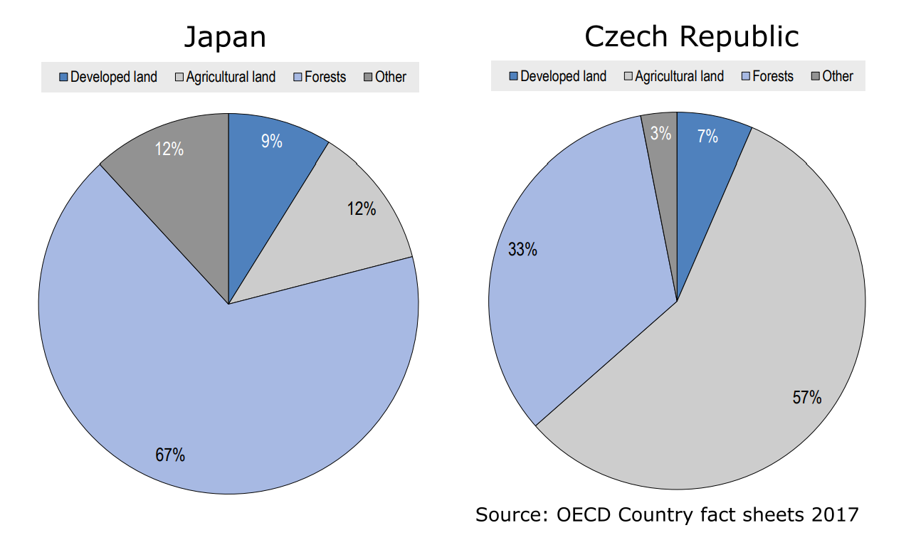
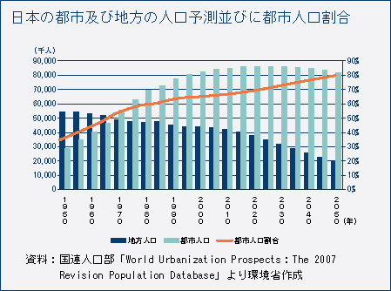
Urbanization of Japan
most of the land uninhabitable
rapid urbanization after WW2
65% of population
in agglomerations
of 1M+(5th in
the world)
depopulation of
rural areas

Slide 4
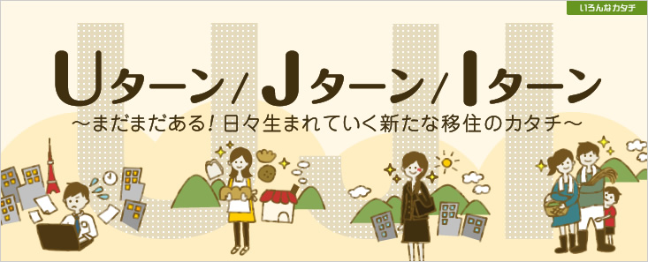
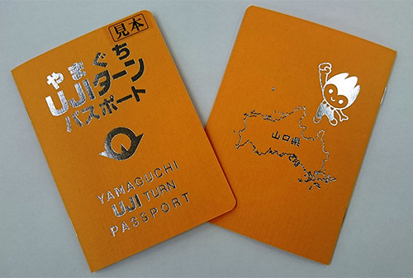
Depopulation of rural areas
7% live in rural areas
35% of cities/towns/villages defined as depopulating (about 30% decline in population in last 45 years)
attempts to stop depopulation to preserve the countryside
campaigns to promote „UJI turns“

Slide 5
History of Japanese forests
until 16th century
exploitative use of forests, deforestation for arable land
construction (eg. Nara and Heian period booms)
fuel
heavy use in 16th century wars
imporant for agriculture (water, leaf litter as fertilizer..)
17th century>Tokugawa regime prosperity
exploitation unsustainable > silviculture
villages start to manage forests (made responsible by gvt)
plantation techniques (hinoki, sugi)
Notes:
1894 – Shiga Shigetaka napsal Nihon fúkeiron kde popisuje kterak Evropané na hory chodí pro zdraví, jako sport, ne aby se setkali s božstvy. V Japonsku dříve na hory chodily pouze náboženské skupiny. Od roku 1894 také přichází konskripční model, takže je třeba, aby populace byla silná a zdravá a lezení po horách je propagováno.

Slide 6
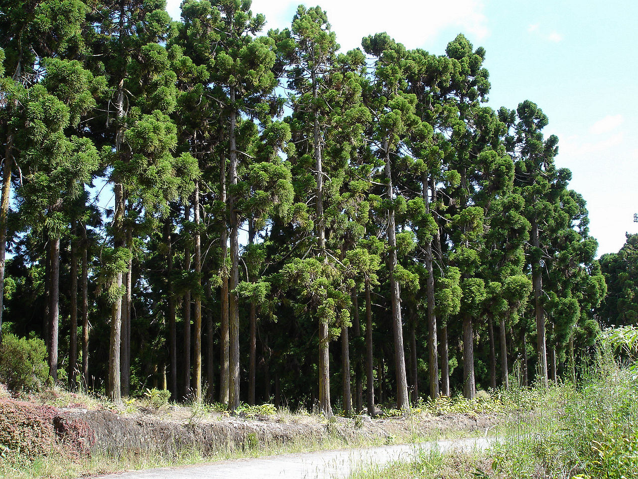
History
end of 19th century
wood still heavily used > forests consist of rather young trees (pine, beech)
reforestation complete by 1920
WW2 brings substantial deforestation
1950s-70s reforestation – largely hinoki and sugi
1980s – decrease in demand for forest products, demographic change > neglected forests

Slide 7
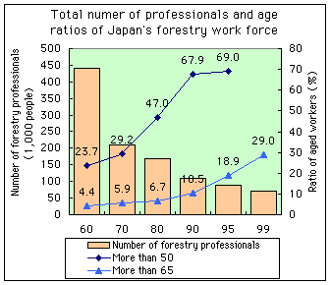
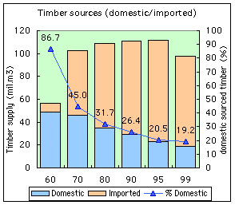
Japanese forests today
about ½ plantations, ½ natural
high timber imports, number of forestry workers decreasing (with urbanization)
neglected but important in preventing landslides

Slide 8
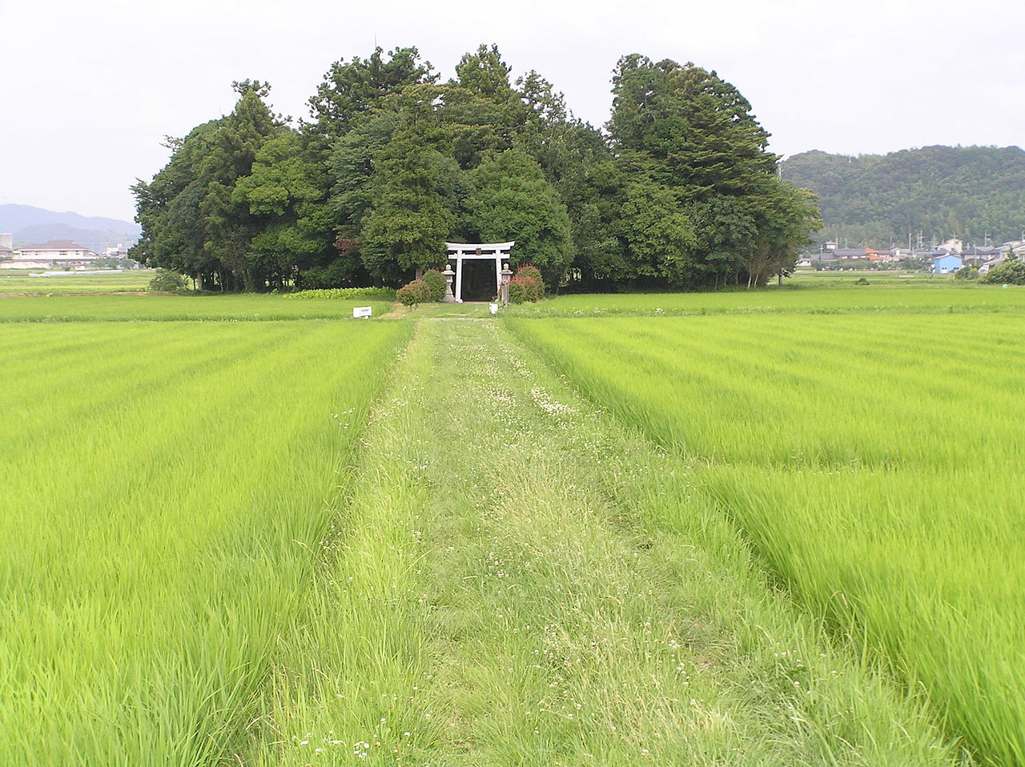
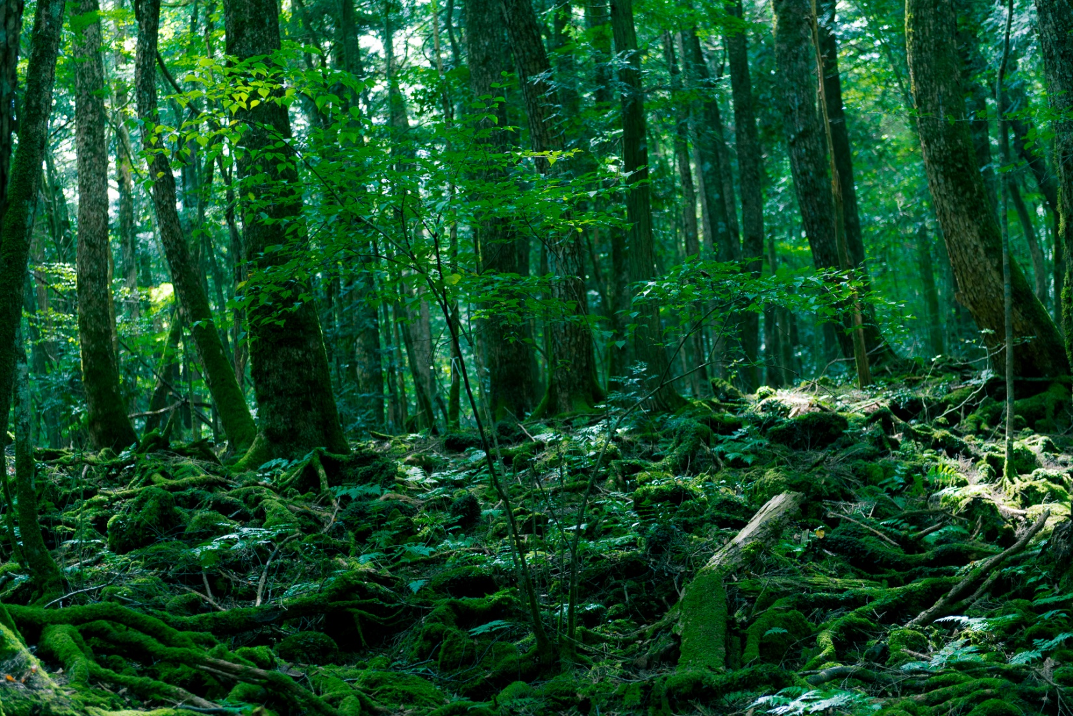
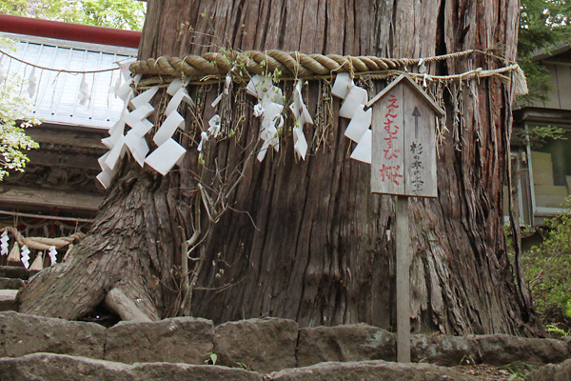
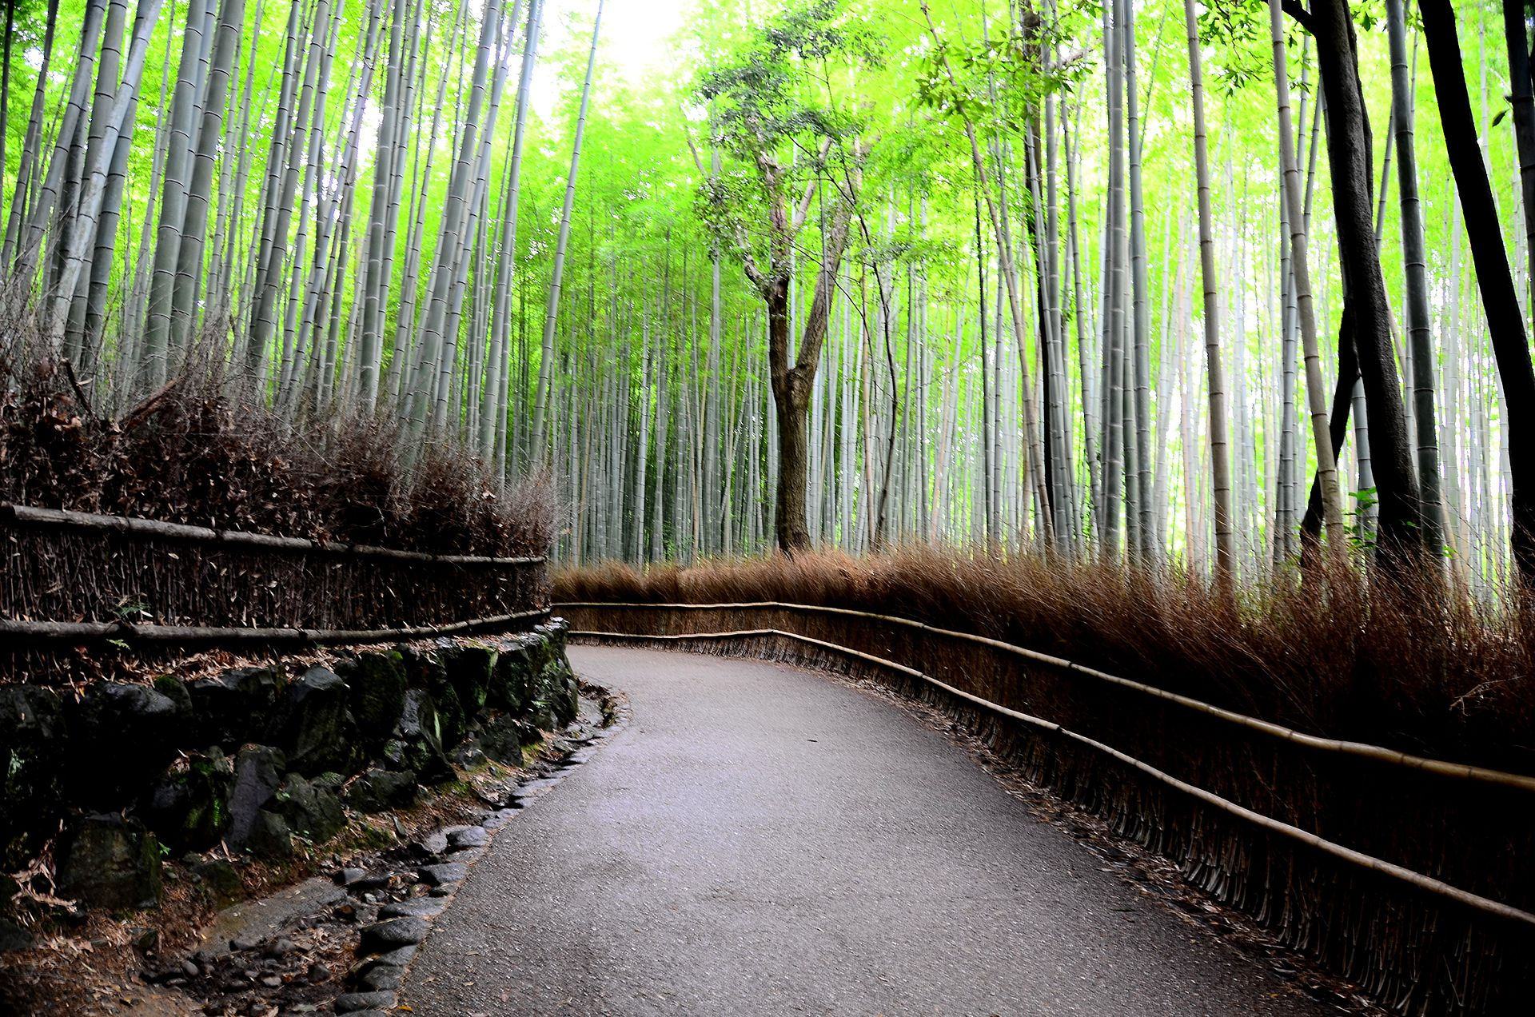
Forests and the Japanese
role of forest small in modern society
shift from agriculture to urban life
natural forests have little recreational use
inaccessible: steep slopes, damp climate > dense vegetation
artificial x natural forest
mystical place
kami can dwell in trees, shrine chinju no mori

Slide 9
2 points to explain
rōnin
masterless samurai > student belonging nowhere
matsuri
Suwa festival (onbashira 2022 + extra video)
Nagano prefecture, once in 6 years
playful child-like state closest to kami
sense of belonging: to the earth, to the community

