Slide 1
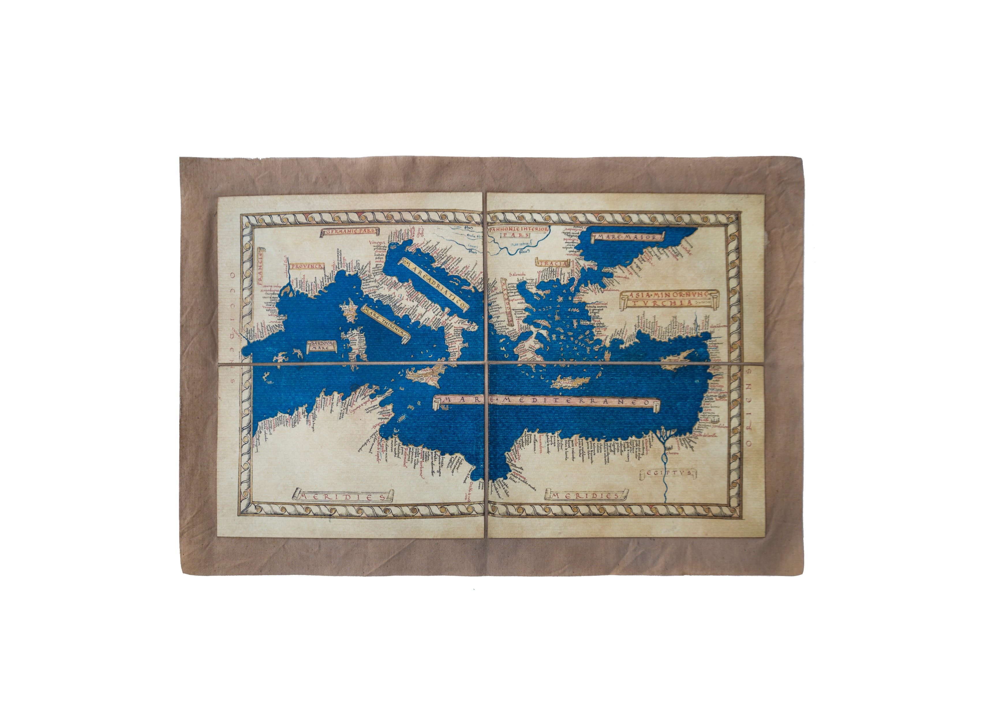
From Port to Port
The Mediterranean History as a Portolano book

Slide 2

Georges Moustaki
En Méditerranée (1971)
Dans ce bassin où jouent
des enfants aux yeux noirs,
il y a trois continents
et des siècles d’histoire,
des prophètes des dieux,
le Messie en personne.
Il y a un bel été
qui ne craint pas l’automne,
en Méditerranée.
Questa foto di Autore sconosciuto è concesso in licenza da CC BY-SA

Slide 3
Summary of presentation
Mapping the Mediterranean
Goods and People across the Sea: a Mediterranean History
A little Portolano

Slide 4
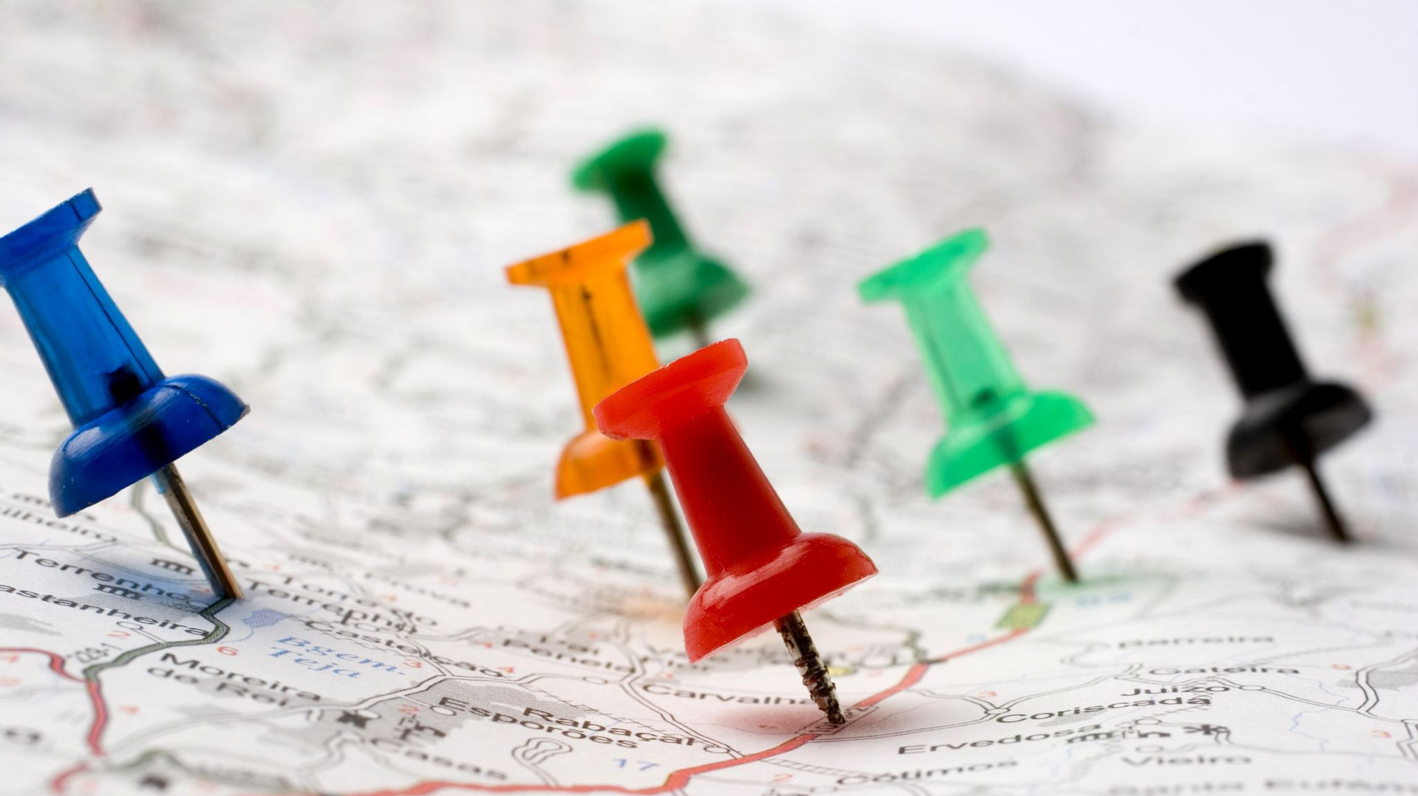
Mapping the Mediterranean

Slide 5
Maps and Mapping Work
“Two important characteristics of maps should be noticed. A map is not the territory it represents, but, if correct, it has a similar structure to the territory, which accounts for its usefulness”. – Alfred Korzybski.
A map is always an interpretation of a territory.
A map is always:
  reduced
  approximated
  symbolic

Slide 6
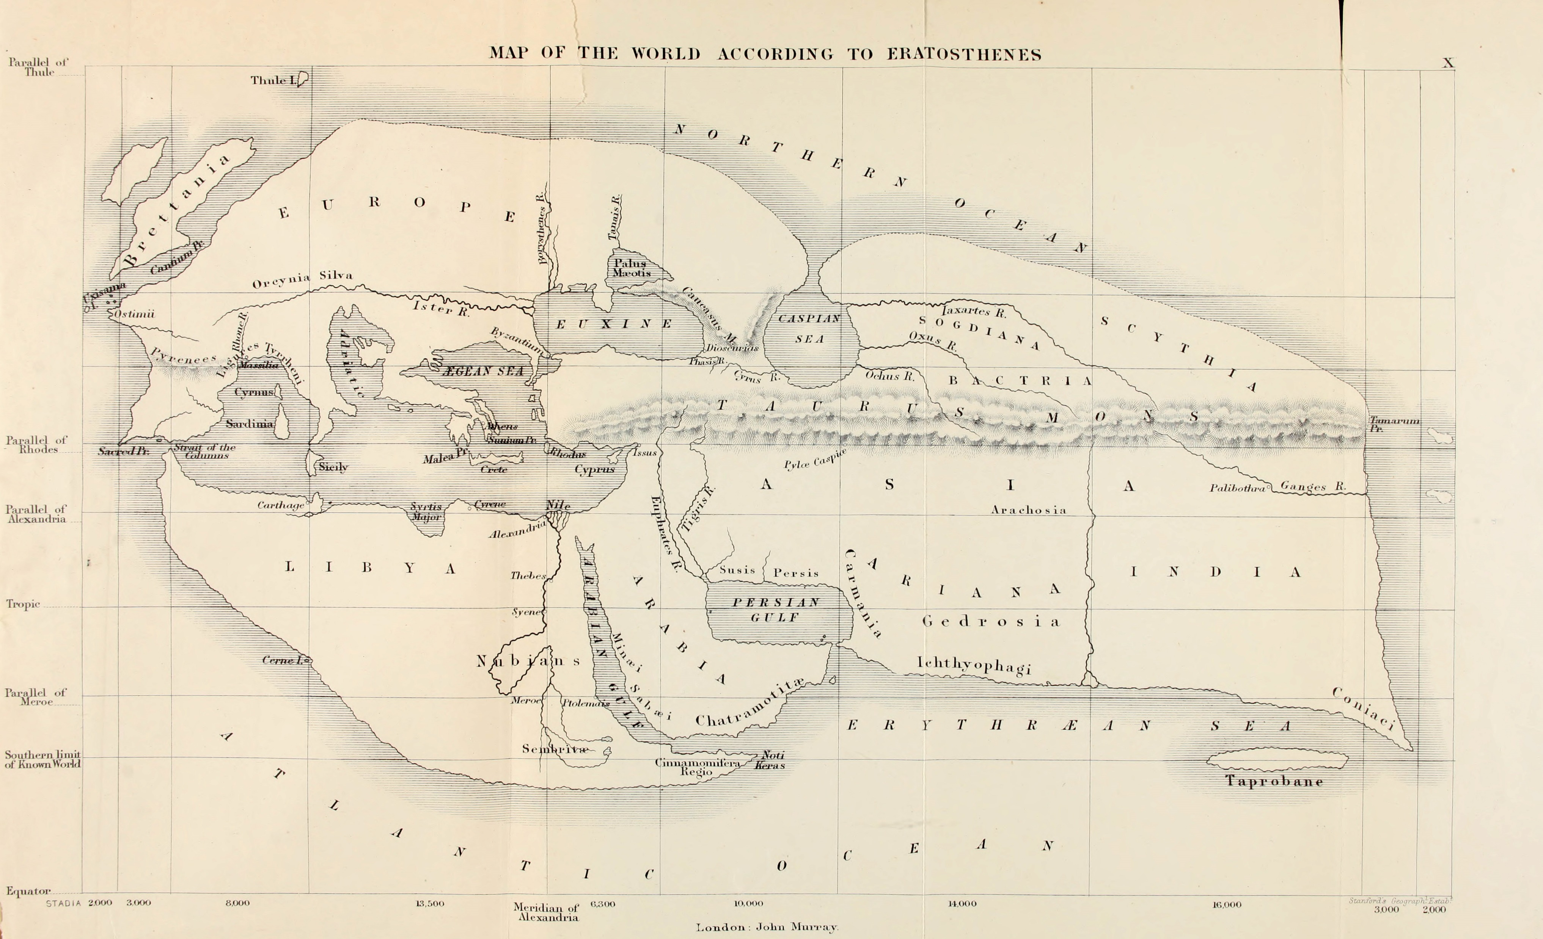
Map of the world according to Eratosthenes (276 BC - 194 DC)

Slide 7
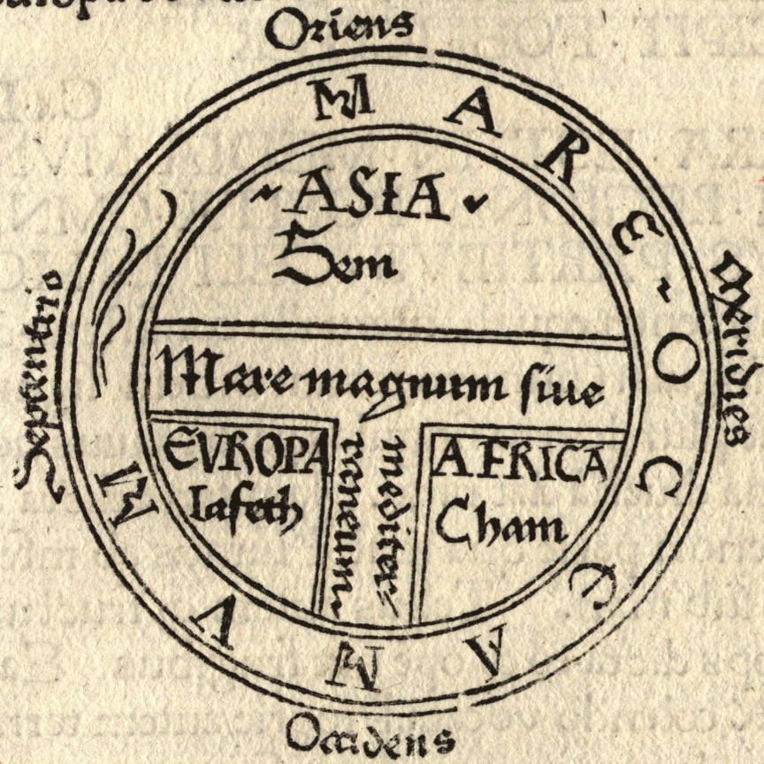
The
T-O Diagram
Image-concept of the known world during the Middle Ages.

Slide 8
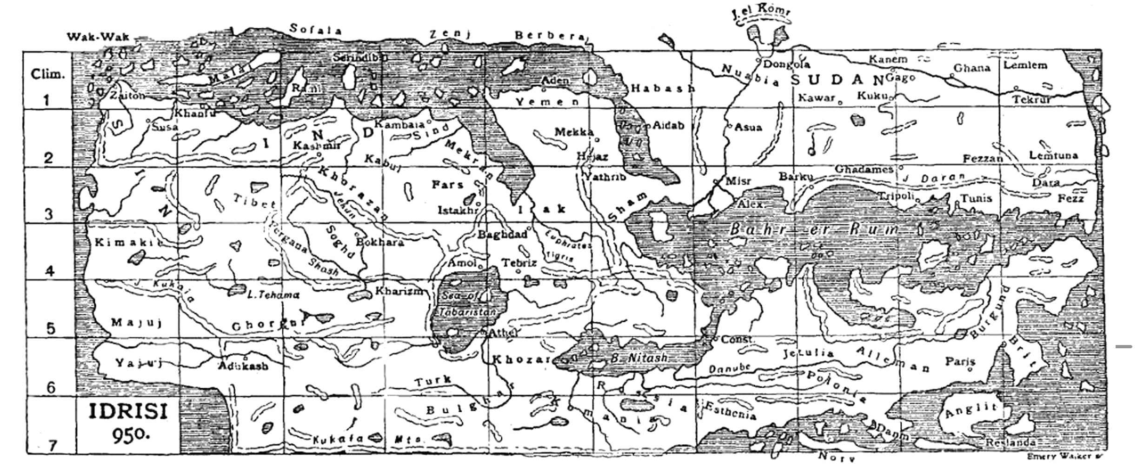
Map of al-Idrisi (1099-1165)

Slide 9

Map of Enrico Martello (1489)

Slide 10
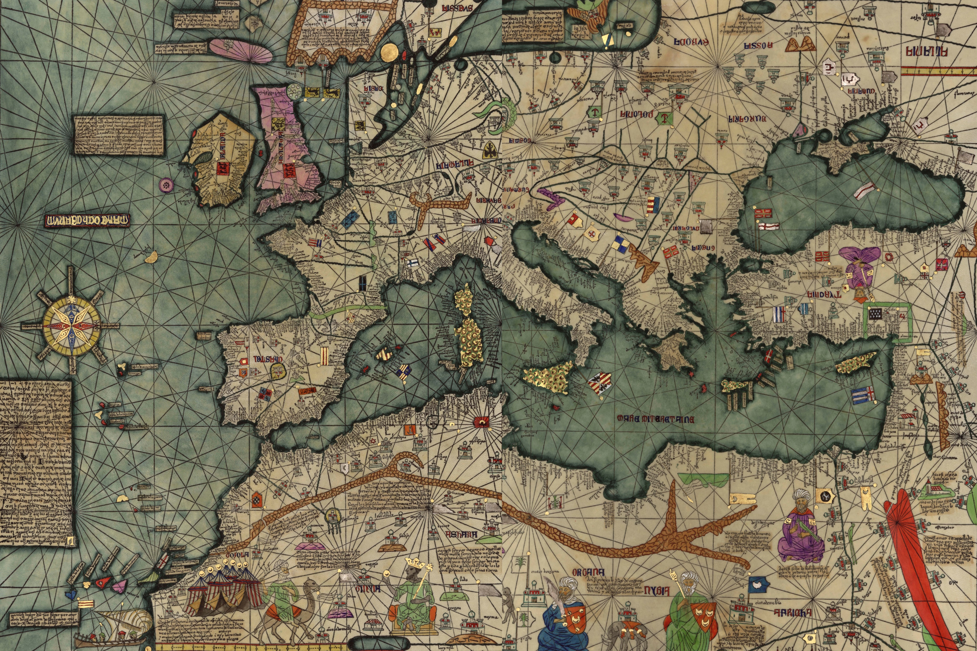
Map of Europe and the Mediterranean from the Catalan Atlas of 1375

Slide 11
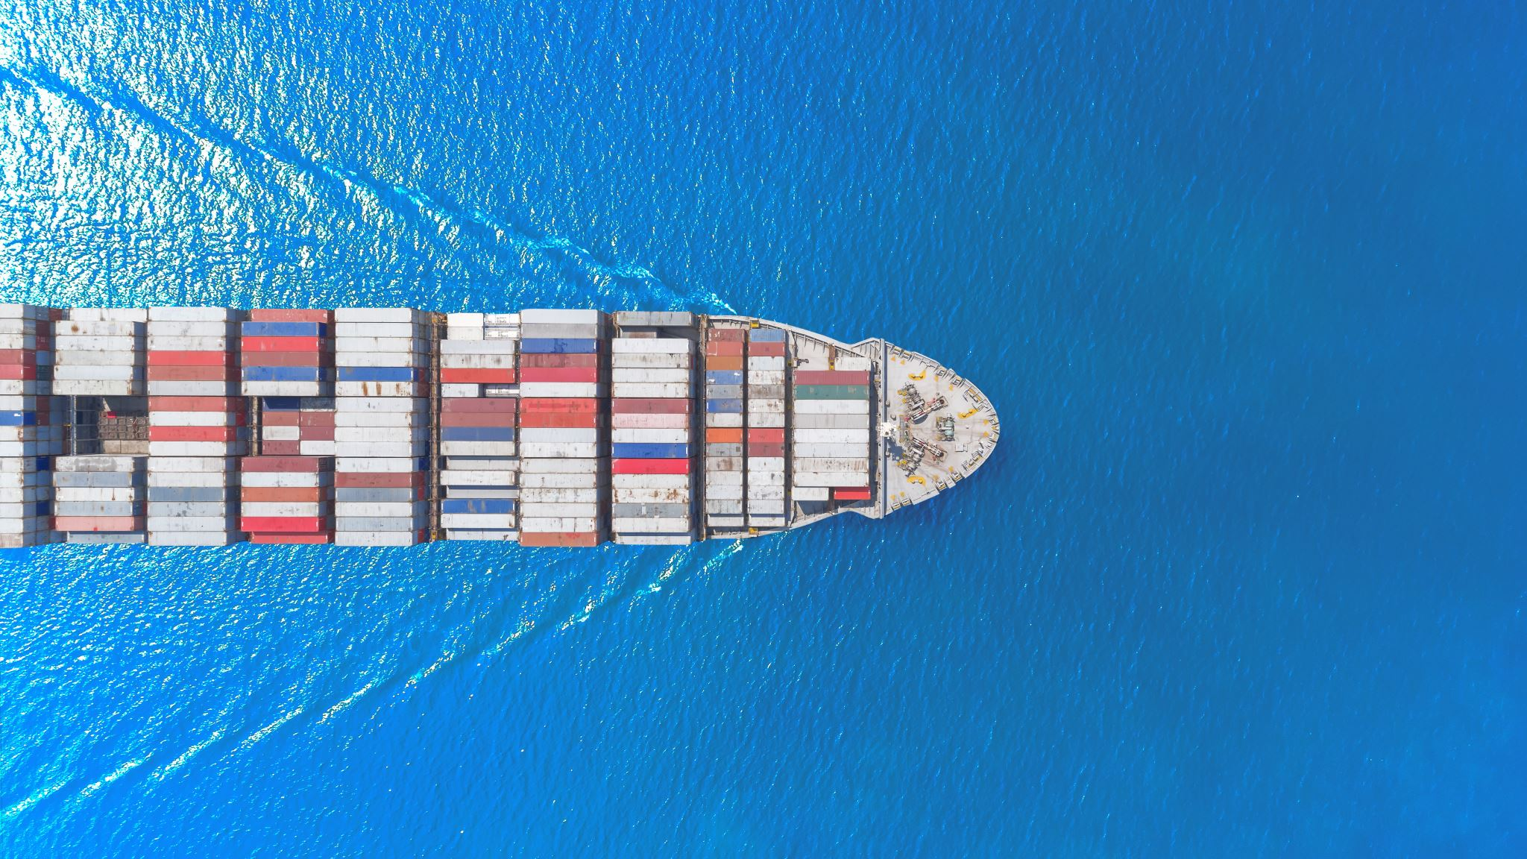
Goods and People across the Sea: a Mediterranean History

Slide 12
Migrations in human history
The human history is the history of human migration.
Since the beginning of humanity, people were moving across the world for some reasons, in the first place for existential needs (e.g., food, shelter, safety, etc.).
The main migrations across the Mediterranean Sea of the past centuries were:
  The Phoenician commercial colonization (they built a lot of Emporia, commercial city);
  Great migration of Greek people to the Southern Italian coasts (Campania, Puglia, Calabria, and Sicilia), the Magna Graecia;
  The Rome domination (military, politic, and commercial) of the Mediterranean Sea.
  The Germanic people migrations.
  The Islamic people domination of Eastern and Southern of the Mediterranean basin and of Iberic (the Al-Andalus) and Sicily.

Slide 13
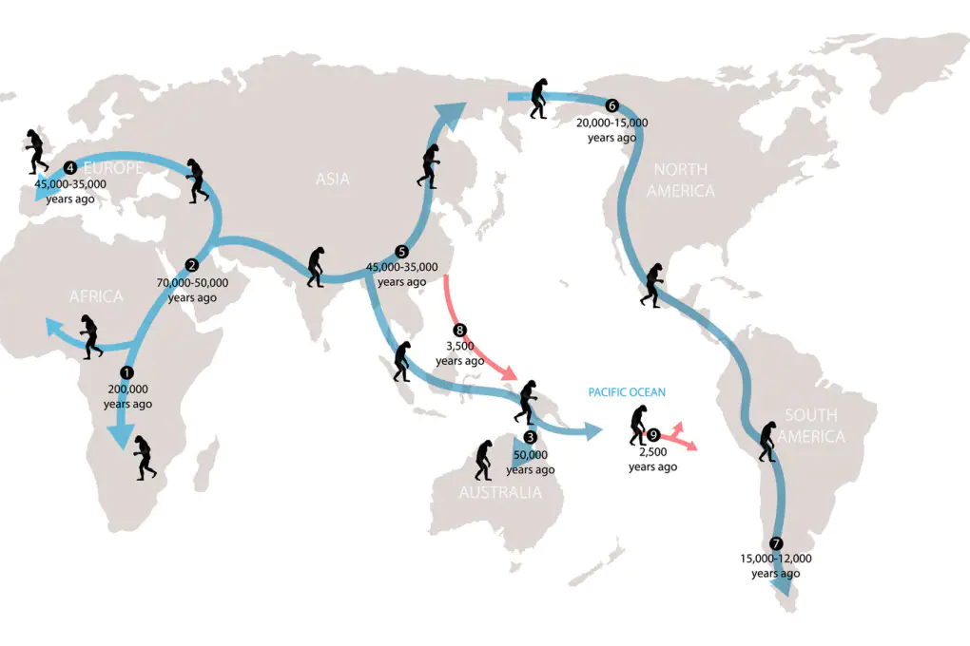
Main prehistoric migrations

Slide 14
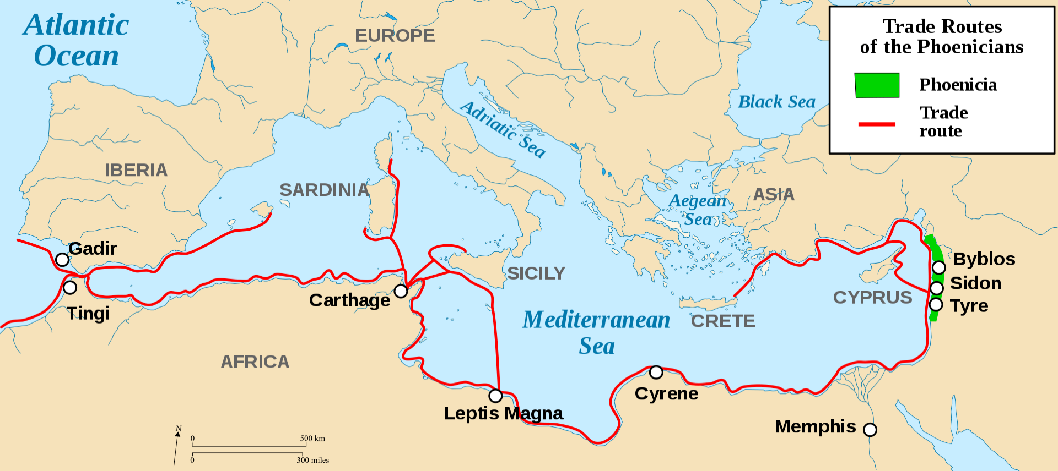
Phoenicians’ trade routes

Slide 15
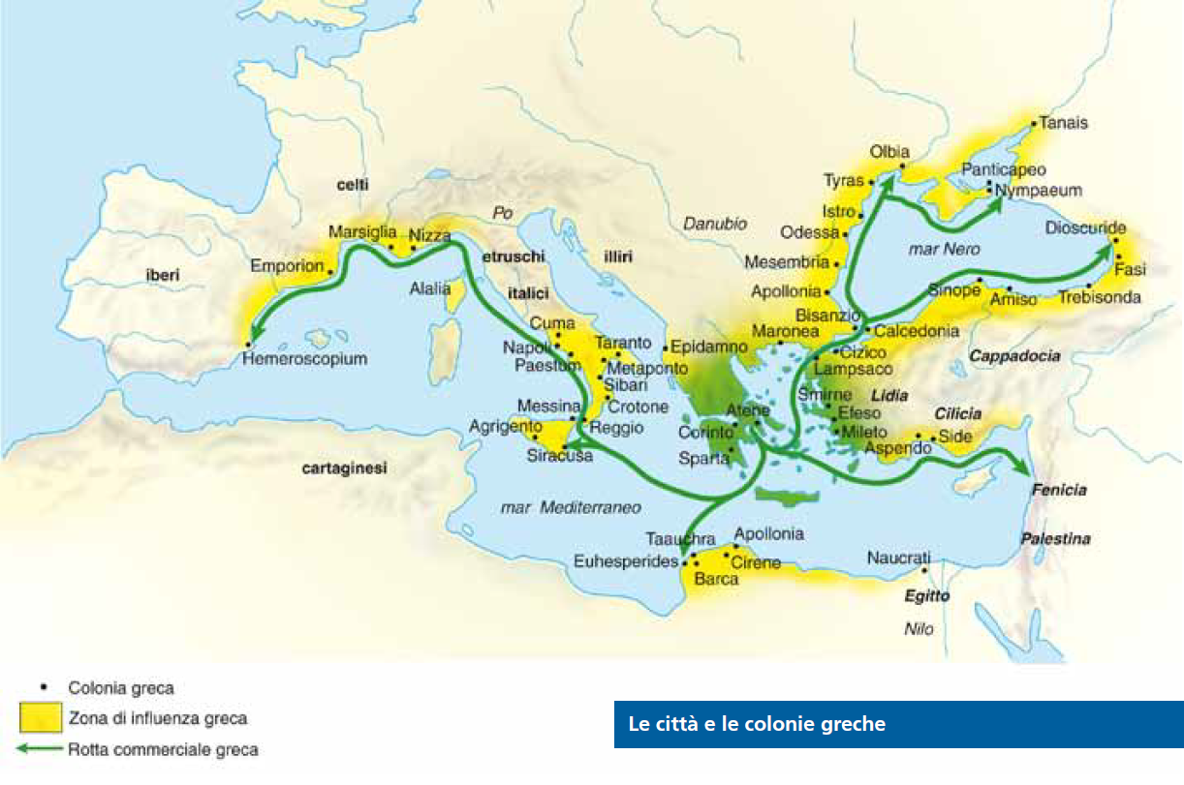
Greek’s trade routes

Slide 16
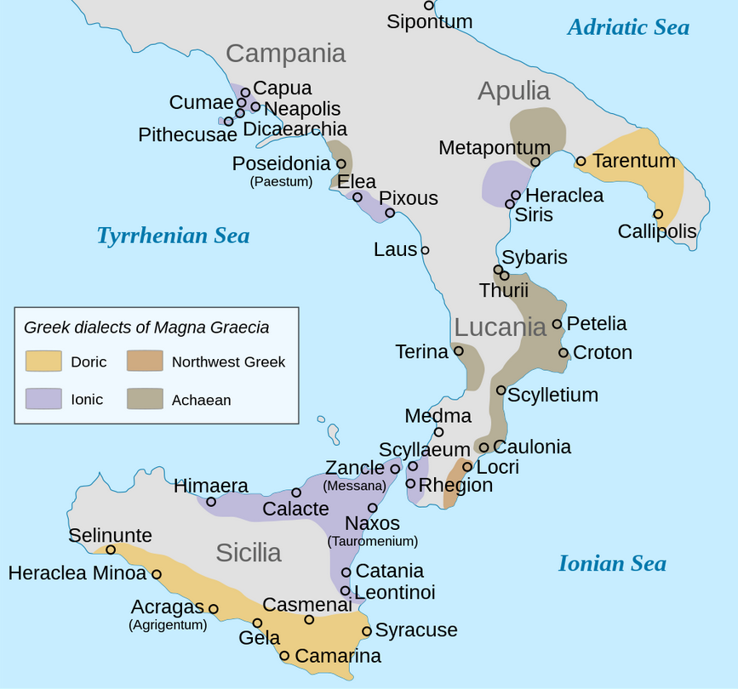
Magna Graecia
(gr. Μεγάλη Ελλάς Megálē Hellás ‘Greater Greece’) the Greek colonies in Southern Italy (from 8th century BC)

Slide 17
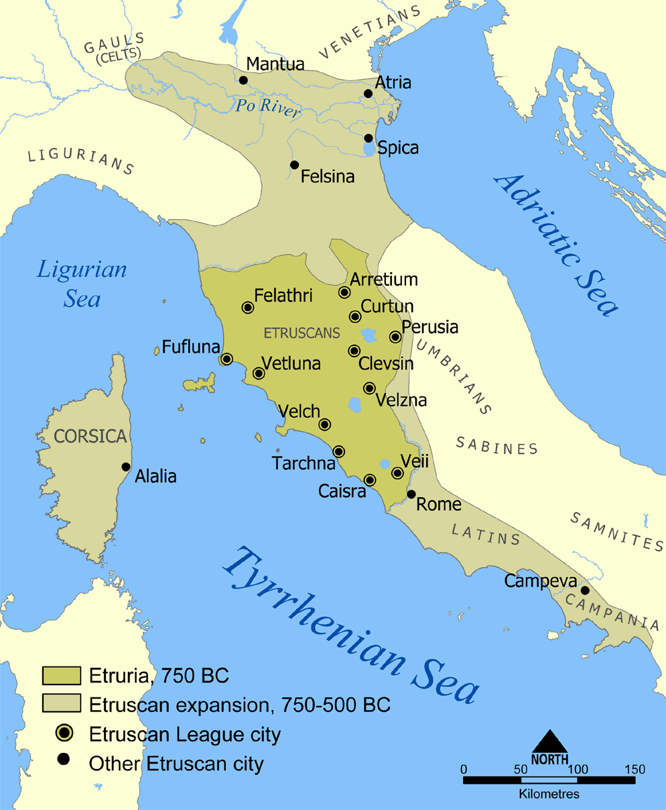
Etruscan cities
Etruscan colonization area and main cities, such as the members of the league: Dodecapolis (Gr. Δωδεκάπολις).

Slide 18
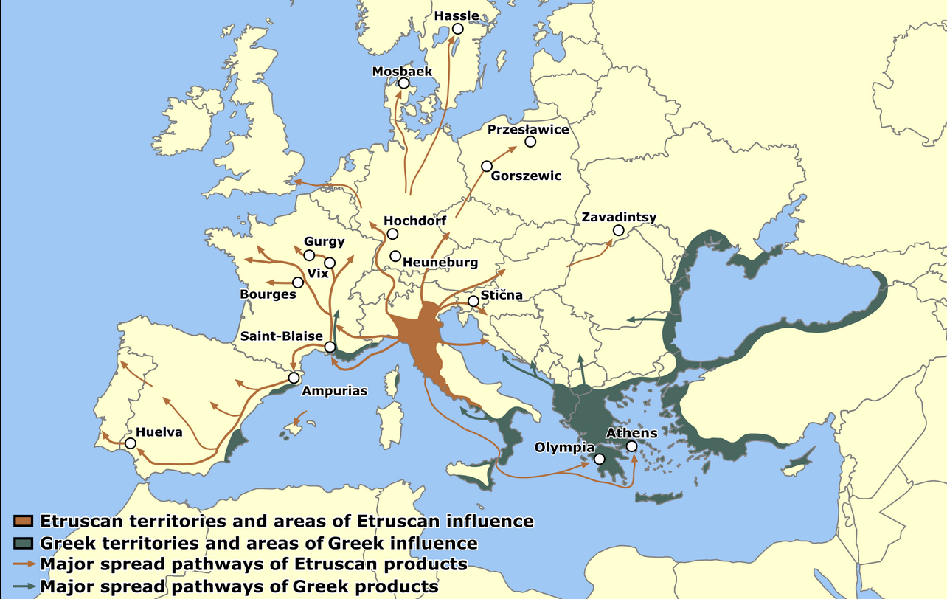
Greek and Etruscan trade routes (8th – 6th BC)

Slide 19
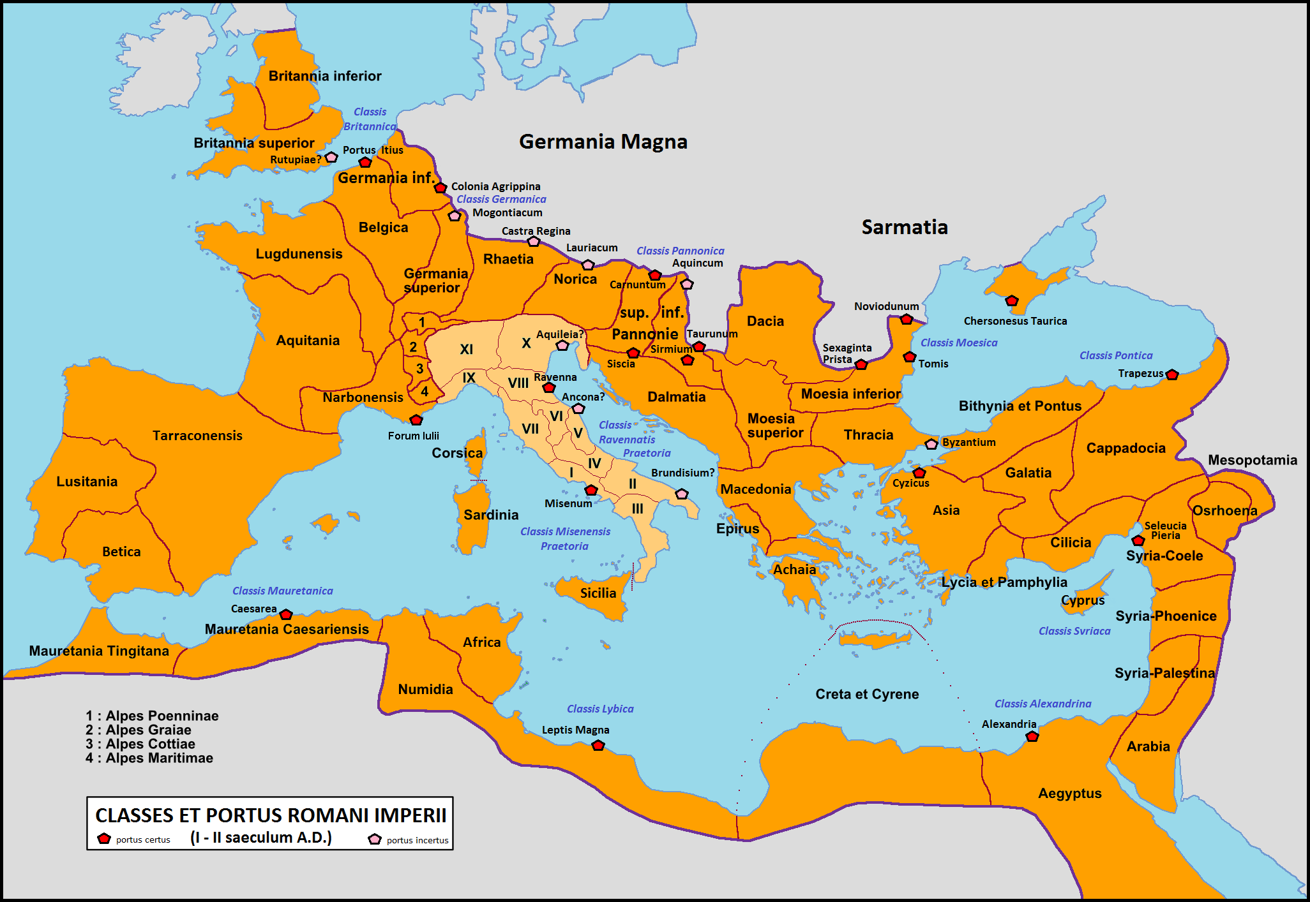
Map of the Roman fleets and major naval bases during the Principate (27 BC – 284 AD)

Slide 20
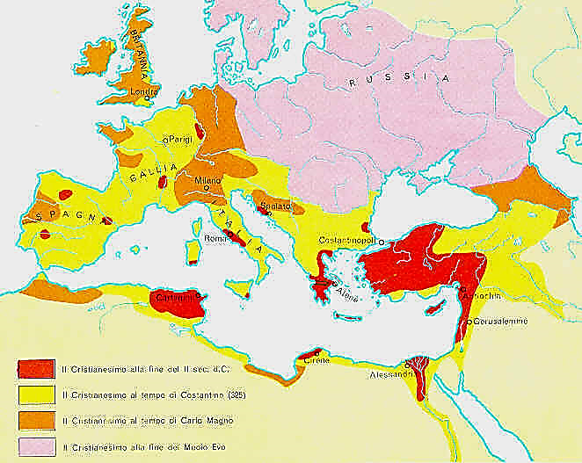
Christianization
Map of the diffusion of Christianity in Europe

Slide 21
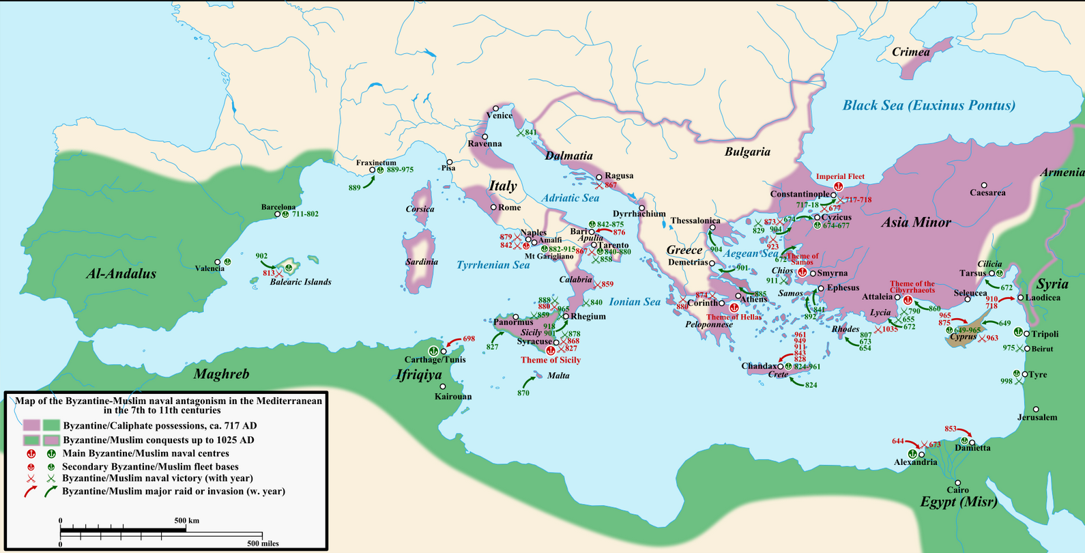
Map of the main Byzantine-Muslim naval operations and battles in the Mediterranean, 7th–11th centuries.

Slide 22
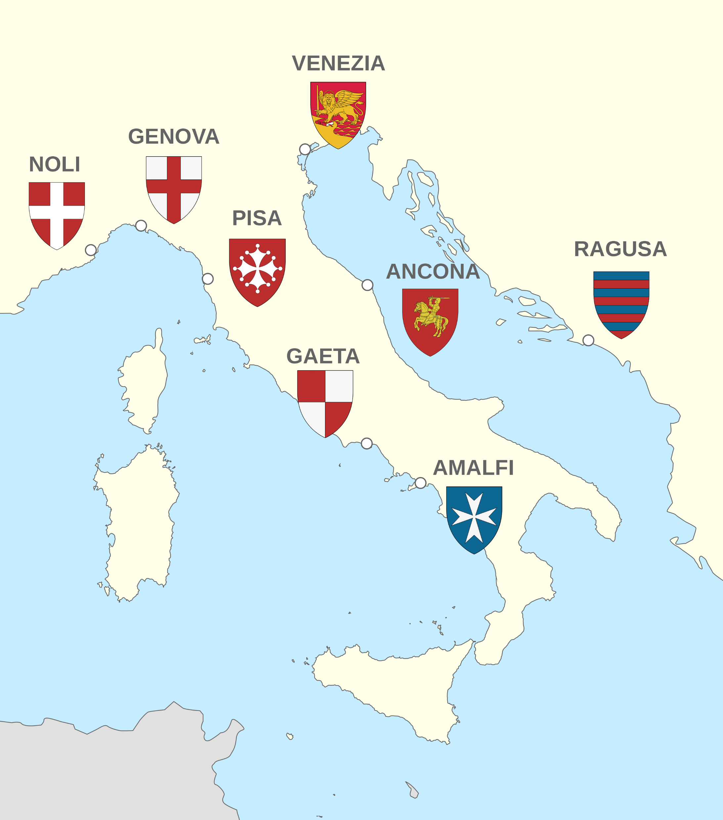
The
Maritime Republics
Also called ‘‘Merchant Republics’’, the Mediterranean thalassocratic city-states in competition during the last centuries of the Middle Ages.

Slide 23
Sabir: a Mediterranean Lingua Franca
Sabir (< saber ‘to know’) was a Lingua Franca (a bridge language) used in Mediterranean basin since 11th century BC.
The language was based mostly on Northern Italy’s languages (mainly Venetian and Genoese) and secondarily from Occitano-Romance languages (Catalan and Occitan) in the Western Mediterranean area, at first, Lingua Franca later came to have more Spanish and Portuguese elements, especially on the Barbary Coast (now referred to as the Maghreb). Lingua Franca also borrowed some elements from Berber, Turkish, French, Greek and Arabic.
Example:
  Se ti sabir
  ti respondir,
  se non sabir
  tazir, tazir. – Molière, Le Bourgeois gentilhomme (1670)

Slide 24
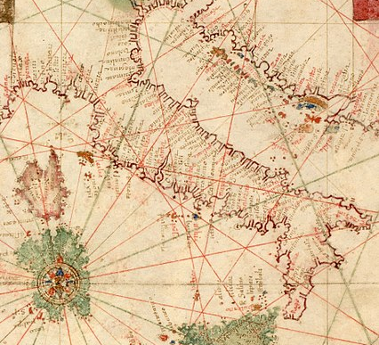
A little Portolano
Questa foto di Autore sconosciuto è concesso in licenza da CC BY-SA

Slide 25
What is a portolan chart?
“portolan chart, also called harbour-finding chart, compass chart, or rhumb chart, navigational chart of the European Middle Ages (1300–1500)”. – Encyclopaedia Britannica
Portolan chart (< it. portolano < it. porto (lat. PORTUS) ‘(chart) relative to the ports’) is the navigation map of Middle Ages, dedicate to the Mediterranean and Black Sea areas.
The principal elements of portolan charts are:
  Sea coasts and port names;
  Windroses;
  Rhumbline networks.

Slide 26
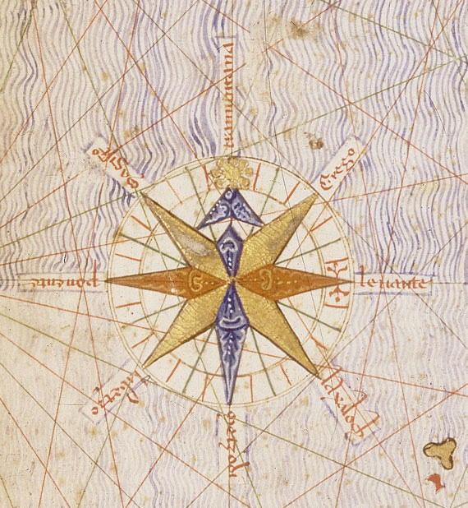
Windrose
The main winds:
(N) Tramontana
(NE) Greco (or Bora)
(E) Levante
(SE) Scirocco
(S) Mezzodì (or Ostro)
(SW) Libeccio (or Garbino)
(W) Ponente
(NW) Maestro (or Mistral)

Slide 27
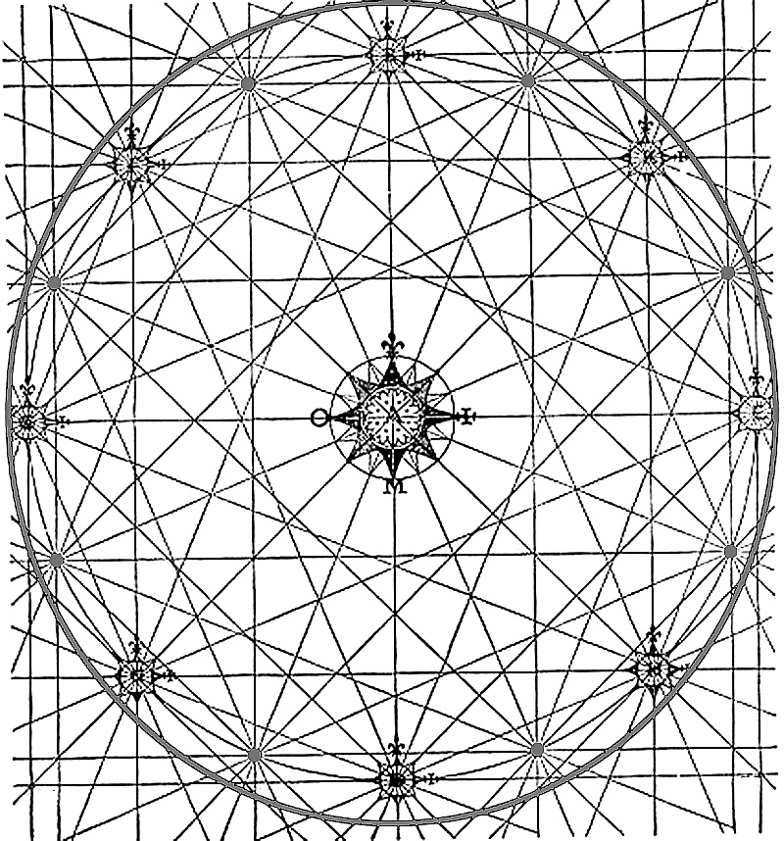
Rhumbline network
Or windrose network.
Starting from a windrose (also called compass rose), the projection lines are drawn.
This lines are the rhumblines, the navigation routes.

Slide 28
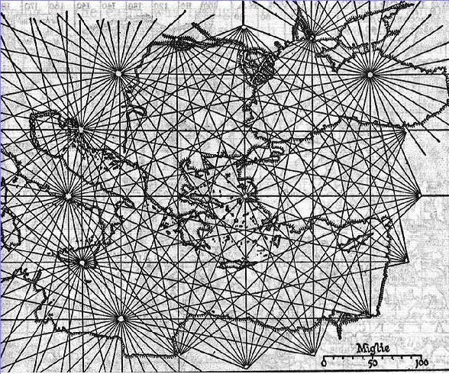
A portolan chart
Pietro Visconti’s portolan chart (1311)

Slide 29
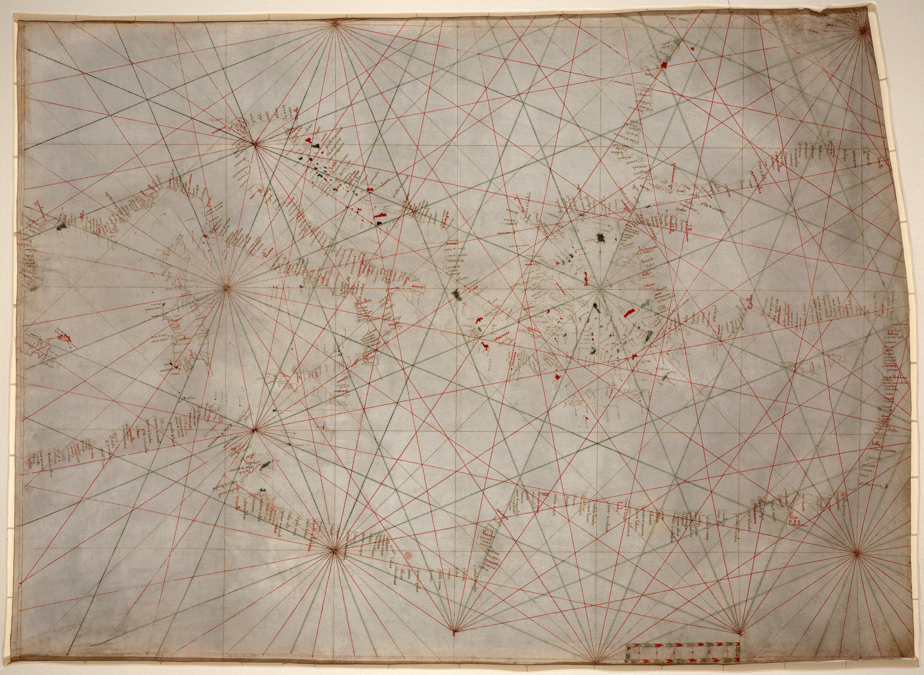
Portolan chart (14th century BC) – Library of Congress (Washington, D.C.)

Slide 30
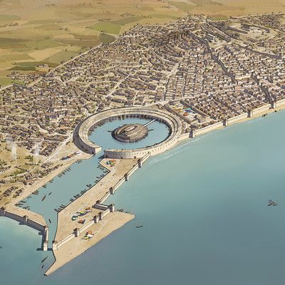
Carthage
Phoenician colony in nowadays Tunis.
Became one of the commercial capital of the Mediterranean area thanks to his favorable position, in the middle of Mediterranean Sea.
Its characteristic is the circular port.

Slide 31
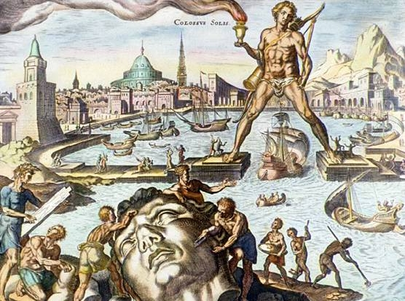
Rhodes
Port of the Aegean sea.
Its lighthouse was on the top of the monumental Colossus, one of the Seven Wonders of the Ancient World.

Slide 32
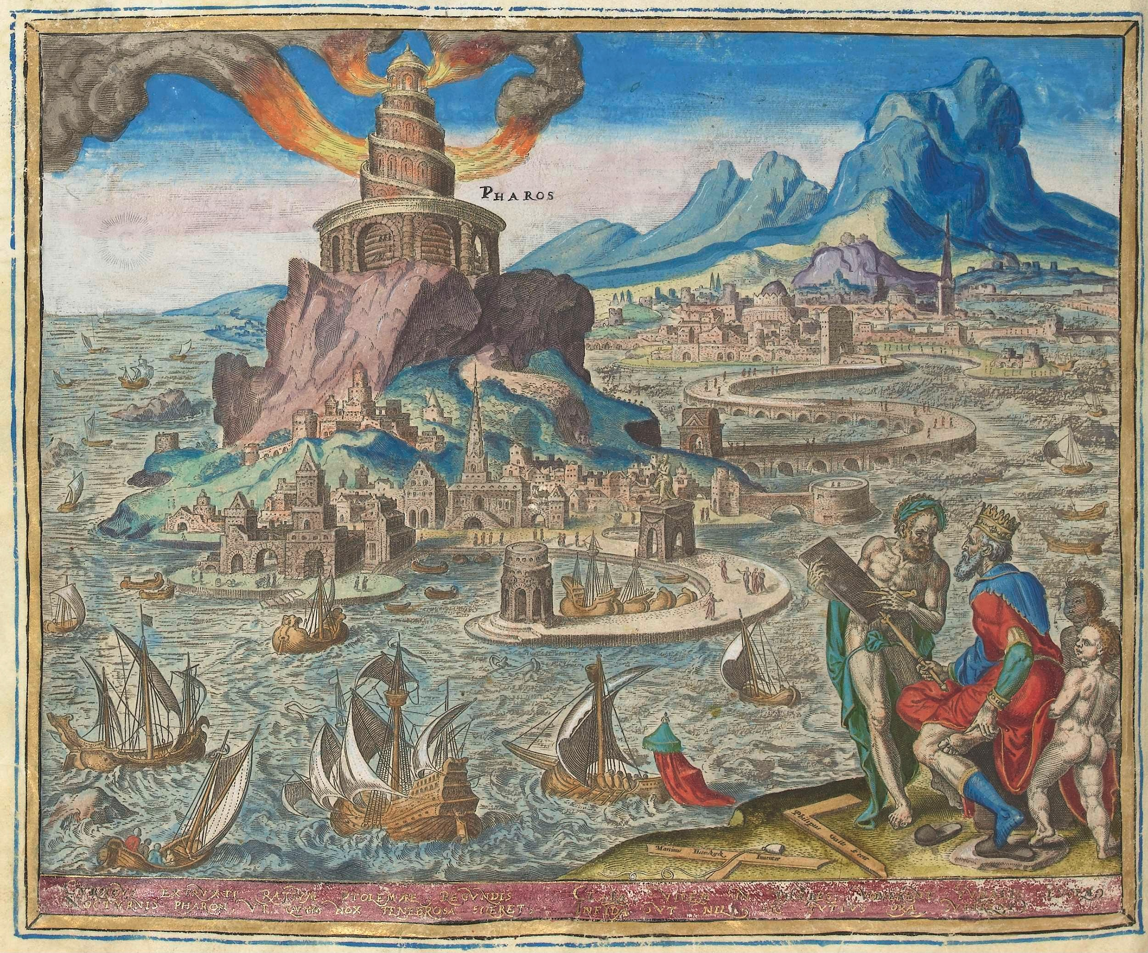
Alexandria
City in Egypt in the Nile Delta and on the Eastern coast of Mediterranean Sea.
Its lighthouse, the Pharos, was one of the Seven Wonders of the Ancient World.

Slide 33
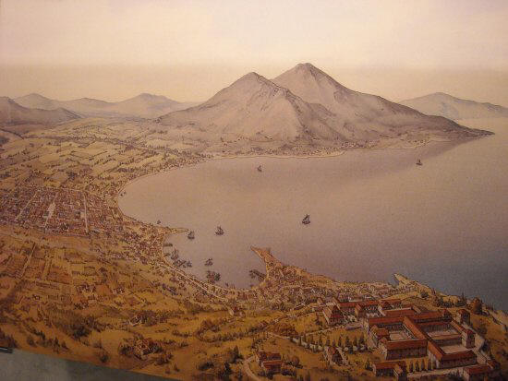
Neapolis
Greek Colony of the Magna Graecia.
Nowadays city of Naples.

Slide 34
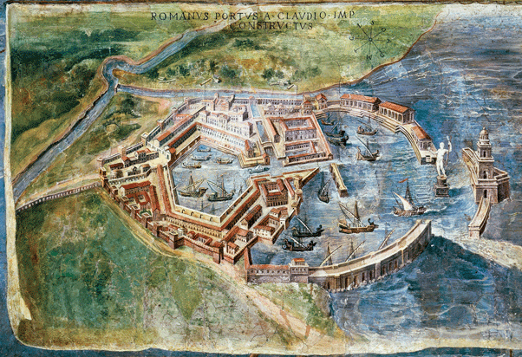
Portus
The fluvial harbor of the Tiber river, one of the main commercial gate of the Ancient Rome.
Nowadays is Ostia (RM).

Slide 35
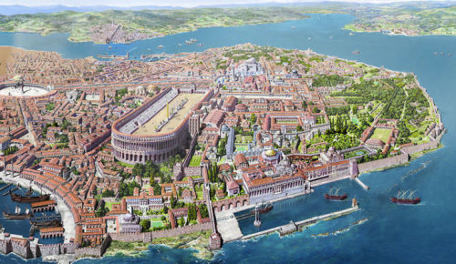
Constantinople
Capital of the Eastern Roman Empire, then Byzantium, capital of the Byzantine Empire (Prosphorion Harbour).
Ottoman Turkish conquests it in 1453.
The gate of Bosphorus.
Now adays Istanbul (Turkey).

Slide 36
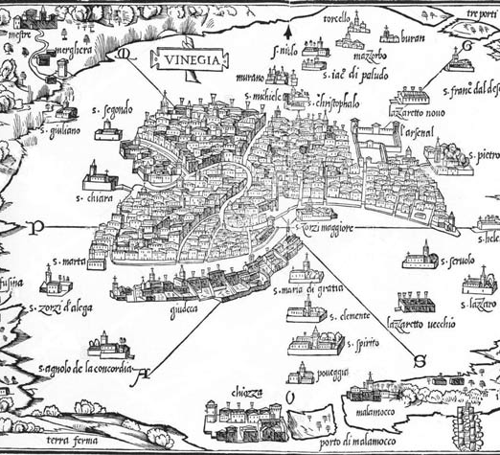
Venezia
City in the Nord-East of the Italian Peninsula on the Adriatic Sea.
It was built on the laguna, a small land surrounded by the sea.
During the centuries, Venice has been one of the commercial capitals of the Middle Ages and Early modern period.

Slide 37
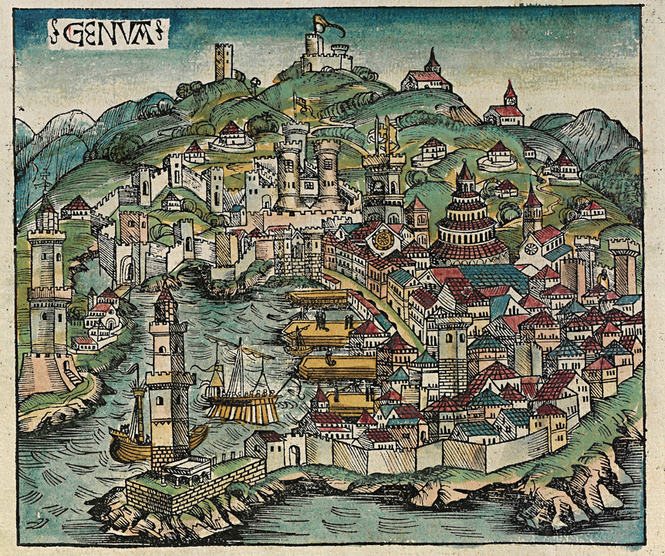
Genova
City in the Nord-West of the Italian Peninsula on the Tyrrhenian Sea.
Like Venice, Genoa has been one of the commercial capitals of the Middle Ages and Early modern period.

Slide 38
Ports and Mediterranean History
It’s commonly known that the Mediterranean Sea was a bridge between people.
The ports are the knots of a network that connect people from different cultures.
The History of the Mediterranean can be considered an history of the people moving across the Mediterranean Sea (e.g., migrations, commences, wars, etc.).
In addition, the domination on the Mediterranean Sea (the so called “thalassocracy”) or part of it has been a crucial aspect for the European politics.
For these reasons, we tried to see the history of the Mediterranean Sea through the history of ports and maritime routes, as a Portolano book.

Slide 39
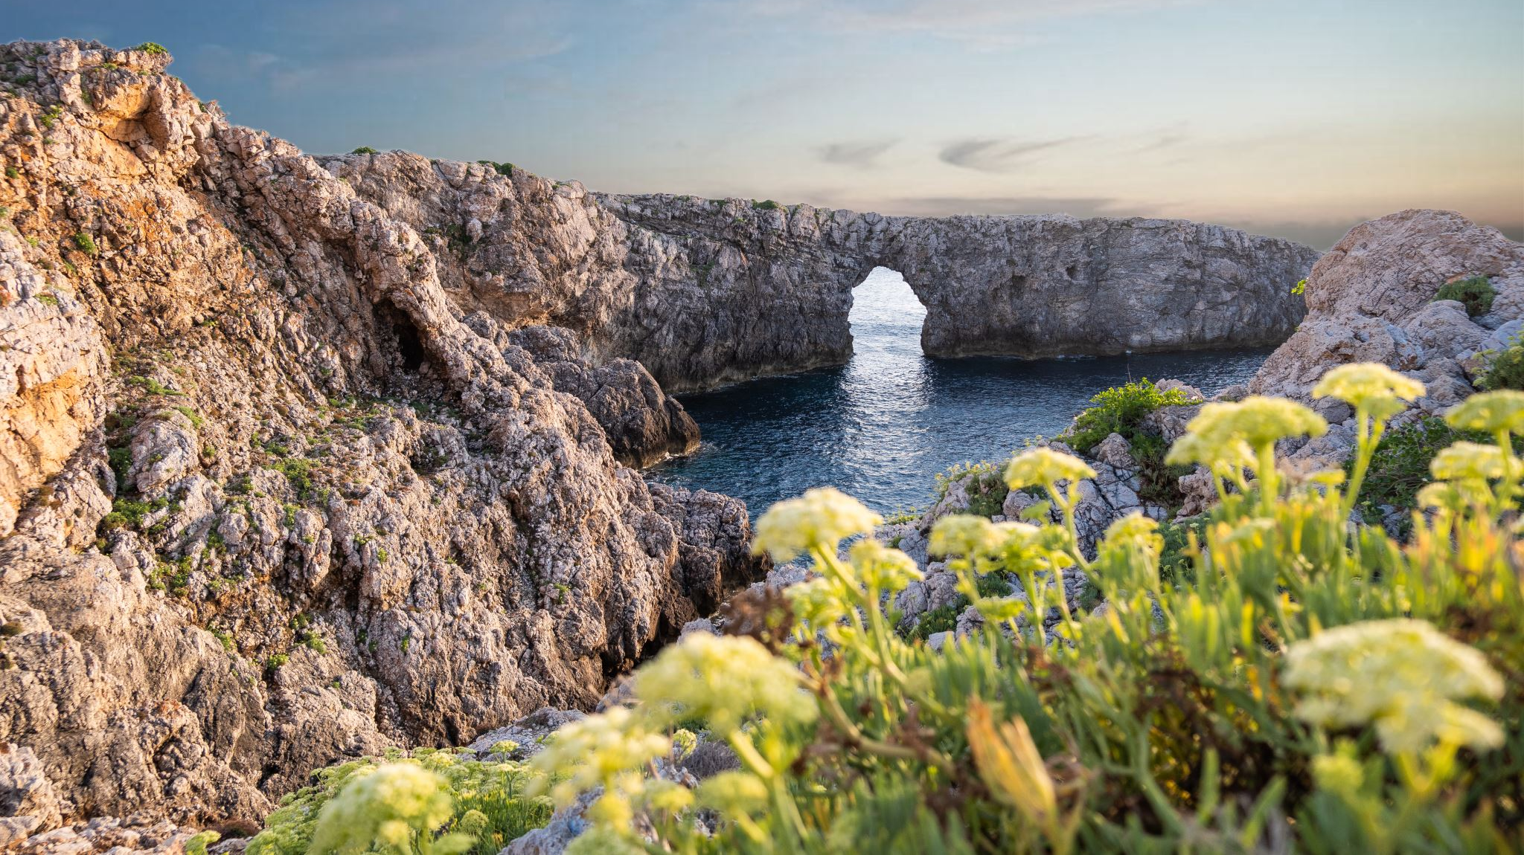
Thank you!

