Slide 1
English for Museology Purpose
Mgr. Lenka Vargová, PhD.
lenka.vargova@uniba.sk
lenka.vargov6@gmail.com

Slide 2
Visiting museums
Why do people visit museums?
What are your expectations of a museum visit?
Have you ever been disappointed by a museum visit? Why?
Do you ever prepare for visiting a museum? How can we do that?
Describe the process of visiting a museum

Slide 3
Visitor motivation
A worthwhile leisure activity
To be with, or do something as, a family of other social group
To be challenged
To actively participate in new experiences
For personal satisfaction and enhancing self-esteem
For fun and entertainment
For education and learning
(Lynda Kelly 2009)

Slide 4
John H. Falk - 5 types of visitors:
EXPLORERS - Visitors who are curiosity driven with a generic interest in the content of the museum. They expect to find something that will grab their attention and fuel their learning.
FACILITATORS - Visitors who are socially motivated. The visit is focused on primarily enabling the experience and learning of others in their accompanying social group.

Slide 5
PROFESSIONALS/HOBBYISTS - Visitors who feel a close tie between museum content and their professional/hobbyist passions. Their visits are typically motivated by a desire to satisfy a specific content related objective.
EXPERIENCE SEEKERS - Visitors who are motivated to visit because they perceive museums as an important destination. Their satisfaction primarily derives from the mere fact of having “been there, done that”

Slide 6
RECHARGERS - Visitors who are primarily seeking to have a contemplative, spiritual and restorative experience. They see museums as a refuge from the work-a-day world or as a confirmation of their religious beliefs.
One visitor can fit into more categories – depending on when and with whom he came
Where do you see yourself fitting in? How can it change based on the situation?
Is there a place for personalisation in museums?

Slide 7
One possibility – structuring of the visit – offer of specific museum trails – „must-see“; what to see with kids; what to see in half an hour, etc; specific types of guided tours – theatrical, night, role-play...
I like... Museums
  Joint marketing campaign of North East English museums – looking up museums based on the visitors´ interests - I like ships, I like science, I like a cup of tea...
  Activity: try to think of a list in 3 categories

Slide 8
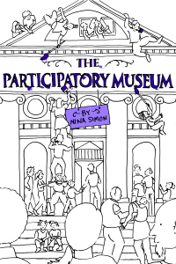
Participation in museums
What is participation in museums?
Is it important?
What forms can it have?
Opening up the Museum -
Nina Simon:
https://www.youtube.com/watch?v=aIcwIH1vZ9w&ab_channel=TEDxTalks

Slide 9
Principles of participation
The importance of participation:
  Makes museums audience-centric institutions
  Getting rid of prejudice
  It enlivens the experience (voluntary)
Different forms / methods of participation
Institution as a platform for multidirectional content experience
Offers visitors ways to contribute to the institution
To enable participation for everyone interested
Using interactive design techniques
The best participatory experiences are scaffolded
Needs to have specified goals

Slide 10
Learning through experience
Experience – personally engaging; characteristics: active engagement, immediacy, individuality, intense,
memorable encounters
Distinguishing quality of museum experience – visual, aesthetic, first-hand experience of artefacts
Facilitated by hands-on and interactive exhibits – „learning by doing“
„immediate experience“ with an exhibit should lead to engagement, reflection and continued engagement with the exhibition

Slide 11
Interactive elements
Simple hands-on exhibits
Participatory exhibits
Interactive exhibits
Focusing visitors´ attention on objects
Increase in interest, change in attitudes
Objects "come to life“
Sharing experience outside the museum
Fun and engaging

Slide 12
Mechanical exhibits – hands-on features, worksheets, mechanical elements, workshops, kids´ zones, games, drawers, climbing grounds.. + engaging all the senses
Information technology / digital exhibits – audio guides, animations, short videos, interactive programmes and games, touch screens, tablets...
Hybrid interactive exhibits - combining digital technology with mechanical elements
Examples?

Slide 13
Visitors and audiences
Who visits museums? How can we categorise museums visitors?
Does it make a difference if museums are free of charge?
What is the difference between audiences, visitors, and communities?
Who are non-visitors? What can be their reasons?
What are some barriers to access?
  Physical access, sensory, intellectual, financial, emotional/ attitudinal, cultural access
How can we overcome them?

Slide 14
Young woman with a water jug
A young woman is found in the center of the picture, standing in the corner of a room facing the viewer . She is opening a window with her right hand, while she holds a brass/silver water jug with her left hand. This jug rests on a larger platter / basin. Both of these, among other objects, are on a table, which is covered by an exotic red rug. Behind the table stands a chair upon which lies a blue material. The woman gazes out the window. The young woman is wearing a crisp white linen headdress and large coif or collar and a dark blue dress with a black and gold bodice. A map hangs in the background on the wall.

Slide 15
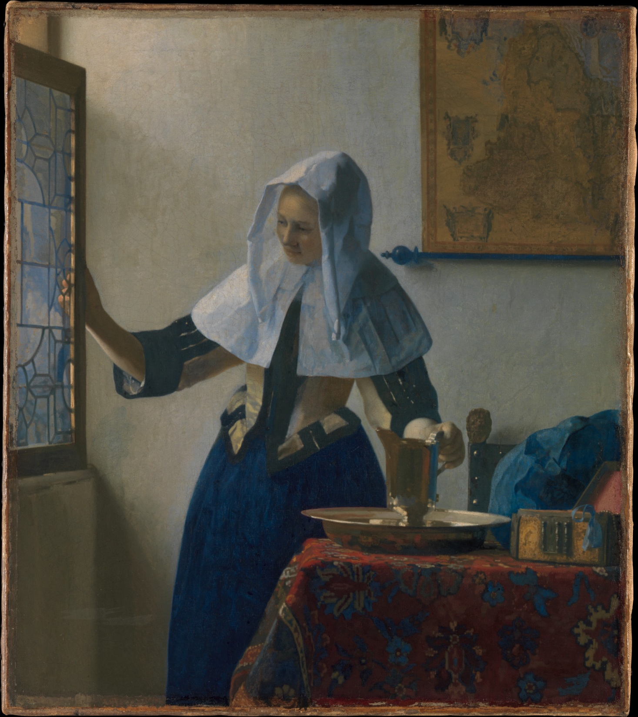
Young Woman with a Water Jug (c.1662),
Jan Vermeer

Slide 16
Museum Ethics
What role does ethics play in a museum?
Are there some regulations as to the proper conduct? Can you think of some negative examples?
Ethics – Case Study
A local collector has one of the finest private collections of material relating to your subject, even though he holds unorthodox views about it. You have fostered good relations with him in the hope that your museum might benefit from this. One day he offers to lend his collection for a temporary exhibition at the museum’s expense, subject to two conditions: that the exhibition only shows material from his collection and that he must be responsible for all label and publication content. Do you accept his offer?

Slide 17
ICOM Code of Ethics for Museums:
  I. Museums preserve, interpret and promote the natural and cultural inheritance of humanity.
  II. Museums that maintain collections hold them in trust for the benefit of society and its development.
  III. Museums hold primary evidence for establishing and furthering knowledge.
  IV. Museums provide opportunities for the appreciation, understanding and management of the natural and cultural heritage.
  V. Museums hold resources that provide opportunities for other public services and benefits.

Slide 18
VI. Museums work in close collaboration with the communities from which their collections originate as well as those they serve.
VII. Museums operate in a legal manner.
VIII. Museums operate in a professional manner.
What is „due dilligence“?
What is „provenance“?
https://icom.museum/en/resources/standards-guidelines/code-of-ethics/

Slide 19
Ethics – Case Study 1
You have been planning for years to organise an important exhibition in your subject but lack of funds has always prevented this. The press and television have publicised your need for a sponsor. To your surprise a large company writes offering to bear the full cost of the exhibition,
subject to their name being associated with it in any publicity. You share this good news with a colleague who tells you that the local community are fighting a campaign against this company because they wish to develop a site of scientific interest which is also sacred to the first
peoples of the area. How do you proceed?
Ethics – Case Study 4
You are a specialist in your subject and your museum encourages its staff to publish academic papers. A commercial gallery, from which your museum occasionally purchases well-documented material for the collections, is now putting on a prestigious exhibition in your subject. The director of the gallery has invited you to write an authoritative introduction to the exhibition catalogue. When you see the list of items included in the exhibition, some have no provenance and you suspect they may have been obtained illegally. Do you accept the invitation?

Slide 20
Museum display & interpretation
What do we mean by museum display?
Can museums be neutral?
What types of exhibition genres are there?
What´s the difference between temporary and permanent exhibition?
What do we mean by „white cube“?
Can objects „speak“? What´s the importance of text?

Slide 21
What´s the exhibition development process?
  Conceptual phase (collecting ideas, assessing resources, exhibition schedule; target audience & theme)
  Developmental phase (planning stage: setting goals, writing the storyline, designing the exhibition, educational plan, estimating costs, a promotional plan; production stage)
  Functional phase (operational stage: maintaining the exhibition, edu activities, visitor surveys, security; terminating stage: dismantling, returning objects to storage)
  Assessment phase (assessment & evaluation, improvements)

Slide 22
Classic exhibition genres
Chronological displays – identify changes over time and their causes
Thematic displays – group and arrange objects according to key ideas, principles, questions or features; „ahistorical“
Monographic / solo displays – present a body of work as authored by a single person or group
National displays – tell the story / are representative of „the nation“

Slide 23
Contemplative display (beautiful & inspiring, art galleries)
Didactic display (telling a story, educational)
Reconstruction display (e.g. open air museums)
Grouped display (most common – groups of objects displayed together, little interpretation)
Visible storage
Discovery display (constructivist – exploring on your own, making your own connections)

Slide 24
What is the basis of an exhibition?
What do we need to create an exhibition?
AMaGA Victoria - Creating a Small Exhibition: https://www.youtube.com/watch?v=2YviD1Pcq9Y&ab_channel=AMaGAVictoria – what advice do they give?
Graphics – display screens & panels, photographs
3D elements – room settings / period rooms, tableau (includes figurines), dioramas, models
Audiovisual & interactive elements

Slide 25
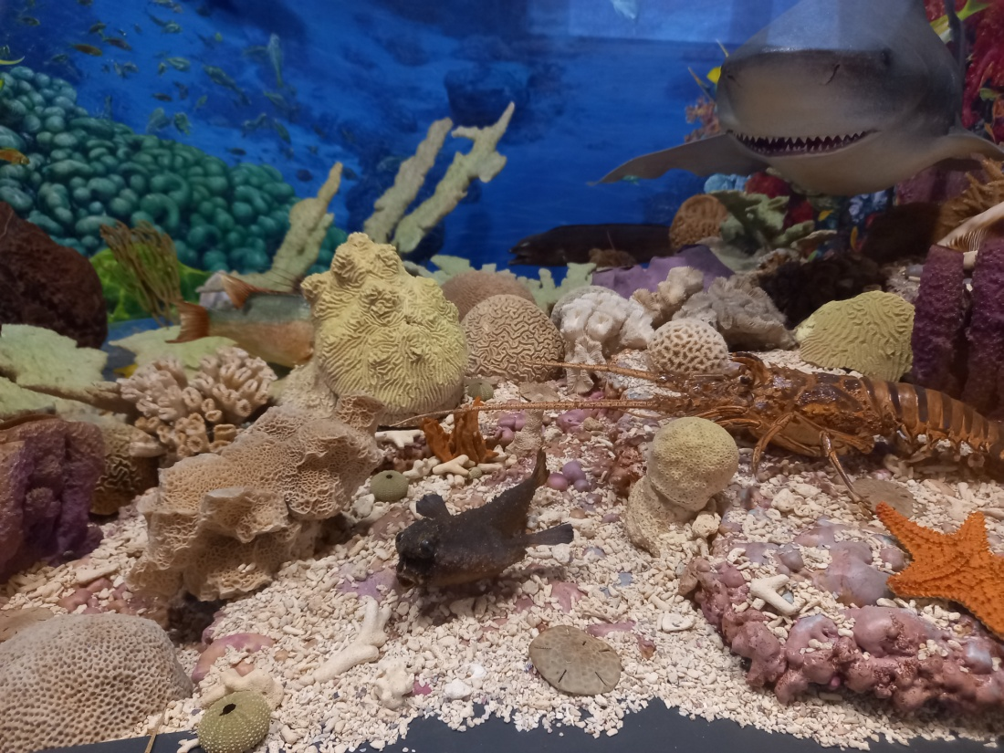
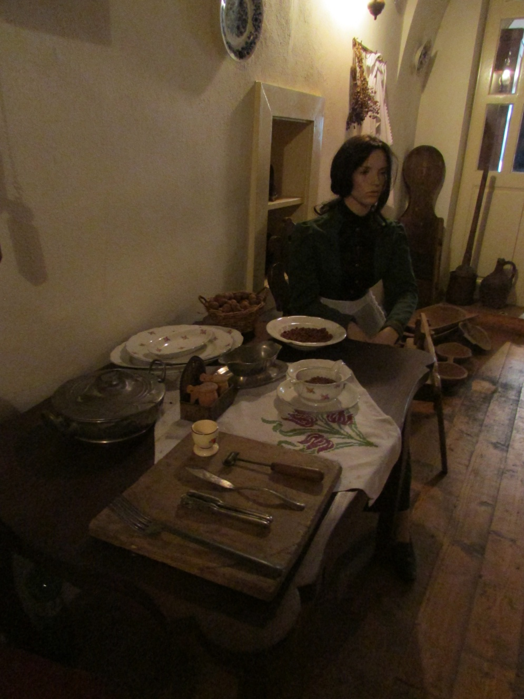
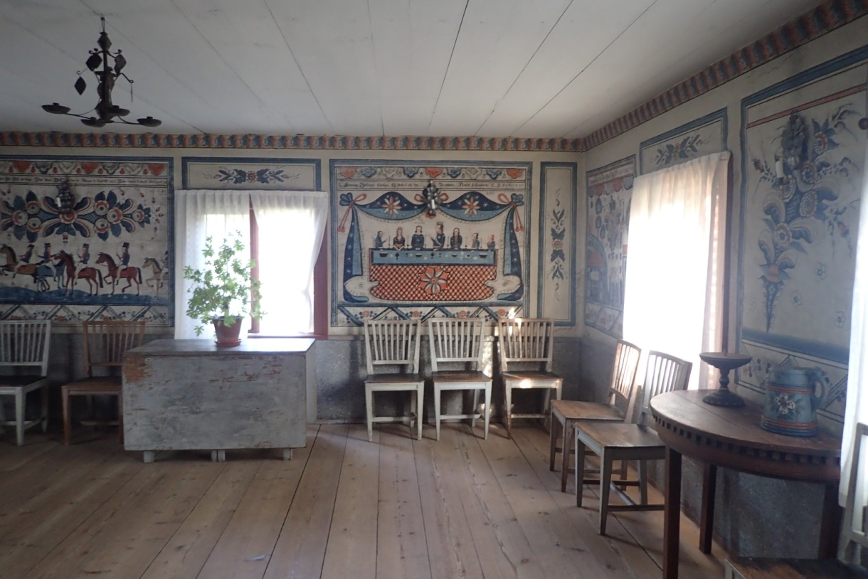
What type of museums uses these methods?

Slide 26
What functions do museum showcases have?
  Protection from theft and damage
  Providing micro-climate (RH, light, temperature)
  Protection from pollutants, insects
  Providing a stage for exhibition and interpretation
Do we always have to use them?
Can you think of an interesting museum display you have seen?

Slide 27
Text in exhibitions
Video – what advice does it give? (4 points)
Skills that can be developed from exploring objects: description, deduction, interpretation, clarification
Make it interesting to the reader, make it relatable
Aim for an average of 10-20 words per sentence, use short paragraphs – fewer than 50 words
Simple, short words make your text more accessible
Use pictures, diagrams, maps or graphs to get your messages across

Slide 28
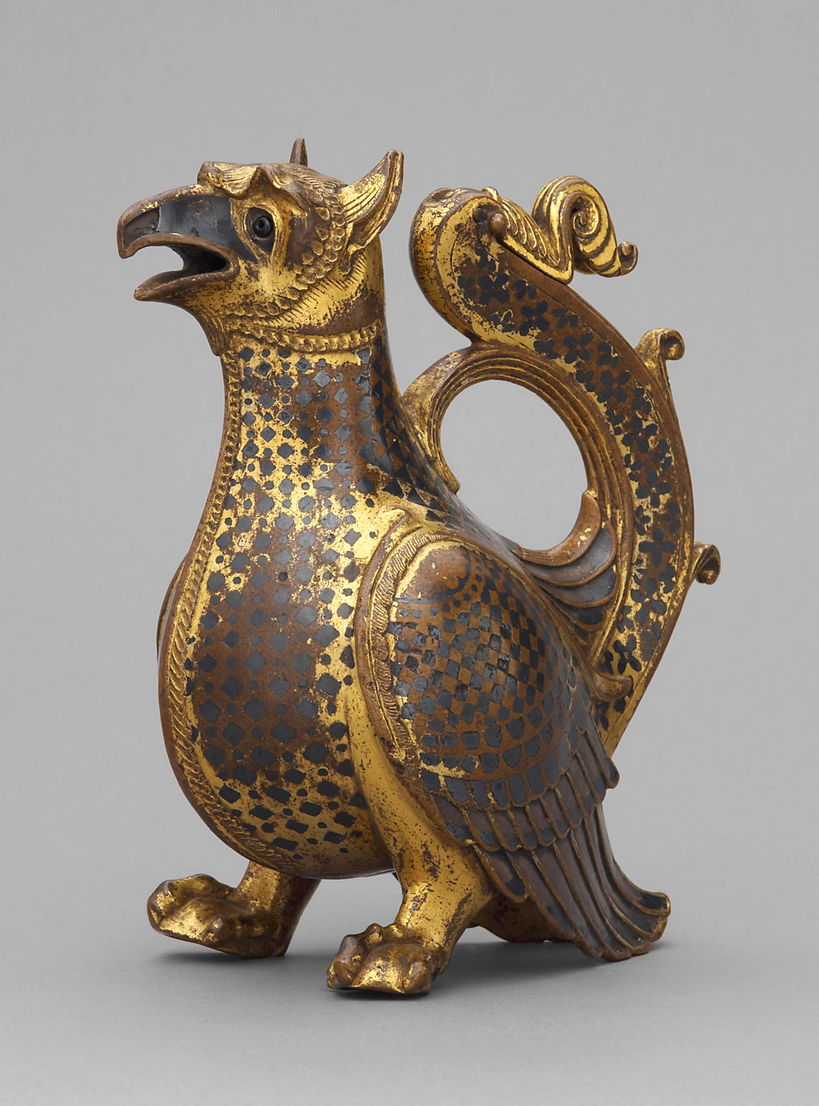
HW – Write a label (45 word limit)
Aquamanile in the Form of a Griffon (KHM), ca. 1120/30
material: Gilded bronze, damascened silver, niello, garnet
H. 17,3 cm, B. 8,5 cm, L. 14,5 cm

Slide 29
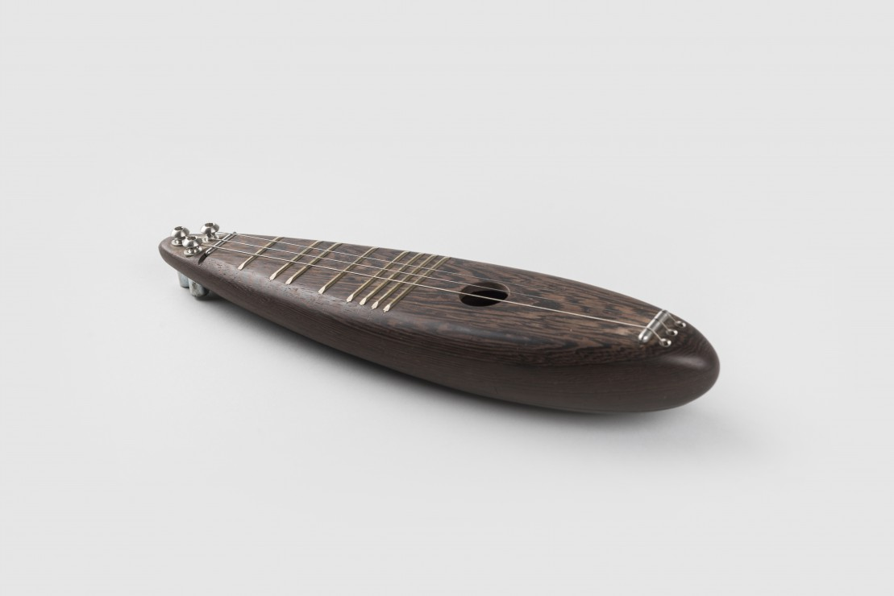
HW 2 – Write a made-up label (45 word limit)
ČUDO (SMD)

Slide 30
Characteristics of a good exhibit
It must be safe and secure
It must be visible
It must catch the eye
It must look good
It must hold attention
It must be worthwhile
It must be in good taste

Slide 31
display - The means by which museums present and interpret objects to their visitors, usually involving design, text and graphics. In the UK and Europe this word is used by choice instead of exhibition
exhibit (noun) a grouping of objects and interpretive materials that form a unit for presentation; the localized grouping of objects and interpretive materials that form a cohesive unit within a gallery
exhibit (verb) to present or expose to view, show, or display

Slide 32
exhibition (noun) - a comprehensive grouping of all the elements (including exhibits and displays) that form a complete public presentation of collections and information for the public use; “An exhibition is a means of communication aiming at large groups of the public with the purpose of conveying information, ideas, and emotions relating to the material evidence of man and his surroundings, with the aid of chiefly visual and dimensional methods”
exhibition (verb) the act or fact of exhibiting collections, objects, or information to the public for the purpose of education, enlightenment, and enjoyment
exhibition policy a written document that states a museum’s philosophy and intent toward public exhibitions

Slide 33
What is a membership? Do museums in Czech Republic offer something like that? Should they?
How can museums use volunteers? Can you volunteer in a museum here?
Who is an educator? What do they do?
What all is part of visitor services?
What is visitor studies? Do we need it?
How do we conduct audience research?

Slide 34
All audience research should be intentional, the Museums Association (2013) in the UK suggests that several questions be asked before conducting audience research:
• What do you want to find out?
• Why do you want to find this out?
• What will be done with the information?
• How are you going to find this out?
• Who are you finding this out from?
• How are you going to tell them?
• How much time, staff, and money will be needed?
• What kind of data do you want to collect (quantitative, qualitative, or a mixture)?
• Will you conduct it in-house or hire a consultant?

