Slide 1
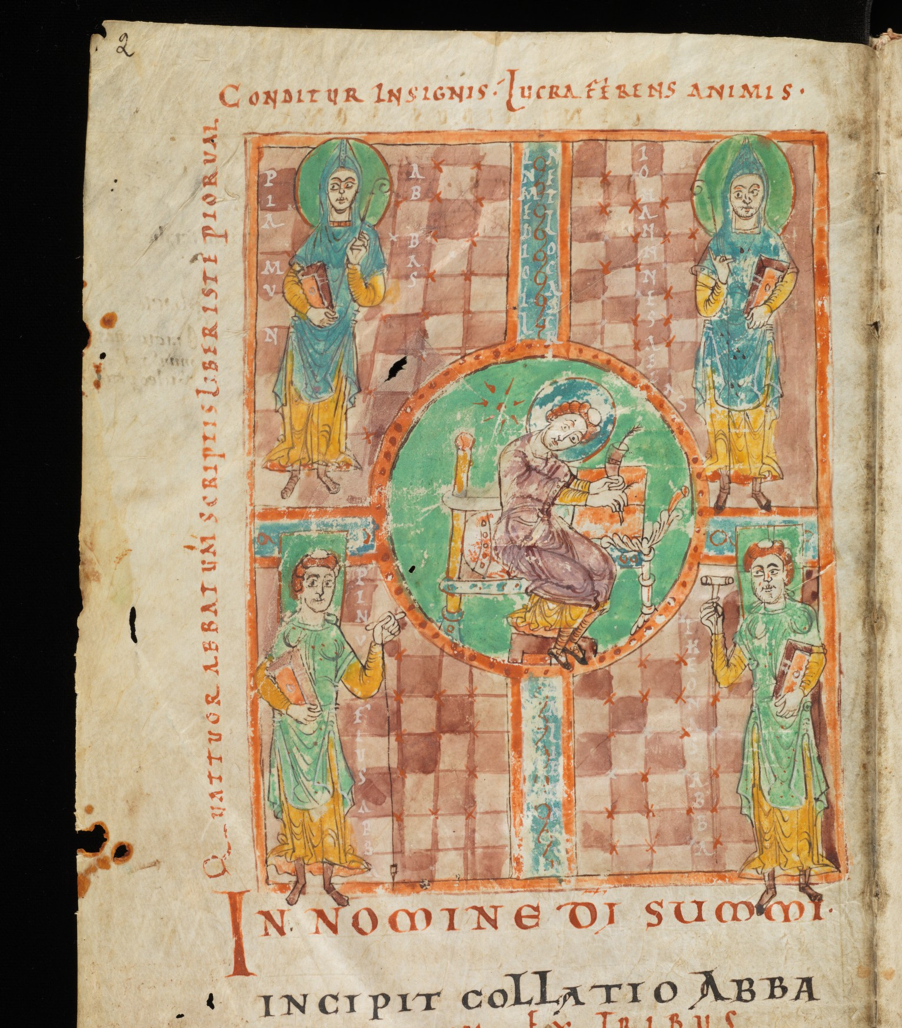
Hermits, the First Monasteries, and Late Antique Society

Slide 2
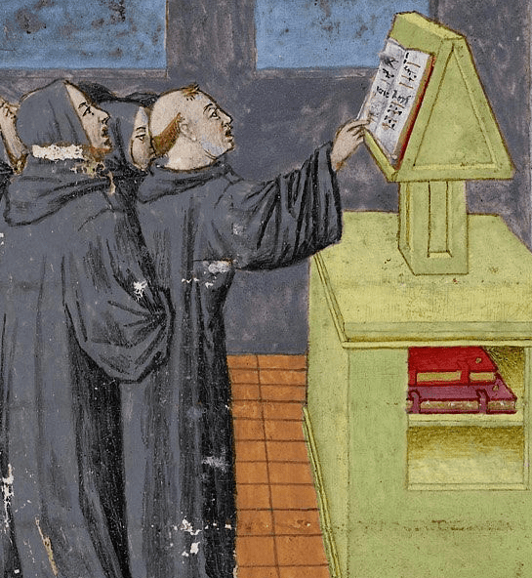
Introduction to course
Key elements:
Short seminars - background, major themes, key lines of historical debate – please ask questions though!
Group reading of sources and discussion – provide depth and multiple perspectives; develop skills in historical interpretation and debate

Slide 3
Why monastic history
For religious studies, studying monastic history gives a unique perspectives on how religion is lived in society
Micro-level (within monasteries), macro-level (the understanding of how parts – i.e. monasteries - affect the whole of religious society – i.e Christendom)
Variety: monasticism is like a religious laboratory – so many things are tried, and the world is affected in so many ways as a result
Monastic tradition affects so much of modern life, even though we are often unaware of it

Slide 4
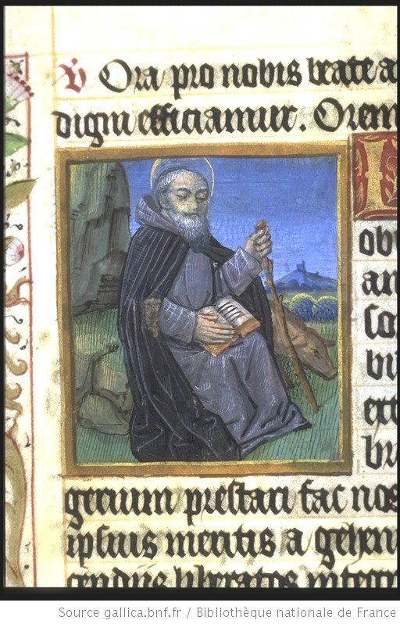
The First Monks
“Monks” and “monasticism”: the root of the words is “monos” in Greek – “alone”, “single”, “one ”. The word for monk in Latin is “monachus”
The first “monks” had no monasteries and no formal communities – they were independent, unmarried recluses

Slide 5
The First Monks
The earliest well-known examples occur in Roman Egypt
Paul of Thebes (d. circa 341 AD, birthplace unknown)
Most famously, Anthony the Great (d. circa 356, from Herakleopolis)
These, however, were not the very first religious recluses in Egypt
Athanasius’s Life of Anthony states that Anthony received training from another recluse before fully committing to this life, and that there were others like this.
Modern scholarship focuses less on exceptional figures.
There were also some similar developments in the Near East and Syria around the same time, i.e. from late 3rd century AD

Slide 6
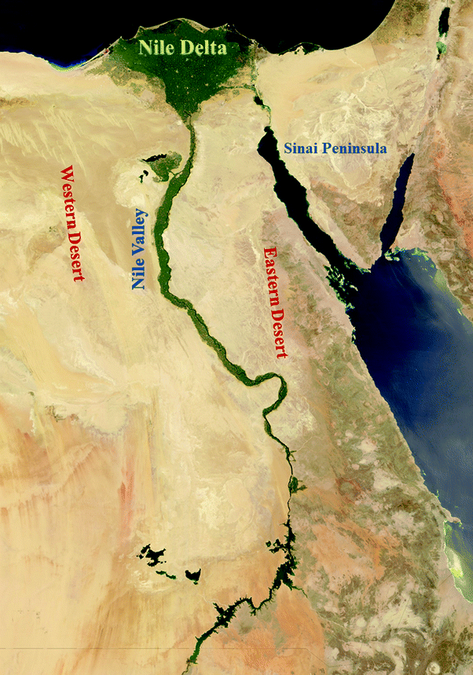
The Egyptian “Desert”
The earliest well-known recluses (e.g. Anthony, Paul of Thebes) were famed for having lived in the vast Egyptian deserts that lay either side the cultivated Nile Valley.
Nile Valley = a thin strip of prosperous land where Christianity was fast becoming the dominant force in the 3rd century AD.
Solitary ascetics did not always chose such desert locations.
Prior to Anthony (and after!), there were recluses who lived in or near villages (Goehring) in or at the edges of the Nile Valley
The recluse whom Anthony is said to receive training from lives near a village

Slide 7
The Egyptian “Desert”
Nevertheless, the aspiration to live in “desert solitude” becomes powerful
This ideal image is dominant in how early Egyptian monks are described in literary sources.
The Latin term for a Christian recluse: eremita from the Greek eremites, meaning of “of the desert” – in English “hermit”; we call their way of life “eremitic”.
Even if early hermits were not always situated in the desert, those who did live outside or even on the margins of the fertile zone faced a challenging living environment.
Such hermits are deliberately setting themselves a tough “ascetic” regime. “Ascetic” and “asceticism” derive from Greek: Askēsis (“training”, “exercise”).

Slide 8
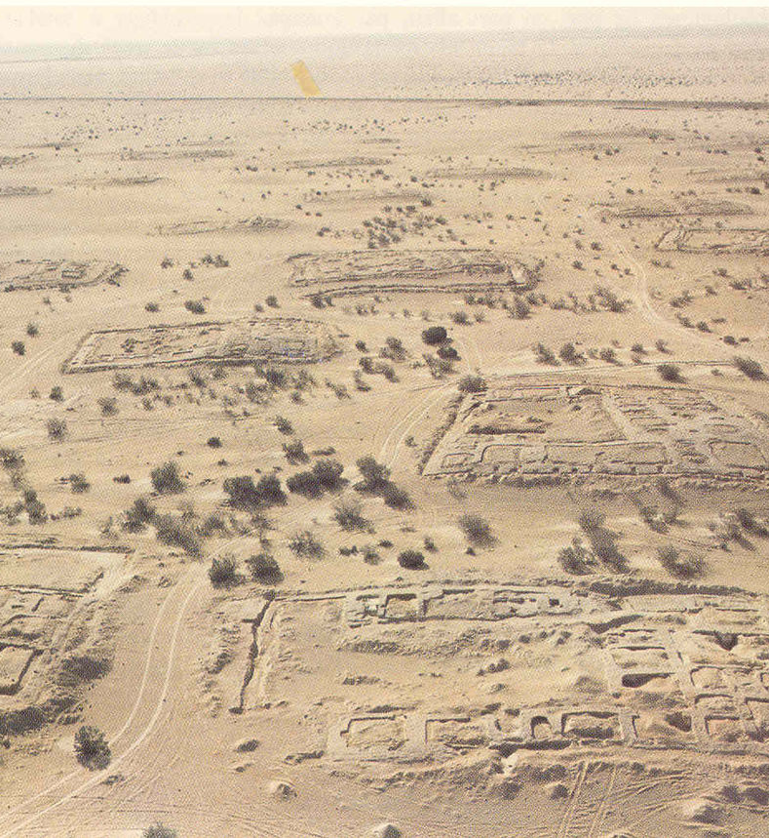
From Hermits to Monasteries
A more practical monastic form quickly emerges, that does not require ascetics to survive alone.
Groups of hermits start to congregate very close to each other, even in very large groups (e.g. Kellia – see picture), and pick leaders.
Athanasius of Alexandria, biographer of Saint Anthony says that the “desert had become a city” by the end of Anthony’s life.
Anthony himself gained follower monks at Pispir (a deserted mountain fort near the Nile).
He retired to a deeper desert location near the Red Sea to regain solitude, but again attracted others there.

Slide 9
From Hermits to Monasteries
Pachomius (c. 292–348): the most celebrated early promoter of the coenobitic (i.e communal) monastic life.
Brings together monks in communal dwellings at Tabennsis, Upper Egypt.
He goes on to form a congregation of nine monasteries and writes the first known monastic rule of life (his Precepts).
But there are many other coenobitic experiments too with quite a variety of forms
Coenobitic comes from the Greek terms “koinos” (“common”) and “bios” (“life”)

Slide 10
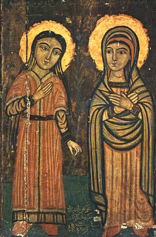
Female Recluses and Nuns
The “Sayings of the Desert Fathers” (Apophthegmata Patrum), a 5th century compilation of early monastic wisdom, actually contains quite a few sayings of “Desert mothers”! E.g.:
Sarah
Syncletica
Matrona.
Women’s coenobitic monasticism also begins early.
Pachomius establishes a female community alongside his first male community, as part of a larger complex.

Slide 11
Female Recluses and Nuns
Women are still found less in the literary evidence though. Why?
Regarding hermits, society is not quite as comfortable with women taking an independent path.
Female coenobitic monasticism is more socially acceptable and even desirable: women are “looked after” in this context, placed in a new family. A place to put unmarried daughters or widows, or family members of male monks.
Nevertheless, there are already fears over the temptation of male monks by female nuns: women seen as particular carriers and transmitters of the sin of lust.
N.B. female monk in Latin is a “monacha” or a “monialis”. In English a female coenobitic monks is much more commonly called a “nun”

Slide 12
Early Monastic Values
A physical life that revolved around self-denial. Some common features:
Celibacy: renunciation of any sexual contact most often seen as critical
Pachomius pays particular attention to this issue in his Precepts – keen to avoid sexual contact and temptation not only with the outside world, but also between the monks.
Thus, knees to be kept covered when sitting together, tunics long enough that they do not go too high when the monk bends over
Diet and fasting: early hermits are especially noted for startling dietary regimes
Paul of Thebes is said to have lived largely from the fruit of a single tree, and bread given to him by a raven
Anthony consumed just bread, water and salt, according to his biographer, Athanasius of Alexandria
Onuphrius (4th or 5th century AD) is said to live entirely on dates
In more normal cases, monks tended to live on a simple, vegetarian diet, based on the what was locally available: bread, lentils, rice etc.

Slide 13
Early Monastic Values
A physical life that revolved around self-denial. Some common features:
Other physical ascetic practices
Basic dwellings: for hermits, caves and or simple constructed cells are frequently reported
Simple clothes: the most rigorous hermits wear rags and hair shirts (e.g. Anthony)
Sleep deprivation; e.g. rising in the middle of the night to pray.
Emphasis on constant or very frequent prayer
Anthony: “he was constant in prayer, knowing that a man ought to pray unceasingly in private” (Athanasius of Alexandria)
Pachomius sets a precise round of daily prayer (e.g. saying the “Jesus prayer” 100 times a day) in his Precepts

Slide 14
Early Monastic Values
A spiritual life focussed on repentance for the sins and impurity of man, as well as contemplating the divine.
An early death and a life of mourning
They are “mortifying” (i.e. killing) their “flesh” in repentance for their worldly sins and to escape temptation. Dorotheus in the Lausiac History of Palladius: “It [the body] kills me; I kill it”.
With this “death” comes inner grief and mourning. Saint Jerome (d.420): a monk is “Is qui luget” – “He who mourns”.
Monks grieve over their own sins. They also mourn for mankind more broadly, condemned to both sin and mortality by Adam’s error in the Garden of Eden (“The Fall”). Finally, they mourning for Christ, condemned to death by sinful men.
With grief came tears. Evagrius of Pontus (d. 399), an Anatolian scholar who became a monk in Egypt, said that physical tears were the surest sign of true repentance.

Slide 15
Early Monastic Values
A spiritual life focussed on repentance for the sins and impurity of man, as well as contemplating the divine.
A new birth
Their focus is on rebuilding and perfecting man’s inner, God-given virtues. Palladius’s Lausiac history speaks of monks perfecting “charity, joy, peace, patience, kindness, goodness and forbearance”.
Becoming a monk comes to be seen as like a second baptism.

Slide 16
Early Monastic Values - Coenobitic
Some traits of Pachomian monasticism (N.B. there is a lot of variety in this period beyond Pachomian norms, but they are certainly influential)
Common enclosure, separate from the rest of society – although how great the distance really was varied. In Pachomian monasticism men and women are kept in separate accommodation.
Common prayer – Pachomius established two daily offices (a fixed observance of prayers and scriptural readings, typically Psalms) – one in the day and one at night.
Common material goods – No personal possessions. Technically, these do not even belong to the monastery, but to God: thus they are to show charity to the poor from them.
Common labour – even a monks body is not his own: they all perform manual labour to support each other even if they might have specialised jobs (i.e. growing vegetables, making clothes).
Common obedience – to an “abba” (male) or “amma” (female): Coptic terms for “father” and “mother”. These figures set the common direction both in life and learning (they lead Scriptural education). The word “abbot” comes from “abba”.

Slide 17
Early Monastic Values - Coenobitic
The positive, regenerative possibilities of monastic life are perhaps especially important for coenobitic monasticism.
Communal monasticism - if more practical - might seem to weaken the monastic purpose: fleeing worldly attachments to focus solely on God.
Physical asceticism somewhat lowered (from stringent self-denial to lack of individual property)
Most importantly, they lived with other men (or women, in female houses)
But living in a religious community had a distinctive spiritual appeal
If people were in perfect harmony in their absolute desire for union with God, could they not live together? Might it even be spiritually helpful for them to be together?
Monks in communities could see themselves as fleeing the disorderly and sinful society of the world to build a more perfect one
Hence the emphasis on “common life” in Pachomian coenobitic monasticism.

Slide 18
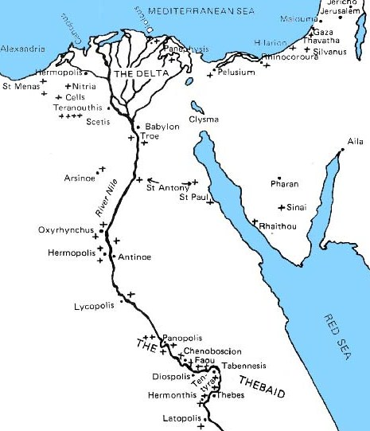
Separation and Support
Literary sources tend to emphasise the separation of monks from regular society.
But the ability to attract so many new recruits – from all segments of society, from very high status to quite low status – suggests strong connections with the outside world.
“Desert” Hermits were often not far from the prosperous fertile zone.
Monasteries were often created in villages, at the edge of this zone or even within it.
Pachomius’s foundations took over deserted villages, but none were really in the desert (Goehring). Tabennsis is on the banks of the Nile!
Early Egyptian Monastic sites (marked with crosses)

Slide 19
Separation and Support
The economic needs of so many monks inevitably also quickly exceeded what they could provide for themselves
Gathering food or cultivating little gardens would not be enough for larger communities
Even monastic literary sources (e.g. the writings of Shenoute, abbot of the White monastery, d. 465) suggest the importance of crafted goods, not only for the community itself but also for exchange with outsiders for supplies.
Egyptian Coptic papyri also complement this picture of very regular economic interaction with society (Wipcyzka).
Gifts of money and land from outsiders made for spiritual benefit (e.g. prayers; benefits from the act of giving to holy men and women). Some social reactions – e.g. lawsuits over family inheritances given away to monks!
Monks who came from privileged backgrounds brought land to their monasteries. Combined with gifts from outsiders, monasteries often accumulated estates that they financially exploited through tenant farmers or labourers.
Early Egyptian Monastic sites (marked with crosses)

Slide 20
The Roots of Monasticism
Why do men and women go to the “desert” (whether real or imagined) to live such an ascetic lives?
Several ways of looking at this question (not mutually exclusive):
Scriptural example
Long-term cultural heritage
Immediate socio-cultural factors

Slide 21
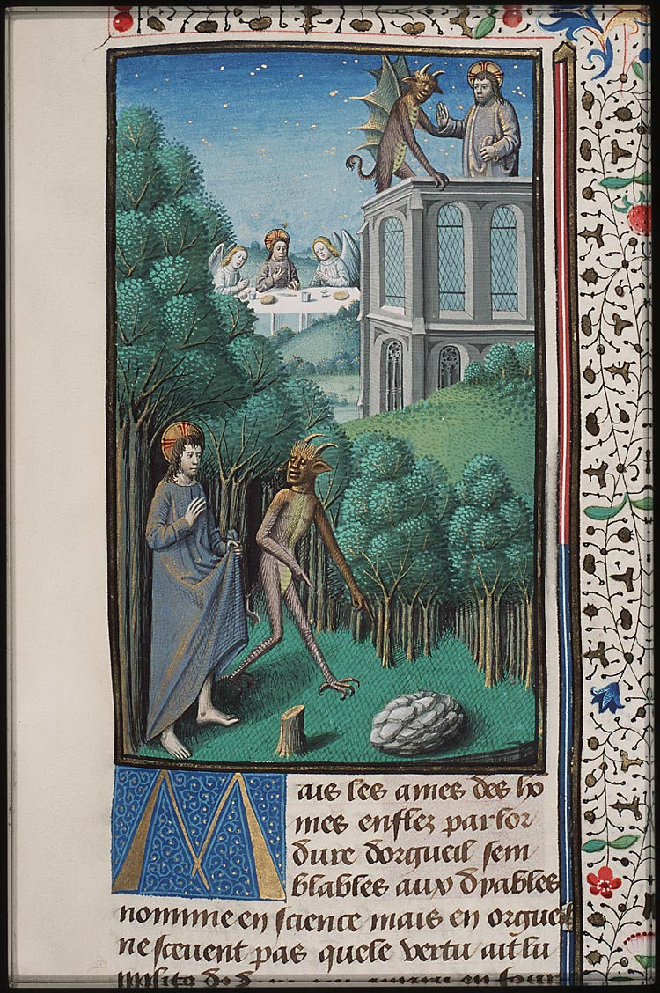
Scriptural Example
Monastic literature of this period (and throughout the Middle Ages) emphasises that monastic life was derived from the teachings of Christ himself
Christ in the wilderness, battling with the devil
“Jesus was led by the spirit into the desert, to be tempted by the devil” – there he “fasted for 40 days and nights” (Matthew 4:1-2)
Christ’s answer to a rich young man
“If you want to be perfect, go, sell your possessions and give to the poor, and you will have treasure in heaven. Then come, follow me” (Matthew 19:21)

Slide 22
Scriptural Example
Monks – especially coenobitic monks – looked to the community of the apostles:
“They devoted themselves to the apostles’ teaching and to fellowship, to the breaking of bread and to prayer. Everyone was filled with awe at the many wonders and signs performed by the apostles. All the believers were together and had everything in common. They sold property and possessions to give to anyone who had need. Every day they continued to meet together in the temple courts. They broke bread in their homes and ate together with glad and sincere hearts, praising God and enjoying the favour of all the people. And the Lord added to their number daily those who were being saved.” (Acts 2:42-47)

Slide 23
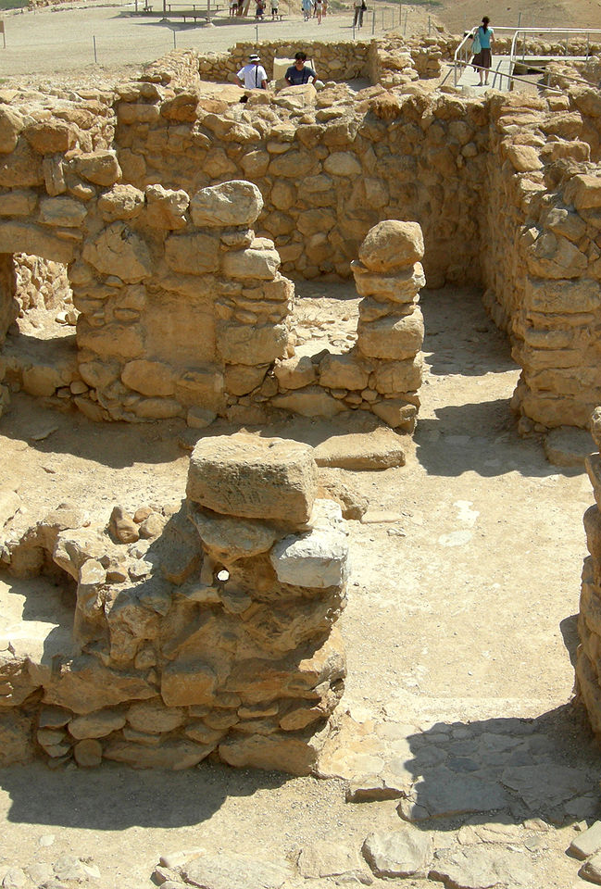
Cultural Heritage
The pursuit of strict, ascetic-style practices is present across multiple religious and cultural backgrounds.
Might Christian monasticism be linked to some of these?
Jewish Thought and Practices
Religious self-denial prominent in Biblical Judaism
Continues in the early Church, magnified by Christ’s example in the wilderness.
Later Jewish “monasticism” – e.g. the Essenes (2nd century BC – 1st century AD)
An interesting antecedent: an ascetic, penitential community living somewhat separately from society. Saint Jerome, who was very knowledgeable of Hebrew traditions noted the similarity.
However: no clear, continuous link to the development of Christian monasticism.

Slide 24
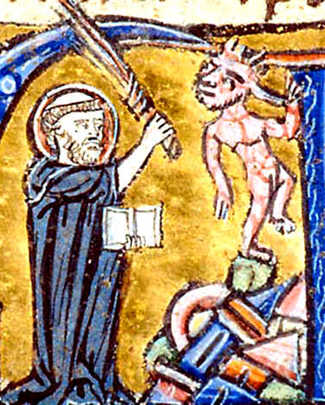
Cultural Heritage
Dualism
An ancient belief – dating back at least as far as Zoroastrianism - in inherently “good” and “bad” elements within the universe.
At the time in which Christian monastic life began to develop, a competing, syncretistic faith – Manichaeism. Presents a battle between a good, spiritual world and a bad, material one.
The rejection of dualism by the Church Fathers (e.g. Augustine, 354-430 AD, pictured on the right – a former Manichaean) and learned monastic writers is strong.
If all creation is God’s then the material world and the body cannot be inherently bad.
Evagrius of Pontus: prefers to see sin originating in 8 evil “thoughts”, rather than the material world. These become the basis for the seven deadly sins.

Slide 25
Cultural Heritage
Dualism
But there are some blurred lines:
Augustine finds man’s attraction to sin in his “carnal [i.e. ‘fleshy’] will” (voluntas carnalis), a defect derived from “the Fall” (i.e. Adam eating the apple) by which mankind, without the help of God’s grace, comes to prefer his own temporal comfort and satisfaction to the spiritual.
How much did most monks truly understood the boundary between emerging theological orthodoxy and dualism?

Slide 26
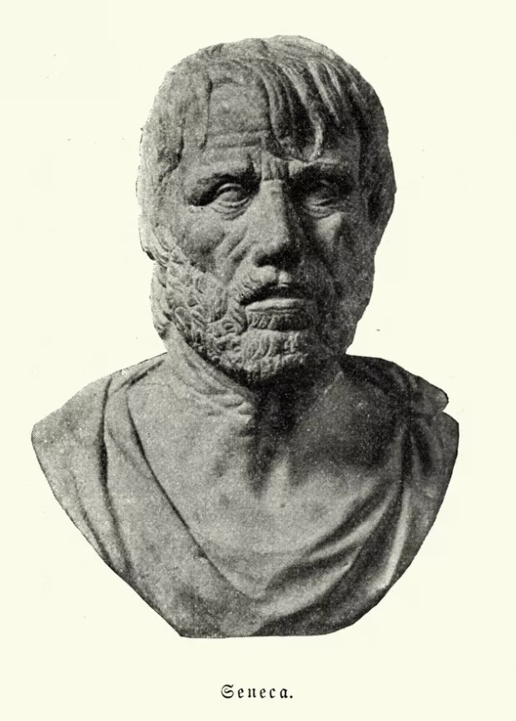
Cultural Heritage
Stoicism - A Hellenistic (i.e. Greek) school philosophy
Key figures: Zeno of Citium (3rd century BC); Seneca (1st century AD)
Key idea: Freedom from external concerns/desires -> reason -> inner peace
Some parallels, but also key differences from learned monastic outlooks
No physical ascetic requirement; stoic ideals practiced by Roman elites like Cicero.
Christian virtues are not without emotion. God is emotional, bonds of love with man.
BUT Evagrius of Pontus does come close.
Believes that monks must develop an apatheia that frees them from worldly passion.
This outlook would lead to some later concerns about his orthodoxy.

Slide 27
Cultural Heritage
Monasticism also represented a clear rejection of parts of existing culture
E.g. Celibacy: practiced in some pagan contexts, but marriage and reproduction are celebrated as pinnacle social norms
By choosing and promoting a celibate life as the most perfect, monks and their supporters in the late Roman empire are overturning cultural norms (Brown).

Slide 28
Immediate Socio-cultural Factors
Late Antique Egypt
Egypt’s “true desert” beyond the fertile zone allowed holy individuals like Anthony to set themselves apart as truly otherworldly in a way that was not as easy elsewhere (Brown).
Egypt was also unusual in that desert regions were so close to the highly-populated and very prosperous fertile area – the “breadbasket” of the Roman Empire at the time.
In Egypt “otherworldly” holy men are in close reach for a prosperous, “worldly” society: a powerful and attractive combination!

Slide 29
Immediate Socio-cultural Factors
Christianity between persecution and imperial religion
Christianity is becoming a very public religion, rather a secretive cult in some of the Empire’s key Mediterranean centres – including the Egypt, the Near East, North Africa, and Rome itself.
Leads to the harshest persecutions yet known: that of Diocletian (emperor 284-305) in particular. Saint Anthony goes to the desert around this time.
But most who become monks are not escaping pagan reaction: rather, from the mid-fourth century Christianity is very well established: Emperor Constantine I legalises the religion in 313, and by 324 it is clearly his favoured religion.

Slide 30
Immediate Socio-cultural Factors
Christianity between persecution and imperial religion
The popular emergence of monasticism in the Christian heartlands of the Empire might be seen as a reaction or counter-culture to this new Christian scenario (Lester K. Little)
Ascetic life is a way of proving one’s piety now martyrdom is less of a threat
A way to set oneself apart, as part of a godly elite, now that the Christian community as a whole cannot be seen so easily seen as such
But its spread and acceptance by those who did not take it up suggests that others were in some way reassured or excited by its presence
Provide prayer and charity for society: taking pressure off other Christians
A “north star” of Christian perfection that others could learn from, even if they did not fully imitate its rigours

Slide 31
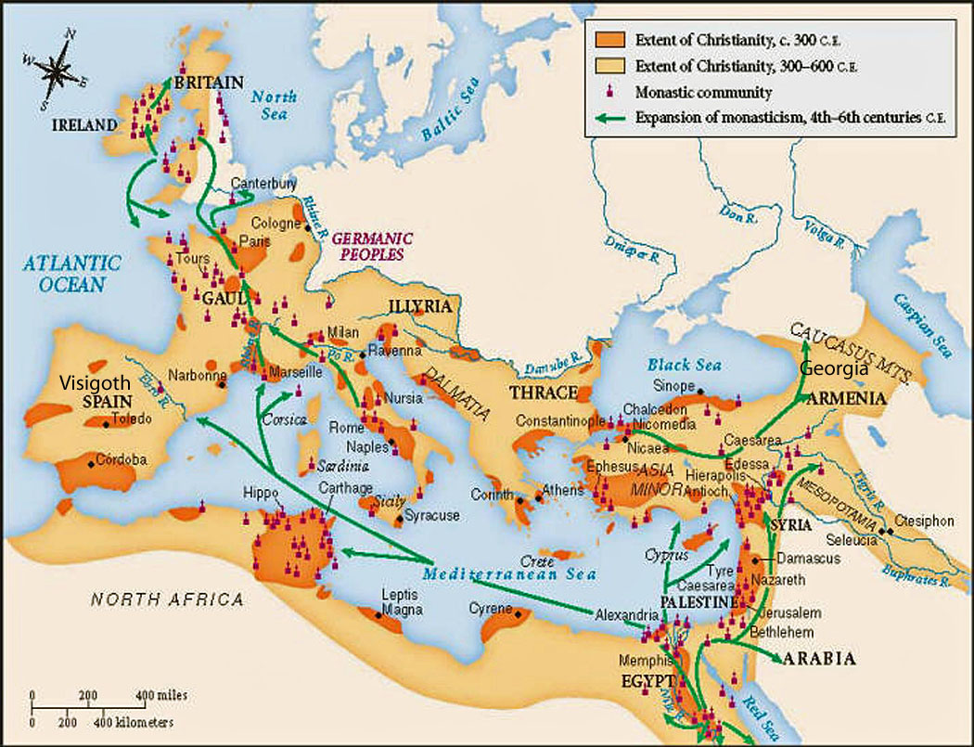
The spread of monasticism in the West
The fame of Egyptian monasticism spread very rapidly
Monastic practices with direct, traceable roots back to Egypt start to make significant headway in Europe around 400 AD
A topic for the next class!

Slide 32
Sources – Life of Saint Anthony (c. 360 AD), by Athanasius of Alexandria
Athanasius – bishop of Alexandria (from 328 AD to his death in 373 AD)
Life of Anthony
Records the life of Anthony: born in Herakliopolos, allegedly in 251, becomes a recluse, eventually moves to Pispir, a deserted mountain fort not far from the Nile. Later moves further into the Eastern Desert, to another mountain near the Red Sea.
Written not long after the death of Anthony (recorded as 356 AD)
Writer knew Anthony personally, but wrote for Written for “brethren in foreign parts” – i.e. outside Egypt
Translated from Greek to Latin before 374 by Evagrius of Antioch. Widely read by monks in both the West and East for centuries to come
Reference: Athanasius, Life of Saint Anthony, trans. H. Ellershaw (1892). http://www.newadvent.org/fathers/2811.htm [I have simplified the language somewhat]

Slide 33
Sources – Life of Saint Anthony (c. 360 AD), by Athanasius of Alexandria
“After the death of his father and mother he was left alone with one little sister: his age was about eighteen or twenty, and on him rested the care of both of his home and his sister. Less than six months after the death of his parents, he went, as was his custom, to the Lord’s House. As he walked, he looked within himself and reflected on how the Apostles left everything behind and followed the Saviour [cf. Mt 4.20]. He reflected also on how, in the Acts [cf. 4.35-7], they [the early Christians] sold their possessions and laid them at the Apostles’ feet for distribution to the needy, and what and how great a hope was laid up for them in heaven. Pondering these things he entered the church, where it happened that the Gospel was being read: he heard the Lord saying to the rich man, “If you would be perfect, go and sell what you have and give to the poor; and come follow Me and you shall have treasure in heaven” [Mt 19.21]. Anthony, as though God had reminded him of the Saints, and the passage had been read just for him, went out immediately from the church, and gave the possessions of his forefathers to the villagers – they were three hundred acres, productive and very fair […]”

Slide 34
Sources – Lausiac History (c. 419-20 AD), by Palladius of Galatia
Palladius – bishop of Heliopolis in Asia Minor (from c. 400 AD until his death in the 420s AD)
Became a monk in 386 AD or sometime after, travelling to Egypt to learn from ascetics there
Lausiac History
Written for an urban, aristocratic audience in Constantinople
Requested by Lausus, chamberlain of the imperial court of Theodosius II
Describes Palladius’s own experiences with the ascetics of Egypt, and above all, his conversations with those he learnt from
Although originally written in Greek, it was probably first translated into Latin in the fifth century and became popular in Western monastic libraries.
Reference: Palladius, The Lausiac History, trans. W.K. Lowther (1918), http://www.tertullian.org/fathers/palladius_lausiac_02_text.htm

Slide 35
Sources – Lausiac History (c. 419-20), by Palladius of Galatia
“… I left Dorotheus before the three years were up, for living with him one got parched and all dried-up. For all day long in the burning heat he would collect stones in the desert by the sea and build with them continually and make cells, and then he would leave them in favour of those who could not build for themselves. Each year he completed one cell. And once when I said to him: "What do you mean, father, at your great age by trying to kill your poor body in these heats?" he answered thus: "It kills me, I kill it." For he used to eat (daily) six ounces of bread and a bunch of herbs, and drink water in proportion. God is my witness, I never knew him stretch his legs and go to sleep on a rush mat, or on a bed. But he would sit up all night long and weave ropes of palm leaves to provide himself with food. Then, supposing that he did this to impress me, I made careful inquiries also from other disciples of his, who lived by themselves, and ascertained that this had been his manner of life from a youth, and that he had never deliberately gone to sleep. “

Slide 36
Sources – Sayings of the Desert Fathers (5th century AD)
The Sayings of the Desert Fathers (Latin: Apophthegmata patrum)
A selection of sayings and anecdotes that are attributed to a number of early Egyptian ascetics, primarily men, but also three women
These sayings and anecdotes were initially transmitted orally
Compiled in Greek sometime in the fifth century, and in Latin probably not long after
Another relatively common text in medieval monastic libraries
The anecdotes here are the two stories that concern Sarah. Not much else is known about her.
Reference: ‘The Sayings of the Desert Fathers’ in The Desert Fathers, ed. and trans. B. Ward (London, 2003), 35-6, 106 [5.10-11, 10.76]

Slide 37
Sources – Sayings of the Desert Fathers (5th century AD)
“They said of Sarah that for thirteen years she was fiercely attacked by the demon of lust. She never prayed that the battle should leave her, but she used to say only, ‘Lord, give me strength.’ … Once when she climbed up on the roof to pray, the spirit of lust appeared to her in bodily form and said to her, ‘You have overcome me, Sarah.’ But she replied, ‘It is not I who have overcome you, but my Lord Christ.’”
“Two monks came from Pelusium to see Sarah. On the way they said to each other, ‘Let us humiliate this amma.’ So they said to her, ‘Take care that your soul be not puffed up, and that you do not say, “Look, some hermits have come to consult me, a woman!” ’ Sarah said to them, ‘I am a woman in sex, but not in spirit.”

Slide 38
Sources – The Conferences (c. 420 AD), by John Cassian
John Cassian (c. AD 360 – c. 435)
Probably born in Eastern Europe; well educated background: Greek and Latin bilingual
As a young adult, he goes to Holy Land, then Egypt with his friend Germanus. They spend 25 years travelling together
Eventually settles in Marseille, Southern Gaul, where he founds two monasteries
The Conferences (c. 420)
A write-up of his and Germanus’s discussions with leading Egyptian hermits and coenobitic monks – their words are recorded in much longer detail than the Sayings of the Desert fathers, although they are reconstructed from Cassian’s memory, long after they occurred
Written in Latin for the benefit of followers in Gaul, at the request of Bishop Castor of Apt
A true classic of Western monastic tradition (especially for the later Benedictine tradition); perhaps the single most important vector for the transmission of Egyptian wisdom to the West

Slide 39
Sources – The Conferences (c. 420 AD), by John Cassian
“Abba Joseph: Hence, as we have said, only the ties of a friendship which is founded upon similarity of virtuousness are trustworthy and indissoluble, for `the Lord makes those of one mind to dwell in the house.’ (Ps. 68:6) Therefore love can abide unbroken only in those in whom there is one chosen orientation and one desire […] If you also wish to preserve this inviolably, you must first strive, after having expelled your vices, to put to death your own will and, with common earnestness and a common chosen orientation, to fulfil diligently what the prophet takes such great delight in: `Behold, how good and how pleasant it is for brothers to dwell in unity.’ (Ps 133:1) This should be understood not in terms of place but spiritually … With God it is common behaviour rather than a common location that joins brothers in a single dwelling."

Slide 40
Sources – Constitution of Valens, 370 AD
Emperor Valens (d. 378)
Eastern Roman Emperor between 364 and 378; brother of Valentian I, Western Roman Emperor
Constitution:
Concerns high-status citizens (curiales – i.e. city councillors) whose wealth in land entailed public services (munera) for the Roman state
These services were primarily financial and formed a key part of the tax system
The source is concerned with such people taking becoming monks and giving this property to their religious communities
This source is part of Roman legal compilatons, albeit we have no knowledge of how successfully it was enforced from Egyptian papyri (see Wipszycka, 163-5)
Reference: The Theodosian Code and Novels and the Sirmondian Constitutions, ed. and trans. C. Pharr (Princeton, 1952), 12.3.63.

Slide 41
Sources – Constitution of Valens, 370 AD
“Certain devotees of idleness have deserted the compulsory services of the municipalities, have undertaken to live in solitude and secret places, and under the pretext of religion have joined with bands of hermit monks. We command, therefore, by Our well considered precept, that such persons and others of this kind who have been apprehended within Egypt shall be routed out from their hiding places by the Count of the Orient and shall be recalled to the performance of the compulsory public services of their municipalities, or in accordance with the tenor of Our sanction, they shall forfeit the allurements of the family property which We decree shall be vindicated by those persons who are going to undertake the per­formance of their compulsory public services.”

Slide 42
Sources – Homilies on the Gospel of Saint Matthew (68), by Saint John Chrysostom
John Chrysostom (d. 407):
Born in Antioch in Syria and lived much of his life there. His mother may have been a pagan and he received a pagan classical education, but was baptised in 368 or 373
Studies theology as part of the Antioch school, and becomes famed for his preaching in the city
Made archbishop of Constantinople in 397
The Homilies on the Gospel of Saint Matthew:
Sermons written down by others as they were said. Originally in Greek, but translated into Latin in the 5th century by Anianus of Celada; enjoy a wide readership in the West
Chrysostom’s preaching is simple and direct and intended for the widest audience
Homily 68 concerns Christ’s parable of the idle and murderous vineyard workers; he contrasts the monks with men of this attitude
Reference: Johannes Chrysostomus, “In Matthaeum homiliae,” Patrologium Graecae 58: 643 [68.3]; trans. G. Melville in G. Melville, The World of Medieval Monasticism (Collegeville MN, 2016).

Slide 43
Sources – Homilies on the Gospel of Saint Matthew (68), by Saint John Chrysostom
“Their work is the same as that of Adam, when in the beginning, before the Fall, clothed in majesty, he communed intimately with God in that most blessed land that he lived in. How could our monks be worse off than Adam before the Fall, since he was entrusted with the building of Paradise? He knew no worldly troubles. Nor do they know them. He came before God with a pure conscience. They do the same. Indeed, they approach God with even more trust, because they are blessed with greater grace by the Holy Spirit.”

Slide 44
Select Bibliography
Beyond the general reading, the following are very useful and easily available:
Peter Brown, The Body and Society (CZ trans: Brno, 2000)
E. Wipszycka, “Resources and Economic Activities of the Egyptian Monastic Communities”, The Journal of Juristic Papyrology 41 (2011), 159-263. https://archiv.ub.uni-heidelberg.de/propylaeumdok/2426/
James Goehring, “Withdrawing from the Desert: Pachomius and the Development of Village Monasticism in Upper Egypt”, Harvard Theological Review 89.3 (1996). https://www.jstor.org/stable/1510047
Maria Chiara Giorda, “Egyptian Nuns in Late Antiquity as Exemplars”, in Medieval Monasticism in the Latin West, vol. 1, ed. A.I. Beech and I. Cochelin (Cambridge, 2020). On IS filestore.

