Slide 1
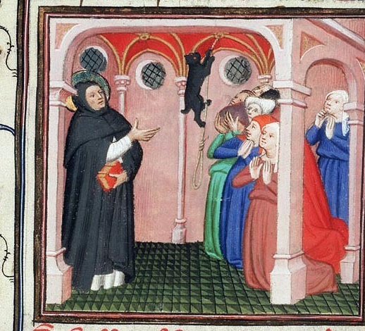
Poverty and Mobility: new religious movements, urban society, and new forms of learning (c.1200-1400)

Slide 2
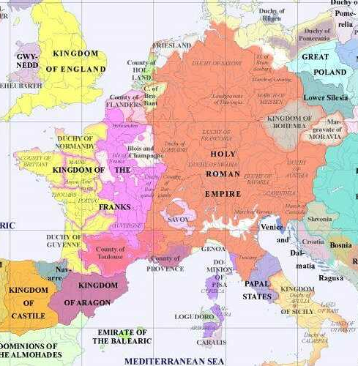
Europe in the 13th and 14th centuries
The period of 1200-1400 saw the development of a number of increasingly mature and ambitious polities
We can start to detect the roots of “countries” as we understand them today. Kings gradually establish more continuous control of their territories: smaller duchies and principalities get squeezed.
The development of lay administrative structures accelerates (e.g. taxation systems).
On the other hand, the post-Gregorian reform papacy had had much success in subjugating the clergy throughout Western/Central Europe to its overall authority.
The papacy also claimed the right to collect tax from ecclesiastical properties across Europe regardless of which polity they were in.
These ever-rising papal ambitions resulted in some significant clashes with kings (e.g. Philip IV of France vs. Boniface VIII) in the thirteenth and fourteenth centuries.
Western and Central Europe, 1200 AD

Slide 3
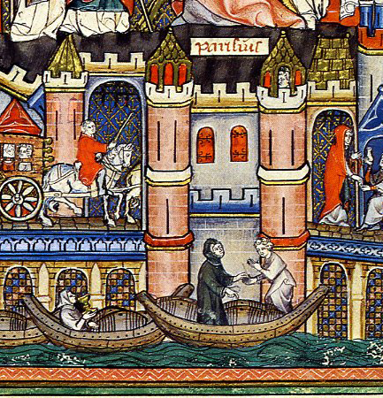
Evolving societies and economies
Societies and economies were also undergoing change around this time.
The Earlier Middle Ages had seen an emphasis on exploitation of rural wealth.
In contrast to Roman elites who depended on a network of towns, tribal polities (e.g. Frankish, Anglo-Saxon Kingdoms) cemented their authority over the countryside.
Church institutions, which sought to reach all people wherever they were, also improved access into rural areas
Monasteries play an important role in building rural economies: built away from cities, need to feed their monks and nuns.
Cistercians arguably go further: noted for their ability to colonize land and make it financially remunerative.
Over time, these rural activities move significantly beyond subsistence, and support specialised industries: e.g. clothmaking.
The result – by the 12th and 13th centuries – is a new wave of urban development to exploit and support these activities via markets, banking and long-distance trade

Slide 4
Evolving societies and economies
As medieval societies and economies evolved, the context of religious culture also evolves.
The growing complexity of trade and exchange gradually helped to raise levels of literacy, semi-literacy and education.
Economic dynamism also encouraged people to live more mobile lives involving more social connections.
Both these things help to create a new curiosity about religion: people seek to interact with it directly in new ways.

Slide 5
Evolving societies and economies
The socio-economic background also created new contexts for ascetic life.
The growth of “profit economies” centred on production, trade, and towns, interacted with Christianity to create a new discussion over wealth and poverty [see Lester K. Little in bibliography].
How could socio-economic development be squared with the message of Christ, who said that “it is easier for a camel to go through the eye of a needle than for someone who is rich to enter the kingdom of God” [Matthew 19:24]?
The growing cities and towns – which included potential patrons of increasing wealth and status – also began to represent a “gap in the market“ for new ascetic religious movements and institutions.

Slide 6
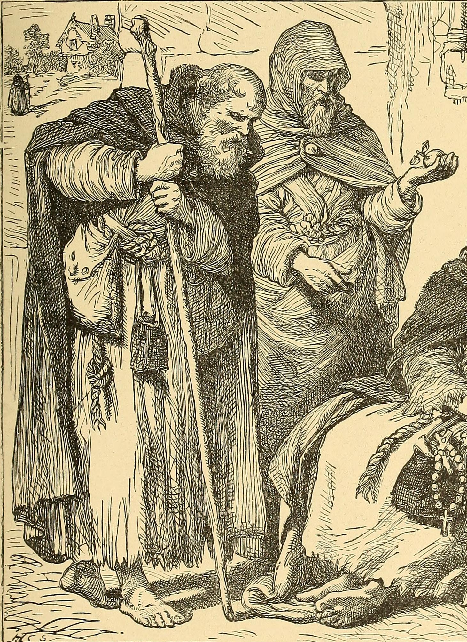
New religious movements
New types of religious movements emerge from the twelfth century, peaking in the early thirteenth century [see Grundmann in bibliography].
These movements tended to emphasise strong ascetic practices, but above all voluntary poverty, modelled on the community of Christ and the apostles (“apostolic poverty”).
Often went further than traditional monastic renunciation of personal property (with goods all owned by the monastery): i.e. being really and truly “poor” in appearance and every aspect of life
In the early days of these movements, some religious men and women lived only by day-to-day begging. From this, they became known as “mendicants” (mendicare = “to beg” in Latin)

Slide 7
New religious movements
Those who lived this sort of life did not enclose themselves but remained in unusually close interaction with society.
While many took influence from eremitic asceticism and spent times in hermitages, they remained mobile and were often found ministering and preaching publicly.
Their preaching emphasised not only the virtues of poverty but also “affective piety” (originally developed by 11th/12th century monks, see lecture 4), founded on God’s love and the bonds of love between Christians.
This helped to justify their lack of enclosure within monasteries, and made their preaching quite inclusive, even for those who did not wish to imitate their poverty.

Slide 8
New religious movements
This combination of poverty and mobility proved particularly popular in towns and cities.
This success can be related to the “profit economy” of towns and cities.
Some Marxist historians have seen their rise as an adversarial response of poor townspeople.
But early converts to new religious movements rarely appear poor, and their early backers were often rich nobles and merchants.
Lester K. Little (see bibliography) suggests that the support of such people for the “poor followers of Christ” helped them to justify their own world of increasing wealth and status.
The ability to move around and preach to people of all kinds also responded to the dynamism of urban environments and the increased religious curiosity found within them.

Slide 9
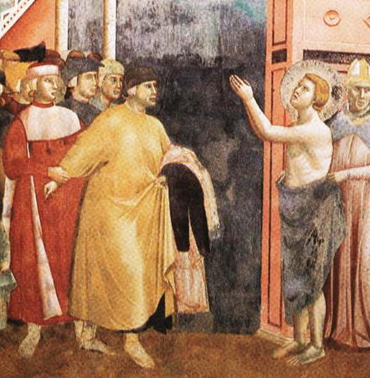
Saint Francis of Assisi
What kind of people followed this new type of religious life?
Francis of Assisi (i.e. St Francis, 1181/2-1226) is the most famous example. His background is indicative of the new economic and social possibilities of this period.
Son of a wealthy Italian silk merchant and a French noble mother, born in the Italian town of Assisi.
Lived a prosperous life in his youth, enjoying fine clothes and developing an interest in poetry.
Became disillusioned with this life between 1202 and 1205: goes on pilgrimage to Rome and prays with the poor.
At a rural chapel outside Assisi dedicated to Saint Peter Damian (see lecture 3), he saw a vision of Jesus, who tells him to repair the chapel
He sold some of his father’s cloth to pay for the repairs, but the priest would not accept it. He hides from his father but is eventually punished by him for his action.
Francesco renounced his vengeful father and his inheritance, even returning his clothes to him.
Saint Francis returning his clothes to his father: fresco from Assisi, c. 1300

Slide 10
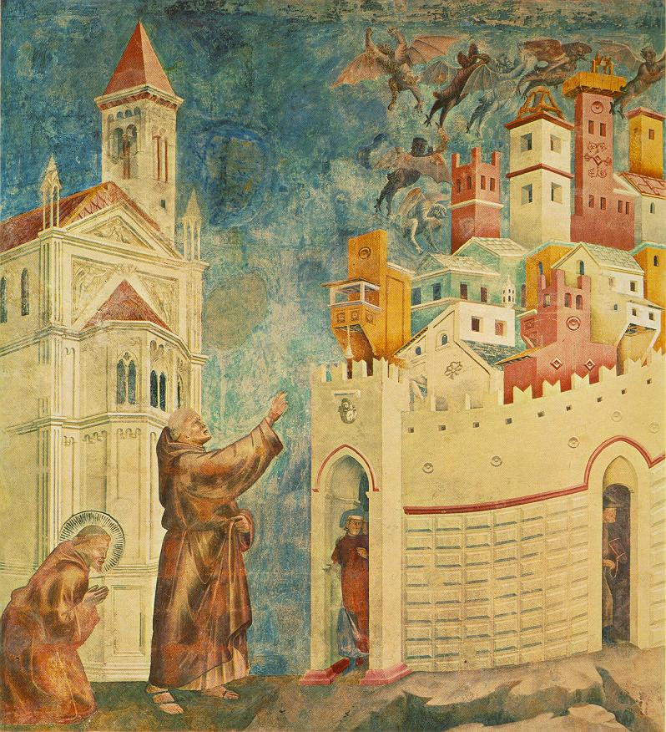
Saint Francis of Assisi and his followers
His initial response to this moment of “conversion” appears influenced by the semi-eremitic monasticism (e.g. Romuald, Peter Damian).
He and his early followers retire to the Umbrian countryside to live a life of extreme poverty, forming their first communities there
But they remain in touch with society at every level, including in the towns from which they came.
They not only preach to the peasants in the countryside, but also beg for donations in the towns to repair chapels and churches.
He and some of his followers exorcise demons from the town of Arezzo on a trip there: Francis then preaches in the town square.
Despite renouncing all property, Francis and his followers show a positivity about the “world” that was uncommon for earlier monks
Francis sees God in every part of His creation: everything from rocks and animals to the ugliest parts of towns!
Francis’s followers would soon come to be known as the “fratres minores” in Latin, or “friars minor” in English – meaning the “lesser brothers” – a reference to their simple lives of poverty and humility.
Saint Francis and Brother Sylvester (his follower) removing demons from Arezzo: fresco from Assisi, c. 1300

Slide 11
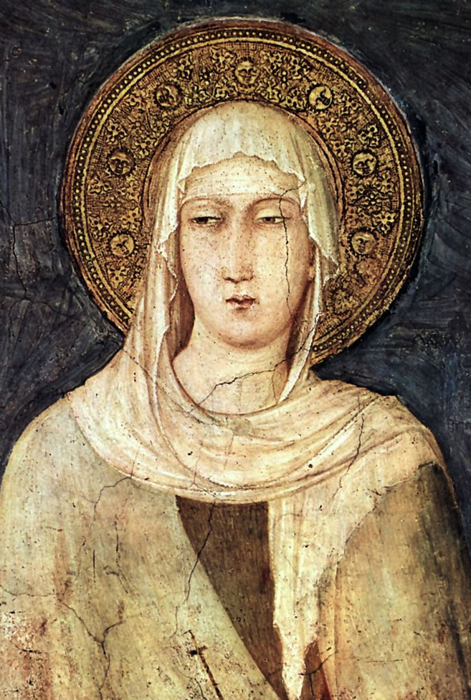
Saint Clare of Assisi and Female Followers
The early circle of Saint Francis was quite attractive to women.
One of his early followers was Clare of Assisi (d. 1253), the eldest daughter of a major noble family.
Heard Francis preaching in 1211 in Assisi and decided to take up a more religious life, against the wishes of her parents.
Francis helped find her a place to stay in a Benedictine nunnery.
She did not profess as a Benedictine, however, and instead, with her sister, began living in a small hermitage adjoined to the chapel of Saint Peter Damian, which Francis has repaired.
Other women joined her there, living a life inspired by Francis’s commitment to poverty, but in a more enclosed environment than his male followers, reflecting the traditionally greater demands for religious women to be shut away.

Slide 12
Saint Clare of Assisi and Female Followers
The style of Saint Clare – inspired by Francis but committing to a more enclosed way of life – was perhaps not followed by all female followers of Francis, however.
Jacques de Vitry (d. 1240), a French canon regular who showed a supportive interest in religious women, suggested in 1216 that both male and female followers of Francis often roamed freely.
Popes Gregory IX and Innocent IV criticised certain “sorores minores” (“minor sisters”) who were apparently roaming freely in Umbria, much like the male friars, as late as 1241 and 1257!

Slide 13
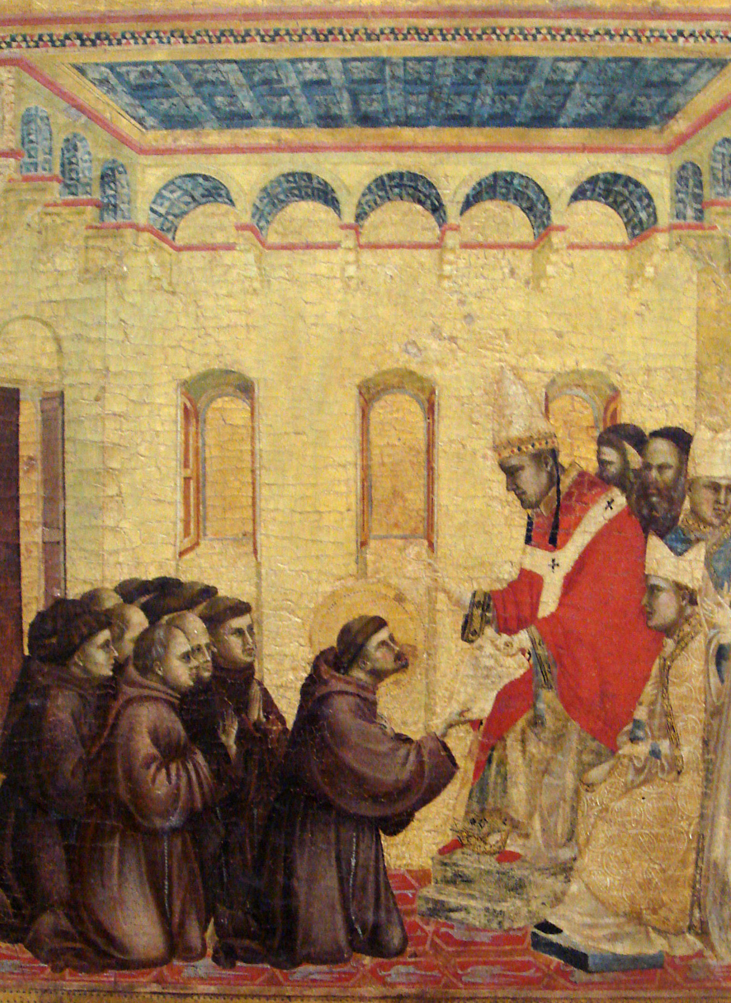
The Franciscans - a challenging movement
The followers of Saint Francis represented a significant challenge for the established church
“Apostolic poverty” could be seen as a critique of the richness of some parts of the Church, including monasteries.
That same poor and humble appearance made them stand out as new competitor for religious benefaction.
Their mobility and openness to the public also represented a challenge – offered preaching and even the sacraments outside of the usual diocesan hierarchies.
The idea that religious women might roam freely was particularly challenging.

Slide 14
The Franciscans - a challenging movement
The papacy did not, however, attack the movement, but offered support in return for compromises.
Pope Innocent III – at the Fourth Lateran Council of 1215 –approved the male followers of Francis as a new religious order
In return, the Order of Friars Minor accepted a more institutional form, under a rule written by Francis of Assisi and revised twice
This rule outlaws communal property – donation to the brothers are to be administered by external protectors
Their vows – poverty, chastity and obedience – differed from Benedictines (stability – i.e. staying attached to the monastery – conversion of morals, and obedience): this reflected their emphasis on sanctity defined by behaviour, not location
They formed a centralised congregation led by a general chapter and a Minister General.

Slide 15
The Franciscans - a challenging movement
The Order of Friars Minor – sometimes called the “First Order of Saint Francis” – also came to oversee other groups derived from Francis’s followers:
The Order of Saint Clare – or the “Second Order of Saint Francis” – was for female followers, known as “Poor Clares”.
They gradually won approval under succession of rules in the mid-thirteenth century.
Most “Poor Clares” ended up following a rule drafted by Urban IV in 1263.
A few houses followed Clare’s own rule of 1253 - , modelled more closely on Francis's - which banned communal property.
Both rules, however, acknowledged that Poor Clares would be enclosed, just like other nuns.
The Third Order of Saint Francis, formalised in 1289 but with older roots, was for lay followers inspired by Francis and Clare
An association for married devotees and men and women who did not want to profess as a Franciscan friar or Poor Clare.
Had no formal vows; rule demanded simple clothing, extra fasting, and to meet for liturgical occasions

Slide 16
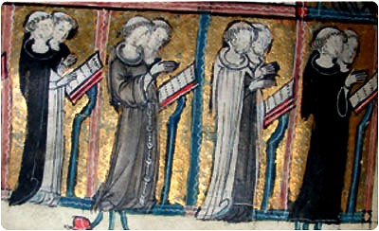
Other Mendicant Orders
The Franciscan movement, in all its branches, became an overnight success.
At Francis’s death in 1226 there were already Franciscan communities spread across multiple regions (Italy, France, Germany, England, Spain, Portugal etc.)
By the 14th century there were hundreds of houses across the Latin West.
But they were not the only movement to emphasise a strong commitment to poverty and mobility – nor the only one to receive papal approvals. There were several other “mendicant orders” that formed in the thirteenth century:
The Augustinian Hermits / Friars
Not to be confused with Augustinian Canons Regular (but often are, even by historians!): their origin lay in men who became travelling hermit preachers in Italy.
In 1215, at the Fourth Lateran Council, Innocent III organised many of them into an order, following the Rule of Saint Augustine
Despite their eremitic origin, their combination of tough ascetic practices (including strong commitment to poverty) and public preaching would make them popular in the towns. Houses would soon be found across Europe.

Slide 17
Other Mendicant Orders
The Dominicans
Evolved from the circle of the Spanish priest Dominic de Guzman (1170-1221), a cathedral school-educated Augustinian Canon Regular who preached publicly in Northern Spain and Southern France.
Travelling to Toulouse in Southern France in 1215 to attempt to convert Cathar heretics (see later slide), he established a small community that would devote itself to a stronger ascetic life (especially poverty) and to effective preaching.
His followers were approved as the “Order of Preachers” - known more commonly as the “Friars Preachers” or the “Dominicans” - in 1216 by Honorius: they would follow the Rule of Saint Augustine and their own constitutions.
Like the Franciscans, the new order came to possess “second” (enclosed nuns) and “third” (lay followers – origin in 1285, formalized in 1405) orders, ruled by a General Chapter. They possessed 100s of houses by 1300, mostly in towns/cities.
The Carmelites
Began as a hermit monks established at Mount Carmel (modern day Israel) during the Crusades in the late 12th century.
They followed a Rule written for them by the Latin Patriarch of Jerusalem – Saint Albert Avogadro – which essentially described the life of a semi-eremitic community. Pope Honorius III approves this rule in 1226.
With the instability of the crusader states, they attempted to establish communities in Europe, initially in rural locations.
By the late thirteenth century, however, their commitment to poverty and interest in preaching began to find its niche in towns, similar to other mendicant orders: they adapt their Rule for this. They possessed c. 150 houses by 1300.

Slide 18
Reactions to Mendicant Orders
The mendicant orders clearly attracted significant positive interest. On the other hand, they were a novelty that challenged local church hierarchies and older monastic orders.
People sometimes looked to mendicants and chose to ignore their parish priests. New, exciting orders also meant existing monastic institutions might receive less patronage – or feel like they were, at very least. Many critics of the mendicants were secular priests or coenobitic monks.
Despite their popularity, they could also meet with public criticism for apparent hypocrisy.
The way they gained financial support could look rather unscrupulous and unfitting with poverty: e.g. chasing people with deceased relatives to give money for funerals. Franciscans, with their particularly strong emphasis on poverty, especially attacked for this.
The lack of enclosure for male mendicants also meant misbehaviour was public – breaches of chastity, drunkenness become frequently commented upon by satirical literature (e.g. the 14th century English poetry of Chaucer, Langland and Gower).

Slide 19
New religious movements, the papacy, and orthodoxy
These mendicant orders were made directly subject to the pope (rather than local bishops).
Through this, the papacy hoped to gain from a new arm of direct influence with reach to the laity.
But the approval of mendicant orders was more than a power-play vs. bishops and lay rulers.
It was also about attempting to stop new religious movements emphasising poverty and mobility spiralling out of control, channelling them into just a few approved orders.
With these orders established, the legislation of the Fourth Lateran Council in 1215 and the Council of Lyon in 1274 thus sought to put an end to the creation of any further new orders and rules.
While new religious movements and congregations would continue to emerge, the papacy insisted that these conform to the basic patterns of life of existing orders.

Slide 20
New religious movements, the papacy, and orthodoxy
Other movements were deemed too challenging and persecuted as “heretics”, who had veered from religious orthodoxy.
The Cathars (Southern France and Northern Italy):
Influenced by “apostolic poverty” (their ministers lived lives of extreme asceticism), but also by “dualist” theology (see lecture 1), with some positing the existence of equal good (spiritual) and bad (physical) forces/Gods in the universe.
Their ministers performed unusual cleansing rituals on believers (the consolamentum) at death.
The Waldensians (Southern France, modern-day Switzerland, Italy, Germany):
The followers of Peter Waldo (d. c. 1205) a merchant from Lyon. Inspired by the ideal of “apostolic poverty”, he gave away his possessions and preached this message to others, who become known as “the poor men of Lyon”.
Less of an obvious theological challenge than the Cathars, but very critical of the established church

Slide 21
New religious movements, the papacy, and orthodoxy
The papacy mandated papal “inquisitors” to put “heretics” on trial – most inquisitors were mendicants!
Mobile and directly tied to the papacy, these orders were well suited to this. The Dominicans – whose very origin was related to Dominic’s desire to convert heretics – were the most common inquisitors.
Most people tried were made to publicly renounce their beliefs and given penances. The unrepentant and repeat offenders could be handed over to lay authorities for execution, typically burning at the stake.
But mendicants – especially Franciscans – could also fall under suspicion of heresy:
The so-called Spiritual Franciscan faction took up more extreme criticisms of the Church from the late 13th century into the early 14th century.
Men like Peter John Olivi (d. 1298) and Angelo da Clareno (d. 1337) criticised the Church for not renouncing property more forcefully and even their own order for using property inappropriate to their vow of poverty.
Pope John XXII (reigns from 1316 to 1334) firmly condemned them in 1317. He also forced the wider Franciscan order to accept that their convents do own property like all other religious houses (including other mendicant orders).

Slide 22
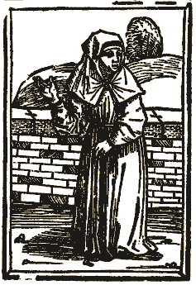
Semi-monastic movements and the boundaries of orthodoxy
Other groups endured a precarious existence at the boundaries of orthodoxy
Groups like the Humiliati (in Italy and Southern France) and the Beghards and Beguines (in Northern France, the Low Countries, and Germany) were characterised by a semi-monastic appearance.
Their members usually co-operated with the Church, but they were often unwilling to take formal monastic vows. Such men and women represented a particular quandary for the papacy and the bishops.
All these groups were broadly tolerated, but also occasionally persecuted: inquisitors were often concerned by the potential for “heresy” among them.
The survival of such precarious groups – which flourished in the most urbanized regions – suggests the increasing desire of people (often from good backgrounds) in these areas to seek a greater involvement in religious life, even at risk of persecution.
A 15th century drawing of a Beguine

Slide 23
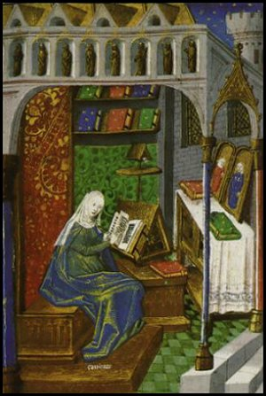
Female experiences
Women could be both prominent and controversial within new religious movements.
Mendicant orders were able to turn many female followers into enclosed nuns, but not all were so easily contained. [See Andenna in bibliography]
Often such independently minded women find both followers and controversy through very emotional displays of religious fervour and visionary experiences.
Clare of Rimini – a widowed Italian Franciscan tertiary (i.e. a member of the third order) from a noble background who became famed for extravagant displays of masochistic asceticism. She was eventually pushed to join the Poor Clares and become an enclosed nun.
Angela of Foligno – an Italian Franciscan tertiary from a wealthy urban background who became famed for visions; familiar with the Spiritual Franciscans. Founded a house for religious women who refused enclosure.
Mary of Oignies (d. 1213) – from a French noble background. She convinces her husband to take a vow of chastity and takes up extreme ascetic practices (wearing a tight rope around her stomach). She also has visceral experiences when taking communion, believing she could taste Christ in it.
Hadewijch – a 13th century woman from Brabant; little known about her, but probably an urban Beguine: writes about her mystical visions in poetic form.

Slide 24
New educational institutions
Against the background of the social changes of the twelfth and thirteenth centuries, something else was occurring: a revolution in education and learning.
A more complex society with growing towns increased appetite for education.
New urban schools emerged, and cathedral schools expanded.
Rural monastic schools were less well-placed to meet the rising demand.
Certain cities and towns become famous for their schools and the masters teaching there. Simultaneously, both Church and lay authorities sought to gain a measure of control over these fast-growing educational centres.
The result: universities (from the latin universitas – i.e. the whole, a corporation).
Bologna: gained its first organisation through a guild of students formed in 1088; the Holy Roman Emperor Frederik Barbarossa provided its first university charter in 1158. Particularly famous for its contributions to legal thought.
Paris: grew primarily out of the Notre Dame cathedral school of Paris. The corporation of teachers and students was recognised as a university in 1200 by the French king Philip Augustus.
Oxford: urban schools existed by 1096; became formally recognised as a university over the course of the first half of the thirteenth century (1200-1250).

Slide 25
New frameworks of knowledge
If educational institutions were evolving, so too was intellectual culture itself, tending towards a more systematic approach:
This culture is often described as “scholastic” – i.e., of the schools (albeit it was not exclusively found there)
Scholasticism is particularly associated with theology, but also affected law (a growing matter of interest) and natural sciences (including medicine).
Across all these fields, scholars began the task of trying both to broaden and to integrate their knowledge of both the worldly and the divine.
New methods of learning and teaching came to the fore: e.g., dialectical reasoning – i.e., a pitting two opposing arguments against each other.

Slide 26
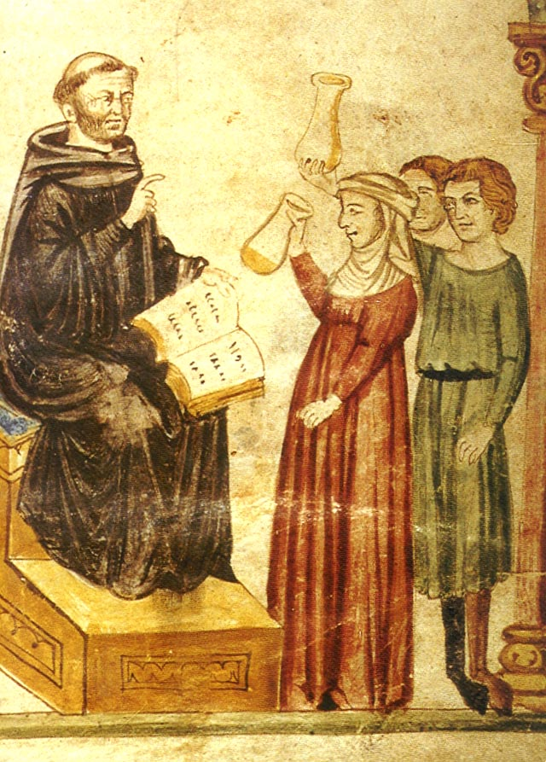
New frameworks of knowledge
Some of scholasticism’s roots predate this period and are not entirely associated with the schools:
The tenth century Norman conquest of Sicily, the progress of the Reconquista in Spain, and the Crusades brought men from the Latin West in contact with Arabic learning.
The Muslim world had preserved (and translated into Arabic) many classical Greek works that had been lost in the West, including some works of Aristotle. Regaining these opens up new intellectual landscapes in both philosophy and science.
The monastic school of Lanfranc and Anselm at Bec and the Cistercians – both also associated with affective piety – were already pioneering more systematic, logical approaches to theology.
But the growth of schools in towns and cities accelerated the trend:
Scholars in these new schools can travel, unconstrained by monastic boundaries, to learn new things, and transmit texts.
The fuller dedication to learning within the schools, less encumbered by monastic duties, accelerates advanced studies.

Slide 27
Monks and the new schools
The growth of new educational institutions naturally challenged the intellectual leadership of traditional monastic schools
And while monks had contributed to the development of scholastic intellectual culture, they could also react negatively to work that was not under their control.
One of the earliest clashes concerned the views of theologian Peter Abelard (1079-1142)
A layman (not even a priest) claimed to offer new insight into God and his creation.
His explorations of virtues, vices and their relation to sin – highly influenced by Aristotle – took the quite extreme view that active consent in knowingly doing wrong was the only criterion for sin.
A challenge particularly to monastic outlooks on sin, which tended towards seeing certain forms of temptation as near-inevitably corrupting and sin-inducing.
Bernard of Clairvaux (1090-1153) – the most influential Cistercian of the 12th century – made it a personal mission to effectively destroy Abelard’s career.
He succeeded in having many of Abelard's propositions condemned at the Council of Sens in 1141.

Slide 28
Monks and the new schools
But neither Bernard or other coenobitic monks could not hold off general trend in higher education. Rather, they were compelled to engage in it (see Clark in Bibliography):
The Cistercian order – with its central organisational structure – was relatively quick to establish studia (houses of learning) in university towns and cities and sent monks to these from the mid-thirteenth century.
As for other Benedictines, the reform efforts of Clement V and Benedict XII aimed to ensure some young Benedictine monks were given allowance to leave their monasteries, at least for a time, to attend university.
The aim in both instances was that university-educated monks would bring this culture back to their own monasteries as teachers, to maintain intellectual standards within these houses.
It also meant the coenobitic orders to still had something to offer young men who wanted to receive an education.
By the fourteenth and fifteenth centuries, these efforts had had a clear effect, increasing monastic influence in the universities:
By 1450 Benedictines and Cistercians actually held many of the key positions at the higher faculties of Paris and Oxford.

Slide 29
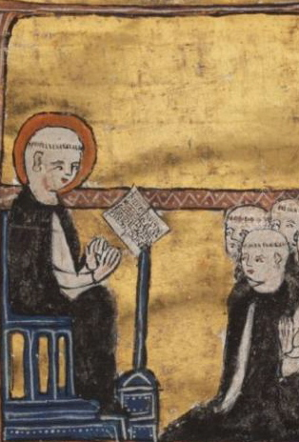
Mendicants and the Schools
If the coenobitic orders were forced to adapt to the schools, the mendicant orders were much quicker to integrate themselves within these institutions.
Saint Francis of Assisi (d. 1226) was initially very suspicious of education, thinking it led to arrogance.
But friars of both his order and others existed in the same urban locations as the new schools and universities.
The mobility of friars also allowed them to engage more readily in the schools than coenobitic monks.
Their strength as organised orders allows them to gain significant power within universities very quickly.

Slide 30
Mendicants and the Schools
The most famous thirteenth century “scholastic” theologians were mendicants.
Thomas Aquinas (1225 – 1274)
First educated at the schools in Naples. He joined to Dominican order, and was allowed to go to Paris and Cologne. Eventually became “regent master in theology” (the highest Dominican position at the university) at Paris.
Most famous work: the Summa theologica (literally, “the whole of theology”), begun in the 1268, but never fully completed.
The Summa leant heavily on Aristotle in an attempt to produce a Christian theory of everything: it features a very strong defence and rationale for vowed religious (i.e. monastic, including mendicant) life.
Bonaventure (1221 –1274)
From Italy, he joined the Franciscans in 1243. His intellectual potential meant he was sent to the University of Paris. He became the leading Franciscan theologian at the university – a contemporary of Aquinas.
While influenced by Aristotle, he leant heavily on the Church Father (and promoter of monasticism) Augustine of Hippo, as well as Neo-Platonist classical philosophy.
He took a more “mystical” approach to knowledge than seen with Aquinas and effectively combined twelfth century “affective piety” with scholasticism.

Slide 31
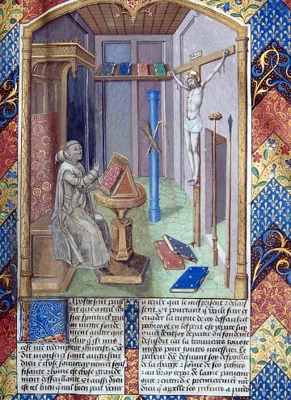
Lay Religious Reading and Monasticism
Ultimately, very few people in medieval Europe went to universities and engaged with the subtleties of scholastic thought.
But basic education was increasingly accessible for the growing urban middle classes. This interacted with the rising lay religious curiosity that helped inspire new religious movements and mendicant orders.
As literacy became more common, some laypeople began to seek a more direct engagement with religious texts: to read them themselves, to read them to others, or to hear them read by others.
Vernacular languages – the spoken languages of day-to-day communication – were starting to take on written form around this time too. This improved lay access to texts: while the person reading still realistically needed a Latin education, a vernacular text read out loud could even be understood by the less literate.
This lay reading interest took a strong interest in the sort of “affective piety” that had been pioneered by 12th century monks. Emotive reading on the life of Christ was particularly popular.
Ludolph of Saxony’s Life of Christ, 15th century French translation

Slide 32
Lay Religious Reading and Monasticism
This kind of text-focused lay piety was notably popular with women, as well as men: for women interaction with vernacular religious textual culture might be seen as a way to teach themselves something in a world that offered them fewer educational choices.
Lay reading circles became active in the sharing and even copying of texts: e.g. “Modern Devout” groups in the Low Countries in the late 14th century and early 15th century – who took on a semi-monastic appearance – were well known for compiling excepts from texts, often in the vernacular.
Nevertheless, such lay men and women also drew on the help of able writers, copyists and translators from within monastic orders. More enclosed orders could be surprisingly active in this. The semi-eremitic Carthusians were particularly noted for their service in this regard.
Ludolph of Saxony’s Life of Christ, 15th century French translation

Slide 33
Monasticism exploded or a monastic explosion?
By the 13th and 14th centuries, religious life and education could no longer be contained within traditional forms. We have seen:
A desire to push further with voluntary poverty than traditional monastic orders
A desire to live out monastic values – ascetic life, affective piety – outside of monasteries as well as within them
The Church struggling to contain these energies within new mendicant orders.
The growth of urban and cathedral schools and the rise of universities
The development of a scholastic intellectual culture for which monastic scholars were no longer the only gatekeepers
The deepening of lay religious interests and desire for direct interaction with religious texts and affective piety
One can look at all this as a great challenge to the status of monastic life.

Slide 34
Monasticism exploded or a monastic explosion?
But one can also look at as evidence of monasticism’s successful influence on society, and adaptability:
The mendicant orders pioneered a new form of monasticism and remain powerful religious forces in the Catholic world to this day!
Both mendicant and coenobitic orders adapted the rise of the universities and came to hold a powerful directing influence within them.
Lay spiritual interest and desire for religious learning still looked to monastic tradition and institutions (both mendicant and coenobitic) for influence.
It is important to remember too that the social changes of this period were not uniform or unidirectional in their effects:
The vast majority of people still lived in the countryside and engaged in simple agricultural activities. More traditional forms of monasticism still held pride of place in many areas.
New forms of religious life – e.g., the mendicants – could find criticisms that stemmed from the apparent hypocrisy caused by the lack of clear dividing lines with society. As we will see, there would be room for more strictly enclosed forms of monasticism to find new niches.

Slide 35
Sources – First Life of Saint Francis, by Thomas of Celano (1228-9)
Thomas of Celano (1185-1260)
From a noble family in central Italy; Thomas received a good education, probably from the Benedictine monastery school at Celano.
He joined the new Franciscan order in 1215.
He was well known for the quality of his writing, and especially his poetic style. He would write three works devoted to the life and miracles of saint Francis at the request of papal and Franciscan authorities.
First Life of Saint Francis
Thomas knew Saint Francis well towards the end of his life (Francis died in 1226) and thus has had heard many things directly from him and other early disciples.
His first account of Francis’s life was written at the request of Pope Gregory IX, around the time that Francis was declared a saint.
Like all “vitae” (saint’s lives), it is meant to describe the virtues of the saint and the miracles they brought about, in order to prove their sanctity.
An extremely popular Latin text in both mendicant and traditional monastic libraries.

Slide 36
Sources – First Life of Saint Francis, by Thomas of Celano (1228-9)
Once, because he was ill, he ate a little bit of chicken. When his physical strength returned, he entered the city of Assisi. When he reached the city gate, he commanded the brother who was with him to tie a cord around his neck and drag him through the whole city as if he were a thief, loudly crying out: ‘Look! See this glutton who grew fat on the flesh of chickens that he ate without your knowledge.’ Many people ran to see this grand spectacle and, groaning and weeping, they said: ‘Woe to us! We are wretches and our life is steeped in blood! With excess and drunkenness we feed out hearts and bodies to overflowing!’ They were touched in their hearts (Acts 2: 37) and were moved to a better way of life by such an example.
[…]
Whenever he found an abundance of flowers, he used to preach to them and invite them to praise the Lord, just as if they were endowed with reason. Fields and vineyards, rocks and woods, and all the beauties of the field, flowing springs and blooming gardens, earth and fire, air and wind: all these he urged to the love of God and to willing service.

Slide 37
Sources – Vox Clamantis (“The Voice of One Crying Out), by John Gower (c.1377-1381)
John Gower (c. 1330-1408)
From a middling family that held some land in the south-east of England.
Seems to have spent much of his life in and around London and may have been a lawyer.
Became a noted poet, writing in Latin, French, and also English.
Received royal commissions for much of his work (from Richard II and Henry IV).
Vox Clamantis
A poetic “dream-vision”, describing the state of English society at the time of writing.
Most famous for its contemporary description of the Peasant’s Revolt of 1381.
But also contained discussions of many other social topics – including the role and place of various religious orders.
A popular text in English court and church circles in the late 14th and 15th centuries: tens of manuscripts; would be printed in the late 15th century by the first English printer, William Caxton.

Slide 38
Sources – Vox Clamantis (“The Voice of One Crying Out), by John Gower (c.1377-1381)
The friar wanders about outside and explores inside, and no place or affair is a mystery to him. Sometimes he is a medical doctor, sometimes a religious confessor, sometimes a mediator in disputes: he gives orders both high and low and at every turn. Thus the friar arrogantly runs around everywhere as if he were the spirit of the Lord. But he only comes to the bed when the husband is away.
[…]
The friars maintain that they are disciples of Christ and that they are pursuing all of their duties after His example […] I would say these men are not disciples but rather “gods”: since both life and death bring money to them.

Slide 39
Sources – Book of Visions, by Hadewijch (c. 1240s)
Hadewijch (lived early to mid 13th century)
Very little is known about her life. She was from Brabant (modern-day Netherlands), it appears, since her works were written in Brabantine Dutch.
Her writings suggest she received some education in Latin, due to the references she is able to make (e.g. Saint Augustine), and French, since her writings appear influenced by the French romantic poetry.
She appears to have lived as a beguine with some other women for some time, to judge by her letters. These also suggest she may have been forced to leave this environment and take up a wandering existence.
She is an example of a new breed of semi-monastic women/pious laywomen who could not be easily contained within orders, and of female engagement with vernacular religious writing.
Book of Visions (c. 1240s)
This text describes Hadewijch’s religious visions in great detail. She talks to Christ directly in these at times, often in very romantic language, full of emotion.
Not widely copied or read at the time but they are thought to have had some influence on other Dutch Christian mystics, including men, e.g. the Augustinian canon John of Ruusbroec.

Slide 40
Sources – Book of Visions, by Hadewijch (c. 1240)
On a certain Pentecost Sunday, I had a vision at dawn. The psalms were being sung in the church, and I was present. My heart and my veins and all my limbs trembled and quivered with eager desire and, as often occurred with me, such madness and fear took over my mind that it seemed to me that I could not fully please my Beloved [i.e. Christ] and that my Beloved would not fulfil my desire […] On that day my mind was filled so fearfully and so painfully by desirous love that each of my limbs threatened to break, and all of my veins were in pain. The longing I felt cannot be expressed by any language of any person I know; and everything I could say about it would be unheard-of to all those who have never come to understand Love as something to work for with desire, and whom Love had never come to possess. I can say this about it: I desired to enjoy my Beloved fully and to understand and taste Him fully. I desired that His humanity should to the fullest extent be united in enjoyment of my humanity, and that my humanity would be strong enough to enter into perfection, until I could content Him, who is perfection itself, in purity and unity.

Slide 41
Sources - Letter to Pope Innocent II, by Bernard of Clairvaux (c. 1141)
Bernard of Clairvaux (1090-1153)
Described in previous lectures: not one of the original Cistercians, but a very early follower who became one of the most influential churchmen in medieval Europe.
Letter to Pope Innocent II (c. 1141)
Innocent II (reigned 1130-1143) had benefitted from Bernard’s influence to become pope. Hs election had been contested with a rival (Anacletus II): Bernard helped him win the support of the French monarchy.
Bernard’s letter to him presented here occurred around the time of the council of clergy convened by the Innocent at Sens in 1141, at which many of Peter Abelard’s doctrines were condemned – at Bernard’s instigation!
The letter is preserved as part of wider manuscript compilations of Bernard’s letters, which, like so many of his other works, were popular with readers throughout the Middle Ages.

Slide 42
Sources - Letter to Pope Innocent II, by Bernard of Clairvaux (c. 1141)
In cities and castles, darkness is being spread in place of light; everywhere poison is being put forward to everybody in place of honey - or rather into the honey [...] A new Gospel is being forged for peoples and communities, a new faith is being propounded, a foundation that is different from what has been established. There is disputation that is immoral about virtues and vices, unfaithful about the sacraments of the church, and neither simple nor sober about the depths of the Holy Trinity; rather everything is served up to us as perversity, everything beyond what is normal and different from what we accept. Goliath [1 Kings 17.41] has advanced with his tall body, fortified with his noble weapons of war, with his shield bearer, Arnold of Brescia [a student of Peter Abelard], going before him. Armour is joined to armour, and there is not a breath that flows through them [Job 41.7]. A bee that was in France has hissed to a bee from Italy, and they assembled as one against the Lord and his anointed [Isa. 7.18].... Goliath, therefore, standing as one with his shield bearer between both sides, shouts against the armies of Israel, challenges the ranks of the saints, all the more boldly as he thinks David is not there.

Slide 43
Sources - Summa Theologica, by Thomas Aquinas (1265-1274)
Thomas Aquinas – discussed in this lecture
Summa Theologica (“The whole of theology”)
Thomas’s unfinished masterpiece, discussing almost every aspect of Christian belief and practice.
Arguably the most important work of Catholic theology ever and still highly influential within the Catholic Church today
The following section discusses and explains the “religious state” (i.e. the way of life of monks, nuns, friars of various orders) within the Church.

Slide 44
Sources - Summa Theologica, by Thomas Aquinas (1265-1274)
The religious state may be considered in three ways. Firstly, as the practice of tending to the perfection of charity. Secondly, as quieting the human mind from external concerns, according to 1 Corinthians 7:3: “I would like you to be free from concern.” Thirdly, as a “holocaust” [a Greek word denoting sacrifice], whereby a man offers himself and his possessions wholly to God. In a corresponding manner, the religious state is constituted by three vows.
Regarding the practice of perfection, a man is required to remove from himself whatever may hinder his affections from tending wholly to God, for it is in this that the perfection of charity consists. Such hindrances are of three kinds. Firstly, the attachment to external goods, which is removed by the vow of poverty. Secondly, the longing for sensual pleasures, chief among which are sexual pleasures, and these are removed by the vow of chastity. Thirdly, the disorderly nature of the human will, and this is removed by the vow of obedience. In a similar way, the noise of worldly concerns is heightened in man by three things. Firstly, the need to manage external possessions, and this solicitude is removed from man by the vow of poverty. Secondly, the need to control one’s wife and children, which is cut away by the vow of chastity. Thirdly, the management of one's own actions, which is eliminated by the vow of obedience, by which a man commits himself to the will of another.
Finally, "a holocaust is the offering to God of all that one has," according to Gregory the Great (Homily 20 on Ezekiel). Now man has possessions in three ways, according to the Philosopher [Aristotle] (Ethic. i, 8). First, he has the possession of external things, which he wholly offers to God by the vow of voluntary poverty. Secondly, the possession of his own body; and this possession he offers to God primarily by the vow of chastity by which he renounces the greatest bodily pleasures. The third is the possession of the soul, which man wholly offers to God by the vow of obedience; by this he offers God his own will by which he makes use of all the powers and habits of the soul.
Therefore the religious state is fittingly constituted by the three vows [of poverty, chastity and obedience].

Slide 45
Source – Life of Saint Jerome, by Simon Winter (c. 1430)
Simon Winter
A canon of the Brigittine double-monastery of Syon in Isleworth (near London), founded by Henry V in 1415.
The Brigittines were a relatively new, coenobitic congregation for both nuns and canons founded by Birgitta of Vadstena (1303-1373), a Swedish princess who became religious visionary. Her male followers lived by the Rule of Saint Augustine as well as additional regulations written by Birgitta: the order was approved by the papacy in 1370.
Simon’s duties involved performing clerical duties (mass, confession etc.) for the nuns in the monastery
But he also fostered connections with pious lay people, and acted as a spiritual guide for them: the most prominent of these followers was Margaret, duchess of Clarence (d. 1436), a widowed sister-in-law of Henry V who sought his counsel towards the end of her life and took to living near the monastery: she was also a major benefactor of the house.
Life of Saint Jerome
Not a famous or well-spread work, known in just one manuscript known at Yale. It is essentially a Middle English translation and compilation of Latin legends concerning the Church Father Saint Jerome (see lecture 2), who was also well-known for founding a religious community in Italy for widows and virgins.
It was written, in the first instance, for Margaret, duchess of Clarence.
Despite it not being a particularly well-known, it represents a witness to monastic-lay interactions in spiritual education in the late Middle Ages.

Slide 46
Source – Life of Saint Jerome, by Simon Winter (c. 1430)
Right noble and worthy lady, and my fully reverend and dear spiritual daughter in our Lord Jesus: I have remembered how on Saint Jerome’s day, that is the day after Michaelmas day, after I told you something of the life and miracles of Saint Jerome, I said that with our Lord’s help, when I had the time, I would write his life and miracles in English, for the praise and worship of our Lord and of him [Jerome]. Not only so that you would understand it more clearly for your own spiritual benefit, but so that it might remain available and be used to edify others who might read it or hear it read. Thus I desire that it should please your ladyship first to read it, and copy it for yourself, and then to let others read it and copy it. For there is something within this book that needs to be known and held in the minds of all people. For in the first and second chapters, we may learn and take an example of how to live a Christian life in penance and rectitude. And in the seventh and ninth chapters, we may lean how to die. And what is more necessary to any man or woman on earth, than to know how to live and how to die?

Slide 47
Bibliography
Beyond the general reading, the following are very useful and easily available:
Lester K. Little, Religious Poverty and the Profit Economy in Medieval Europe (Cornell University Press, 1978) [Chapter on “Urban religious life” on IS].
Herbert Grundmann, Religious Movements in the Middle Ages (trans. Steven Rowan), University of Notre Dame Press, 1995. www.jstor.org/stable/j.ctvpj7dp4. (esp. chapters 1 and 2).
C. Andenna, “Female Religious Life in the Twelfth and Thirteenth Centuries”, in A. I. Beach & I. Cochelin (eds.), The Cambridge History of Medieval Monasticism in the Latin West (Cambridge University Press, 2020) [article uploaded to IS]
James G. Clark, “Monks and the Universities, c. 1200–1500.” Chapter. in The Cambridge History of Medieval Monasticism in the Latin West, ed. Alison I. Beach and Isabelle Cochelin, 1074–92 (Cambridge, 2020) [article uploaded to IS]

