Slide 1
Korean class
WEEK 6

Slide 2

Index
Sixth principle
Day of week / Month
Dialogue

Slide 3
Sixth principle
When = 언제
      [eon-jae]
Where = 어디서
[eo-di-seo]
Who = 누가
[nu-ga]
What = 무엇을 / 뭐를
[mu-eoss-eul /mwo-leul]
How = 어떻게
[eo-tteok-e]
Why = 왜
[wae]

Slide 4
Sixth principle
When = 언제
[eon-jae]

Slide 5
Sixth principle
Joenghyeon : 너 학교 언제가?
[neo-hak-gyo-eon-jae-ga?
=When do you go to school?
Seryeong : 나 어제 갔다왔어.
[na eo-jae-gad-da-wot-eo]
=I went yesterday.

Slide 6
Sixth principel
Where = 어디서
[eo-di-seo]

Slide 7
Sixth principle
Joenghyeon : 이번 BTS 콘서트 어디서 한대?
[i-beon BTS concert eo-di-seo han-dae?]
=Where is the BTS concert going to be held?
Seryeong : 서울에서 해!
[seoul e-seo hae!]
=In Seoul!

Slide 8
Sixth principle
Who = 누가
[nu-ga]

Slide 9
Sixth principle
Jeonghyeon : 내 빵 누가 먹었어?
[nae-bbang-nu-ga-meok-eoss-eo?]
=Who ate my bread?
Seryeong : 나도 몰라.
[na-do mol-la]
=I don’t know.

Slide 10
Sixth principle
What = 무엇을=뭐를
[mu-eoss-eul = mwo-leul]

Slide 11
Sixth principle
Jeonghyeon : 너 뭐 가지고 싶어?
[neo-mwo ga-ji-jo-sip-eo?]
=What do you want to get?
Seryeong : 나 새로운 신발 가지고싶어.
[na-sae-ro-wun sin-bal-ga-ji-go-sip-eo]
=I want to get new shoes.

Slide 12
Sixth principle
Why = 왜
[wae]

Slide 13
Sixth principle
Jeonghyeon : 너 왜 늦었어?
[neo-wae-neut-eoss-eo?]
=Why are you late?
Seryeong : 지하철을 놓쳤어.
[ji-ha-chul-eul-not-chyeot-eo]
=I missed the subway.

Slide 14
Sixth principle
How = 어떻게
[eo-tteok-e]

Slide 15
Sixth principle
Jeonghyeon : 이거 어떻게 만들어?
[i-geo-eo-tteok-e-man-deul-eo?]
=How do I make this?
Seryeong : 내가 너를 도와줄게
[nae-ga neo-leul- do-wa-jul-gae]
=I will help you

Slide 16
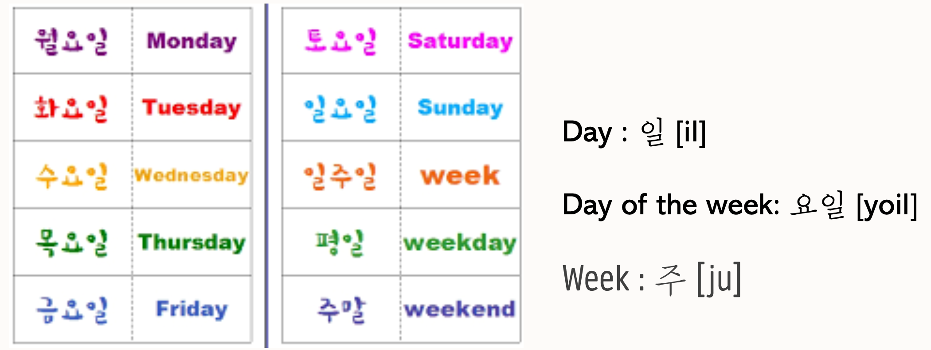
Day of week

Slide 17
Day of week
Weekday = 평일 [Pyeong-il]
Weekend = 주말 [Ju-mal]
A Week = 일주일 [il-ju-il]

Slide 18
Day of week
Monday = 월요일 [Wor-yo-il]
Tuesday = 화요일 [Hwa-yo-il]
Wednesday = 수요일 [Su-yo-il]
Thursday = 목요일 [Mok-yo-il]
Friday = 금요일 [Kum-yo-il]
Saturday = 토요일 [To-yo-il]
Sunday = 일요일 [il-yo-il]

Slide 19
month
July = 7월 [chil-wol]
August = 8월 [pal-wol]
September = 9월 [gu-wol]
October = 10월 [si-wol]
November = 11월 [sib-il-wol]
December = 12월 [sib-i-wol]

Slide 20
dialogue
Seryeong : 이번방학에 어디로 여행 갈거야?
[i-beon banghak-e eo-di-ro yeo-hang gal-geo-ya?]
=Where will you go to travel this vacation?
Jeonghyeon : 나는 스위스에 갈거야
[na-neun swiss-e gal-geo-ya]
= I will go Switzerland

Slide 21
dialogue
Seryeong : 왜 스위스에 가기로 결정했어?
[wae-swiss-ro-gyeol-jeong-haess-eo?]
=Why did you decide to go Switzerland?
Jeonoghyeon : 왜냐하면, 나 아직 한 번도 안가봤거든
[wae-nya-ha-myeon, na-a-jig-han-beon-do an-ga-bwat-geo-deun]
=Because, I haven't been there yet

Slide 22
dialogue
Seryeong : 좋겠다! 거기 어떻게 갈거야?
[jot-get-da! Geo-gi e-ddeot-ge-gal-geo-ya?]
=Good for you! How will you go there?
Jeonghyeon : 비행기 타고 갈거야
[bi-haeng-gi-ta-go-gal-geo-ya]
=I will go by plane

Slide 23
dialogue
Seryeong : 언제 출발 할거야?
[eon-jae-chul-bal-hal-geo-ya?]
=When will you depart?
Jeonghyeon : 12월 2일 금요일에!
[sib-i-wol sib-i-il to-yo-il-e!]
=On Friday 2nd December!

Slide 24
REVIEW ! - iNFORMAL / POLITE EXPRESSION
Change noun ‘I’ : 나[na] -> 저[jeo]
내[nae] -> 제[jae]
Add 요[yo] end of verb
야 [ya] -> 예요[ye-yo] / 이에요[i-ae-yo]

Slide 25
REVIEW ! - negative expression
1. Adding 안 [an] before a verb
2. Using the negative verb ending,
지 않다 [ ji an-ta]

Slide 26

Thank you

