Slide 1
Korean class
WEEK 6

Slide 2
Index
Counter
Adverb
Key Sentences
Korea’s Culture
Notes:
ㅇㅇㅇㅇㅇㅇㅇㅇㅇㅇㅇㅇㅇㅇㅇㅇㅇㅇㅇㅇㅇㅇㅇㅇㅇㅇㅇ

Slide 3
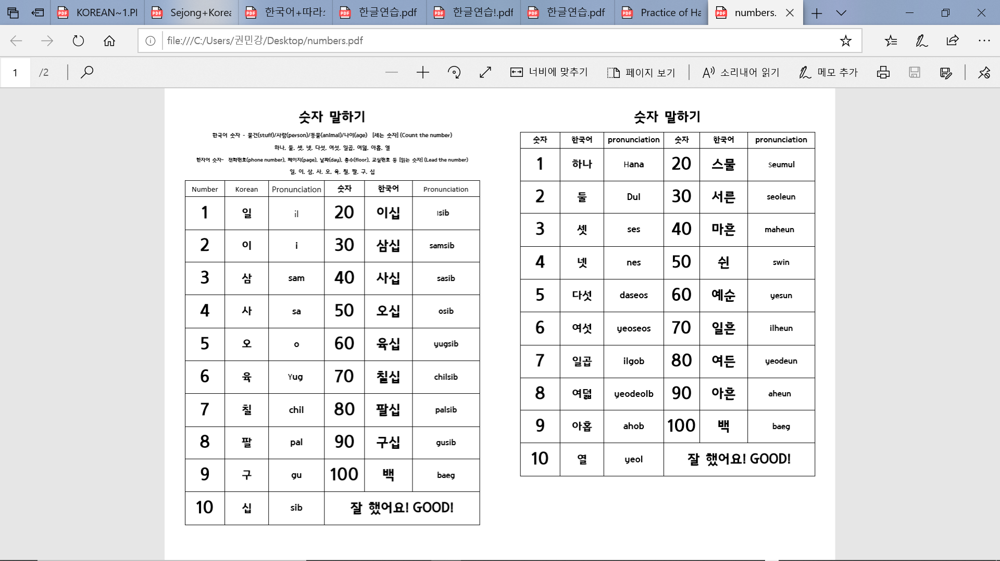
Korean Numbers
Native-Korean Numbers
➔ Read Dates (11/17)
➔ Read Money (50 won)
1 | 하나(한) | Hana(Han)
2 | 둘(두) | Dul(Du)
3 | 셋(세) | Set(Se)
4 | 넷(네) | Net(Ne)
5 | 다섯 | Daseot
6 | 여섯 | Yeoseot
7 | 일곱 | Ilgob
8 | 여덟 | Yeodeol
9 | 아홉 | Ahop
10 | 열 | Yeol
20 | 스물 | Seumul
30 | 서른 | Seoreun
40 | 마흔 | Maheun
50 | 쉰 | Swin
60 | 예순 | Yesun
70 | 일흔 | Ilheun
80 | 여든 | Yeodeun
90 | 아흔 | Ahuen
Sino-Korean Numbers
Things With Counters
(5 flowers) ➔
*How about Time??
(Native Number) 시 [si] (Sino Number) 분 [bun]
Ex. 11:55
10+1+si,
열(yeol)+한(han) 시(si)
50+5+bun
오십(osib)+오(o) 분(bun)
Notes:
Before we learn counters, we need to slightly know about Korean numbers systems first.
Korean language has two different number systems. One is called the Sino-Korean numbers system, which is of Chinese origin.
The other is Native Koreans numbers system.
We learned some examples which use Sino-Korean, dates. Also, when we say money, we use Sino Korean. But when words are with counters, mostly we use Native Korean Numbers.
The most complicated case is for time.
When we want to express time, we use both Sino Korean and Native Korean. For example, if we want to say 11:55, we use Native Korean for eleven and Sino Korean for 55.
Then, for 11, we can find ‘Yeol’, ‘han’. And, for 55, we can find ‘Osib’, ‘o’.
It looks difficult, but once you all memorize how to say native Korean 1 to 12, you can feel much easier.
Anyway, again, there are two number systems in Korean, and for counters, we use Native Korean Numbers.

Slide 4
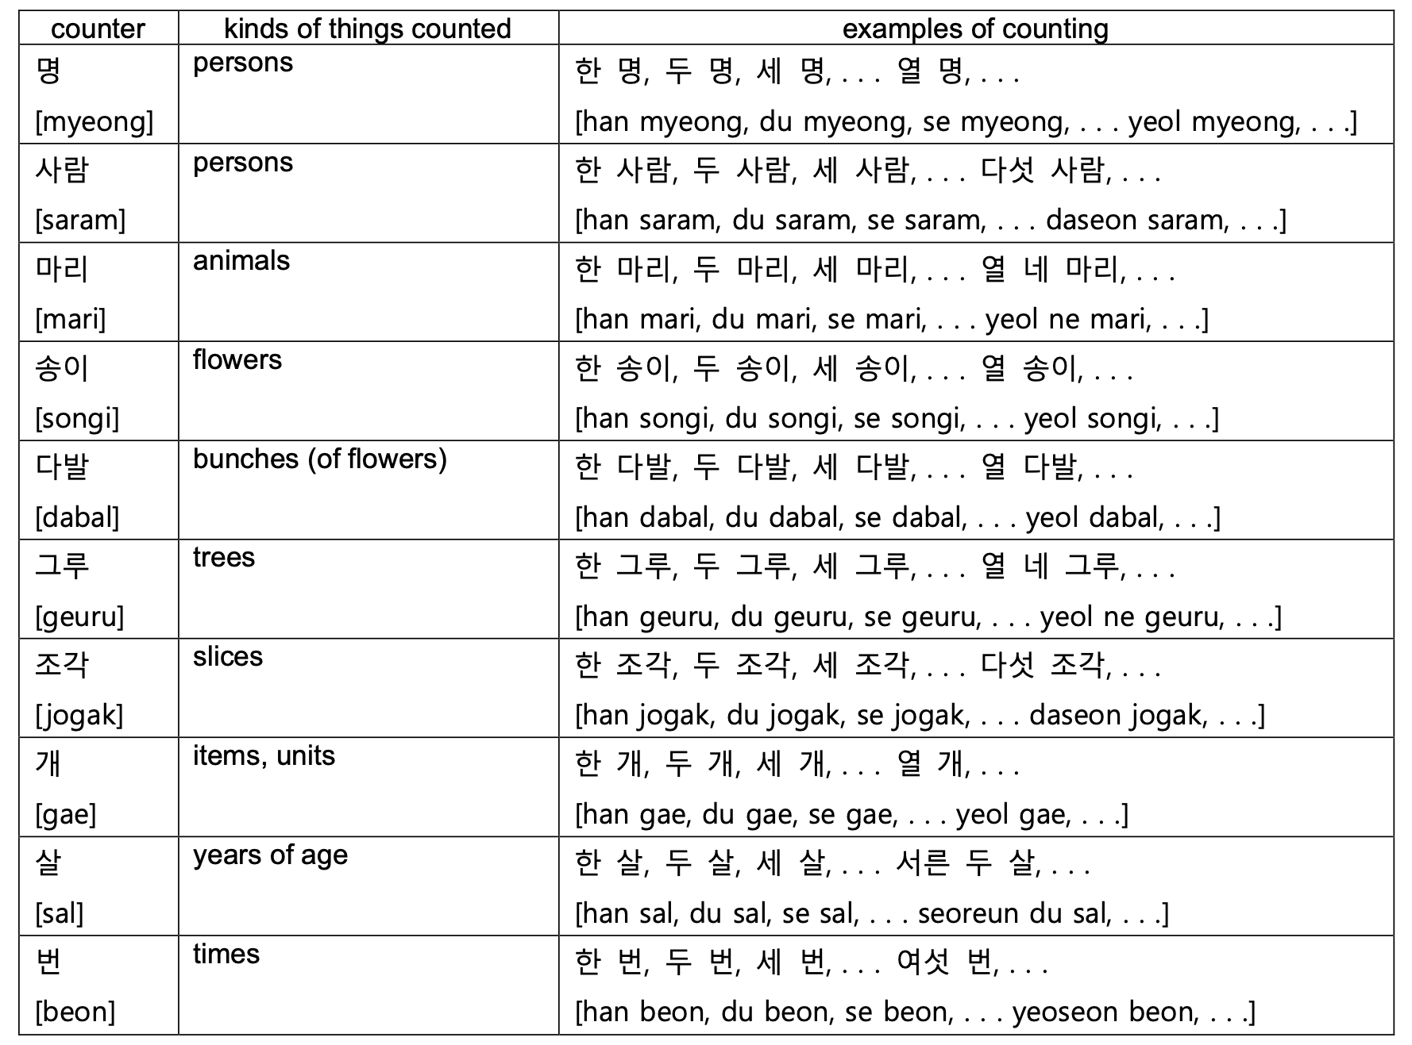
counter
Notes:
Korean Counters help to talk about things which is countable. There are a lot of counters in Korean, so we will study basic counters today.
Let’s repeat these together first.
명 and 사람 is similar, but 명 is more frequently used I think. It doesn’t have different meaning though.
In formal situation, we use 분(bun).
And also, ‘개(gae)’ is the most frequently used counter. When you don’t know what counter to use, 개 will work. Just be careful not to use 개 when you count people, because it is only for non-human things. Also not for animals.
Let’s take a closer look at these.

Slide 5
English (number + word)
Native-Korean Numbers
Two students
One person
Five roses
Three times
Six pinetrees
Fourty-seven slices
Fifty-three chocolates
86 years old
[Changing with Counters]
1) 하나(hana) + (Counter) ➔ 한 (Han)
2) 둘(dul) + (Counter) ➔ 두 (Du)
3) 셋(set) + (Counter) ➔ 세 (Se)
4) 넷(net) + (Counter) ➔ 네 (Ne)
[Combination]
Ex. 17 = 10+7 ➔ 열(yeol) + 일곱(ilgop)
Ex. 89 = 80+9 ➔ 여든(yeodeun)+아홉(ahop)
1 | 하나(한) | Hana(Han)
2 | 둘(두) | Dul(Du)
3 | 셋(세) | Set(Se)
4 | 넷(네) | Net(Ne)
5 | 다섯 | Daseot
6 | 여섯 | Yeoseot
7 | 일곱 | Ilgob
8 | 여덟 | Yeodeol
9 | 아홉 | Ahop
10 | 열 | Yeol
20 | 스물 | Seumul
30 | 서른 | Seoreun
40 | 마흔 | Maheun
50 | 쉰 | Swin
60 | 예순 | Yesun
70 | 일흔 | Ilheun
80 | 여든 | Yeodeun
90 | 아흔 | Ahuen
Korean (word + number + counter)
학생 두 명 [hak-saeng du myeong]
한 사람 [han sa-ram ]
장미 다섯 송이 [jang-mi daseot song-i]
세 번 [se beon]
소나무 여섯 그루 [so-na-mu yeoseot geuru]
마흔일곱 조각 [ma-heun il-gop jo-gak]
초콜릿 쉰세 개 [(chocolate) swin se gae]
여든여섯 살 [yeo-deun yeo-seot sal]
*BE CAREFUL! Counters are not in English.
Notes:
And when native-Korean numbers are combined with counters, 하나, 둘, 셋, and 넷 change. 하나 into 한, 둘 into 두, 셋 into 세, and 넷 into 네. They are changed only when counter is behind them.
How to make number more than 10? It is also same as sino Korean numbers. For example, if you want to say 17, then it is 10+7. so you say 10, 열 first and then say 7, 일곱.
Now let’s practice how to use counters.
Two students – students are people, so we can use 명 or 사람. This time are going to use 명.
First, put ‘학생’, which means students in English, at first. Then, put numbers next. Two is ‘두’ in Native Korean.
And Finally, put counter.
Next example is quite interesting. ‘한’, which means 1(one) in Korean, goes first.
It’s because the counter ‘사람(saram)’ literally means person. There are some counters which also have meaning. 사람, 번 or 조각 is examples. In those cases, we don’t have to put word first, so we delete them.
Again, one, ‘한’ and then counter, ‘사람(saram)’.

Slide 6
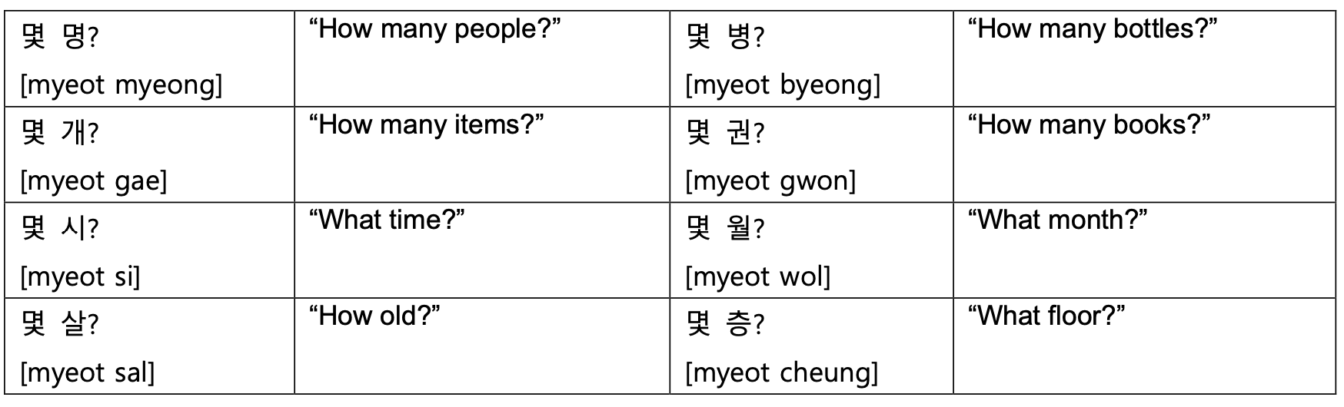
Question word
Notes:
Now we are going to learn the question word, ‘몇’ which means how many in Korean.
It may feel difficult for you guys. As you learned before, in Korean, date or time are all expressed by numbers. So when we ask date or time, we use ‘몇(myeot)’. We also use 몇 for age or floor.
Let’s take a closer look again.

Slide 7
Question word [몇]
Basic Form: 몇 [myeot] + (Counter)
What time shall we meet?
➔몇 시에 만날까요?
[myeot sie mannalkkayo?]
What time shall we eat dinner?
➔몇 시에 저녁 먹을까?
[myeot sie jeonyeok meogeulkka?]
몇 [myeot]
When we do not know the number of persons or objects, we use ‘몇’ to ask the number.
Related to numbers
Similar to ‘How Many’
How many credits do you take this semester?
이번 학기에 몇 학점 들어?
[ibeon hakgie myeot hakjeom deureo?]
Counters are always behind it
It doesn’t always have to be in front of the sentences.
Notes:
‘몇’ is used when we do not know the number of persons or objects. It is ‘How many’ in English.
It has different meaning, which mean ‘some’ or ‘few’, but this time we will not gonna learn.
Counter always follows ‘몇’. And we don’t always have to use ‘몇‘in front of the sentence. It is usual btw.
Let’s practice with some examples.
What time shall we meet?
In Korean, we think ‘time’ is related with numbers, so we use ‘몇’.
And we learned before, ‘시’ is used when we want to express time. 11시 55분.
So ‘몇 시‘ means What time. Let’s practice together.
We can also make different sentence by change ‘만날까요’. [저녁 먹을까 설명]
There is another example. How many credits do you take this semester?
Again, credits are countable, so we use ‘몇‘ to ask. 몇 + 학점(credits). 들어 is take, and this semester is 이번 학기 in Korean.
Let’s repeat together. [이번 학기에 몇 학점 들어?]

Slide 8
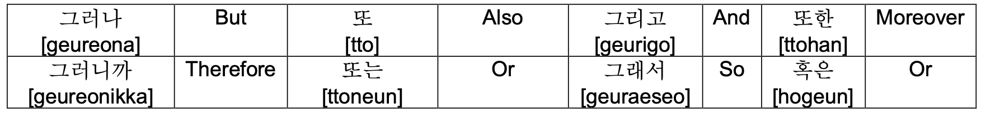
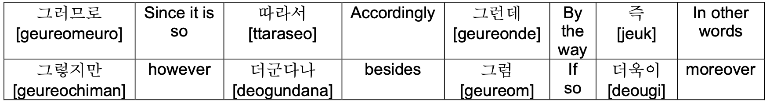
Adverb
Notes:
Let’s learn about adverbs that are used a lot in Korean.
The adverbs on this slide are mainly used between sentences to change the conversation flow.
Let’s read it one by one together

Slide 9
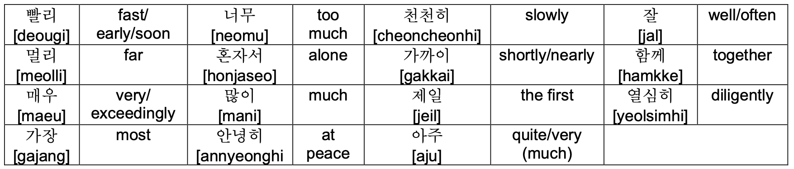
Adverb
[bballi]
Notes:
읽기
매우, 너무, 아주 all have similar meanings. If you're trying to say “it is very delicious“(맛있다), you can say 매우 맛,아주 맛, 너무 맛 all.

Slide 10
Key sentences
- in café & restaurant
물/한/잔/주시겠어요? “Could I have a glass of water?”
[mul /han/jan/ju si ge sseo yo?]
:→(what) (how many)잔 (action/verb)시겠어요?
Ex) 콜라 한 잔 주시겠어요? Can I have a coke, please? [kolla han jan jusigesseoyo?]
Ex) 물 세 잔 주시겠어요? Can I have three glasses of water? [mul se jan jusigesseoyo?]
냅킨은 /어디 /있나요? “Where is the napkin?”
[naeb kin eun eo di it na yo?]
:→(what)은/는 어디 (action/verb)나요?
Ex) 필릭스는 어디 있나요? Where is Felix? [Felix neun eodi it na yo? ]
Ex) 필릭스는 어디 가나요? Where is Felix going? [Felix neun eodi ganayo?]
주다(give)= 주+다
[ju da]
있다(is)= 있+다
[it da]
가다(go)= 가+다
[ga da]
Notes:
Next, let's learn about the key sentence. The sentence is divided into four parts. Restaurants & cafes, personal questions, time & date, and in school.
Along with the key sentence, I will tell you the general form of the sentence like this. Various sentences can be made by putting the appropriate components in the blanks in this basic sentence format.
영어-한국어
Water corresponds to What you want.
And then you put the numbers that you learned earlier that are used to count the units. Like 한, 두, 세
“잔” is measure nouns.
Then you can put action or verb stem here.
In this sentence, verb ‘주다’ is put here.
When I want water, I get water, but the other person gives me water. In Korean, we usually say 'could I have~' as ‘~ 주시겠어요?’
예시
읽기
--------------
영어-한국어
냅킨 corresponds to What.
Then you can put action or verb stem here.
In this sentence, verb ‘있다’ is put here.
예시
읽기

Slide 11
Key sentences
- in café & restaurant
오늘/ 카페에서/ 숙제를/ 했어요. “I did my homework at the café today”
[o neul ka pe e seo sug je leul hae sseo yo]
:→(when), (where)에서 (what)을/를 (action/verb)어요.
Ex) 어제 식당에서 라면을 먹었어요 I ate ramen at a restaurant yesterday
[eoje sikdangeseo ramyeoneul meogeosseoyo]
Ex) 오늘 학교에서 숙제를 했어요 I did my homework at school today
[oneul hakgyoeseo sukjereul haesseoyo ]
하다(do)= 하+다
[ha da]
했어요(did)
[hae sseo yo]
먹다(eat)= 먹+다
[meokda]
먹었어요(ate)
[meogeosseoyo]
Notes:
영어-한국어
오늘 corresponds to When.
카페에서 corresponds to where
숙제 corresponds to what
Then you can put action or verb stem here.
In this sentence, verb ‘하다’ is put here.
The form of the word 하다 has changed to the past tense 했어요.
예시
읽기
--------------

Slide 12
Key sentences
- in café & restaurant
주다(give)= 주+다
[ju da]
아메리카노/ 두/ 잔 /이랑 /초콜렛 마카롱 /하나/ 주세요.
“(Give me) two glasses of Americano and one chocolate macaron”
[Americano/du/jan/Ilang/chocolate macaron/ha na/ju se yo]
:→ (what) (how many)잔 이랑 (what)(how many) (action/verb)세요.
화장실이/어디/있는지/알/수 있을까요? “Can I know where the toilet is?”
[hwa jang sil i /eo di/it neun ji/al/su i sseul kka yo?]
:→(where)이/가 어디 (action/verb)는지 (action/verb) 수 있을까요?
있다(is)= 있+다
[it da]
알다(know)= 알+다
[al da]
Notes:
영어-한국어
You can put in the target you want and the quantity of the target.
읽기
----------
영어-한국어
When you wonder where the place is, you can ask questions by putting a word indicating the place.
알다 is know so you should add verb stem 알 here.
읽기

Slide 13
Key sentences
- in café & restaurant
주문(noun: order)= 주문+하다 (verb: order)
[ju mun ha da]
너는 /뭐 /주문/ 할래? “What do you want to order?”
[neo neun /mwo/ ju mun/ hal lae?]
:→(who)은/는 뭐 (action/verb) 할래?
Ex) 아빠는 뭐 주문 할래? Dad, what do you want to order?
[appaneun mwo jumun hallae?]
Notes:
영어-한국어
너 corresponds to Who.
주문 is order.
You can add action noun 주문 in here.
예시
읽기

Slide 14
Key sentences
- in café & restaurant
남은 음식 포장해주세요. “Please wrap up the leftovers.”
[nam eun eum sig po jang hae ju se yo]
:→(what) (action/verb)세요
어떤 메뉴가 제일 인기 많나요? “Which menu is the most popular?”
[eo tteon me nyu ga je il in gi manh na yo?]
:→ 어떤 (what)이/가 제일 인기 (action/verb)나요?
포장해주다(wrap up)= 포장해주+다
[po jang hae ju da]
많다 [adjective](a lot, most, much)= 많+다
[manh da]
Notes:
영어-한국어
남은 음식 corresponds to What.
Then put action or verb stem 포장해주 here.
읽기
-------
영어-한국어
메뉴 corresponds to What.
많다 is adjective in Korean and mean a lot many, much, most. So you can put 많 the adjective stem in here.
읽기

Slide 15
Key sentences
- in café & restaurant
피클이랑 김치 더 주시겠어요?
“Would you please give more pickle and kimchi?”
[pi keul I lang gim chi deo ju si ge sseo yo?]
:→(what)(이)랑 (what) 더 (action/verb) 시겠어요?
Notes:
영어-한국어
You can put in the target you want this blank.
Also you can say 이랑 or 랑. It depends on the presence of a 받침.
If previous word have 받침, you should say 이랑. But there is no 받침, you should add just ‘랑’
읽기

Slide 16
Key sentences
- private question
가족은 /몇 /분/이나 /됩니까? How many people are there in your family?
[gajogeun/ myeot/ bun/ina /doemnikka]
→(noun)은 /몇 /(counter)/이나 /됩니까?
Ex) 꽃은 몇 송이나 됩니까? How many flowers are there?
[kkocceun myeot songina doepnikka?]
남편은 무슨 일을 하세요? What does your husband do for a living?
[nampyeoneun museun ireul haseyo]
→(noun)은 무슨 (noun)을 하세요?
Notes:
영어 한국어
Fill in the blanks with the objects you are curious about and the units of objects you are curious about.
예시
읽기
-----------
＇남편＇ is a noun that represents a husband
‘’일' is a noun that refers to a job or work.
In this English sentences, there is no noun that corresponds to ‘일’ exactly. You just have to memorize it like an expression.
읽기

Slide 17
Key sentences
- private question
아들은 둘이고 딸은 없습니다. I have two sons, but no girls.
[adeureun durigo ttareun eopseumnida]
→(noun)은 (number)고 (noun)은 (number)입니다.
기혼입니다. / 미혼입니다. I’m married. / I’m single.
[gihonimnida. / mihonimnida]
→ (noun)입니다.
없다 [adjective](no, not exist)= 없+다
[eop da]
없습니다(polite)
[eop seum ni da]
Notes:
영어 한국어
명사를 넣고 숫자를 넣는다.
하지만 이 문장에서 딸은 없다. “없습니다“ is polite expression of ‘없다‘
읽기
---------
영어 한국어
기혼, 미혼, is a noun is Korean.
읽기

Slide 18
Key sentences
- private question
나이를 여쭤봐도 될까요?
May I ask your age?
[naireul yeojjwobwado doelkkayo]
→(noun)을 여쭤봐도 될까요?
Notes:
시작!!
나이 is noun and means age.
May I ask = 여쭤봐도 될까요? Is polite expression.

Slide 19
Key sentences
- private question
당신의 종교는 뭡니까? What’s your religion?
[dangsinui jonggyoneun mwomnikka]
→당신의 (noun)은 뭡니까?
저는 기독교 신자입니다. I’m a Christian.
[jeoneun gidokgyo sinjaimnida]
→저는 (religion) 신자입니다.
Notes:
종교 = religion. 당신의 = your, what is = 뭡니까?
So you can create many sentence chaging this noun black.
For example, What’s your religion? = 당신의 이름(name)은 뭡니까?
Next,
You can answer by putting the religion corresponding to the blank.
Christian is 기독교 in Korean.

Slide 20
Key sentences
- private question
태어나다(be born)= 태어나+다 [tae eo na da]
자라다(Grow up, raise)= 자라+다[jarada]
나오다(Graduate)= 나오+다[na o da]
전공하다(Major in)=전공하다 [jeon gong ha da]
전주에서 태어나 서울에서 자랐습니다.
I was born in Jeonju and raised in Seoul.
[Jeonjueseo taeeona seoureseo jaratseumnida]
→(place)에서 (verb) (place)에서 (verb).
어느 학교 나오셨나요? Which school did you graduate from?
[eoneu hakgyo naosyeonnayo]
→ 어느 (noun) (verb)?
교육학을 전공하고 있습니다. I’m majoring in education.
[gyoyukageul jeongonghago itseumnida]
Notes:
Be born = 태어나다. 자라다
You can add appropriate place and verb here.
For example, Germany 독일.
학교 = noun
나오셨나요? =is a pollite questionable form of 나오다.
You can change this word to give various answers.
예를 들어 Economics

Slide 21
Key sentences
- private question
몇 시에 만날까요?
What time shall we meet?
[myeot sie mannalkkayo]
→몇 시에 (verb)?
6시 45분이에요.
It’s quarter to seven.
[6si 45bunieyo]
→(number)시
(number)분이에요.
오늘이 무슨 요일이죠?
What day is it today?
[oneuri museun yoirijyo]
→(noun)이
무슨 요일이죠?

Slide 22
Key sentences
- time & date
What day is ~?
~이/가 무슨 요일이죠?
What day is it tomorrow?
내일이 무슨 요일이죠?
[naeiri museum yoirijyo?]
What day is Christmas?
크리스마스가 무슨 요일이죠?
[(Christmas) ga museun yoirijyo?]
*내일 - tomorrow

Slide 23
Key sentences
- private question
생일이 언제십니까?
When is your birthday?
[saengiri eonjesimnikka]
→(noun)이 언제입(십)니까?
다음 모임은 7월 15일 화요일입니다.
The next meeting will be on Tuesday, July 15th.
[daeum moimeun 7wol 15il hwayoirimnida.]
→(noun)은 (number)월 (number)일 (day)입니다.
우리 휴가가 언제 시작이지?
What date does our vacation start?
[uri hyugaga eonje sijagiji]
→(noun)이 언제 (verb)?

Slide 24
Key sentences
- time & date
When is your ~ ?
~ 이 언제입(십)니까?
~ will be on (N: date).
~ 은 N월 N일 N요일입니다.
What date does (schedule) (end/start)?
(schedule)이 언제 (끝나지/시작하지)?
What date does mid-term test start?
중간고사가 언제 시작하지?
[junggangosa-ga
eonje- sijakaji?]
What date does this trip end?
이 여행이 언제 끝나지?
[i yeohaeng-i eonje- kkeunnaji?]
When is the vacation?
휴가가 언제십니까?
[hyuga-ga eonje-simnikka?]
When is your Final test?
기말고사가 언제입니까?
[gimalgosa-ga eonje-imnikka?]
Next concert will be on Wednesday, November 16th.
다음 콘서트는 11월 16일 수요일입니다.
[daeum (concert) neun 11wol 16il suyoirimnida]
Mid-term test will be December 25th.
중간고사는 12월 25일입니다.
[junggangosa-neun 12wol 25irimnida.]
*휴가 – vacation / 기말고사 – final test / 중간고사 – midterm test / 여행 – trip

Slide 25
Key sentences
- private question
언제 서울에
도착했습니까?
When did you arrive
in Seoul?
[eonje seoure
dochakaetseumnikka]
→언제 (noun)에 (verb)?
가장 편한 시간은 언제세요
When is the most convenient time for you?
[gajang pyeonhan siganeun eonjeseyo]
→(adj) 시간은 언제세요?
벌써 6시가 넘었어요.
It’s already after six.
[beolsseo yeoseot siga neomeosseoyo]
→벌써 (time)이/가 넘었어요.

Slide 26
Key sentences
- time & date
When did you (verb) (place)?
언제 (place)에 (verb)?
When is (adj.) time for you?
당신에게 (adj.) 시간은 언제세요?
It’s already after (time).
벌써 (time)이/가 넘었어요.
It’s already after seven.
벌써 일곱 시가 넘었어요.
[beolsseo ilgop siga neomeosseo-yo.]
When did you arrive in Brno?
언제 브루노에 도착했습니까?
[eonje (Brno) eh dochakaetseumnikka]
When did you visit NewYork?
언제 뉴욕에 방문했나요?
[eonje (NewYork) eh bangmun-haennayo?]
When is the best time for you?
당신에게 최고인 시간은 언제세요?
[dangsin-ege choego-in sigan-eun eonje-seyo?]
*방문하다 – visit, 최고 – the best

Slide 27
Key sentences
- private question
전공 수업 건물을 찾아가려면 어디로 가야하나요?
“Where should I go to find the major class building?”
[jeongong sueop geonmureul chajagaryeomyeon eodiro gayahanayo]
:→(where) 을 찾아가려면
어디로 가야하나요?
학생 식당에 가서 점심먹자.
“Let’s have a lunch in student cafeteria”
[haksaeng sikdange gaseo jeomsimmeokja.]
:→(where)에 가서 점심먹자.
이번 학기에 몇 학점 들어?
“How many credits do you take this semester?”
[ibeon hakgie myeot hakjeom deureo]
:→(when)에 몇 학점 들어?

Slide 28
Key sentences
- time & date
When is your ~ ?
~ 이 언제입(십)니까?
~ will be on (N: date).
~ 은 N월 N일 N요일입니다.
What date does (schedule) (end/start)?
(schedule)이 언제 (끝나지/시작하지)?
What date does mid-term test start?
중간고사가 언제 시작하지?
[junggangosa-ga eonje- sijakaji?]
What date does this trip end?
이 여행이 언제 끝나지?
[i yeohaeng-i eonje- kkeunnaji?]
When is the vacation?
휴가가 언제십니까?
[hyuga-ga eonje-simnikka?]
When is your Final test?
기말고사가 언제입니까?
[gimalgosa-ga eonje-imnikka?]
Next concert will be on Wednesday, November 16th.
다음 콘서트는 11월 16일 수요일입니다.
[daeum (concert) neun 11wol 16il suyoirimnida]
Mid-term test will be December 25th.
중간고사는 12월 25일입니다.
[junggangosa-neun 12wol 25irimnida.]
*휴가 – vacation / 기말고사 – final test / 중간고사 – midterm test / 여행 – trip

Slide 29
Key sentences
- private question
과제 제출일이 언제까지야?
“When is the dead-line of assignment?”
[gwaje jechuriri eonjekkajiya]
:→(what)이 언제까지야?
장학금을 받으려면 어떤
기준을 충족해야 하나요?
“Which criteria should be met to get a scholarship?”
[janghakgeumeul badeuryeomyeon eotteon gijuneul
chungjokaeyahanayo]
:→(what)을 받으려면 어떤 기준을 충족해야 하나요?
오늘 팀플하러 가야 해.
“I have to go to the team
meeting today.”
[oneul timpeulhareo gayahae]
:→(when) (what)하러 가야 해

Slide 30
Key sentences
- time & date
Which criteria should be met to get ~ ?
~ 을/를 받으려면 어떤 기준을 충족해야 하나요?
I have to go to (schedule) (time).
(time) (schedule)러 가야 해.
Which criteria should be met to get credits?
학점을 받으려면 어떤 기준을 충족해야 하나요? [hakjeomeul badeuryeomyeon eotteon gijuneul chungjokaeya hanayo?]
Which criteria should be met to get bonus point?
추가 점수를 받으려면 어떤 기준을 충족해야 하나요?
[chuga jeomsu-reul badeuryeomyeon eotteon gijuneul chungjokaeya hanayo?]
I have to go to eat dinner now.
지금 저녁먹으러 가야 해
[jigeum jeonyeongmeogeuro gaya hae]
I have to go to take a quiz tomorrow.
내일 퀴즈 보러 가야 해
[naeil (Quiz) boreo gaya hae]
*추가 점수 – bonus point / 지금 – now / 퀴즈 - quiz

Slide 31
Key sentences
- private question
오늘 같이 과제 할래?
“Do you want to work
together today?”
[oneul gachi gwaje hallae]
:→(when) 같이 (what)할래?
수업 끝나고 아르바이트
가야해.
“I have to go for part time job after class.”
[sueop kkeunnago
areubaiteu gayahae]
:→(what) 끝나고
(where)가야해.
시험 끝나고 술 마시러
가자.
“Let’s go drink after
the exam.”
[siheom kkeunnago
sulmasireo gaja]
:→(what) 끝나고
술 마시러 가자.

Slide 32
Key sentences
- time & date
I have to go for (schedule) after ~.
~ 끝나고 (schedule) 가야 해.
Do you want to ~ together (time)?
(time) 같이 ~ 할래?
Do you want to drink alcohol together now?
지금 같이 술 마시러 갈래?
[jigeum gachi sul masireo gallae?]
Do you want to see a movie together next Monday?
다음 월요일에 같이 영화 볼래?
[daeum woryoire gachi yeonghwa bollae?]
I have to go for doing assignment after lunch.
저녁식사 끝나고 과제 하러 가야 해.
[jeonyeo-ksiksa kkeunnago gwaje hareo gaya hae]
I have to go for having lunch after this class.
이 수업 끝나고 점심 먹으러 가야 해.
[i sueop kkeunnago jeomsim meogeuro gaya hae]
*영화 – movie / 과제 – assignment / lunch – 점심(식사) / 수업 - class

Slide 33
Grammar - palatalization
A phenomenon in which ㄷ, ㅌ meets 'ㅣ‘ [i] vowels and turns into‘ㅈ, ㅊ’.
ㄷ+ㅣ= 지
ㅌ+ㅣ= 치
Example) 같이 /ga-ti/: together – 가치[gachi]
해돋이 /hae-do-di/ : sunrise – 해도지[hae-do-ji]

Slide 34
Grammar - liquidization
'ㄴ' is pronounced as [ㄹ] in front or behind＇ㄹ’
ㄹ + ㄴ + ㄹ =ㄹ
Example ) 논리 /non-li/ : logic – 놀리[nol-li]
온라인 :On-line – 올라인[Ol-line]
난로 /nan-lo/: Stove – 날로[nal-lo]

Slide 35
Batchim pronounce
Consonant base | Pronunciation | Example
ㄱ,ㅋ,ㄲ | [ㄱ] | 책[책]:Book-{Caeck}, 부엌[부억]:Kitchen-{Bueok}, 약[약]:Medicine-{Yak},
ㄴ | [ㄴ] | 산[산]:Mountain-{San}
ㄷ,ㅅ,ㅆ,ㅈ,ㅊ,ㅌ,ㅎ | [ㄷ] | 낮[낟]:Daytime-{Not}, 꽃[꼳]:Flower-{ggoat}
ㄹ | [ㄹ] | 길[길]:Road-{Gil}
ㅁ | [ㅁ] | 몸[몸]:Body-{Moam}
ㅂ,ㅍ | [ㅂ] | 밥[밥]:Rice-{Bap}, 숲[숩]:Forest-{Soop}
ㅇ | [ㅇ] | 강[강]:River-{Gang}
Notes:
There may be more than one consonant for ‘batchim’, but today we will only lean cases which only one consonant comes.
And before we start, we should know that ‘ㄸ’, ‘ㅉ‘ and ‘ㅃ’ do not come as a ‘Batchim’.
The remaining consonants can be divided into seven types according to the pronounced consonants.
First, ㄱ, ㅋ and ㄲ are all prodounced as ‘ㄱ’. They have k sound. [책] Chae / k. [부엌] Boo-Eo / k. [닦다] Da / k – Da]
And we can pronounce ㄴ 받침, with the alphabet ‘n’. [산] sa / n. [간] Ga / n.
Next is quite challenging. ㄷ, ㅅ, ㅆ, ㅈ, ㅊ, ㅌ and ㅎ are pronounced as ‘ㄷ’. They all have ‘t’ sound 받침.
[받침] Ba / t – chim. [씻다] Ssi / t – da. [낮] Na – t. (➔Not). [꽃] Ggo – t. (➔Ggoat).
Consonant ㄹ also sounds same even it is in the batchim position. You can add ‘l’ at the end.
[길] Gi / l. [말] Ma / l.
Consonant ㅁ sounds same even it is in the batchim position. You can add ‘m’ at the end.
[몸] mo / m (➔ moam). [감] Ga / m.
ㅂ and ㅍ all sound ㅂ, which sounds ‘p’, when they are batchim.
[밥] Ba / p. [숲] Soo / p
Finally, it’s “o”. ‘o' has no pronunciation when it first came to syllable. It only makes an ng sound when it uses as 받침.
[아이브] ah – i – beu. [강] Ga / ng.

Slide 36
Grammar - nasalization
A phenomenon in which consonants other than the original nasal sounds are changed to nasal sounds (ㄴ, ㅁ, ㅇ) under the influence of neighboring nasal sounds.
Example)
국물 : soup – 궁물[goong-mool]
대통령 : president – 대통녕[dae-tong-nyung]
국립 : national – 국닙 – 궁닙[goong-nip]
'ㅂ, ㄷ, ㄱ’ + ‘ㄴ, ㅁ’ → ［ㅁ, ㄴ, ㅇ］
'ㅁ, ㅇ’ + ‘ㄹ’ → ［ㅁ, ㅇ］ + ［ㄴ］
‘ㅂ, ㄷ, ㄱ’ + ‘ㄹ’ → ‘ㅂ, ㄷ, ㄱ’ + ［ㄴ］ → ［ㅁ, ㄴ, ㅇ］ + ［ㄴ］
Notes:
When a ㄴ, ㄹ, or ㅁ interacts with other consonants, sometimes it undergoes nasalization. Nasalization basically means it forces another consonant to become a nasal sound ㄴ, ㅇ or ㅁ.

Slide 37
Grammar – nasalization Example
First Syllable Consonant | Second Syllable Consonant | Becomes… |  | Examples
ㅂ/ㄷ/ㄱ | ㄴ/ㅁ | ㅂ→ㅁ ㄷ→ㄴ ㄱ→ㅇ | No change | 밥맛[밤맏] 악마[앙마] 거짓말[거진말] | [Bammat] [Angma] [Geojinmal]
ㅁ/ㅇ | ㄹ | No change | ㄹ→ㄴ | 심리[심니] 승리[승니] | [Simni] [Seungni]
ㅂ/ㄷ/ㄱ | ㄹ | ㅂ→ㅁ ㄷ→ㄴ ㄱ→ㅇ | ㄹ→ㄴ | 왕십리[왕심니] 덧니[던니] 폭력[퐁녁] | [wangsimni] [deonni] [pongnyeok]
With batchim pronounciation…
거짓말 → [거짇말] → [거진말]
덧니→[덛니]→[던니]
Notes:
When a ㄴ, ㄹ, or ㅁ interacts with other consonants, sometimes it undergoes nasalization. Nasalization basically means it forces another consonant to become a nasal sound ㄴ, ㅇ or ㅁ.

Slide 38
Important !!
When you write, you must use original word !
These grammatical rules are only used when you speak.
같이 ( ㅇ )
가치 ( x )
대통령 ( ㅇ )
대통녕 ( x )

Slide 39
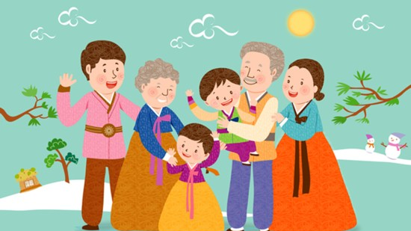
Korea’s culture - holiday

Slide 40
추석 [chusuk]
Chuseok is Korean Thanksgiving Day (August 15th in the lunar calendar)
Eat 송편[songpyeon] - Rice cake made of rice flour mixed with boiling water and stuffed with sesame, beans, and red beans in a half-moon shape.
강강술래[GangGangSulRae]
씨름[SsiRuem]

Slide 41
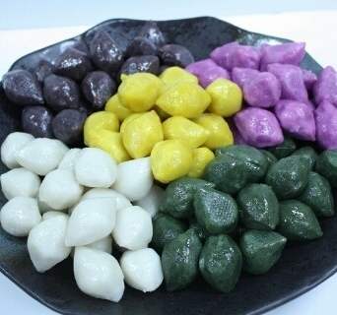
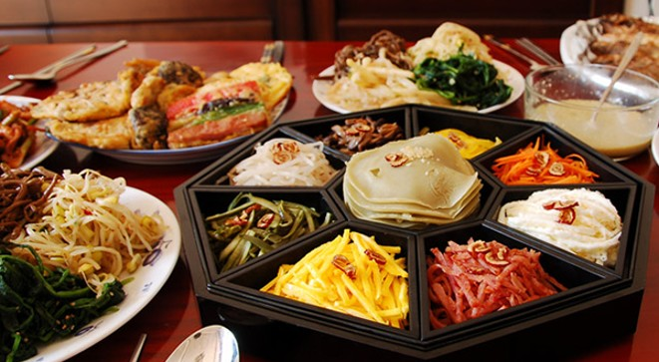
Video: https://youtu.be/_8SBM-aZoTI

Slide 42
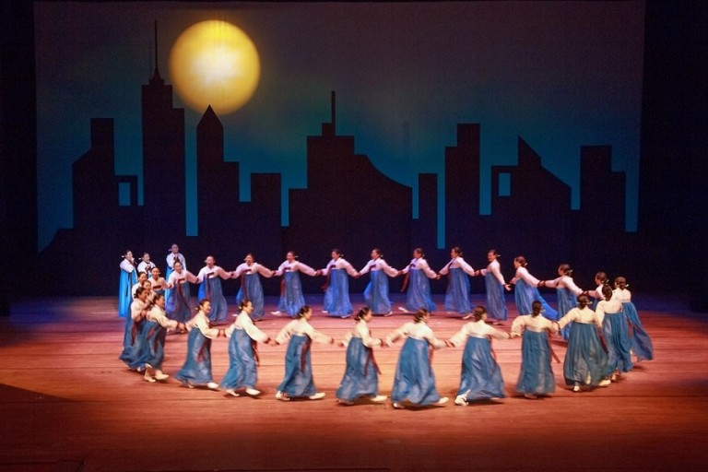
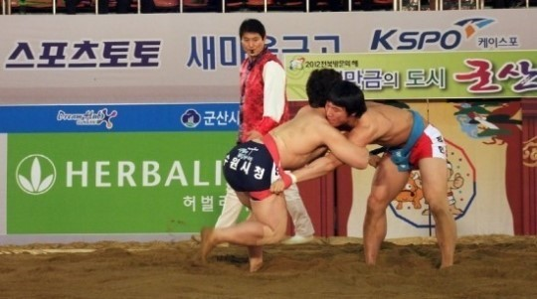

Slide 43
Watch video
강강술래 [ganggangsulrae]
https://youtu.be/FtXMvWOzwI4

Slide 44
설 [sul]
It is the first day of the New Year, and there is a custom of greeting and saying words of blessing as the first holiday of the year.(January 1st, in the lunar calendar)
윷놀이[Yutnoli]
떡국[ddeokguk]

Slide 45
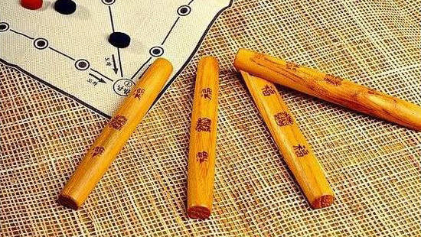

Slide 46
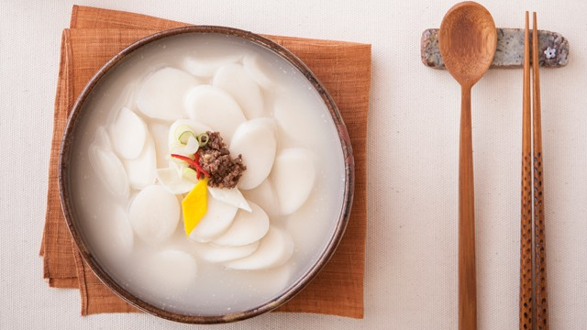

Slide 47
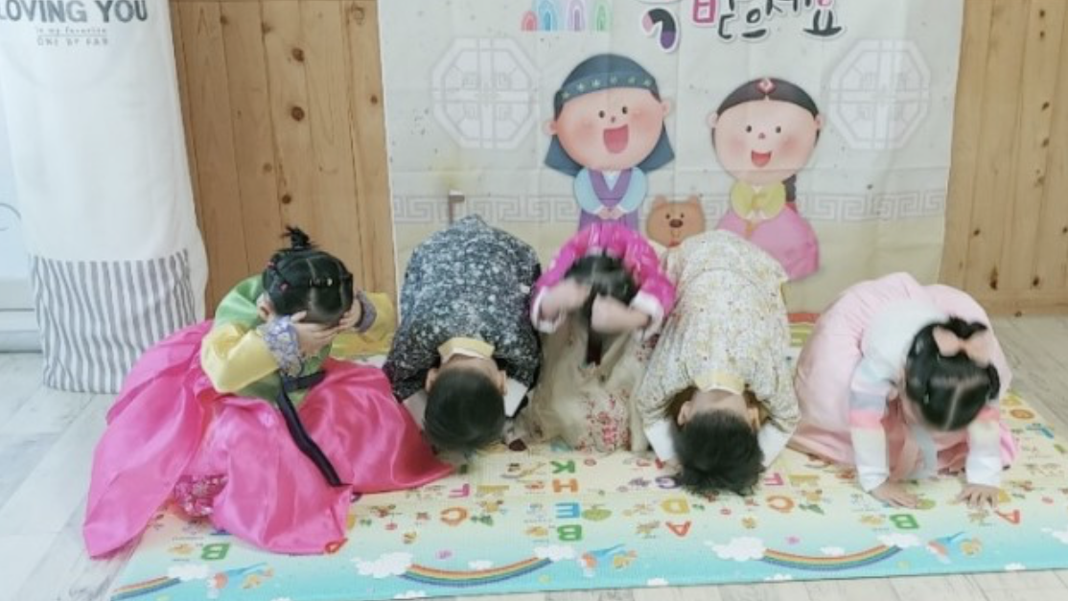

Slide 48
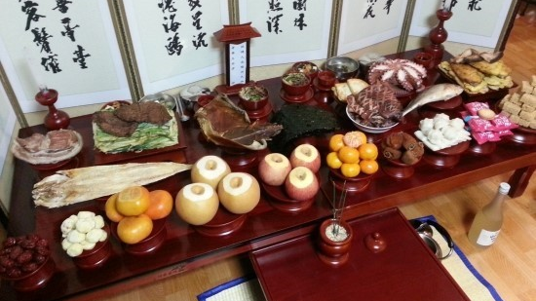

Slide 49
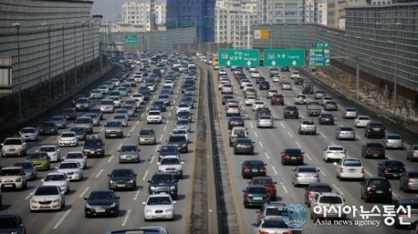

Slide 50
Useful websites
King Sejong Institute
http://www.sejonghakdang.org/sjcu/home/main.do
Talk to me in Korean
https://talktomeinkorean.com/

Slide 51

Thank you

