Slide 1
Korean class
WEEK 6

Slide 2
Index
Brief Review (week 1,2,3)
Grammar

Slide 3
Review

Slide 4
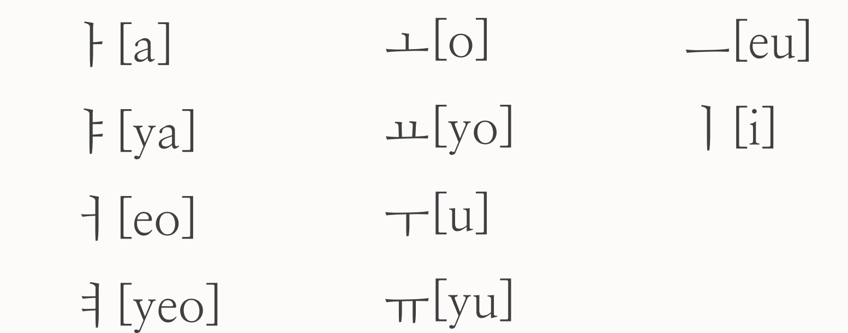
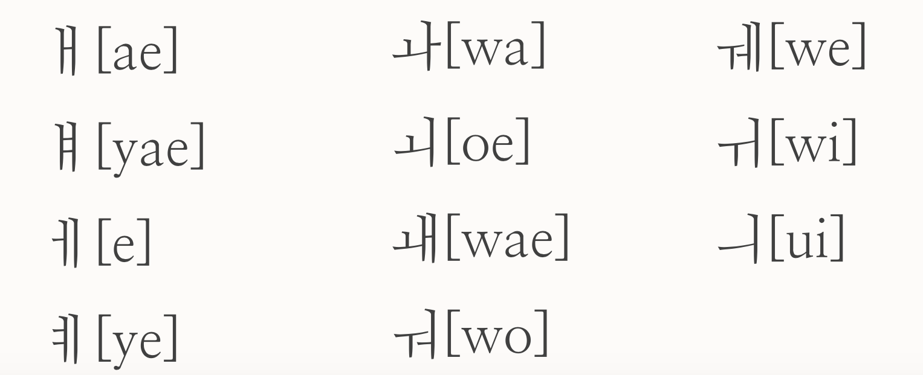
Review

Slide 5
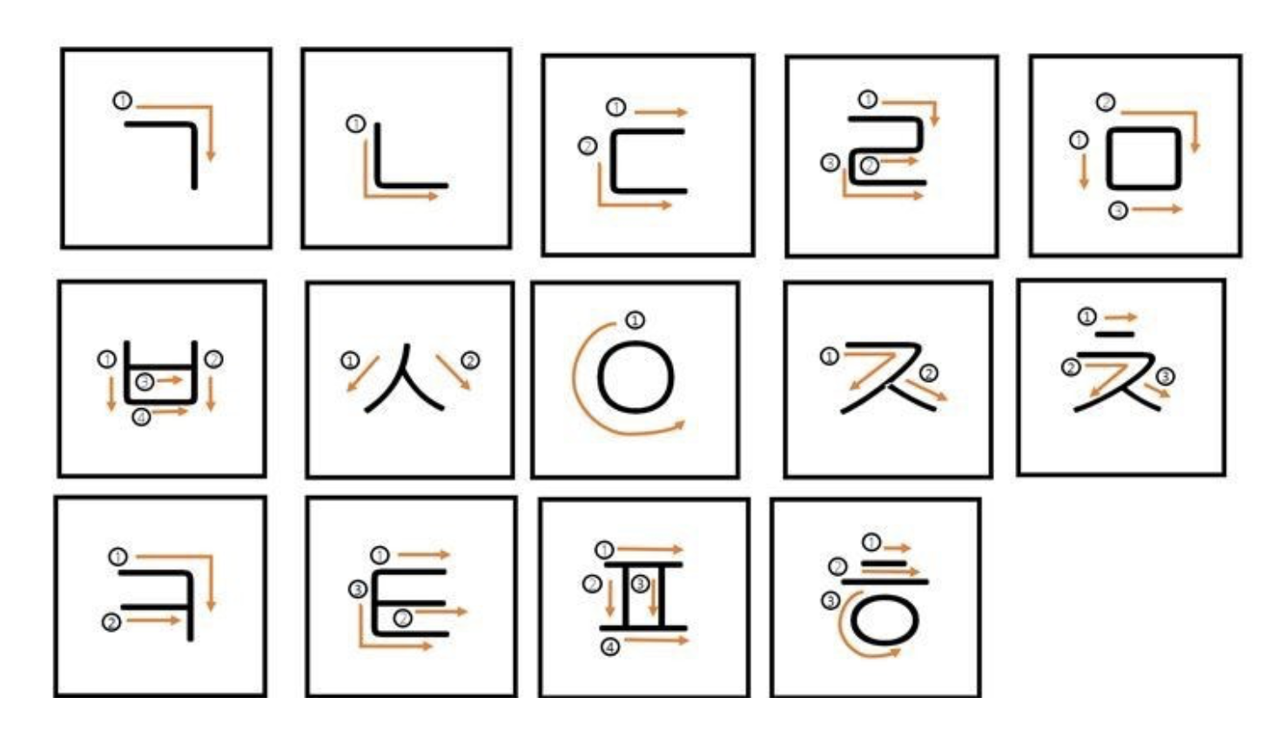
How to write consonant

Slide 6
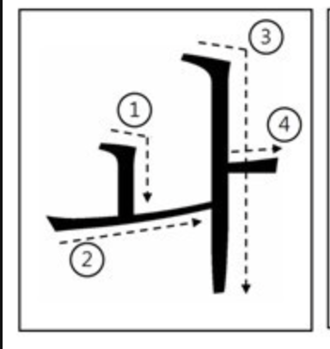
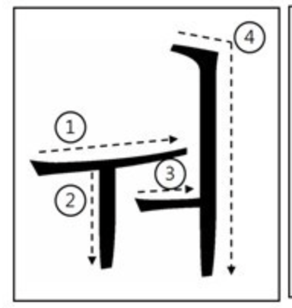
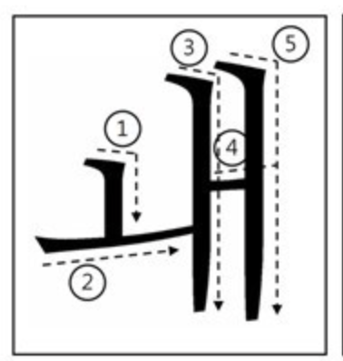
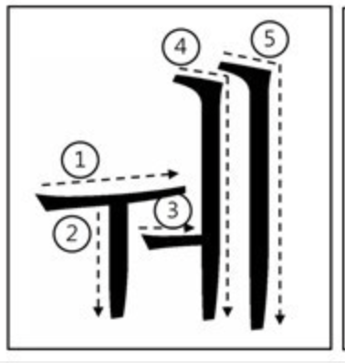
How to write vowel
Notes:
ㅔ ㅐ ㅖ ㅒ ㅚ ㅟ ㅢ

Slide 7
Informal/polite expression
Hi Informal/polite
안녕 / 안녕하세요
{An-nyeong / An-nyeong-ha-sae-yo}
Bye
잘 가 / 안녕히가세요
{Jal-ga / An-nyeong-hee-ga-sae-yo}
Sorry Informal/polite
미안해 / 미안해요 / 죄송합니다.
{Mi-an-hae / Mi-an-hae-yo / Jwae-song-hap-ni-da}
Thank you
고마워 / 고마워요 / 감사합니다.
{Go-ma-wo / Go-ma-wo-yo / Gam-sa-hap-ni-da}

Slide 8
Informal/polite expression
I
➔ Informal : 나는
➔ Polite : 저는
My
➔ Informal : 나의
➔ Polite : 저의
Me
Informal : 나
➔ Polite : 저
Your
Informal : 너
Polite : 당신

Slide 9
Review
Behind Vowel
Behind
Consonant
< Be – verb >
Am , Are , Is = - 다 , - 이다 ( da / I – da )
< Informal expression>
야 [Ya]
Ex) I am Haeryeon. 나는 해련이야.
Ex) What is that ? 저건 뭐야?
< Polite Expression >
에요 [Yeyo] =. 이에요 [i - yae – yo]
Ex) I am Nahyun. 저는 나현이에요.
Ex) What is this? 이건 뭐에요?

Slide 10
Review – topic marker
Topic Marker - 는 / 를
a grammatical particle used to mark the topic of a sentence.
Ex) I ate chocolate. 나는 초콜렛을 먹었다.
Ex) I like Korean. 나는 한국어를 좋아한다.
Notes:
여기까지 복습하고 워드로 넘어가기

Slide 11
Grammar - palatalization
A phenomenon in which ㄷ, ㅌ meets 'ㅣ‘ [i] vowels and turns into‘ㅈ, ㅊ’.
ㄷ+ㅣ= 지
ㅌ+ㅣ= 치
Example) 같이 /ga-ti/: together – 가치[gachi]
해돋이 /hae-do-di/ : sunrise – 해도지[hae-do-ji]

Slide 12
Grammar - liquidization
'ㄴ' is pronounced as [ㄹ] in front or behind＇ㄹ’
ㄹ + ㄴ + ㄹ =ㄹ
Example ) 논리 /non-li/ : logic – 놀리[nol-li]
온라인 :On-line – 올라인[Ol-line]
난로 /nan-lo/: Stove – 날로[nal-lo]

Slide 13
Grammar - nasalization
A phenomenon in which consonants other than the original nasal sounds are changed to nasal sounds (ㄴ, ㅁ, ㅇ) under the influence of neighboring nasal sounds.
Example)
국물 : soup – 궁물[goong-mool]
대통령 : president – 대통녕[dae-tong-nyung]
국립 : national – 국닙 – 궁닙[goong-nip]
'ㅂ, ㄷ, ㄱ’ + ‘ㄴ, ㅁ’ → ［ㅁ, ㄴ, ㅇ］
'ㅁ, ㅇ’ + ‘ㄹ’ → ［ㅁ, ㅇ］ + ［ㄴ］
‘ㅂ, ㄷ, ㄱ’ + ‘ㄹ’ → ‘ㅂ, ㄷ, ㄱ’ + ［ㄴ］ → ［ㅁ, ㄴ, ㅇ］ + ［ㄴ］

Slide 14
Important !!
When you write, you must use original word !
These grammatical rules are only used when you speak.
같이 ( ㅇ )
가치 ( x )
대통령 ( ㅇ )
대통녕 ( x )

Slide 15
Basic word -

Slide 16
Dialogue
Nahyun- Hi, When will we meet?
: 안녕 우리 언제 만날까?
(an-nyeong, uri eonje mannalkka?)
Haeryeon - How about meeting on November 9th?
:11월 9일 수요일에 만나는거 어때?
(mannaneungeo eottae?)

Slide 17
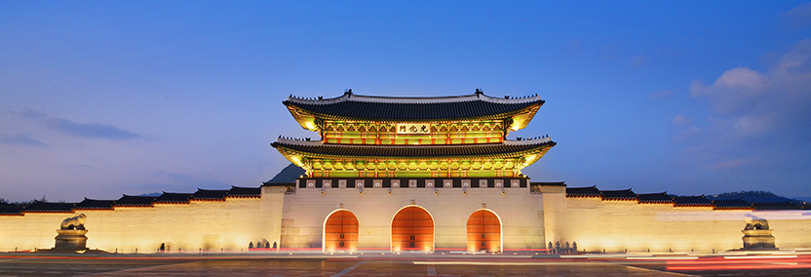
Dialogue
Nahyun- Okay, let's think about where to meet
: 좋아 어디서 만날지 생각해보자
(joha eo-die-seo man-nal-ji saeng-gak-hae-bo-ja)
Haeryeon - I want to go to Gyeongbokgung Palace
:나는 경복궁을 가고싶어
(na-neun gyeongbokgung-eul ga-go-sip-eo)

Slide 18
Dialogue
Nahyun- What should I take to Gyeongbokgung Palace?
: 경복궁까지 뭐 타고 가는게 좋을까?
(gyeongbokgung-kka-ji mwo-tago ka-neun-ge joh-eul-kka?)
Haeryeon – I think the bus and subway will be convenient
:버스랑 지하철이 편할 것 같아
(bus-rang jihacheor-i pyeon-hal-geot-gata)

Slide 19
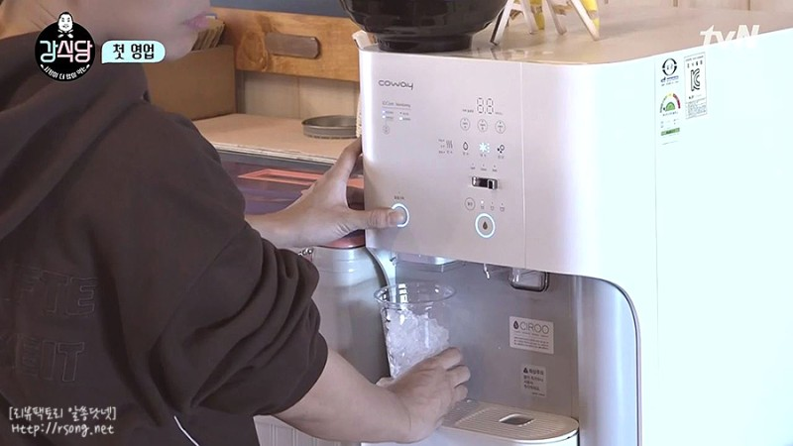
Korean culture-Restaurant
1. You don’t have to order the water (water is for free, also not tap water)
2. When you order, you can call the waiter (you don’t have to wait until they come to your table)
Even, the restaurant has a bell for each tables to call waiters
3. Side dishes can be refilled free of charge in most places
4. You have to go to the counter yourself to pay after eating
(The waiter won’t come to your seat)
5. They don't clean up the plates until customers finish eating and leave
6. You don’t have to pay the tip for the waiter

Slide 20
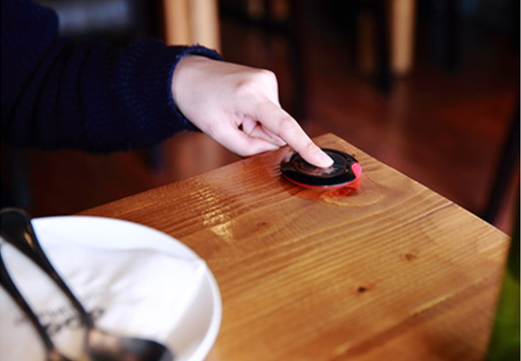
Korean culture-Restaurant
1. You don’t have to order the water (water is for free, also not tap water)
2. When you order, you can call the waiter (you don’t have to wait until they come to your table)
Even, the restaurant has a bell for each tables to call waiters
3. Side dishes can be refilled free of charge in most places
4. You have to go to the counter yourself to pay after eating
(The waiter won’t come to your seat)
5. They don't clean up the plates until customers finish eating and leave
6. You don’t have to pay the tip for the waiter

Slide 21
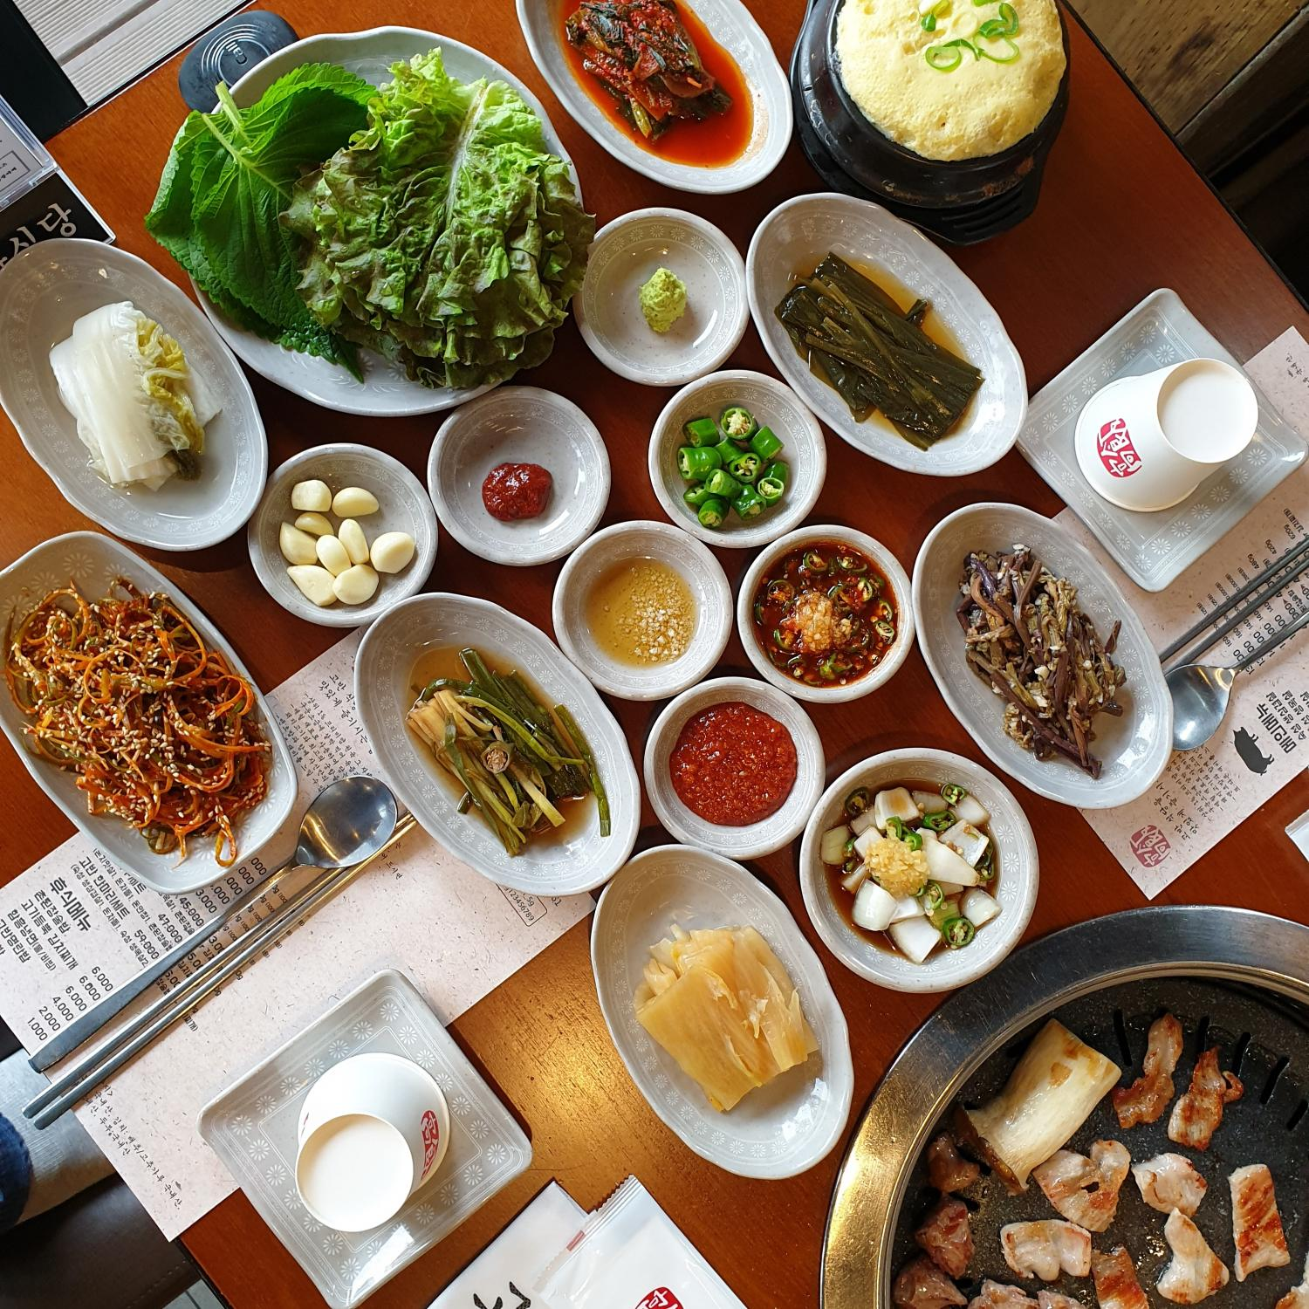
Korean culture-Restaurant
1. You don’t have to order the water (water is for free, also not tap water)
2. When you order, you can call the waiter (you don’t have to wait until they come to your table)
Even, the restaurant has a bell for each tables to call waiters
3. Side dishes can be refilled free of charge in most places
4. You have to go to the counter yourself to pay after eating
(The waiter won’t come to your seat)
5. They don't clean up the plates until customers finish eating and leave
6. You don’t have to pay the tip for the waiter

Slide 22
Thank you

