Slide 1
Korean class
WEEK 6

Slide 2
Postposition Particles – subject making
이[i] / 가[ga]
The role of subject marking particles is relatively simple compared to that of role of topic marking particles.
Words ending with a consonant + -이
Words ending with a vowel + -가

Slide 3
Example
가방 [ga-bang] + 이 [i]
=bag
학교 [hak-gyo] + 가 [ga]
=school
아버지[a-beo –ji] + 가 [ga]
= I
선물이 왔다. [ seon-mul-i-what-da] = A gift is came
=gift

Slide 4
Spacing is Important !!!!! (띄어쓰기)
The meaning of sentences with the same words and postpositions(조사 = 은/는/이/가 etc.) in the same order depends on how you space them.
아버지가 방에 들어가셨다. (abeojiga bang-e deul-eogasyeossda)
= Father went in the room
아버지가방에들어가셨다. (abeojigabang-edeul-eogasyeossda)
= Father went in the bag

Slide 5
Spacing is Important !!!!! (띄어쓰기)
친구가 자꾸만 져요. (Chinguga jakkuman jyeoyo.)
= My friend keeps losing.
친구가 자꾸 만져요. (Chinguga jakku manjyeoyo.)
= My friend keeps touching me.

Slide 6
Spacing is Important !!!!! (띄어쓰기)
나물좀 줘.
= Give some vegetables.
나 물 좀 줘.
= Give me some water.

Slide 7
Postpositional particles – object making
을[eul] / 를[leul]
Words ending with a consonant + -을
Words ending with a vowel + -를

Slide 8
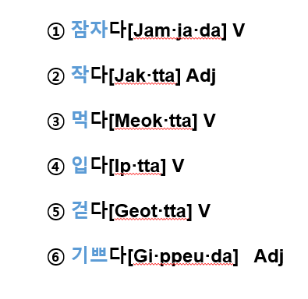
Stems of verbs and adjectives
The stems of verbs and adjectives do not stand alone, and they are always conjugated by various or inflectional endings.
Stem of verbs and adjectives
(descriptive verbs)
+ -다
anything being left out after you take ‘-다’ out from the verbs and adjectives is the stem

Slide 9
Review
Past expression
1. Verb stems ending with vowels ᅩ [o] or ᅡ [a] + 았어요 [ass-eo-yo]
2. Verb stems ending with vowels OTHER THAN ᅩ or ᅡ + 었어요 [eoss-eo-yo]
3. Verb stem 하 + 였어요 [yeoss-eo-yo]

Slide 10
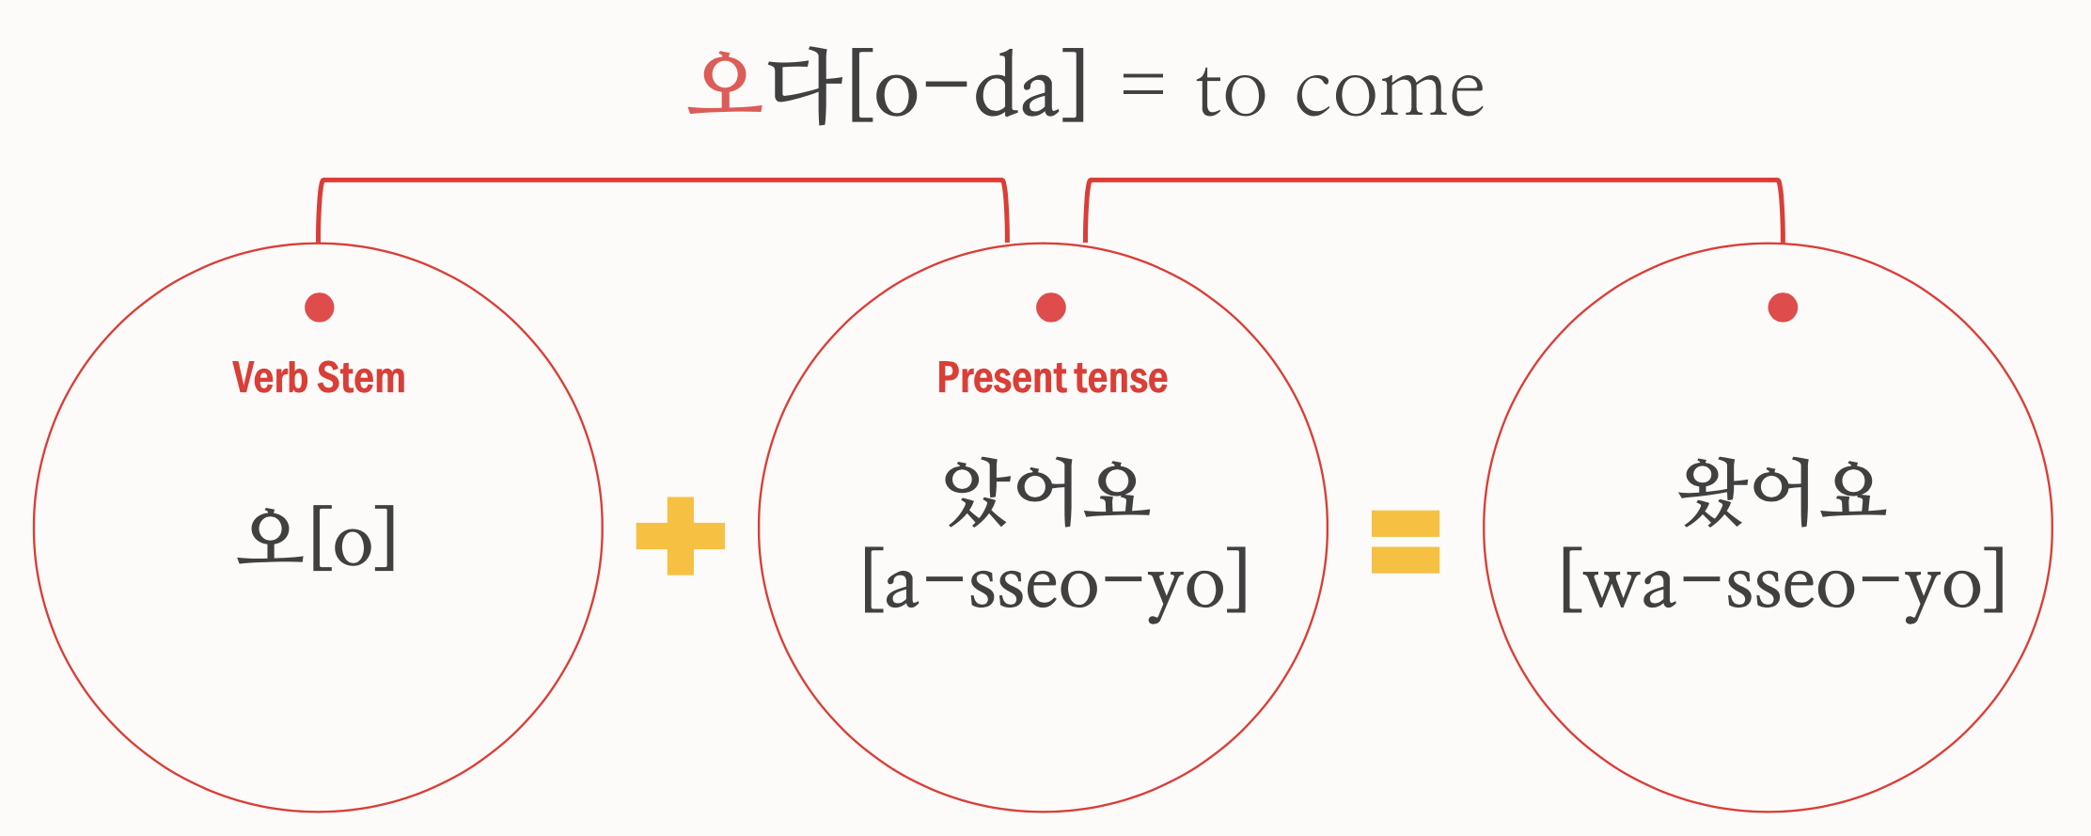
Review
Past expression

Slide 11
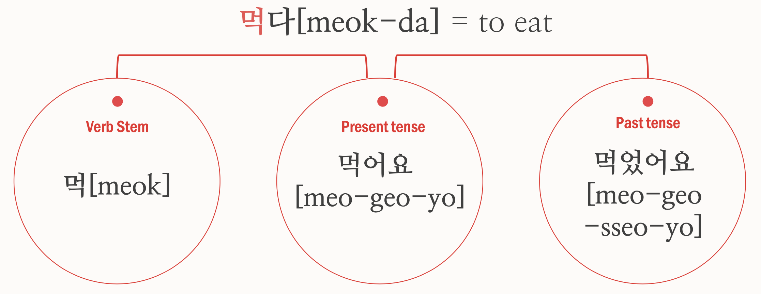
Review
Past expression

Slide 12
1. Past tense marker 었, 았
Subtle differences

Slide 13
Review
Future expression
If you want to make a future expression,
add –ㄹ/을 거야,거다 to verb’s ending
–ㄹ/을 거예요 (polite)

Slide 14
Review
Future expression

Slide 15
Review
Negative expression – ‘안’
There are mainly two ways to make negative sentence
1. Adding 안 [an] before a verb
2. Using the negative verb ending, 지 않다 [ ji an-ta]

Slide 16
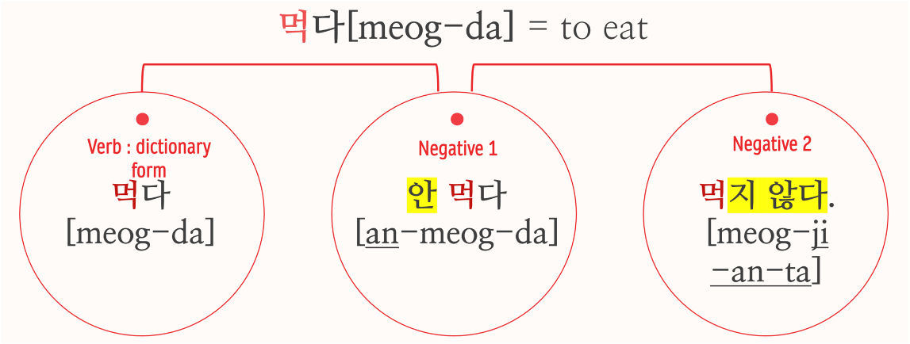
Review
Negative expression

Slide 17
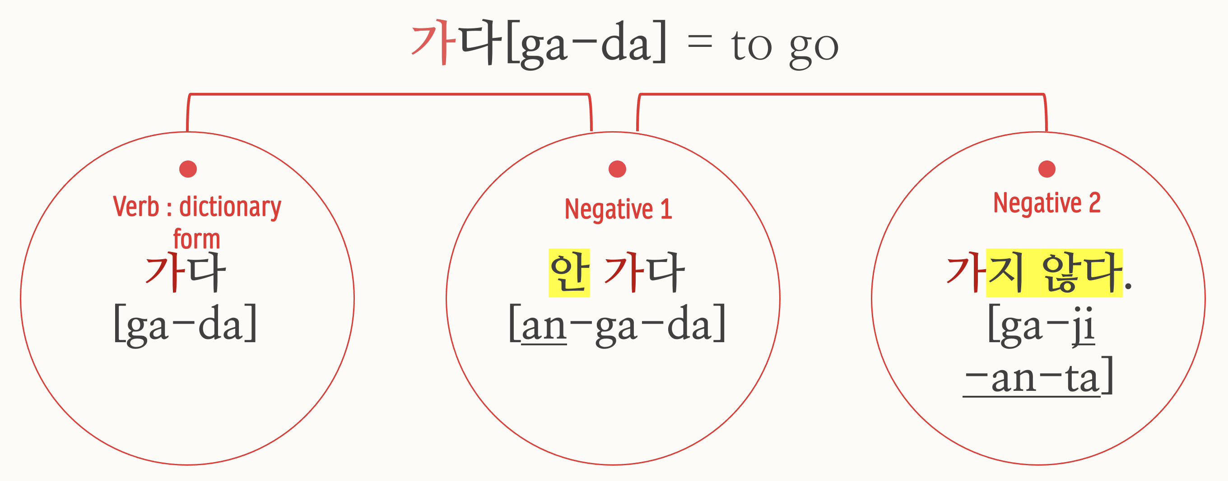
Review
Negative expression

Slide 18
Negative expression
Using ‘안’ [an]
Using ‘못’ [mot]
It is used
1. Indicate that a certain action
does not occur
A certain state does not
3. Simply denies an objective fact
by the will of the subject to perform the action
It is used
Indicate that the ability for the subject's will is insufficient
Or it cannot happen due to other circumstances
Notes:
In Korean, you can make negative sentences using 못 and 안
The two are used in different situations
안 used
2. Indicate that a certain action does not occur
2. A certain state does not
3. Simply denies an objective fact by the will of the subject to perform the action
In conclusion, what the subject who performs the action does not do by will is to use ‘안’
못 used
Indicate that the ability for the subject's will is insufficient
Or it cannot happen due to other circumstances
It is used it for situations you can't do

Slide 19
Negative expression
Using ‘안’ [an]
Using ‘못’ [mot]
I didn’t meet him
나는 그를 안 만났다.
[naneun geuleul an man-natda]
I didn’t eat it
나는 그것을 안먹었다.
[naneun geugeos-eul an neog-eot da]
I couldn’t meet him
나는 그를 못 만났다.
[naneun geu-leul mot man-natda]
I couldn’t eat it.
나는 그것을 못 먹었다.
[naneun geugeos-eul mot meog-eot da]
Notes:
“안 만나다＂ means not meeting by my will ＂못 만나다＂ is not because of my will, but because of other situations

Slide 20
Negative expression – ‘못’
There are mainly two ways to make “못” [mot] negative sentence
1. Adding 못 [mot] before a verb
2. Using the negative verb ending, -지 못하다 [ ji mot-hada]
Notes:
Like the negative expression ‘안’ sentence that we saw in the review, There are two ways of using the word "mot" in negative sentences

Slide 21
Negative expression – ‘못’

Slide 22
Negative expression – ‘못’

Slide 23
Negative expression – ‘못’
Since the negative 못 refers to one’s ability or volition,
it cannot be used with the adjectives which describe states or quantity
못 높아요 high (x)
못 좁아요 narrow (x)
못 많아요 a lot (x)
못 적어요 a few (x)

Slide 24
Negative expression
Notes:
I made a simple example. Let's solve it together

Slide 25
Korean culture-Dating culture
If a stranger approaches you suddenly, they will be wary
It’s quite rude to date someone else when you’re meeting one person and also not good to go club when you are in a relationship
Because they prefer clear relations, they need clear words when starting a relationship
From the day they started dating, they start counting, and 100unit days are important days for couples. ( But couples who date for a long time sometimes skip them)
If they eat meal together, after it’s essential to go to a cafe or to a wine bar or pub
Couple items such as couple rings are worn a lot even if they are not serious relationship like getting marriage

Slide 26
Thank you

