Slide 1
CEFR: obávaný, neznámý, inspirativní

Slide 2
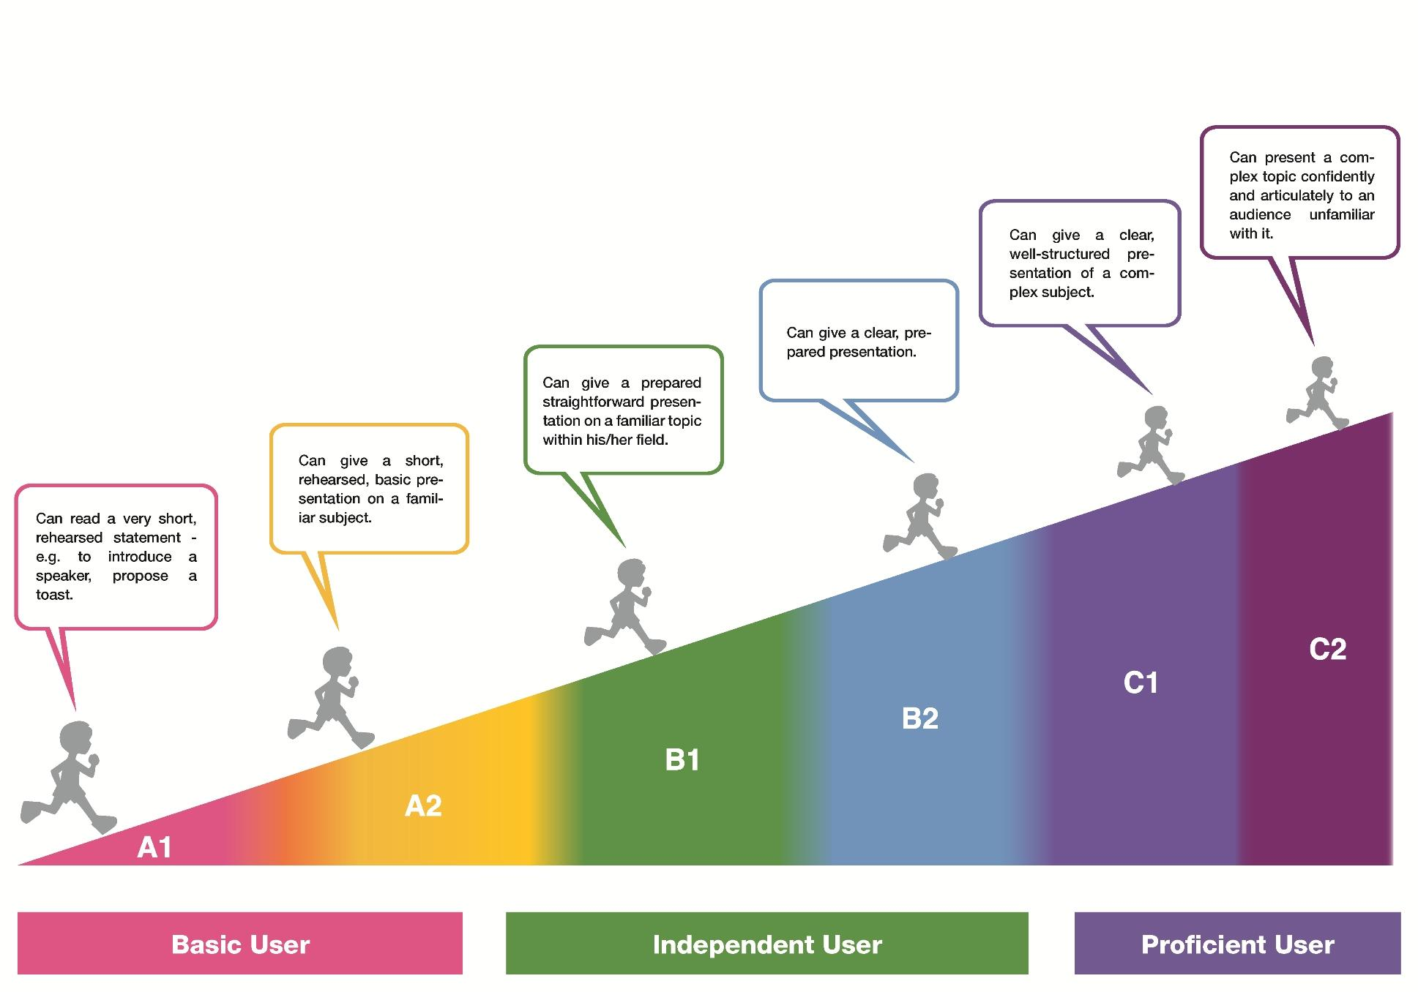
Co Vás napadne, když se řekne CEFR?

Slide 4
Co je CEFR? Nebo není?

Slide 5
Co znamenají tato čísla?
6
2001
2020

Slide 6
Co znamenají tato čísla?
6 úrovní
2001 starší verze
2020 nová verze, nové koncepty (mediace, plurilingvismus, online komunikace)

Slide 7
K čemu je CEFR?
The CEFR provides a common basis for the elaboration of language syllabuses, curriculum guidelines, examinations, textbooks, etc. across Europe.

Slide 8
Význam CEFRu
It describes in a comprehensive way what language learners have to learn to do in order to use a language for communication and what knowledge and skills they have to develop so as to be able to act effectively. The description also covers the cultural context in which language is set. The Framework also defines levels of proficiency which allow learners' progress to be measured at each stage of learning and on a life-long basis.

Slide 9
CEFR je třeba přizpůsobit konkrétnímu kontextu
One thing should be made clear: the CEFR does not set out to tell practitioners what to do, or how to do it. It raises questions but doesn’t provide ready-made anwers.

Slide 10
„Zubatý profil“

Slide 11
Profil fiktivního uživatele

Slide 12
6 úrovní, „meziúrovně“

Slide 13
Komunikační situace a všeobecné kompetence
In any communicative situation, general competences (for example, knowledge of the world, sociocultural competence, intercultural competence, professional experience if any) are always combined with communicative language competences (linguistic, sociolinguistic and pragmatic competences) and strategies (some general, some communicative language strategies) in order to complete a task.

Slide 15
Historie CEFRu
The first specification of this “threshold level” was formulated for the English language (Threshold level, 1975), quickly followed by French (Un Niveau Seuil, 1976).
other levels were developed for a number of languages. These proficiency levels constitute one of the origins of the six-level scale of the CEFR.
1990’s: A descriptive scheme and scaled descriptions of L2 proficiency
2000s: The CEFR is adopted in Europe and beyond
2020: The CEFR renewed: The CEFR Companion volume

Slide 16
Klíčové koncepty

Slide 17
Důraz na akci, mediace, plurilingvismus
https://www.coe.int/en/web/common-european-framework-reference-languages/home

Slide 18
Aktivita Plurilingvismus: Jaké jazyky figurují ve Vašem životě? Kam byste je situovali a jaké by měly barvy?

Slide 19
Aktivita Plurilingvismus

Slide 20
CEFR a plurilingvismus

Slide 21
CEFR a online komunikace

Slide 22
Fonologická kompetence

Slide 23
Děkuji Vám za pozornost

