Slide 1
Vlastníci (The Owners, 2019)
Directed by Jiří Havelka

Slide 2
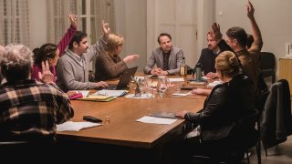
Brief synopsis and character introduction
Taking place almost entirely in one room, the film is about a meeting of apartment owners who are discussing the need for repairs.
Zahradkas (young family)
Mr Kubat (socialist engineer)
Roubickova (lawyer)
Mr Nitransky (a Slovak)
Horvathova, and Prochazkova, (two middle aged/elderly women),
Mr Svec (somewhat of an ‘idiot’)
Cermak brothers (white collar businessmen)

Slide 3
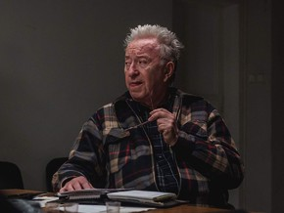
Mr Kubat
He is an elderly engineer who lived through communist Czechoslovakia
Idealist about pre-1989 Czech Republic
“Back then they were made from steel, not plastic like today”
Gas pipes serve as a metaphor; the steel pipes represent Kubat’s memory of strong and stable authoritarian government of communist days, and plastic pipes represent flimsiness and artificiality of today’s government.

Slide 4
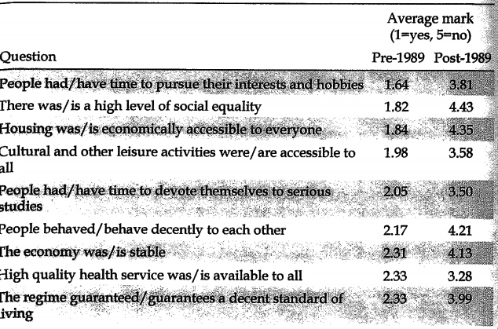
Mr Kubat
A 2010 survey of Britske Listy asking people to compare the pre-1989 era with the post-1989 era.
Over 60s make up 55% of the respondent base despite over 65s only making up 15% of the total Czech population
‘What’s this verifier? When I did it people just believed each other.’
Despite preaching the importance of believing people and treating others with respect, Kubat proves to be the opposite of this
Havelka is communicating his opinion on this elderly generation as hypocritical and obstructive
Culik, J. (2011) Current Czech opinion of the pre-1989 and post-1989 regimes: remarkable levels of dissatisfaction. In: Hayoz, N., Jesien, L. and Koleva, D. (eds.) Twenty Years after the Breakdown of Communism in CEE: Promises, Meanings and Implications of 1989. Peter Lang: Bern, Switzerland, pp. 461-494

Slide 5
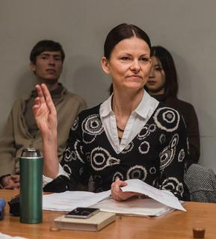
Mrs Roubickova
Incessantly obstructive with her constant gatekeeping of the laws of the apartment block and of the meeting itself.
She demands a vote for a scrutineer which initiates an endless loop of voting
Havelka effectively portrays the excess and impracticality of such obssessive bureaucracy

Slide 6
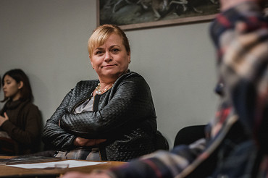
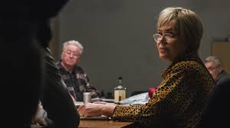
Mrs Horvathova and mrs prochazkova
Mrs Prochazkova, Mrs Horvathova, and Mr Kubat are particularly vulgar and racist
Mrs Horvathova repeatedly refers to the young Japanese woman as Chinese despite her, on numerous occasions, stating that she is from Japan.
Ghanaians in Mrs Prochazkova’s flat are ‘spreading “embola” through their sperm’
In 2016 the total number of reported hate crimes was 43 while in 2019 it had reached 90, an exponential rise that the commission has noted as ‘alarming’. European Commission Against Racism and Intolerance, ECRI REPORT ON THE CZECH REPUBLIC (sixth monitoring cycle) (2020) p.13
Mrs Prochazkova
Mrs Horvathova

Slide 7
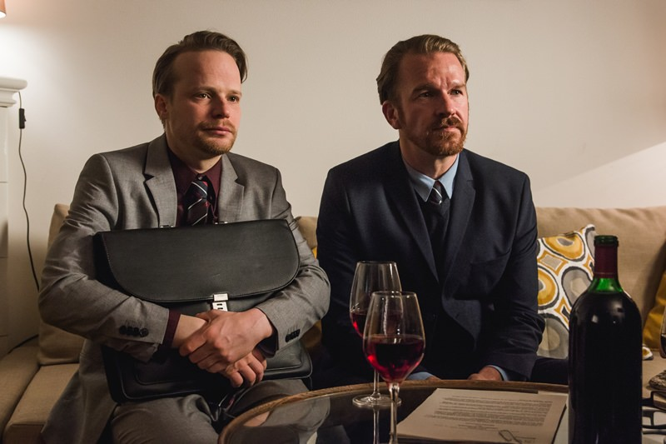
The Cermak brothers
Throughout the film the brothers are, on the surface, very well-mannered and are not emotionally influenced by the proceedings, projecting a friendly, yet formal image of themselves.
Vow to run the association ‘like a firm’.
The involvement of very wealthy oligarchs in the public sphere has led the country to become run ‘like a firm’, in the words of oligarch and prime minister, Andrej Babis.

Slide 8
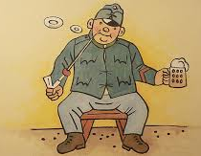
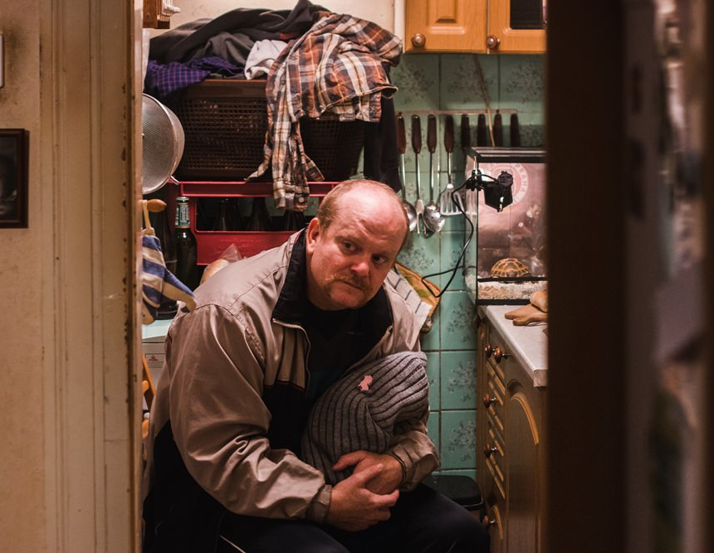
Mr Svec
His Mother told him to always vote ‘for’ no matter what.
On the surface he appears to be an idiot
In many ways he is similar to Good Soldier Svejk; he avoids the grinding reality of the meeting by perhaps pretending to be an idiot

Slide 9
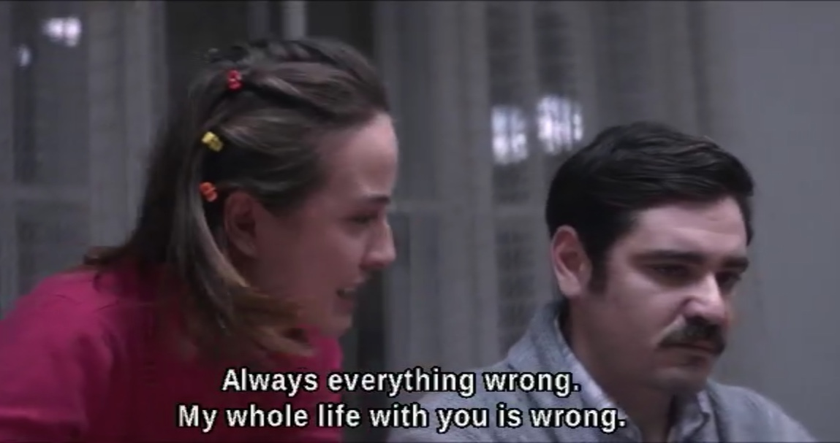
Zahradkas
Beacon of sanity and rationality
They represent the views of Jiri Havelka
Any sane, rational person would react the way they do

Slide 10
Conclusion

