Slide 1
Focus Groups
CMAa11 Qualitative Research

Slide 2
What are we going to talk about today?
The origin of focus groups
The principle and purpose of focus groups as a research method
How to conduct focus groups
Focus group guide
Focus group moderation
The role of the assistant

Slide 3
Question for the beginning
What do you know or how do you imagine a focus group?

Slide 5
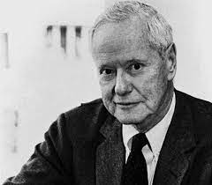
What is the origin of focus groups?
Sociology (40s-50s)
Something extra:
Robert K. Merton (1910 – 2003) and Paul Lazarsfeld
WWII: research on the effects of US war mobilization propaganda (to increase willingness to mobilize and fight, to make fighting meaningful)
The Bureau of Applied Social Research, Columbia University
Original research: confrontation with the material and dichotomous indication of emotions ("like" "dislike" button) -> analytical speculation about the reasons
Introduction of the focused interviews method
Discussion of the reasons for positive and negative emotions
Form: more of an individual or a serial interview
Goal: confirm or modify experimental hypotheses
Interpretation of the meaning of US propaganda materials: https://www.archives.gov/exhibits/powers-of-persuasion

Slide 6
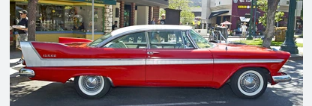
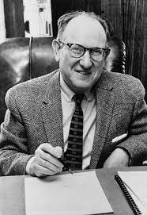
Further developments
Marketing (50s-80s)
Some findings:
Ernest Dichter (1907 – 1991)
American Freudian psychologist and analyst, Austrian immigrant
reactions to the inadequacy of consumer surveys and sales metrics
Marketing: a tool for externally creating needs so that they are experienced as internal
Commodity fetishism and consumer hedonism as instruments of defence of society against totalitarianism (fascism and communism).
New concept of FG (application of therapeutic procedures and techniques):
room with one-way mirror
gather the target group
reveal desires and predispositions
build a brand identity (and create a need and sense of empowerment)
Compton Agency (soap sales): bathing is also a symbolic and mental cleansing, it is not the instrumental reason for use that is important, but the meaning in life -> "Start again with ...„
Chrysler Corporation (Plymouth sales): advertise in women's magazines + keep low-selling types of goods
Reason for the use and success of the lighter: symbolic reasons (need to control the fire)
Cake ready mix: necessary to add something yourself
Mattel (Barbie): a doll is not just for play, it is also about aspirational identification

Slide 7
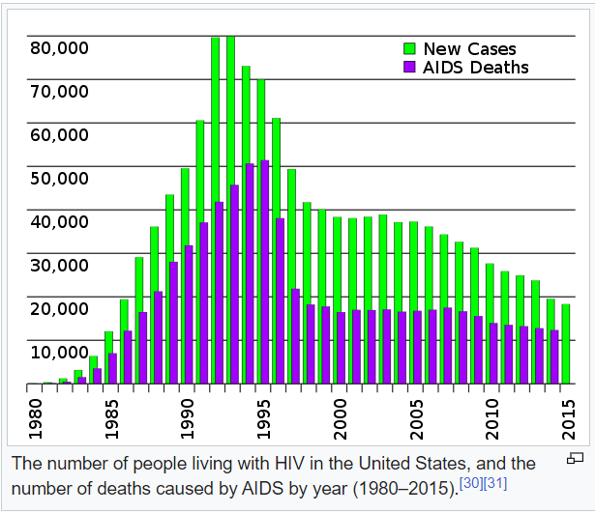
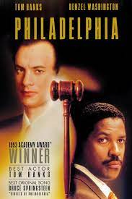
Further developments
Medical/nursing studies (80s)
FGs are beginning to return to academia, now without the emphasis on hypothesis testing
Topics related to sexuality and sexually transmitted diseases (STDs) at the beginning
efforts to understand the spread (risk factors and populations)
disease progression and impact
stigma mechanisms
Later and now:
interest in experiencing all kinds of diseases and disabilities
setting and availability of therapeutic procedures and services
public image of diseases and attitudes towards health -> planning of health campaigns and their effectiveness

Slide 8
Further developments
Other areas
Political Science/Politics:
Reagan administration - attitudes toward the US-USSR relationship
Labour Party: attitudes of the British towards tuition fees
Applied areas:
Urban planning
Evaluation of services and policies (government, commercial and non-government institutions)
Management (organisational culture, process setting) professional/expert groups (identification of systemic barriers in medicine, law, education, etc.)

Slide 9
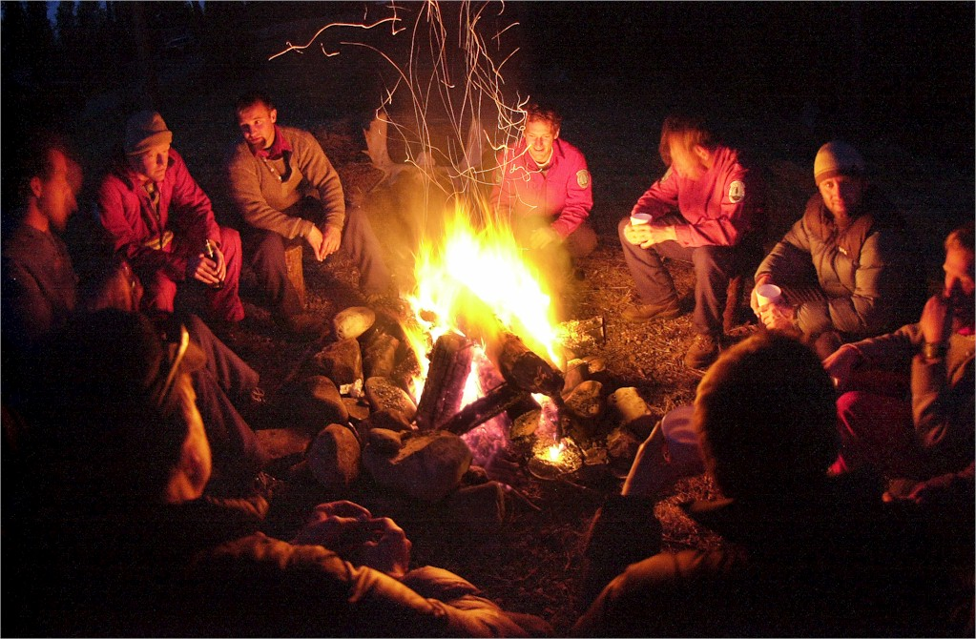
The nature of FG as a research technique
Takes advantage of the group's presence…
...discussing views, opinions and attitudes, values and meaning…
...towards a certain phenomenon/event - they concentrate on its meaning, which is the common focus of interest.

Slide 10
What is the principle of their operation?
The main advantage and principle of the technique is the effect of social moderation = mutual influence of actors based on interaction, through which it also manifests itself.
It always exists, but in individual interviews it is only indirect and difficult to detect.
People make sense of the world not in a vacuum but in interaction (Weber, Schütz, Goffman, Garfinkel).

Slide 11
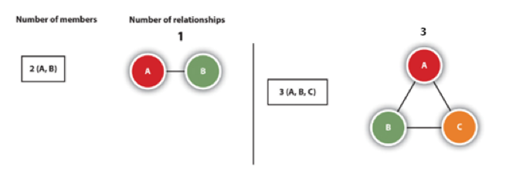
What is the principle of their operation?
Georg Simmell (1858-1918)
society can only be studied through social interactions
study of forms of social interaction social interaction can also take place at the dyadic level, but it will always lead to consensus or polarization
but only the triad brings real social cooperation (cliques, relations of dominance and subordination, collective identity and consciousness can emerge)

Slide 12
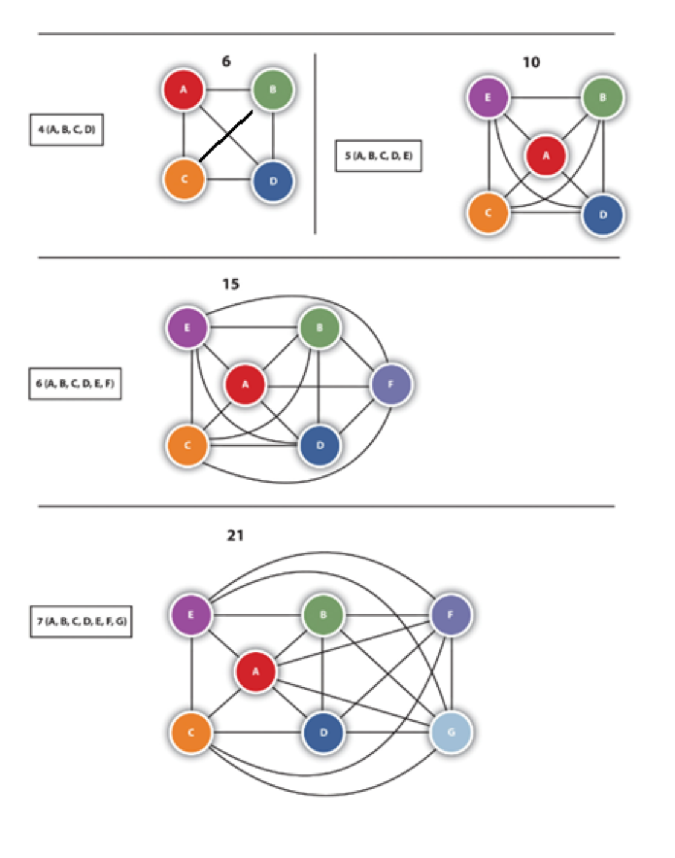
What is the principle of their operation?
More actors -> more interactions and iterations:
a wider variety of views and opinions
saves time and resources reduces the risk of forgetting
Fern (1982): 1 FG can generate up to 70% of the data as a series of interviews.

Slide 13
FG output?
social moderation => collective narrative (result of interactions -> collective meaning)
Personal (who)
Influence of individual characteristics
Personal sense
Frequency as a guide!!!! majority attitudes, not an explanatory characteristic (not a statistically representative sample)
Collective (what => shared meaning)
Group identities, shared language, memory, meaning
Boundaries, dimensions, layers of the phenomenon
Taboo
Group rules and norms
Procedural (how)
Consensus building, conflict emergence and their dynamics
Methods of prioritization
Ways of reaching the goal (consensus x compromise)
Decision-making methods (authoritative, non-hierarchical)
Transforming personal sense into shared meaning

Slide 14
FG output?
The quality, richness and depth of the collective narrative depends on the ratio of:
Positive dynamics:
FG can usually strengthen the feeling of openness, group safety ("I'm not alone in this")
reduce the distance between participants and the moderator
cultivate interactions
Negative dynamics:
bystander effect (diffusion of responsibility): risk of passivity "there are enough of them, let them talk“
"bandwagon effect/groupthink“: the effect of sticking to a position, an opinion, a stance that is perceived as "strong" regardless of one's own real perspective
spiral of silence: monitoring the environment - assessing acceptability (fear of confrontation or non-acceptance) -> presenting attitudes
polarization and amplification of extremes (attempt to distinguish oneself, to perform dominance)

Slide 15
How to do focus groups?
Preparation
Definition of the research problem and research question
Group discussion scenario/guide
Recruitment of participants
Realization
Moderation, assistance
Data recording
Data processing
Data analysis
Writing output (research report, academic text)

Slide 16
Focus group guide
What is it and what is it good for?
A pre-prepared list of topics and questions that the moderator uses to guide the group discussion
Function:
Defines the researched field/topic Identifies the main areas of interest in this field/topic
Helps maintain encounter structure (introduction, core, conclusion) and expectations
Some (very experienced) researchers don't use it at all.

Slide 17
Focus group guide
The Structure
Hourglass:
It follows the logic of the discussion
Avoids unwanted skipping and repetitiveness
Builds rapport (relationship of trust, reciprocity and commitment)
Enhances logic
Reduces fatigue
Also used in other data collection methods (interviews, questionnaire)
Introduction/Greetings
Opening questions Introductory questions (warm-up) Key topics (core)
Final questions Free addition, debreefing, feedback

Slide 18
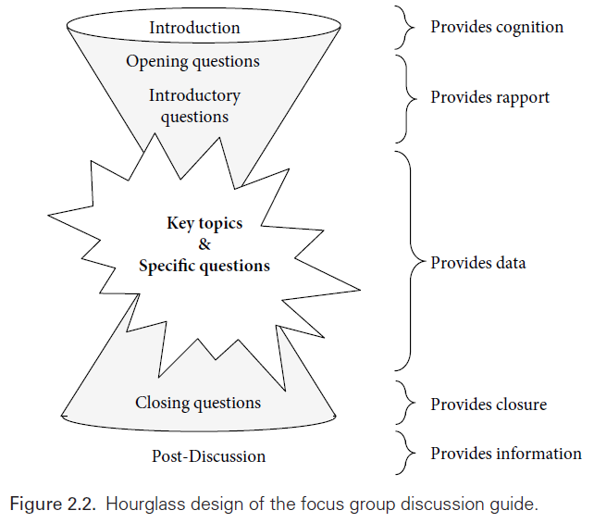
Focus group guide structure
Introduction/Welcome
Goal:
To put the participants in a situation
Address initial needs (where am I, how will it work, should I be afraid?)
Form:
Text x bullets
Relaxed friendly expression
Varying degrees of formality (beware of being too formal)
Content:
Welcome and "props": greetings, explicitly name the meeting (without a detailed description yet), thanks for attending, introduction of the researcher (who I am, for whom I work, possibly experience with research), introduction of the note-taker (+brief description of his/her role)
Treatment of initial needs: more detailed description of the nature of the meeting (topic in multiple sentences), topic segments of debate, length of meeting, sponsor/funding/independence, format = debate = importance of everyone's voice, collect a range of attitudes and perspectives, respond to each other
Rules and ethics, "calming down": define the rules (politeness, respect, conflict yes, but politely, agreement and disagreement ok, not jumping into each other's mouths, confidentiality), explain the logic of data collection and the need to record, explain what will happen with the recording and the data, what the output will look like, ask for 'enthusiastic' consent, strong emphasis on anonymity and confidentiality and link to need for openness, no right or wrong answers, not testing, option not to answer (off-record), 'feel at home' (refreshments)
Formalities: info consent ( if not signed in advance), socdem questionnaire (if not provided in advance or collected at the end), name cards (nicknames), silence phones
Pre-start questions

Slide 19
Focus group guide structure
Introduction of the moderator/note-taker
Sponsor
Topic and reason for the meeting
Introduction/Welcome Example (text)
Independence
The importance of the voice of the participant(s)
Openness/honesty
Functions of the note taker
Recording
Confidentiality
Consent
Rules
Agreement/conflict
Respect
Duration
Refreshments
Questions

Slide 20
Focus group guide structure
Opening Questions
Beginning of the discussion
Often one question:
Inclusive: so that everyone can/should respond very short and simple
reduces fear of difficulty breaking the silence (important for further speaking) has no informative value
does not encourage debate (just a "round")
Usually:
introduction + something about yourself (what you saw last time on a streaming platform, studio type/discipline, how you are, what the road was like)
beware of possible pitfalls (breaking anonymity, polarization/conflict)

Slide 21
Focus group guide structure
Opening Questions
The question can be replaced by a simple activity with an assignment (next class)
Limits:
starting activity does not lead to "talking" (this occurs only at the first "real question„)
may take time

Slide 22
Focus group guide structure
Opening Questions

Slide 23
Focus group guide structure
Introductory questions (warm-up)
Typically a series of questions and probes:
approx. 3 to 5 questions connection to the topic ("warm" the debate)
but the generality and lower difficulty
approx. for 15 minutes (initial "operating temperature" time) Alternative: introducing the definition of the main topic (based on "public knowledge„):
"We hear about... What do you think of this term?" "We often see ... what for you ... means?" "... When and where do you encounter this term?"

Slide 24
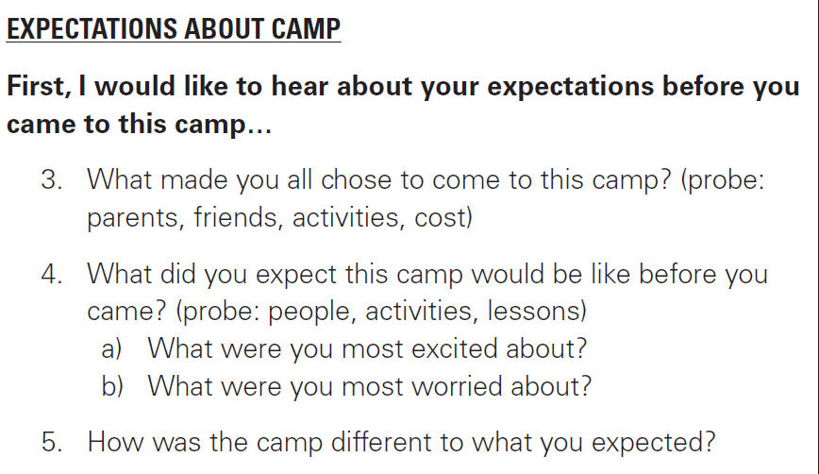
Focus group guide structure
Introductory questions (warm-up)

Slide 25
Focus group guide structure
Key topics (core)
The most important part of the discussion Half to two-thirds of the time
A series of questions with a direct link to research objectives Mono/multi-thematic (as needed)
Location: approx. third to half of the quide (optimum "operating temperature") carefully prepared probes (it is necessary to "touch" the phenomenon in detail)
Highly detailed analysis

Slide 26
Focus group guide structure
Key topics (core)

Slide 27
Focus group guide structure
Closing questions
A series of more general, easier questions/tasks:
They indicate the last part of the discussion They relax participants and help to concentrate "before the finish"
Allow summarization (for both sides) Don't rush
Possibilities:
ranking: topics, arguments, meanings according to some logic (e.g., importance, frequency, positivity,...) summary: the moderator summarizes the key findings in a few theses/points and let them be briefly "validated" or expanded
role play: participants play the role of advisor/director/leader/politician/expert/celebrity and formulate a message of "what should be done"/"what they themselves would do"

Slide 28
Focus group guide structure
Closing questions

Slide 29
Focus group guide structure
Free addition, debreefing, feedback
Filling in "blind spots"
the equivalent of "diagnosis with your hand on the doorknob" in medicine
indication of omission of significant aspects or possibilities of changing the way of questioning (e.g. we did not beat sensitivity) do not underestimate time
Invitation to reflect on progress and impressions, control of harm
Opportunity to further (re-)explain the purpose and process
Thank you, farewell, invitation to take refreshments away

Slide 30
Focus group guide structure
Free addition, debreefing, feedback

Slide 31
Focus group guide structure
Probes
Complementary questions
Maintain the moderator's focus (memory tool)
When it's not enough, they point to new perspectives
They are generated from available knowledge and research invention There's no need to overload the debate:
usually the main questions and questions provoking a range of answers
Optional (but recommended) Not an exhaustive "list of possibilities"

Slide 32
Key roles in FG
Moderator
Notetaker/Assistant
Ensures the progress
Welcome phase
Instruction
Formalities Focus the discussion
Closing, farewell
Maintains integrity
Rapport
Controls the dynamics
Atmosphere Tempers too assertive
Encourages the silent
Separate data source, rescue in case of recording impossibility or failure
Ensures notetaking
Topics of discussion Parts of important speeches
Turns and changes in discussion Mutual reactions
Nonverbal communication Body, face, nodding... Intensity of dis/agreement
Disruptive factors
Notation without interpretation Ensures recording
Ensures the device and its functionality Turns recording on and off
Helps with activities (distributes papers, materials, if not done by a moderator) Sitting aside

Slide 33
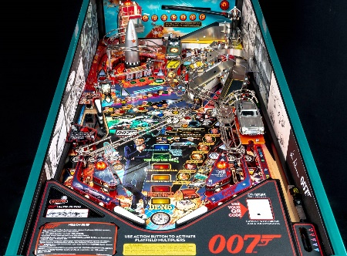
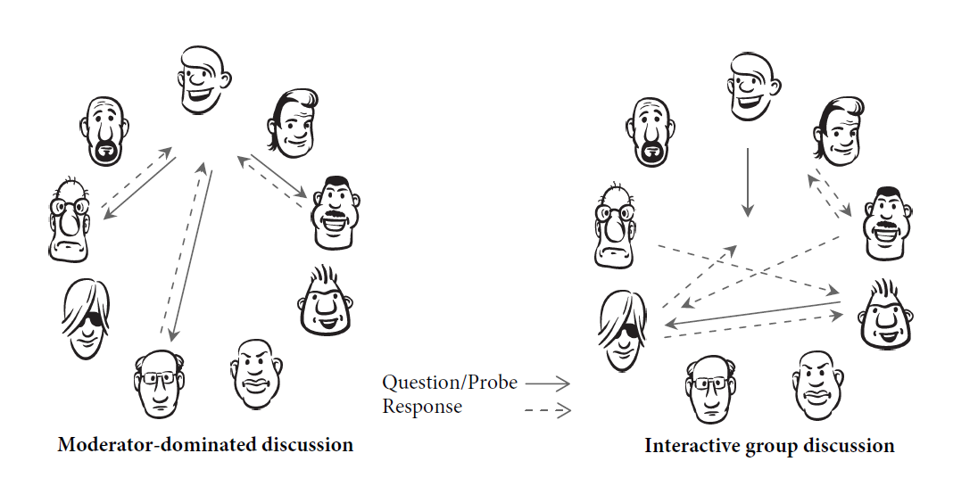
Moderation
Uses group dynamics but does not lead the group (it is not a questionnaire)
Keeps within the bounds of topic and functional atmosphere
But not every deviation is a problem (it's a matter of degree)
Conflict is not in principle a bad thing.
Ideal: only mild asking about reason and meaning and indicating transitions between parts, participants interact fluently on their own and lead to explanations
Moderation changes during FG:
Initially more active, then more passive.
Active moderation
More directive Constant comparison of what has been said, how, why and how it relates to research goals Relation of the "now" situation to the whole of the investigation
Based on the targeted directing of the discussion
Passive moderation
"Invisibility" of the moderator Concentration within the situation "now" Listening quietly, appreciating and maintaining debate

Slide 34
Group dynamics
Based on the mix of participant characteristics and the moderation style
Silent participant
Dominant participant
Barriers to expressing oneself
Expression rare, silent Risk of oversights
Risk of "fading out" (the longer the silence, the longer the silence)
Techniques:
Eye contact: direct, slightly longer, not too long The appeal: firstly, in general terms, "so we have several views here, do the others have the same, or do you differ in something?";
moderately directed "we have several views here, if anyone would like to add theirs ones, we appreciate everyone's views...";
Highly addressed "Peter/Martina, how about you, I'd be very happy if you share your view too, if you don't mind..."
Encouragement can bring relief to the participant, as well as more stress
More silent participants/ic may indicate a problem in recruitment or topic (or just a taboo that needs to be better grasped)
Without scruples, trying to dominate, to be first, to have the strongest voice
Expressing everything, a lot and as loudly as possible, possible aggression
Risk of collapse of the collective narrative and negative social moderation (silencing, reluctance to express oneself)
The need to respect but at the same time moderate
Techniques:
Eye contact: at the end of the speech, the moderator moves on to the other participants and stays with them, lowering his/her eyes to the remarks
Body: turned to the side, head towards others
Verbal: Slight "Thank you for your insight, what do others think?"; Middle: "Thank you, I see you have much to say about XY and I would be happy if you would continue to participate, however it would be very nice if we could give space to others.„
Expressive: " Mary/Peter, can we please agree that you will think more about others and give them space as well?„
Good to combine with repeating the rules of group debate, and agreeing to them at the beginning.
In the last instance, interrupting and asking for a moment between the four eyes on the side: clarifying the rules and offering or asking to leave
Maintain professional performance
More dominant participants/ic may indicate polarity in the topic. Calm the argument by emphasizing the rules and possibly using or diverting to another topic.

Slide 35
Group dynamics
"Wandering" participant
Trying to be a good participant, communicatively solved nervousness, talkativeness
A long, off-topic statements with no clear direction or conclusion
Risk of loss of collective narrative (fatigue) and noise (uncertainty of the direction and content of the discussion)
Techniques (according to the type of " wandering"):
Long/repetitive speeches
Eye contact: at the end of the talk, the moderator moves on to the next participants and stays with them, lowering his/her eyes to the notes
Body: rotated sideways, forehead to others
Verbal: Slight "Thank you for your insight, what do others think?";
Middle: "That was very detailed. Thank you, I can see that you have a lot to say about XY and I would be happy for you to continue to be involved, however it would be very nice if we tried to give space to others."
Expressive: " Mary/Peter, thank you for your detailed insight. Can we agree on more space for the others?"
Interrupting, jumping in to talk, thanking and politely reiterating the need to give space to others.
Confused speeches
To try to summarize one main thesis for others, to have it validated by "Thanks, I understand that correctly, right...?" Alternatively, to avoid a new iteration, "Thanks, Peter/Mary thinks that..., so what about the others?
Maintain a professional approach

Slide 36
Group dynamics
"Group thinking"
Sensitivity, taboo, group silence
Sticking to one point of view
Suspiciously intense and fast consensus
According to some, a natural part of social dynamics; according to others, necessary to address:
Use a lighter version of some activation: often pre-write/mark/grade for yourself and then read
One question asked several times differently
Sensitivity/taboo
Depersonalization techniques
"Hypothetical" situations (personal) "What if" (general)
"Have you ever met?"
Personal disclamer
It has to be engaging enough, but not too discrediting
Group silence
Activation Reformulation of the question
Reduction of abstractness Example

