Slide 1
Defining research projects: theory & research problem
Martina Novotná
2. 10. 2023 | CMAa11 Qualitative Research

Slide 2
CONTENT OF THE LECTURE
The role of theory in research – choice of topic and theoretical problem
01
01
Topic introduction: Interviews with international students studying in the Czech Republic
02
Research questions and aim of the research
03

Slide 3
QUALITATIVE RESEARCH: STEPS
Literature review
Browsing the available literature
(theory and research studies)
Creating a topic guide
Data collection
1
2
3
4
Finding a research gap and formulating a research objective → research questions
Selection of participants
Data analysis
Writing a research report
Putting results into theory (benefits/limits)

Slide 4
ANCHORING THE PROBLEM IN THEORY
01
Narrow definition of the research field
Where to start
Contribution
Building on previous research: what are the current questions?
What limits and future recommendations do others highlight?
Trying to get a handle on current thinking on the topic.
What could we contribute to the research?
How is our proposal different?
Clearly and concisely stated research objectives and research questions.
Not everything can be covered, nor is it desirable
It is better to cover a smaller number of phenomena but more thoroughly

Slide 5
BUT WHERE AND HOW TO START?

Slide 6
SOME STRATEGIC TIPS FOR THEORETICAL REVIEW
Narrow the scope of your interest as much as possible. Find your accurate KW.
STOP downloading new papers!
Google Scholar, Scopus, theses.cz,
discovery.muni.cz, SAGE journals, JSTOR journals, specific journals
Writing notes
& keep tracking what I have read and what is in front of me
Connected Papers
Journal of International Students
The Interdisciplinary Journal of Study Abroad
Journal of Studies in International Education

Slide 7
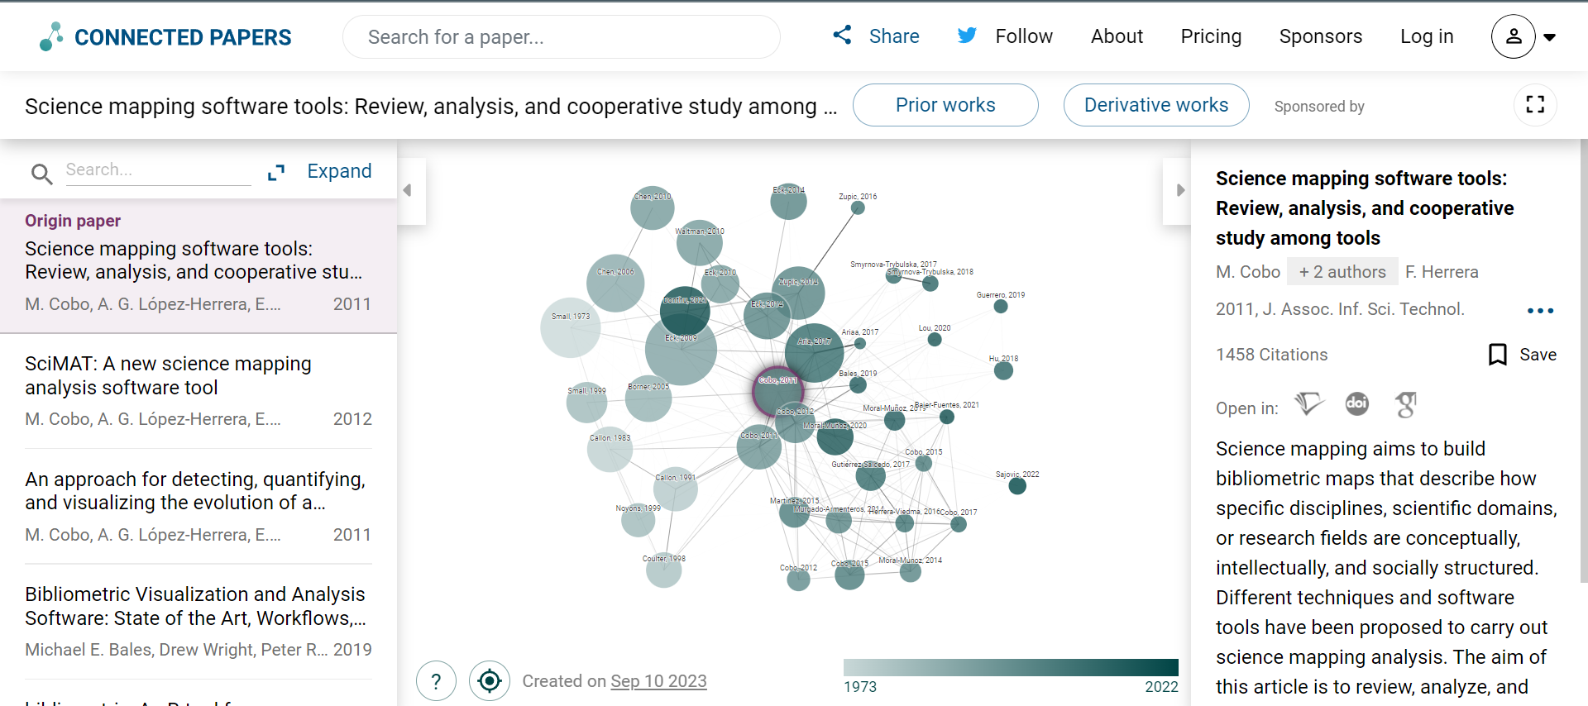

Slide 9
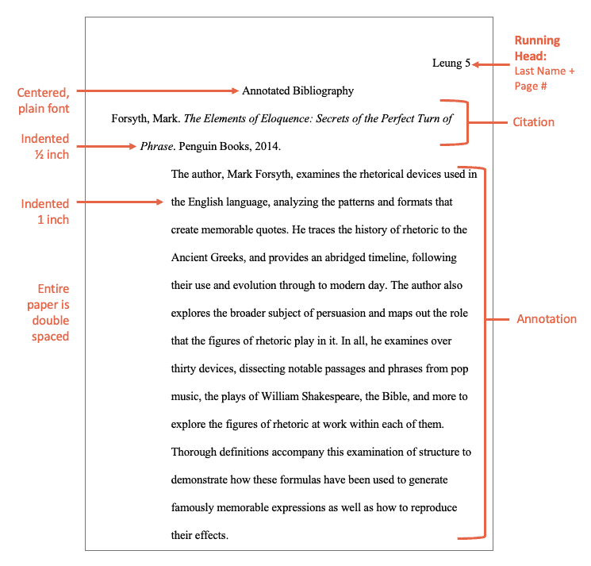
Analyze your source and write the description
🔗https://www.easybib.com/guides/citation-guides/citation-basics/annotated-bibliographies/

Slide 10
WHY international students‘ mobility?
02
🔗 https://uis.unesco.org/en/uis-student-flow
In 2014, there were 4.2 million students who crossed borders, in 2018, this number had increased to 5.6 million (UNESCO, 2020).
Topic that has been researched from many different angles (educators, geographers, economists, sociologists, and others)
“students who have crossed borders expressly with the intention to study”
(OECD, 2009., p.311)
Various levels of education are explored
“as crossing country borders for the purpose of or in the context of tertiary
education” (Richters & Teichler, 2006, p. 78)

Slide 11
DIFFERENT TYPES OF MOBILITIES
Full degree program in a foreign country
Short-term study-abroad experience as part of degree program at home institution
Crossborder collaborative degree programs between two or more institutions or providers
Research and fieldwork
Internships and practical experiences
Study tour, workshops
(Knight, 2012)

Slide 12
WHAT are the topics ISM
Broad topics: Cultural adjustment, learning experiences, psychological adjustment, and perceived benefits
KW: cultural adaptation, academic adaptation, academic performance, satisfaction, motivation, support, mental health, well-being, social network, intercultural sensitivity, and identity
Long-term studies: sociocultural, emotional and academic well-being
Short-term studies: language learning, pedagogy, intercultural competencies
COVID-19 and how it shaped foreign mobility other crises (Russo-Ukrainian war)

Slide 13
ISM and (social) media
NEWS CONSUMPTION: Changing news media habits (local, international, national news), changes within the frequency of getting information (Metyková, 2010, Novotná, 2020)
NEW TECHNOLOGY & COMMUNICATION: Keeping in touch with family and friends from home country (Kim,2016) and the role of social media in building new relationships in foreign countries.
PLACE PERCEPTION VIA TECHNOLOGY: People who come from the same country and their role (Martin & Rawzi, 2014).

Slide 14
(Kim, 2016)
I have no problem with my English, but I still don’t want to speak too much in English. I get exhausted. So after school, I want to relax with Korean language. I feel at home while watching Korean TV shows.
I buy a few magazines, one is Creative Review, this is a British one, the other is Urban Design magazine so it’s all within my interests but I do spend all the time on the Internet especially with Polish newspaper Gazeta [Wyborcza].
(Metyková, 2007)
Because there are a lot of Chinese people here, we often use Weibo to exchange information. Like, where is there good food; where is there a sale on; where is a room available. […]
(Martin & Rawzi, 2014)
I went to Nike and Adidas to get my shoes. And I [took] photos and sent it through [smartphone app] WeiXin to my parents to see if these shoes are good enough. And they said, it’s pretty. And they said OK, get [a pair].

Slide 15
IS ANY TOPIC THAT RESONATES WITH YOU ACCORDING TO FOREIGN MOBILITY?

Slide 16
WHICH ROLE DOES MEDIA PLAY IN THE CASE OF YOUR STAY IN A FOREIGN COUNTRY?

Slide 17
IDENTIFY RESEARCH GAP
Identify research questions (your interest/knowledge in the field)
Gaps can be in methodology, context (time, country)…
How could you contribute to the field? What is the sub-topic relevance?
Identify key literature
& terms

Slide 18
SUM UP: WHEN CHOOSING YOUR SUB-TOPIC, KEEP IN MIND
Access to your participants (try to at least think about how you will find your participants; would it be hard?)
Go through the literature in a team. Try to be effective.
Draw down possible topics.
Make sure that the sub-topic is not too narrow or too broad.

Slide 19
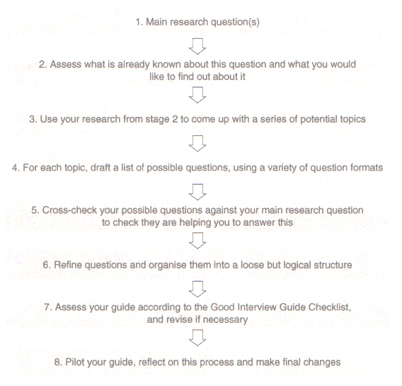
03
(Bret & Wheeler, 2022)

Slide 20
FORMULATION OF MAIN RESEARCH QUESTIONS AND SECONDARY RESEARCH QUESTIONS
Avoid phrasing questions with YES/NO answers
RQs are phrased as what, how and why?
The formulation of one or more general questions supplemented by more focused sub-questions is recommended. Strategies vary in this respect.
For final bachelor/master theses, it is recommended/ customary to include an explicitly worded central research question.

Slide 21
RQ1: What discussion dynamics can demobilize participation in online debates during global crises? RQ2: What role do cross-cutting discussions and their characteristics play in the unwillingness to participate in discussions on Facebook? RQ3: How are online cross-cutting discussions related to the perception of polarization among the public? RQ4: How does incivility affect active participation in discussions on Facebook?
EXAMPLES OF RESEARCH QUESTIONS AND THEIR FORMULATION
(Novotná et al., 2023)

Slide 22
FLOW OF THE RESEARCH
1.
8. 10.
Here you are
3.
Selecting research topics and creating Teams
2.
Literature review I.
3 Teams (3-4 members)
You will get one supervisor who will be here to provide you with support in teams.
Getting to know the literature. 1st phase of literature review – gap and narrow scope of your interest
15. 10.
5.
Literature review II.
4.
Formulating research
questions
& aim
You go back to literature (narrow to your sub-topic)
2-3 questions

Slide 23
Any questions?

Slide 24
Sources
Chen, Y. A., Fan, T., Toma, C. L., & Scherr, S. (2022). International students’ psychosocial well-being and social media use at the onset of the COVID-19 pandemic: A latent profile analysis. Computers in Human Behavior, 137, 107409. https://doi.org/10.1016/j.chb.2022.107409.
Gümüş, S., Gök, E., & Esen, M. (2019). A review of research on international Student MOBILITY: Science mapping the existing knowledge base. Journal of Studies in International Education, 24(5), 495-517. https://doi.org/10.1177/1028315319893651.
Kim, T. (2020) Young Migrant Vietnamese in the Czech Republic Reflect Diasporic Contexts in Their Identification of Cultural Proximity with Korean Media, Journal of Intercultural Studies, 41(4), 524-539, DOI: 10.1080/07256868.2020.1779199
Kim, Tae-Sik. (2016). Transnational communication practices of unaccompanied young Korean students in the United States. Asian and Pacific Migration Journal, 25(2), 148-167. https://doi.org/10.1177/0117196816639055
Knight, J. (2012). Student mobility and internationalization: Trends and tribulations. Research in Comparative and International Education, 7(1), 20–33.
Martin, F., & Rizvi, F. (2014). Making Melbourne: Digital connectivity and international students’ experience of locality. Media, Culture & Society, 36(7), 1016-1031. https://doi.org/10.1177/0163443714541223
UNESCO UIS. (2020, December). National Monitoring: Outbound internationally mobile students by host region. http://data.uis.unesco.org/

Slide 25
Metyková, M. (2010). Only a mouse click away from home: transnational practices of Eastern European migrants in the United Kingdom. Social Identities, 16(3), 325-338. https://doi.org/10.1080/13504630.2010.482418.
Novotná, M., Macková, A., Bieliková, K., & Rossini, P. (2023d). Barriers to participation in polarized online discussions about COVID-19 and the Russo-Ukrainian war. Media and Communication, 11(3). https://doi.org/10.17645/mac.v11i3.6657
Organisation for Economic Co-Operation and Development. (2009). Education at a glance 2009: OECD indicators.
Richters, E., & Teichler, U. (2006). Student mobility data: Current methodological issues and future prospects. In M. Kelo, U. Teichler, & B. Wächter (Eds.), EURODATA: Student mobility in European higher education (pp. 78–95). Lemmens.
Pictures and presentations motives
https://www.pexels.com/
https://storyset.com/
https://www.flaticon.com/

