Slide 1
Other Modernisms
Introduction
20 September 2023
Dr Marta Filipová
Dr Julia Secklehner

Slide 2
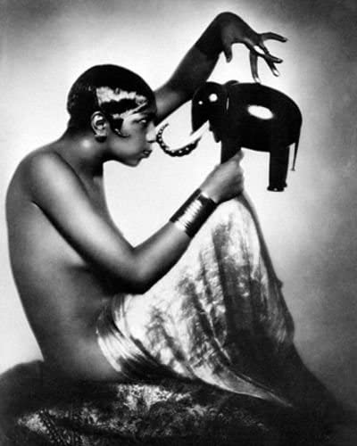
Introduction
Name three things about yourself that your colleagues should know about you
Name up to five artists related to modernism
Name your favourite artwork
Bruce Teleky, Josephine Baker with elephant model (1925)

Slide 3
Course schedule
- 1 lecture per week
- invited speakers (in person and online): lecture and a discussion – prepare questions!
- recommended reading for each session
- study trip
- reading week – no lecture on 29 November – you can prepare your posters ☺

Slide 4
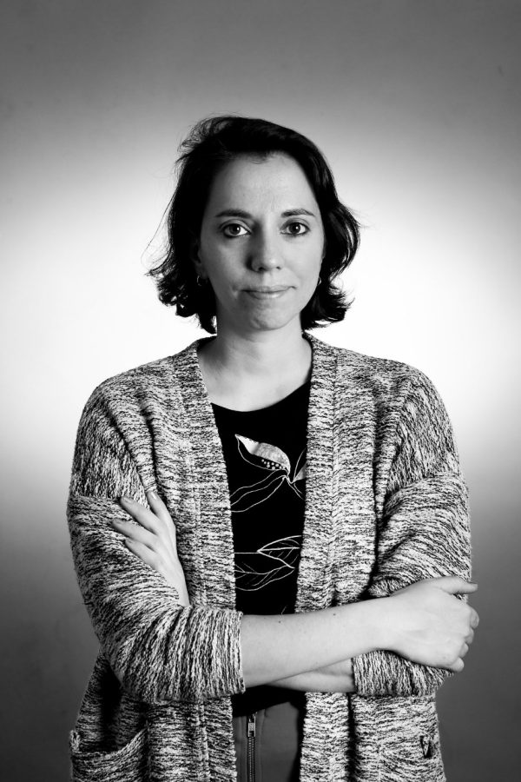
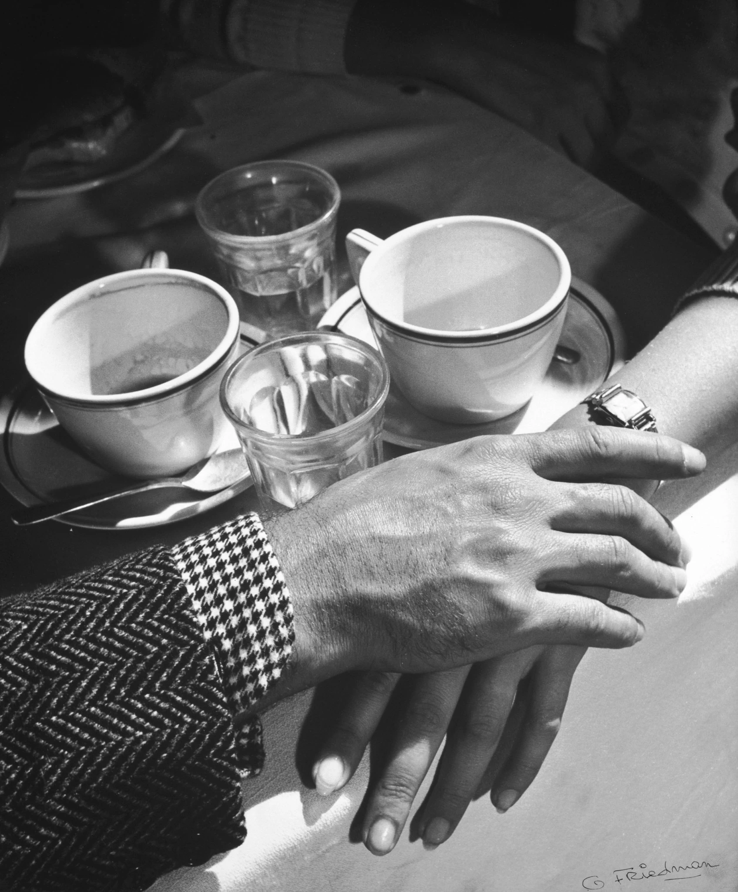
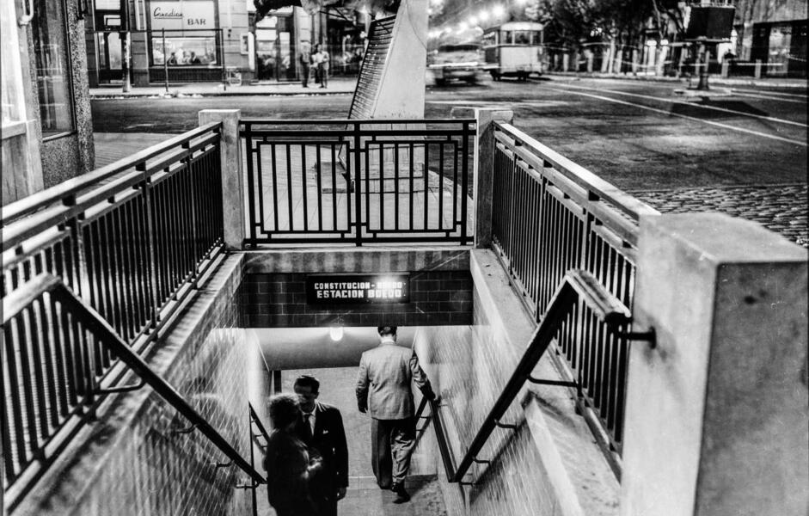
27 September
Latin American photography
Invited speaker: Dr Julieta Pestarino, CMAT Visiting Fellow & Kunsthistorisches Institut Florence

Slide 5

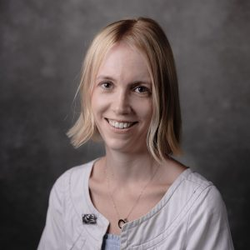
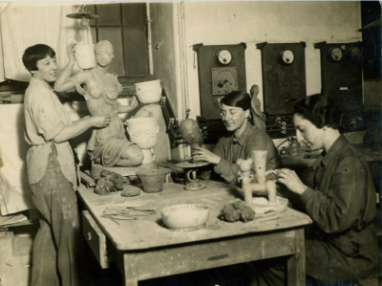
4 October
The Female Secession
Invited speaker: Prof Megan Brandow-Faller, City University of New York Kingsborough (online)
Ceramics workshop if Vally Wieselthier, MAK, Vienna

Slide 6
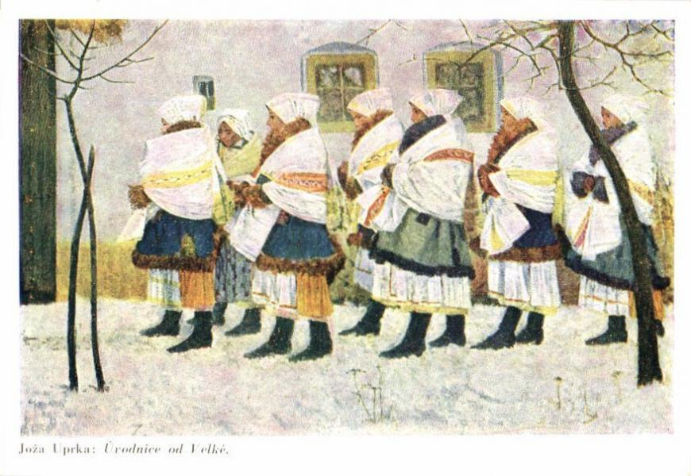
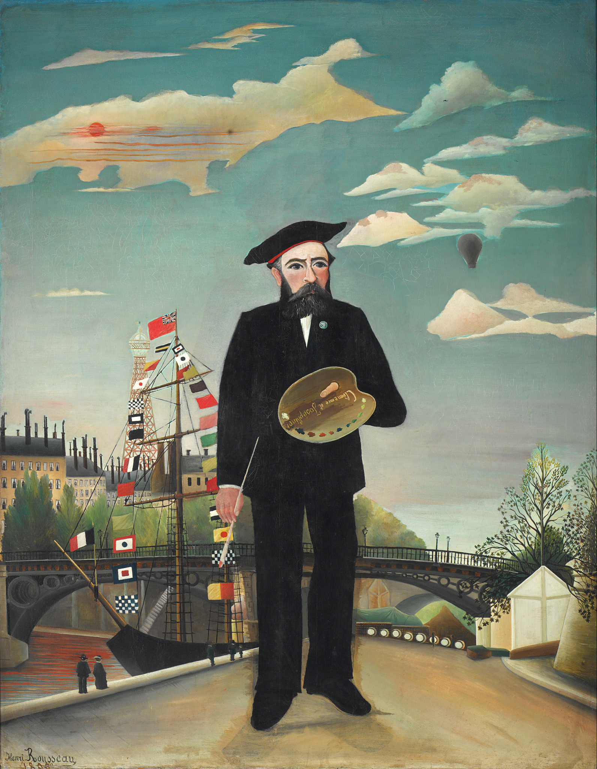
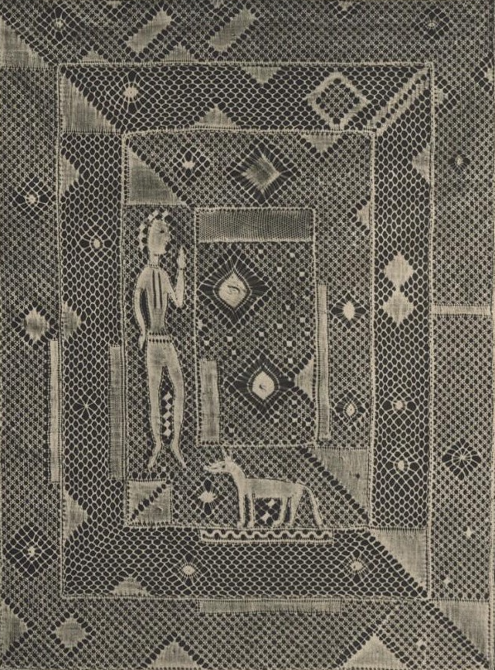
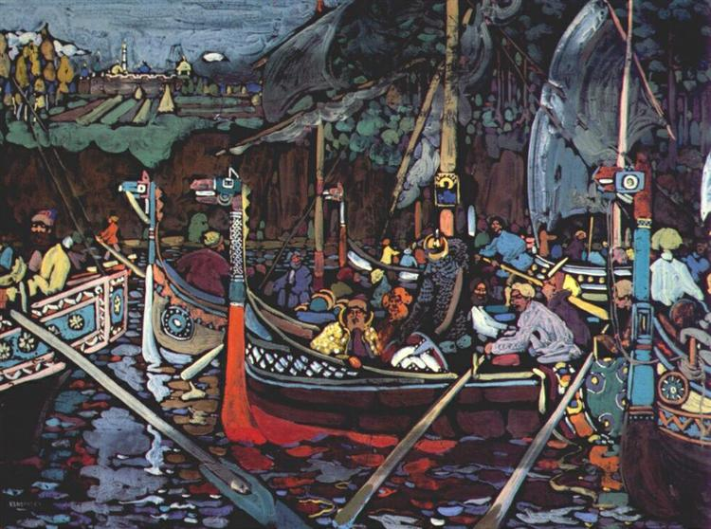
Joža Uprka, Girls of Velká in procession, 1896, National Gallery Prague.
11 October
Primitivism and the modern
Marta Filipová
Henri Rousseau, Myself, Portrait-Landscape, 1890, National Gallery Prague.
Vassily Kandinsky, Song of the Volga, 1909, Georges Pompidou Center, Paris, France.
Emilie Paličková-Milde, Lace, 1929, The Museum of Decorative Arts, Prague

Slide 7
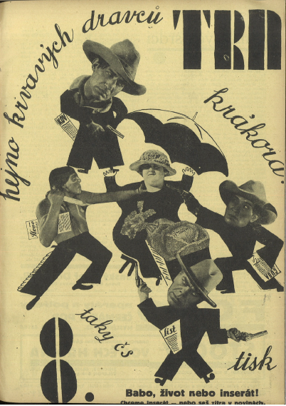
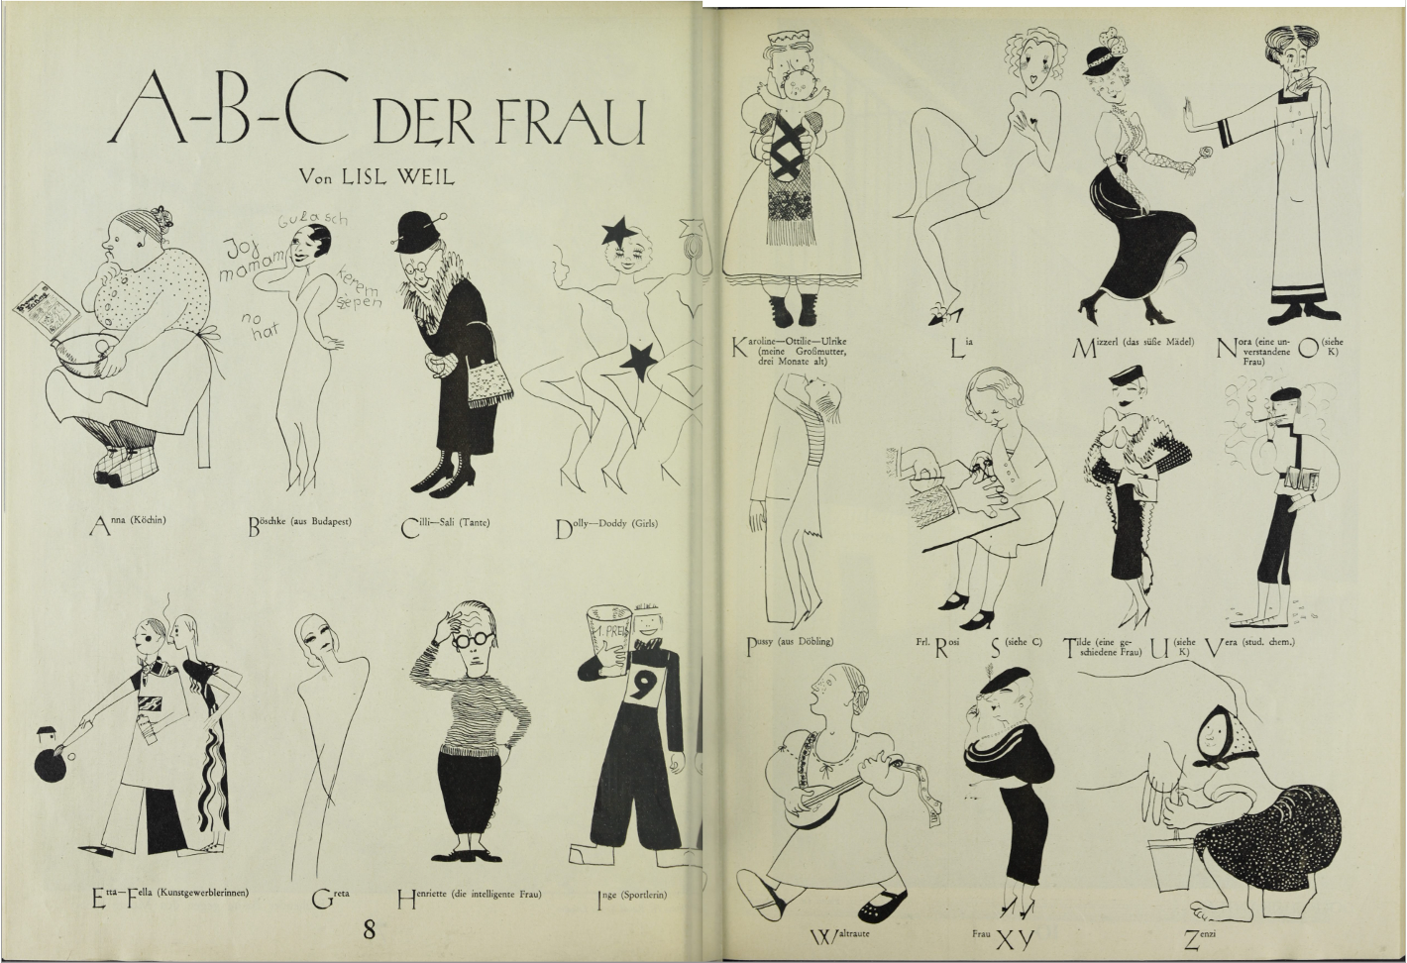
18 October
Popular illustration and magazine cultures
Julia Secklehner
Lisl Weil, ‘ABC of women’, Die Bühne 347 (1933), 10-11.
Trn 5:8 (April 1929).

Slide 8
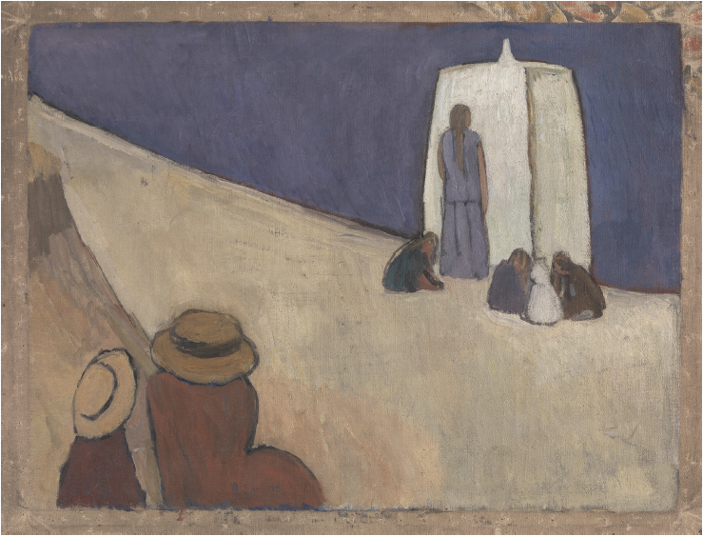
25 October
To be confirmed
Vanessa Bell, Studland Beach, c. 1912. Oil on canvas, 76.2 × 101.6 cm. London: Tate.

Slide 9
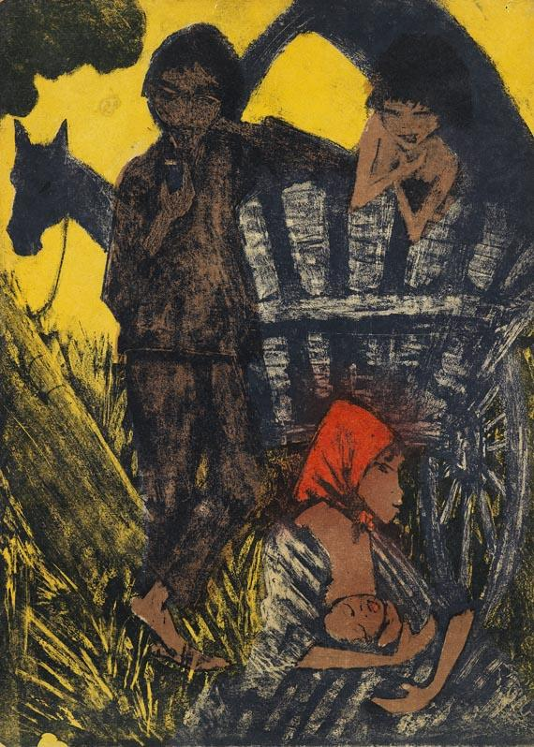
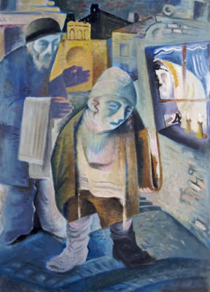
Otto Müller, Gypsy Album (1927)
1 November
Minority modernisms
Julia Secklehner
František Reichentál, Sabbath in Bratislava, n.d.

Slide 10
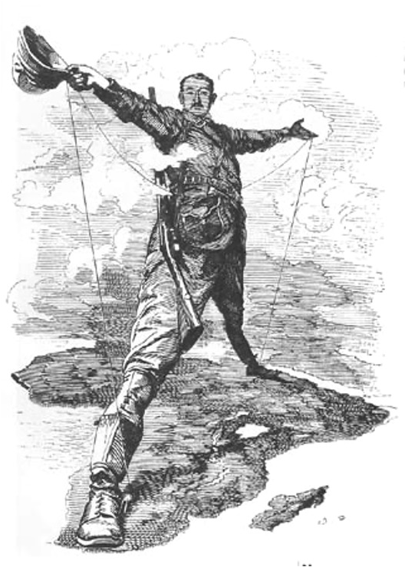
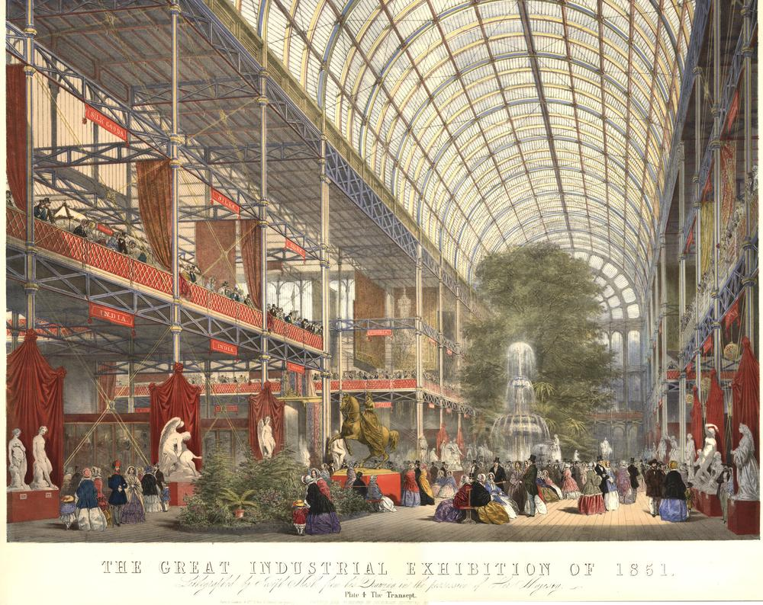
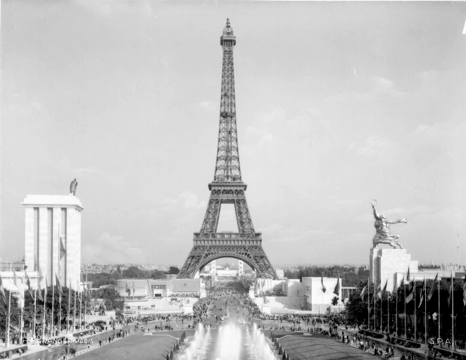
8 November
Modernism at the fair
Marta Filipová
Joseph Nash, The Great Exhibition, 1851, British Museum.
German and Soviet pavilions at International Exposition of Art and Technology in Modern Life, 1937.
Edward Linley Sambourne, The Rhodes Colossus, Punch, 1892.

Slide 11
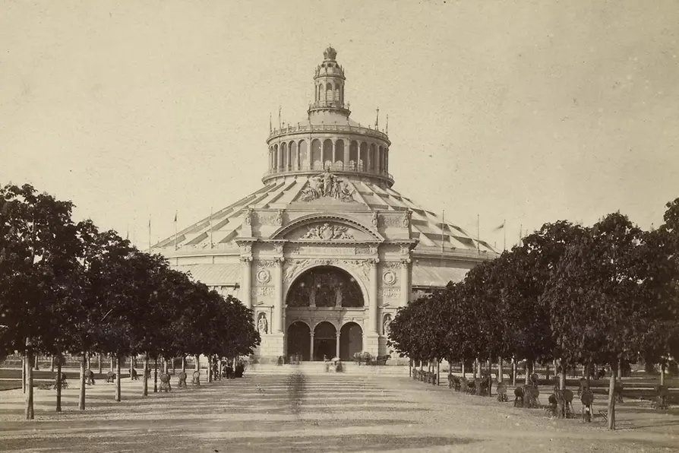
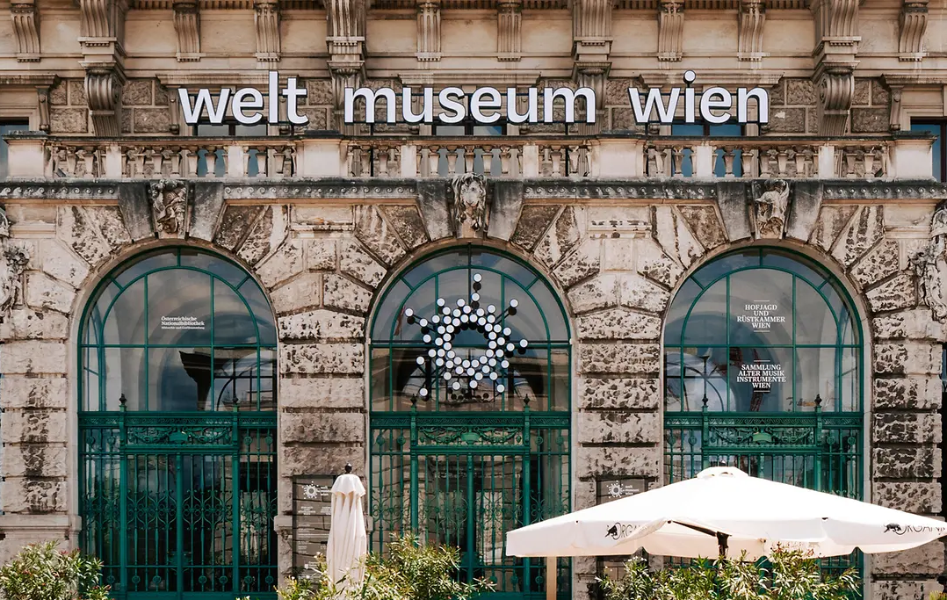
15 November
Study visit
Visions and New Beginnings: 150 Years of the Vienna World’s Fair (different locations around Vienna)
https://www.wien.info/en/travel-info/ivie-app/the-world-s-fair-challenge-a-fun-way-to-discover-vienna-457178
1873 World's Fair: Rotunda with south portal. – © Wien Museum
150 years of the Vienna World’s Fair (Weltmuseum Vienna)
https://www.weltmuseumwien.at/fileadmin/user_upload/WMW_Weltausstellung_Booklet_Web.pdf

Slide 12
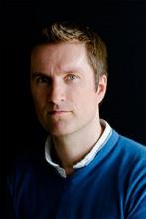
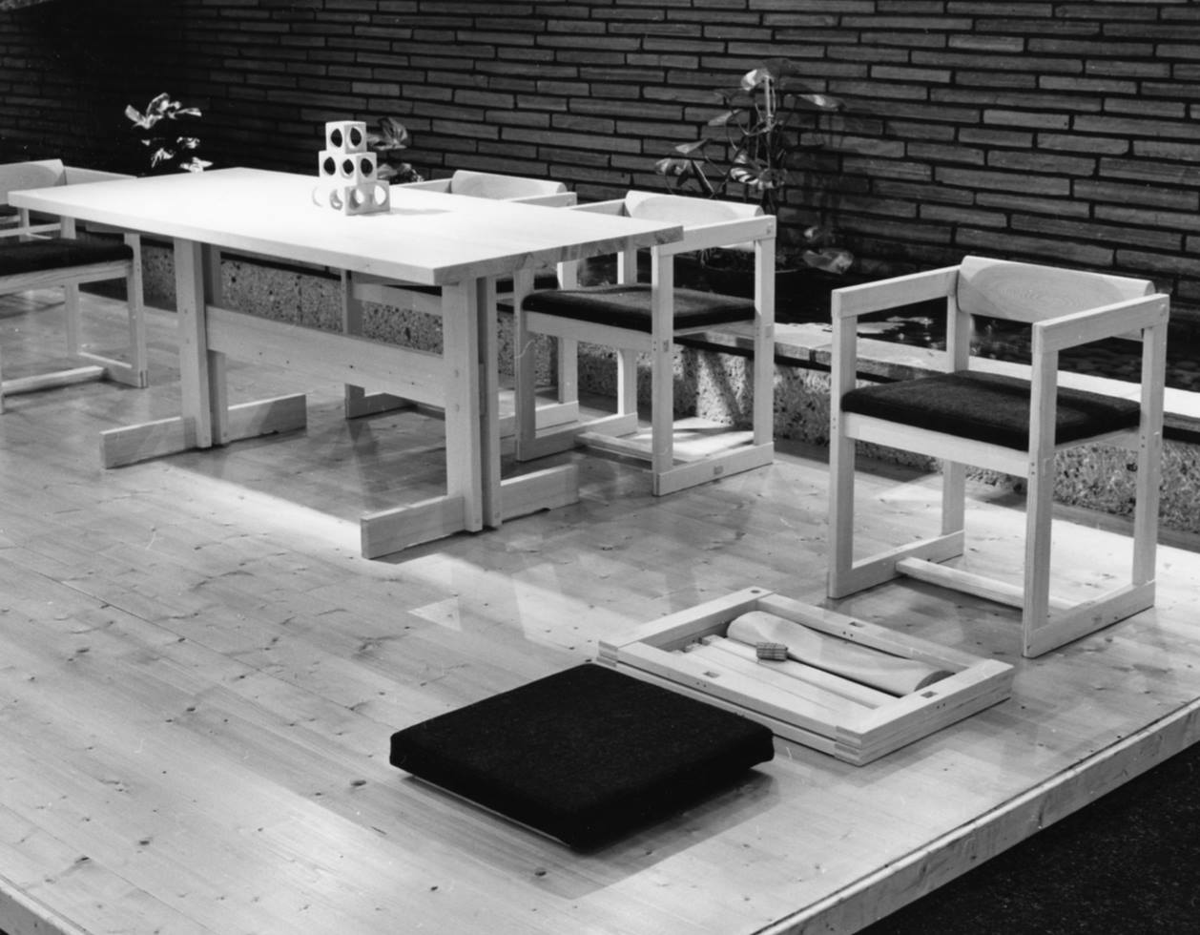
22 November
Norwegian wood: Scandinavian design and beyond
Invited speaker: Prof. Kjetil Fallan, University of Oslo

Slide 13

29 November
Reading week
What to do during reading week?
https://medium.com/youalberta/7-tips-to-help-you-get-the-most-out-of-reading-week-fdda6f1e8b38

Slide 14
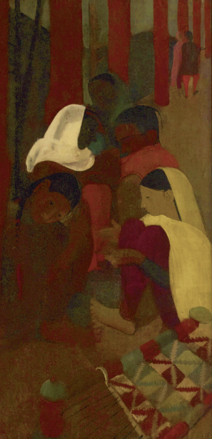
6 December
Student presentations
Amrita Sher-Gil, Red Verandah, 1938. Oil on canvas, 73.7 × 146 cm. New Delhi: National Gallery of Art

Slide 15
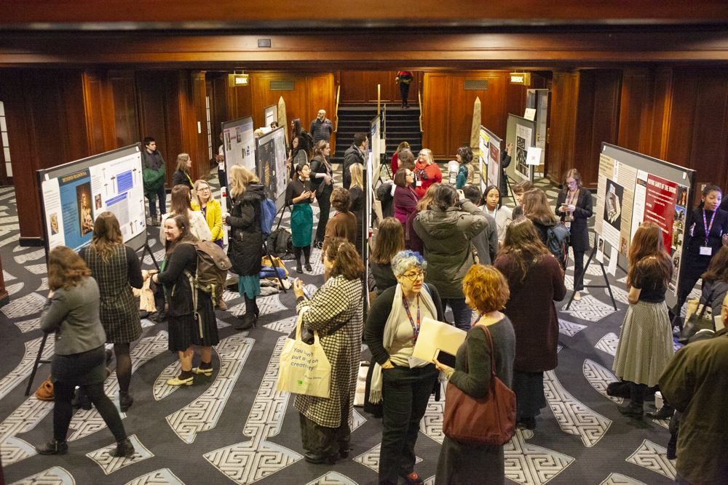
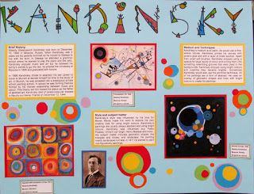
13 December
Posters and feedback

Slide 16
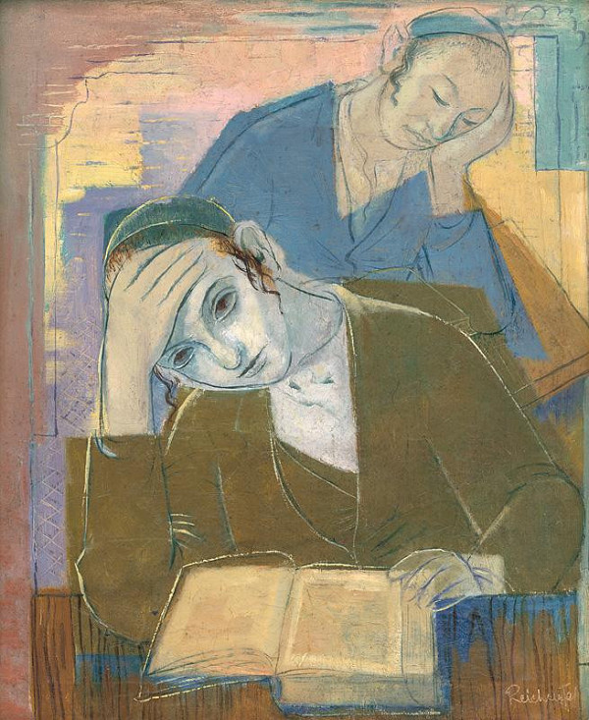
Assessment
- choose an object based on the topics discussed in the couse
TASK 1: Presentation
- 5 minutes
- 5 slides
- open feedback round
TASK 2: Poster
- A2 format
- about the object of your choice
- details on poster-making follow later
- deadline: 10 December 2023
Your assessment is based on these criteria:
- attendance and active participation
- presentation
- poster
František Reichentál, Two Talmudists, 1932

